Slide 1
Select, filter and
calculate new columns
Which item earned the most money in the practice shop?
Machine Learning | Session 8 of 24 | Week 3, Tables and statistics
Holiday Data and AI Camp | The National ICT Innovation Hub, Nakawa
Notes:
Laptops open, please. Today is session 8 and our topic is select, filter and calculate new columns.
By the end of today you will be able to pick a column, keep rows that meet a condition, add a revenue column and total it by item.
We will answer one question: Which item earned the most money in the practice shop?

Slide 2
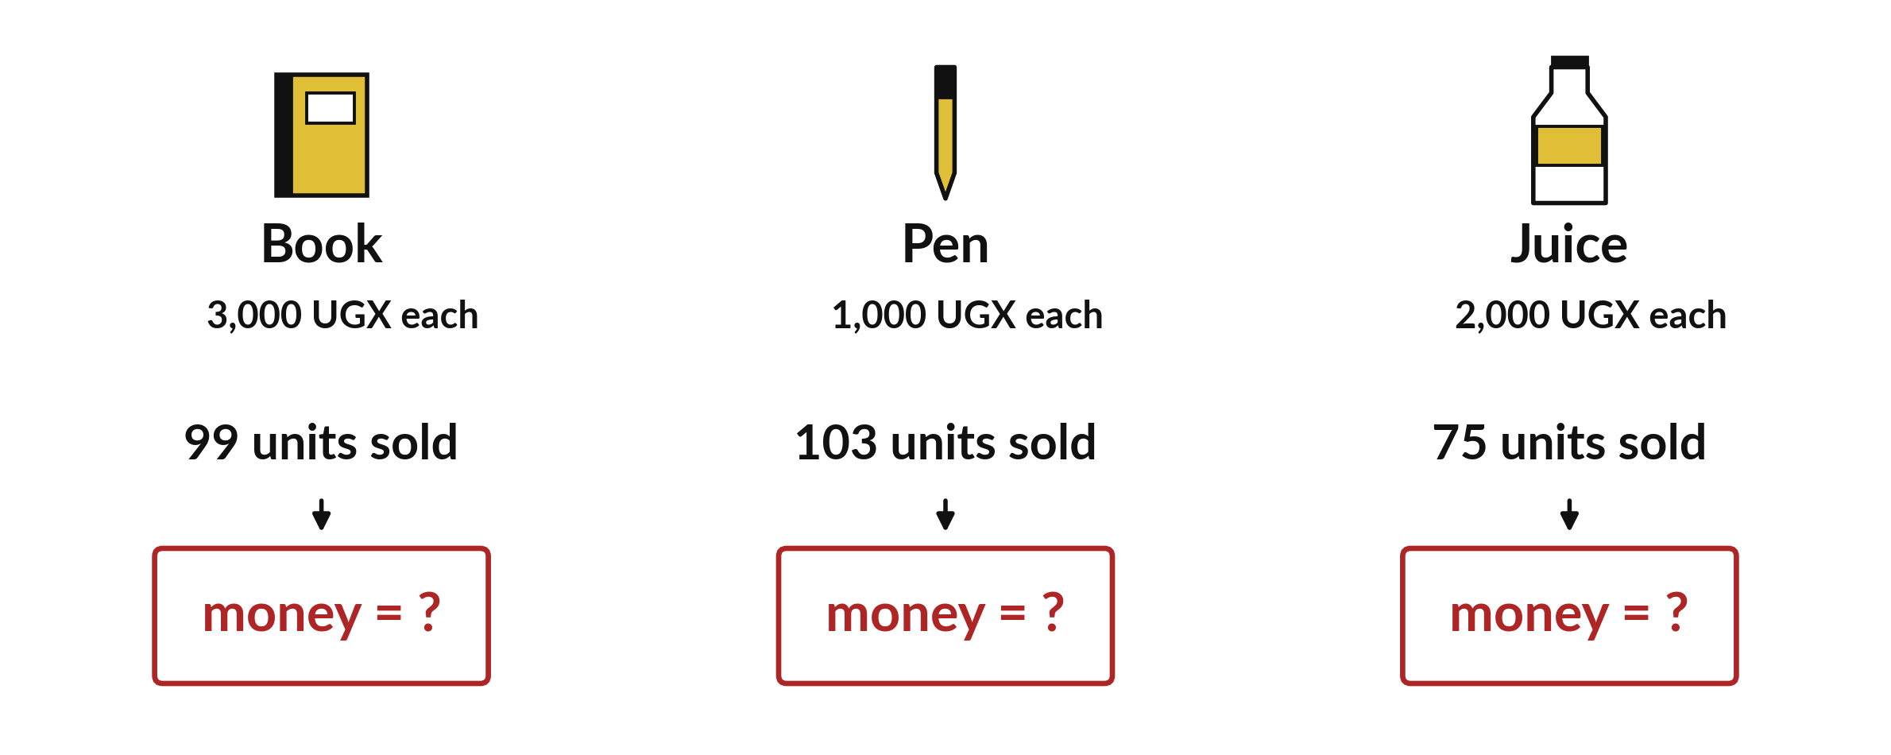
Which item earned the most
money in the practice shop?
Notes:
Three items, three prices, three counts of how many were sold. The book has the highest price, but the pen and the juice sold more. Which one brought in the most money? Make a guess now. By the end of this session you will have the answer from the data, and you will know how to get it with code.

Slide 3

Three hours, mostly doing
Most of our time is spent doing, in small steps, with a guess before every run.
Notes:
Here is how the 3 hours go. Each bar is as long as the time we spend on that part.
First, 10 minutes. Recall. Then, 50 minutes. Block A. After that, 15 minutes. Break away from screens. Next, 50 minutes. Block B. Then, 40 minutes. Make. Then, 15 minutes. Exit ticket, save, and an individual check with each learner.
Notice how much of the time is yours. You listen for a short while and then you do. That is on purpose, because you learn this by doing it.

Slide 4



Words for today (1 of 2)
select a column
Name the column in square brackets to look only at it.
Reading only the price line of the register.
filter
Keep only the rows where a comparison is True.
Picking out the sales of 5 units or more.
new column
A column calculated from other columns, added to the table.
Multiplying units by price on every line.
Notes:
First the words, because every one of them is used in the code later.
select a column. Name the column in square brackets to look only at it. Think of a shop. Reading only the price line of the register.
filter. Keep only the rows where a comparison is True. Imagine it like this. Picking out the sales of 5 units or more.
new column. A column calculated from other columns, added to the table. An example from everyday life. Multiplying units by price on every line.

Slide 5



Words for today (2 of 2)
sum
All the values added together.
Adding up the day's takings.
group
Gather rows with the same label before calculating.
Sorting the sales into three piles by item.
revenue
Money received from sales: units times price. It is not profit.
The takings before paying for stock.
Notes:
Here are the rest of today's words.
sum. All the values added together. Here is a way to see it. Adding up the day's takings.
group. Gather rows with the same label before calculating. A small example. Sorting the sales into three piles by item.
revenue. Money received from sales: units times price. It is not profit. Picture this. The takings before paying for stock.

Slide 6
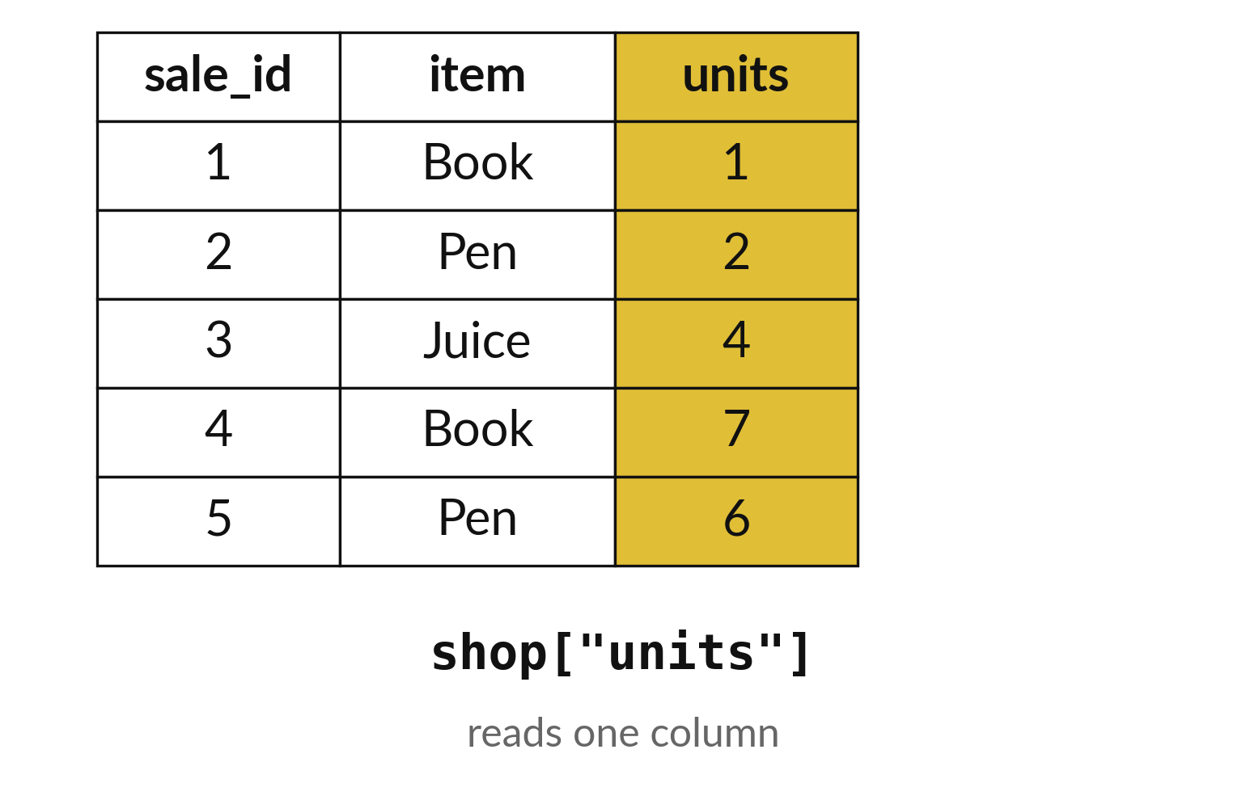
Selecting a column pulls one list out of the table
Square brackets and a name pick a column.
The result is one column of values.
The table itself stays the same.
Notes:
To look at one column, write the table name, then square brackets, then the column name in quotation marks. Python hands back just that column.
Nothing is removed from the table. You have only taken a look at one part of it. What would you write to see the units column?

Slide 7
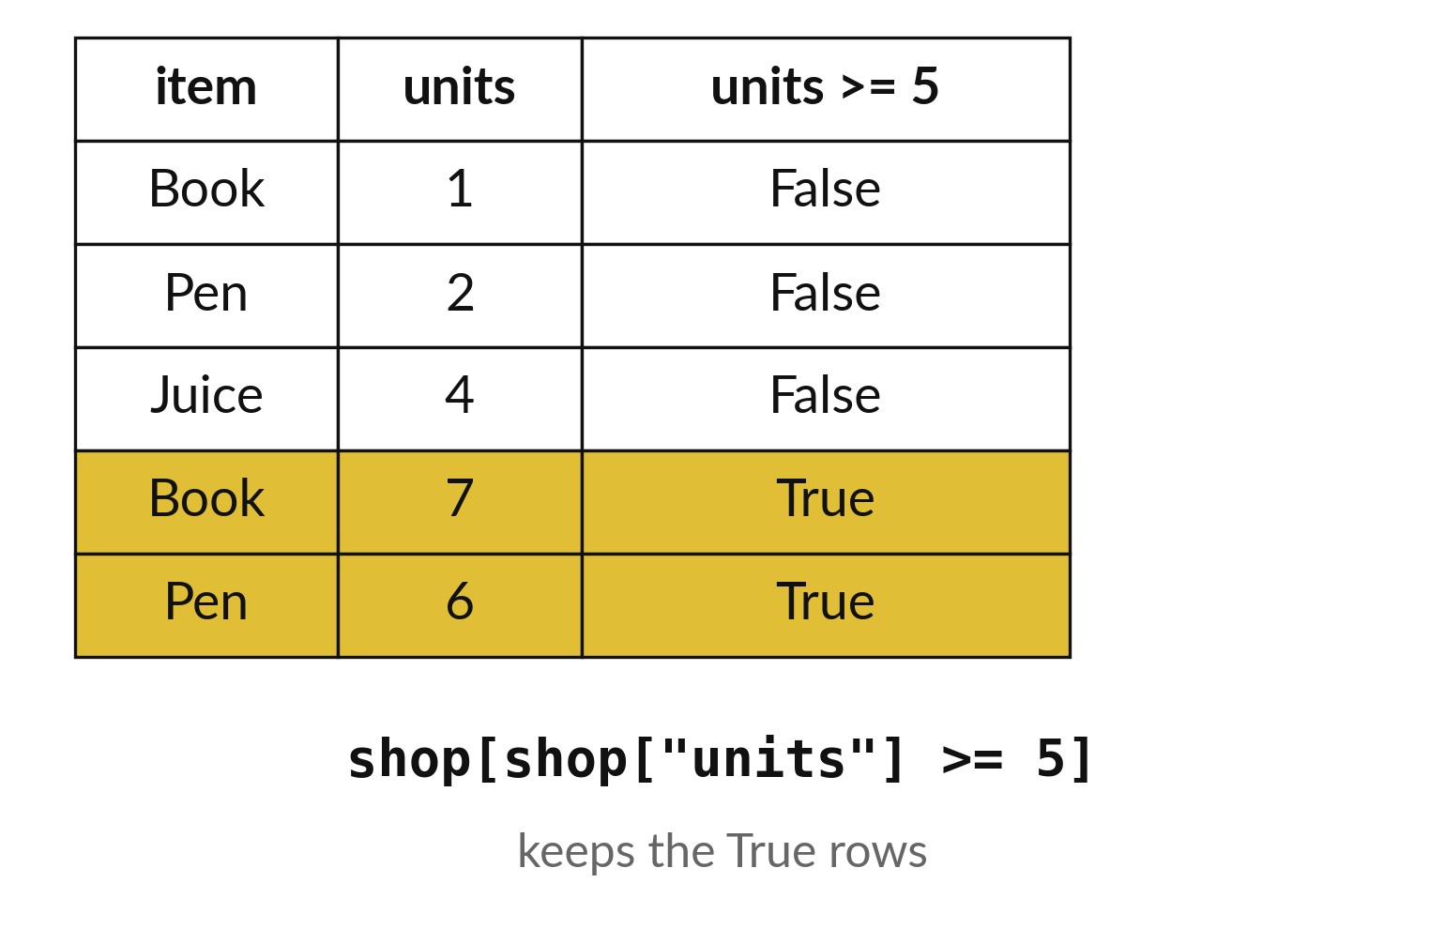
A filter keeps the rows that pass a test
The test is written inside the brackets.
Rows that pass are kept.
Rows that fail are left out of the result.
Notes:
A filter asks a yes or no question about every row. Is units five or more? Rows that answer yes are kept. Rows that answer no are left out of the new table.
Predict how many of the first few rows would stay if we only kept sales of five units or more.

Slide 8
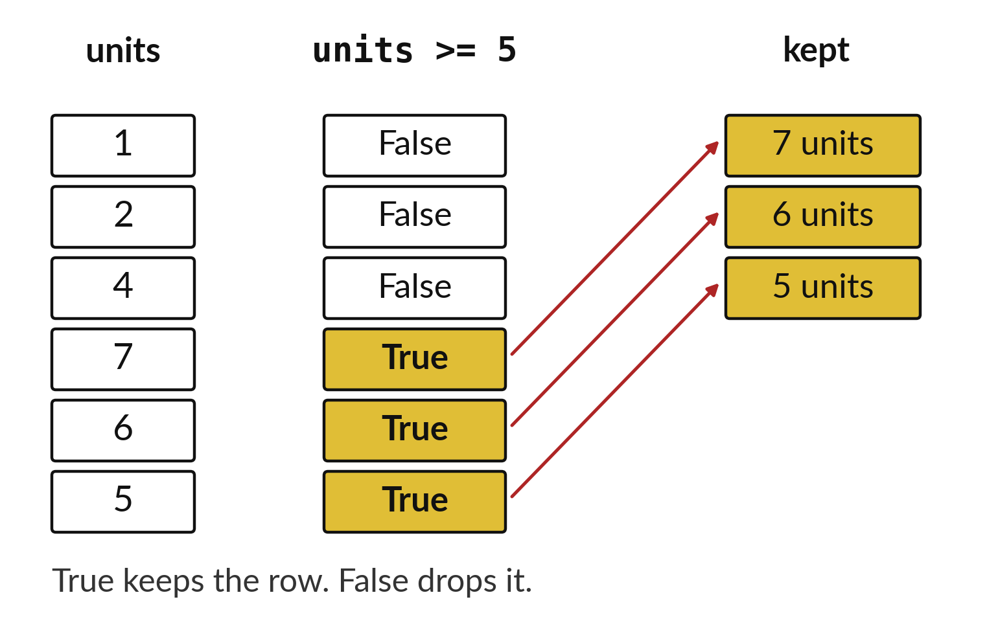
The filter makes a True or False for every row first
True keeps a row.
False drops it.
Read the mask before you trust the filter.
Notes:
Behind the filter is a list of True and False, one for each row. Python builds this list first, then keeps the rows marked True.
If a filter gives a surprising result, print the True and False list on its own. It tells you exactly which rows passed and why.

Slide 9

Predict: Select and filter
import pandas as pd
shop = pd.read_csv("camp_shop.csv")
units = shop["units"]
big = shop[shop["units"] >= 5]
print(len(big))
print(units.sum())
Predict how many of the 60 sales have 5 units or more.
Write your guess on paper before we run it.
Notes:
Read the practice shop and keep the large sales.
Your turn to guess. Predict how many of the 60 sales have 5 units or more. Put it on paper first. We will check it together in a moment.

Slide 10
Run it: Select and filter
30
277
The cell prints 30 and 277.
shop["units"] selects one column.
The comparison inside the outer brackets gives True or False for every row, and only the True rows stay.
That filter keeps 30 sales.
All 60 sales together sold 277 units.
Notes:
I will run it, and you compare with your guess. Match each line of the output with the line of code that made it.
The cell prints 30 and 277. shop["units"] selects one column. The comparison inside the outer brackets gives True or False for every row, and only the True rows stay. That filter keeps 30 sales. All 60 sales together sold 277 units.
Check your paper. Were you close?

Slide 11

Investigate: Select and filter
1. Is the filter deleting the other 30 rows?
2. Why can the sum of units not tell us the money earned?
Notes:
Now we look closely at select and filter. I have two questions for you.
Question one. Is the filter deleting the other 30 rows? Talk it over with your neighbour for a minute.
No. The big table is a new, smaller table. shop still has all 60 rows.
Question two. Why can the sum of units not tell us the money earned? Think about it for a moment, then tell the person next to you.
Here is how I would answer it. The three items have different prices, so units and money are different quantities.

Slide 12

Modify: change one thing
Filter the Juice sales with 5 units or more and count them.
Then tell your neighbour what changed and how you know.
Notes:
Time to experiment. Filter the Juice sales with 5 units or more and count them. After you run it, say in one sentence what changed and how you checked.
You should see this. Seven sales.

Slide 13

Break
15 minutes away from your screen
Stand up. Drink some water. Tell someone what you guessed in the first half.
Notes:
Break time. 15 minutes away from your screens. Stand up, drink some water and tell someone what you guessed in the first half.
When we come back we start the second idea.

Slide 14
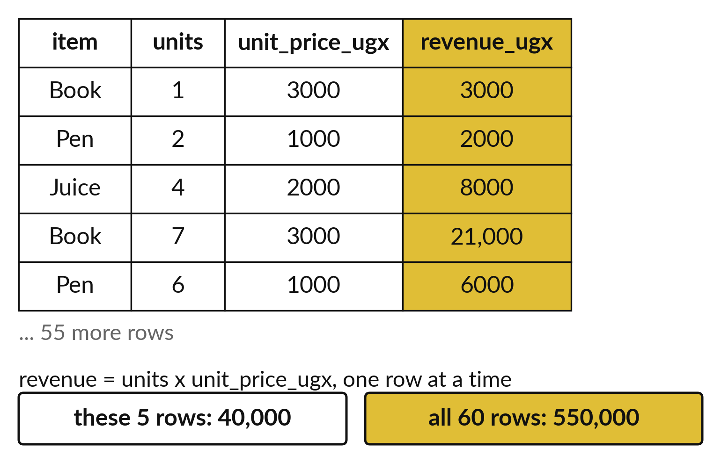
A new column is worked out one row at a time
Revenue is units times unit price.
Every row gets its own revenue.
The five rows shown add up to 40,000.
Notes:
Money earned is called revenue. For each sale it is the units multiplied by the price of one unit. Python does this for every row at once and stores the answers in a new column.
The five rows on the slide add up to forty thousand shillings. Add up the whole column of sixty rows and you get the revenue of the shop: five hundred and fifty thousand shillings in this practice file.

Slide 15
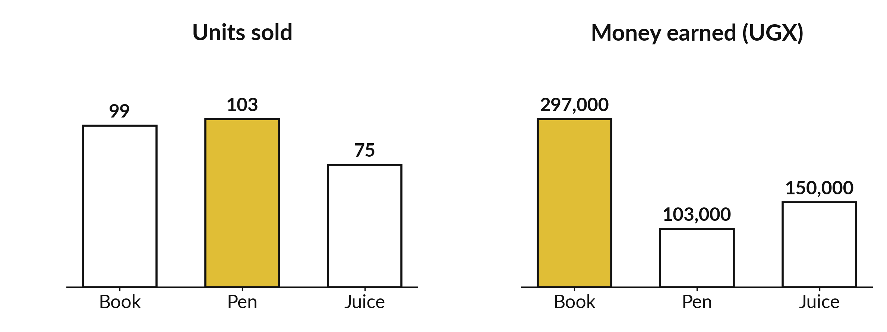
More units sold does not
always mean more money
Book: 297,000 UGX. Juice: 150,000 UGX. Pen: 103,000 UGX.
Notes:
Group the sales by item and add up the revenue. The book earned two hundred and ninety seven thousand shillings. The juice earned one hundred and fifty thousand. The pen earned one hundred and three thousand.
The pen sold the most units, yet it earned the least, because each pen costs so little. Units and money tell different stories.

Slide 16

Predict: A revenue column and totals by item
shop["revenue_ugx"] = shop["units"] * shop["unit_price_ugx"]
total_revenue = shop["revenue_ugx"].sum()
by_item = shop.groupby("item")["revenue_ugx"].sum()
print(total_revenue)
print(by_item)
Predict which item earns the most money. Is it the one with the most units?
Write your guess on paper before we run it.
Notes:
Multiply units by price on every row, then add the money for each item.
Now your guess. Predict which item earns the most money. Is it the one with the most units? Put your guess on paper now, even if you are unsure.

Slide 17
Run it: A revenue column and totals by item
550000
item
Book 297000
Juice 150000
Pen 103000
Name: revenue_ugx, dtype: int64
The total is 550000 shillings.
Book earns 297000, Juice 150000 and Pen 103000.
Pen sold the most units, 103, but Book earns the most money because each Book costs 3000.
Notes:
Watch the output as it appears. Match each line of the output with the line of code that made it.
The total is 550000 shillings. Book earns 297000, Juice 150000 and Pen 103000. Pen sold the most units, 103, but Book earns the most money because each Book costs 3000. Assigning to a new column name creates the column, and the groupby line adds the revenue of each item separately.
Tell the person next to you whether your guess matched.

Slide 18
Investigate: A revenue column and totals by item
1. Pen sold the most units. Why is it last for revenue?
2. Do the three item totals add up to the overall total?
Notes:
Now we look closely at A revenue column and totals by item. I have two questions for you.
Question one. Pen sold the most units. Why is it last for revenue? Think about it for a moment, then tell the person next to you.
Here is how I would answer it. A pen costs only UGX 1000, so its units bring in little money.
Question two. Do the three item totals add up to the overall total? Have a go in your head first.
What I would say is this. Yes: 297000 + 150000 + 103000 is 550000. If they did not, something would be wrong.

Slide 19
Modify: change one thing
Group the units column by item instead and print the totals.
Then tell your neighbour what changed and how you know.
Notes:
Your hands on the keyboard now. Group the units column by item instead and print the totals. Then explain to your neighbour what the change did.
The result: Book 99, Juice 75, Pen 103.

Slide 20
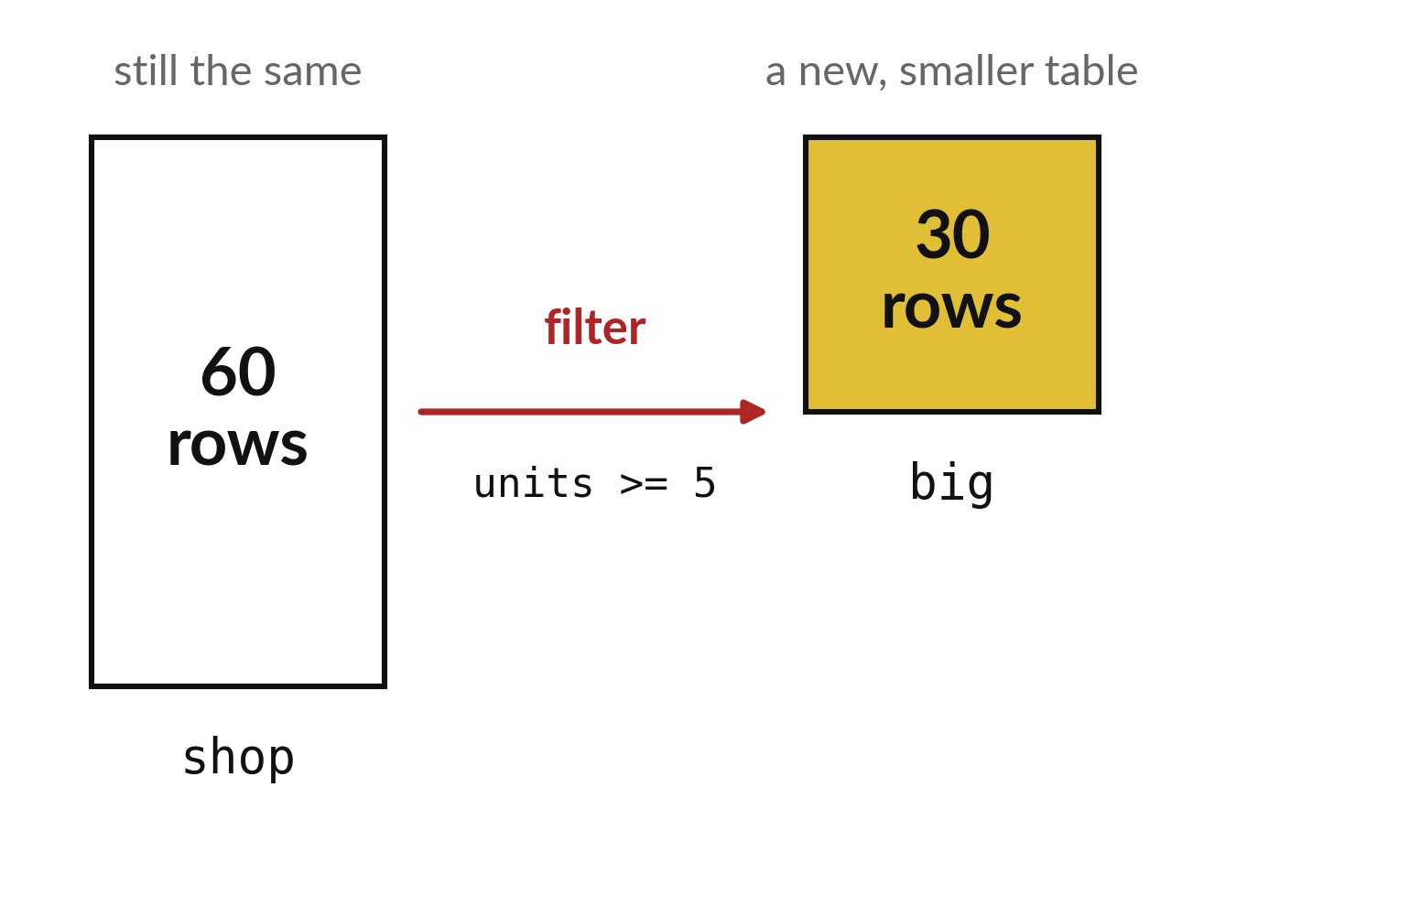
A filter gives a new, smaller
table and keeps the original
The big table keeps all 60 rows.
The filtered table is a separate copy.
Name it so you can find it later.
Notes:
When you filter, Python builds a second table and leaves the first one untouched. That is why you give the result its own name.
If you ever want all sixty rows back, they are still there in the original table.

Slide 21

Make: your own version
Keep the rows with units of at least 3.
Calculate the total units and the mean units per row.
Say why these two numbers are different quantities.
Save it as ML08. Write two sentences: what you changed and how you checked it.
Notes:
This task is yours. Run your code after every step so you can see where a problem begins. If you get stuck for a few minutes, read your error message, check the error card, and then ask me.
Save it as ML08. I will come round to each of you and ask what you changed and how you checked it.

Slide 22

Two errors you may meet today
It means: The column name is spelled differently from the header.
Fix: Print the headers with list(shop.columns) and copy the exact name.
KeyError: 'unit'
It means: The comparison matches no rows, often because of a typo in a text value.
Fix: Check the spelling and capital letters of the value you compare with.
The filter returns an empty table
Notes:
Here are two errors from this session, so you recognise them when they appear.
This is the first one. You will see: KeyError: 'unit'. It means this: the column name is spelled differently from the header. To fix it, print the headers with list(shop.columns) and copy the exact name.
The next one. You will see: The filter returns an empty table. It means this: the comparison matches no rows, often because of a typo in a text value. To fix it, check the spelling and capital letters of the value you compare with.
When you are stuck, read the last line of the message first.

Slide 23

Finish this sentence in your notebook
A filter keeps the rows I ask for, and a grouped total shows who earns the money.
Then save your notebook, close it and open it again to check it saved.
Notes:
Last step. Our question for today was: Which item earned the most money in the practice shop?
Finish this sentence in your notebook, in your own words. A filter keeps the rows I ask for, and a grouped total shows who earns the money.
Then save your notebook, close it and open it again to check it saved.

