Slide 1
Project data and a safe plan
Which dataset and which question can I answer with a fair test in two weeks?
Machine Learning | Session 19 of 24 | Week 7, Your project
Holiday Data and AI Camp | The National ICT Innovation Hub, Nakawa
Notes:
Here we go. Today is session 19 and our topic is project data and a safe plan.
By the end of today you will be able to describe a supplied dataset, spot a leakage column, and write a seven-heading project plan the instructor can approve.
We will answer one question: Which dataset and which question can I answer with a fair test in two weeks?

Slide 2
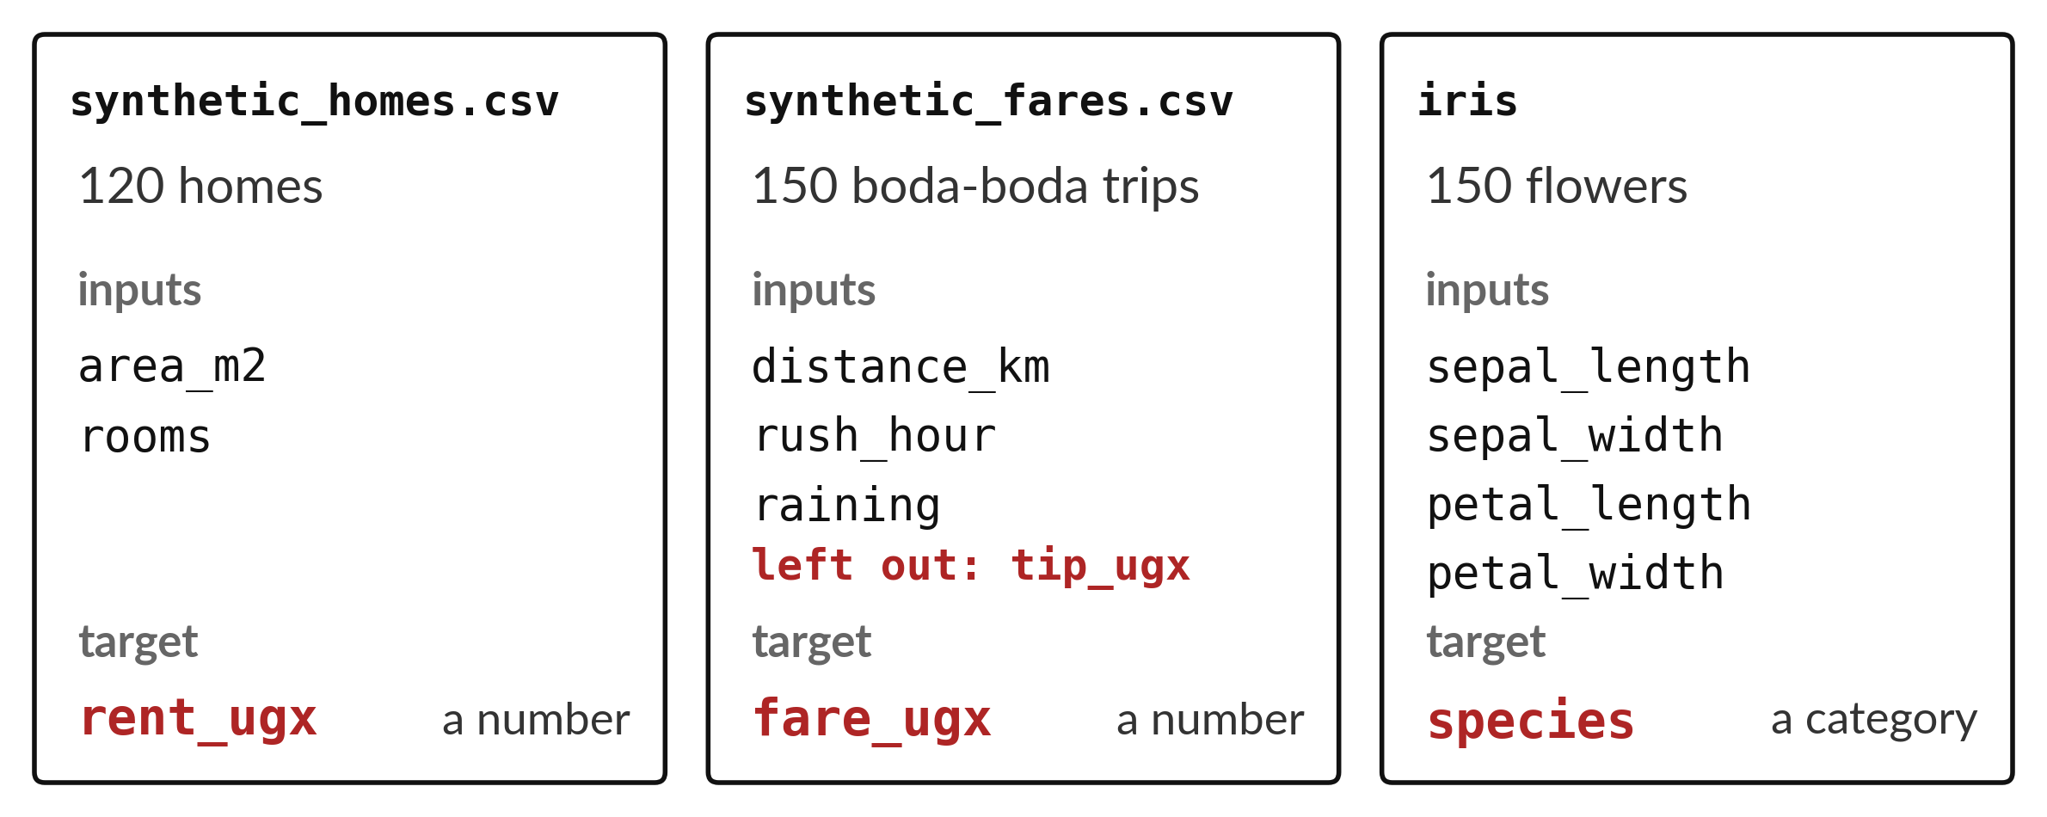
Which dataset and which question can
I answer with a fair test in two weeks?
Notes:
You have met three datasets. The homes file has a hundred and twenty homes and its target is the rent, a number. The fares file has a hundred and fifty boda-boda trips and its target is the fare, also a number. The iris file has a hundred and fifty flowers and its target is the species, a category. For your project you pick the one you can answer with a fair test in two weeks.

Slide 3
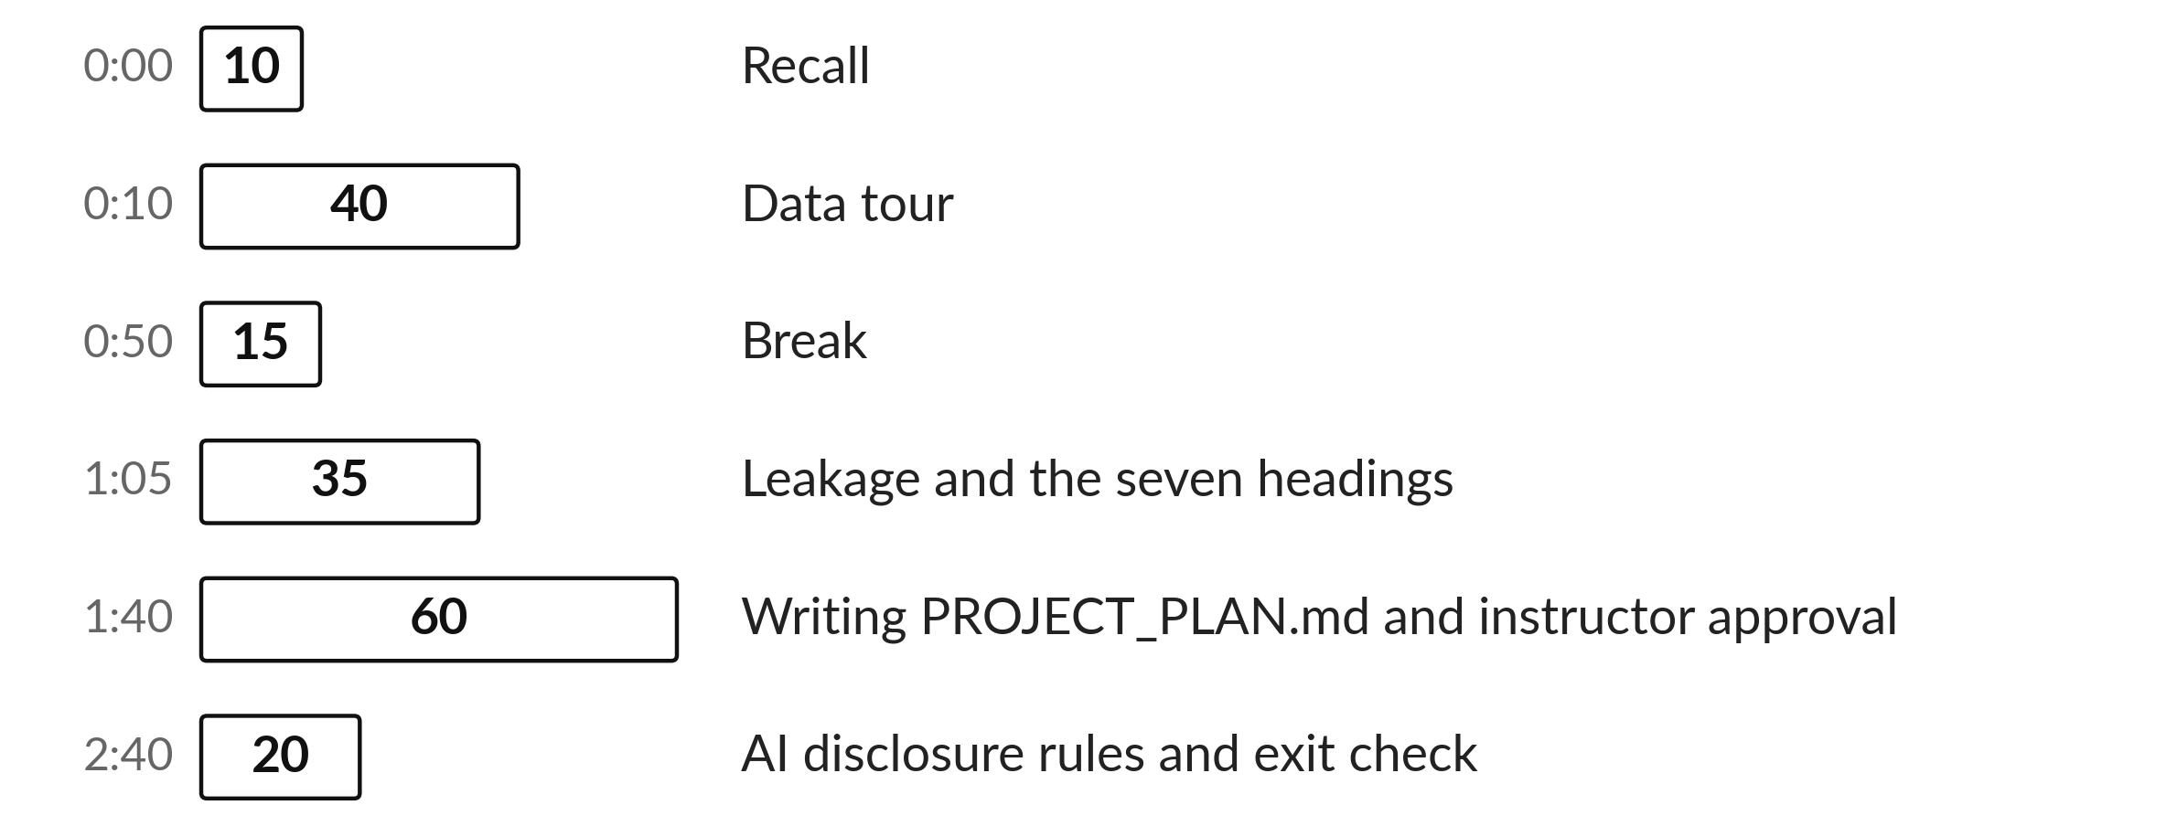
Three hours, mostly doing
Most of our time is spent doing, in small steps, with a guess before every run.
Notes:
Here is how the 3 hours go. Each bar is as long as the time we spend on that part.
First, 10 minutes. Recall. Then, 40 minutes. Data tour. After that, 15 minutes. Break. Next, 35 minutes. Leakage and the seven headings. Then, 60 minutes. Writing PROJECT_PLAN.md and instructor approval. Then, 20 minutes. AI disclosure rules and exit check.
Notice how much of the time is yours. You listen for a short while and then you do. That is on purpose, because you learn this by doing it.

Slide 4


Words for today (1 of 2)
project plan
A short page that fixes the question, data, target, inputs, baseline, test and limits before any building.
A drawing of the house before laying bricks.
leakage column
A column only known after the answer, so it must not be an input.
A tip that is only known after the ride.
Notes:
Here are the words for today. Listen for the picture that goes with each one.
project plan. A short page that fixes the question, data, target, inputs, baseline, test and limits before any building. You have seen this before. A drawing of the house before laying bricks.
leakage column. A column only known after the answer, so it must not be an input. A tip that is only known after the ride.

Slide 5


Words for today (2 of 2)
inputs
The columns known before the prediction.
The clues you are given.
limits
What the data and the model cannot tell us.
The edges of the map.
Notes:
Two more words to know before we start.
inputs. The columns known before the prediction. Imagine it like this. The clues you are given.
limits. What the data and the model cannot tell us. An example from everyday life. The edges of the map.

Slide 6
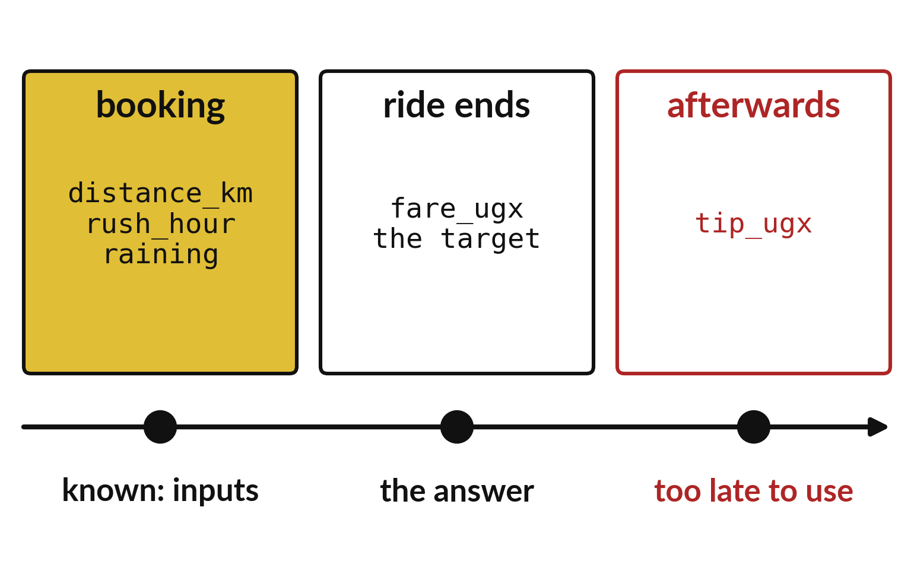
Only columns known at booking can be inputs
Distance, rush hour and rain are known at booking.
The fare is known when the ride ends.
The tip comes after, so it leaks.
Notes:
Follow a boda-boda trip in time. At booking we know the distance, whether it is rush hour and whether it is raining. When the ride ends we know the fare. Afterwards, maybe, comes a tip.
The tip is known too late to help predict the fare, so it must stay out of the inputs.

Slide 7
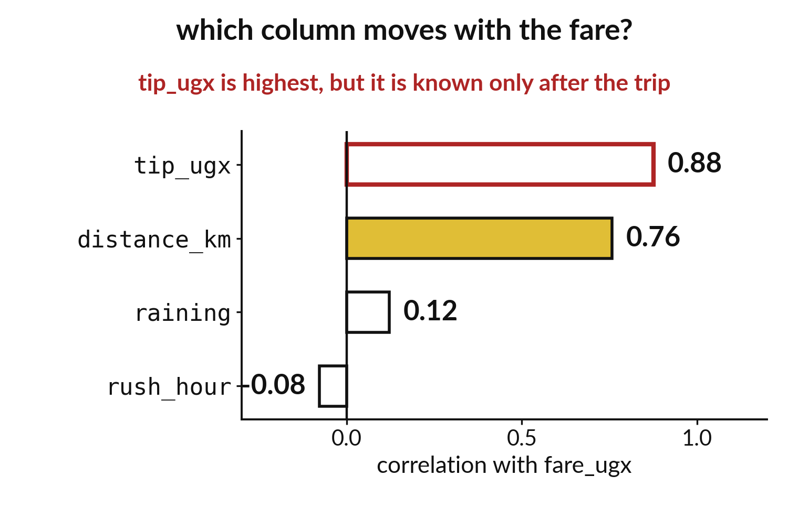
The tip tracks the fare most closely: a warning
The tip has the highest correlation, 0.88.
Distance follows at 0.76.
A strong link does not make a column fair.
Notes:
Correlation measures how closely two columns move together. The tip moves most closely with the fare, at zero point eight eight. Distance is next, at zero point seven six.
A high number tempts us to use the tip. But the tip is only known after the trip, so using it would be cheating.

Slide 8

Predict: Tour the fares data
import pandas as pd
fares = pd.read_csv("synthetic_fares.csv")
print(fares.shape)
corr = (
fares[["distance_km", "rush_hour", "raining", "tip_ugx", "fare_ugx"]]
.corr()["fare_ugx"]
.round(2)
)
print(corr)
Predict which column moves most closely with fare_ugx.
Write your guess on paper before we run it.
Notes:
synthetic_fares.csv holds 150 invented boda-boda trips. Look at its shape and at how each column moves with the fare.
Now your guess. Predict which column moves most closely with fare_ugx. Write one line on paper. I will give you a minute.

Slide 9
Run it: Tour the fares data
(150, 6)
distance_km 0.76
rush_hour -0.08
raining 0.12
tip_ugx 0.88
fare_ugx 1.00
Name: fare_ugx, dtype: float64
The table has 150 rows and 6 columns.
Distance has a correlation of 0.76 with the fare, rain 0.12 and rush hour about minus 0.08.
The tip column has the highest value, 0.88.
A correlation near 1 means the two columns rise together.
Notes:
Watch the output as it appears. Match each line of the output with the line of code that made it.
The table has 150 rows and 6 columns. Distance has a correlation of 0.76 with the fare, rain 0.12 and rush hour about minus 0.08. The tip column has the highest value, 0.88. A correlation near 1 means the two columns rise together. The tip rises with the fare because it is a share of the fare, and it is only known after the trip, so using it to predict the fare would be cheating. That makes tip_ugx a leakage column.
Tell the person next to you whether your guess matched.

Slide 10

Investigate: Tour the fares data
1. Why can tip_ugx not be an input?
2. Which columns are sensible inputs?
Notes:
Now we look closely at tour the fares data. I have two questions for you.
Question one. Why can tip_ugx not be an input? Have a go in your head first.
Here is how I would answer it. It is known only after the ride, and it is calculated from the fare. The model would be given the answer.
Question two. Which columns are sensible inputs? Write your answer in one line before we compare.
What I would say is this. distance_km, rush_hour and raining. All three are known before the ride starts.

Slide 11

Modify: change one thing
Print the correlation of the fare with the trip_id column.
Then tell your neighbour what changed and how you know.
Notes:
Your hands on the keyboard now. Print the correlation of the fare with the trip_id column. When you have run it, tell your neighbour what changed and how you know.
Here is what happens. It is close to zero: trip_id is only a label.

Slide 12

Break
15 minutes away from your screen
Stand up. Drink some water. Tell someone what you guessed in the first half.
Notes:
Break time. 15 minutes away from your screens. Stand up, drink some water and tell someone what you guessed in the first half.
When we come back we start the second idea.

Slide 13
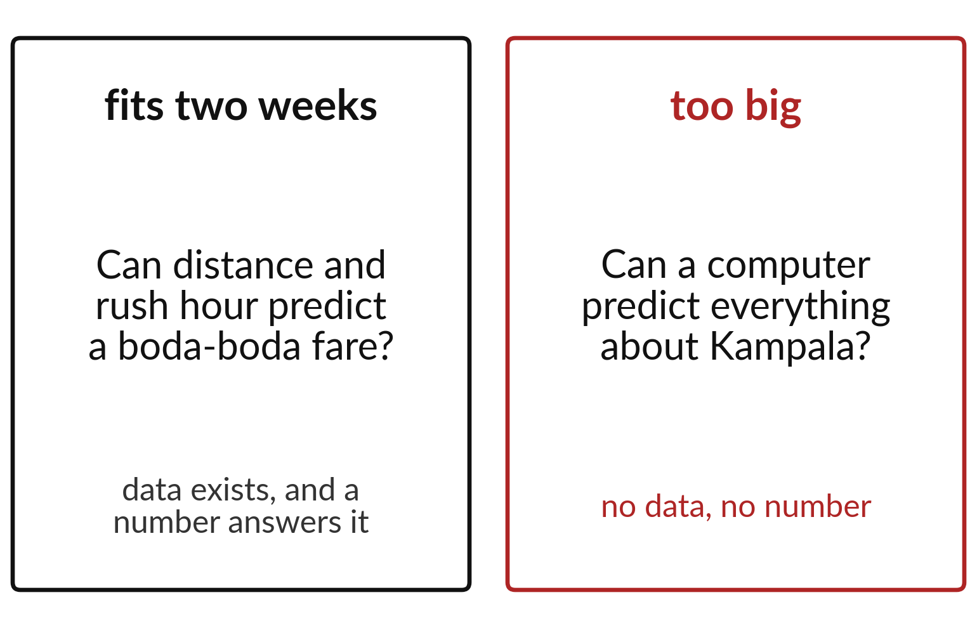
A safe project question fits two weeks
Choose a question with data behind it.
The answer should be a number or a label.
Avoid questions about everything.
Notes:
On the left is a question that fits two weeks. Can distance and rush hour predict a boda-boda fare? There is data, and the answer is a number. On the right is a question that is far too big. Nothing in our files can answer it.
Test your own question against these two cards.

Slide 14

Predict: A plan needs seven headings
Write the target and two inputs for your project before looking at the example.
Write your guess on paper before we run it.
Notes:
The plan has seven headings: question, dataset, target, inputs, baseline, evaluation and limits. Write one sentence under each.
This is the part where you decide. Write the target and two inputs for your project before looking at the example. Jot it on paper before anyone speaks.

Slide 15

Run it: A plan needs seven headings
An example plan: question, can distance and rush hour predict a boda-boda fare; dataset, synthetic_fares.csv; target, fare_ugx; inputs, distance_km, rush_hour and raining; baseline, the mean fare of the training trips; evaluation, mean absolute error in shillings on a locked test; limits, invented data and 150 trips.
Notes:
Let us see what happens. Match each line of the output with the line of code that made it.
An example plan: question, can distance and rush hour predict a boda-boda fare; dataset, synthetic_fares.csv; target, fare_ugx; inputs, distance_km, rush_hour and raining; baseline, the mean fare of the training trips; evaluation, mean absolute error in shillings on a locked test; limits, invented data and 150 trips. The options are synthetic_homes.csv (rent from area and rooms), synthetic_fares.csv and the iris flowers. Real people's records are not used. Repeat the AI rules: any assisted step is logged in AI_USE_LOG.md after your own attempt, or the log says No AI assistance used.
Which line of the output matches which line of the code? Point to each pair.

Slide 16

Investigate: A plan needs seven headings
1. Which heading stops you using the test answers to choose a model?
2. Why is the home_id column not an input for homes?
Notes:
Now we look closely at A plan needs seven headings. I have two questions for you.
Question one. Which heading stops you using the test answers to choose a model? Write your answer in one line before we compare.
What I would say is this. Evaluation. It states which rows are locked and which metric is used.
Question two. Why is the home_id column not an input for homes? Say it quietly to yourself before anyone answers.
Let me answer it. It is only a label. It carries no information about rent.

Slide 17

Modify: change one thing
Write the leakage column you will exclude and why.
Then tell your neighbour what changed and how you know.
Notes:
Change one thing and watch what happens. Write the leakage column you will exclude and why. Run it, then tell someone what you saw.
What you should find: For fares: tip_ugx, because it is known only after the trip.

Slide 18
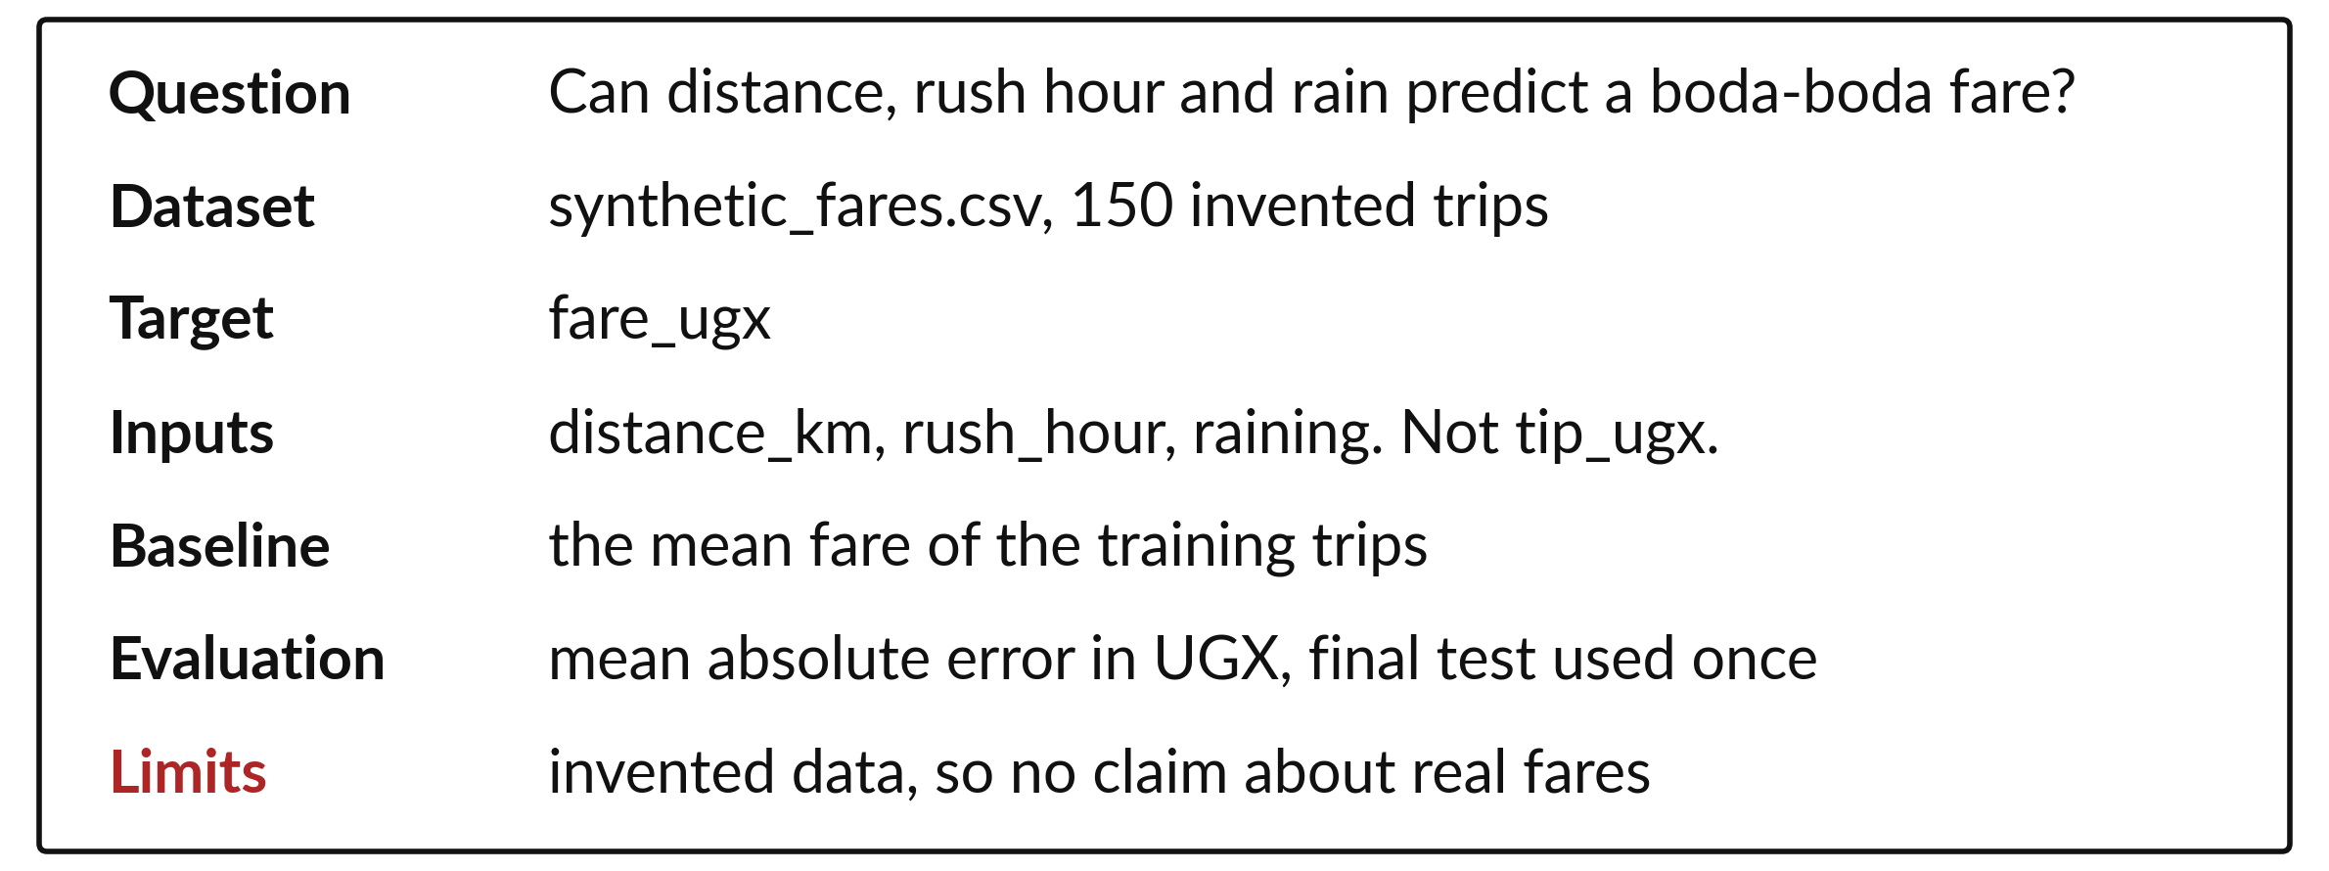
A project plan has seven headings
Write each heading before any code.
Notes:
Your plan has seven headings: the question, the dataset, the target, the inputs, the baseline, the evaluation and the limits. Fill them in before you write a single line of code.
The plan keeps you honest. When the results arrive, you cannot quietly change the question to fit them.

Slide 19

Make: your own version
Write PROJECT_PLAN.md using the seven headings.
Name one leakage column and exclude it.
Ask the instructor to approve the scope before you build.
Save it as ML19. Write two sentences: what you changed and how you checked it.
Notes:
Now you do the real work yourself. Start with the first step. If you get stuck for a few minutes, read your error message, check the error card, and then ask me.
Save it as ML19. I will come round to each of you and ask what you changed and how you checked it.

Slide 20

Two errors you may meet today
It means: The column is called tip_ugx.
Fix: Print fares.columns and copy the exact names.
KeyError: 'tip'
It means: It asks for real people's data, an app or a neural network.
Fix: Reduce it to one supplied table, one target and one baseline.
The plan promises too much
Notes:
Two things are likely to go wrong today. It helps to know them before they happen.
This is the first one. You will see: KeyError: 'tip'. It means this: the column is called tip_ugx. To fix it, print fares.columns and copy the exact names.
The next one. You will see: The plan promises too much. It means this: it asks for real people's data, an app or a neural network. To fix it, reduce it to one supplied table, one target and one baseline.
If you meet one of these, fix it and carry on. It happens to everyone.

Slide 21

Finish this sentence in your notebook
A project plan names the question, target, inputs and test before any code, and it excludes the column that gives the answer away.
Then save your notebook, close it and open it again to check it saved.
Notes:
Before we finish, go back to the question we began with: Which dataset and which question can I answer with a fair test in two weeks?
Copy this sentence into your notebook and make it yours. A project plan names the question, target, inputs and test before any code, and it excludes the column that gives the answer away.
Then save your notebook, close it and open it again to check it saved.

