Slide 1
The final test and a
reproducible handover
How well does my frozen model do on rows nobody has used?
Machine Learning | Session 22 of 24 | Week 8, Hand over
Holiday Data and AI Camp | The National ICT Innovation Hub, Nakawa
Notes:
Let us begin. Today is session 22 and our topic is the final test and a reproducible handover.
By the end of today you will be able to run the final test once, report it separately from validation, and hand over a project that reruns from a restarted kernel.
We will answer one question: How well does my frozen model do on rows nobody has used?

Slide 2
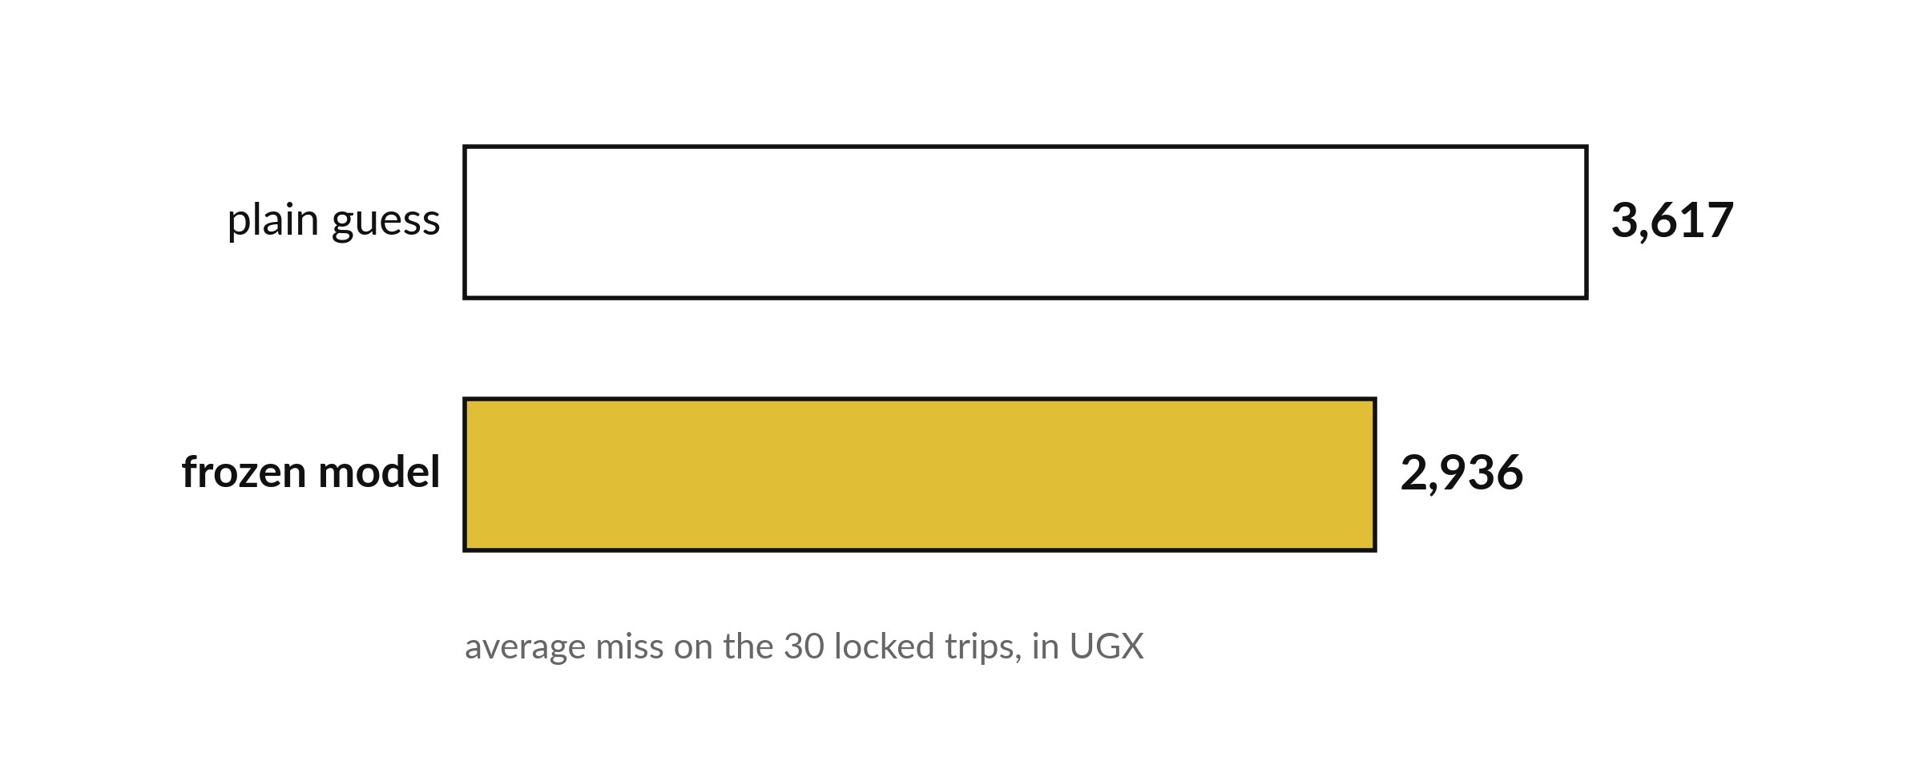
How well does my frozen model
do on rows nobody has used?
Notes:
Here is the answer to the question for today. On the thirty locked trips, the plain guess misses by three thousand six hundred and seventeen shillings. The frozen model misses by two thousand nine hundred and thirty six. The model still wins, though by less than on validation. That is a normal and honest result.

Slide 3
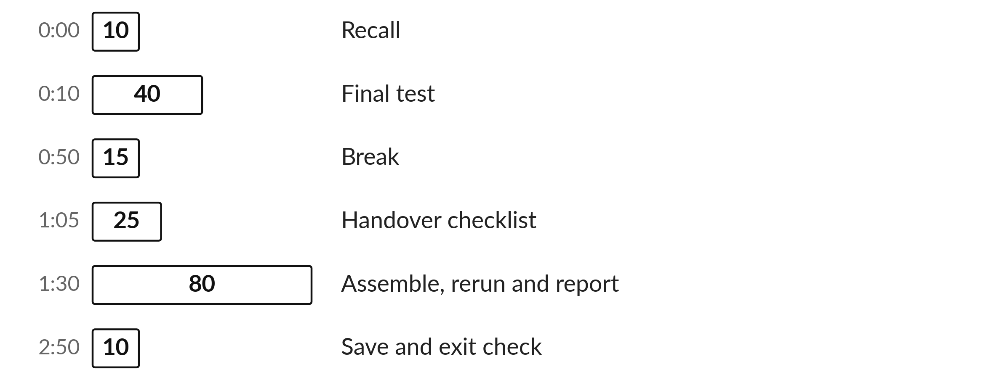
Three hours, mostly doing
Most of our time is spent doing, in small steps, with a guess before every run.
Notes:
Here is how the 3 hours go. Each bar is as long as the time we spend on that part.
First, 10 minutes. Recall. Then, 40 minutes. Final test. After that, 15 minutes. Break. Next, 25 minutes. Handover checklist. Then, 80 minutes. Assemble, rerun and report. Then, 10 minutes. Save and exit check.
Notice how much of the time is yours. You listen for a short while and then you do. That is on purpose, because you learn this by doing it.

Slide 4


Words for today (1 of 2)
frozen model
A model whose inputs and settings are fixed before the final test.
An answer sheet handed in.
handover
Everything another person needs: data origin, code, instructions and limits.
Passing on the keys with directions.
Notes:
Here are the words for today. Listen for the picture that goes with each one.
frozen model. A model whose inputs and settings are fixed before the final test. A small example. An answer sheet handed in.
handover. Everything another person needs: data origin, code, instructions and limits. Picture this. Passing on the keys with directions.

Slide 5


Words for today (2 of 2)
restart and run all
Restart the kernel and run every cell from the top.
Starting the game from the first level.
limit
A fair statement of what the result cannot show.
The edge of what you know.
Notes:
Two more words to know before we start.
restart and run all. Restart the kernel and run every cell from the top. Starting the game from the first level.
limit. A fair statement of what the result cannot show. Think of a shop. The edge of what you know.

Slide 6
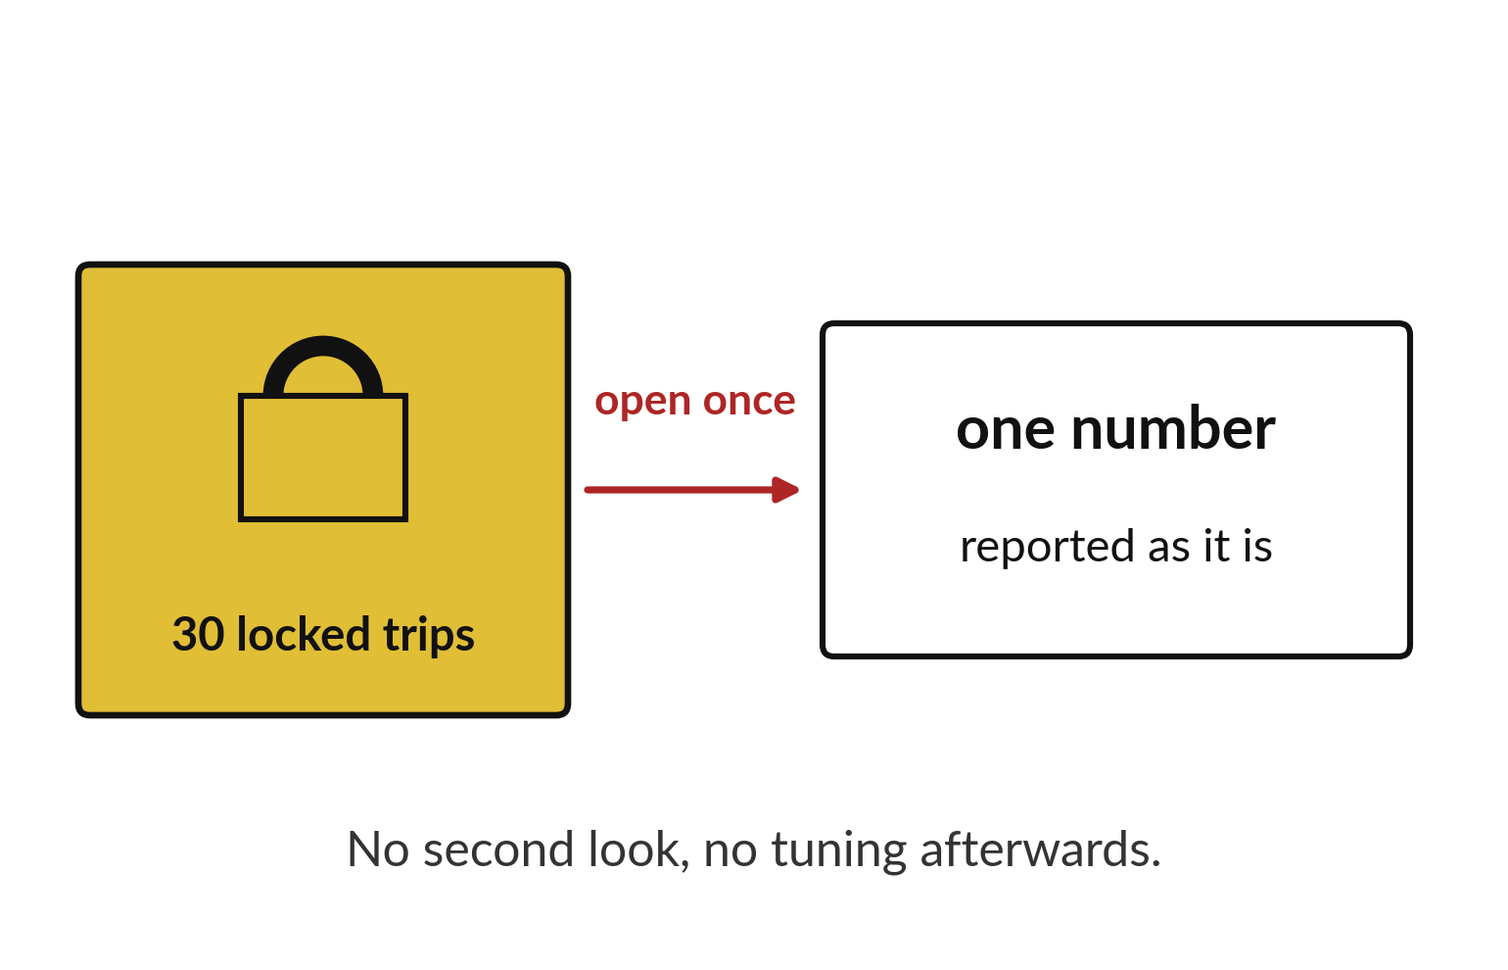
The locked trips are opened once and reported
Thirty trips stayed locked until now.
Open them once.
Report whatever number appears.
Notes:
The thirty locked trips have waited all this time. Now we open them once, with the model already frozen, and write down the number.
If the number is disappointing we report it anyway. Changing the model now and trying again would make the test worthless.

Slide 7

Predict: Run the final test once
Predict whether the final test error will be above or below the validation error of 2255.
Write your guess on paper before we run it.
Notes:
The fares model with three inputs was chosen on validation.
Make a prediction. Predict whether the final test error will be above or below the validation error of 2255. Write one line on paper. I will give you a minute.

Slide 8

Run it: Run the final test once
The cell prints 2936 and 3617.
On the locked 30 trips the model misses by about UGX 2936 and the plain guess by about UGX 3617.
The model is still better, but its lead is much smaller than the validation lead of 2255 against 4361.
Notes:
Running it now. Match each line of the output with the line of code that made it.
The cell prints 2936 and 3617. On the locked 30 trips the model misses by about UGX 2936 and the plain guess by about UGX 3617. The model is still better, but its lead is much smaller than the validation lead of 2255 against 4361. This is normal: the test has only 30 trips, and the validation lead may have been lucky. Report the final number as it is, next to the validation number, and do not change the model to improve it.
Keep your guess. We use it in the next step.

Slide 9

Investigate: Run the final test once
1. Why report the final score separately from validation?
2. Can you change the model if the final score is disappointing?
Notes:
Now we look closely at Run the final test once. I have two questions for you.
Question one. Why report the final score separately from validation? Have a go in your head first.
Let me answer it. Validation was used to choose the model, so only the final test is an honest score.
Question two. Can you change the model if the final score is disappointing? Write your answer in one line before we compare.
The answer is this. No. Changing it after seeing the test would use the test twice, and a new locked test would be needed.

Slide 10

Modify: change one thing
Calculate how much smaller the model's error is than the baseline's on the final test, as a percentage.
Then tell your neighbour what changed and how you know.
Notes:
Make one small change. Calculate how much smaller the model's error is than the baseline's on the final test, as a percentage. After you run it, say in one sentence what changed and how you checked.
You should see this. About 19% smaller.

Slide 11

Break
15 minutes away from your screen
Stand up. Drink some water. Tell someone what you guessed in the first half.
Notes:
Break time. 15 minutes away from your screens. Stand up, drink some water and tell someone what you guessed in the first half.
When we come back we start the second idea.

Slide 12
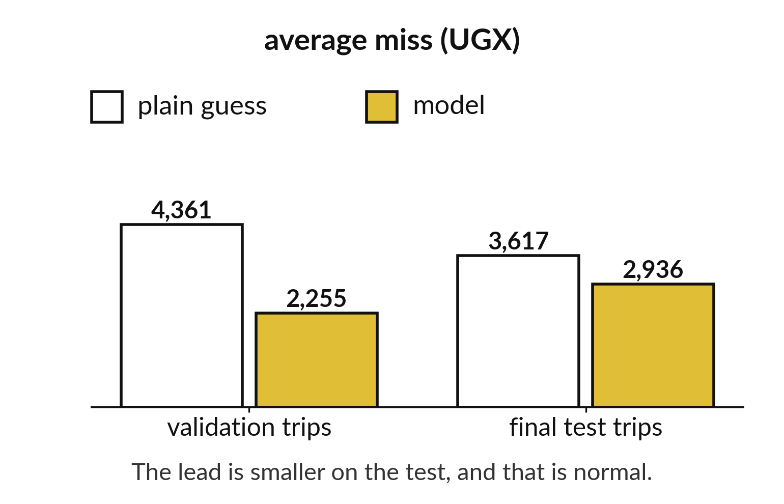
The lead over the plain guess shrinks at the test
Validation lead: 4,361 against 2,255.
Final test lead: 3,617 against 2,936.
A smaller lead on fresh trips is normal.
Notes:
On validation the model beat the plain guess by a wide margin. On the final test the margin is smaller. This happens because we chose the model using the validation trips, so it looked a little better there than it really is.
The final test gives the honest figure.

Slide 13
Predict: The handover checklist
Write the three things you think a stranger needs first to rerun your project.
Write your guess on paper before we run it.
Notes:
Another person should be able to rerun your folder. Work through the list with a partner.
Time to commit to an answer. Write the three things you think a stranger needs first to rerun your project. Jot it on paper before anyone speaks.

Slide 14
Run it: The handover checklist
The checklist: restart the kernel and run all cells from the top; the data file sits beside the notebook; the data origin and the fact that it is synthetic are stated; the final test is reported separately from validation; limits are written next to the result; project.ipynb, the data dictionary and report.pdf or report.docx are saved together; every file opens when reopened.
Notes:
Now we run it. Match each line of the output with the line of code that made it.
The checklist: restart the kernel and run all cells from the top; the data file sits beside the notebook; the data origin and the fact that it is synthetic are stated; the final test is reported separately from validation; limits are written next to the result; project.ipynb, the data dictionary and report.pdf or report.docx are saved together; every file opens when reopened. A model on invented teaching data is a demonstration, and nobody should use it to make decisions about people.
If your guess was off, find the line that surprised you.

Slide 15

Investigate: The handover checklist
1. Why restart the kernel before the final run?
2. What does the report say about the model's limits?
Notes:
Now we look closely at the handover checklist. I have two questions for you.
Question one. Why restart the kernel before the final run? Write your answer in one line before we compare.
The answer is this. Hidden steps are exposed when the notebook runs from a clean start.
Question two. What does the report say about the model's limits? Say it quietly to yourself before anyone answers.
The data is invented, the test is small, and the model has not been tried on real trips.

Slide 16

Modify: change one thing
Swap notebooks with a partner. Follow their instructions without asking questions and note where you stall.
Then tell your neighbour what changed and how you know.
Notes:
Now it is your turn to change something. Swap notebooks with a partner. Follow their instructions without asking questions and note where you stall. Then explain to your neighbour what the change did.
The result: Every stall is a missing instruction. Add it.

Slide 17
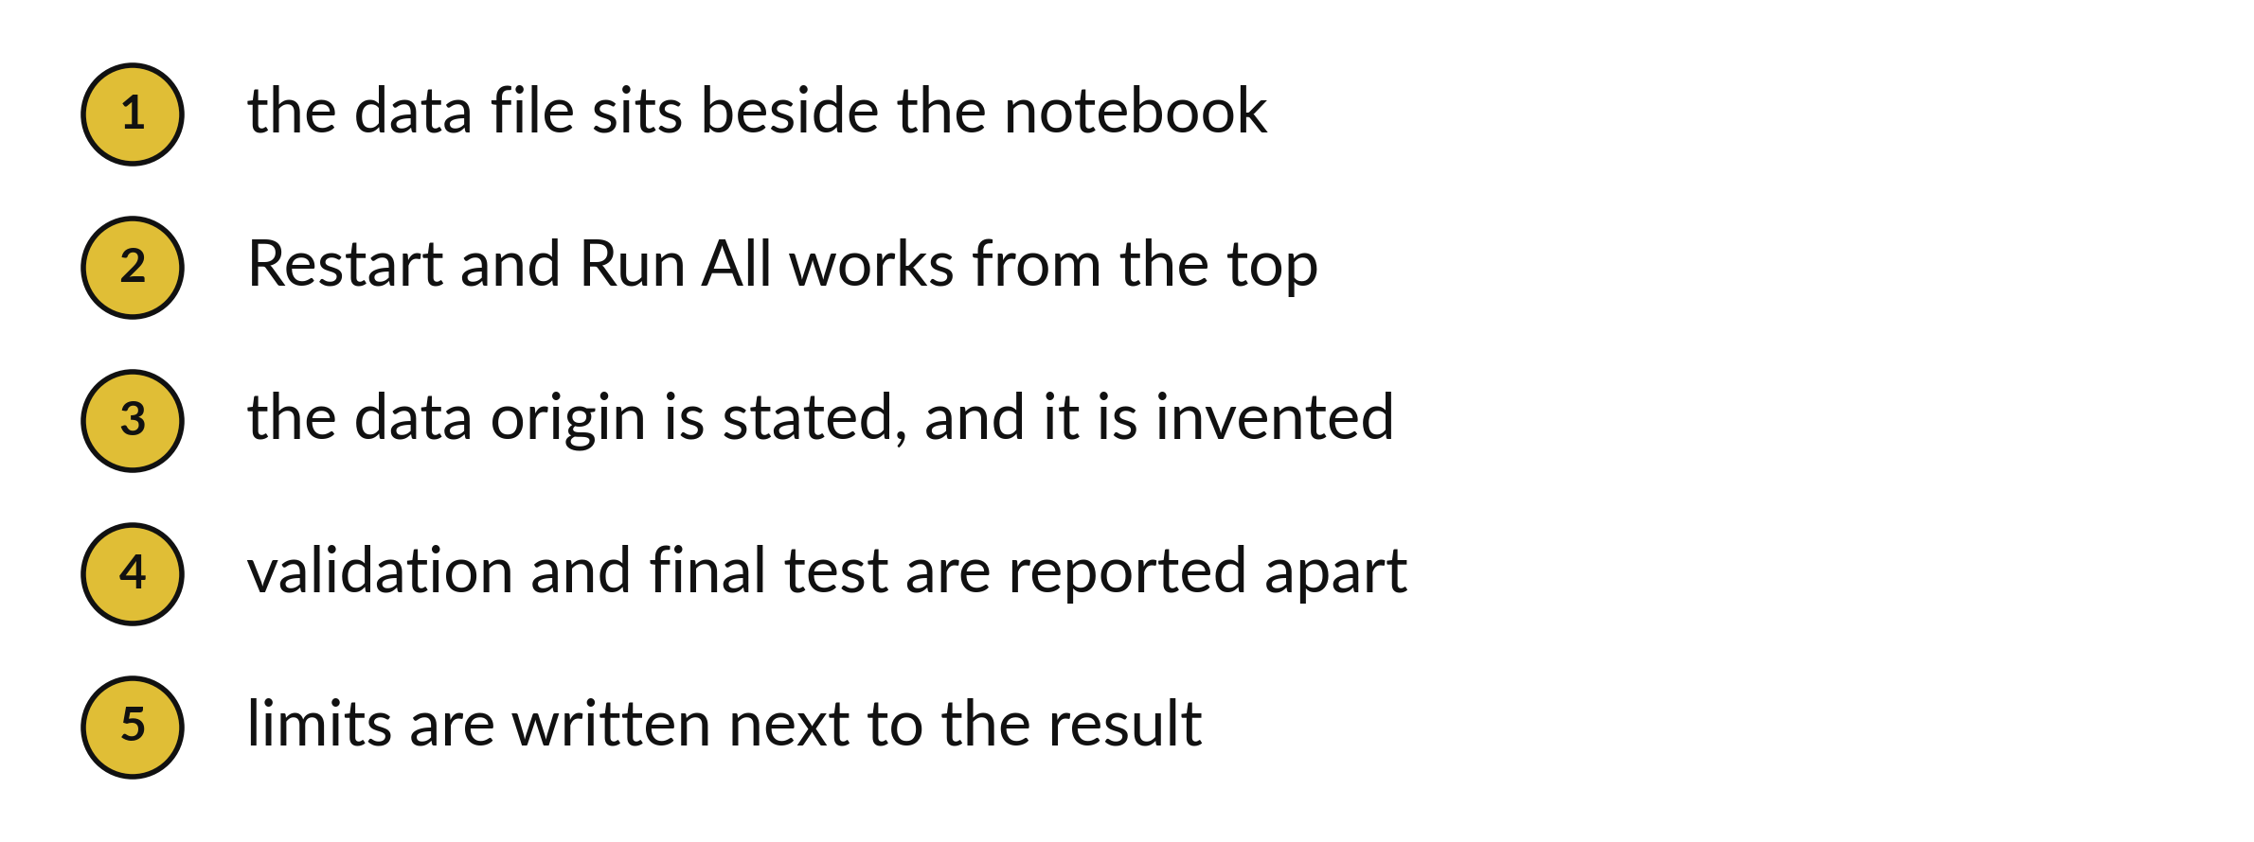
A handover lets someone else rerun your work
Tick every line before you hand over.
Notes:
A handover means somebody else can pick up your folder and run it. Keep the data file next to the notebook. Check that restart and run all works from the top. State where the data came from, and say that it is invented.
Report validation and final test separately, and write the limits next to the result.

Slide 18
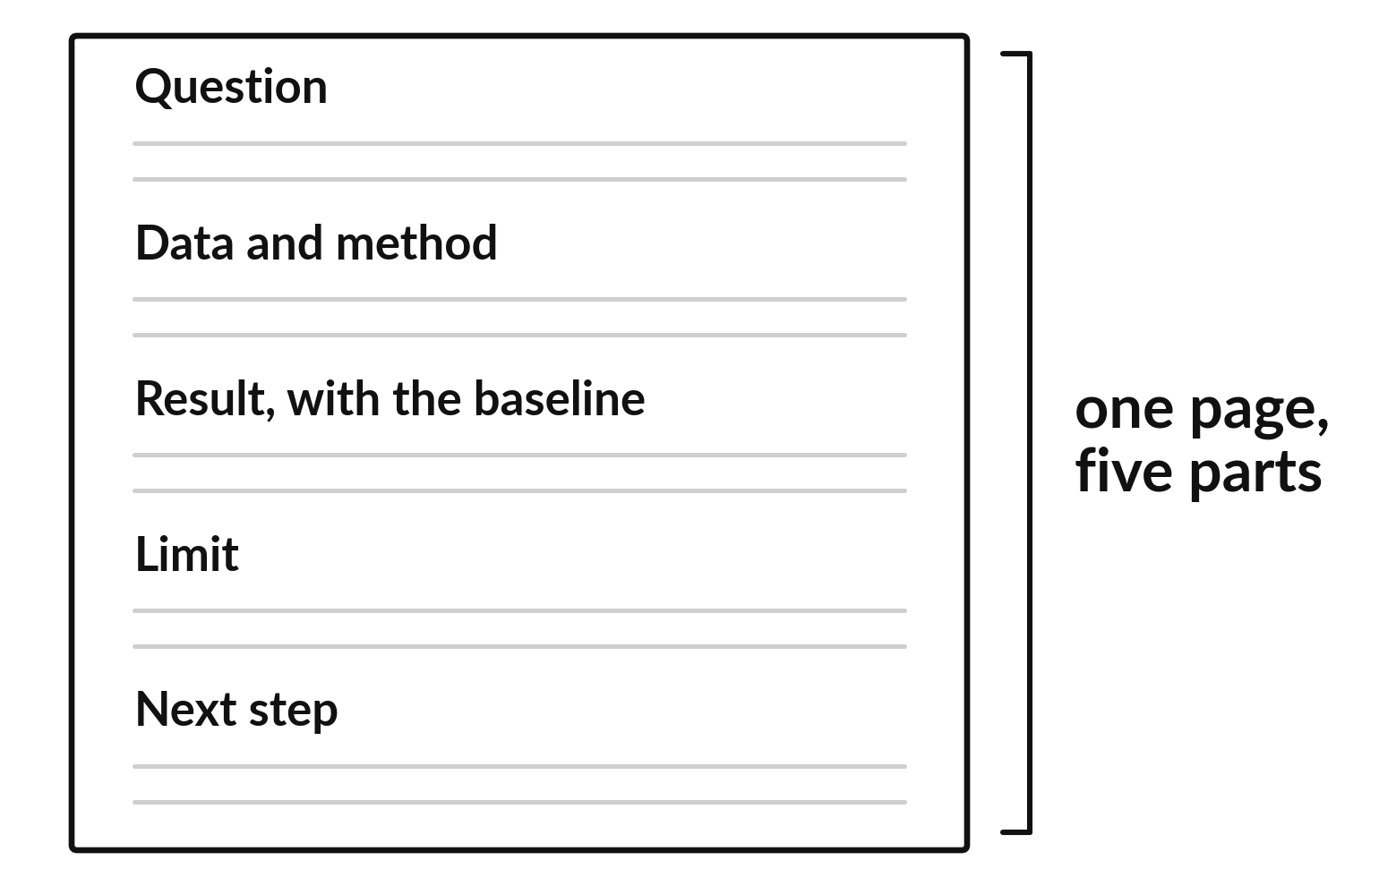
A one page report has five parts
Question, then data and method.
Result with the baseline beside it.
End with a limit and a next step.
Notes:
Your report fits on one page. Open with the question. Describe the data and method. Give the result, with the baseline beside it so a reader can judge. Add one limit and one next step.
A stranger should be able to read it in two minutes.

Slide 19

Make: your own version
Use the project checklist.
Reopen all submitted files.
Submit project.ipynb, your data dictionary and report.pdf or report.docx together through the instructor's collection route.
Save it as ML22. Write two sentences: what you changed and how you checked it.
Notes:
Now you do the real work yourself. Start with the first step. If you get stuck for a few minutes, read your error message, check the error card, and then ask me.
Save it as ML22. I will come round to each of you and ask what you changed and how you checked it.

Slide 20

Two errors you may meet today
It means: A cell used a name that was only created in a deleted or skipped cell.
Fix: Run all cells from the top and add the missing step.
NameError after restarting the kernel
It means: The split or the model settings changed.
Fix: Use the same random_state and settings as in validation.
The final score differs from last time
Notes:
Two things are likely to go wrong today. It helps to know them before they happen.
This is the first one. You will see: NameError after restarting the kernel. It means this: A cell used a name that was only created in a deleted or skipped cell. To fix it, Run all cells from the top and add the missing step.
The next one. You will see: The final score differs from last time. It means this: the split or the model settings changed. To fix it, use the same random_state and settings as in validation.
If you meet one of these, fix it and carry on. It happens to everyone.

Slide 21

Finish this sentence in your notebook
The final test is run once, reported next to validation, and the project reruns from a restarted kernel.
Then save your notebook, close it and open it again to check it saved.
Notes:
Before we finish, go back to the question we began with: How well does my frozen model do on rows nobody has used?
Copy this sentence into your notebook and make it yours. The final test is run once, reported next to validation, and the project reruns from a restarted kernel.
Then save your notebook, close it and open it again to check it saved.

