Slide 1
Parent showcase
and next steps
Can I show and explain my own work with nothing to help but what I know?
Machine Learning | Session 24 of 24 | Week 8, Hand over
Holiday Data and AI Camp | The National ICT Innovation Hub, Nakawa
Notes:
Welcome back. Today is session 24 and our topic is parent showcase and next steps.
By the end of today you will be able to present your project, explain one decision, make one small code change without AI, and name your next learning goal.
We will answer one question: Can I show and explain my own work with nothing to help but what I know?

Slide 2
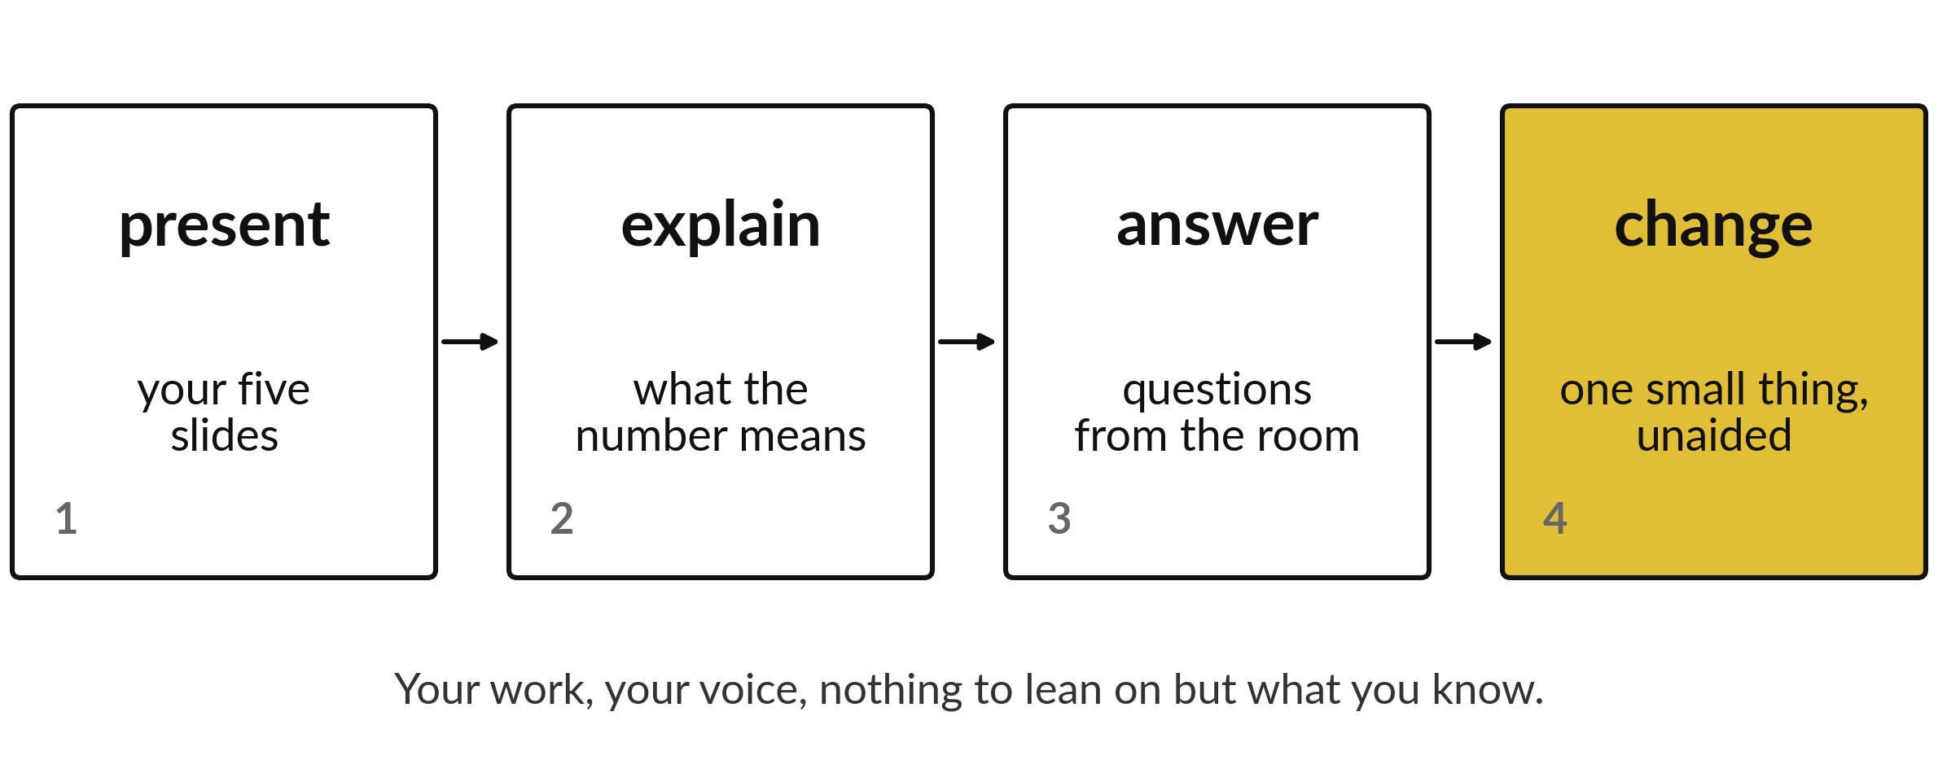
Can I show and explain my own work
with nothing to help but what I know?
Notes:
The showcase has four parts. You present your five slides. You explain what the number means. You answer questions from the room. Then you make one small change to your own code with nobody helping. This is your chance to show that the work is yours and that you understand it.

Slide 3
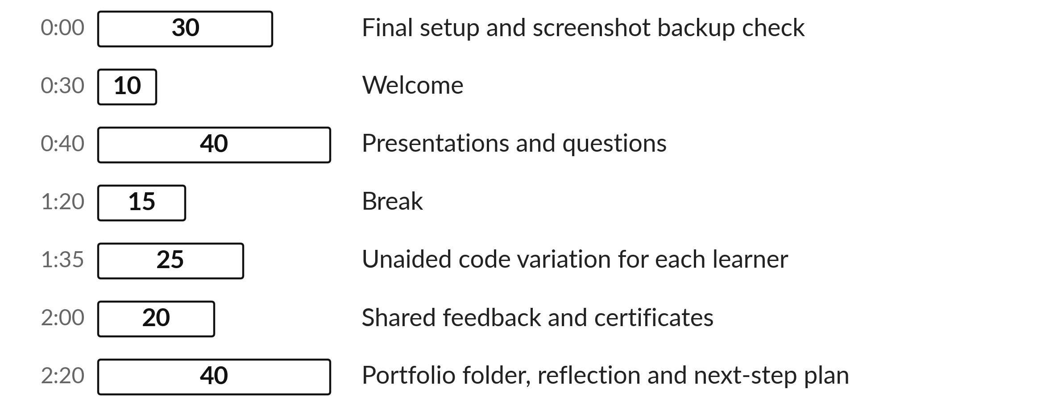
Today's plan in minutes
Your families come to see what you built. You show it and answer questions.
Notes:
Here is how the 3 hours go. Each bar is as long as the time we spend on that part.
First, 30 minutes. Final setup and screenshot backup check. Then, 10 minutes. Welcome. After that, 40 minutes. Presentations and questions. Next, 15 minutes. Break. Then, 25 minutes. Unaided code variation for each learner. Then, 20 minutes. Shared feedback and certificates. Last, 40 minutes. Portfolio folder, reflection and next-step plan.
Your families come to see what you built. You show it and answer questions. Ask me now if any part of the plan is unclear.

Slide 4



Words for today (1 of 2)
showcase
A short event where you present your project to parents and guardians.
A school open day.
unaided
Done with no AI assistance, with assistant windows closed.
A closed-book exam.
completion record
A note of the track finished and the evidence assessed.
A school report.
Notes:
We need a few words today. For each one I will say what it means and give you something to picture.
showcase. A short event where you present your project to parents and guardians. An example from everyday life. A school open day.
unaided. Done with no AI assistance, with assistant windows closed. Here is a way to see it. A closed-book exam.
completion record. A note of the track finished and the evidence assessed. A small example. A school report.

Slide 5

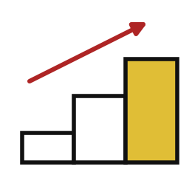

Words for today (2 of 2)
portfolio
The folder of your own project files and feedback.
Your best exercise books.
next step
One learning goal for after the camp.
The next chapter you plan to read.
feedback
A strength and a next step from the instructor.
A teacher's comment.
Notes:
More words for today.
portfolio. The folder of your own project files and feedback. Picture this. Your best exercise books.
next step. One learning goal for after the camp. You have seen this before. The next chapter you plan to read.
feedback. A strength and a next step from the instructor. A teacher's comment.

Slide 6
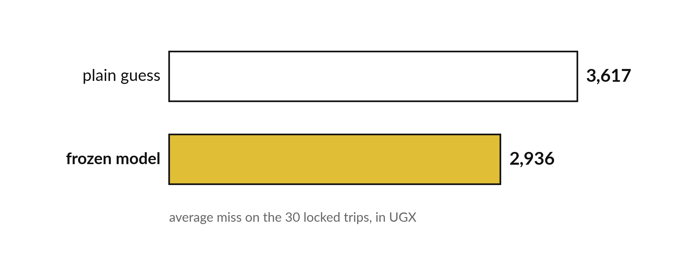
Quote the number you measured when asked
The final test is your evidence.
Notes:
Questions from the room are easier when you have your numbers ready. The plain guess misses by three thousand six hundred and seventeen shillings on the locked trips. Your frozen model misses by two thousand nine hundred and thirty six.
If you do not know an answer, say so, and say how you would find out.

Slide 7
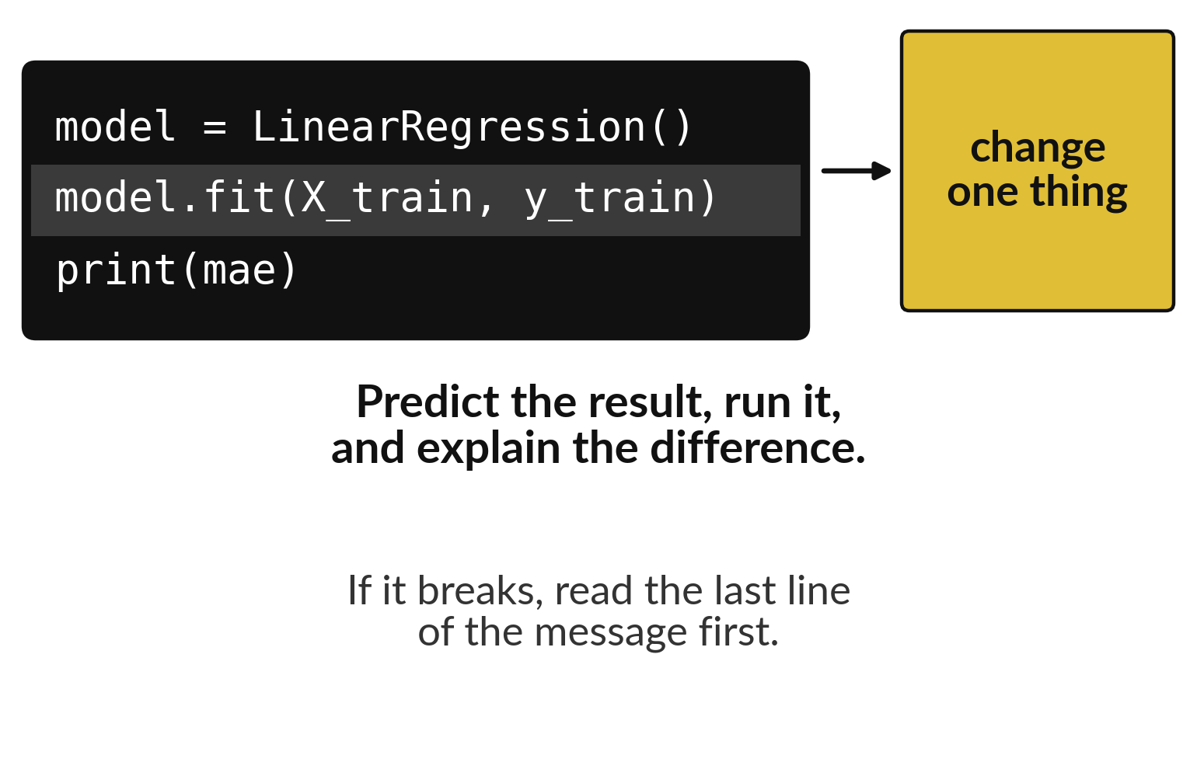
One unaided change shows you know your code
Change one thing in your own notebook.
Predict the result first.
Run it and explain the difference.
Notes:
At the end you change one thing in your own code, perhaps a setting or an input. Say what you expect to happen before you run it. Then run it and explain the difference.
If something breaks, read the last line of the error first. That line usually tells you what to look at.

Slide 8

Predict: Present and explain
Write the one decision in your project you will explain if asked.
Write your guess on paper before we run it.
Notes:
Each learner has five minutes to present and three minutes for questions. Explain the input, the output and one failure case.
Time to commit to an answer. Write the one decision in your project you will explain if asked. Guess on paper first. Surprises are useful.

Slide 9

Run it: Present and explain
The instructor uses the same demonstration rubric for every learner.
You show your own work, explain one decision, and answer an instructor-chosen question about your code unaided.
Close assistant windows and turn off generative suggestions.
Notes:
Now we run it. Match each line of the output with the line of code that made it.
The instructor uses the same demonstration rubric for every learner. You show your own work, explain one decision, and answer an instructor-chosen question about your code unaided. Close assistant windows and turn off generative suggestions. If the technology fails, use the screenshot backup and explain the steps; a short live rerun can be arranged later.
If your guess was off, find the line that surprised you.

Slide 10

Investigate: Present and explain
1. What is a failure case?
2. What if the laptop fails?
Notes:
Now we look closely at present and explain. I have two questions for you.
Question one. What is a failure case? Say it quietly to yourself before anyone answers.
The answer is this. An input where the model does badly, with a reason.
Question two. What if the laptop fails? Give it thirty seconds and then we will hear a few answers.
Show the backup and explain the workflow. Rerun later if evidence is missing.

Slide 11

Modify: change one thing
Say one thing your model gets wrong and why.
Then tell your neighbour what changed and how you know.
Notes:
Now it is your turn to change something. Say one thing your model gets wrong and why. When you have run it, tell your neighbour what changed and how you know.
Here is what happens. For example: it misses fares for very long trips, because it learned from short ones.

Slide 12

Break
15 minutes away from your screen
Stand up. Drink some water. Tell someone what you guessed in the first half.
Notes:
Break time. 15 minutes away from your screens. Stand up, drink some water and tell someone what you guessed in the first half.
When we come back we start the second idea.

Slide 13
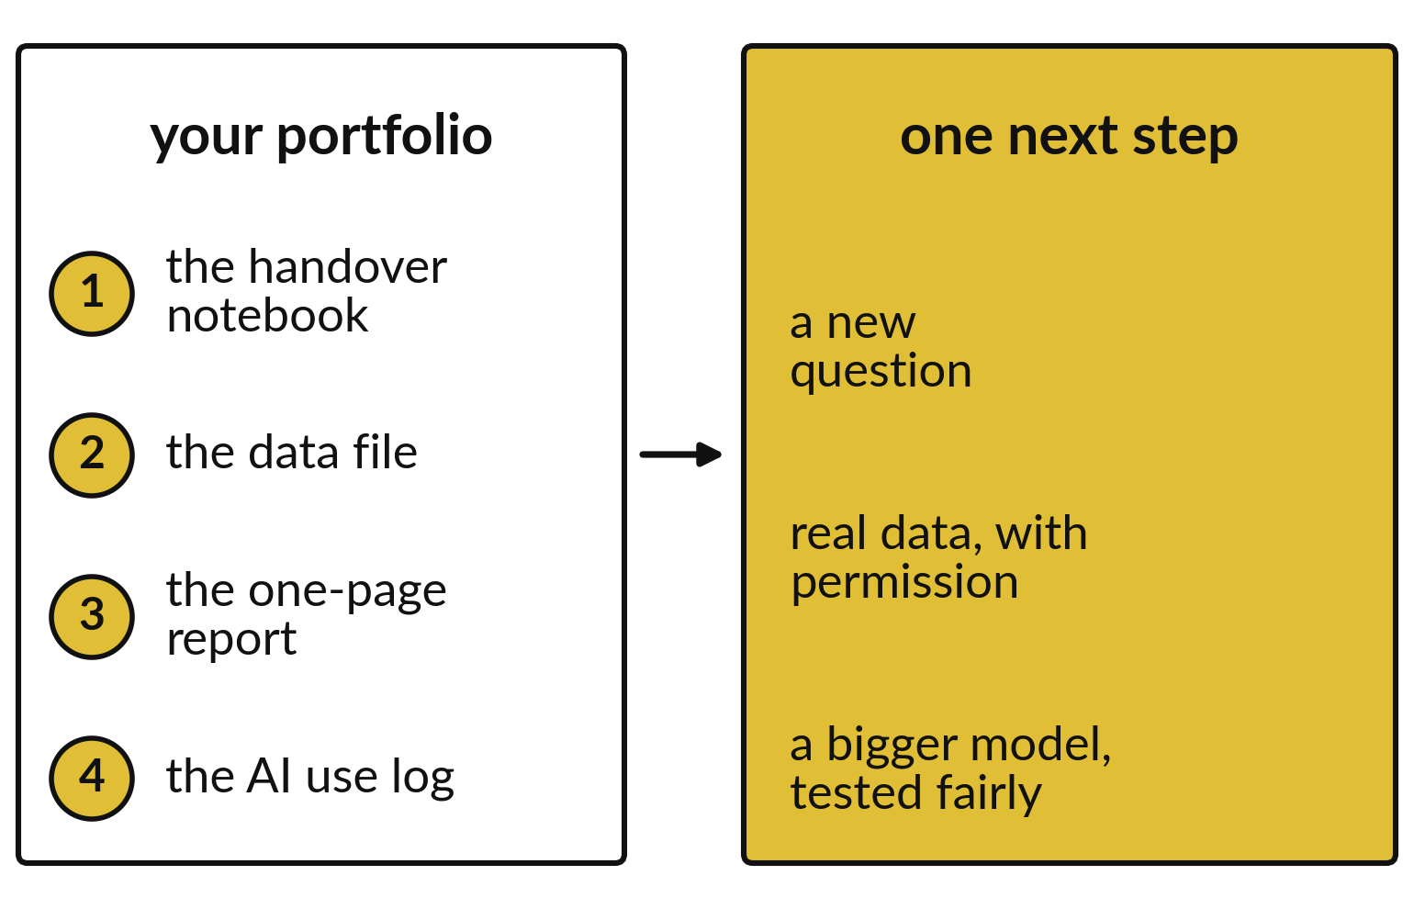
Your portfolio and your
next step go home with you
Keep the notebook, data, report and AI log together.
Pick one next step.
Ask a new question next time.
Notes:
Before you leave, collect your portfolio: the handover notebook, the data file, the one page report and your AI use log. Keep them in one folder.
Then choose one next step. A new question, real data used with permission, or a bigger model tested fairly.

Slide 14
Predict: A small change, unaided
Before the change, predict whether your error will go up or down.
Write your guess on paper before we run it.
Notes:
The instructor chooses one small change to your code, such as a different test size or one more input. Make it and say what you expect.
Your turn to guess. Before the change, predict whether your error will go up or down. Write it on paper. It does not have to be right.

Slide 15
Run it: A small change, unaided
The change is small on purpose.
It shows that you understand the notebook.
A completion record follows the published policy: attendance, both checkpoints, the project and this demonstration.
Notes:
I will run it, and you compare with your guess. Match each line of the output with the line of code that made it.
The change is small on purpose. It shows that you understand the notebook. A completion record follows the published policy: attendance, both checkpoints, the project and this demonstration. The certificate is issued by the programme provider and is not a university qualification or a certificate from another course provider.
Check your paper. Were you close?

Slide 16
Investigate: A small change, unaided
1. What does the certificate show?
2. What is a good next learning goal?
Notes:
Now we look closely at A small change, unaided. I have two questions for you.
Question one. What does the certificate show? Give it thirty seconds and then we will hear a few answers.
The track you finished and the evidence that was assessed.
Question two. What is a good next learning goal? Talk it over with your neighbour for a minute.
Here is how I would answer it. One specific thing, such as a second model on the same data, or a chart you did not finish.

Slide 17
Modify: change one thing
Write your next learning goal on one line.
Then tell your neighbour what changed and how you know.
Notes:
Time to experiment. Write your next learning goal on one line. Run it, then tell someone what you saw.
What you should find: A specific goal you can start next week.

Slide 18

Make: your own version
Present your project, say who helped you, and choose one next learning goal.
Keep your project folder and feedback after the camp.
Save it as ML24. Write two sentences: what you changed and how you checked it.
Notes:
This is your own task for today. Take it one step at a time. If you get stuck for a few minutes, read your error message, check the error card, and then ask me.
Save it as ML24. I will come round to each of you and ask what you changed and how you checked it.

Slide 19

Two errors you may meet today
It means: A name or a cell order changed.
Fix: Restart, run all cells, then read the last line of the error.
The change breaks the notebook
It means: More than one idea per slide.
Fix: Use the five slides and leave the extra detail for questions.
The demonstration is too long
Notes:
Everyone meets errors, including me. Two are likely today, so let us meet them now.
This is the first one. You will see: The change breaks the notebook. It means this: A name or a cell order changed. To fix it, restart, run all cells, then read the last line of the error.
The next one. You will see: The demonstration is too long. It means this: more than one idea per slide. To fix it, use the five slides and leave the extra detail for questions.
Keep this slide in mind when something stops working.

Slide 20

Finish this sentence in your notebook
I can show my own work, explain one decision, and change one thing in my code without help.
Then save your notebook, close it and open it again to check it saved.
Notes:
We are nearly done. Remember the question from the start of the session: Can I show and explain my own work with nothing to help but what I know?
Write this sentence in your notebook and finish it your own way. I can show my own work, explain one decision, and change one thing in my code without help.
Then save your notebook, close it and open it again to check it saved.

