Slide 1
Features and choosing a
model, and your project
Which model should we recommend for predicting cooling load, and how do we explain the choice to someone who pays?
CML3112 | Civil Engineering and Architecture | Week 11, class 4 of 4 | Tuesday 24 November 2026, 11:00 to 14:00
KLAi | International University of East Africa | Jotham Martin Wambi
Notes:
Welcome to the last teaching class of the semester. Over three weeks you have built a model, judged it, and learned how to trust it. Today you compare several models and choose one. In real work you will have several candidate models for predicting cooling load, and you must choose one fairly and explain the choice to the client who pays for the cooling plant.
The ideas come first, then the lab, then the quiz for this block.

Slide 2



Today in one view: what you will leave with
By the end of today you can
Build a new feature, test it with a feature ablation (ablation study) and say what the result shows
Compare five candidate models with the same cross-validation protocol (model selection) and choose the simplest one that is good enough (parsimony)
Write a one-page decision memo and explain how the timed, auto-graded project works
Notes:
Here is what you can do by the end of today. You can build a new feature from what you know about the machine, test it with a feature ablation, also called an ablation study, and say what the result shows. You can compare five candidate models with the same cross-validation protocol, which is model selection, and choose the simplest one that is good enough.
And you can write the choice down in a one-page decision memo and explain how the project works. The quiz for this block opens in the last 20 minutes of the class.

Slide 3
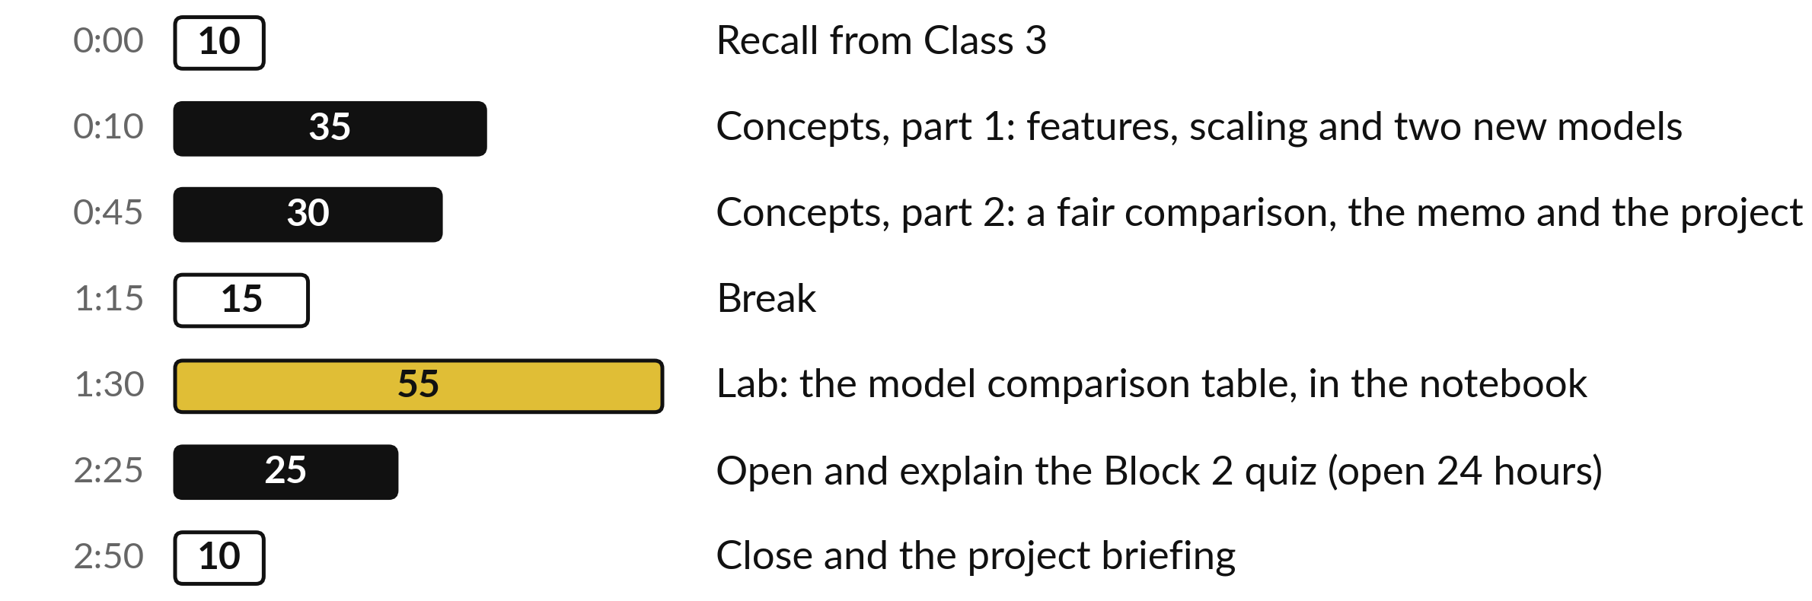
Your three hours: models
and memo first, then the lab
Concepts first, with no laptops. Then the lab. The quiz opens in the last 20 minutes (open 24 hours).
Notes:
This is the last full class of the semester. The first part is concepts only, with no laptop: new features, two new models, a fair way to compare them and how to write the decision down. Then a break. Then the lab, where you build the comparison table on your own data.
The Block 2 quiz opens in the last 20 minutes of this class and stays open for 24 hours, and the project rules are part of the concepts.

Slide 4

Three questions from last time
1. What is overfitting, and how do we spot it?
2. What is K-fold cross-validation for?
3. What is data leakage?
Answer aloud first. Then we check together.
Notes:
Three quick questions from Class 3. Answer aloud first, and then we check together. It is a warm-up to bring last time back.
Question one. What is overfitting, and how do we spot it? Take a moment.
A good answer is this. The model fits noise in its training set, so it does very well on training rows and clearly worse on rows it has never seen. We spot it when the training error is small and the validation error is much bigger (a large generalisation gap).
Question two. What is K-fold cross-validation for? Say it to yourself first.
A good answer is this. K-fold cross-validation tests a model several times, each time holding out a different fold (part) of the training set, so we see how much the score moves.
Question three. What is data leakage? Think about your own task as you answer.
A good answer is this. Information from held-out rows reaching the model while it learns. It makes the score too kind, so the model looks better than it is.
If an answer was missing, do not worry. Your notes from last class have it. Now to today.

Slide 5





Words we use today
Word | What it means
Feature engineering | Building a new feature (input variable) from existing features, using what you know about the machine.
Feature ablation | Also called an ablation study. Train with a feature and without it, on the same rows and metric, and compare the errors.
Ridge regression | Linear regression with regularisation: an L2 penalty on large weights. Alpha is the regularisation strength.
k-NN | k-nearest neighbours: average the targets of the k closest training rows. k is a hyperparameter (a setting chosen before training).
Decision memo | A one-page note with your choice, numbers and limits. A related industry term is model card.
Notes:
Five words for today. I give the plain meaning of each, and we use every one of them before the end of the session.
Feature engineering. Building a new feature (input variable) from existing features, using what you know about the machine.
Feature ablation. Also called an ablation study. Train with a feature and without it, on the same rows and metric, and compare the errors.
Ridge regression. Linear regression with regularisation: an L2 penalty on large weights. Alpha is the regularisation strength.
k-NN. k-nearest neighbours: average the targets of the k closest training rows. k is a hyperparameter (a setting chosen before training).
Decision memo. A one-page note with your choice, numbers and limits. A related industry term is model card.

Slide 6



Class 3 in short: overfitting,
cross-validation and data leakage
Question from Class 3 | Short answer
What is overfitting, and how do we spot it? | The model fits noise in its training set, so it does well on training rows but worse on new rows. We spot it by a large generalisation gap: small training error, much bigger validation error.
What is K-fold cross-validation for? | K-fold cross-validation tests a model several times. Each time a different fold (part) of the training set is held out for scoring, so we see how much the score moves.
What is data leakage? | Information from the held-out rows reaching the model while it learns, for example a mean worked out on all rows. The score looks too good.
Check your own answers against these before we move on to today’s ideas.
Notes:
Here are the three answers from Class 3, so that you can check yourself and revise from this slide later. Overfitting is a model that fits noise in its training set and so does worse on rows it has never seen. K-fold cross-validation tests a model several times, holding out a different fold each time.
Data leakage is information from the held-out rows reaching the model while it learns, which makes the score too kind. If one of your answers was different, say how, and we will look at it together. Which of the three do you find hardest to explain to a friend?

Slide 7
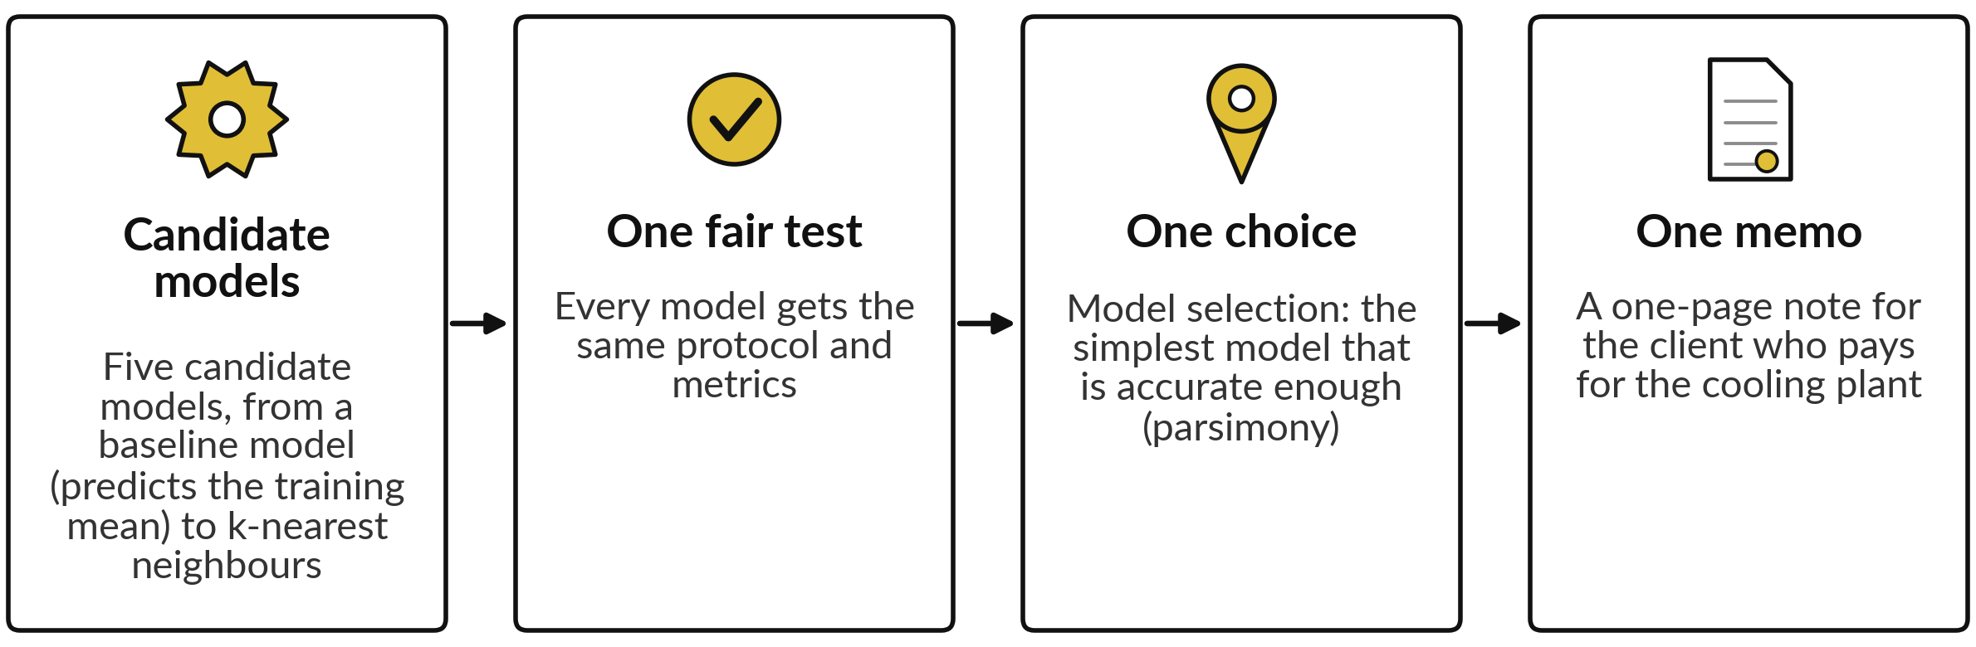
In real work you compare several
models, choose one and explain why
The picture shows today’s four moves. Whoever pays for the building work wants the choice, the error in kW and the doubts on one page.
Notes:
Last class you learned how to trust one model. In a real project you rarely have one. You have several candidate models, and someone has to choose. That someone is you, and the person who pays, the client who pays for the cooling plant, will ask why. So today has four moves.
Build the candidate models. Test them fairly, with the same cross-validation protocol and metrics. That is model comparison. Then choose the simplest model that is accurate enough, which is model selection. And write the choice on one page. Which of those four do you think is hardest to do well, and why?

Slide 8
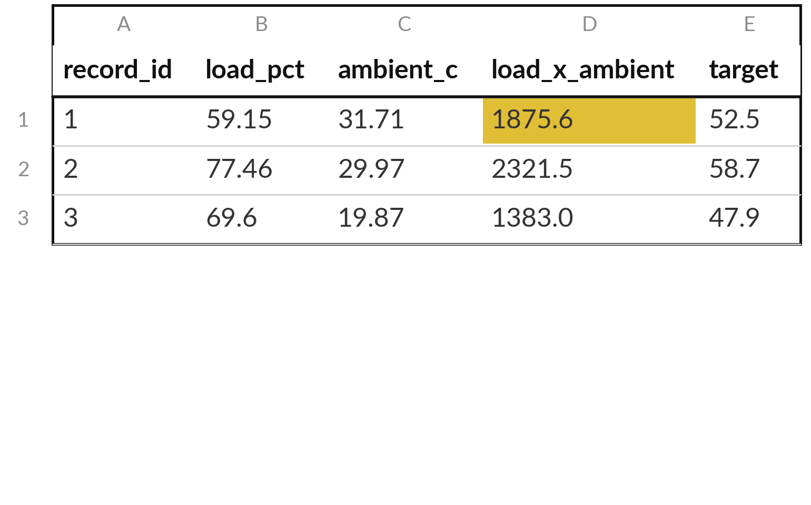
A new feature can carry what
you know about the machine
Three training rows. The highlighted column is a new feature: load_pct times ambient_c.
Feature engineering builds a new feature from existing ones. Here, hot air may change what a load costs.
A product of two features is an interaction feature. Row 1: 59.15 x 31.71 = 1875.6.
Notes:
The model sees only the columns in the table. If you know something about the machine, you can hand it over as a new feature. This is called feature engineering. Here is an idea from engineering sense. A building that is working hard in hot air may behave differently from what the two readings give separately.
So we build a column, load times ambient, and call it load_x_ambient. A column made by multiplying two features is called an interaction feature. Check row one by hand: 59.15 times 31.71 is 1875.6. Notice that this is only an idea. We have not yet shown that it helps.

Slide 9
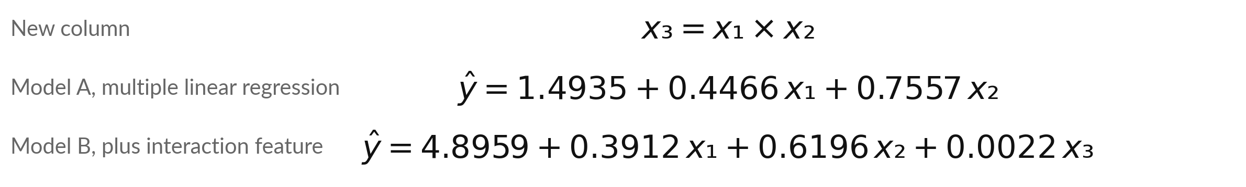
The new feature is a product, and the extended
linear regression model gets one more weight
Symbol | What it means | In our data
x₁, x₂ | load_pct (percent), ambient_c (deg C) | Row 1: 59.15 and 31.71
x₃ | load_x_ambient: x₁ times x₂ | Row 1: 1875.6
y-hat | Prediction (kW) | Row 1, B: 4.8959 + 23.14 + 19.65 + 4.13 = 51.8
b₀ | Intercept (bias): y-hat when every feature is 0 | A: 1.4935 B: 4.8959
b₁, b₂, b₃ | Weights (coefficients): one more unit of a feature adds its weight | A: 0.4466, 0.7557. B: 0.3912, 0.6196, 0.0022
Notes:
Here is the maths for the new feature. The product is x three equals x one times x two, where x one is load and x two is ambient temperature. Model A is the linear regression model you know, with an intercept of 1.49 and two weights. Model B adds a third weight, b three, for the new feature.
Each weight tells you what one more unit of that feature adds to the prediction while the other features stay fixed. In model A, one more percent of load adds 0.45 kW. Work row one by hand with model B: the prediction is 51.8 kW and the actual value is 52.5.
Which weight in model B is the smallest, and what might that tell us?

Slide 10
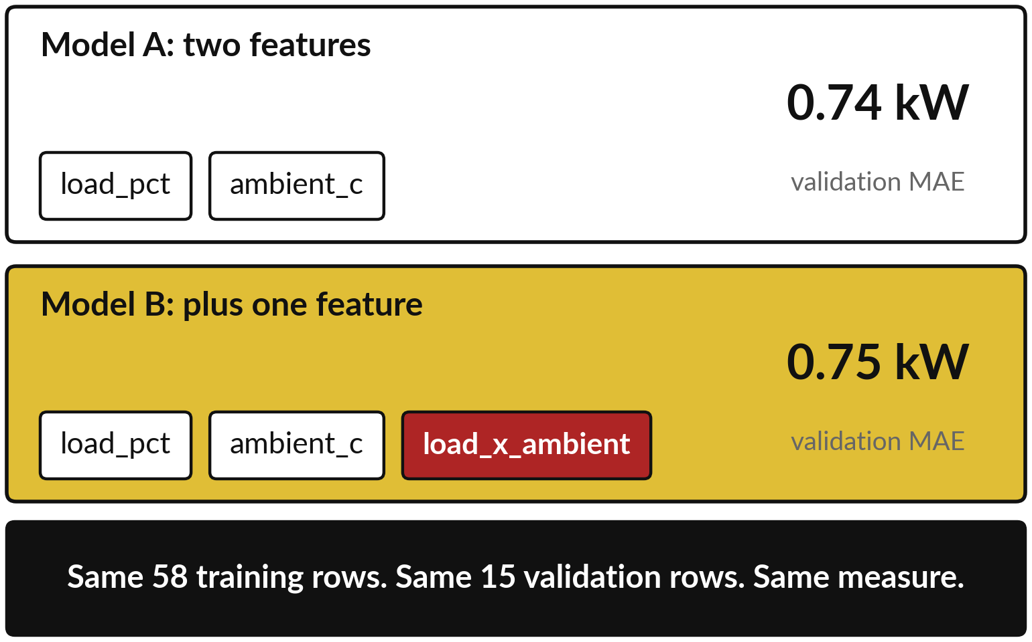
A feature ablation tests one change on its
own, with everything else kept the same
A feature ablation (ablation study): train with a feature and without it, then compare the errors.
Red box: the new feature. MAE is the mean absolute error, the average size of the prediction error.
Same training and validation sets. Only the features differ.
Notes:
How do we find out whether a new feature helps?
We run a feature ablation, also called an ablation study. Build two versions of the model. They differ in one thing only, here the list of features. Both learn from the same 58 training rows, and both are scored on the same 15 validation rows with the same measure, MAE, the mean absolute error.
Model A with two features has an MAE of 0.74 kW. Model B with the extra feature has an MAE of 0.75. If anything else had changed as well, such as the rows or the measure, we could not say which change mattered. Which one is better, A or B?

Slide 11
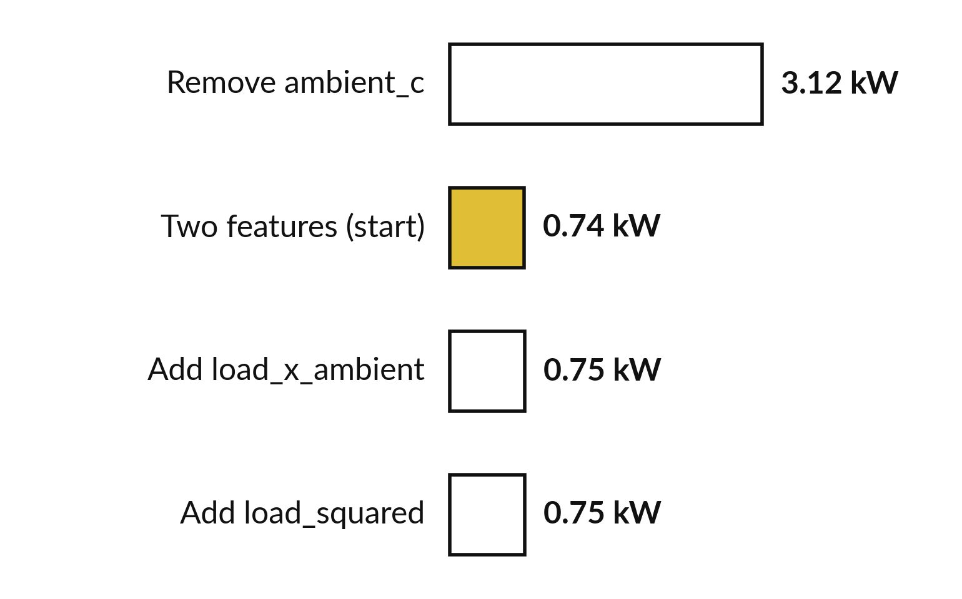
Removing ambient_c hurts a lot,
and the new features do not help
Each bar is the validation MAE of one version of the linear regression model. A shorter bar is a better model.
Without ambient_c the error grows from 0.74 to 3.12 kW.
Adding load_x_ambient or load_squared (load times itself) changes it by almost nothing.
Test every idea before you keep it.
Notes:
Here are four versions of the linear regression model, all scored on the same validation rows. Remove ambient_c and the error jumps from 0.74 to 3.12 kW. So that feature matters. Add our new product column and the error goes from 0.74 to 0.75, a change of 0.005.
Add the load squared and it is 0.75. Those changes are tiny, and slightly the wrong way. A good idea from engineering sense did not help here. That is a normal result, and it is why we test every idea before we keep it. Would you keep the new feature?

Slide 12
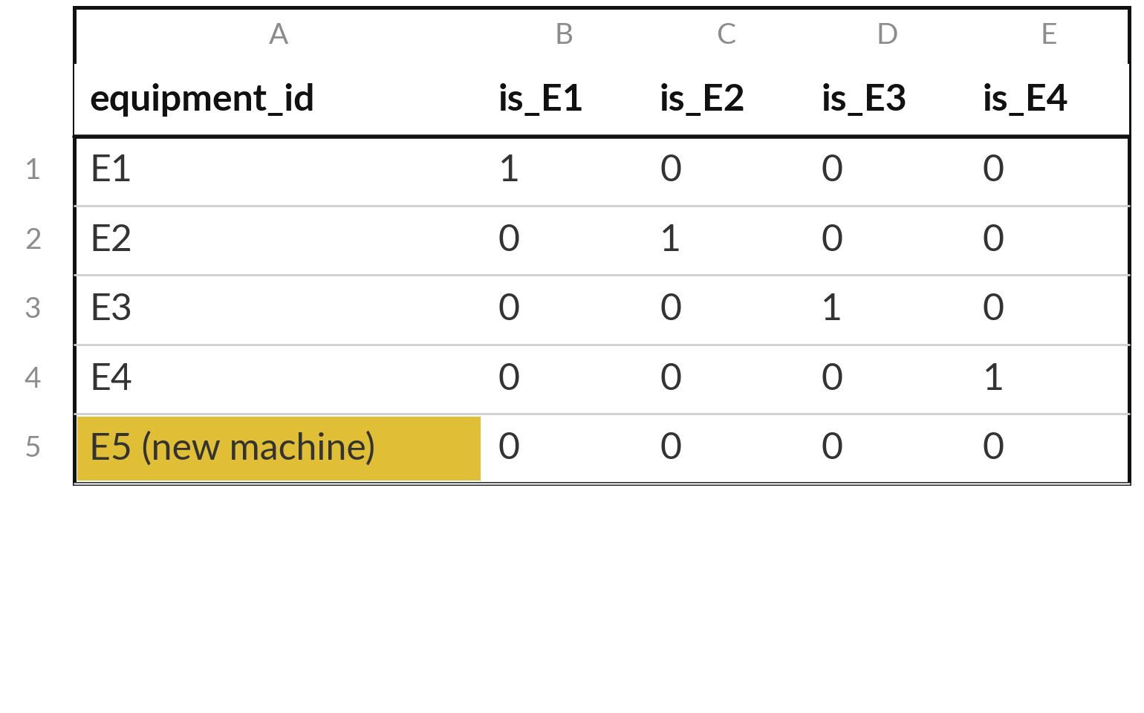
One-hot encoding turns a categorical feature into 0 and
1 columns, and equipment_id stays out of the features
One-hot encoding gives each category of a categorical feature its own column: 1 if the row is in it, 0 if not.
The model trained on E1 to E4 has no is_E5 column, so E5 in these four columns is all zeros.
A column per known machine says nothing about a new one, so equipment_id stays out of the features.
Notes:
A model needs numbers, so a categorical feature such as equipment_id has to be turned into numbers. One-hot encoding gives each group its own column, with a one where the row belongs and a zero elsewhere. Read a row across and you see a single one. That is a useful tool, and you will meet it again.
But look at the last row. A model trained on E1 to E4 has columns for those four only. E5 is a machine group it never saw, so if we squeeze E5 into those columns we get four zeros, which says nothing about E5. Our aim is a model that works on a building it has never met, so here we leave equipment_id out.
Where would a one-hot column be a good idea?

Slide 13
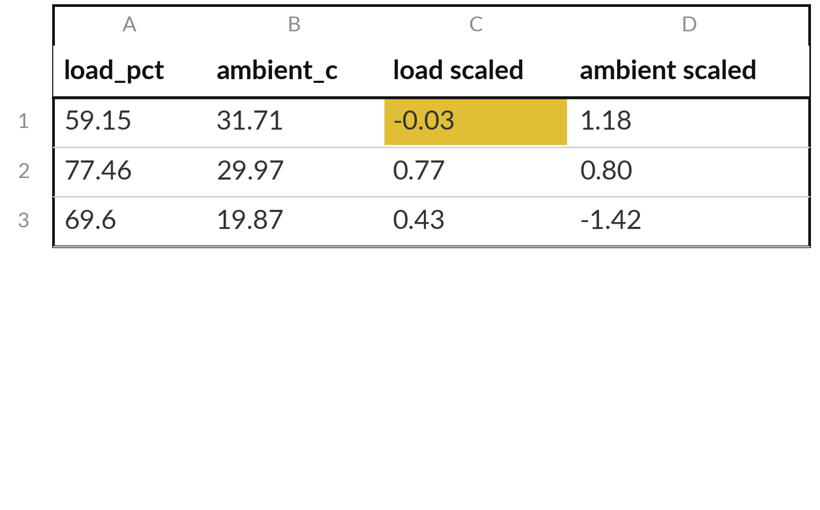
Scaling puts every feature on the same ruler
Standardisation (z-score): scaled value = (value minus training mean) divided by training standard deviation.
Row 1 by hand: (59.15 - 59.9) / 22.7 = -0.03.
StandardScaler is the scikit-learn tool that learns the mean and standard deviation from the training set, then applies them to any rows. Ridge regression and k-NN need it.
Notes:
You met scaling in Class 2. We need it again today, because both new models are sensitive to units. Load runs from about 20 to 90, while ambient temperature runs over a much smaller range, and a distance would be dominated by load. Scaling fixes that. Take the training mean of load, 59.9, and the standard deviation, 22.7.
Row one has load 59.15, so its scaled value is 59.15 minus 59.9, divided by 22.7, which is -0.03. Remember the data leakage rule from Class 3: the mean and standard deviation come from the training rows only.

Slide 14
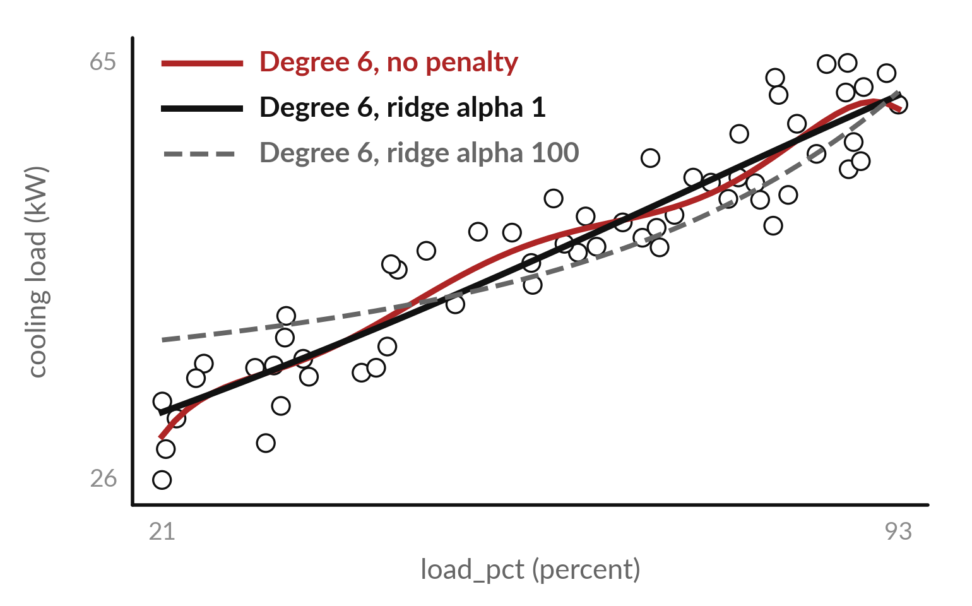
Ridge regression adds an L2 penalty on large
weights so a flexible curve stops fitting noise
Regularisation shrinks the weights (coefficients). Ridge regression adds an L2 penalty: alpha times the sum of squared weights.
Dots: training rows. Curves: degree-6 fits of load_pct. A bigger alpha (the regularisation strength) gives a flatter curve.
Validation MAE (kW): 3.32 none, 3.05 alpha 1, 4.68 alpha 100. Not the later two-feature model.
Notes:
Here is a flexible curve, a sixth-degree polynomial of load, through our training dots. With no penalty it can bend to follow noise. Regularisation means penalising large weights. Ridge regression uses an L2 penalty, and alpha is the regularisation strength. On the validation rows the error is 3.32 kW with no penalty, 3.05 with alpha 1, and 4.68 with alpha 100, which flattens the curve too much.
These curves are sixth-degree polynomials of load alone, so their alpha 1 error is a different model from the ridge regression on two features, with alpha 1, that you meet on the next slides. Do not compare the two numbers. Ridge is a preview. A little penalty helped here, and too much hurt.
Where do you think the right amount lies?

Slide 15
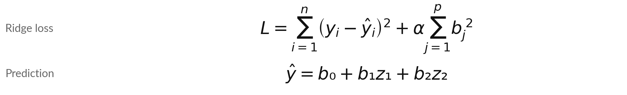
Ridge regression minimises squared
errors plus alpha times squared weights
Symbol | What it means | In our data
L | Loss function: the number made small | One value per choice of weights
yᵢ, ŷᵢ | Actual and predicted target of training row i (kW) | i = 1 to 58
n | Number of training rows | n = 58
alpha | Regularisation strength. 0 gives linear regression | We try 0.1, 1 and 10
b₁, b₂, p | The p weights, one per feature. b₀ is not penalised | b₁ load, b₂ ambient, p = 2
z₁, z₂ | The features after scaling | z₁ scaled load_pct, z₂ scaled ambient_c
Notes:
This is the ridge regression loss function, the number the computer tries to make small. The first part is the sum of the squared errors over the training rows, the same fit measure as before. The second part is the L2 penalty: alpha times the sum of the squared weights.
A big weight costs a lot, so the computer is pushed to keep the weights small. With alpha equal to zero there is no penalty and you get ordinary linear regression. The prediction below uses scaled features z, so every weight is on the same ruler. Why must the features be scaled before we penalise the weights?

Slide 16
A bigger alpha shrinks the weights, but on this
ridge regression on two features the error grows
alpha | Weight b₁ (load) | Weight b₂ (ambient) | Sum of squared errors | L2 penalty: alpha x sum of squared weights | Loss L | Validation MAE (kW)
0 (ordinary linear regression) | 10.15 | 3.44 | 48.3 | 0.0 | 48.3 | 0.74
0.1 | 10.13 | 3.43 | 48.3 | 11.4 | 59.8 | 0.75
1 | 9.97 | 3.36 | 50.4 | 110.6 | 161.1 | 0.84
10 | 8.58 | 2.75 | 202.4 | 811.2 | 1013.6 | 1.82
Ridge regression on two features. load_pct was rescaled, so b₁ = 10.15 means: 22.7 more percent of load adds 10.15 kW. Alpha 1: loss 50.4 + 110.6 = 161.1. Its error 0.84 is not the degree-6 curve error.
Notes:
Now the real numbers, from your training rows, for linear regression with two features, here with an L2 penalty added. Each row is one value of alpha. With alpha equal to zero the weights are 10.15 and 3.44, and the squared errors add up to 48.3. As alpha grows, the weights shrink, to 8.58 and 2.75 at alpha ten, but the squared errors climb to 202.4.
Check alpha one by hand: 50.4 plus 110.6 gives a loss of about 161.1. The linear regression model has few weights to calm down, so here the penalty only costs us accuracy. When would it pay off?

Slide 17
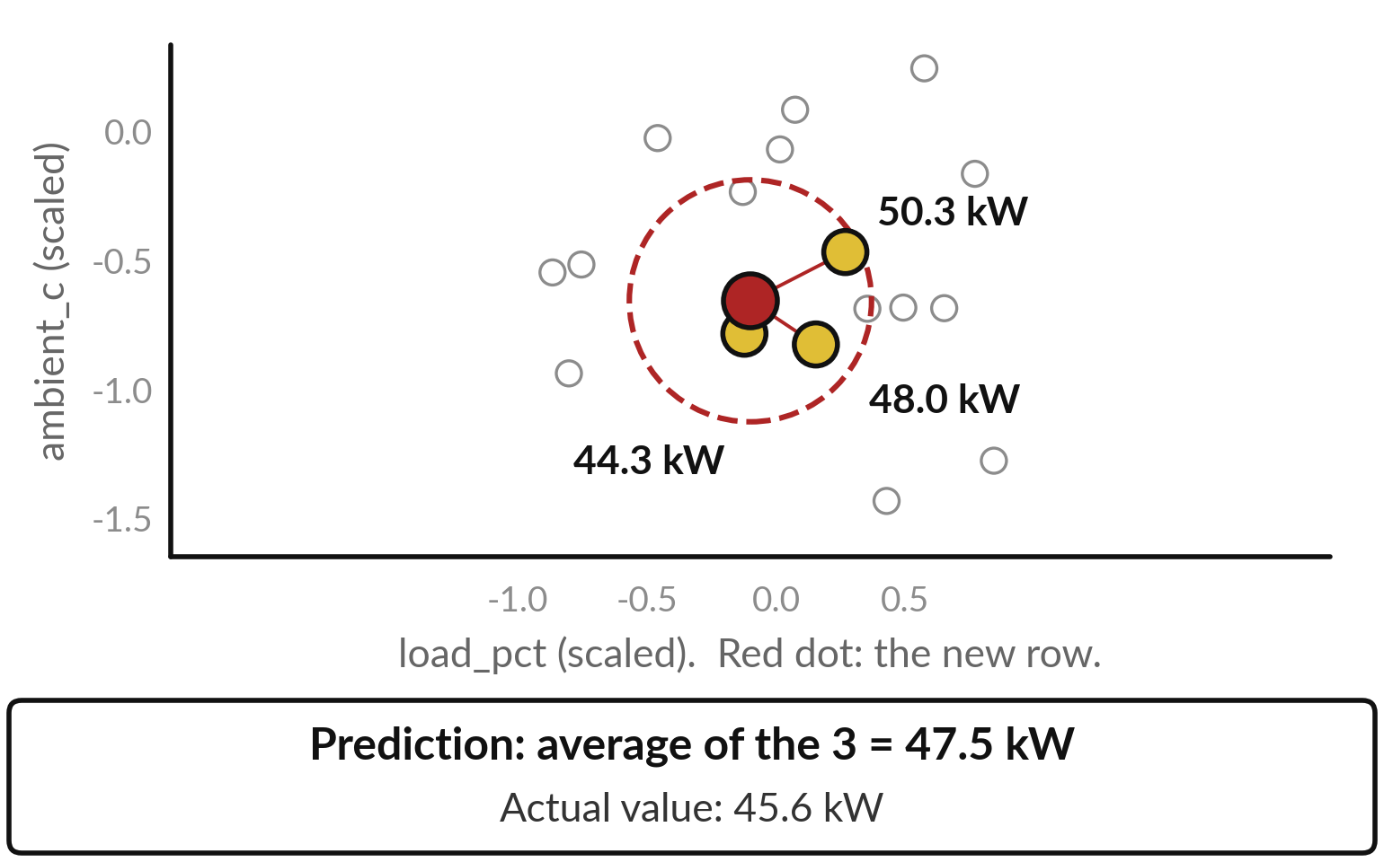
k-nearest neighbours (k-NN) predicts from
the k training rows most like the new row
k-NN stands for k-nearest neighbours: find the k training rows closest to the new row and average their targets.
Grey dots: training rows. Red dot: the new row, record 5. Gold dots: its 3 nearest neighbours, labelled with their targets.
k = 3 is a hyperparameter (a setting chosen before training). Both axes are scaled.
Notes:
This picture shows k-nearest neighbours, or k-NN, a very different kind of model. Each grey dot is a training row, placed by its scaled load and scaled ambient temperature. The red dot is a new row. To predict, we find the three training rows closest to it, the gold dots, and average their targets: 44.3, 48.0 and 50.3.
The average is 47.5 kW, and the real value was 45.6. There are no coefficients to learn. The model simply remembers the training rows. Why did we scale the features first?

Slide 18
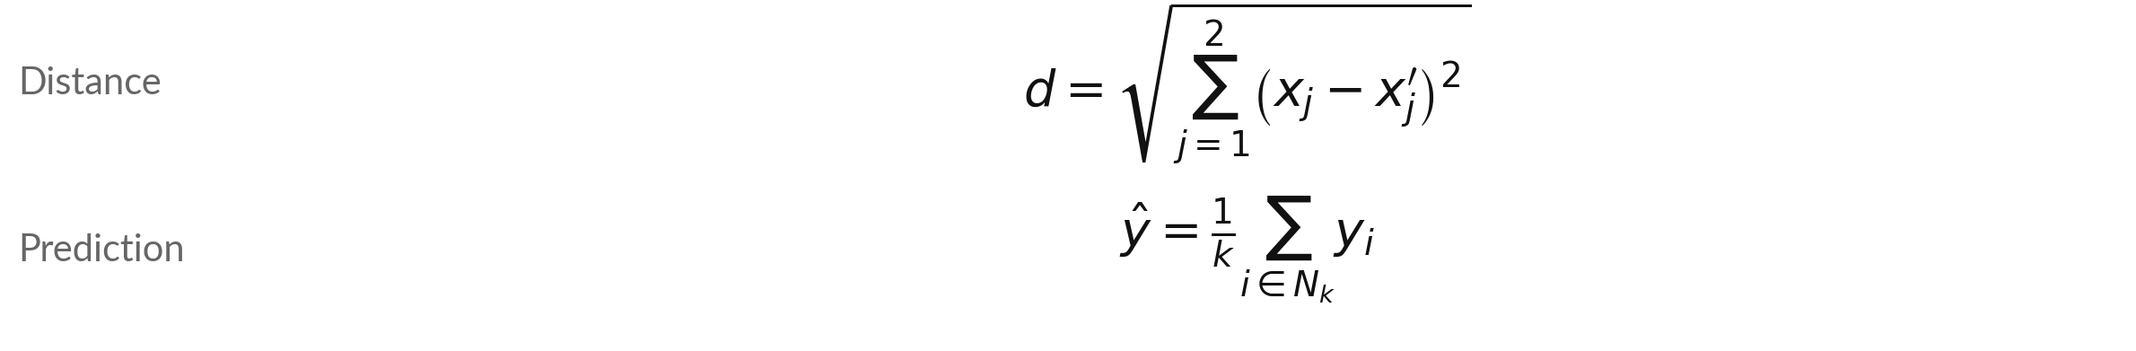
k-NN measures distance on the scaled
features, then averages the k nearest targets
Symbol | What it means | In our data
d | Distance from the new row to one training row | Nearest row: 0.129 (no unit)
x, x′ | Scaled feature: new row (x), training row (x′) | Two features: scaled load_pct, scaled ambient_c
k | How many nearest rows we average. We choose it | k = 3
N | The k training rows with the smallest d | Records 67, 22, 45
y | Target of one neighbour (kW) | 44.3, 48.0, 50.3
y-hat | The prediction for the new row (kW) | 47.5 kW
Notes:
Two formulas run the whole model. The first is the Euclidean distance, the straight-line distance on the picture. For each feature j, subtract the training row from the new row, square the gap, add the gaps up and take the square root. We use the scaled features, so load and temperature count equally.
The second formula is the prediction. Find the k rows with the smallest distance, call that set N k, and take the plain average of their targets. Here k is three and the average is 47.5 kW. What would happen to the distance if we skipped the scaling?

Slide 19


Worked example: the four closest
training rows to the new row, record 5
Training row (record_id) | Scaled load x₁ | Scaled ambient x₂ | Distance d | Target y (kW)
67 | -0.123 | -0.770 | 0.129 | 44.3
22 | 0.153 | -0.812 | 0.305 | 48.0
45 | 0.267 | -0.454 | 0.413 | 50.3
81 | -0.129 | -0.221 | 0.423 | 46.4 (4th, not used)
New row: x₁ = -0.100, x₂ = -0.643. Record 67: d = square root of ((-0.123 − (-0.100))² + (-0.770 − (-0.643))²) = 0.129. Prediction = (44.3 + 48.0 + 50.3) / 3 = 47.5 kW. Actual: 45.6 kW.
Notes:
Now we work it through with real numbers. The new row is record 5, with scaled load -0.100 and scaled ambient -0.643. The table lists the four training rows closest to it, nearest first. Take the first one, record 67. The gap in load is -0.023, the gap in ambient is -0.127.
Square both, add, and take the square root: the distance is 0.129. The fourth row is a little farther away, so with k equal to three it is left out. The prediction is the average of the first three targets, 47.5 kW. The actual value was 45.6. Why does the fourth row not count?

Slide 20
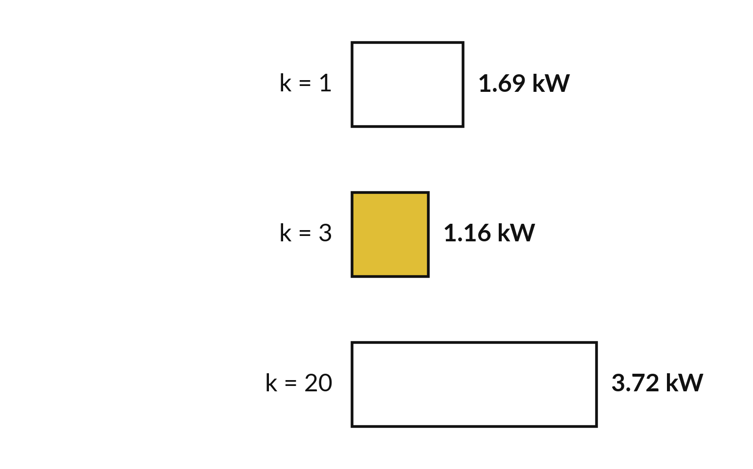
The size of k matters: too small chases
noise, too large flattens the pattern
k is a hyperparameter: a setting we choose before training. We try a few values and compare the validation MAE.
Each bar is the k-NN validation MAE for one k. Shorter is better.
k = 1 copies one row, noise included. k = 20 averages so many rows that the pattern is lost.
Notes:
Same validation rows, three values of k. With k equal to one, the model copies its single nearest row, noise and all, and the error is 1.69 kW. With k equal to three it is 1.16, the best of the three. With k equal to twenty, it averages so many rows that it flattens the pattern, and the error is 3.72.
So k is a hyperparameter, chosen before training, and we choose it with the validation set. Ridge regression and k-NN are previews today. Next semester you meet support vector machines, random forests and boosting. What would k equal to the whole training set predict?

Slide 21
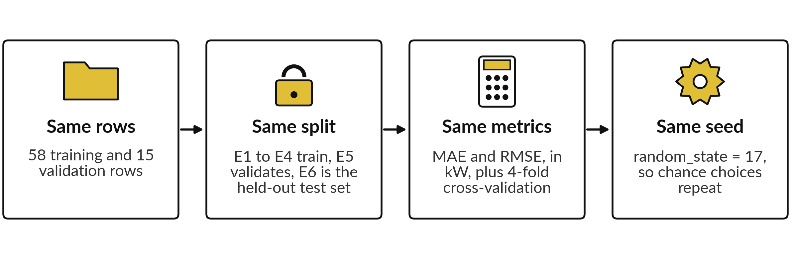
A fair model comparison keeps four
things the same for every model
The picture shows the four rules of the protocol that every candidate model follows. Change one thing at a time: if two things change, you cannot say which one caused the difference.
Notes:
Now the rules for a fair race. Every candidate gets the same rows, the same split, the same measure and the same seed. The same rows means the same 58 training rows and the same 15 validation rows. The same split means whole equipment groups, with E6 held out.
The same metrics means MAE and RMSE in kW, and the same four-fold cross-validation. And the same seed means that wherever chance is involved, such as in the tree, we fix random_state at 17, so the result is repeatable. If one model got an easier test, the table would be a story about the test and not about the models.
Which of the four is easiest to forget?

Slide 22
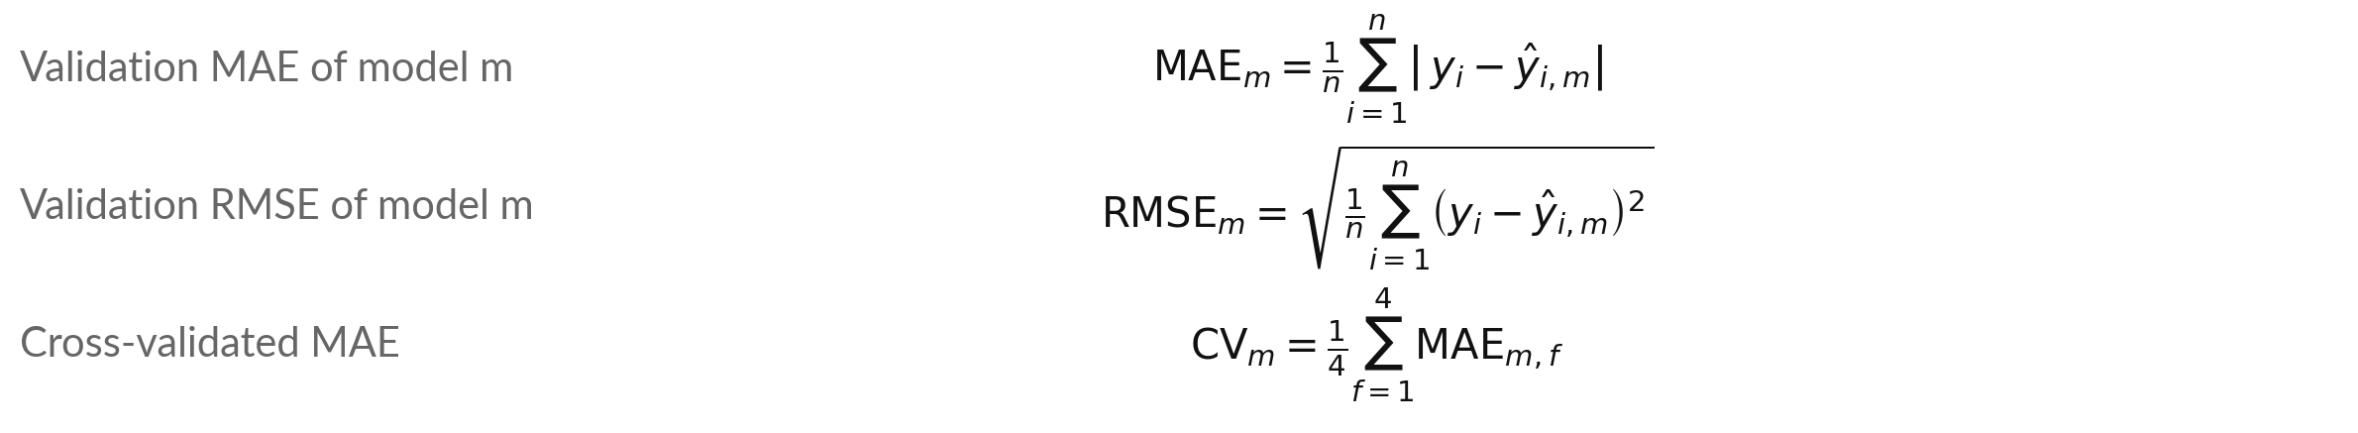
Every model gets MAE, RMSE and
four-fold cross-validation scores
Symbol | What it means | In our data
m, i, n | Model, validation row, number of rows | Five models; group E5, n = 15
y, ŷ | Actual target, and prediction (kW) | Linear regression: MAE = 0.74, RMSE = 0.88
MAE, RMSE | Mean absolute error; root mean squared error | Same unit as the target (kW)
CV (model m) | Cross-validated MAE: mean of 4 fold MAEs | Linear regression: 0.76, 0.77, 0.76, 0.74; mean 0.76 kW
Notes:
This is how every row of the model comparison table is scored, and it is why the table is fair. The first formula is the mean absolute error: for each validation row, take the gap between the actual target and the prediction, remove the sign, and average. The second is the root mean squared error: square each gap, average, then take the square root, so large errors count more.
The third repeats the MAE on four folds. In each fold one equipment group is held out, the model learns from the other three, and we average the four results. For the linear regression model the four fold errors are 0.76, 0.77, 0.76, 0.74, and their mean is 0.76 kW.
Why do we use four folds as well as the validation rows?

Slide 23




Model comparison table: five candidate
models on the same 15 validation rows
Model | Validation MAE | Validation RMSE | Cross-validated MAE (mean of 4 folds) | Lowest to highest fold MAE
Baseline model | 9.69 | 11.13 | 8.50 | 6.18 to 9.89
Linear regression | 0.74 | 0.88 | 0.76 | 0.74 to 0.77
Decision tree, depth 4 | 3.39 | 4.45 | 2.85 | 2.41 to 3.53
Ridge regression, alpha 1 | 0.84 | 1.00 | 0.80 | 0.65 to 0.90
k-NN, k = 3 | 1.16 | 1.38 | 1.89 | 1.76 to 2.07
Errors in kW; lower is better. Baseline model: predicts the training mean. Ridge regression (two features) uses load_pct and ambient_c. A fold is one group, E1 to E4, held out.
Notes:
This is the model comparison table, the centre of today. Each row is one model. The first two numbers are the error on the same validation rows. The last two come from cross-validation on the training rows, where each equipment group takes a turn as the held-out machine, so we see the average error and how far it moves from fold to fold.
The baseline model has an MAE of 9.69 kW. Linear regression, ridge regression and k-NN all do far better. The decision tree sits in between. Read the table slowly. Which row would you look at first?

Slide 24
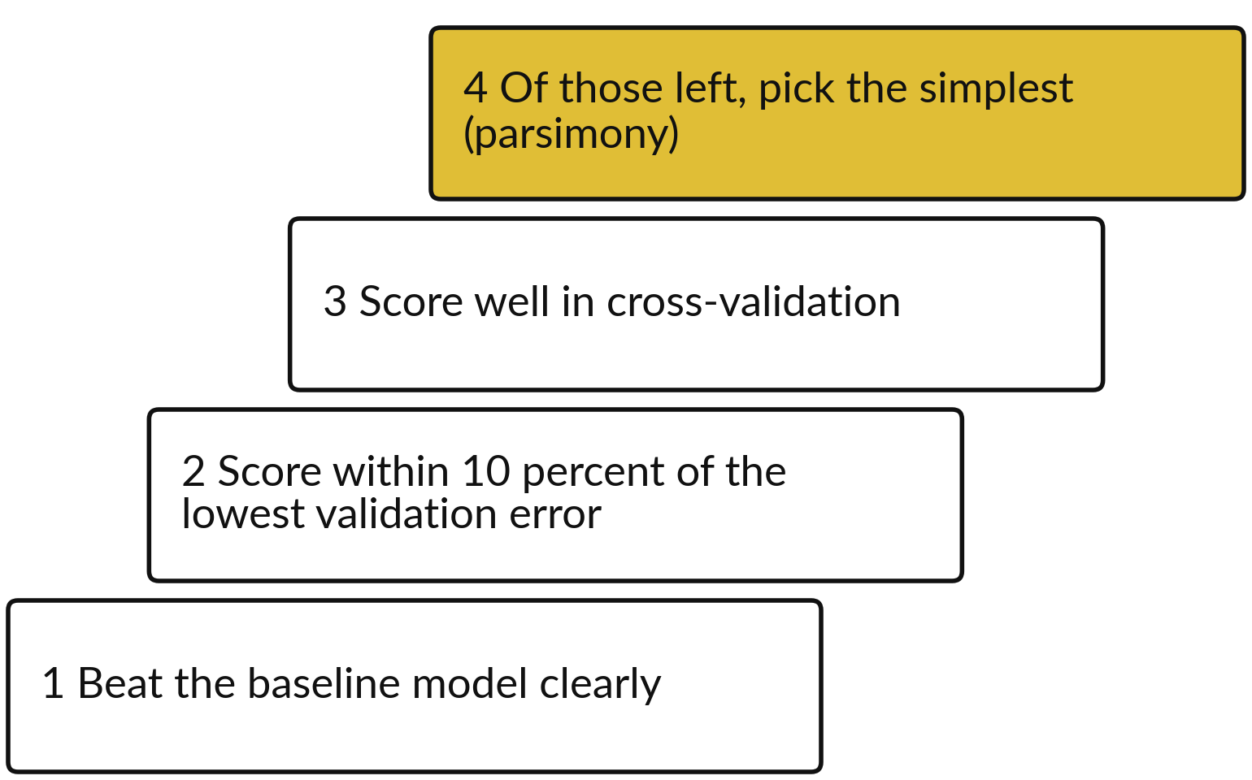
Model selection: choose the simplest
model that is good enough (parsimony)
Model selection: choose one of the candidate models. Parsimony: prefer the simpler model when scores are close.
Baseline model: MAE 9.69 kW. Linear regression: 0.74.
No other model beats linear regression on the 15 validation rows or in cross-validation.
Notes:
Work through four tests in order. First, the model must beat the baseline model. The linear regression model has an MAE of 0.74 kW and the baseline model has 9.69, so it does. Second, it must score within ten percent of the lowest validation error. Third, it must also do well in cross-validation.
Fourth, of those left, pick the simplest. That is parsimony: when scores are close, prefer the simpler model. The linear regression model has the lowest validation error of the four real models and the lowest cross-validated error too. Why does a simple rule help when you explain it to the payer?

Slide 25



The model comparison table has three
limits, and you must say them out loud
The data are synthetic, which means invented for teaching. Real plant data would behave differently.
There are only 15 validation rows, all from group E5. A small gap between two models may be luck.
The test set E6 has 15 rows and no model has used them. We use it once, after we choose.
Notes:
Before we trust the table, three limits. First, these are synthetic teaching data, so real plant data would behave differently. Second, there are only 15 validation rows, from one equipment group, so a small gap between two models may be luck. Third, the test set has 15 rows and nobody has used it.
A good report says its limits out loud, because the person who pays will find them anyway. Which limit worries you most, and why?

Slide 26
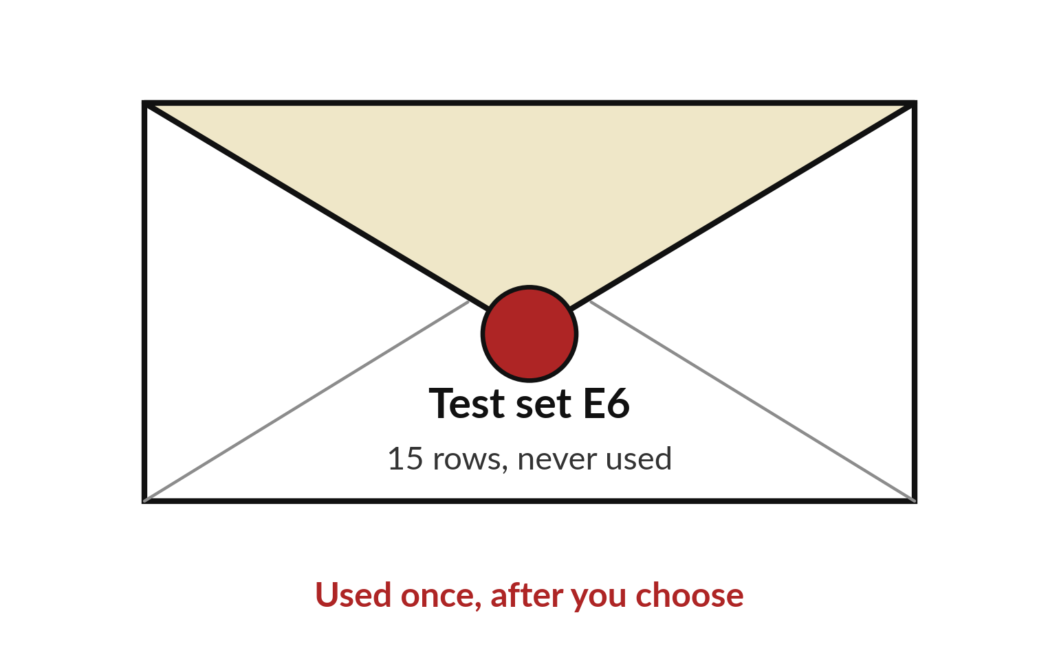
The held-out test set is used
once, after the model is chosen
The held-out test set (hold-out set) is drawn as a sealed envelope. No model has used its rows.
It is the last check. We use it once, after we choose a model, for one honest score of generalisation.
Using it and then changing your choice makes it an unfair test.
Notes:
Look at the envelope. The test set has 15 rows and nobody has used it. It is used once, after you have chosen, to give one honest number for the model you chose. Think of an exam paper. If you read the paper first and then revise, your mark no longer tells us what you know.
If you use the test set and then change your choice, it is no longer a fair test. We do not report test numbers today. In your project you use it once, after you choose your model. Why must you use it only once?

Slide 27
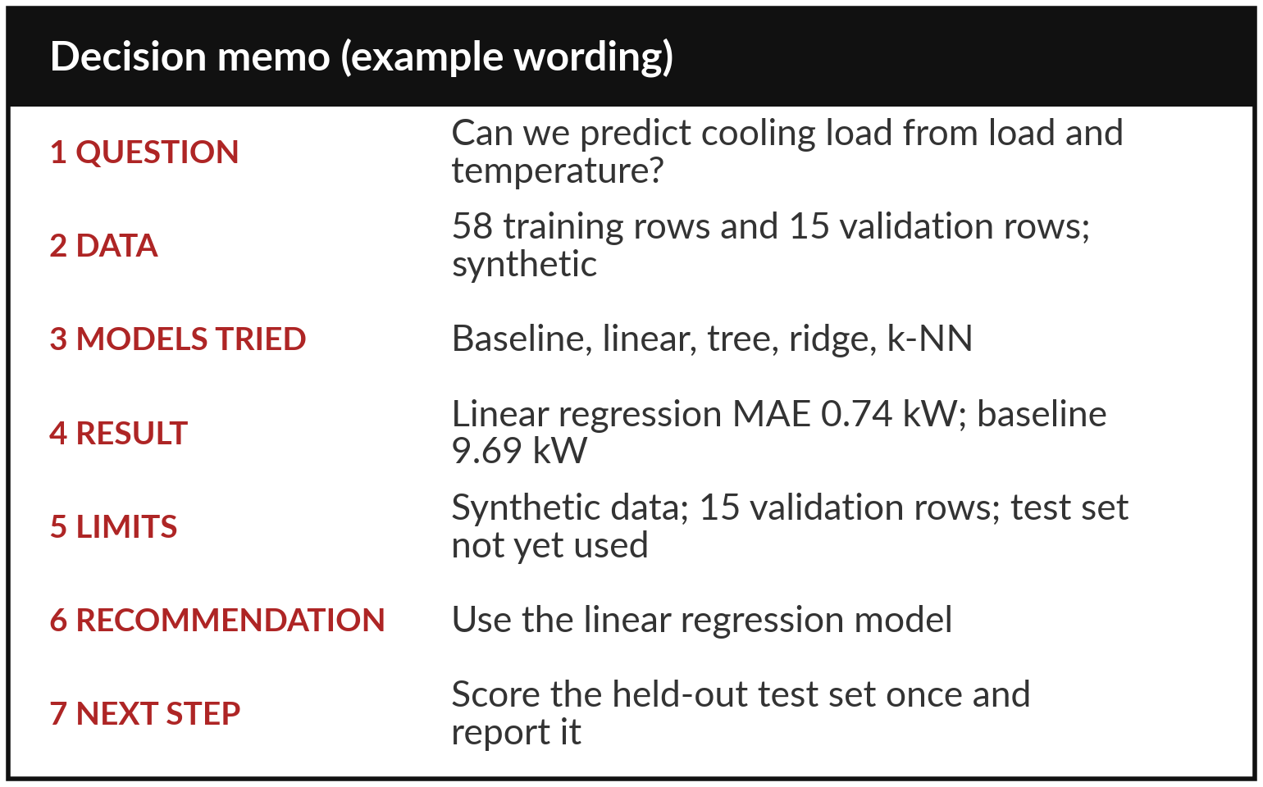
A decision memo fits on one
page and has seven parts
A decision memo is a one-page note that lets the reader act. A related term is model card.
The picture shows an example memo with its seven numbered parts, filled in with our numbers.
Give the result with its unit, say what you do not know, and end with what to do next.
Notes:
The last skill today is writing the choice down. A decision memo has seven parts, and it fits on one page. The question. The data. The models you tried. The result, with its unit. The limits. Your recommendation. And what to do next. The example on the left uses our numbers and invented wording.
Notice the result line: it says the linear regression model has an MAE of 0.74 kW, so the reader knows what the number means. The person who pays, the client who pays for the cooling plant, will read this and nothing else. Which part would you be most tempted to leave out?

Slide 28
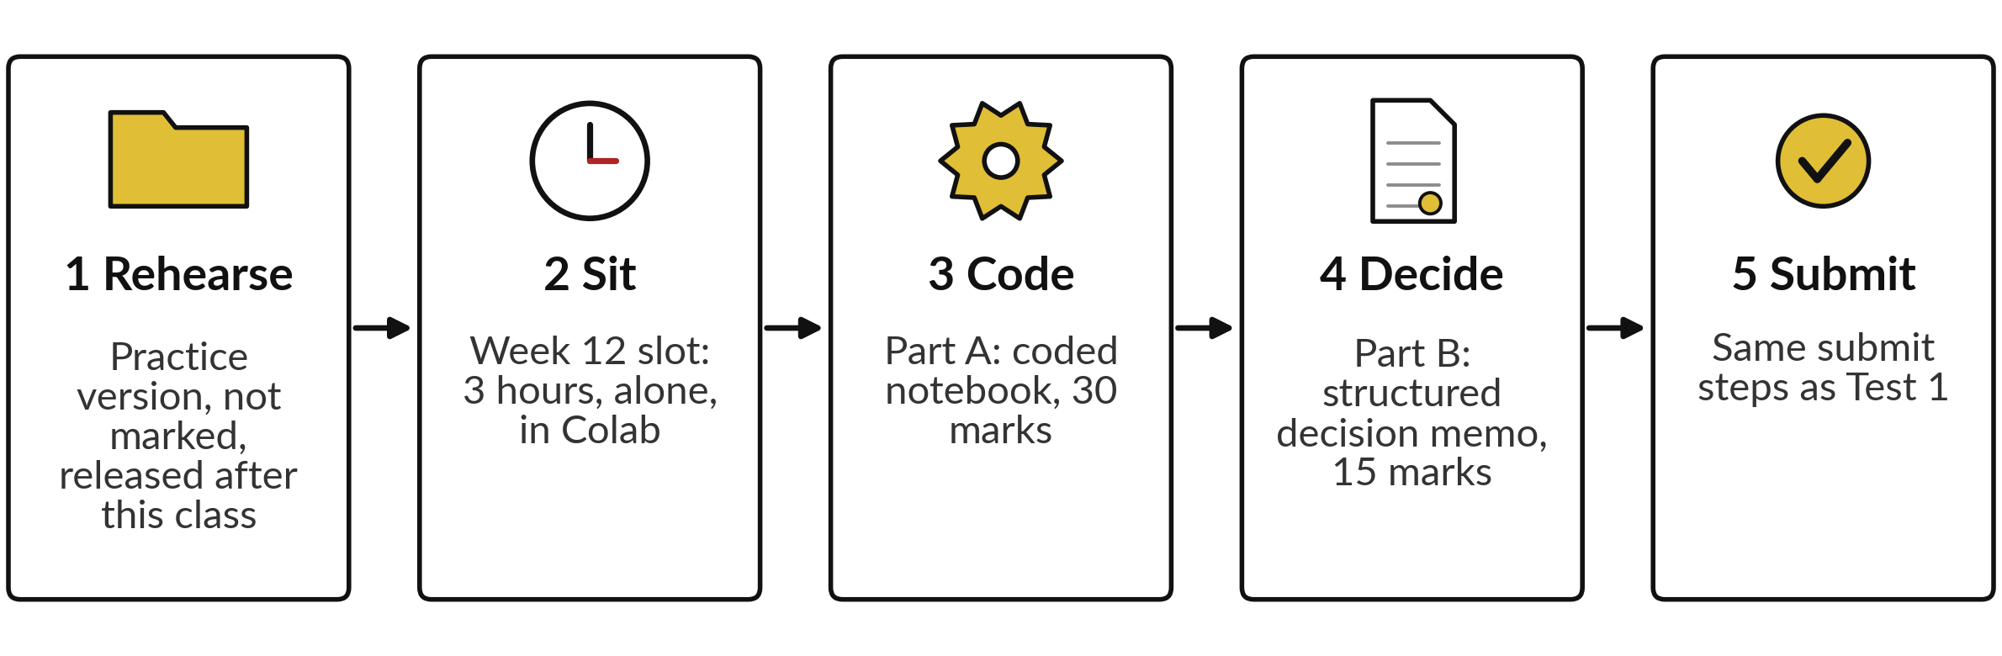
Your project is an individual, timed
practical sitting that the computer grades
The five stages of the project: it is individual, timed and auto-graded, covers only Weeks 1 to 11, and is worth 45 percent. There is no demo, no presentation and no clinic.
Notes:
Here is your project. It works like Practical Test 1. It is individual, timed, highly automated and auto-graded. You sit it alone, for three hours, supervised, in Colab, in your Week 12 class slot. It covers only what we taught in Weeks 1 to 11, and it counts for 45 percent of the course.
Part A is the coded notebook, out of 30. Part B is a structured decision memo inside the notebook, out of 15. There is no demo, no presentation and no clinic. Right after this class you get a practice version, the rehearsal, which is not marked. Which step do you want to practise first?

Slide 29



The project is auto-graded and
worth 45 percent of the course
Item | What you need to know
Format | Individual, timed, highly automated and auto-graded, like Practical Test 1. A 3-hour supervised practical sitting in Colab. It covers only Weeks 1 to 11.
Part A: 30 marks | The coded notebook, auto-graded.
Part B: 15 marks | A structured decision memo inside the notebook, auto-graded: structured fields cross-checked against your own results, plus keyword checks on two short answers.
Nothing in the project is taught after Class 4.
Notes:
This slide says what the project is. It is an individual, timed, auto-graded sitting of three hours in Colab, like Practical Test 1, and it covers only Weeks 1 to 11. Part A, the coded notebook, is out of 30. Part B is a structured decision memo inside the notebook, out of 15.
Both parts are auto-graded. Part B is checked by structured fields that are cross-checked against your own results, plus keyword checks on two short answers. Together they count for 45 percent of the course. Which part do you expect to find harder?

Slide 30

A rehearsal comes first, and the
sitting is in your Week 12 class slot
Item | What you need to know
Rehearsal | A practice version of the project is released right after Class 4. It is not marked. Use it to practise the same steps.
The sitting | Proposed: Tuesday 1 December, 11:00 to 14:00 (lecturer to confirm). Your own Week 12 class slot.
How to submit | Restart and run all, save, then the submit cell, the same mechanism as Practical Test 1. The Practical Test 1 rule on AI and copying applies.
All dates are proposed. Your lecturer confirms them. There is no demo, no presentation and no clinic.
Notes:
The practice version, the rehearsal, is released right after this class. It is not marked, so use it to practise every step. The sitting itself is in your own Week 12 class slot. The proposed time for your cohort is Tuesday 1 December, 11:00 to 14:00, and your lecturer confirms it.
You submit the way you did in Practical Test 1: restart and run all, save, then the submit cell. The Practical Test 1 rule on AI tools and copying applies. There is no demo, no presentation and no clinic. When will you do the rehearsal?

Slide 31
Read the recipe before you write it:
a dictionary of models and a loop
In plain words
models = {"linear": with_imputer(LinearRegression()),
"tree": with_imputer(DecisionTreeRegressor(
max_depth=4, random_state=17))}
for name, model in models.items():
model.fit(X_train, y_train)
y_pred = model.predict(X_valid)
print(name, mean_absolute_error(y_valid, y_pred))
A dictionary stores each model under a name.
with_imputer is a helper, a small function we write once and reuse. It makes a scikit-learn pipeline: median imputation (SimpleImputer) of missing values, then the model.
The loop takes each model in turn: train (fit) on the training set, predict the validation set (inference), print the MAE.
To add a model, add one line to the dictionary.
Notes:
Before the break, look at the recipe you will use. A dictionary holds each candidate under its name. The helper with_imputer wraps a model in a pipeline with median imputation of missing values, using the training medians. Then a loop takes each model in turn and gives it the same treatment: train on the training set, predict the validation set, print the score.
This is how the table stays fair, because no model gets special treatment. To add ridge regression or k-NN, you add one line to the dictionary. Can you read the loop aloud in plain words?

Slide 32


Today in five lines: test ideas, compare
fairly, choose simply, write it down
A new feature is an idea: test it with a feature ablation.
Ridge regression and k-NN need scaled features.
A fair model comparison keeps rows, split, metrics and seed the same.
Choose the simplest model that is good enough (parsimony), and say the limits.
Use the held-out test set once, at the end, and write the decision memo.
Notes:
Let me gather today into five lines. A new feature is an idea, and we test it with a feature ablation before we keep it. Ridge and k-NN are two more models, and both need scaled features. A fair model comparison uses the same rows, the same split, the same metrics and the same seed.
We choose the simplest model that is good enough, and we say what the numbers cannot tell us. And the held-out test set is used once, at the end, while the decision memo has seven parts. Say one of these lines to the person next to you in your own words, then we take the break.

Slide 33
Part 2: the lab
Close the slides. Open the notebook. One model comparison table, five candidate models, your own data.
Notes:
That is the end of the concepts. Everything you need is on the slides you have just seen, and every term is explained again inside the notebook. Please open the notebook now, and keep the slides closed except for the check slides at the end of the deck.
I will walk around. Raise your hand if a cell gives an error. Remember to run the cells in order from the top, and to write your predictions before you run each cell.

Slide 34
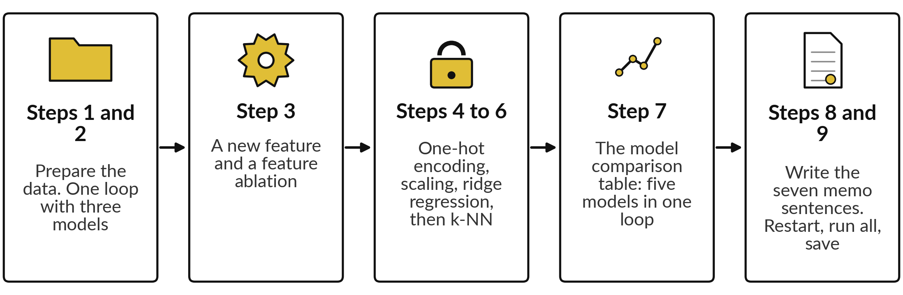
The lab has nine notebook steps in five groups,
and the model comparison table is the centre
The nine notebook steps, in five groups. In each step: predict, run, then read.
Notes:
Here are the nine steps of the notebook, in five groups. Steps one and two: prepare the data, then run one loop with three models. Step three: test the new feature with a feature ablation. Steps four to six: look at one-hot encoding, then scaling and ridge regression, then k-NN with a few values of k.
Step seven is the centre: the model comparison table of five models, with the cross-validated range. Steps eight and nine: fill in the decision memo with your own sentences, then restart, run all and save. Each step asks you to predict first, then run, then read. Predicting before you run is how you find out what you really understand.

Slide 35








Check your numbers against
these before you move on
Step | You should see
Training, validation, test rows | 58, 15, 15
Linear regression, two features, validation MAE | 0.74 kW
Linear regression plus load_x_ambient, validation MAE | 0.75 kW
Linear regression with load_pct only, validation MAE | 3.12 kW
Ridge regression, degree-6 polynomial of load_pct alone, alpha 1, validation MAE | 3.05 kW
Ridge regression, two features, alpha 1, validation MAE (a different model) | 0.84 kW
k-NN, k = 3, validation MAE | 1.16 kW
Linear regression, cross-validated MAE (mean of 4 folds; lowest to highest) | 0.76 (0.74 to 0.77)
If your number differs, stop and ask. Do not change a number to match. Find the step that went wrong.
Notes:
Use this table as your checkpoint. If your numbers match, carry on. If they do not, stop and call me over, because every later step builds on the earlier ones. The most common reason is a cell that was run out of order, or a new feature built on the training table but not on the validation table.
Do not edit a number to make it match. The aim is to understand why it is different, and that is a skill you will need in every project, including yours.

Slide 36


Four errors you will meet, what
they mean and what to do
Error message | What it says | What to do
KeyError: load_x_ambient | The new feature exists in one table only | Build it on both the training table and the validation table
ValueError: contains NaN | A model received a missing value (NaN) and has no imputation step | Wrap the model with with_imputer(...) or add a SimpleImputer to the pipeline
inconsistent numbers of samples | X and y have different numbers of rows because they come from different tables | Rebuild X_train and y_train from the same table
NameError: with_imputer | The cell that defines the helper function with_imputer has not been run | Run all cells from the top, in order
Notes:
Errors are normal, and reading them is a skill. Here are four you will most likely meet today. A key error on the new feature means you built it on the training table but not on the validation table, so build it on both. A value error about NaN means a model has no imputation step, so use with_imputer.
An error about inconsistent numbers of samples means X and y came from different tables. And a name error on with_imputer means you skipped the helper cell, so run all cells from the top. Read the last line of the error first. It usually tells you the answer.

Slide 37


How this class counts towards your coursework
The Block 2 quiz opens in the last 20 minutes of this class and stays open for 24 hours.
The Block 2 assignment (A9, A10, A11) closes on Tuesday 1 December, 11:00 (Kampala time).
The Engineering ML project is an individual, timed, auto-graded 3-hour sitting worth 45 percent (Part A 30, Part B 15). Proposed: Tuesday 1 December, 11:00 to 14:00, lecturer to confirm.
The rehearsal (a practice project) is released after this class and is not marked.
Notes:
A word on how this counts. The Block 2 quiz opens in the last twenty minutes of this class, after the lab, and stays open for twenty-four hours. The twenty-five minutes on the clock are for opening it and explaining how it works. The Block 2 assignment has three parts, A9, A10 and A11, and it closes on Tuesday 1 December, 11:00, Kampala time.
The project is an individual, timed, auto-graded sitting of three hours in Week 12, worth 45 percent of the course: Part A, the coded notebook, out of 30, and Part B, the structured decision memo, out of 15. The proposed time for your cohort is Tuesday 1 December, 11:00 to 14:00, and your lecturer confirms it.
The rehearsal is released right after this class and is not marked. Use it to practise.

Slide 38
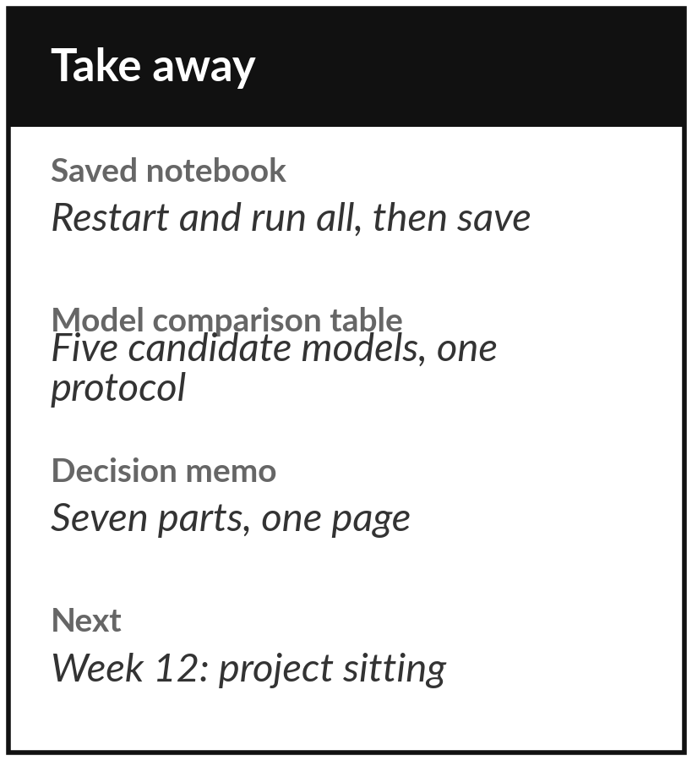
Save the notebook and keep
your memo for the project
What you keep from today
Your lab notebook, saved with all cells run in order, and your decision memo with its sentences filled in.
Our question today
Which model should we recommend for predicting cooling load, and how do we explain the choice to someone who pays?
Next class
Week 12 (proposed): the timed Engineering ML project, 3 hours in your usual class slot. A rehearsal version is released after this class.
Notes:
Before you go, restart the notebook, run all cells from the top and save it. Keep the model comparison table and your memo, because the project uses the same steps. The project is an individual, timed, auto-graded sitting of three hours in your Week 12 class slot. My proposed time for your cohort is Tuesday 1 December, 11:00 to 14:00, and your lecturer confirms it.
A practice version, the rehearsal, is released right after this class and is not marked. Use it.
We began with this question: Which model should we recommend for predicting cooling load, and how do we explain the choice to someone who pays? Before you go, say in one sentence what you can now say about it.

