Slide 1
Your first model: baseline model, linear regression and prediction error
How can a computer predict crusher energy demand from load and temperature, and how do we know it is any good?
CML3113 | Mining and Petroleum Engineering | Week 8, class 1 of 4 | Friday 6 November 2026, 08:00 to 11:00
KLAi | International University of East Africa | Jotham Martin Wambi
Notes:
Welcome to the second half of the semester. Today is your first full machine learning model. We use the crusher data and we predict crusher energy demand. You have spent seven weeks learning to read, clean and chart data. Now that work pays off, because a model is only as good as the rows we give it. The ideas come first, then the lab.

Slide 2



Today in one view: what you will leave with
By the end of today you can
Explain features, target variable, baseline model and prediction error using the crusher data
Say why some rows must be held out (validation set and test set) while a model trains
Train a linear regression model and a decision tree in Python and compare them with a baseline model
Notes:
Here is what you can do by the end of today. You can explain the words feature, target variable, baseline model and prediction error using the data in front of you. You can say why some rows must be held out, in a validation set and a test set, while a model trains.
And you can train a linear regression model and a decision tree in Python and compare both with a baseline model. Nothing is submitted today. The lab prepares you for part A of the first assignment, and I explain how at the end.

Slide 3
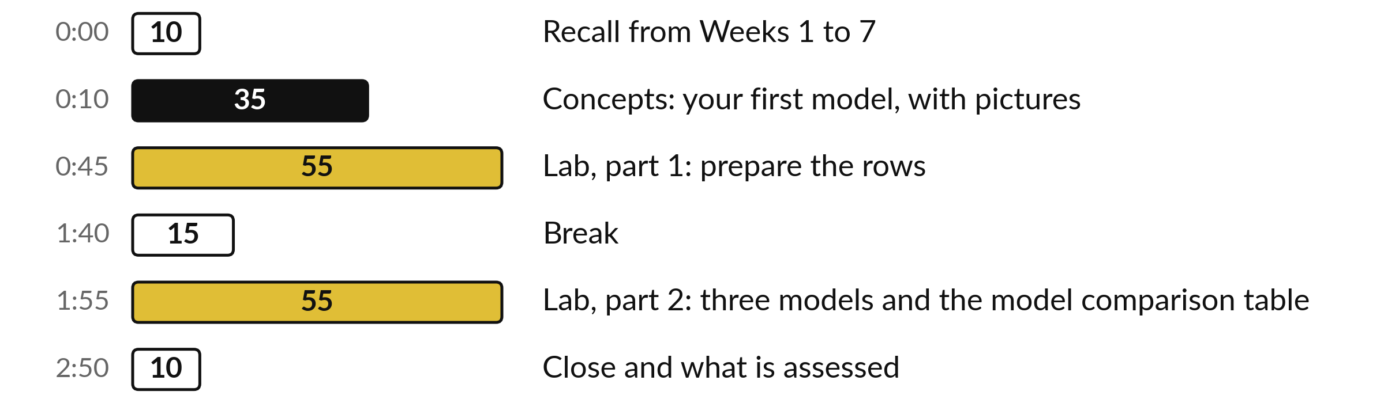
Your three hours: ideas first, then the lab
A short concepts section with pictures first. Then most of the time is the lab, with the notebook open.
Notes:
You already met the words and the ideas in the theory session. Today we look at them again with pictures, for thirty-five minutes, and then we spend almost all of the time on the lab. The concepts come first, then the break comes in the middle of the lab, and you will have the notebook open from the second half of the first hour. Ask your question when it comes to you.

Slide 4

Three questions from last time
1. What does data.shape tell you about a table?
2. Why do we clean a copy of the file and keep the original unchanged?
3. What is a missing value, and how does pandas show it?
Answer aloud first. Then we check together.
Notes:
Three quick questions from the first seven weeks. Answer aloud first, and then we check together. It is a warm-up to bring last time back.
Question one. What does data.shape tell you about a table? Take a moment.
A good answer is this. It gives the number of rows and then the number of columns.
Question two. Why do we clean a copy of the file and keep the original unchanged? Say it to yourself first.
A good answer is this. So we can always go back to the raw data and check what we changed.
Question three. What is a missing value, and how does pandas show it? Think about your own task as you answer.
A good answer is this. It is an empty cell with no reading. pandas shows it as NaN.
If an answer was missing, do not worry. Your notes from last class have it. Now to today.

Slide 5
Answers to the three questions
at the start of the class
Question | Short answer
What does data.shape tell you about a table? | It gives the number of rows and then the number of columns.
Why do we clean a copy of the file and keep the original unchanged? | So we can always go back to the raw data and check what we changed.
What is a missing value, and how does pandas show it? | It is an empty cell with no reading. pandas shows it as NaN.
Check each answer against your own. If one surprised you, look back at Weeks 1 to 7 before the lab.
Notes:
Here are the short answers to the three questions. Data dot shape gives the number of rows and then the number of columns, so ninety-one rows and five columns for our file. We clean a copy and keep the original unchanged, so we can always go back and check what we changed.
And a missing value is an empty cell with no reading. pandas shows it as NaN. If you answered all three correctly, you are ready for today. If one surprised you, look it up before the lab.

Slide 6




Words we use today
Word | What it means
Feature | An input column (also called an input variable or predictor) that the model reads to make a prediction. Here: load_pct and ambient_c.
Target variable | The column we want to predict. Here: crusher energy demand in kWh/t. When the target is a class such as yes or no, it is called a label. In Class 2 we make a yes or no label from the target.
Baseline model | The simplest possible model, which every other model must beat. Here it predicts the mean of the training targets for every row.
Prediction error (residual) | For one row: actual value minus predicted value. Later slides combine many errors into one score, the MAE or the RMSE.
Training set and validation set | The training set is the rows the model learns from. The validation set is held-out data: rows kept back while the model trains, used to compare models fairly.
Notes:
Five words for today. I give the plain meaning of each, and we use every one of them before the end of the session.
Feature. An input column (also called an input variable or predictor) that the model reads to make a prediction. Here: load_pct and ambient_c.
Target variable. The column we want to predict. Here: crusher energy demand in kWh/t. When the target is a class such as yes or no, it is called a label. In Class 2 we make a yes or no label from the target.
Baseline model. The simplest possible model, which every other model must beat. Here it predicts the mean of the training targets for every row.
Prediction error (residual). For one row: actual value minus predicted value. Later slides combine many errors into one score, the MAE or the RMSE.
Training set and validation set. The training set is the rows the model learns from. The validation set is held-out data: rows kept back while the model trains, used to compare models fairly.

Slide 7

A prediction turns past readings
into a number you can act on
Plan crusher power for next week
Spot a crusher that uses more energy per tonne than it should
Estimate the energy bill for a month of ore
Notes:
Let us start with why anyone predicts a number. With crusher readings you can do things like these. Plan crusher power for next week. Spot a crusher that uses more energy per tonne than it should. Estimate the energy bill for a month of ore. Every one of those is a decision that costs money or safety if it is wrong, and every one starts with a number we do not yet know.
That is what a model does for us: it takes readings we already have and gives a good guess for the number we want. Which of these three sounds closest to something you would do in your own field?

Slide 8
A glossary you will meet again in
textbooks and documentation
Term | What it means in plain words
Linear regression | Predicts the target as an intercept plus weighted features. Simple (also called univariate): one feature. Multiple: two or more features. Multivariate regression means several targets, a different thing.
MAE, MSE and RMSE | Three scores that sum up many prediction errors, in the unit of the target (MSE: unit squared).
Missing value and imputation | A missing value is an empty cell (NaN). Imputation fills it, for example with the median.
Parameters and hyperparameter | Parameters (intercept, coefficients) are learned. A hyperparameter, such as max_depth, is chosen before training.
Pipeline | Chains preprocessing and a model, and runs them in order.
Each term is explained again where it first matters.
Notes:
Before the ideas, here is a short glossary. These are the real industry names, and you will meet them again in textbooks, documentation and interviews, so we use them from the start. Linear regression is a model that predicts the target as an intercept plus weighted features. MAE, MSE and RMSE are three ways to sum up prediction errors.
A missing value is an empty cell, and imputation fills it. Parameters are learned, and a hyperparameter is chosen before training. A pipeline runs the steps in order. Each term comes back later with a picture, and gradient descent and the loss function have their own slides. Which of these have you already heard somewhere?

Slide 9
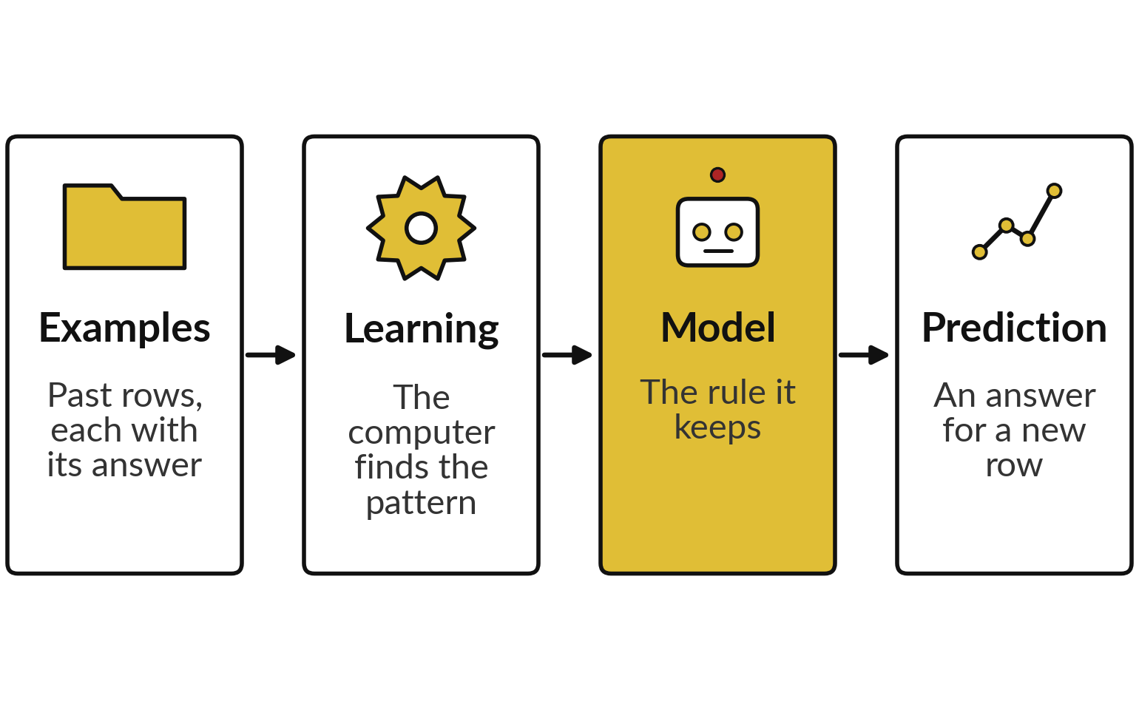
Machine learning finds the rule from
examples, so nobody writes it by hand
A model is the rule the computer found.
We do not write the rule ourselves. The computer finds it from the examples.
Every example row must include its answer, which we call the target variable.
Notes:
Here is the whole idea of machine learning in one picture. We give the computer examples, which are past rows that include the answer. It looks for a pattern that links the inputs to the answer. What it keeps is called the model. Then, when a new row arrives without an answer, the model produces a prediction.
Compare that with what you did in Weeks 3 and 4, where you wrote every rule yourself with if and else. Today the computer finds the rule. Our job is to give it good rows and to check its work.

Slide 10
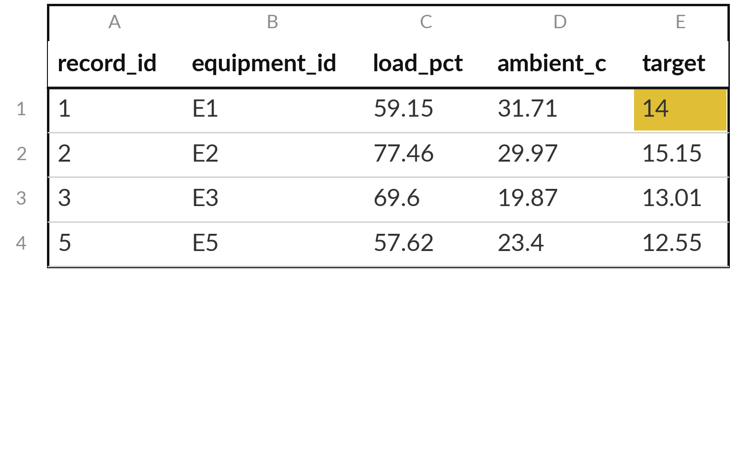
Every row is one reading: the inputs are
features and the answer is the target variable
The model reads the features and predicts the target variable (yellow): crusher energy demand in kWh/t.
Features (input variables): load_pct (percent of full load) and ambient_c (deg C).
record_id and equipment_id only label the row.
Record 4 is left out: its target is a missing value (NaN).
Notes:
Look at the table. Each row is one reading of one crusher. The columns load_pct and ambient_c tell us how hard it was working and how warm the air was. Those are the features, also called input variables or predictors: the things the model is allowed to see.
The last column is the target variable, crusher energy demand in kWh/t. It is the answer we want the model to learn to guess. The record number and the equipment label help us keep track, but they are not features today. Which column is the target?

Slide 11
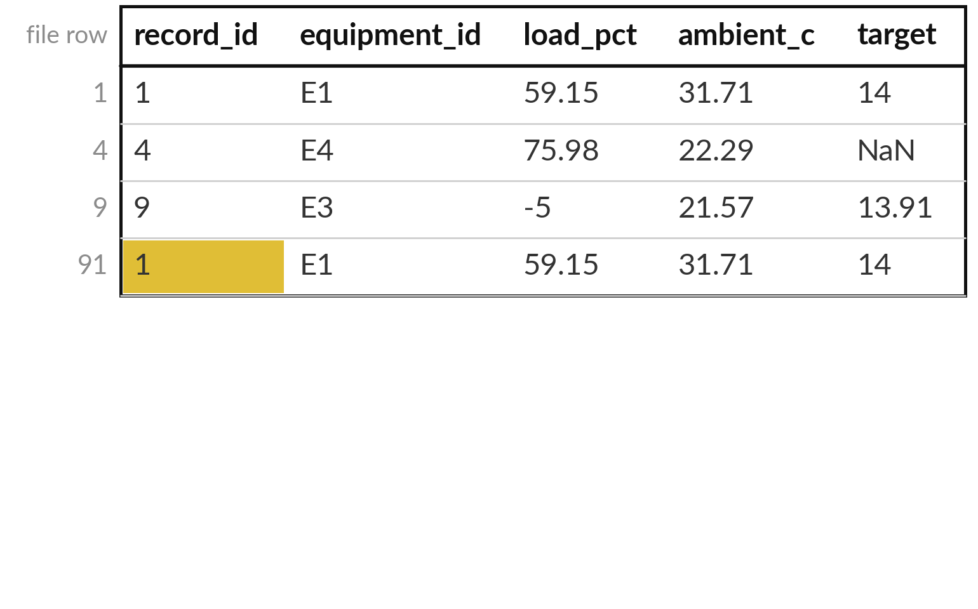
Before we model, we remove
the rows we cannot trust
Our file has 91 rows. Three kinds of row cannot be used.
record_id 1 is in row 1 and again in the last row, row 91 (yellow). Keep the first.
record_id 4 has a missing target (NaN): nothing to learn from.
record_id 9 has load_pct -5: impossible.
Notes:
This is the Week 6 data cleaning you already know, now with a purpose. Our file has 91 rows, and three kinds of trouble. One record number appears twice, once near the top and once in the very last row of the file, so we keep the first copy.
One row has no target, so there is no answer to learn from. And one row has a load below zero percent, which cannot happen, so it is a recording error. After removing them we keep 88 rows. One more missing value remains, in a feature column, and we deal with it later by imputation.
Notice that we clean a copy and keep the raw file safe.

Slide 12
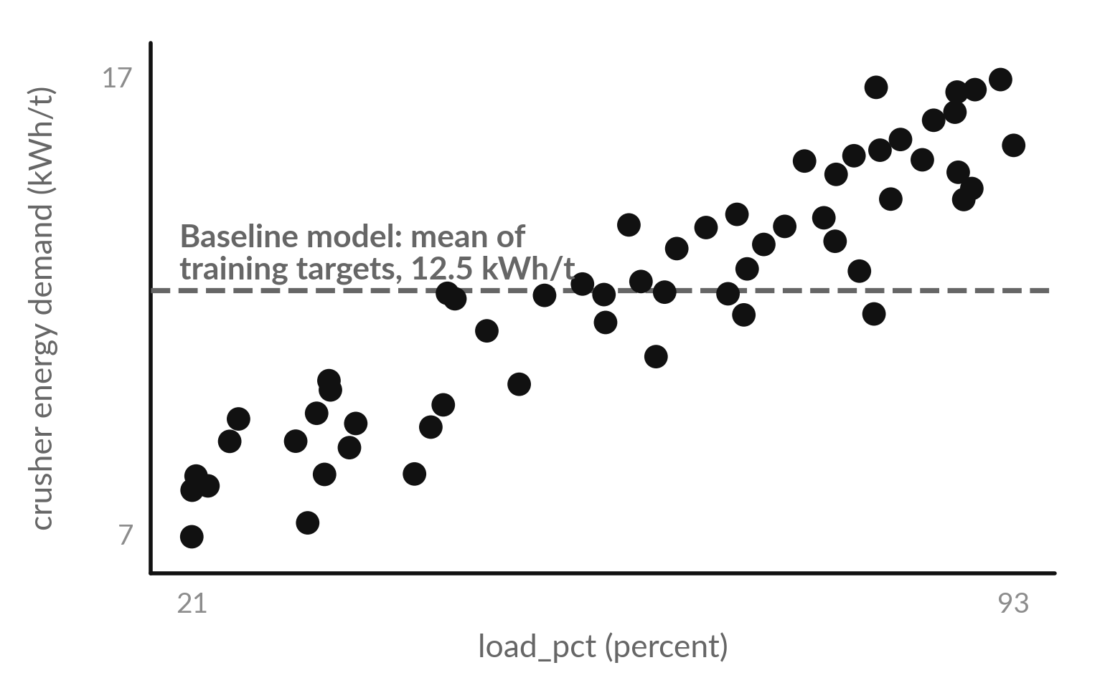
The baseline model comes first: predict
the mean of the training targets every time
Each dot is one training row. The dashed line is the baseline model: it predicts 12.5 kWh/t for every row.
A baseline model is the simplest possible model: it predicts the mean of the training targets and ignores the features.
Every other model must beat it. If it cannot, it has learned nothing useful.
Notes:
Each dot is one training row. Before building anything clever, we build the simplest possible model, called the baseline model. It predicts the mean of the training targets, 12.5 kWh/t, for every row, whatever the load. That dashed line is the baseline model. Look at the dots: it is fine for rows near the middle and very wrong at both ends.
This matters because any model has to do better than the baseline model, or it is not worth the trouble. How large do you think its prediction error will be, on average?

Slide 13
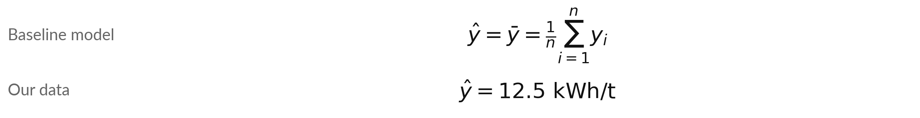
The baseline model as a formula:
the mean of the training targets
Symbol | What it means | In our data
y-hat and y-bar | The prediction, which is the mean of the y_i. | 12.5 kWh/t
y_i | The actual target of training row i. | column target, in kWh/t
n | How many training rows there are. | 58 rows (E1 to E4)
sum, i = 1 to n | Add up the values from row 1 to row n. | all training rows
We add the 58 training targets and divide by 58. The validation set plays no part.
Notes:
Here is the baseline model written as a formula. The symbol y with a little hat on top means a prediction. The symbol y with a bar on top means the mean. To get it we add up the targets of all 58 training rows and divide by 58.
For our data that gives 12.5 kWh/t. Every row gets that same prediction. Notice that the validation set never takes part, because it is held out. Read the table row by row and check that you can say what each symbol means in our data.

Slide 14
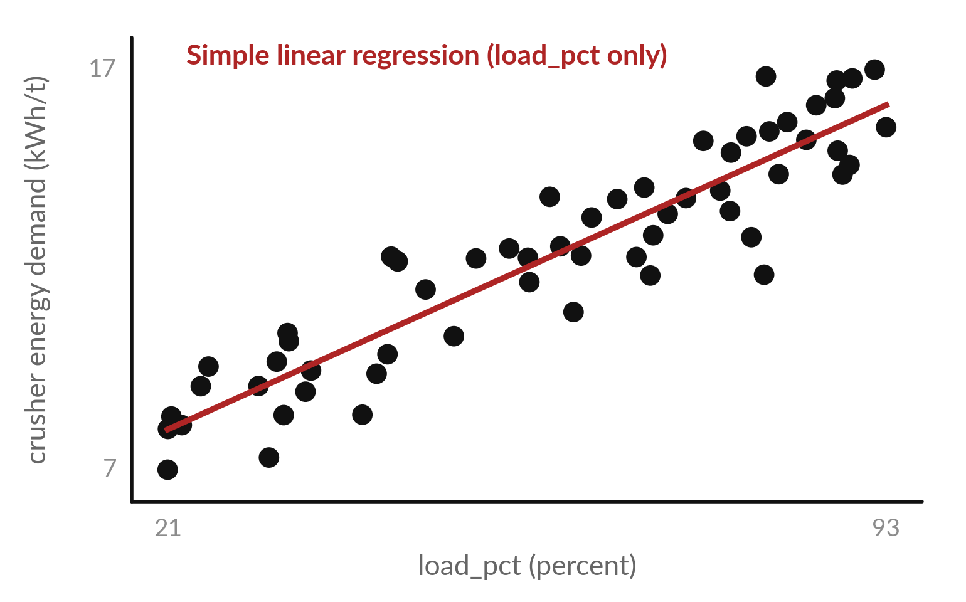
Simple linear regression fits a line through
the dots and beats the baseline model
Simple (univariate) linear regression: one feature, load_pct. Each extra 1 percent of load adds 0.12 kWh/t.
At zero load it starts at 5.6 kWh/t (the intercept).
It predicts the target as an intercept plus a weighted feature.
On the validation set its MAE is 0.98 kWh/t.
Notes:
This model is called simple linear regression, or univariate linear regression, because it has one feature. The line has two numbers. The intercept, 5.6 kWh/t, is where it starts at zero load. The slope, 0.12, says that each extra one percent of load adds that much to the prediction.
This is the model: a rule that stands in for the table. Give it any load and it reads off a prediction. We drew it with load alone to keep the picture simple. On the validation set its mean absolute error is about 0.98 kWh/t. In the lab the model also uses ambient_c, so it learns one weight for each feature.
With two or more features the model is called multiple linear regression. Multivariate strictly means several targets, so we say multiple.

Slide 15
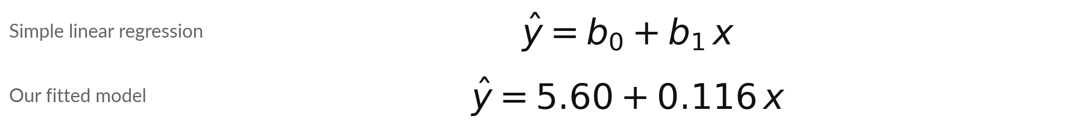
Simple linear regression is a
formula with two learned numbers
Symbol | What it means | In our data
y-hat | The predicted target. | crusher energy demand, in kWh/t
x | The feature of the row. Here the load alone. | column load_pct, in percent
b0 | The intercept (bias): the prediction when x is 0. | 5.60 kWh/t
b1 | The slope, or coefficient (weight): how much the prediction grows when x grows by 1. | 0.116 kWh/t per percent of load
Example: at load_pct = 60 the prediction is 5.60 + 0.116 x 60, which is about 12.5 kWh/t.
Notes:
The fitted red line is a formula. The prediction equals b zero plus b one times x. B zero is the intercept, the value where the line starts at zero load. B one is the slope, how much the prediction grows when the load grows by one percent.
For our data b zero is 5.60 and b one is 0.116. Try it at a load of sixty percent: 5.60 plus 0.116 times sixty gives about 12.5 kWh/t. The computer finds b zero and b one by itself. Which load gives the largest prediction?

Slide 16
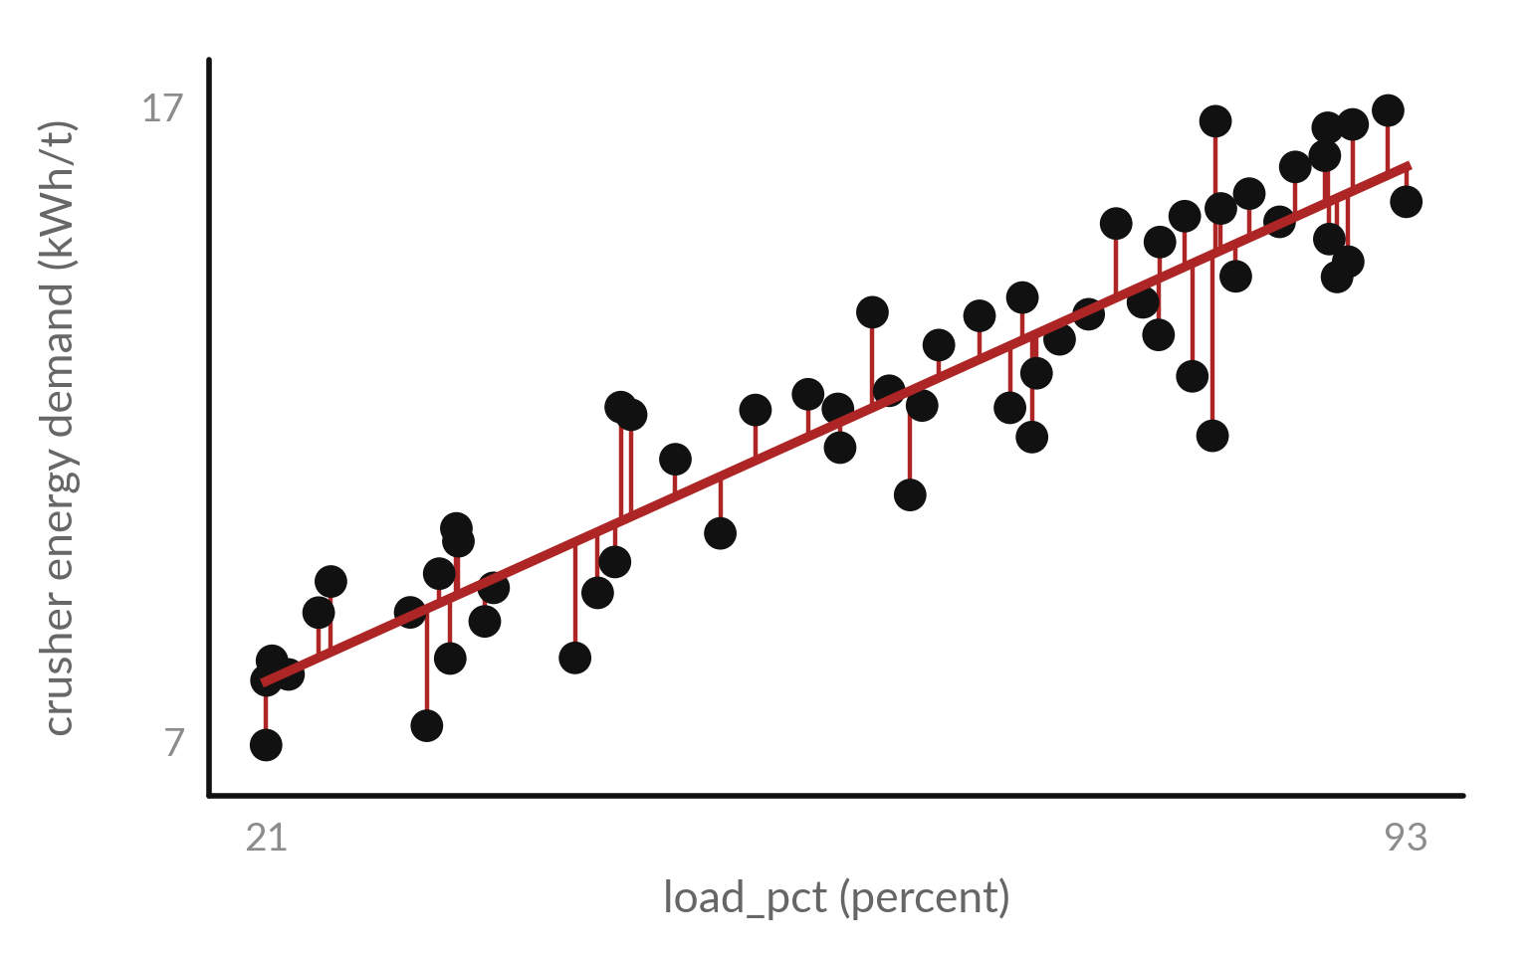
The prediction error (residual) is the
actual value minus the predicted value
Prediction error (residual) = actual value minus predicted value, for one row. The line is simple linear regression.
Each red segment joins a dot (actual) to the line (predicted). Its length is the error size.
Positive error: the model predicted too low.
A good model leaves short segments.
Notes:
How do we know if a model is good?
We look at its prediction errors, also called residuals. Each red segment is the distance between an actual value and what the model predicted. That distance is the error, actual minus predicted. If the model predicted too low, the error is positive. If it predicted too high, the error is negative.
A good model leaves small errors. A poor one leaves large errors. To compare models we need one number that sums up all the errors, and two ways to do that come next.

Slide 17
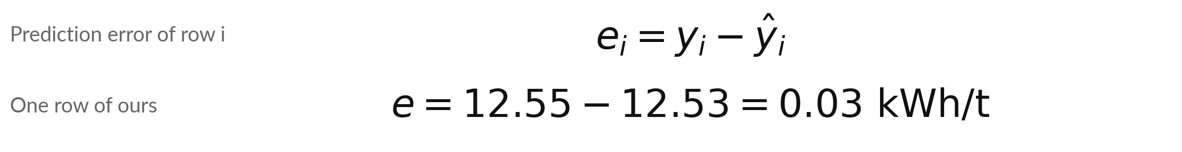
The prediction error of one row is the
actual value minus the predicted value
Symbol | What it means | In our data
e_i | The prediction error (residual) of row i. Negative means the prediction was too high. | in kWh/t
y_i | The actual target of row i. | column target, in kWh/t
y-hat_i | The prediction for row i. | baseline model: 12.53 kWh/t
i and n | The row number i runs from 1 up to n, the number of rows. | one row at a time
Our row: record_id 5, load_pct 57.62, ambient_c 23.4. The baseline model predicted too low by 0.03 kWh/t.
Notes:
Here is the prediction error as a formula. For row i, the error e i equals the actual value y i minus the prediction y hat i. The small i just says which row we mean. Our example is the first validation row, record 5. Its actual target is 12.55 kWh/t.
The baseline model predicts 12.53. So the error is 0.03, and the sign tells us the prediction was too low. Work out the same error yourself with a calculator before you move on.

Slide 18
Worked example with hypothetical numbers: four
prediction errors give MAE 2.75 and RMSE 3.5
Reading | Actual | Predicted | Error e | Absolute error |e| | Squared error e x e
1 | 70 | 72 | -2 | 2 | 4
2 | 80 | 77 | +3 | 3 | 9
3 | 90 | 90 | 0 | 0 | 0
4 | 60 | 66 | -6 | 6 | 36
MAE = (2 + 3 + 0 + 6) / 4 = 2.75. MSE = (4 + 9 + 0 + 36) / 4 = 12.25. RMSE = square root of 12.25 = 3.5. These four readings are hypothetical (made up) to show the arithmetic.
Notes:
Here are four hypothetical readings, made up so that you can follow the arithmetic by hand. Reading four has a prediction error of minus six. If we simply averaged the errors, the plus and minus would cancel, which hides the problem. So we remove the sign. Take the absolute value of each error: two, three, zero, six.
Their mean is 2.75. That is the mean absolute error, MAE. Or square each error first: four, nine, zero, thirty-six, mean 12.25, and take the square root to get back to the original unit: 3.5. That is the root mean squared error, RMSE. Check the first one on your own page.

Slide 19
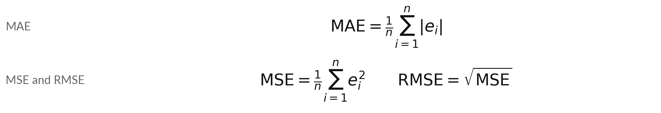
Three ways to turn many errors into
one number: MAE, MSE and RMSE
Symbol | What it means | In our data
n | How many rows we score. | 15 validation rows
|e_i| and e_i squared | The error with its sign removed, and the error multiplied by itself. | kWh/t and kWh/t squared
sum | Add the values for rows 1 to n. | all validation rows
MAE and RMSE are in the unit of the target. MSE is in the unit squared. Lower is better.
Notes:
Here are the three measures as formulas. For MAE we take the absolute value of every error, add them up and divide by n, the number of rows. For MSE we square every error, add them up and divide by n. RMSE is the square root of the MSE, which brings us back to the unit of the target.
In our lab we score on the 15 validation rows, so n is 15. MAE and RMSE are the two you will quote. Which one punishes a large error more?

Slide 20
Our own validation rows: the baseline
model and simple linear regression
record_id | load_pct | ambient_c | Actual | Baseline model | Baseline error | Linear regression | Linear regression error
5 | 57.62 | 23.4 | 12.55 | 12.53 | +0.03 | 12.27 | +0.29
11 | 26.14 | 33.98 | 7.62 | 12.53 | -4.91 | 8.62 | -1.00
17 | 61.76 | 34.28 | 13.62 | 12.53 | +1.09 | 12.74 | +0.87
23 | 20.73 | 30.81 | 8.20 | 12.53 | -4.33 | 8.00 | +0.20
Values in kWh/t. Linear regression is simple (load_pct only). Absolute errors over 15 rows add up to 40.7 for the baseline (MAE = 40.7 / 15 = 2.71) and 14.7 for linear regression (MAE = 0.98).
Notes:
Now the same arithmetic on real rows. These are the first four validation rows. The baseline model predicts 12.53 for every row, so its error is the actual value minus 12.53. The simple linear regression prediction changes from row to row, because it uses the load, and its errors are much smaller.
Over all 15 validation rows, the baseline model has absolute errors that add up to 40.7. Divide by 15 and you get an MAE of 2.71 kWh/t. Simple linear regression gets 0.98. Multiple linear regression, which uses both features, does better still, and it comes in a few slides.

Slide 21


MAE and RMSE both measure
prediction error in the target’s own unit
MAE
RMSE
The mean of the absolute errors
Every error counts by its size
Easy to explain to a client
Squares the errors, takes the mean, then the root
One large error counts for much more
Use it when large errors are costly
Both are in kWh/t: "the model is off by about this many kWh/t".
Notes:
Both measures answer the question: how far off are we, on average?
MAE treats every error the same way. If one reading was off by six and another by two, they count as six and two. RMSE squares first, so the error of six counts for nine times the error of two. That makes it the stricter measure, and the right one when a large error is dangerous, such as a motor overheating.
Both are in kWh/t, the same unit as the target, so we can say in plain words how far off we are. RMSE is always at least as big as MAE. Which would you quote to a client?

Slide 22
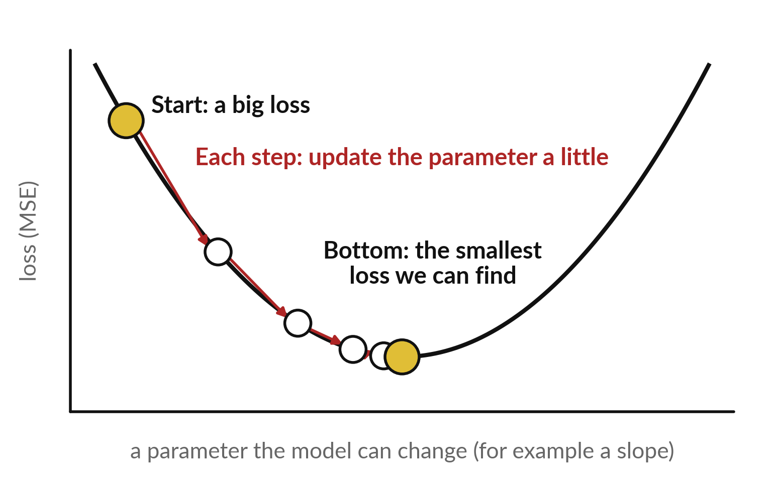
Gradient descent trains a model by walking
downhill on the loss, one small step at a time
Training starts with a poor model and improves its parameters (here the slope) by repeating small steps.
Loss function: how wrong the model is, as one number (here the MSE).
Gradient: the slope of the loss. It shows which way is downhill.
Learning rate: the size of each step.
Notes:
How does the computer train the model?
By trial and improvement. It starts with a poor model, measures the loss, given by the loss function, a single number for how wrong it is, and works out which direction lowers the loss. That direction is the gradient. Then it takes a small step in that direction, and the size of the step is the learning rate.
Too big and it overshoots. Too small and it takes forever. It repeats until the loss stops falling. Picture walking down a hill in fog, feeling the slope with your feet. That method is called gradient descent, and the numbers it adjusts are the parameters of the model.

Slide 23
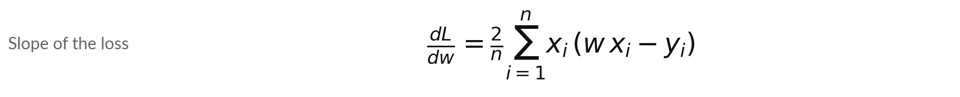
Gradient descent, part 1:
how steeply the loss slopes
Symbol | What it means | In our data
L | The loss function: the MSE of the model y-hat = w x. | our tiny illustrative example
w | The parameter (slope) of the model. It has no intercept, to keep the example small. | w stands in for b1
x_i, y_i, n | Input and answer of row i, and the number of rows. | x = 1, 2, 3; y = 2, 4, 6; n = 3
dL/dw | How fast the loss changes when w changes. | at w = 0 it is -18.67
A negative slope of the loss means that a bigger w lowers the loss, so we move w upwards.
Notes:
Here is gradient descent as two formulas, and this is the first. It tells us how steeply the loss slopes at the current w. The tiny example uses illustrative, hypothetical data, x equal one, two, three and y equal two, four, six, so n is three. The model is y hat equals w times x, with no intercept, to keep the example small.
In effect w plays the part of b one. At w equal zero the slope of the loss is minus 18.67 for our tiny example, which says that a bigger w lowers the loss. The update rule, which comes next, uses this number.

Slide 24
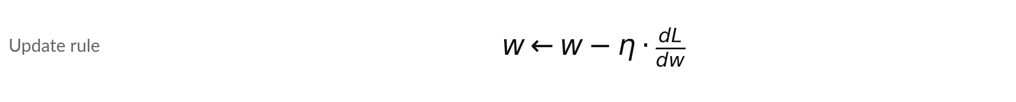
Gradient descent, part 2:
change w a little, downhill
Symbol | What it means | In our data
w | The parameter (slope) we are improving. It starts at 0. | the tiny example
arrow | Replace the old w by the new value on the right. | one update per step
dL/dw | The slope of the loss from the last slide. | at w = 0 it is -18.67
eta | The learning rate: the size of each step. | 0.05
New w = old w minus the learning rate times the slope of the loss. We repeat this update again and again.
Notes:
This is the second formula, the update rule. The new w equals the old w minus the learning rate times the slope of the loss. If the slope of the loss is negative, we are on the downhill side, so minus a negative number makes w bigger. The learning rate eta is 0.05.
The arrow means replace the old w by the new value. Next we calculate the first step by hand.

Slide 25
On a tiny illustrative example, five
steps almost reach the best slope
Step | w after the step | Loss after the step
0 (start) | 0 | 18.667
1 | 0.933 | 5.31
2 | 1.431 | 1.51
3 | 1.697 | 0.43
4 | 1.838 | 0.122
5 | 1.914 | 0.035
Illustrative (hypothetical) data: x = 1, 2, 3 and y = 2, 4, 6, so the best w is 2. Step 1 by hand: dL/dw = (2/3) x (1 x (0 - 2) + 2 x (0 - 4) + 3 x (0 - 6)) = -18.67. New w = 0 - 0.05 x (-18.67) = 0.933.
Notes:
Here is the tiny illustrative example with one step worked by hand. The inputs are one, two, three and the answers are two, four, six, so the best slope is exactly two. We start the slope at zero. The slope of the loss at zero is minus 18.67.
The new w is zero minus 0.05 times minus 18.67, which is 0.933. After step two it is 1.431. After five steps it is 1.914, very close to two, and the loss has fallen to 0.035. Nobody told the computer the answer was two. In the lab scikit-learn trains the model for us.

Slide 26
Multiple linear regression has three
learned parameters: b0, b1 and b2
Symbol | What it means | In our data
y-hat | The predicted target. | crusher energy demand, in kWh/t
x1, x2 | The two features (input variables) of a row. | x1 = load_pct (percent), x2 = ambient_c (deg C)
b0 | The intercept (bias): the prediction if both features were 0. | 1.16 kWh/t
b1, b2 | The coefficients (weights) of x1 and x2. | b1 = 0.120 per percent, b2 = 0.159 per deg C
You train this multiple linear regression model in the lab. Training chooses b0, b1 and b2 to make the training MSE small.
Notes:
This is the model you will train in the lab, multiple linear regression. It is the same idea as simple linear regression, but with two features. The prediction equals b zero plus b one times x one plus b two times x two. X one is the load in percent and x two is the ambient temperature.
After training on our rows, b zero is 1.16, b one is 0.120 and b two is 0.159. These three numbers are the parameters the model has learned. In the lab you print them. Each coefficient tells you how much the prediction moves for one more unit of its feature.

Slide 27
What one more unit of a
feature does to the prediction
Case | load_pct (percent) | ambient_c (deg C) | Prediction (kWh/t) | Change
Start | 60 | 25 | 12.33
load_pct up by 1 | 61 | 25 | 12.45 | +0.120
ambient_c up by 1 | 60 | 26 | 12.49 | +0.159
Both up by 1 | 61 | 26 | 12.61 | +0.279
This is multiple linear regression. Its coefficient for load_pct is not the same as the 0.116 of simple linear regression, because now the two features share the work. The start values 60 and 25 are chosen for the example.
Notes:
Let us use the formula. Take a reading with a load of sixty percent and an ambient temperature of twenty-five degrees. The prediction is 12.33 kWh/t. Now raise the load by one percent and keep the ambient temperature fixed. The prediction rises by 0.120, which is b one.
Raise the ambient temperature by one degree instead and it rises by 0.159, which is b two. Raise both and the changes add up to 0.279. That is how you read a coefficient: the change in the prediction for one more unit of that feature, with the other feature held fixed.

Slide 28
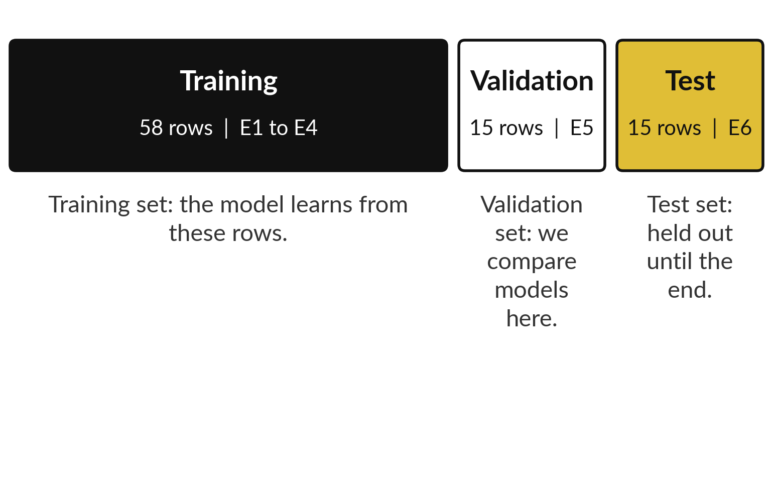
Hold out rows while the model
trains, so the evaluation is fair
After cleaning, 88 rows remain. We cut them into three sets by equipment group.
Held-out data are rows not used to fit the model: the validation and test sets.
Each equipment group goes into one set only.
Notes:
Suppose you learned ten answers by heart and I tested you on the same ten. You would look brilliant and I would learn nothing. A model is the same. So we cut the 88 clean rows into three groups. The training set, 58 rows, is what the model learns from.
The validation set, 15 rows, is held-out data that the model never trains on, and we use it to compare models. The test set, 15 rows, is also held out and stays untouched until the end of the block. We cut by equipment group, E1 to E4, then E5, then E6, so the model is judged on whole crusher groups it has never met.
Why would mixing the groups give us a rosier score?

Slide 29
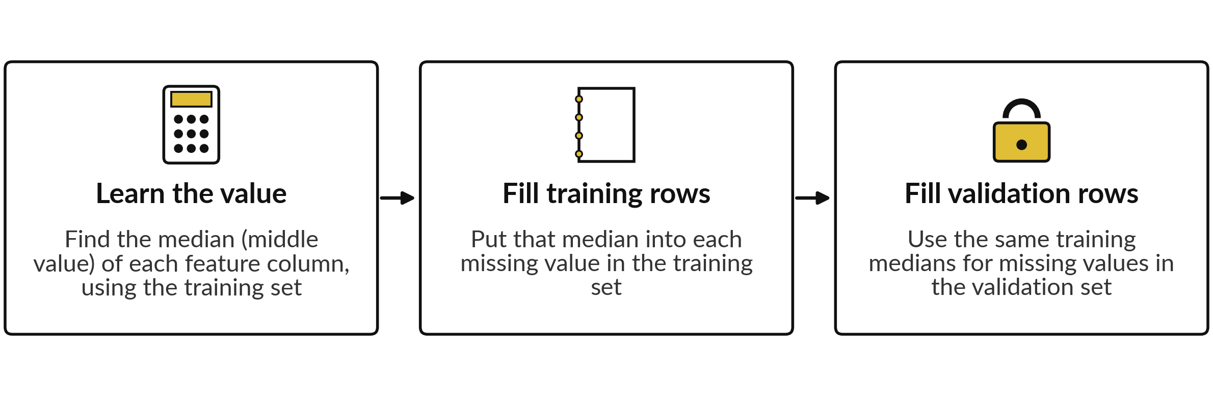
Imputation fills a missing value with
the training median of its column
A model cannot use a missing value (empty cell, NaN). One training ambient_c value is missing. Medians: load_pct 62.8, ambient_c 26.1. Filling them is imputation (SimpleImputer).
Notes:
One feature value is missing, and a model cannot use a missing value. So we fill it by imputation, with the median, the middle value of that column. The important rule is where the median comes from. We find it from the training rows only, here 62.8 for load and 26.1 for ambient temperature.
We use that same number to fill missing values in the validation set too. If the validation set helped decide the fill, information would leak from the held-out data into the model, which is called data leakage, and our score would be a little too kind. The scikit-learn tool that does this is called SimpleImputer, and we meet it in the lab.

Slide 30
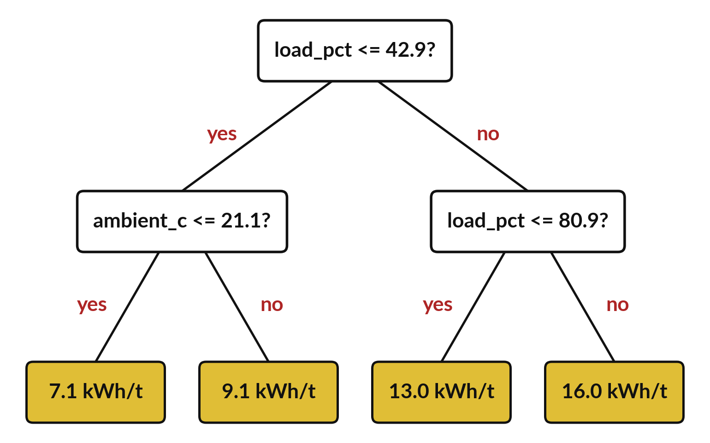
A decision tree learns a short list of
yes or no questions about the features
A row follows yes or no answers down to one yellow box, a leaf node. That leaf gives the prediction.
Each question is an internal node: a split on a feature and a threshold. The top one asks: is load_pct at most 42.9?
The prediction is the mean target of the training rows in that leaf node.
Notes:
A second kind of model. A decision tree asks yes or no questions about the features and sends each row down one branch until it reaches a leaf node, the yellow box at the bottom. Each question is an internal node. The first box asks whether load_pct is at most 42.9.
If yes, the row goes left. If no, it goes right. Each yellow box is a leaf node. It predicts the mean target of the training rows that ended up there during training. This small tree has only two questions on any path, so you can read it like a rule.
Which question does the tree ask first, and why do you think it picked that one?

Slide 31
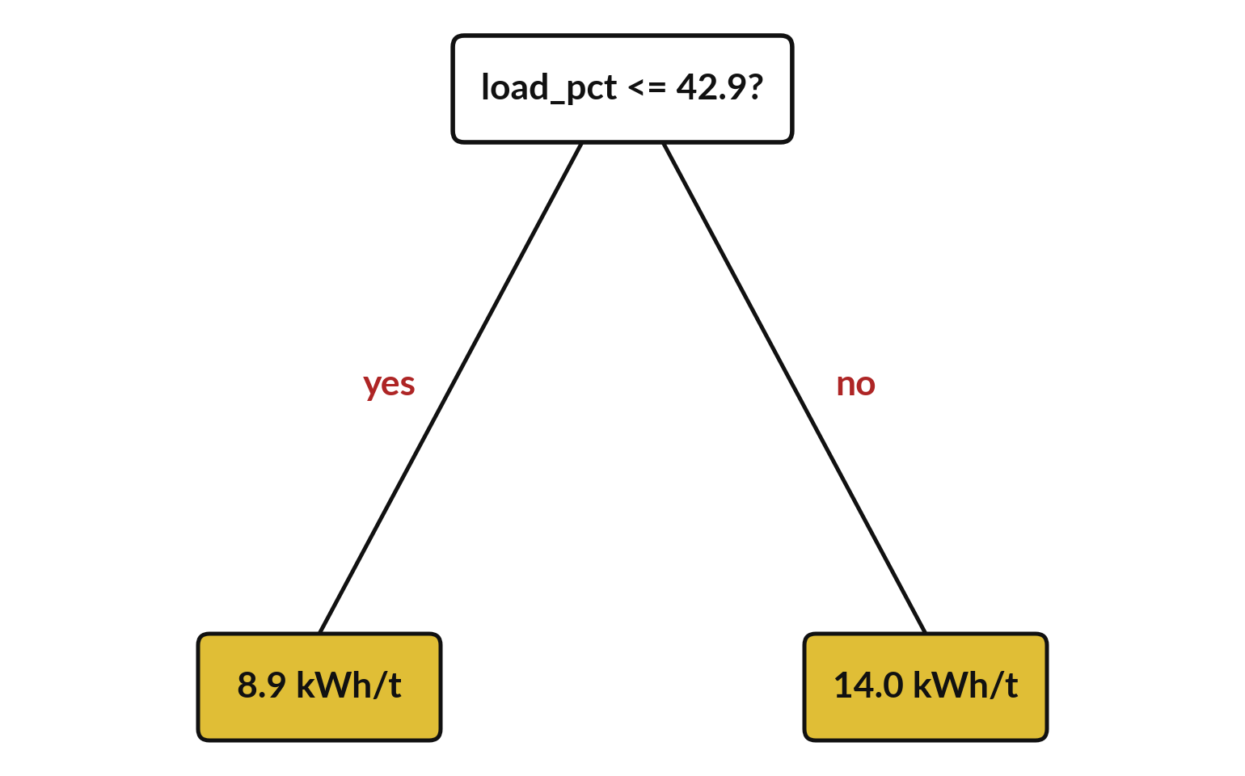
max_depth is the largest number
of questions a row can be asked
max_depth is a hyperparameter: a setting we choose before training. It limits how many questions a row meets.
This tree has max_depth 1: one question, two answers. The last tree had max_depth 2.
A deeper tree can fit the training set more closely, even overfit it (fit noise). Class 3 tests that. The lab uses max_depth 4.
Notes:
The setting called max_depth is the largest number of questions a row can be asked on the way down. It is a hyperparameter, which means a setting that we choose before training. The computer does not learn it, unlike the parameters. This tree has depth one, so one question and two answers.
The earlier tree had depth two. A deeper tree asks more questions and can fit the training rows more closely, even to the point of overfitting, which means fitting noise in the training set. In the lab you use depth four. Class 3 shows when deeper trees stop being helpful.
Why would a tree that is perfect on its training set still disappoint us?

Slide 32
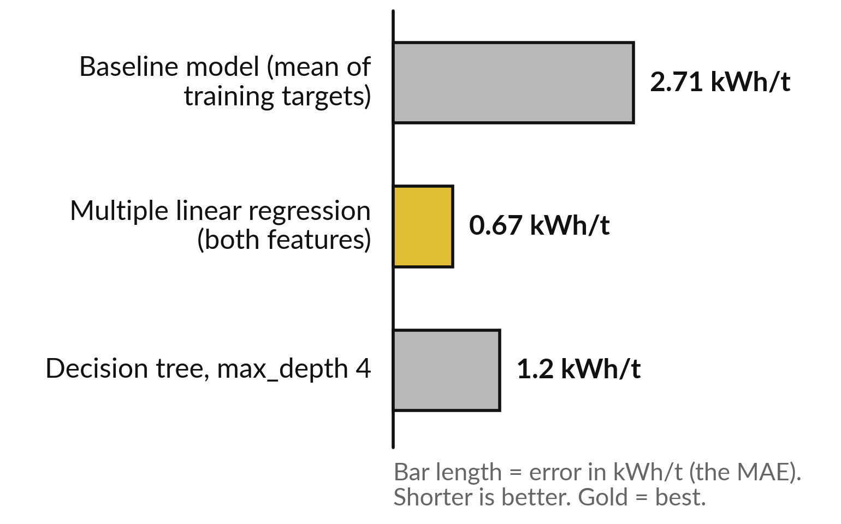
Model comparison: three models
evaluated on the same validation set
Multiple linear regression has a validation MAE of 0.67 kWh/t. The baseline model has 2.71 kWh/t.
Each bar is the MAE on the validation set.
Simple linear regression (load_pct only) scored 0.98 kWh/t, not shown.
You produce these numbers in the lab.
Notes:
This is where we are heading. Three models, all trained on the same training set and all evaluated on the same validation set. The baseline model has a mean absolute error of 2.71 kWh/t. The decision tree has 1.20. Multiple linear regression has only 0.67, the best of the three.
That is a different model from simple linear regression, which scored 0.98. The RMSE tells the same story: 3.28, 1.45 and 0.81. Do not memorise these numbers. The point is that you will produce them yourself in the lab, and that a fair comparison always includes the baseline model.

Slide 33
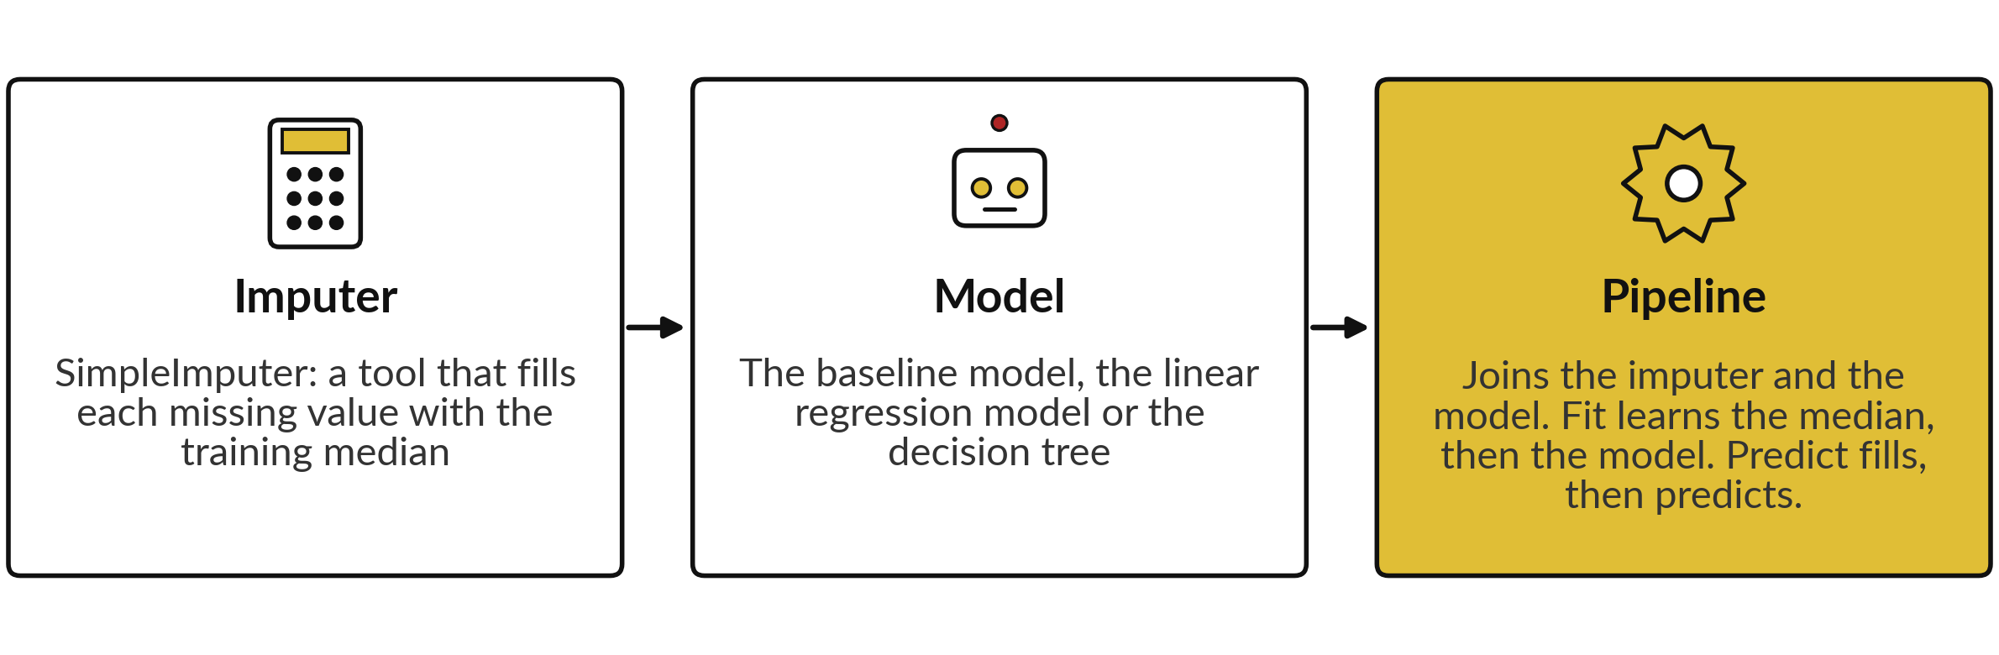
A pipeline chains preprocessing and
a model, and runs its steps in order
In the code that follows, the pipeline has two steps: the imputer first, then the linear regression model.
Notes:
Before the code, two terms. An imputer is a tool that fills missing values, here with the median of the training set. A pipeline chains preprocessing and a model, and runs its steps in order. Our pipeline has two steps: first the imputer, then the model. When we fit the pipeline, it learns the medians and then learns the model.
When we predict with it, it fills any missing value first and then predicts. Why do we put the imputer inside the pipeline instead of filling the cells by hand?

Slide 34
Read the workflow before you
write it: create, fit, predict, score
In plain words
imputer = SimpleImputer(strategy="median")
model = make_pipeline(imputer, LinearRegression())
model.fit(X_train, y_train)
y_pred = model.predict(X_valid)
mae = mean_absolute_error(y_valid, y_pred)
Line 1: create an imputer (it fills missing values).
Line 2: make a pipeline: imputer, then linear regression.
Line 3, fit (training): learn the median, then b0, b1 and b2.
Line 4, predict (inference): y_pred holds the predicted validation targets.
Line 5: score y_pred by the MAE.
X is a table of features. y is the target variable.
Notes:
Before we leave the concepts, look at the code you will use. Create an imputer, which fills missing values. Join it with an untrained linear regression model in a pipeline. Fit the pipeline, which means train it on the training set. Predict, which is also called inference, means produce predicted targets for the validation set.
Then score the predictions by comparing them with the actual targets. The imputer is there because one training value is missing, and a model alone would stop with an error. A capital X is the table of features, and a lowercase y is the target variable. The tree uses the same steps with a different second piece in the pipeline.
You do not need to memorise it, because the notebook explains every line.

Slide 35
Part 2: the lab
Close the slides and open the lab notebook. Use the slides "Check your numbers" and "Four errors you will meet" at the end of this deck.
Notes:
That is the end of the concepts. Everything you need is on the slides you have just seen, and every term is explained again inside the notebook. Please open the notebook now, and keep the slides closed except for the check slides at the end of the deck.
I will walk around. Raise your hand if a cell gives an error. Remember to run the cells in order from the top.

Slide 36
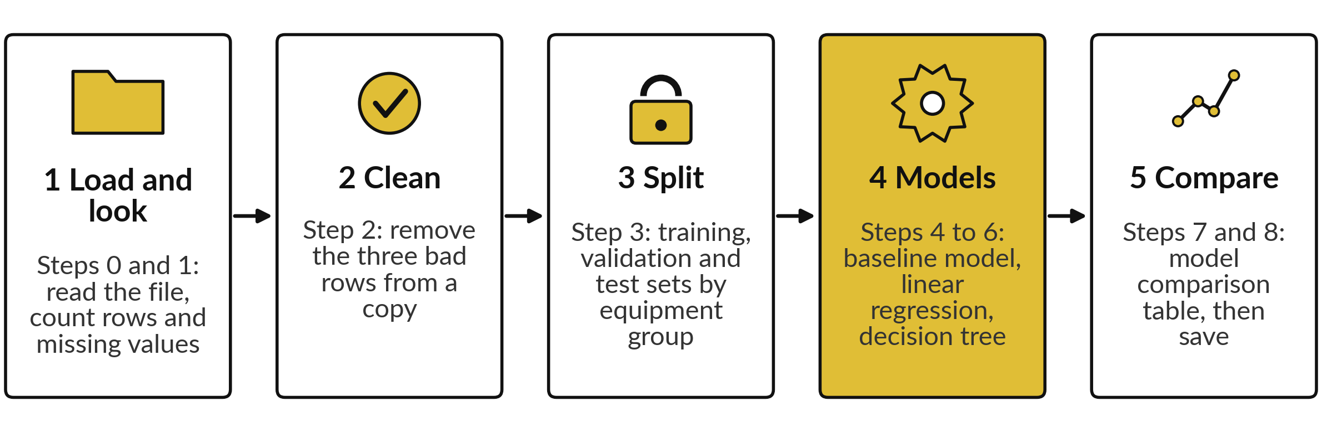
The lab has five stages, and the
notebook numbers its steps 0 to 8
In every step: predict first, run the cell, read the output, then change one thing.
Notes:
Here are the five stages of the lab. One, load the file and look at it. Two, clean it by removing the three bad rows. Three, split by equipment group into a training set, a validation set and a test set. Four, train the baseline model, the linear regression model and the decision tree.
Five, put the scores side by side in a model comparison table and save. The notebook numbers its steps from zero to eight, so a stage can contain several steps. Each step asks you to predict first, then run, then read the output. Predicting before you run is how you find out what you really understand. Do not skip the predict cells.

Slide 37







Check your numbers against
these before you move on
What the notebook prints | You should see
Rows and columns of the raw file | 91 rows, 5 columns
Rows left after removing the 3 bad rows | 88
Rows in the training, validation and test sets | 58, 15, 15
Baseline model: MAE on the validation set | 2.71 kWh/t
Simple linear regression (load_pct only): MAE (Step 5, CHANGE task) | 0.98 kWh/t
Multiple linear regression: MAE | 0.67 kWh/t
Multiple linear regression: intercept, coefficient of load_pct, coefficient of ambient_c | 1.157, 0.120, 0.159
Decision tree, max_depth 4: MAE | 1.20 kWh/t
If your number differs, stop and ask. Do not change a number to match. Find the step that went wrong.
Notes:
Use this table as your checkpoint. If your numbers match, you can carry on. If they do not, stop and call me over, because every later step builds on the earlier ones. The most common reason is a cell that was run out of order, or a row removed twice.
Do not edit a number to make it match. The aim is to understand why it is different, and that is a skill you will need in every project.

Slide 38




Four errors you will meet, what
they mean and what to do
Error message | What it says | What to do
FileNotFoundError | The CSV is not beside the notebook | Upload engineering_data.csv in the Files panel
KeyError: target | The code uses a column name that is not in the table, often a spelling difference | Print data.columns and copy the name exactly
NameError | The code uses a name from a cell that has not been run yet | Run all cells from the top, in order
ValueError: contains NaN | A missing value (an empty feature cell) reached the model | Fit the model inside the imputer pipeline, as in Step 5
Notes:
Errors are normal, and reading them is a skill. Here are the four you will most likely meet. File not found means the data file is not next to the notebook, so upload it. Key error means you spelled a column name differently from the file, so print the columns and copy the name.
Name error means you skipped a cell above, so run all cells from the top. And a value error about NaN means a missing value reached the model, so use the imputer pipeline. Read the last line of the error first. It usually tells you the answer.

Slide 39




How this class counts towards your coursework
Nothing is submitted today.
Block 1 is Classes 1 and 2. Its assignment has two parts: A7 (regression) and A8 (classification).
The Block 1 assignment closes on Friday 20 November, 08:00 (Kampala time).
The Block 1 quiz opens in the last 20 minutes of Class 2 and stays open for 24 hours.
Keep your saved Class 1 notebook for the assignment. Class 2 has its own notebook, and you reuse these cleaning steps.
Notes:
A word on how this counts. Nothing is submitted today. Block 1 is this class and the next one. Its assignment has two parts: part A on regression, which repeats the steps of today's lab with the assignment notebook, and part B on classification, which follows next class.
The Block 1 assignment closes on Friday 20 November, 08:00, Kampala time. The Block 1 quiz opens in the last 20 minutes of Class 2, stays open for 24 hours, and covers both classes. Keep your saved Class 1 notebook for the assignment. Next class has its own notebook, and you reuse the cleaning steps from this one.

Slide 40
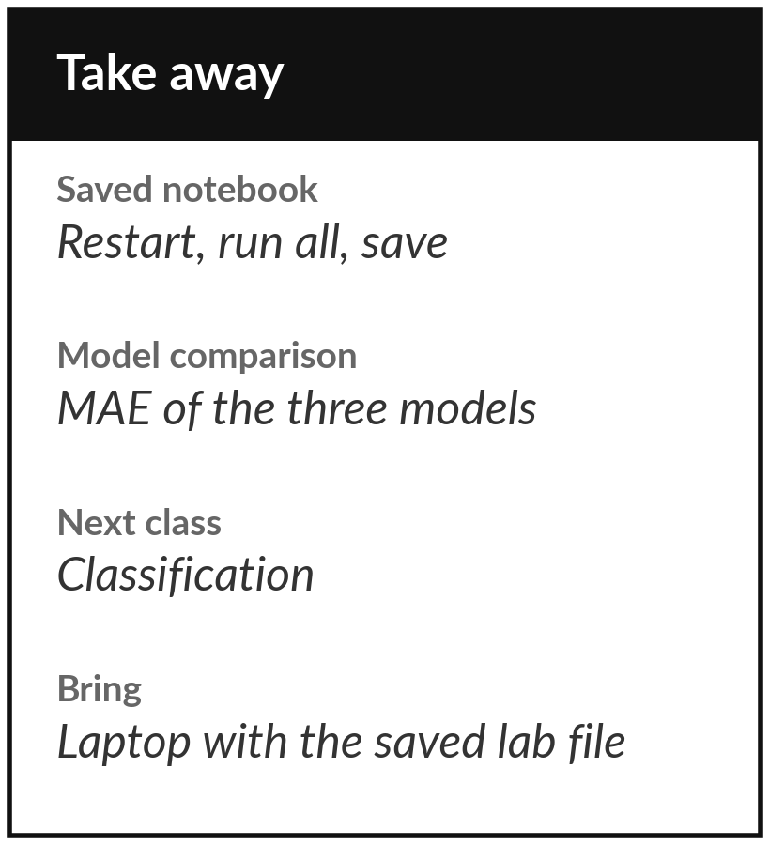
Save the notebook and
keep your three MAE scores
What you keep from today
Keep your lab notebook, saved after you restart the session and run all cells in order. Keep your three MAE numbers from the model comparison table: the baseline model, the multiple linear regression model and the decision tree.
Our question today
How can a computer predict crusher energy demand from load and temperature, and how do we know it is any good?
Next class
Class 2: classification, where the model answers yes or no.
Notes:
Before you go, restart the notebook, run all cells from the top and save it. Keep the three MAE scores from the model comparison table: the baseline model, the multiple linear regression model and the decision tree. Next class we predict a yes or no answer, for example fault or no fault, and we learn how to measure a model that answers that way.
If anything today was unclear, write the question down and bring it.
We began with this question: How can a computer predict crusher energy demand from load and temperature, and how do we know it is any good? Before you go, say in one sentence what you can now say about it.

