Slide 1
Sort, group, mean and median
Which item earns the most, and what is a typical sale in a small practice shop?
Python for Data Analysis | Session 9 of 24 | Week 3, Tables in pandas
Holiday Data and AI Camp | The National ICT Innovation Hub, Nakawa
Notes:
Let us begin. Today is session 9 and our topic is sort, group, mean and median.
By the end of today you will be able to total a column by group, sort the result, and say when the median describes a column better than the mean.
We will answer one question: Which item earns the most, and what is a typical sale in a small practice shop?

Slide 2
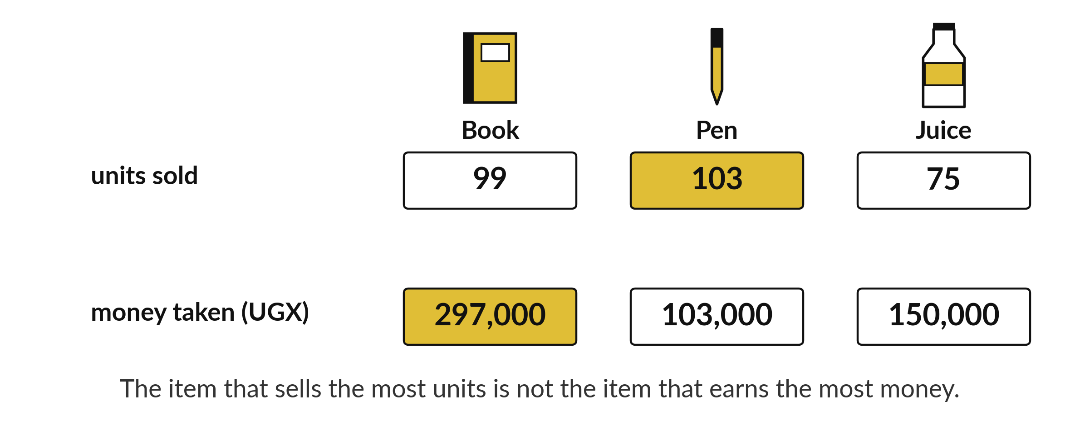
Which item earns the most, and what is
a typical sale in a small practice shop?
Notes:
The Sunrise Shops sold thousands of items over sixty days. The owner has two questions. Which item earns the most money, and what does a typical sale look like? A single total cannot answer either one. We need to sort the sales into piles, one pile for each item, and then measure each pile. That is what group, sort, mean and median are for, and today you will use all four.

Slide 3

Three hours, mostly doing
Most of our time is spent doing, in small steps, with a guess before every run.
Notes:
Here is how the 3 hours go. Each bar is as long as the time we spend on that part.
First, 10 minutes. Recall. Then, 50 minutes. Block A. After that, 15 minutes. Break away from screens. Next, 50 minutes. Block B. Then, 40 minutes. Make. Then, 15 minutes. Exit ticket, save, and an individual check with each learner.
Notice how much of the time is yours. You listen for a short while and then you do. That is on purpose, because you learn this by doing it.

Slide 4

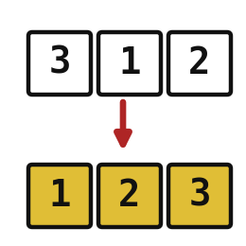

Words for today (1 of 2)
group
Gather rows with the same label before you calculate.
Sorting the sales into piles by item.
sort
Put rows in order from smallest to largest or the other way.
Lining up pupils by height.
mean
The total shared out equally: add the values and divide by how many.
Sharing a bag of mandazi equally.
Notes:
Here are the words for today. Listen for the picture that goes with each one.
group. Gather rows with the same label before you calculate. Sorting the sales into piles by item.
sort. Put rows in order from smallest to largest or the other way. Think of a shop. Lining up pupils by height.
mean. The total shared out equally: add the values and divide by how many. Imagine it like this. Sharing a bag of mandazi equally.

Slide 5
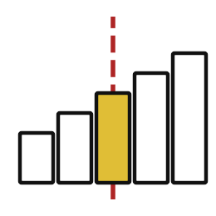


Words for today (2 of 2)
median
The middle value once the values are in order.
The pupil standing in the middle of a line sorted by height.
proportion
A part divided by the whole. Times 100 it becomes a percentage.
12 pupils out of 20 passed.
denominator
The whole that a proportion is measured against.
The 20 in 12 out of 20.
Notes:
Two more words to know before we start.
median. The middle value once the values are in order. An example from everyday life. The pupil standing in the middle of a line sorted by height.
proportion. A part divided by the whole. Times 100 it becomes a percentage. Here is a way to see it. 12 pupils out of 20 passed.
denominator. The whole that a proportion is measured against. A small example. The 20 in 12 out of 20.

Slide 6
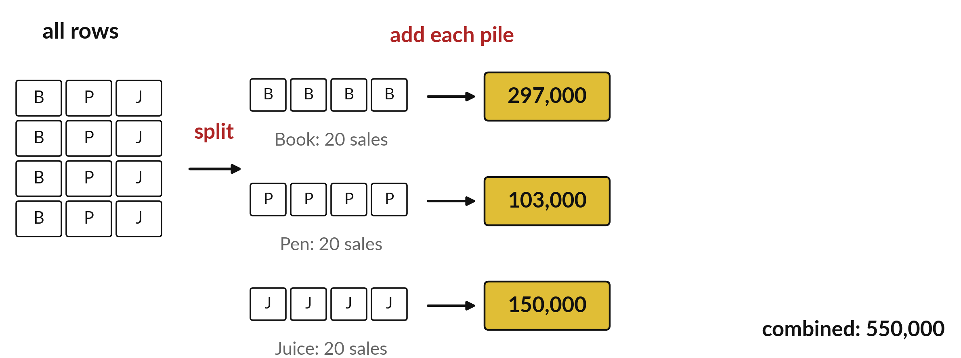
Group splits rows, adds each pile, then combines
Split by item, add each pile, combine into one small table.
Notes:
Grouping happens in three moves. Split means the rows are sorted into piles by the column you name, for example one pile for each item. Apply means we calculate on each pile separately, for example the sum of revenue. Combine means the answers come back together as one small table with one row per pile.
Follow the picture from left to right. Where did the Pen pile go, and what number came out of it?

Slide 7
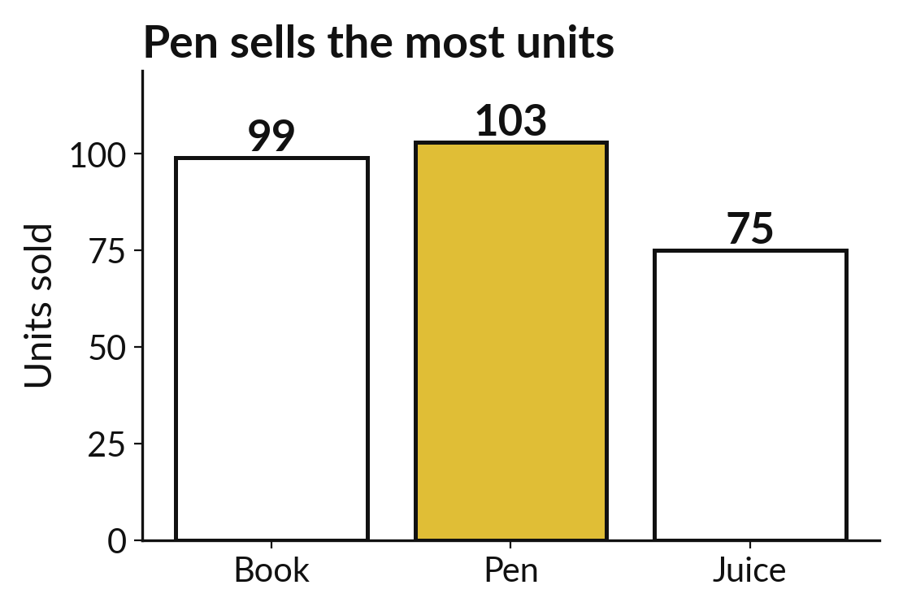
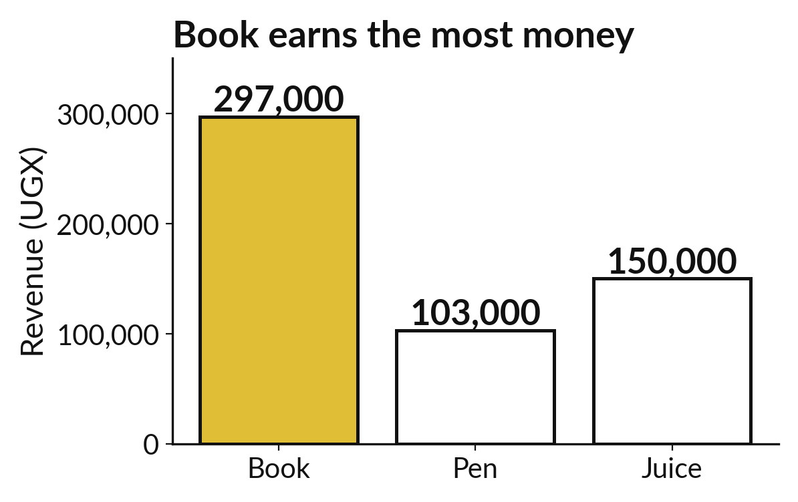
The best seller by units is not the top earner
By units: Pen sells 103, Book 99, Juice 75.
By revenue: Book earns 297,000, Juice 150,000, Pen 103,000.
Notes:
Here are the same sixty sales grouped by item, drawn two ways. On the left each bar counts units. Pen sells the most, one hundred and three. On the right each bar adds up money. Now Book is on top with two hundred and ninety seven thousand shillings, because each book costs far more than a pen.
So which item is the best seller? It depends on the question. Before you answer anything, decide whether you are counting units or counting money.

Slide 8

Predict: Group, total and sort
import pandas as pd
shop = pd.read_csv("camp_shop.csv")
shop["revenue_ugx"] = shop["units"] * shop["unit_price_ugx"]
units_by_item = shop.groupby("item")["units"].sum()
revenue_by_item = (
shop.groupby("item")["revenue_ugx"]
.sum()
.sort_values(ascending=False)
)
print(units_by_item)
print(revenue_by_item)
Predict which item sold the most units and which earned the most money.
Write your guess on paper before we run it.
Notes:
groupby gathers the rows with the same item. A calculation such as sum then works inside each group.
Make a prediction. Predict which item sold the most units and which earned the most money. Write it on paper. It does not have to be right.

Slide 9
Run it: Group, total and sort
item
Book 99
Juice 75
Pen 103
Name: units, dtype: int64
item
Book 297000
Juice 150000
Pen 103000
Name: revenue_ugx, dtype: int64
Pen sold the most units, 103.
Book earned the most money, 297000 shillings, then Juice 150000 and Pen 103000.
The three revenues add to 550000.
The item that sells the most units is not the item that earns the most.
Notes:
Running it now. Match each line of the output with the line of code that made it.
Pen sold the most units, 103. Book earned the most money, 297000 shillings, then Juice 150000 and Pen 103000. The three revenues add to 550000. The item that sells the most units is not the item that earns the most.
Keep your guess. We use it in the next step.

Slide 10

Investigate: Group, total and sort
1. Why does Pen sell the most units and earn the least money?
2. How do you check the grouped totals?
Notes:
Now we look closely at group, total and sort. I have two questions for you.
Question one. Why does Pen sell the most units and earn the least money? Give it thirty seconds and then we will hear a few answers.
Let me answer it. A Pen costs 1000 shillings and a Book costs 3000, so each Pen sale brings in less.
Question two. How do you check the grouped totals? Talk it over with your neighbour for a minute.
The answer is this. Add them up and compare with the overall total of 550000.

Slide 11

Modify: change one thing
Group the revenue by date and find the date with the most revenue.
Then tell your neighbour what changed and how you know.
Notes:
Make one small change. Group the revenue by date and find the date with the most revenue. Run it, then tell someone what you saw.
What you should find: 2026-12-20 with 47000.

Slide 12

Break
15 minutes away from your screen
Stand up. Drink some water. Tell someone what you guessed in the first half.
Notes:
Break time. 15 minutes away from your screens. Stand up, drink some water and tell someone what you guessed in the first half.
When we come back we start the second idea.

Slide 13
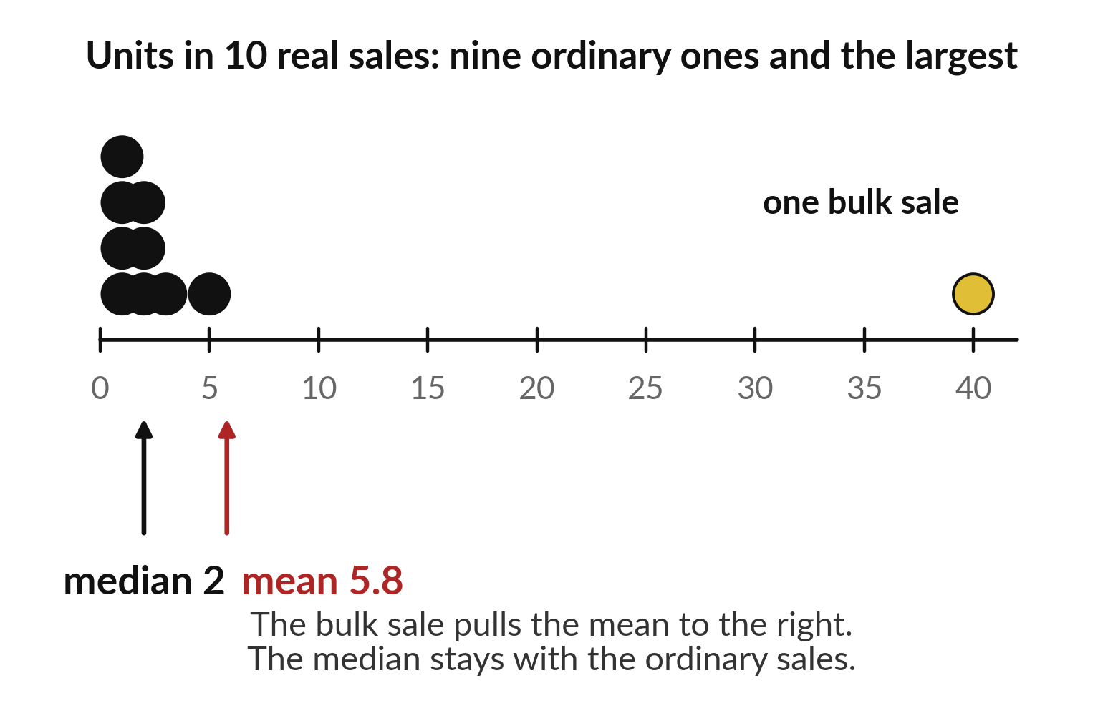
One huge sale lifts the mean but not the median
The mean adds everything and divides by the count.
The median is the middle value in sorted order.
A big value drags the mean along, and the median holds still.
Notes:
The mean is the total divided by how many values there are. The median is the middle value once the values are lined up in order. On the picture the mean sits like a balance point, and when one very large value joins the line, the balance point slides toward it. The middle value hardly moves.
In the Sunrise sales the mean sale is four thousand two hundred and fourteen shillings but the median is two thousand four hundred. Which one describes a typical sale better?

Slide 14
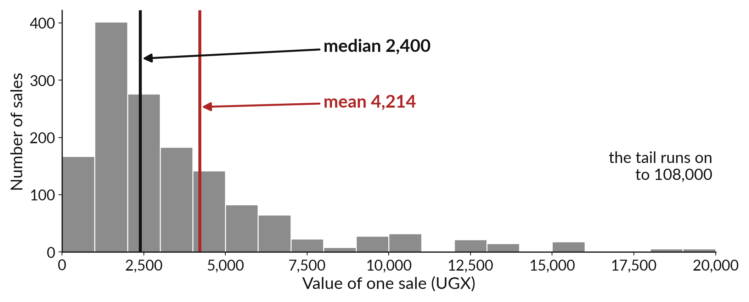
A skewed histogram puts
the mean right of the median
Most sales are small, and a few are very large.
Notes:
This histogram counts how many sales fall in each range of value. Most of the bars crowd on the left, where the small sales are. A few sales reach out to the right, up to one hundred and eight thousand shillings. That long tail drags the mean to the right of the median.
When a distribution looks like this we call it skewed. For a typical sale, quote the median, and mention the mean as the number the big sales push up.

Slide 15
Predict: Mean, median and a proportion
sunrise = pd.read_csv("sunrise_sales.csv")
sunrise["line_value"] = sunrise["units"] * sunrise[
"unit_price_ugx"
]
mean_value = sunrise["line_value"].mean()
median_value = sunrise["line_value"].median()
bulk = (sunrise["units"] >= 10).sum()
share = bulk / len(sunrise)
print(round(mean_value), median_value)
print(bulk, len(sunrise), round(share * 100, 1))
Predict whether the mean sale value is above or below the median.
Write your guess on paper before we run it.
Notes:
Now meet the bigger Sunrise Shops table: 1513 sales from three shops. The mean can be pulled up by a few huge sales.
Time to commit to an answer. Predict whether the mean sale value is above or below the median. Put it on paper first. We will check it together in a moment.

Slide 16
Run it: Mean, median and a proportion
4214 2400.0
36 1513 2.4
The mean sale value is about 4214 shillings and the median is 2400.
A few bulk purchases pull the mean up.
36 of the 1513 sales have 10 units or more, which is 2.4 percent.
The 1513 is the denominator.
Notes:
Now we run it. Match each line of the output with the line of code that made it.
The mean sale value is about 4214 shillings and the median is 2400. A few bulk purchases pull the mean up. 36 of the 1513 sales have 10 units or more, which is 2.4 percent. The 1513 is the denominator.
If your guess was off, find the line that surprised you.

Slide 17
Investigate: Mean, median and a proportion
1. Which number is a better answer to "what does a typical sale bring in"?
2. Why must you say that the whole is 1513 sales?
Notes:
Now we look closely at mean, median and a proportion. I have two questions for you.
Question one. Which number is a better answer to "what does a typical sale bring in"? Talk it over with your neighbour for a minute.
The answer is this. The median, 2400, because a few bulk sales inflate the mean.
Question two. Why must you say that the whole is 1513 sales? Think about it for a moment, then tell the person next to you.
A percentage with no stated whole cannot be compared with another percentage.

Slide 18
Modify: change one thing
Find the proportion of sales with 5 units or more.
Then tell your neighbour what changed and how you know.
Notes:
Now it is your turn to change something. Find the proportion of sales with 5 units or more. After you run it, say in one sentence what changed and how you checked.
You should see this. About 8.7 percent, 132 of 1513.

Slide 19
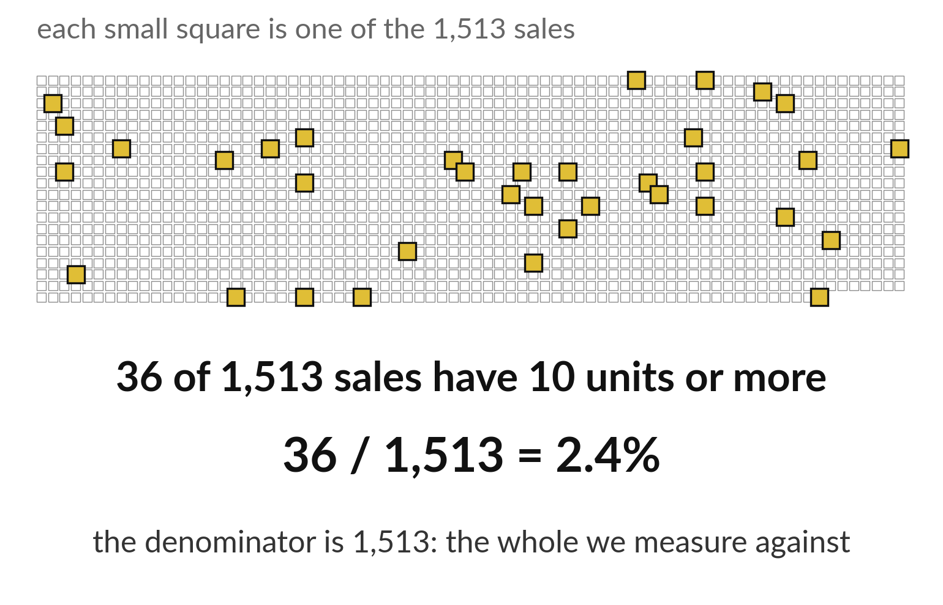
A proportion divides a part by its whole
The part goes on top.
The whole, the denominator, goes underneath.
Say which whole you divided by.
Notes:
A proportion tells you how big a part is compared with the whole. The part goes on top. The whole goes underneath, and that bottom number is called the denominator. In the picture the gold squares are the part and all the squares together are the whole.
The denominator is where mistakes hide. Central Market earns two million nine hundred and ninety seven thousand shillings out of six million three hundred and seventy five thousand nine hundred. Divide the first by the second to get its share.

Slide 20
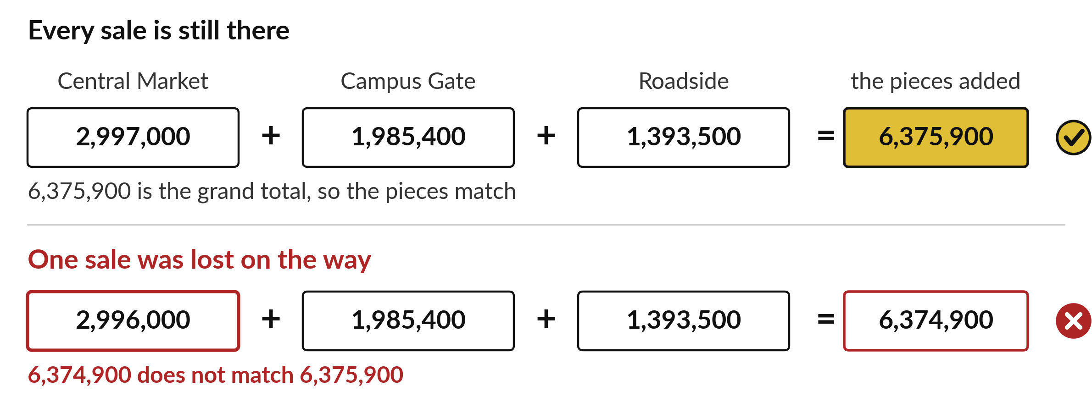
Branch totals must add up to the grand total
Add the pieces and compare with the total before grouping.
Notes:
After any grouping, add the pieces and compare with the total you got without grouping. The three branch totals are two million nine hundred and ninety seven thousand, one million nine hundred and eighty five thousand four hundred, and one million three hundred and ninety three thousand five hundred. They add up to six million three hundred and seventy five thousand nine hundred, which is the grand total.
If your pieces do not add up to the whole, something went wrong, and it is better to find that now than after the report is written.

Slide 21

Make: your own version
Add the line_value column and total it for each branch_id in the Sunrise sales. Sort the three totals from largest to smallest. Check that the three totals add up to the overall total.
Save it as DA09. Write two sentences: what you changed and how you checked it.
Notes:
Now you do the real work yourself. Start with the first step. If you get stuck for a few minutes, read your error message, check the error card, and then ask me.
Save it as DA09. I will come round to each of you and ask what you changed and how you checked it.

Slide 22

Two errors you may meet today
It means: You grouped a column that has not been created yet in this session.
Fix: Run the cell that creates the revenue column before the cell that groups it.
KeyError: 'revenue_ugx'
It means: Rows were lost or counted twice before grouping.
Fix: Compare len() before and after each step to find where rows changed.
The totals do not add to the overall total
Notes:
Two things are likely to go wrong today. It helps to know them before they happen.
This is the first one. You will see: KeyError: 'revenue_ugx'. It means this: you grouped a column that has not been created yet in this session. To fix it, Run the cell that creates the revenue column before the cell that groups it.
The next one. You will see: The totals do not add to the overall total. It means this: rows were lost or counted twice before grouping. To fix it, compare len() before and after each step to find where rows changed.
If you meet one of these, fix it and carry on. It happens to everyone.

Slide 23

Finish this sentence in your notebook
A grouped total answers a question about each group, and the median stays steady when a few sales are huge.
Then save your notebook, close it and open it again to check it saved.
Notes:
Before we finish, go back to the question we began with: Which item earns the most, and what is a typical sale in a small practice shop?
Copy this sentence into your notebook and make it yours. A grouped total answers a question about each group, and the median stays steady when a few sales are huge.
Then save your notebook, close it and open it again to check it saved.

