Slide 1
NumPy: the numbers underneath pandas
How spread out are the daily customer counts, and which sales are unusually large?
Python for Data Analysis | Session 13 of 24 | Week 5, Explore with NumPy and seaborn
Holiday Data and AI Camp | The National ICT Innovation Hub, Nakawa
Notes:
Let us begin. Today is session 13 and our topic is NumPy: the numbers underneath pandas.
By the end of today you will be able to turn a column into a NumPy array, calculate its mean, median, spread and percentiles, and find unusually large values.
We will answer one question: How spread out are the daily customer counts, and which sales are unusually large?

Slide 2
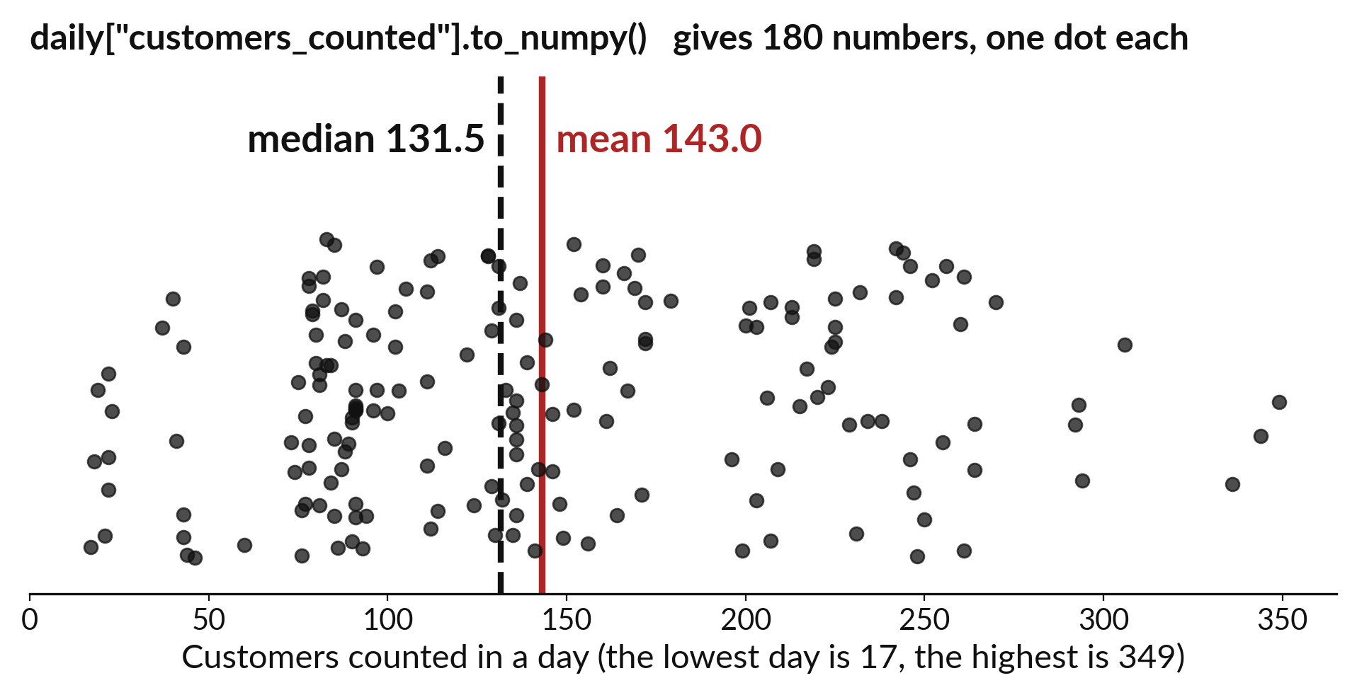
How spread out are the daily customer
counts, and which sales are unusually large?
Notes:
Two questions today. How spread out are the daily customer counts, and which sales are unusually large? Over the sixty days the shops counted on average one hundred and forty three customers, but some days were much quieter and some much busier. And among the sales, a handful are far larger than the rest. To measure spread and spot the outliers we use NumPy, the number tools that pandas is built on.

Slide 3

Three hours, mostly doing
Most of our time is spent doing, in small steps, with a guess before every run.
Notes:
Here is how the 3 hours go. Each bar is as long as the time we spend on that part.
First, 10 minutes. Recall. Then, 50 minutes. Block A. After that, 15 minutes. Break away from screens. Next, 50 minutes. Block B. Then, 40 minutes. Make. Then, 15 minutes. Exit ticket, save, and an individual check with each learner.
Notice how much of the time is yours. You listen for a short while and then you do. That is on purpose, because you learn this by doing it.

Slide 4
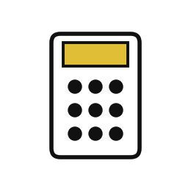
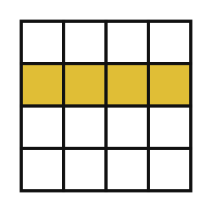
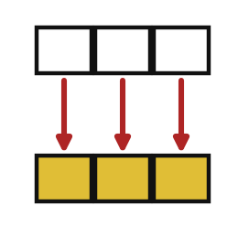
Words for today (1 of 2)
NumPy
The library of fast number tools that pandas is built on. We load it as np.
The calculator inside the register.
array
A row of numbers that NumPy can calculate with all at once.
A strip of numbers on a ruler.
element-wise
Doing the same calculation to every number in an array at once.
Adding 100 shillings to every price on the board.
Notes:
First the words, because every one of them is used in the code later.
NumPy. The library of fast number tools that pandas is built on. We load it as np. Think of a shop. The calculator inside the register.
array. A row of numbers that NumPy can calculate with all at once. Imagine it like this. A strip of numbers on a ruler.
element-wise. Doing the same calculation to every number in an array at once. An example from everyday life. Adding 100 shillings to every price on the board.

Slide 5
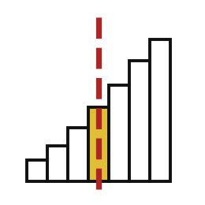
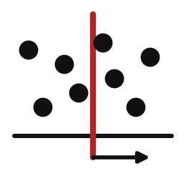

Words for today (2 of 2)
percentile
The value below which a given share of the numbers fall.
The mark that 75 out of 100 pupils did not beat.
standard deviation
A number for how far values typically sit from their mean.
How far pupils usually stand from the middle of the line.
outlier
A value far from the rest.
One huge order in a week of small sales.
Notes:
Here are the rest of today's words.
percentile. The value below which a given share of the numbers fall. Here is a way to see it. The mark that 75 out of 100 pupils did not beat.
standard deviation. A number for how far values typically sit from their mean. A small example. How far pupils usually stand from the middle of the line.
outlier. A value far from the rest. Picture this. One huge order in a week of small sales.

Slide 6
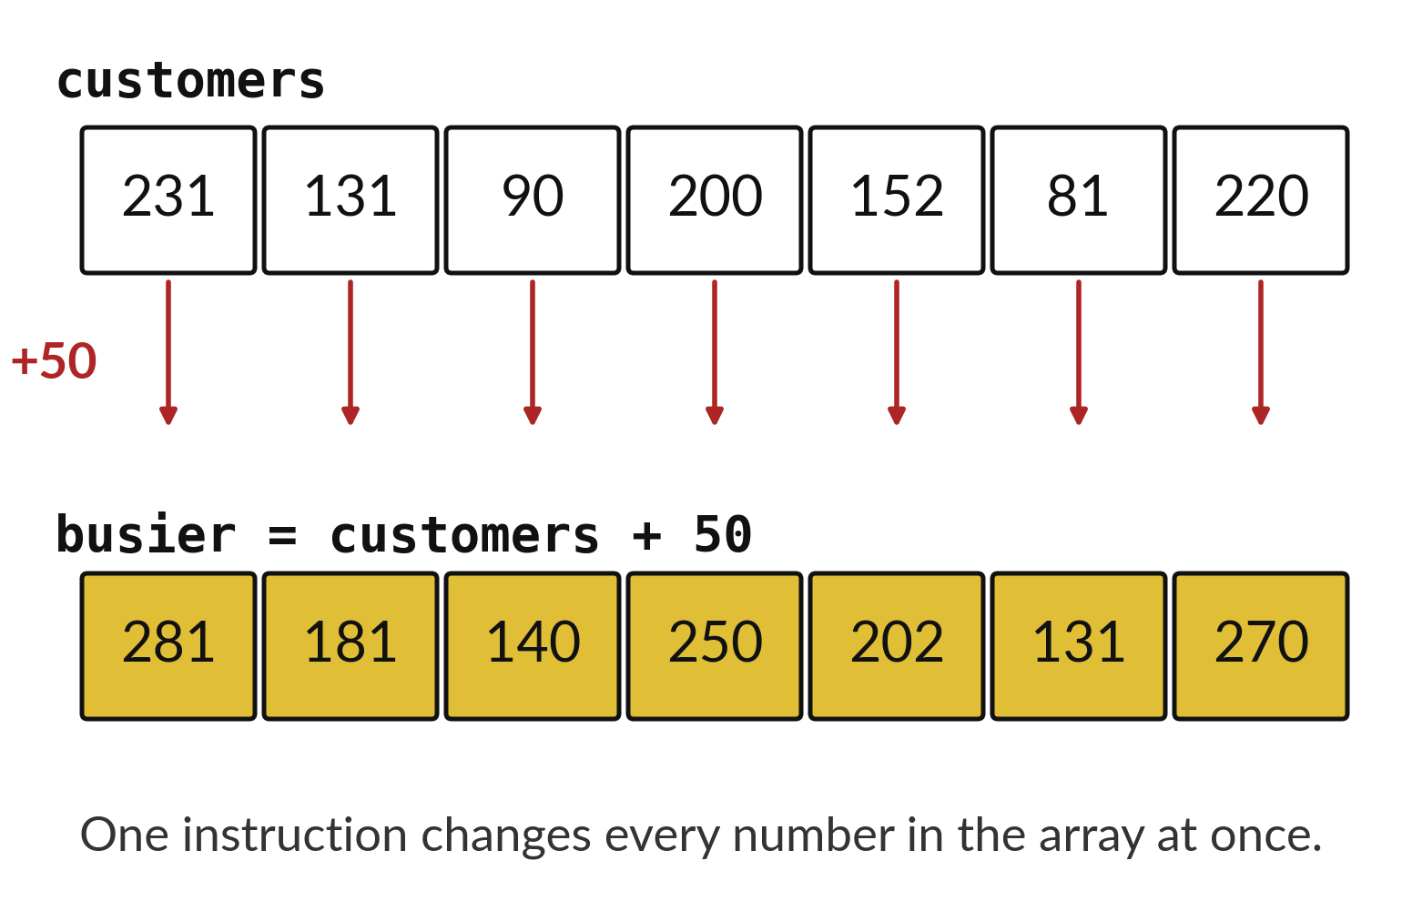
NumPy works on a whole
array of numbers at once
Each box holds one number.
One instruction acts on every box.
Every element changes by the same rule.
Notes:
An array is a row of numbers, like a strip of boxes on a ruler. NumPy can act on the whole strip with one instruction. If we add fifty customers to every day in the array, every box rises by fifty. We do not write a loop. NumPy does the work box by box, and it does it fast.
The word for this is element-wise. Each element is changed by the same rule, and you see it in the picture: seven boxes go in, seven changed boxes come out.

Slide 7
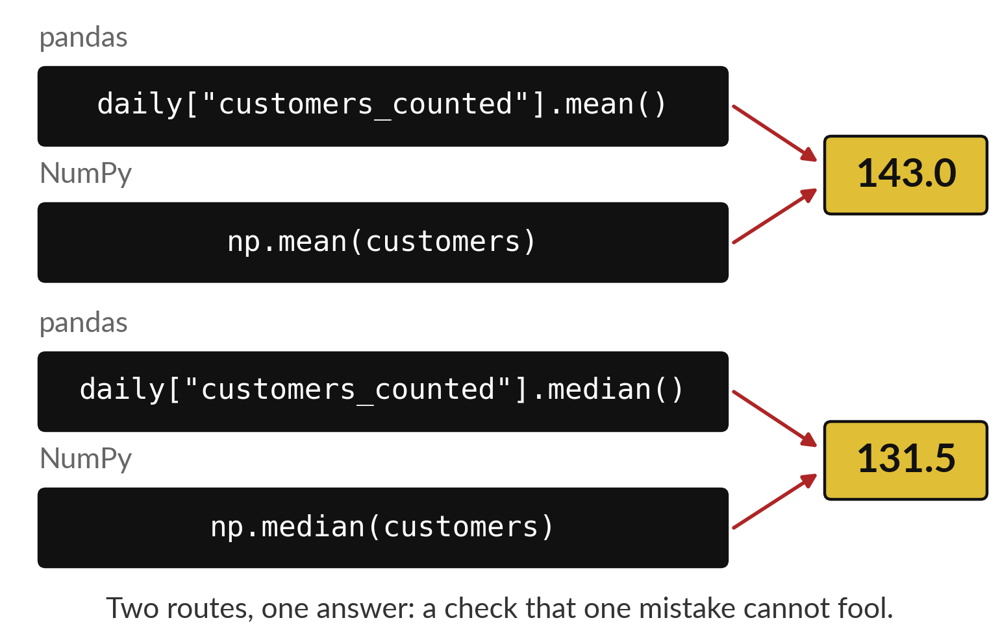
NumPy and pandas reach
the same answer two ways
pandas works on named columns.
NumPy works on bare arrays.
Both must agree on the mean and the median.
Notes:
pandas columns are built on top of NumPy arrays, so the two can reach the same answer by different routes. With pandas we name the column and ask for the mean. With NumPy we turn the column into an array and call the NumPy function.
The two numbers should agree. If they differ only in the last decimal places, that is rounding, and it is nothing to worry about.

Slide 8

Predict: Arrays, summaries and percentiles
import numpy as np
import pandas as pd
daily = pd.read_csv("sunrise_daily_summary.csv")
customers = daily["customers_counted"].to_numpy()
print(customers.shape)
print(round(np.mean(customers), 1), np.median(customers))
print(np.percentile(customers, [25, 75]))
print(customers.max() - customers.min())
print(np.mean(customers) == daily["customers_counted"].mean())
Predict whether the mean or the median of the daily counts is bigger.
Write your guess on paper before we run it.
Notes:
Each shop counted its customers every day for 60 days: 180 counts in all. .to_numpy() turns a column into an array.
Make a prediction. Predict whether the mean or the median of the daily counts is bigger. Put it on paper first. We will check it together in a moment.

Slide 9
Run it: Arrays, summaries and percentiles
(180,)
143.0 131.5
[ 86.75 203.75]
332
True
The array has shape (180,).
The mean is 143.0 and the median 131.5, so the mean is bigger.
The 25th and 75th percentiles are 86.75 and 203.75: a quarter of the days had fewer than 87 customers and a quarter had more than 204.
Notes:
Running it now. Match each line of the output with the line of code that made it.
The array has shape (180,). The mean is 143.0 and the median 131.5, so the mean is bigger. The 25th and 75th percentiles are 86.75 and 203.75: a quarter of the days had fewer than 87 customers and a quarter had more than 204. The range is 332. The last line prints True, because pandas and NumPy give the same mean.
Keep your guess. We use it in the next step.

Slide 10

Investigate: Arrays, summaries and percentiles
1. Why are the mean and the median different here?
2. What do the two percentiles tell the owner?
Notes:
Now we look closely at arrays, summaries and percentiles. I have two questions for you.
Question one. Why are the mean and the median different here? Talk it over with your neighbour for a minute.
Let me answer it. Three shops of very different sizes are in the same column. The busy shop pulls the mean up.
Question two. What do the two percentiles tell the owner? Think about it for a moment, then tell the person next to you.
The answer is this. Half of all shop-days fall between 87 and 204 customers. That is the usual range of a day.

Slide 11

Modify: change one thing
Add 50 to every count at once and print the new mean.
Then tell your neighbour what changed and how you know.
Notes:
Make one small change. Add 50 to every count at once and print the new mean. After you run it, say in one sentence what changed and how you checked.
You should see this. 193.0.

Slide 12

Break
15 minutes away from your screen
Stand up. Drink some water. Tell someone what you guessed in the first half.
Notes:
Break time. 15 minutes away from your screens. Stand up, drink some water and tell someone what you guessed in the first half.
When we come back we start the second idea.

Slide 13
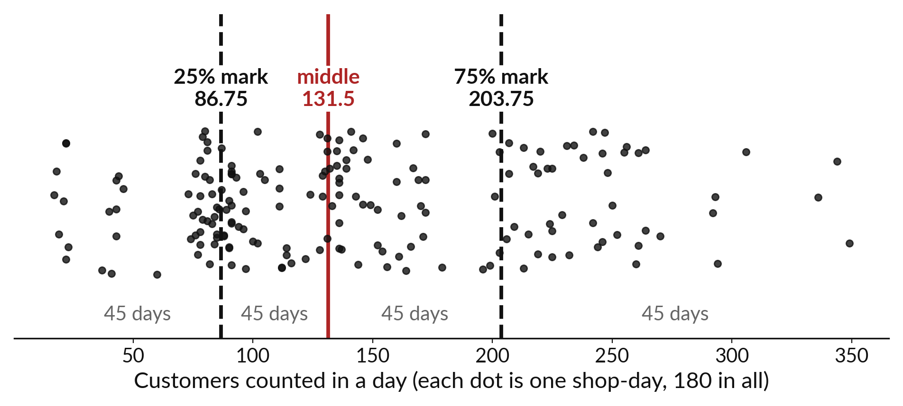
Percentiles split the sorted values into parts
For customers, the quartiles are 86.75 and 203.75 and the median is 131.5.
Notes:
Line up the daily customer counts from smallest to largest. The twenty fifth percentile is the value that a quarter of the days fall below. For us that is eighty six point seven five customers. The median is the middle, one hundred and thirty one point five. The seventy fifth percentile is two hundred and three point seven five, the value that three quarters of the days fall below.
The gap between the first and third quartile holds the middle half of the days. That gap is a fair measure of the usual spread.

Slide 14
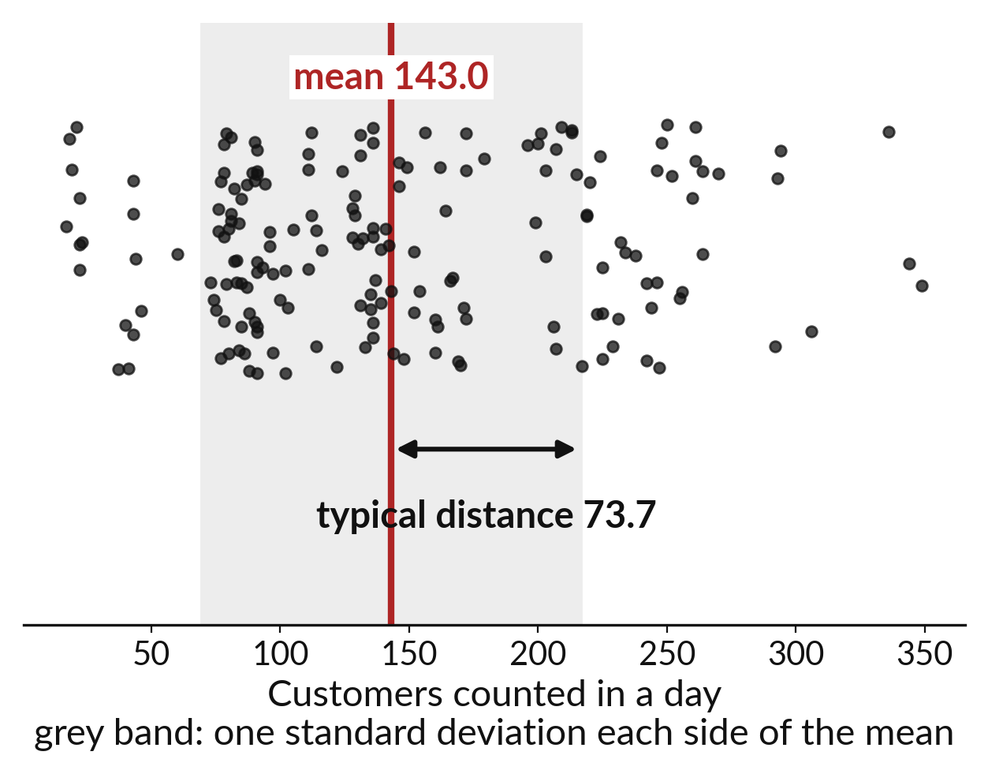
Standard deviation is the typical gap to the mean
Each day sits some distance from the mean.
The standard deviation is the typical size of that distance.
For customers it is 73.7.
Notes:
The standard deviation answers a plain question. How far, on a typical day, is the customer count from the mean? The mean is one hundred and forty three. The standard deviation is seventy three point seven, so a typical day is about seventy four customers above or below the mean.
A small standard deviation means the days are all alike. A big one means the days vary a lot.

Slide 15
Predict: Spread and outliers
sunrise = pd.read_csv("sunrise_sales.csv")
values = (
sunrise["units"] * sunrise["unit_price_ugx"]
).to_numpy()
q1, q3 = np.percentile(values, [25, 75])
fence = q3 + 1.5 * (q3 - q1)
big = values[values > fence]
print(q1, q3, fence)
print(len(big), big.max())
print(round(np.std(customers), 1))
Predict how many of the 1513 sales are unusually large by that rule.
Write your guess on paper before we run it.
Notes:
The standard deviation says how far values usually sit from their mean. A common rule marks a value as an outlier when it is more than 1.5 times the gap between the quartiles above the upper quartile.
Time to commit to an answer. Predict how many of the 1513 sales are unusually large by that rule. Put your guess on paper now, even if you are unsure.

Slide 16
Run it: Spread and outliers
1200.0 4500.0 9450.0
137 108000
73.7
The quartiles are 1200 and 4500, so the fence is 9450.
137 of the 1513 sales are above it, and the largest is 108000.
The standard deviation of the daily customer counts is 73.7.
A few large sales sit far out.
Notes:
Now we run it. Match each line of the output with the line of code that made it.
The quartiles are 1200 and 4500, so the fence is 9450. 137 of the 1513 sales are above it, and the largest is 108000. The standard deviation of the daily customer counts is 73.7. A few large sales sit far out. They are real sales, so we report them and do not delete them.
If your guess was off, find the line that surprised you.

Slide 17
Investigate: Spread and outliers
1. Should we delete the 137 outliers?
2. What does a standard deviation of 73.7 customers tell us?
Notes:
Now we look closely at spread and outliers. I have two questions for you.
Question one. Should we delete the 137 outliers? Think about it for a moment, then tell the person next to you.
The answer is this. No. They are real sales, mostly bulk purchases. We report them and say that they pull the mean up.
Question two. What does a standard deviation of 73.7 customers tell us? Have a go in your head first.
Daily counts typically sit about 74 customers from the mean of 143.

Slide 18
Modify: change one thing
Count the sales with a value above 20000.
Then tell your neighbour what changed and how you know.
sunrise = pd.read_csv(
"sunrise_sales.csv"
)
values = (
sunrise["units"] * sunrise[
"unit_price_ugx"
]
).to_numpy()
q1, q3 = np.percentile(
values, [25, 75]
)
fence = q3 + 1.5 * (q3 - q1)
big = values[values > fence]
print(q1, q3, fence)
print(len(big), big.max())
print(round(np.std(customers), 1))
Notes:
Now it is your turn to change something. Count the sales with a value above 20000. Then explain to your neighbour what the change did.
The result: A small number that stays unusual.

Slide 19
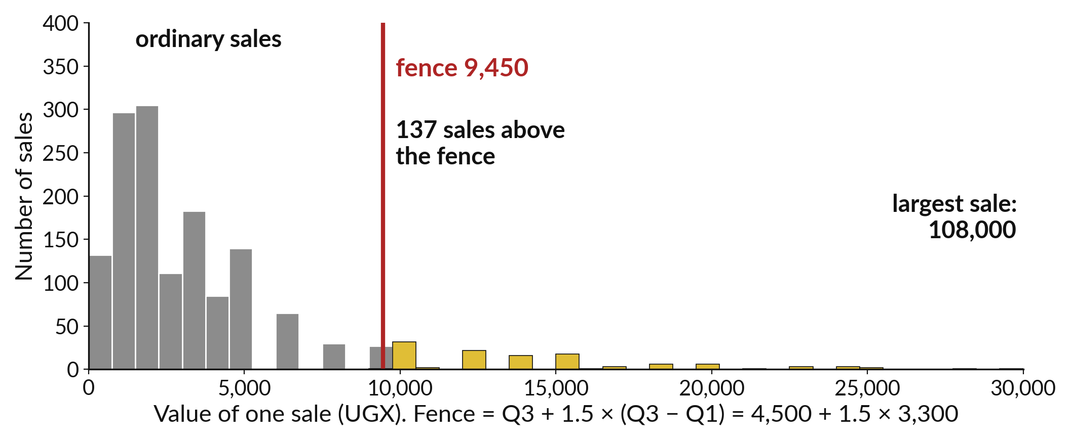
A fence at 9,450 flags 137 unusually large sales
Fence: the third quartile plus one and a half times the quartile gap.
Notes:
How big is unusually big? We use a fence. Take the third quartile, four thousand five hundred shillings, and add one and a half times the distance between the quartiles. That puts the fence at nine thousand four hundred and fifty shillings. One hundred and thirty seven sales land above it, and the largest is one hundred and eight thousand.
An outlier is a value to look at before you decide anything. Check whether the sale is real.

Slide 20

Make: your own version
Take the revenue_ugx column of the daily summary as a NumPy array. Find its mean, median and the 25th and 75th percentiles with NumPy. Then find the same four numbers with pandas and check that the two routes agree.
Save it as DA13. Write two sentences: what you changed and how you checked it.
Notes:
This task is yours. Run your code after every step so you can see where a problem begins. If you get stuck for a few minutes, read your error message, check the error card, and then ask me.
Save it as DA13. I will come round to each of you and ask what you changed and how you checked it.

Slide 21

Two errors you may meet today
It means: shape is a value you read. It takes no brackets, and brackets try to call it like a function.
Fix: Remove the brackets after shape.
TypeError: 'tuple' object is not callable
It means: Decimals are stored with tiny rounding differences.
Fix: Compare with np.allclose, or round both to the same number of places.
The mean from NumPy and pandas differ in the last digits
Notes:
Here are two errors from this session, so you recognise them when they appear.
This is the first one. You will see: TypeError: 'tuple' object is not callable. It means this: shape is a value you read. It takes no brackets, and brackets try to call it like a function. To fix it, remove the brackets after shape.
The next one. You will see: The mean from NumPy and pandas differ in the last digits. It means this: decimals are stored with tiny rounding differences. To fix it, compare with np.allclose, or round both to the same number of places.
When you are stuck, read the last line of the message first.

Slide 22

Finish this sentence in your notebook
NumPy gives me the numbers underneath a column, and an outlier is a real value I report, not one I delete.
Then save your notebook, close it and open it again to check it saved.
Notes:
Last step. Our question for today was: How spread out are the daily customer counts, and which sales are unusually large?
Finish this sentence in your notebook, in your own words. NumPy gives me the numbers underneath a column, and an outlier is a real value I report, not one I delete.
Then save your notebook, close it and open it again to check it saved.

