Slide 1
Exploring distributions with seaborn
What does a typical sale look like, and does it differ between the three shops?
Python for Data Analysis | Session 14 of 24 | Week 5, Explore with NumPy and seaborn
Holiday Data and AI Camp | The National ICT Innovation Hub, Nakawa
Notes:
Here we go. Today is session 14 and our topic is exploring distributions with seaborn.
By the end of today you will be able to draw a histogram and a box plot with seaborn and describe the shape, the middle and the outliers of a column.
We will answer one question: What does a typical sale look like, and does it differ between the three shops?

Slide 2
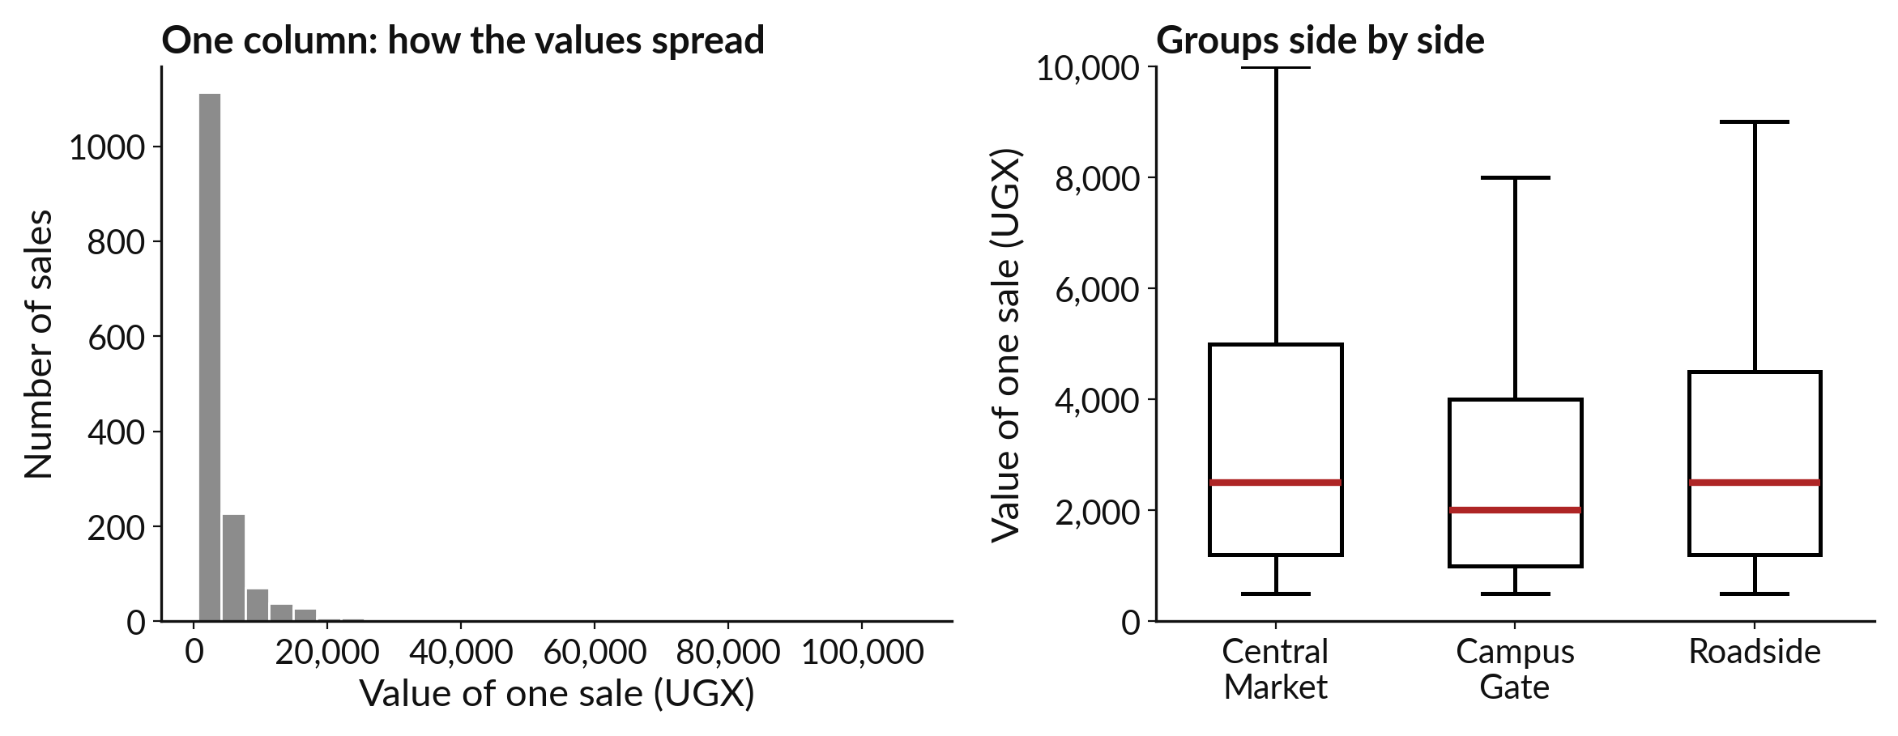
What does a typical sale look like, and
does it differ between the three shops?
Notes:
What does a typical sale look like, and does it differ between the three shops? A single average cannot answer that, because sales come in many sizes. We need to see the whole shape of the values, and then see it again for each shop. Today we draw histograms and box plots with a library called seaborn, which makes these pictures in one line, and we look for the differences.

Slide 3

Three hours, mostly doing
Most of our time is spent doing, in small steps, with a guess before every run.
Notes:
Here is how the 3 hours go. Each bar is as long as the time we spend on that part.
First, 10 minutes. Recall. Then, 50 minutes. Block A. After that, 15 minutes. Break away from screens. Next, 50 minutes. Block B. Then, 40 minutes. Make. Then, 15 minutes. Exit ticket, save, and an individual check with each learner.
Notice how much of the time is yours. You listen for a short while and then you do. That is on purpose, because you learn this by doing it.

Slide 4

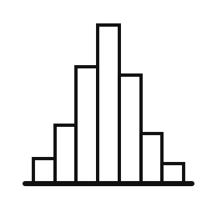
Words for today (1 of 2)
seaborn
A library that draws statistical charts. It sits on top of matplotlib and takes a DataFrame directly.
A set of ready-made stencils for charts.
exploratory analysis
Looking at the data from several sides to see what is there before you answer a question.
Walking round a shop before you count the stock.
distribution
How the values of one column are spread out.
How the pupils spread across height bands.
Notes:
We need a few words today. For each one I will say what it means and give you something to picture.
seaborn. A library that draws statistical charts. It sits on top of matplotlib and takes a DataFrame directly. Here is a way to see it. A set of ready-made stencils for charts.
exploratory analysis. Looking at the data from several sides to see what is there before you answer a question. A small example. Walking round a shop before you count the stock.
distribution. How the values of one column are spread out. Picture this. How the pupils spread across height bands.

Slide 5

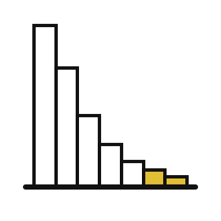
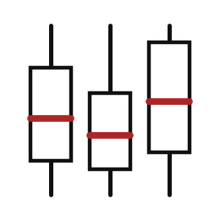
Words for today (2 of 2)
box plot
A box from the lower to the upper quartile with a line at the median and dots for outliers.
A five-number summary drawn as a picture.
skewed
Bunched at one end with a long tail at the other.
Most pupils short and a few very tall.
group comparison
Drawing the same chart for each group side by side.
Comparing the three shops on one page.
Notes:
More words for today.
box plot. A box from the lower to the upper quartile with a line at the median and dots for outliers. You have seen this before. A five-number summary drawn as a picture.
skewed. Bunched at one end with a long tail at the other. Most pupils short and a few very tall.
group comparison. Drawing the same chart for each group side by side. Think of a shop. Comparing the three shops on one page.

Slide 6
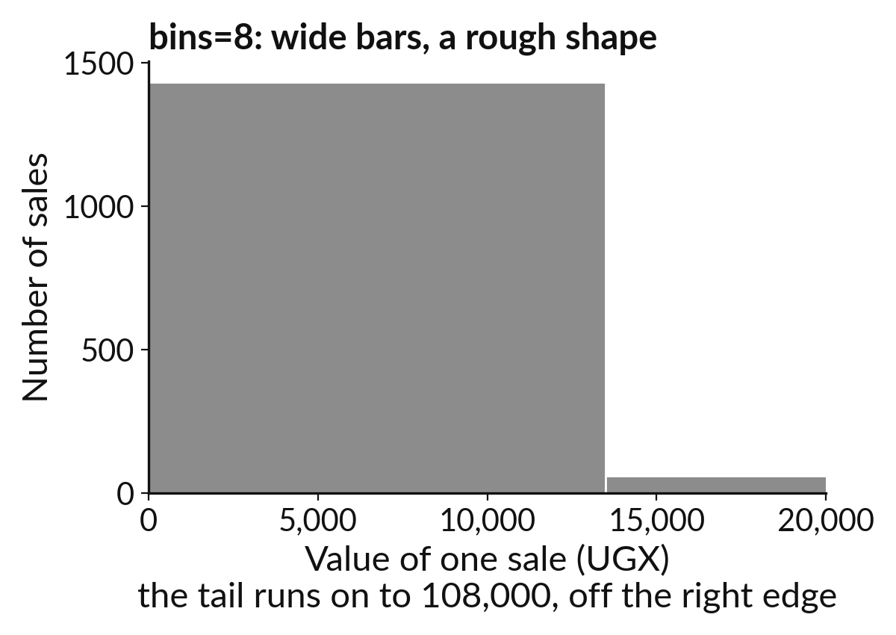
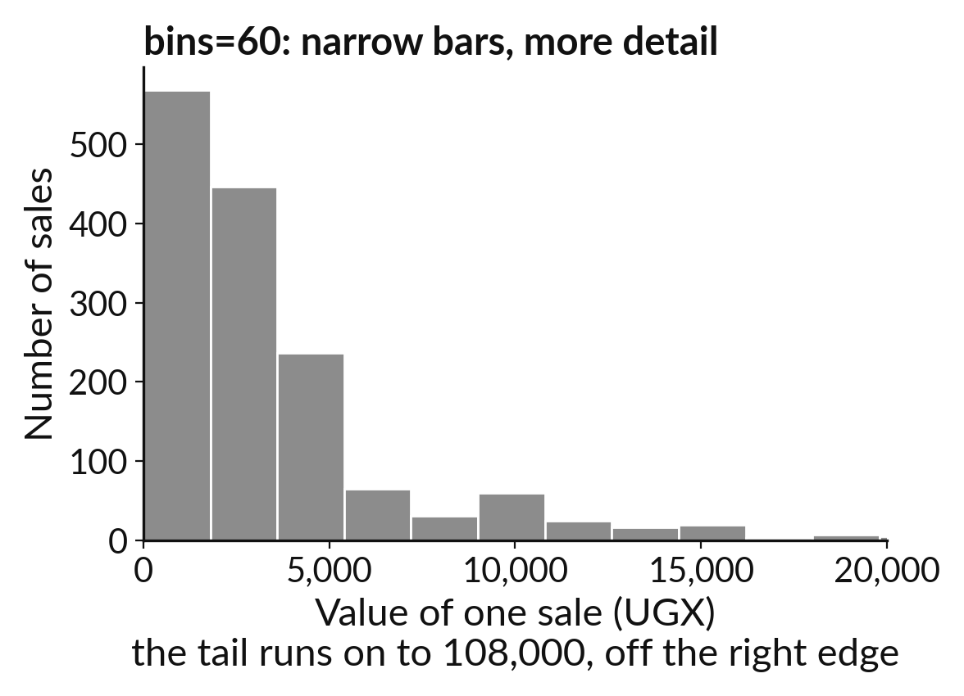
The bin count decides how much shape you see
8 bins: wide bars give a rough shape.
60 bins: narrow bars give more detail.
Notes:
A histogram sorts the values into ranges called bins. On the left we used eight wide bins, so we only see a rough shape. On the right we used sixty narrow bins, and we see much more detail, including some jumps that the wide bars hid.
There is no single right number of bins. Try a few, and pick the one that shows the shape clearly without turning it into noise.

Slide 7
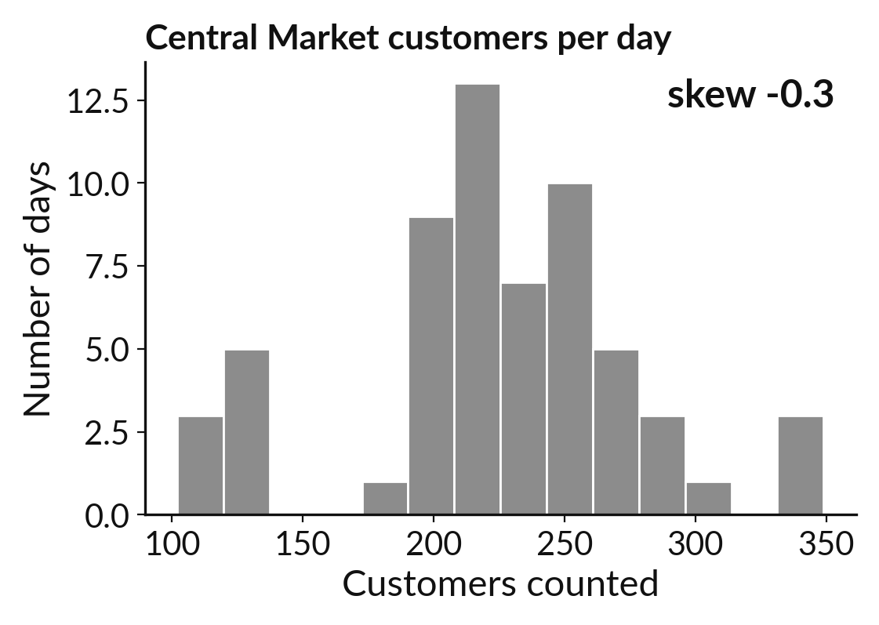
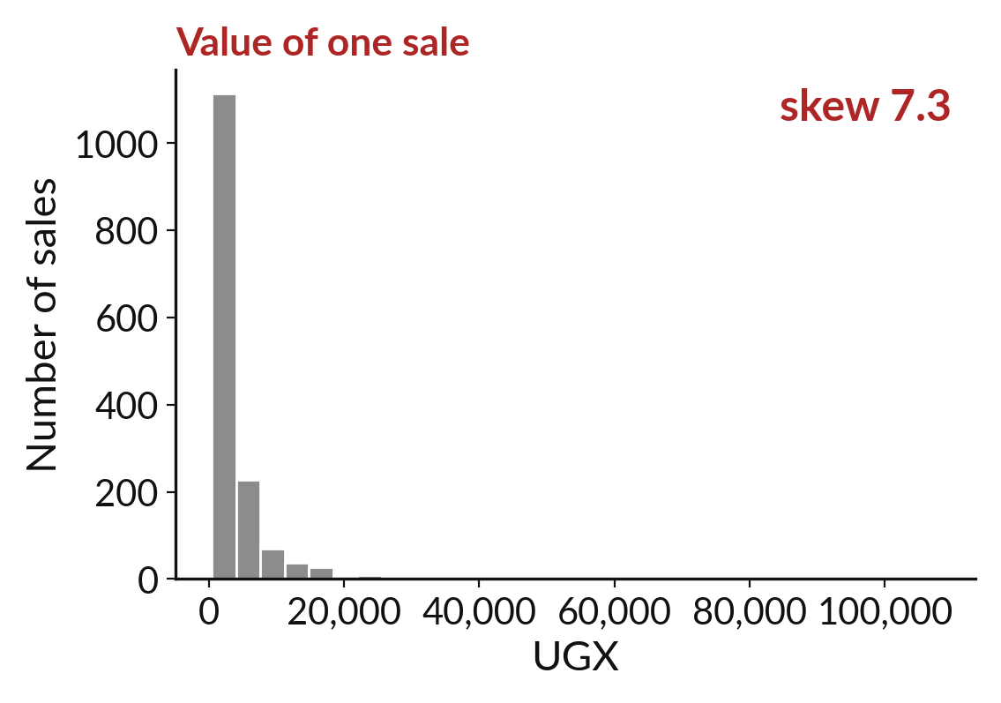
A skewed distribution has a long tail on one side
Balanced: the mean and median are close together.
Skewed: a long tail pulls the mean away from the median.
Notes:
Two distributions. On the left the values spread about equally on both sides of the middle, and the mean and the median are close. We call it balanced. On the right most values are small and a few are very large. That long tail pulls the mean away from the median.
The line value of a sale is skewed, with a skewness of about seven. When you see this shape, choose the median.

Slide 8

Predict: A histogram of sale values (1 of 2)
import pandas as pd
import seaborn as sns
import matplotlib.pyplot as plt
sunrise = pd.read_csv("sunrise_sales.csv")
sunrise["line_value"] = sunrise["units"] * sunrise["unit_price_ugx"]
Read the first part of the code. 5 lines. Say what each one does.
The second part comes next.
Notes:
Read this first part of the code with me before we run anything. ['sns.histplot draws a histogram from a DataFrame.', 'Name the DataFrame in data= and the column in x=.', 'A map turns branch ids into names.']

Slide 9
Predict: A histogram of sale values (2 of 2)
sunrise["branch"] = sunrise["branch_id"].map(
{1: "Central Market", 2: "Campus Gate", 3: "Roadside"}
)
sns.histplot(data=sunrise, x="line_value", bins=30)
plt.xlabel("Value of one sale (UGX)")
plt.show()
print(round(sunrise["line_value"].skew(), 1))
Predict whether the histogram is balanced or skewed to the right.
Write your guess on paper before we run it.
Notes:
sns.histplot draws a histogram from a DataFrame. Name the DataFrame in data= and the column in x=.
Now your guess. Predict whether the histogram is balanced or skewed to the right. Put your guess on paper now, even if you are unsure.

Slide 10
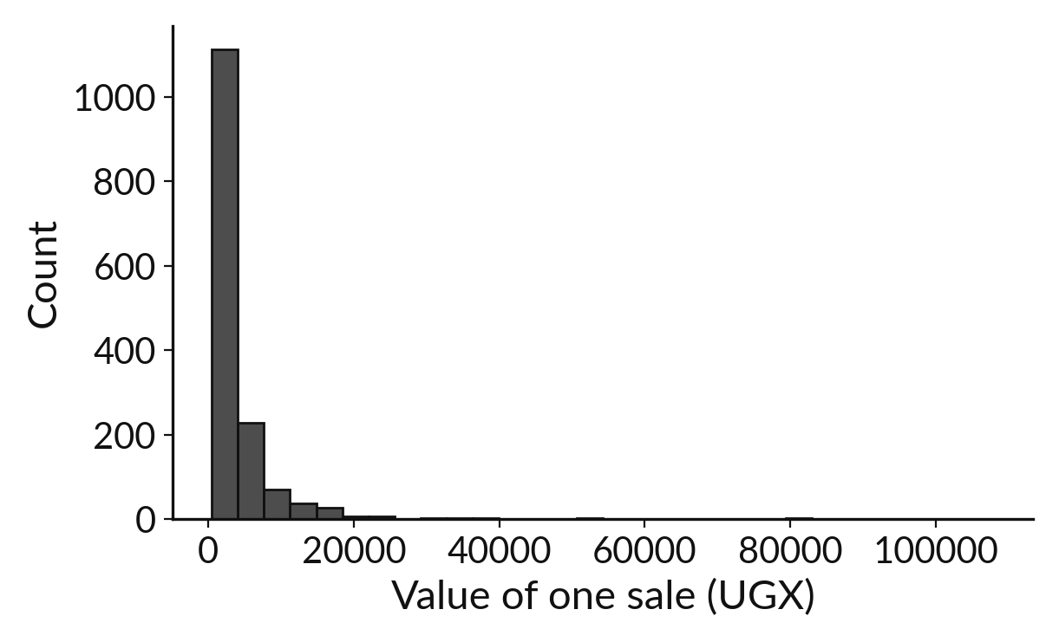
Run it: A histogram of sale values
The histogram is bunched at the low end with a long tail to the right.
The skew is 7.3.
A positive skew above 1 means a long right tail.
Most sales are small and a few are large.
Notes:
Watch the output as it appears. Match each line of the output with the line of code that made it.
The histogram is bunched at the low end with a long tail to the right. The skew is 7.3. A positive skew above 1 means a long right tail. Most sales are small and a few are large.
Tell the person next to you whether your guess matched.

Slide 11

Investigate: A histogram of sale values
1. What does the long right tail mean for the mean and the median?
2. What does exploratory analysis do that a single total does not?
Notes:
Now we look closely at A histogram of sale values. I have two questions for you.
Question one. What does the long right tail mean for the mean and the median? Think about it for a moment, then tell the person next to you.
Here is how I would answer it. The tail pulls the mean above the median. The median is the better description of a typical sale.
Question two. What does exploratory analysis do that a single total does not? Have a go in your head first.
What I would say is this. It shows the shape of the data, so we see the bulk purchases that one total hides.

Slide 12

Modify: change one thing
Draw the histogram again with bins=60 and say what changes.
Then tell your neighbour what changed and how you know.
Notes:
Your hands on the keyboard now. Draw the histogram again with bins=60 and say what changes. Run it, then tell someone what you saw.
What you should find: The bars get narrower and the long tail shows more detail.

Slide 13

Break
15 minutes away from your screen
Stand up. Drink some water. Tell someone what you guessed in the first half.
Notes:
Break time. 15 minutes away from your screens. Stand up, drink some water and tell someone what you guessed in the first half.
When we come back we start the second idea.

Slide 14
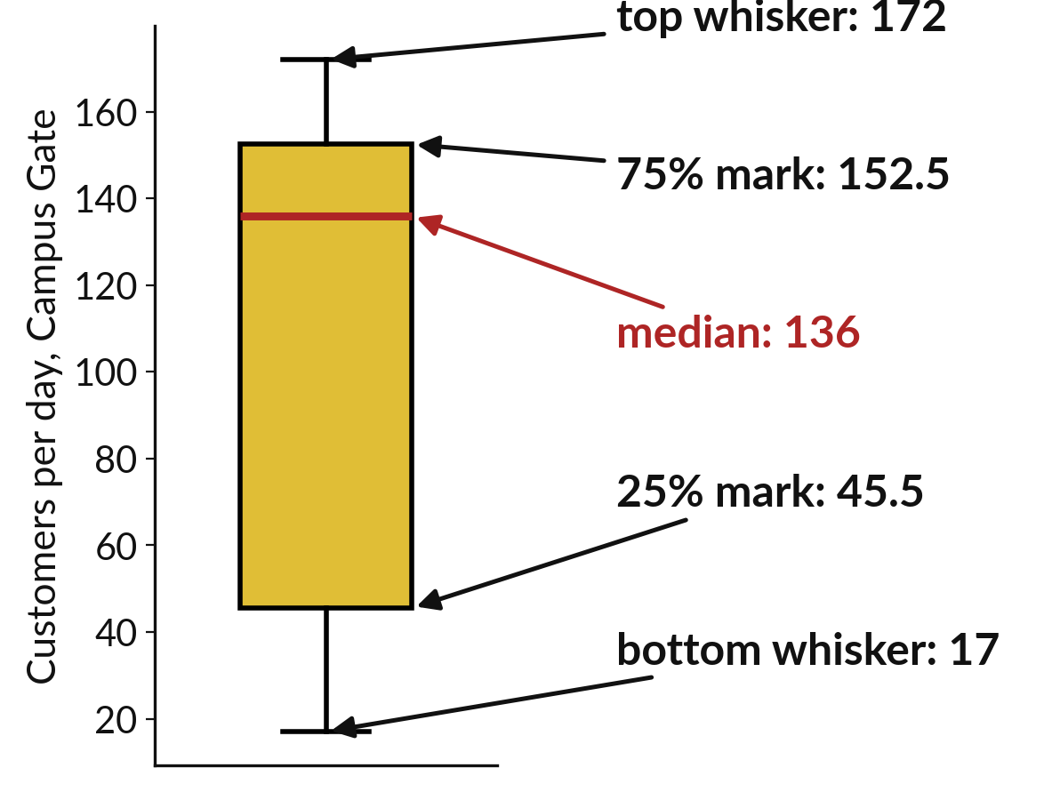
A box plot packs the median
and quartiles into a box
The box holds the middle half of the values.
The line inside the box is the median.
Dots beyond the whiskers are outliers.
Notes:
A box plot is a histogram folded into a small shape. The box runs from the first quartile to the third, so it holds the middle half of the values. The line inside the box is the median. The whiskers reach out toward the smallest and largest values that are not outliers, and any dots beyond the whiskers are the unusual ones.
Find the median, the box and one outlier on the picture.

Slide 15
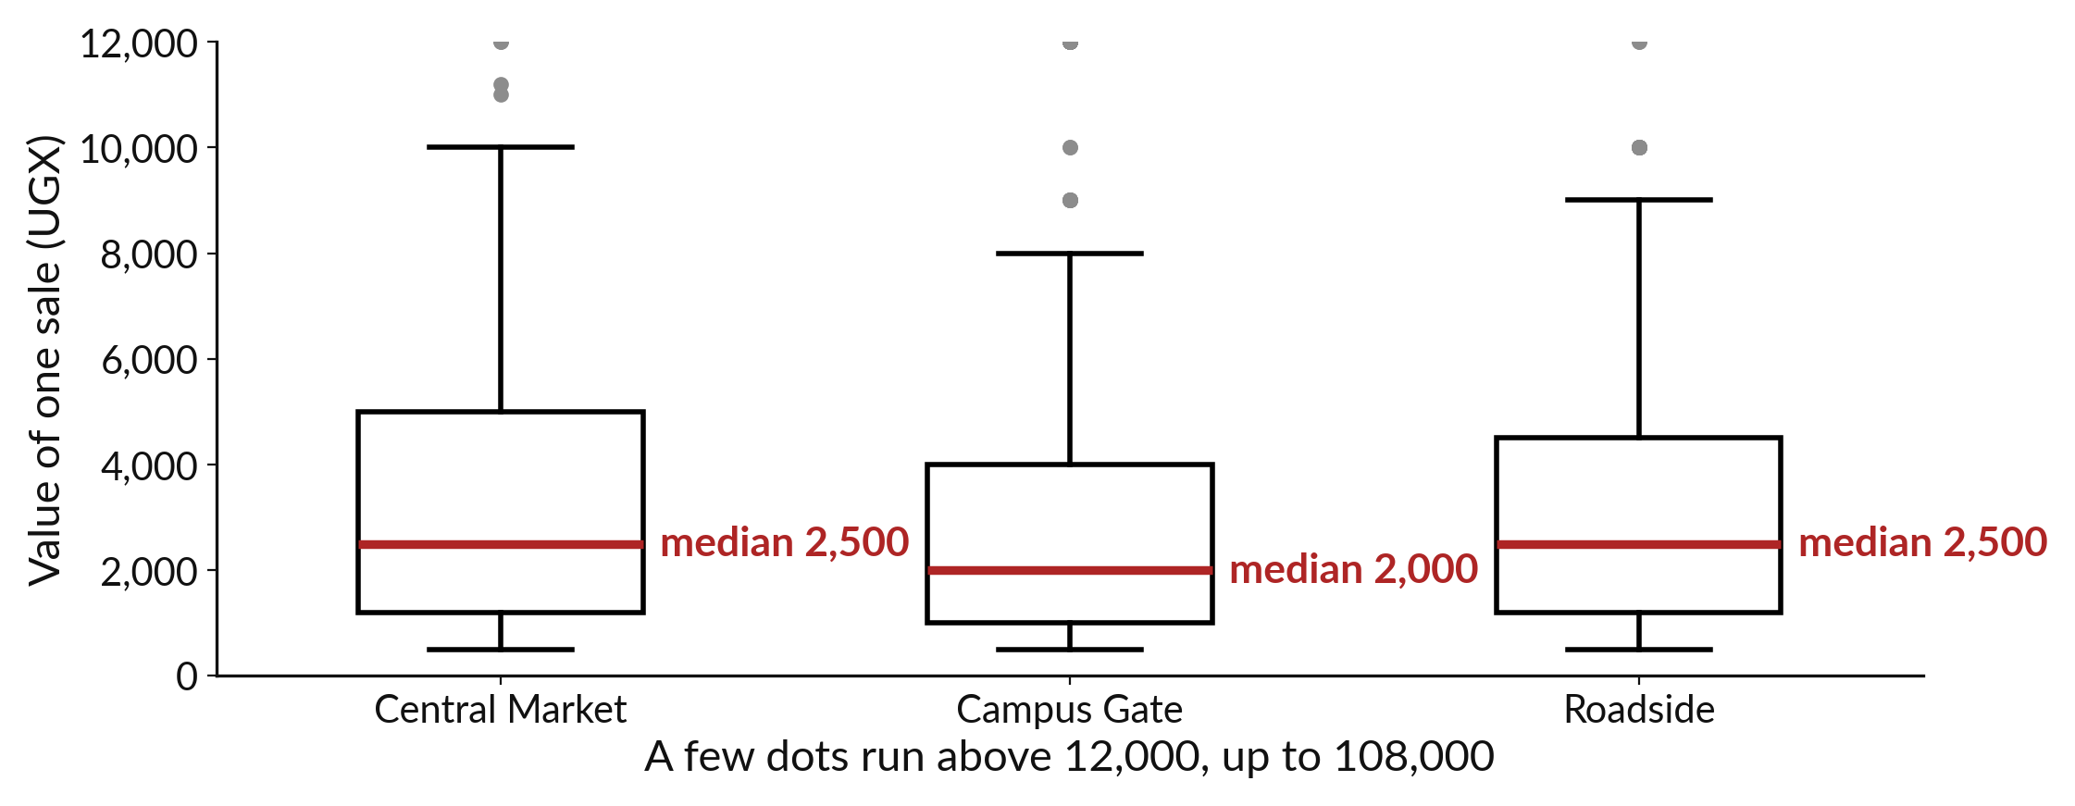
Box plots put the three shops side by side
One box for each shop makes the comparison in one glance.
Notes:
Now we draw one box for each shop on the same axis. The reader can compare the three medians, the three spreads and the outliers in a single glance, without reading a table. The median sale is two thousand five hundred at Central Market, two thousand at Campus Gate and two thousand five hundred at Roadside.
Look at where the lines in the boxes sit, and at how tall the boxes are. A taller box means more variety in that shop. A few very large sales are drawn as dots above the boxes, and the largest is one hundred and eight thousand.

Slide 16

Predict: A box plot for each shop
sns.boxplot(data=sunrise, x="branch", y="line_value")
plt.ylabel("Value of one sale (UGX)")
plt.show()
medians = sunrise.groupby("branch")["line_value"].median()
print(medians)
Predict which shop has the highest median sale.
Write your guess on paper before we run it.
Notes:
sns.boxplot draws one box for each group. The line inside the box is the median.
This is the part where you decide. Predict which shop has the highest median sale. Write one line on paper. I will give you a minute.

Slide 17
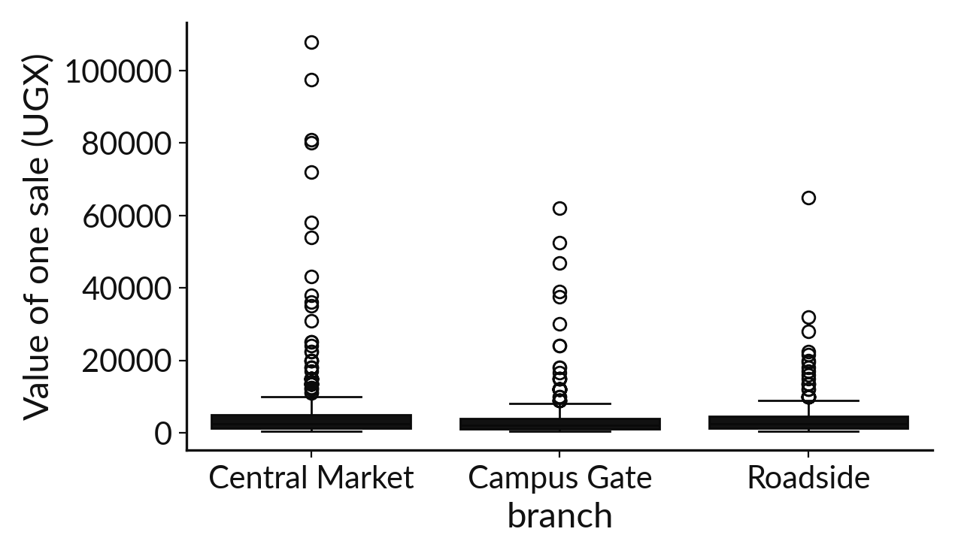
Run it: A box plot for each shop
The medians are 2500 at Central Market, 2000 at Campus Gate and 2500 at Roadside.
The boxes look alike and every shop has dots well above its whiskers: bulk sales happen in all three.
Notes:
Let us see what happens. Match each line of the output with the line of code that made it.
The medians are 2500 at Central Market, 2000 at Campus Gate and 2500 at Roadside. The boxes look alike and every shop has dots well above its whiskers: bulk sales happen in all three. The shops differ more in how many sales they make than in how big a typical sale is.
Which line of the output matches which line of the code? Point to each pair.

Slide 18
Investigate: A box plot for each shop
1. Do the shops differ much in typical sale value?
2. What do the dots above each box show?
sns.boxplot(
data=sunrise, x="branch",
y="line_value"
)
plt.ylabel(
"Value of one sale (UGX)"
)
plt.show()
medians = sunrise.groupby(
"branch"
)["line_value"].median()
print(medians)
Notes:
Now we look closely at A box plot for each shop. I have two questions for you.
Question one. Do the shops differ much in typical sale value? Have a go in your head first.
What I would say is this. Not much. Two medians are 2500 and one is 2000.
Question two. What do the dots above each box show? Write your answer in one line before we compare.
Let me answer it. Unusually large sales. They exist at all three shops.

Slide 19
Modify: change one thing
Use the box plot to compare the units column across shops. Print the median units for each shop.
Then tell your neighbour what changed and how you know.
Notes:
Change one thing and watch what happens. Use the box plot to compare the units column across shops. Print the median units for each shop. After you run it, say in one sentence what changed and how you checked.
You should see this. A similar median at each shop.

Slide 20
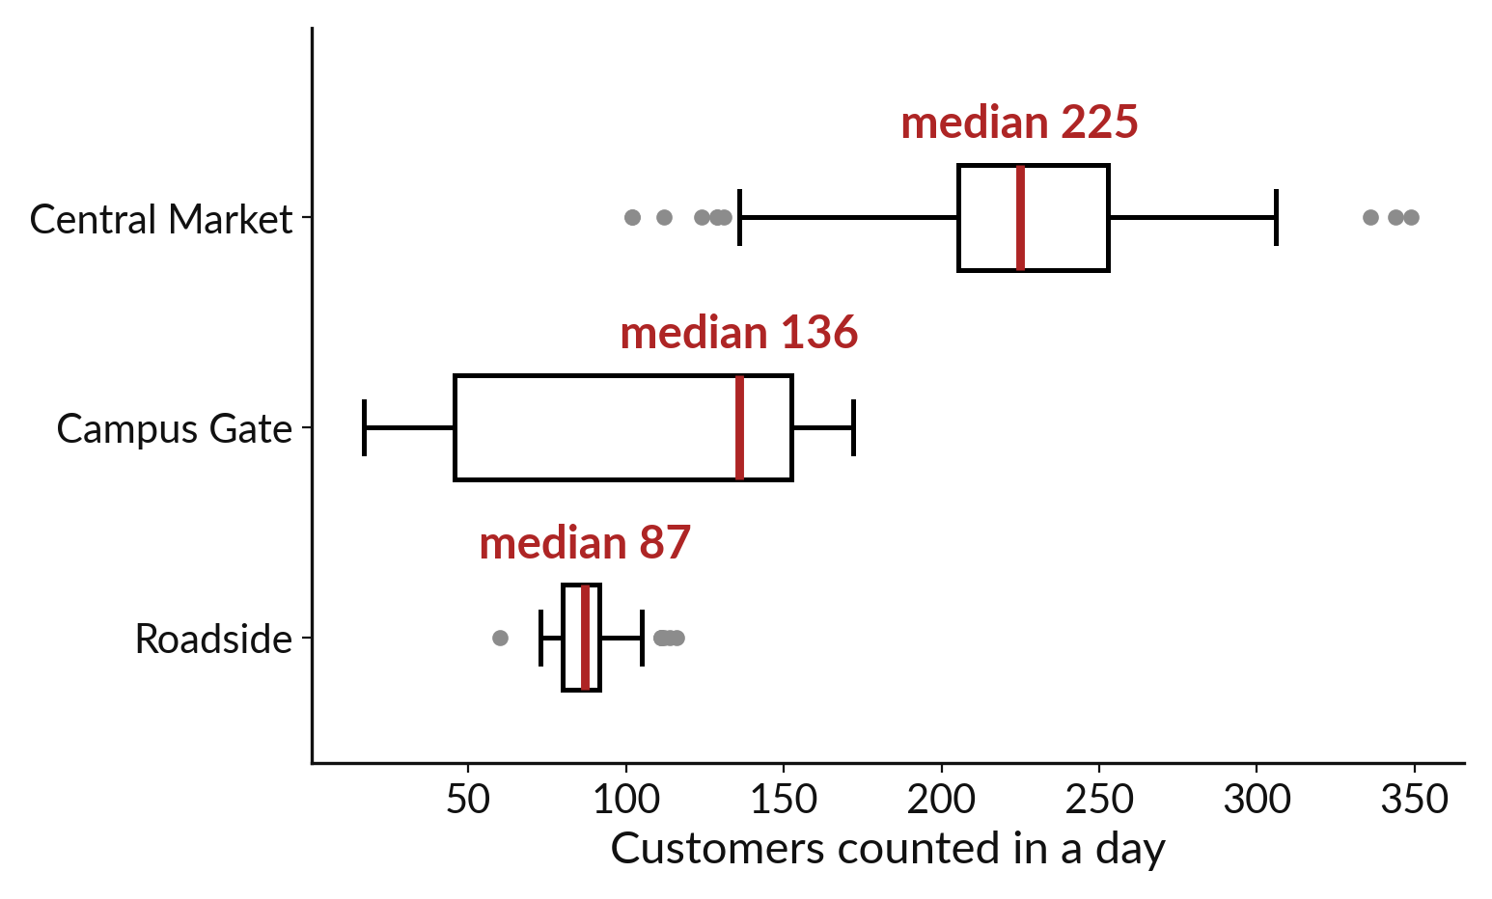
Each shop median is a fair way to compare shops
Compute the median for each shop.
Check it against the line in its box.
Write the finding in one sentence.
Notes:
The last step is to turn the picture into a sentence. We group by shop and ask for the median of the customers counted. The three medians should match the lines inside the three boxes.
Then you write one sentence that names the shops and quotes the numbers. A finding without a number is only an opinion. Roadside has the lowest median, eighty seven customers a day.

Slide 21

Make: your own version
Explore the daily customer counts. Draw a histogram of customers_counted and a box plot of customers_counted for each branch. Write the median for each branch and one finding in a sentence.
Save it as DA14. Write two sentences: what you changed and how you checked it.
Notes:
This is your own task for today. Take it one step at a time. If you get stuck for a few minutes, read your error message, check the error card, and then ask me.
Save it as DA14. I will come round to each of you and ask what you changed and how you checked it.

Slide 22

Two errors you may meet today
It means: seaborn was not imported in this session.
Fix: Run import seaborn as sns in the first cell, then run the chart cell.
NameError: name 'sns' is not defined
It means: The column name in x= or y= is not in the DataFrame.
Fix: Print list(daily.columns) and copy the exact name.
ValueError: Could not interpret value for x
Notes:
Everyone meets errors, including me. Two are likely today, so let us meet them now.
This is the first one. You will see: NameError: name 'sns' is not defined. It means this: seaborn was not imported in this session. To fix it, Run import seaborn as sns in the first cell, then run the chart cell.
The next one. You will see: ValueError: Could not interpret value for x. It means this: the column name in x= or y= is not in the DataFrame. To fix it, print list(daily.columns) and copy the exact name.
Keep this slide in mind when something stops working.

Slide 23

Finish this sentence in your notebook
A histogram shows the shape of one column and a box plot lets me compare groups.
Then save your notebook, close it and open it again to check it saved.
Notes:
We are nearly done. Remember the question from the start of the session: What does a typical sale look like, and does it differ between the three shops?
Write this sentence in your notebook and finish it your own way. A histogram shows the shape of one column and a box plot lets me compare groups.
Then save your notebook, close it and open it again to check it saved.

