Slide 1
Project question and a safe plan
Which three questions can our data answer, and how will we show the answers?
Python for Data Analysis | Session 19 of 24 | Week 7, Show it
Holiday Data and AI Camp | The National ICT Innovation Hub, Nakawa
Notes:
Here we go. Today is session 19 and our topic is project question and a safe plan.
By the end of today you will be able to write a narrow project plan with a question, the data, the measures, the charts and the limits, and have it approved.
We will answer one question: Which three questions can our data answer, and how will we show the answers?

Slide 2
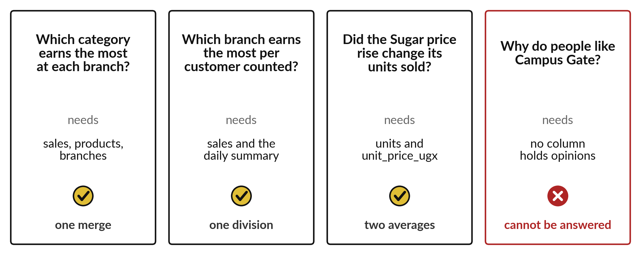
Which three questions can our data
answer, and how will we show the answers?
Notes:
Now the project begins. Which three questions can our data answer, and how will we show the answers? Not every question can be answered. Look at the four cards. The first three need columns that exist, so a merge, a division or a comparison of two averages will answer them. The fourth asks why people like a shop, and no column holds an opinion. Today you choose questions that your data can answer, and write a safe plan.

Slide 3

Today's plan in minutes
Most of the time is your own build, with a check and a partner.
Notes:
Here is how the 3 hours go. Each bar is as long as the time we spend on that part.
First, 10 minutes. Recall, retrieve yesterday, three questions on paper. Then, 50 minutes. Block A, predict, run, investigate, modify. After that, 15 minutes. Break away from screens. Next, 50 minutes. Block B, predict, run, investigate, modify. Then, 40 minutes. Make, the independent task and the project journal. Then, 15 minutes. Exit ticket, save, and an individual check with each learner.
Most of the time is your own build, with a check and a partner. Ask me now if any part of the plan is unclear.

Slide 4



Words for today (1 of 2)
project question
One question a table can answer with numbers.
Which item sells most, asked of a till roll.
scope
How much the project covers, and what it leaves out.
The fence round a garden.
data dictionary
A list of every column with its meaning and unit.
The key to a map.
Notes:
First the words, because every one of them is used in the code later.
project question. One question a table can answer with numbers. An example from everyday life. Which item sells most, asked of a till roll.
scope. How much the project covers, and what it leaves out. Here is a way to see it. The fence round a garden.
data dictionary. A list of every column with its meaning and unit. A small example. The key to a map.

Slide 5


Words for today (2 of 2)
limitation
What the data or method cannot tell us.
The part of the map that is blank.
licence
The rules that say how you may use a dataset.
The terms on a borrowed book.
disclosure
A plain statement of any help or AI tool you used.
Writing your sources at the end of an essay.
Notes:
Here are the rest of today's words.
limitation. What the data or method cannot tell us. Picture this. The part of the map that is blank.
licence. The rules that say how you may use a dataset. You have seen this before. The terms on a borrowed book.
disclosure. A plain statement of any help or AI tool you used. Writing your sources at the end of an essay.

Slide 6
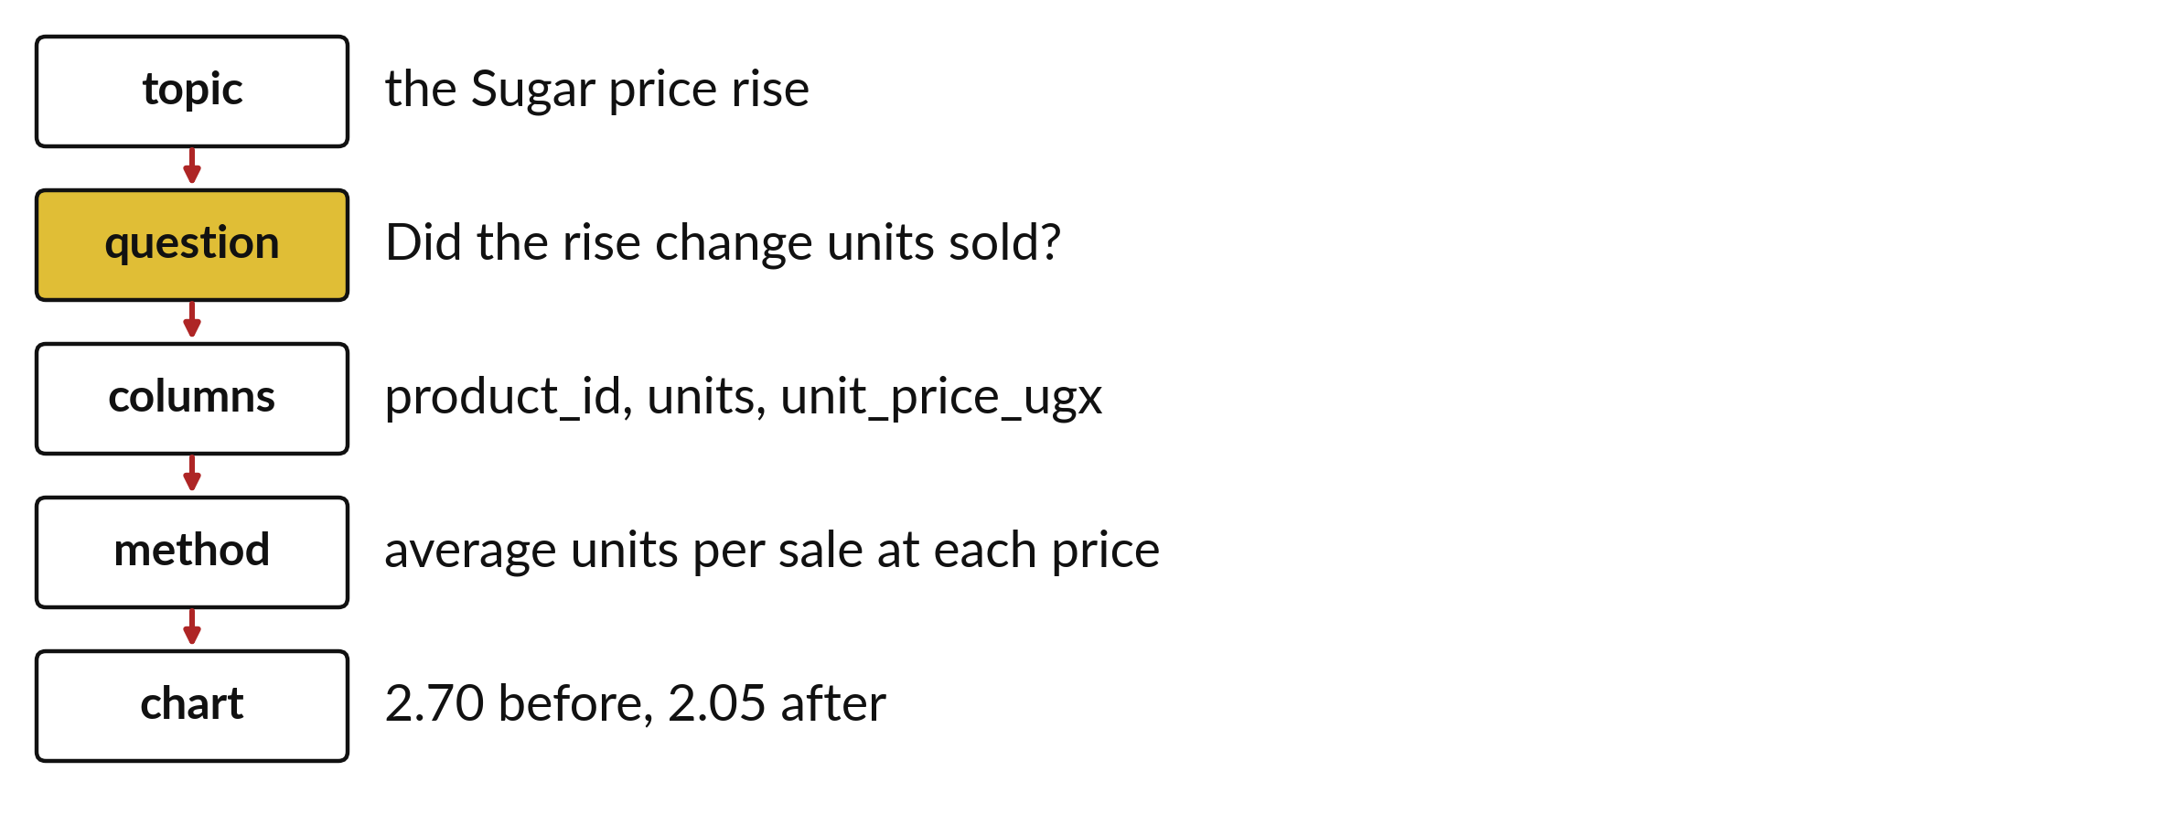
A good question uses columns that exist
Start vague, then name the columns and the calculation.
Notes:
A project question gets better in steps. We start vague, such as which shop is good. Then we say what good means, for example earning the most money. Then we name the columns we would use and the calculation, which here is total revenue by shop.
The final version is a question that someone could answer from the table in a few lines of code.

Slide 7
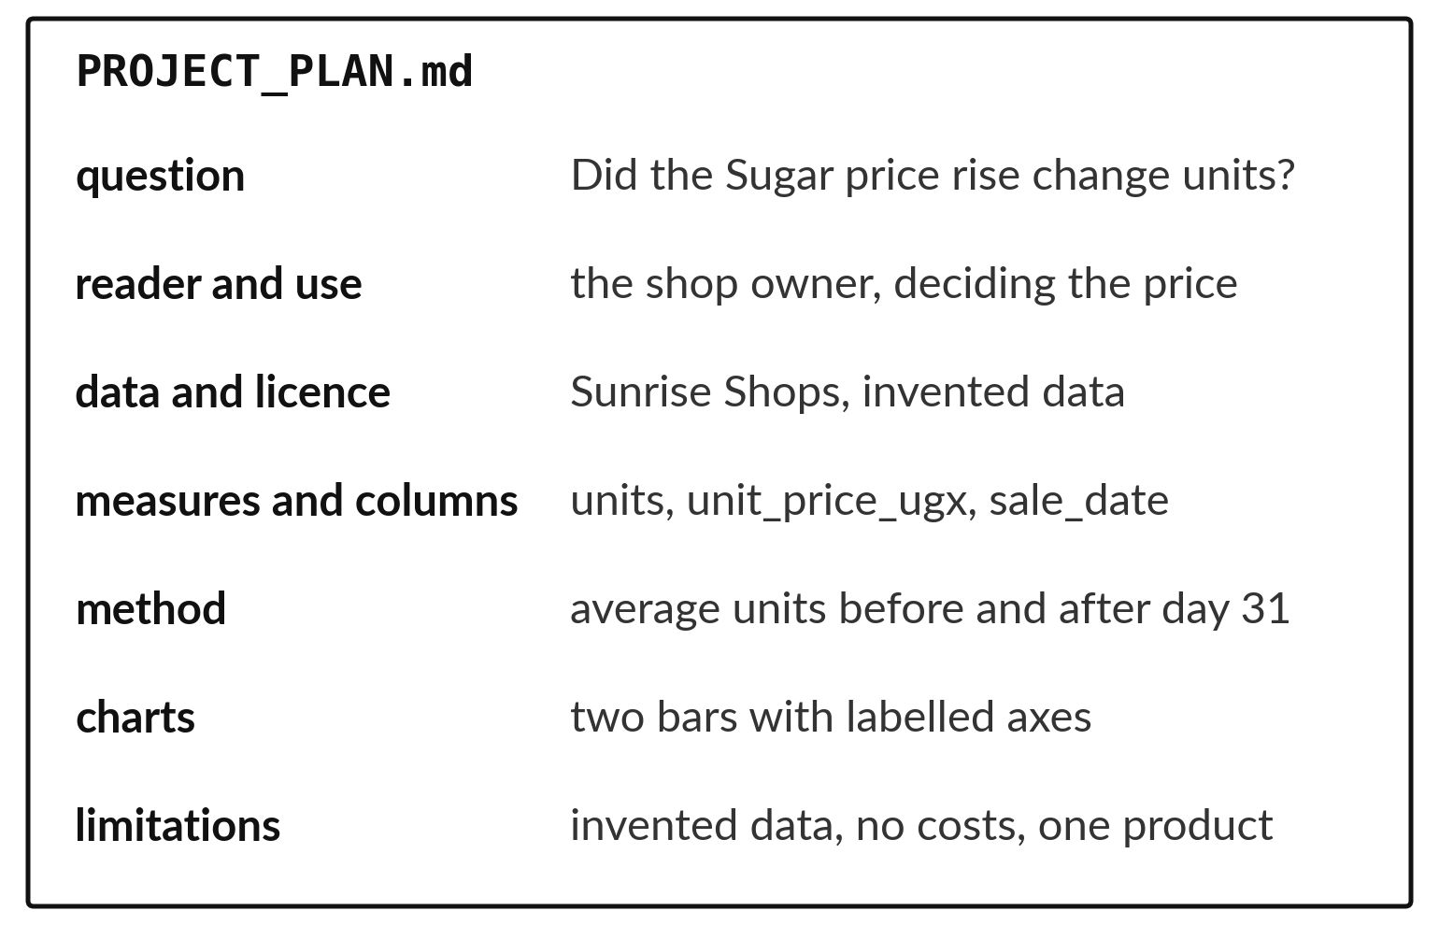
The plan has seven headings on one page
The question, the data and its licence.
The columns, the charts and the checks.
The limitations and the risks.
Notes:
The plan lives in a file called PROJECT PLAN. It has seven headings, and it fits on one page. It names the data file and says where it came from. It lists your three questions and, for each, the columns it needs and the chart you will draw.
It also says what could go wrong. Your instructor approves the plan before you start, which saves you from building the wrong thing.

Slide 8

Predict: From a topic to three questions
Predict which of these questions the Sunrise Shops data can answer with the taught methods: (a) Which category earns the most at each branch? (b) Why do people like Campus Gate? (c) What will sales be next month?
Write your guess on paper before we run it.
Notes:
A project serves a reader. Decide who needs the answer and what choice it could help with.
Now your guess. Predict which of these questions the Sunrise Shops data can answer with the taught methods: (a) Which category earns the most at each branch? (b) Why do people like Campus Gate? (c) What will sales be next month? Put it on paper first. We will check it together in a moment.

Slide 9

Run it: From a topic to three questions
Question (a) can be answered: it needs the sales, products and branches tables, a merge and a group total.
Question (b) asks for reasons, and the data has no opinions.
Question (c) asks for a forecast, which this course does not teach.
Notes:
Watch the output as it appears. Match each line of the output with the line of code that made it.
Question (a) can be answered: it needs the sales, products and branches tables, a merge and a group total. Question (b) asks for reasons, and the data has no opinions. Question (c) asks for a forecast, which this course does not teach. A narrow descriptive question with named columns is the right size.
Tell the person next to you whether your guess matched.

Slide 10

Investigate: From a topic to three questions
1. What makes question (a) answerable?
2. How would you narrow question (b) so the data can answer it?
Notes:
Now we look closely at from a topic to three questions. I have two questions for you.
Question one. What makes question (a) answerable? Talk it over with your neighbour for a minute.
Here is how I would answer it. Every column it needs exists, and the method is one we have used.
Question two. How would you narrow question (b) so the data can answer it? Think about it for a moment, then tell the person next to you.
What I would say is this. Ask something countable, such as which shop has the highest revenue per customer.

Slide 11

Modify: change one thing
Write one more question the Sunrise data can answer, and name the columns it needs.
Then tell your neighbour what changed and how you know.
Notes:
Your hands on the keyboard now. Write one more question the Sunrise data can answer, and name the columns it needs. When you have run it, tell your neighbour what changed and how you know.
Here is what happens. Any narrow question with named columns, for example: did the Sugar price rise change its units sold? It needs product_id, units and sale_date.

Slide 12

Break
15 minutes away from your screen
Stand up. Drink some water. Tell someone what you guessed in the first half.
Notes:
Break time. 15 minutes away from your screens. Stand up, drink some water and tell someone what you guessed in the first half.
When we come back we start the second idea.

Slide 13
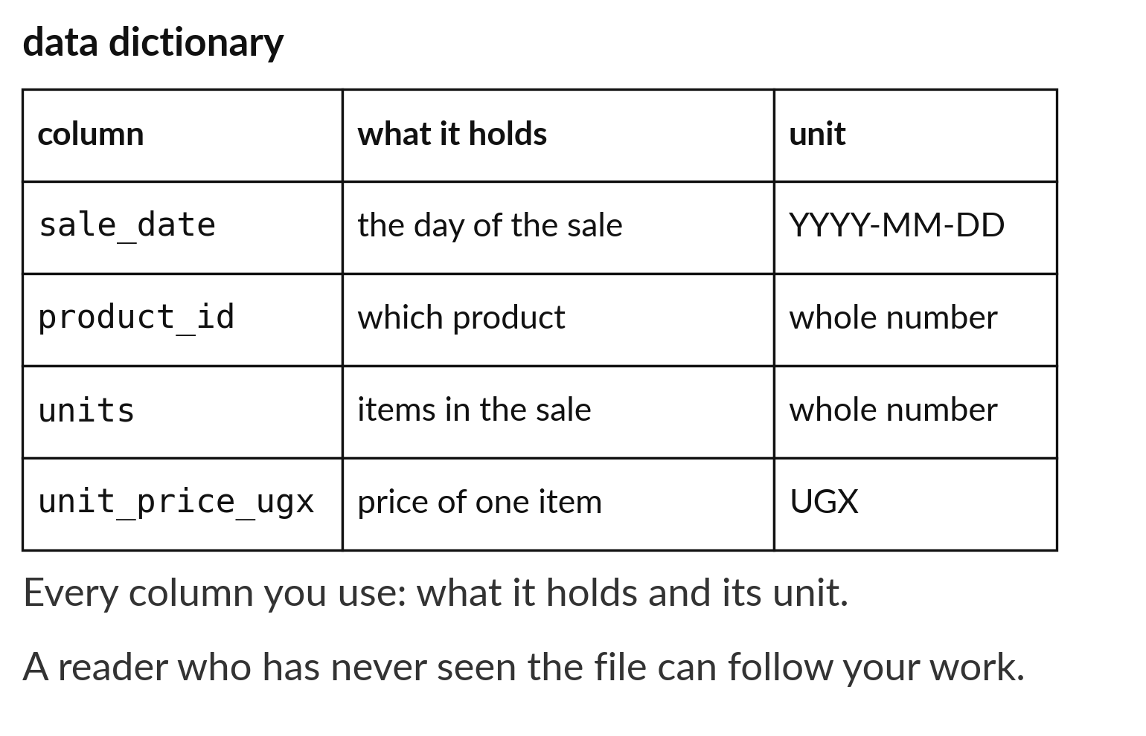
A data dictionary gives each column a meaning
One line for each column you use.
Say what it means in plain words.
Give the unit, such as shillings.
Notes:
A data dictionary is a short list that explains the table. For each column we write its name, what it means in plain words and its unit. For example, units is the number of items sold in one sale, and unit price is the price of one item in Uganda shillings.
If you cannot write the meaning of a column, you should not build a finding on it.

Slide 14
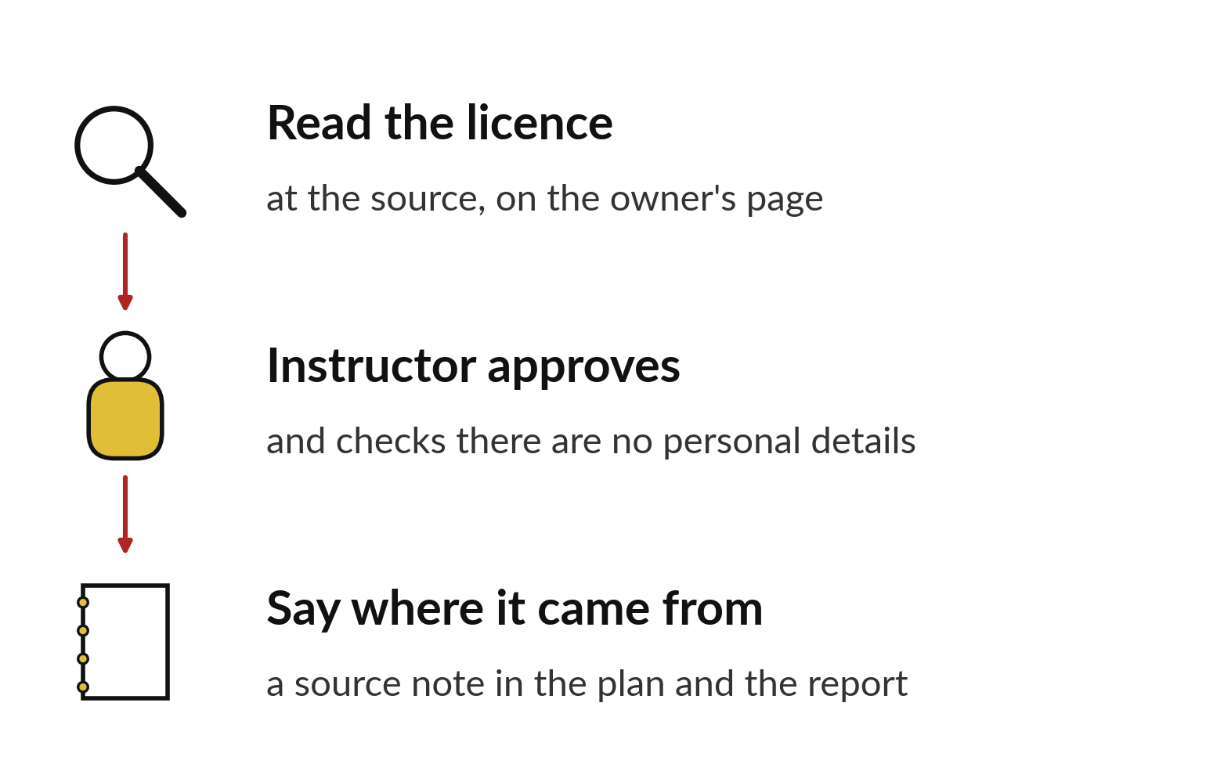
Read the licence at the source before using data
Read the licence at the source.
The instructor approves it and checks for personal details.
Write where it came from in your plan.
Notes:
Real data belongs to someone. The licence says how we may use it. Before using a public dataset, we go to the page where it was published and read the licence. We check that it allows study, and we note the source and the date we downloaded it.
If the data is invented, like Sunrise Shops, we say so in the plan. Either way, a reader should know where the numbers came from.

Slide 15
Predict: The plan and the data
Predict which heading is hardest to write, and why.
Write your guess on paper before we run it.
Notes:
Your PROJECT_PLAN.md has seven headings: question, reader and use, data source and licence, measures and columns, method, charts, limitations. Start with Sunrise Shops, which is invented and needs no permission.
This is the part where you decide. Predict which heading is hardest to write, and why. Put your guess on paper now, even if you are unsure.

Slide 16
Run it: The plan and the data
Most learners find limitations hardest, because it means saying what the data cannot show.
A good limitation names a missing column or a kind of conclusion the project will not draw: no costs means no profit, invented data means no claim about real shops.
Notes:
Let us see what happens. Match each line of the output with the line of code that made it.
Most learners find limitations hardest, because it means saying what the data cannot show. A good limitation names a missing column or a kind of conclusion the project will not draw: no costs means no profit, invented data means no claim about real shops.
Which line of the output matches which line of the code? Point to each pair.

Slide 17
Investigate: The plan and the data
1. Why must the licence be read at the source?
2. What goes in the data dictionary?
Notes:
Now we look closely at the plan and the data. I have two questions for you.
Question one. Why must the licence be read at the source? Think about it for a moment, then tell the person next to you.
What I would say is this. The licence says what you may do with the data. Only the owner of the data can tell you.
Question two. What goes in the data dictionary? Have a go in your head first.
Let me answer it. Each column you use, its meaning and its unit.

Slide 18
Modify: change one thing
Write the limitations heading for your own plan in two sentences.
Then tell your neighbour what changed and how you know.
Notes:
Change one thing and watch what happens. Write the limitations heading for your own plan in two sentences. Run it, then tell someone what you saw.
What you should find: Two sentences naming what the data cannot show.

Slide 19
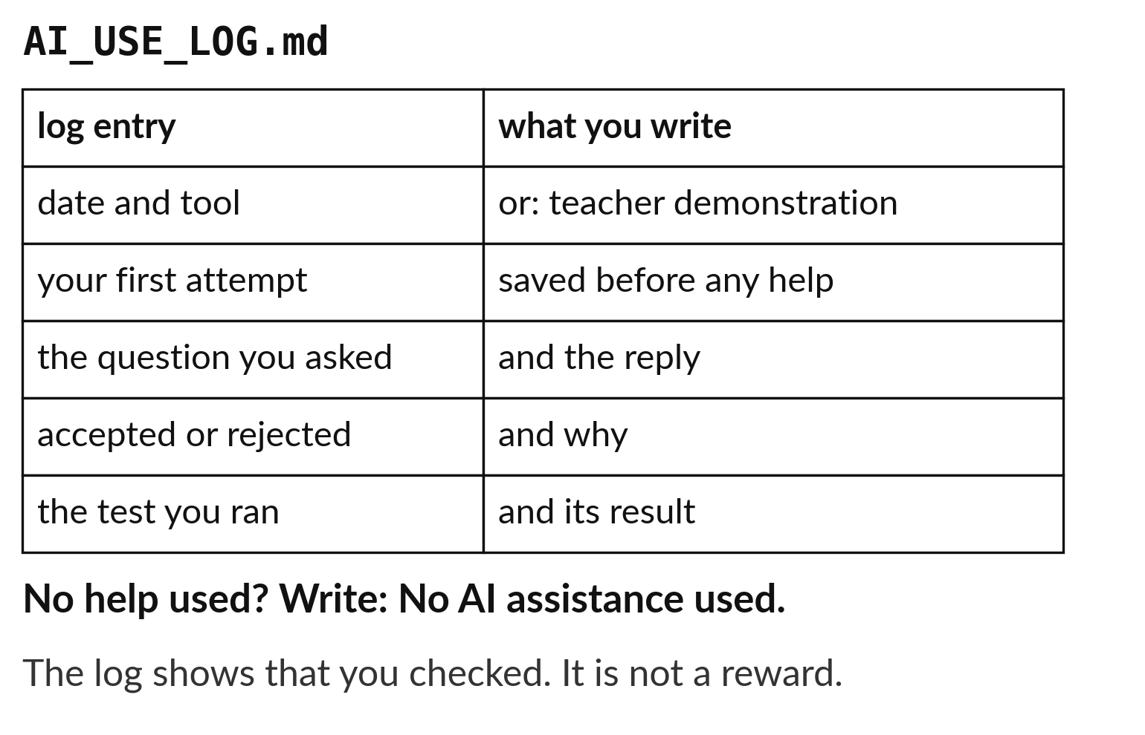
Log every AI use and explain the lines you keep
Write what you asked and what it gave.
Say what you kept and why.
Or write: No AI assistance used.
Notes:
You may use an AI assistant for hints, as long as you keep a log. Each entry records what you asked, what came back, and what you kept or rejected. You must be able to explain every line you keep. If you did not use an assistant, you write that in the log in plain words.
The log is part of your submission. It shows that the work and the understanding are yours.

Slide 20

Make: your own version
Write PROJECT_PLAN.md with the seven headings. Name the data file and its licence or its invented status. List the three questions, the columns each needs, the charts and the limitations. Ask the instructor to approve a narrow scope before you build.
Save it as DA19. Write two sentences: what you changed and how you checked it.
Notes:
This task is yours. Run your code after every step so you can see where a problem begins. If you get stuck for a few minutes, read your error message, check the error card, and then ask me.
Save it as DA19. I will come round to each of you and ask what you changed and how you checked it.

Slide 21

Two errors you may meet today
It means: The data has no costs, so profit cannot be worked out.
Fix: Change the measure to revenue and say so in the limitations.
The plan promises profit
It means: The question asks for something the data never recorded.
Fix: Narrow the question to the columns you have, or choose another dataset.
A question needs a column that does not exist
Notes:
Here are two errors from this session, so you recognise them when they appear.
This is the first one. You will see: The plan promises profit. It means this: the data has no costs, so profit cannot be worked out. To fix it, change the measure to revenue and say so in the limitations.
The next one. You will see: A question needs a column that does not exist. It means this: the question asks for something the data never recorded. To fix it, narrow the question to the columns you have, or choose another dataset.
When you are stuck, read the last line of the message first.

Slide 22

Finish this sentence in your notebook
My plan has three questions that my data can answer, and it says what my data cannot show.
Then save your notebook, close it and open it again to check it saved.
Notes:
Last step. Our question for today was: Which three questions can our data answer, and how will we show the answers?
Finish this sentence in your notebook, in your own words. My plan has three questions that my data can answer, and it says what my data cannot show.
Then save your notebook, close it and open it again to check it saved.

