Slide 1
Lists, vectors and NumPy arrays
Why do the numbers in a list need a fixed order and a unit?
Machine Learning | Foundation lab F02
Holiday Data and AI Camp | The National ICT Innovation Hub, Nakawa
Notes:
Let us begin. Today is session 2 and our topic is lists, vectors and NumPy arrays.
By the end of today you will be able to explain the idea in your own words and run the worked example.
We will answer one question: Why do the numbers in a list need a fixed order and a unit?

Slide 2
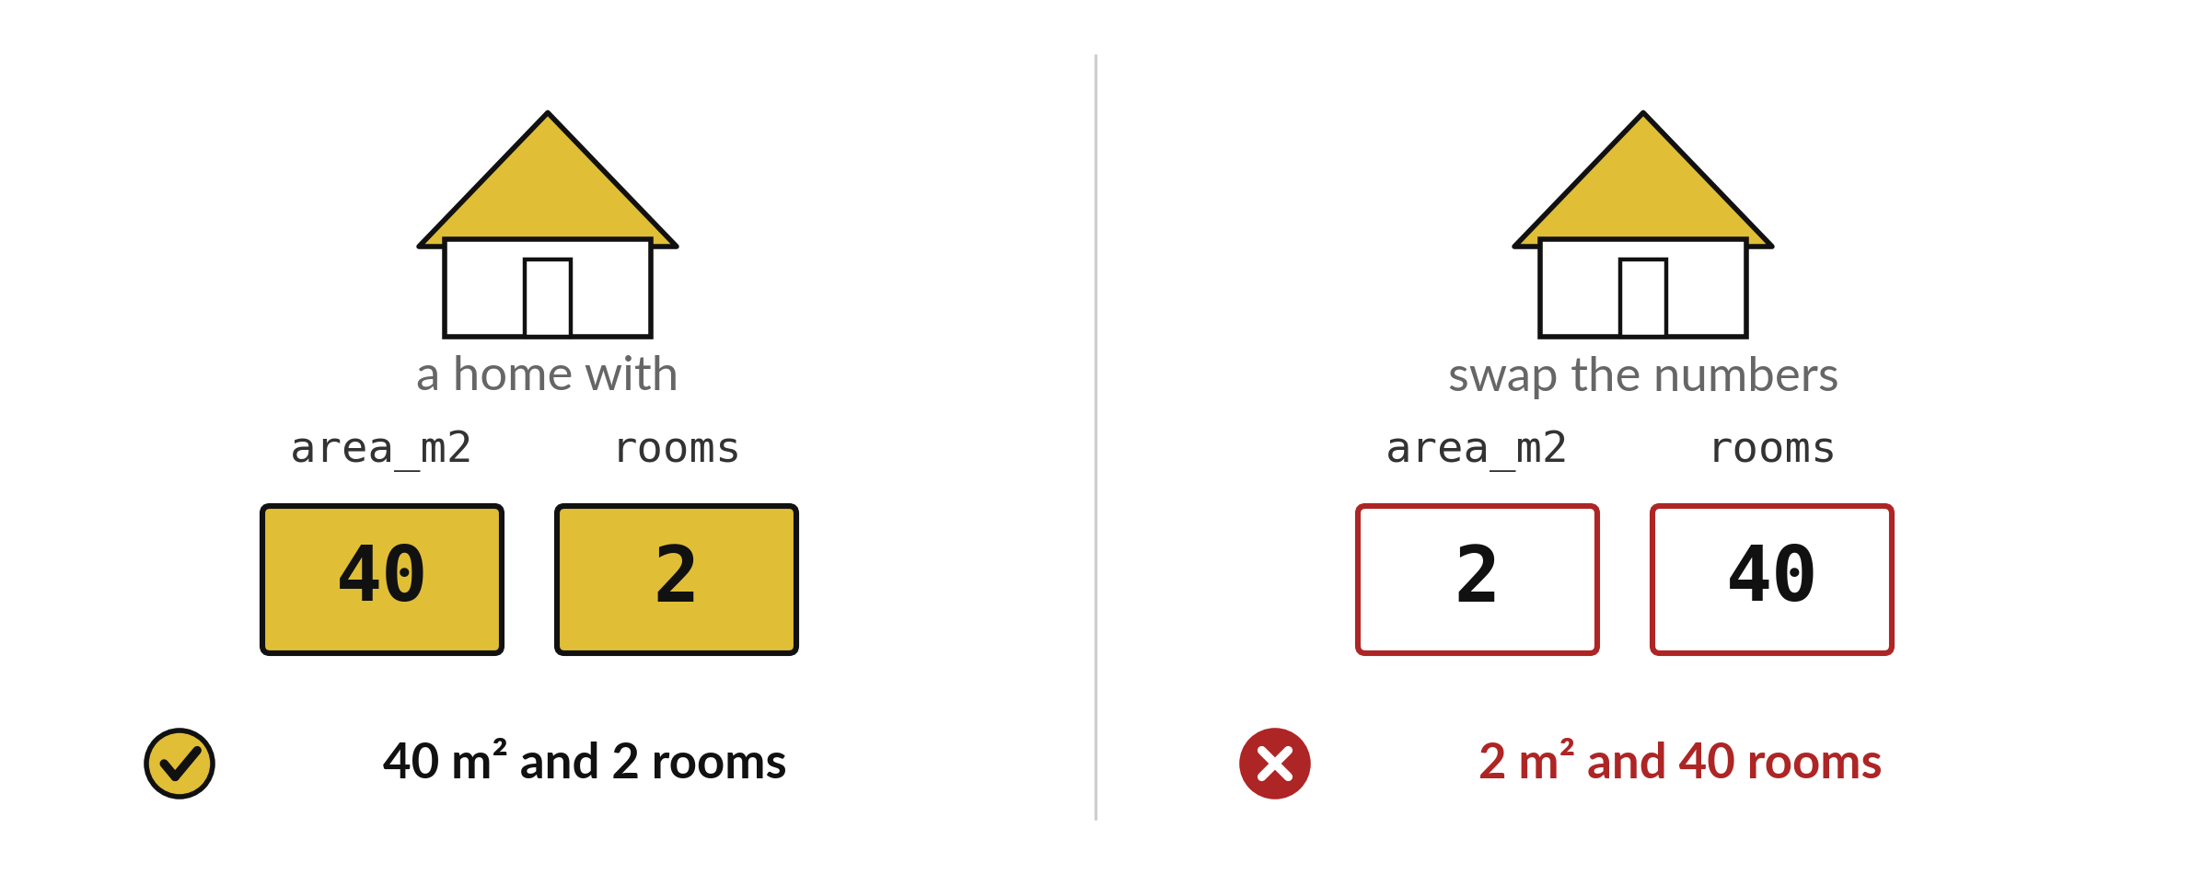
Why do the numbers in a list
need a fixed order and a unit?
Notes:
Here are two numbers, forty and two. In the first order they describe a home with forty square metres and two rooms. Swap them and the numbers describe two square metres and forty rooms, which is not a home at all. The order of the numbers gives them their meaning. Today we store such numbers in a list and in an array, and we see how each behaves when we do sums with it.

Slide 3

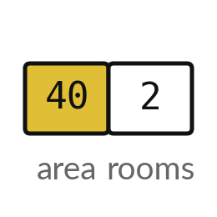
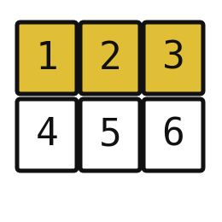
Words for today (1 of 2)
scalar
A single number.
One mark.
vector
An ordered list of numbers whose positions have meanings.
A home described by area, then rooms.
NumPy array
A list of numbers that can be calculated with all at once.
A whole row of marks marked together.
Notes:
We need a few words today. For each one I will say what it means and give you something to picture.
scalar. A single number. Picture this. One mark.
vector. An ordered list of numbers whose positions have meanings. You have seen this before. A home described by area, then rooms.
NumPy array. A list of numbers that can be calculated with all at once. A whole row of marks marked together.

Slide 4
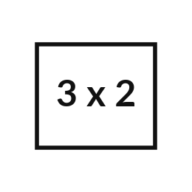
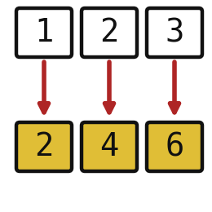
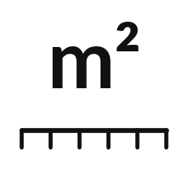
Words for today (2 of 2)
shape
The size of an array, such as (2,) for two numbers.
Counting the boxes in a row.
element-wise
Doing the same calculation to every number.
Adding the same bonus to every pupil's mark.
unit
What a number measures, such as square metres.
Shillings, kilograms or metres.
Notes:
More words for today.
shape. The size of an array, such as (2,) for two numbers. Think of a shop. Counting the boxes in a row.
element-wise. Doing the same calculation to every number. Imagine it like this. Adding the same bonus to every pupil's mark.
unit. What a number measures, such as square metres. An example from everyday life. Shillings, kilograms or metres.

Slide 5
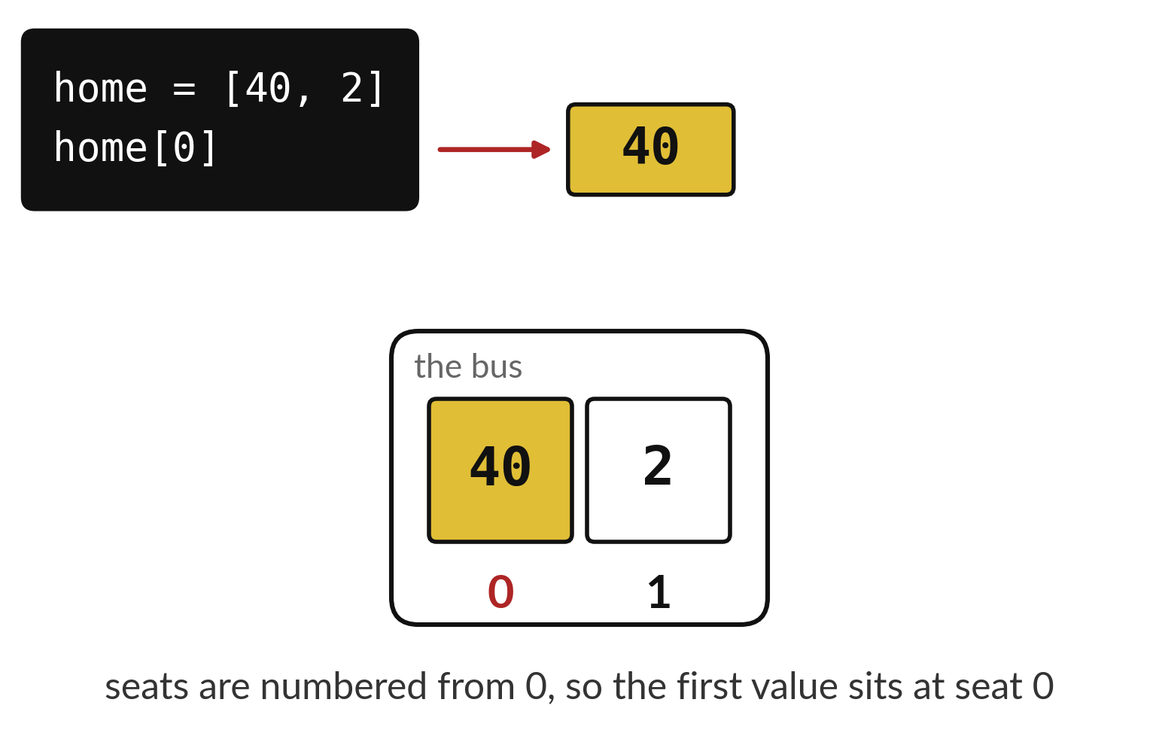
A vector is a list whose order carries meaning
Seat 0 holds the area in square metres.
Seat 1 holds the number of rooms.
Swap the seats and the meaning changes.
Notes:
A list of numbers where the order matters is called a vector. Here seat zero holds the area and seat one holds the rooms. Python does not know that. You do. The only way to keep the meaning straight is to remember, and write down, what each position stands for.
Home with a zero in brackets gives forty. What does home with a one in brackets give?

Slide 6
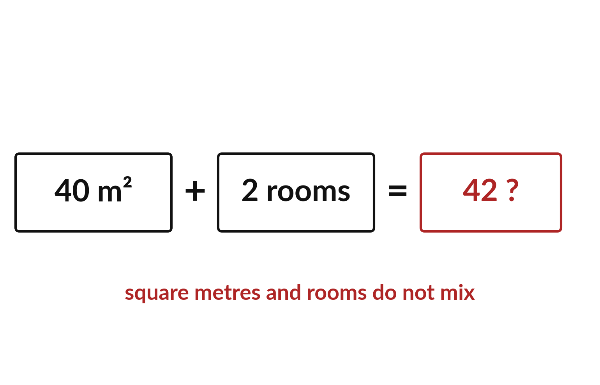
Add area to area and rooms to rooms
Every number carries a unit.
Square metres plus rooms makes no sense.
Write the unit beside the number you store.
Notes:
Every number in a home vector carries a unit. Forty has a unit, square metres. Two has a unit, rooms. If you add them you get forty two of nothing in particular. A calculation only makes sense when the units match.
That is why the second number in a home vector must never be added to the first. In the lab you write the unit in a comment or a column name every time.

Slide 7

Predict: lists as vectors
import numpy as np
home = [40, 2]
print(len(home))
joined = home + [10, 1]
print(joined)
home_array = np.array([40, 2])
print(home_array.shape)
added = home_array + np.array([10, 1])
doubled = home_array * 2
print(added)
print(doubled)
Work the paper example first: Draw two labelled boxes: area_m2 and rooms. Then predict every line the code will print.
Write your guess on paper before we run it.
Notes:
A scalar is one number. A vector is an ordered group of numbers, and the order gives each number its meaning: [40, 2] could be a home with an area of 40 square metres and 2 rooms.
Make a prediction. Work the paper example first: Draw two labelled boxes: area_m2 and rooms. Then predict every line the code will print. Put your guess on paper now, even if you are unsure.

Slide 8
Run it: lists as vectors
2
[40, 2, 10, 1]
(2,)
[50 3]
[80 4]
2, then [40, 2, 10, 1] (the lists are joined), then (2,), then [50 3] and [80 4] (calculated one by one).
Notes:
Running it now. Match each line of the output with the line of code that made it.
2, then [40, 2, 10, 1] (the lists are joined), then (2,), then [50 3] and [80 4] (calculated one by one).
Keep your guess. We use it in the next step.

Slide 9
Investigate: lists as vectors
1. What does each line of the code do?
2. Which number surprised you?
import numpy as np
home = [40, 2]
print(len(home))
joined = home + [10, 1]
print(joined)
home_array = np.array([40, 2])
print(home_array.shape)
added = home_array + np.array(
[10, 1]
)
doubled = home_array * 2
print(added)
print(doubled)
Notes:
Now we look closely at lists as vectors. I have two questions for you.
Question one. What does each line of the code do? Think about it for a moment, then tell the person next to you.
Let me answer it. Read each line aloud and say what it stores or prints.
Question two. Which number surprised you? Have a go in your head first.
The answer is this. Say which printed value differed from your paper work, and why.

Slide 10

Modify: change one thing
Make a NumPy array for a home of 65 square metres and 3 rooms.
Then tell your neighbour what changed and how you know.
Notes:
Make one small change. Make a NumPy array for a home of 65 square metres and 3 rooms. Then explain to your neighbour what the change did.
The result: Shape (2,); a total of 7 both ways.

Slide 11

Make: your own version
Make a NumPy array for a home of 65 square metres and 3 rooms. Print its shape. Add a text cell that labels the units of each position. Add the item counts [1, 4, 2] with a loop and then with .sum(). Save F02.ipynb.
Save it as F02. Write two sentences: what you changed and how you checked it.
Notes:
This is your own task for today. Take it one step at a time. If you get stuck for a few minutes, read your error message, check the error card, and then ask me.
Save it as F02. I will come round to each of you and ask what you changed and how you checked it.

Slide 12

Two errors you may meet today
It means: The array has two items, so its positions are 0 and 1 only.
Fix: Use position 0 or 1, or check the length with len().
IndexError: index 2 is out of bounds for axis 0 with size 2
It means: Adding lists with plus joins them end to end.
Fix: Turn the lists into arrays first, then add them.
The two lists joined instead of adding
Notes:
Everyone meets errors, including me. Two are likely today, so let us meet them now.
This is the first one. You will see: IndexError: index 2 is out of bounds for axis 0 with size 2. It means this: the array has two items, so its positions are 0 and 1 only. To fix it, use position 0 or 1, or check the length with len().
The next one. You will see: The two lists joined instead of adding. It means this: adding lists with plus joins them end to end. To fix it, turn the lists into arrays first, then add them.
Keep this slide in mind when something stops working.

Slide 13

Finish this sentence in your notebook
I can explain lists, vectors and NumPy arrays in my own words.
Then save your notebook, close it and open it again to check it saved.
Notes:
We are nearly done. Remember the question from the start of the session: Why do the numbers in a list need a fixed order and a unit?
Write this sentence in your notebook and finish it your own way. I can explain lists, vectors and NumPy arrays in my own words.
Then save your notebook, close it and open it again to check it saved.

