Slide 1
Matrices, weighted sums and slope
How does a model turn two measurements into one prediction?
Machine Learning | Foundation lab F04
Holiday Data and AI Camp | The National ICT Innovation Hub, Nakawa
Notes:
Welcome back. Today is session 4 and our topic is matrices, weighted sums and slope.
By the end of today you will be able to explain the idea in your own words and run the worked example.
We will answer one question: How does a model turn two measurements into one prediction?

Slide 2
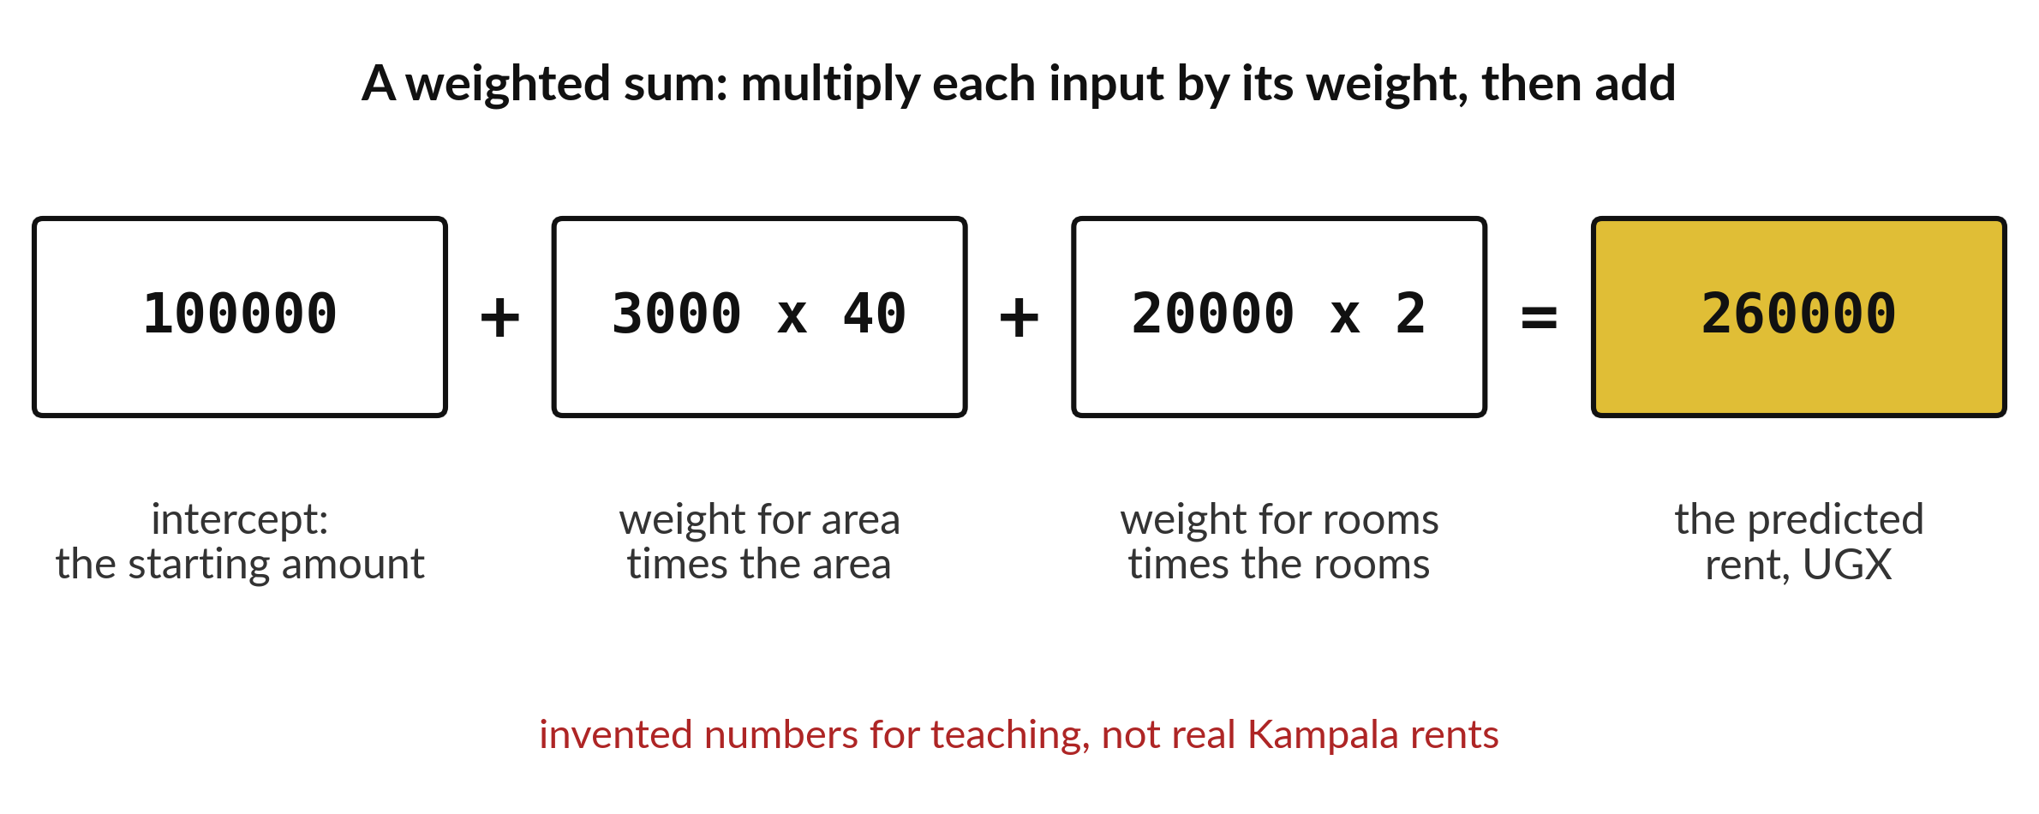
How does a model turn two
measurements into one prediction?
Notes:
Here is how a model turns two measurements into one prediction. Start with a fixed amount, the intercept. Add the area times its weight. Add the rooms times their weight. The total is the predicted rent. These numbers are invented for teaching. A real model learns its weights from examples, but the arithmetic is exactly this.

Slide 3

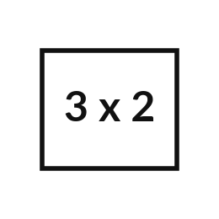

Words for today (1 of 2)
matrix
A table of numbers with rows and columns.
A page of a register.
shape
Rows by columns.
How many lines and headings.
weight
A number that says how much an input counts.
How many marks each question is worth.
Notes:
First the words, because every one of them is used in the code later.
matrix. A table of numbers with rows and columns. Here is a way to see it. A page of a register.
shape. Rows by columns. A small example. How many lines and headings.
weight. A number that says how much an input counts. Picture this. How many marks each question is worth.

Slide 4
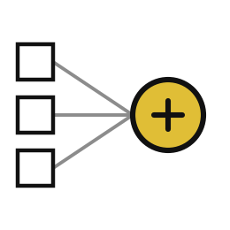
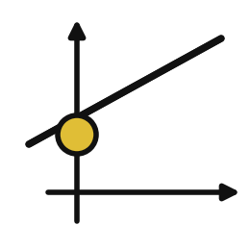
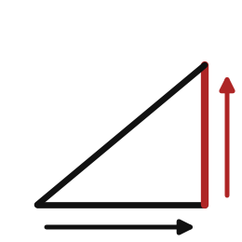
Words for today (2 of 2)
weighted sum
Multiply each input by its weight and add the results.
Adding up the marks of every question.
intercept
The starting amount before any input is added.
A fixed fee.
slope
How much the answer changes when one input rises by one unit.
Extra rent for each extra square metre.
Notes:
Here are the rest of today's words.
weighted sum. Multiply each input by its weight and add the results. You have seen this before. Adding up the marks of every question.
intercept. The starting amount before any input is added. A fixed fee.
slope. How much the answer changes when one input rises by one unit. Think of a shop. Extra rent for each extra square metre.

Slide 5
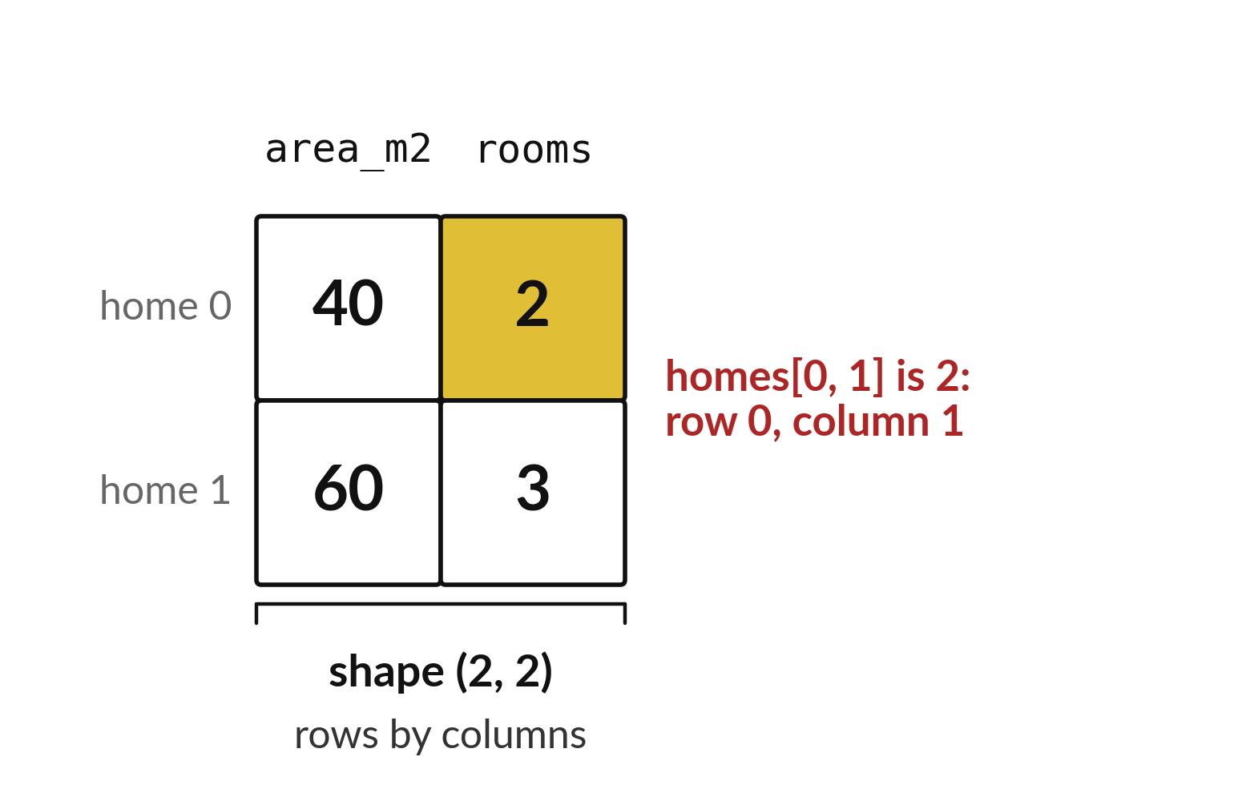
A matrix holds one home on every row
Two homes with two measurements each.
The shape is 2 by 2.
homes[0, 1] means row 0, column 1.
Notes:
A matrix is a table of numbers. Here each row is one home, with its area in the first column and its number of rooms in the second. The shape is rows by columns, so two by two.
To pick one number, give the row and then the column. Homes zero comma one is the rooms of the first home, which is two.

Slide 6

Predict: weighted sums
import numpy as np
homes = np.array([[40, 2], [60, 3]])
weights = np.array([3000, 20000])
intercept = 100000
print(homes.shape)
print(homes[0, 1])
predictions = intercept + np.dot(homes, weights)
print(predictions)
Work the paper example first: Draw a table with two rows and the columns area and rooms. Then predict every line the code will print.
Write your guess on paper before we run it.
Notes:
A matrix is a rectangular table of numbers, and its shape is rows by columns. In NumPy a 2-D array holds one home on each row: [[40, 2], [60, 3]] has two homes with two measurements each.
Time to commit to an answer. Work the paper example first: Draw a table with two rows and the columns area and rooms. Then predict every line the code will print. Jot it on paper before anyone speaks.

Slide 7
Run it: weighted sums
(2, 2)
2
[260000 340000]
Line one: (2, 2), the shape of two rows and two columns.
Line two: 2, the rooms of home 0.
Line three: 260000 and 340000, the rents predicted for the two homes.
Notes:
Now we run it. Match each line of the output with the line of code that made it.
Line one: (2, 2), the shape of two rows and two columns. Line two: 2, the rooms of home 0. Line three: 260000 and 340000, the rents predicted for the two homes.
If your guess was off, find the line that surprised you.

Slide 8

Investigate: weighted sums
1. What does each line of the code do?
2. Which number surprised you?
Notes:
Now we look closely at weighted sums. I have two questions for you.
Question one. What does each line of the code do? Write your answer in one line before we compare.
The answer is this. Read each line aloud and say what it stores or prints.
Question two. Which number surprised you? Say it quietly to yourself before anyone answers.
Say which printed value differed from your paper work, and why.

Slide 9

Modify: change one thing
Add the home [50, 2] as a third row.
Then tell your neighbour what changed and how you know.
Notes:
Now it is your turn to change something. Add the home [50, 2] as a third row. Run it, then tell someone what you saw.
What you should find: Shape (3, 2).

Slide 10
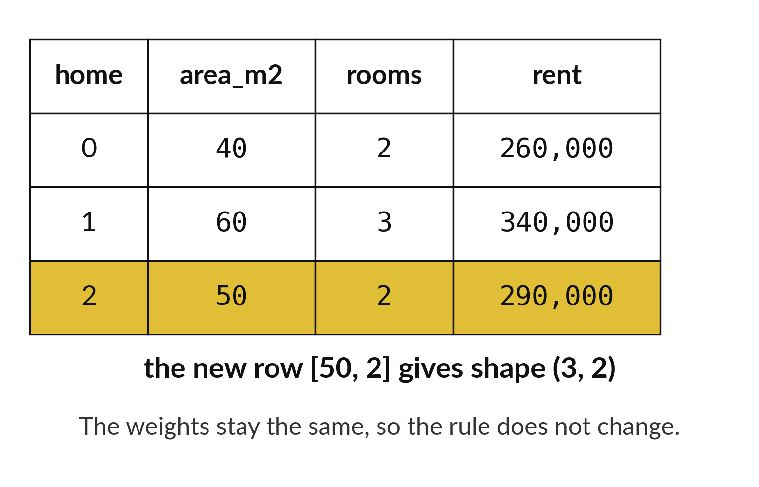
A new row is predicted with the same weights
Add the home [50, 2] as a third row.
The shape becomes 3 by 2.
Its prediction is 290,000.
Notes:
Add a third home with fifty square metres and two rooms. The matrix now has three rows. The weights do not change, so the same rule gives a prediction for the new row: two hundred and ninety thousand shillings.
Check it on paper. A hundred thousand, plus three thousand times fifty, plus twenty thousand times two.

Slide 11

Make: your own version
Add the home [50, 2] as a third row. Predict its result on paper before you run. State the new shape and what each weight means. Explain why these numbers say nothing about real rents in Kampala. Save F04.ipynb.
Save it as F04. Write two sentences: what you changed and how you checked it.
Notes:
This task is yours. Run your code after every step so you can see where a problem begins. If you get stuck for a few minutes, read your error message, check the error card, and then ask me.
Save it as F04. I will come round to each of you and ask what you changed and how you checked it.

Slide 12

Two errors you may meet today
It means: Two plain lists cannot be multiplied together.
Fix: Turn them into arrays, or use np.dot to multiply and add matching elements.
TypeError: can't multiply sequence by non-int of type 'list'
It means: The columns were swapped, so a weight met the wrong input.
Fix: Label the paper table first and match each weight to its column.
The prediction looks wrong for one home
Notes:
Here are two errors from this session, so you recognise them when they appear.
This is the first one. You will see: TypeError: can't multiply sequence by non-int of type 'list'. It means this: two plain lists cannot be multiplied together. To fix it, turn them into arrays, or use np.dot to multiply and add matching elements.
The next one. You will see: The prediction looks wrong for one home. It means this: the columns were swapped, so a weight met the wrong input. To fix it, label the paper table first and match each weight to its column.
When you are stuck, read the last line of the message first.

Slide 13

Finish this sentence in your notebook
I can explain matrices, weighted sums and slope in my own words.
Then save your notebook, close it and open it again to check it saved.
Notes:
Last step. Our question for today was: How does a model turn two measurements into one prediction?
Finish this sentence in your notebook, in your own words. I can explain matrices, weighted sums and slope in my own words.
Then save your notebook, close it and open it again to check it saved.

