Slide 1
Values, names and types
What kind of thing is each part of a sale?
Machine Learning | Session 2 of 24 | Week 1, Python and a first prediction
Holiday Data and AI Camp | The National ICT Innovation Hub, Nakawa
Notes:
Good to see you. Today is session 2 and our topic is values, names and types.
By the end of today you will be able to create whole numbers, decimals and text, and predict what happens when a name is given a new value.
We will answer one question: What kind of thing is each part of a sale?

Slide 2
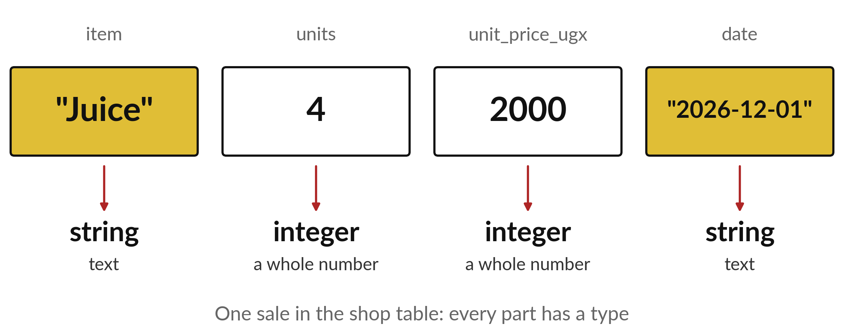
What kind of thing is each part of a sale?
Notes:
Here is one sale from a practice shop: a bottle of juice, four units, two thousand shillings each. Each part is a different kind of thing. The name is words. The count is a whole number. A price might have a decimal point. Python needs to know which kind it has, because each kind behaves differently. Today we learn the kinds and how to store them.

Slide 3

Three hours, mostly doing
Most of our time is spent doing, in small steps, with a guess before every run.
Notes:
Here is how the 3 hours go. Each bar is as long as the time we spend on that part.
First, 10 minutes. Recall. Then, 50 minutes. Block A. After that, 15 minutes. Break away from screens. Next, 50 minutes. Block B. Then, 40 minutes. Make. Then, 15 minutes. Exit ticket, save, and an individual check with each learner.
Notice how much of the time is yours. You listen for a short while and then you do. That is on purpose, because you learn this by doing it.

Slide 4
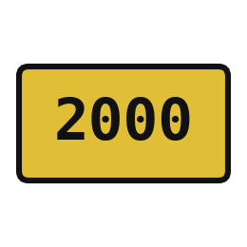
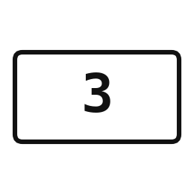
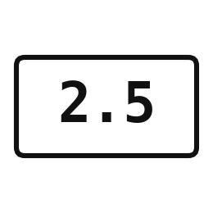
Words for today (1 of 2)
value
One piece of information, such as 2000 or Juice.
One entry in a receipt.
integer
A whole number with no decimal part.
Counting 3 books.
float
A number with a decimal part.
A price of 2500.5 shillings.
Notes:
First the words, because every one of them is used in the code later.
value. One piece of information, such as 2000 or Juice. You have seen this before. One entry in a receipt.
integer. A whole number with no decimal part. Counting 3 books.
float. A number with a decimal part. Think of a shop. A price of 2500.5 shillings.

Slide 5
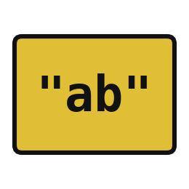

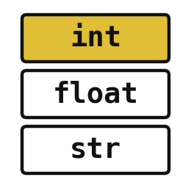
Words for today (2 of 2)
string
Text inside quotation marks.
A name written on a label.
variable
A name that points to a value.
A label on a box of stock.
type
The kind of value: integer, float or string.
Knowing whether a box holds pens or juice.
Notes:
Here are the rest of today's words.
string. Text inside quotation marks. Imagine it like this. A name written on a label.
variable. A name that points to a value. An example from everyday life. A label on a box of stock.
type. The kind of value: integer, float or string. Here is a way to see it. Knowing whether a box holds pens or juice.

Slide 6
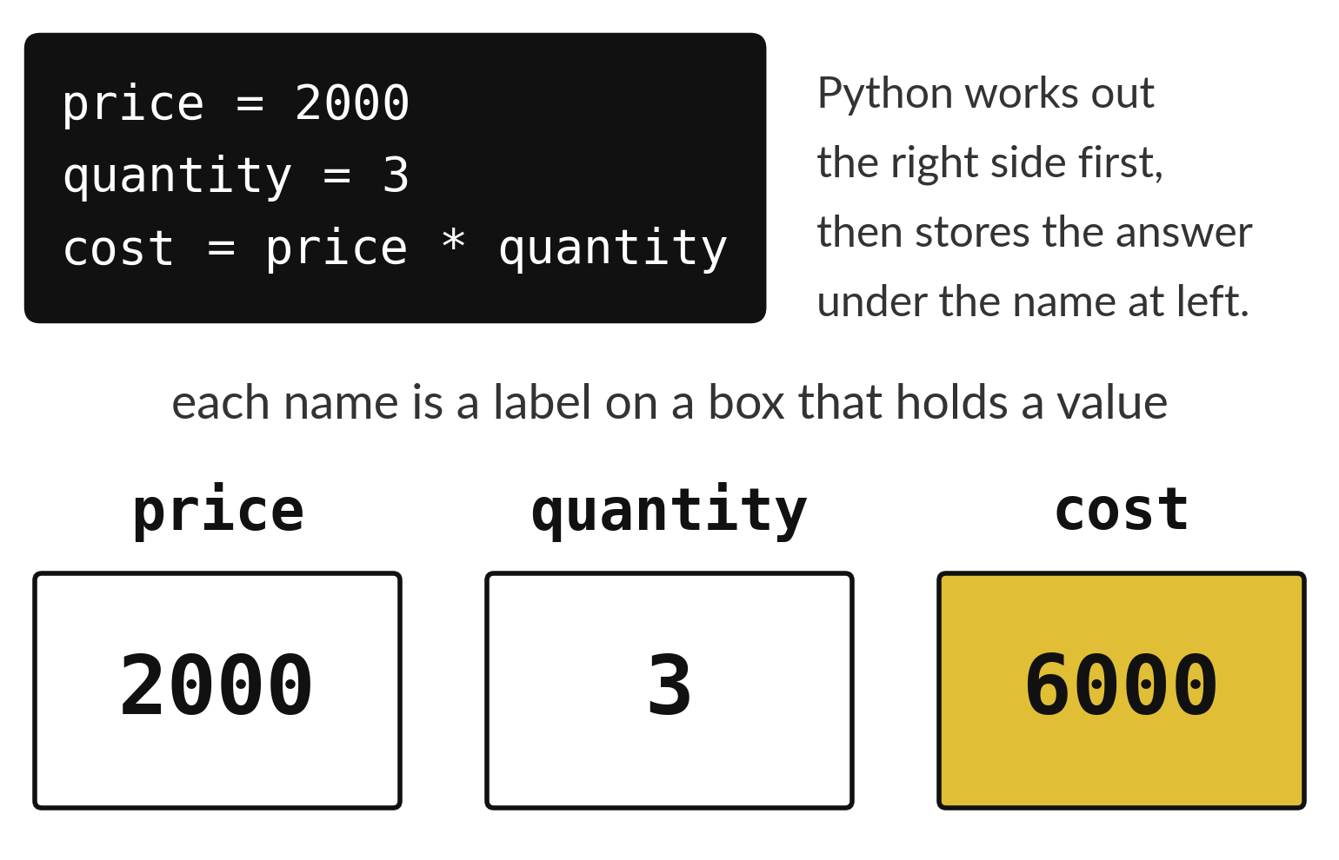
A variable is a labelled box that holds a value
The name is the label on the box.
The value is what sits inside.
The equals sign stores a value in a box.
Notes:
Picture the boxes in a storeroom. Every box has a label, and inside is what you counted. A variable is exactly that. The label is the name, like price. The contents are the value, like two thousand.
The equals sign puts a value into a labelled box. In the last line, Python works out price times quantity first, and then stores the answer in a new box called cost. What number ends up inside cost?

Slide 7
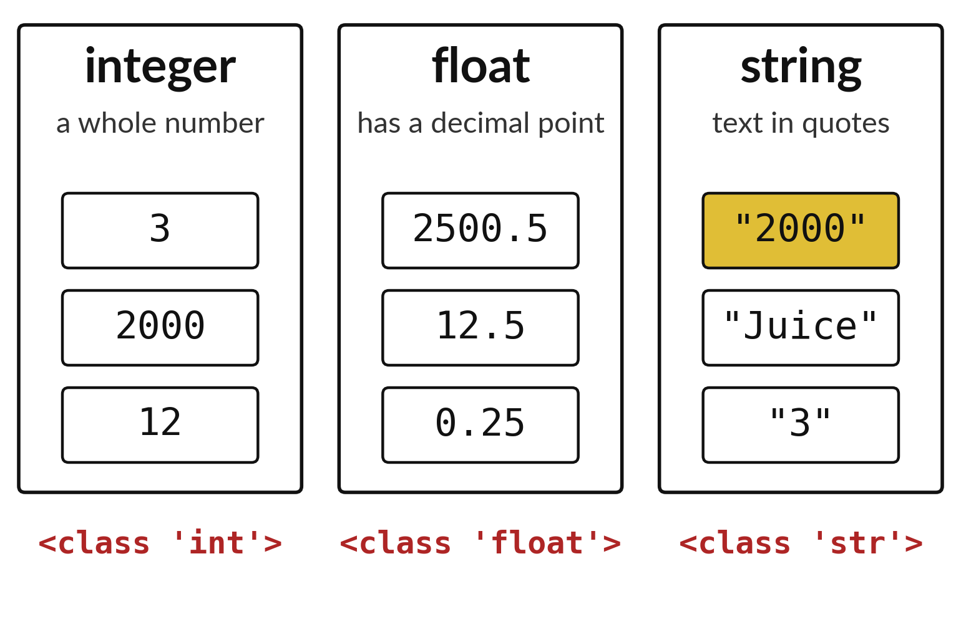
The type of a value decides
what you can do with it
A whole number is an integer.
A number with a decimal point is a float.
Text in quotation marks is a string.
Notes:
Python sorts every value into a type. Whole numbers are integers. Numbers with a decimal point are floats. Anything inside quotation marks is a string, which is a word for text.
Look at the string bin. The last example is the character three in quotation marks. It looks like a number, but Python treats it as text. Asking Python for the type tells you which bin a value is in.

Slide 8
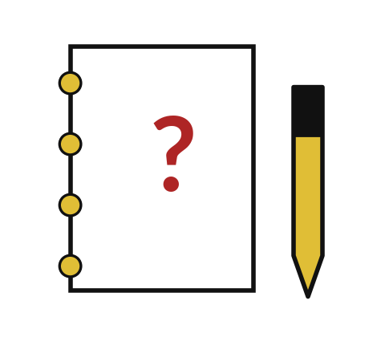
Predict: Names point to values
price = 2000
quantity = 3
cost = price * quantity
print(cost)
print(type(price))
print(type("2000"))
Predict the three lines the cell will print.
Write your guess on paper before we run it.
Notes:
A shop sells 3 items at UGX 2000 each.
This is the part where you decide. Predict the three lines the cell will print. Put it on paper first. We will check it together in a moment.

Slide 9
Run it: Names point to values
6000
<class 'int'>
<class 'str'>
The cell prints 6000, then <class 'int'>, then <class 'str'>.
price and quantity are variables.
2000 is an integer.
The quoted 2000 is a string, which is text.
The equals sign stores the value on its right under the name on its left.
Notes:
Let us see what happens. Match each line of the output with the line of code that made it.
The cell prints 6000, then <class 'int'>, then <class 'str'>. price and quantity are variables. 2000 is an integer. The quoted 2000 is a string, which is text. The equals sign stores the value on its right under the name on its left.
Which line of the output matches which line of the code? Point to each pair.

Slide 10
Investigate: Names point to values
1. Why is type("2000") a string?
2. What does the equals sign do in cost = price * quantity?
price = 2000
quantity = 3
cost = price * quantity
print(cost)
print(type(price))
print(type("2000"))
Notes:
Now we look closely at names point to values. I have two questions for you.
Question one. Why is type("2000") a string? Talk it over with your neighbour for a minute.
What I would say is this. Quotation marks make it text. Python cannot multiply it like an amount of money.
Question two. What does the equals sign do in cost = price * quantity? Think about it for a moment, then tell the person next to you.
Let me answer it. It calculates the right side first, then stores the answer under the name cost.

Slide 11
Modify: change one thing
Change quantity to 5 and run the whole cell again.
Then tell your neighbour what changed and how you know.
price = 2000
quantity = 3
cost = price * quantity
print(cost)
print(type(price))
print(type("2000"))
Notes:
Change one thing and watch what happens. Change quantity to 5 and run the whole cell again. When you have run it, tell your neighbour what changed and how you know.
Here is what happens. cost becomes 10000.

Slide 12

Break
15 minutes away from your screen
Stand up. Drink some water. Tell someone what you guessed in the first half.
Notes:
Break time. 15 minutes away from your screens. Stand up, drink some water and tell someone what you guessed in the first half.
When we come back we start the second idea.

Slide 13
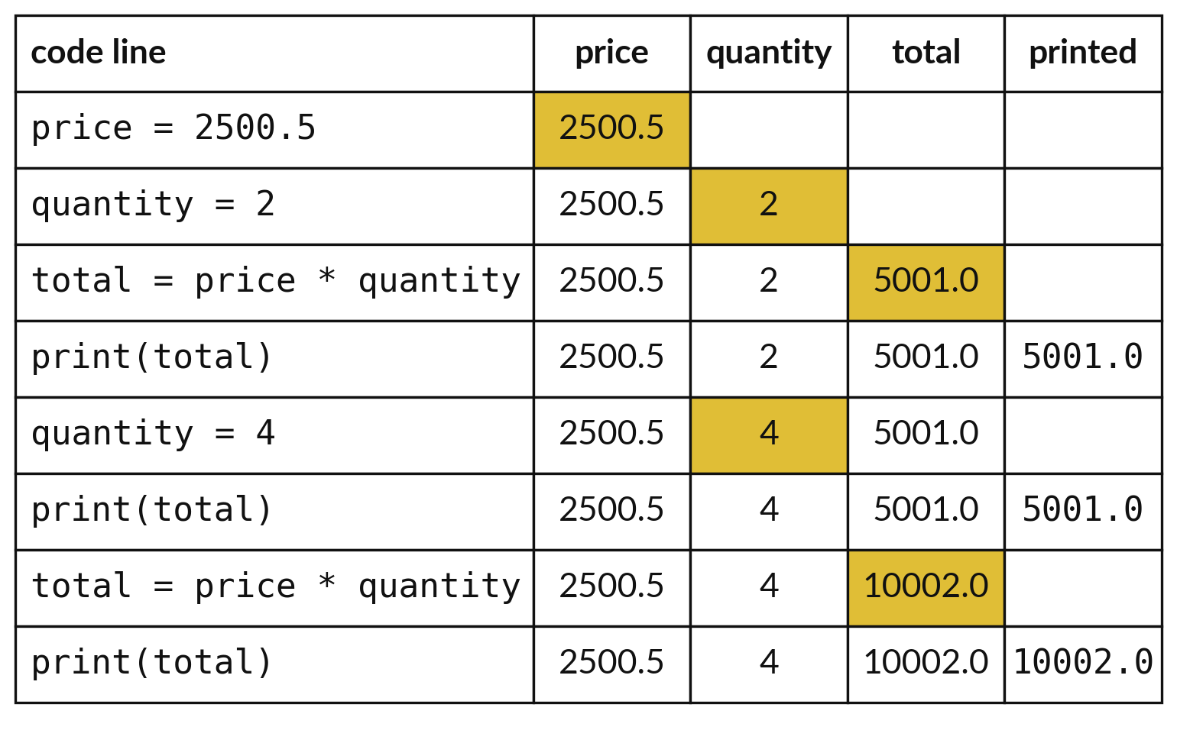
Python runs the lines from the top, one at a time
Each row is one line running.
Gold marks the value that just changed.
total changes only when its own line runs again.
Notes:
This table follows the notebook line by line. Gold marks the number that changed on that line. First price and quantity are stored. Then total is calculated and printed as five thousand and one.
Next, quantity becomes four. Look at the total column on that row. It has not moved, because the line that calculates total has not run again. Only when we run it again does total become ten thousand and two. Where would you expect surprises like this in your own notebooks?

Slide 14
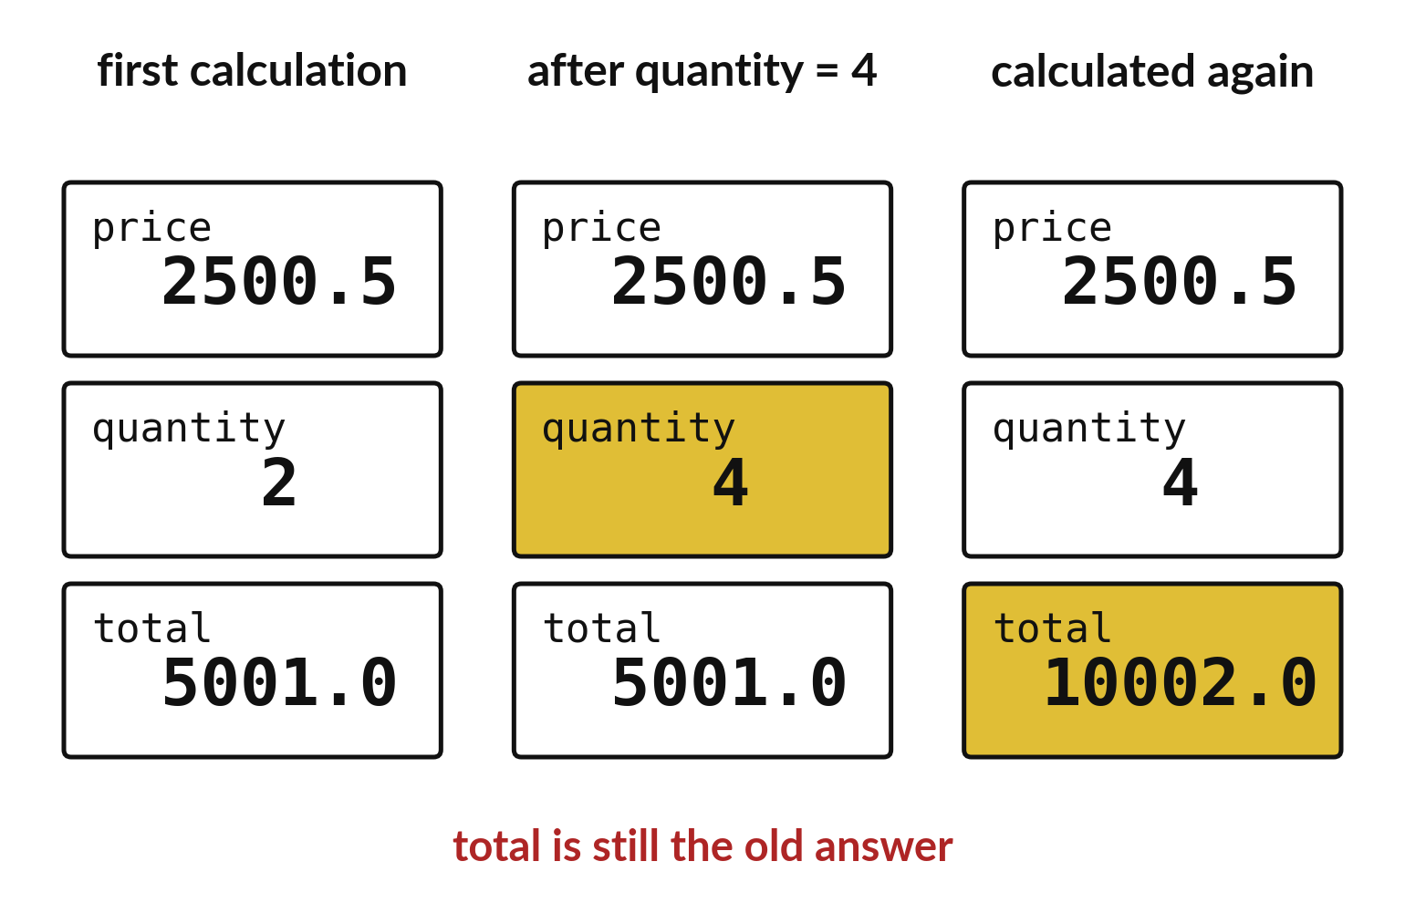
A calculated value waits until you calculate again
Changing quantity does not change total.
The line that calculates total must run again.
Python reads from the top down.
Notes:
Here is the same idea as three snapshots. In the first, total is five thousand and one. In the second we changed quantity, and total still says five thousand and one. In the third we ran the calculating line again and total caught up.
If a number in your notebook looks wrong after an edit, ask which line you forgot to run again.

Slide 15
Predict: A name keeps its value until you change it
price = 2500.5
quantity = 2
total = price * quantity
print(total)
quantity = 4
print(total)
total = price * quantity
print(total)
Predict the three numbers printed. Will the second one change after quantity changes?
Write your guess on paper before we run it.
Notes:
Here is the code. Read it line by line.
Make a prediction. Predict the three numbers printed. Will the second one change after quantity changes? Put your guess on paper now, even if you are unsure.

Slide 16
Run it: A name keeps its value until you change it
5001.0
5001.0
10002.0
The cell prints 5001.0, then 5001.0, then 10002.0.
2500.5 is a float.
Changing quantity does not change total until the line that calculates total runs again.
Python works from the top of the cell to the bottom.
Notes:
Running it now. Match each line of the output with the line of code that made it.
The cell prints 5001.0, then 5001.0, then 10002.0. 2500.5 is a float. Changing quantity does not change total until the line that calculates total runs again. Python works from the top of the cell to the bottom.
Keep your guess. We use it in the next step.

Slide 17
Investigate: A name keeps
its value until you change it
1. Why does the second print still show 5001.0?
2. What line makes the third number different?
price = 2500.5
quantity = 2
total = price * quantity
print(total)
quantity = 4
print(total)
total = price * quantity
print(total)
Notes:
Now we look closely at A name keeps its value until you change it. I have two questions for you.
Question one. Why does the second print still show 5001.0? Think about it for a moment, then tell the person next to you.
Let me answer it. total was calculated when quantity was 2. Python does not recalculate by itself.
Question two. What line makes the third number different? Have a go in your head first.
The answer is this. The second total = price * quantity line, which runs with quantity equal to 4.

Slide 18
Modify: change one thing
Set quantity to 10, recalculate total and print it.
Then tell your neighbour what changed and how you know.
price = 2500.5
quantity = 2
total = price * quantity
print(total)
quantity = 4
print(total)
total = price * quantity
print(total)
Notes:
Make one small change. Set quantity to 10, recalculate total and print it. Run it, then tell someone what you saw.
What you should find: The total is 25005.0.

Slide 19
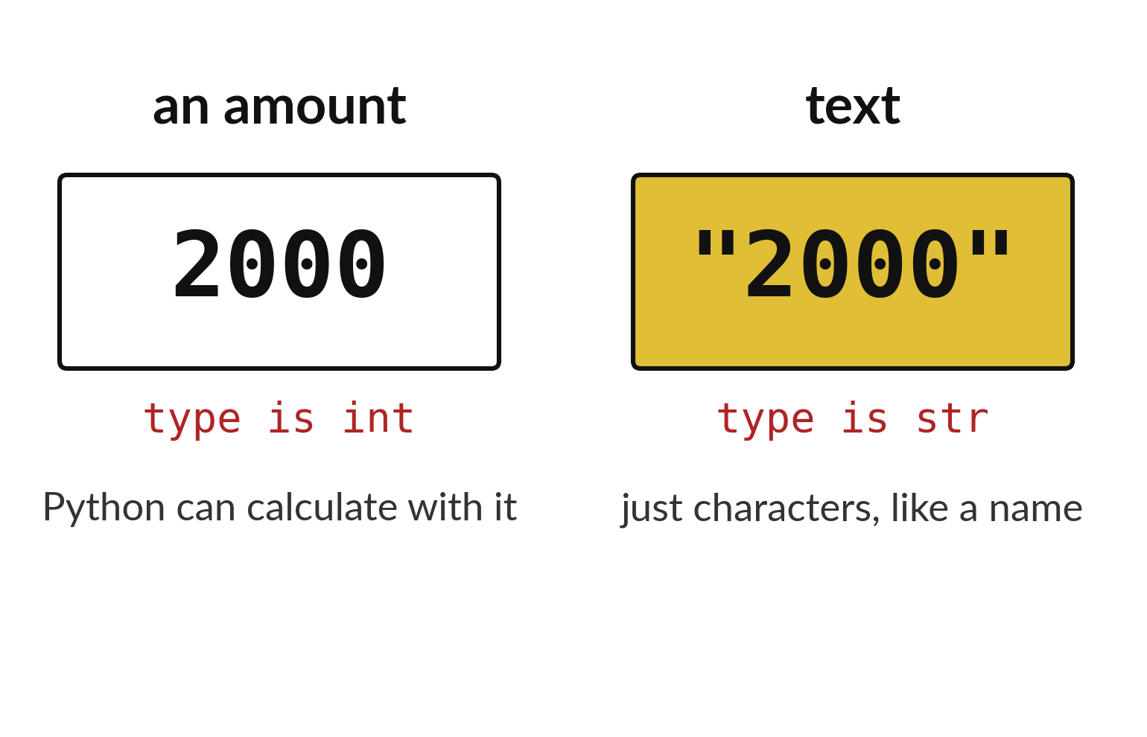
Quotation marks turn an amount into text
2000 is an amount Python can calculate with.
"2000" is characters, like a name.
The type tells you which one you have.
Notes:
To finish, look at these two values side by side. Both look like two thousand. The left one is an integer you can add and multiply. The right one has quotation marks, so Python sees four characters, like a name.
In the practice task you write one sentence about this difference. Use the word type in it.

Slide 20

Make: your own version
Create a decimal price of 2500.5 and a quantity of 2. Print the total. Write one sentence on why "2500.5" with quotation marks is different.
Save it as ML02. Write two sentences: what you changed and how you checked it.
Notes:
This task is yours. Run your code after every step so you can see where a problem begins. If you get stuck for a few minutes, read your error message, check the error card, and then ask me.
Save it as ML02. I will come round to each of you and ask what you changed and how you checked it.

Slide 21

Two errors you may meet today
It means: Python has not run a line that creates that name in this session.
Fix: Run the cell that creates the name first, and check the spelling and capital letters.
NameError: name 'price' is not defined
It means: You tried to multiply two pieces of text.
Fix: Remove the quotation marks around the number.
TypeError: can't multiply sequence by non-int of type 'str'
Notes:
Here are two errors from this session, so you recognise them when they appear.
This is the first one. You will see: NameError: name 'price' is not defined. It means this: Python has not run a line that creates that name in this session. To fix it, Run the cell that creates the name first, and check the spelling and capital letters.
The next one. You will see: TypeError: can't multiply sequence by non-int of type 'str'. It means this: you tried to multiply two pieces of text. To fix it, remove the quotation marks around the number.
When you are stuck, read the last line of the message first.

Slide 22
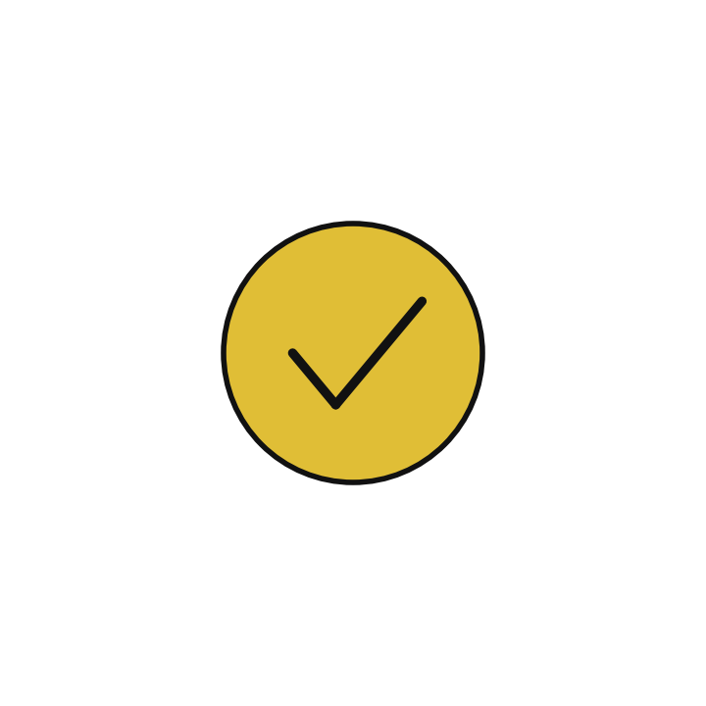
Finish this sentence in your notebook
A variable is a name that points to a value, and the value stays until I store a new one.
Then save your notebook, close it and open it again to check it saved.
Notes:
Last step. Our question for today was: What kind of thing is each part of a sale?
Finish this sentence in your notebook, in your own words. A variable is a name that points to a value, and the value stays until I store a new one.
Then save your notebook, close it and open it again to check it saved.

