Slide 1
Lists, dictionaries and loops
How do I repeat one calculation for every item in a list?
Machine Learning | Session 5 of 24 | Week 2, Python you need
Holiday Data and AI Camp | The National ICT Innovation Hub, Nakawa
Notes:
Here we go. Today is session 5 and our topic is lists, dictionaries and loops.
By the end of today you will be able to read a list position and a dictionary key, and trace a loop that adds up values.
We will answer one question: How do I repeat one calculation for every item in a list?

Slide 2
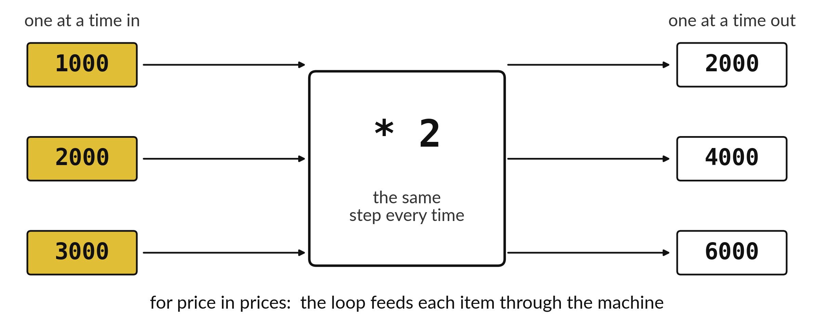
How do I repeat one calculation
for every item in a list?
Notes:
Here are three prices. We want every one of them doubled. We could write the sum three times, but with three hundred prices that would be tiring. The picture shows the trick. Feed the prices one at a time through the same machine, and collect the answers. In Python that idea is called a loop. Today you learn to store many values together and to loop over them.

Slide 3

Three hours, mostly doing
Most of our time is spent doing, in small steps, with a guess before every run.
Notes:
Here is how the 3 hours go. Each bar is as long as the time we spend on that part.
First, 10 minutes. Recall. Then, 50 minutes. Block A. After that, 15 minutes. Break away from screens. Next, 50 minutes. Block B. Then, 40 minutes. Make. Then, 15 minutes. Exit ticket, save, and an individual check with each learner.
Notice how much of the time is yours. You listen for a short while and then you do. That is on purpose, because you learn this by doing it.

Slide 4

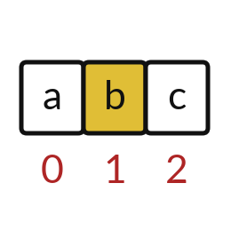
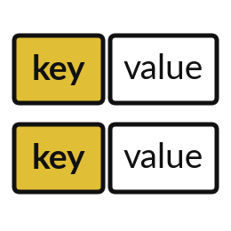
Words for today (1 of 2)
list
Several values kept in order inside square brackets.
A queue of customers.
index
The position of an item in a list, counting from 0.
The house number of a plot.
dictionary
Pairs of a name and a value inside curly brackets.
A phone book of names and numbers.
Notes:
First the words, because every one of them is used in the code later.
list. Several values kept in order inside square brackets. A queue of customers.
index. The position of an item in a list, counting from 0. Think of a shop. The house number of a plot.
dictionary. Pairs of a name and a value inside curly brackets. Imagine it like this. A phone book of names and numbers.

Slide 5

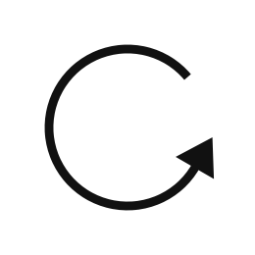
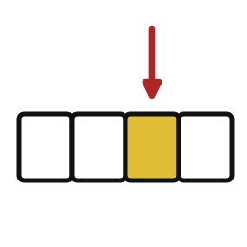
Words for today (2 of 2)
key
The name used to look up a value in a dictionary.
The name you look up in a phone book.
loop
A for statement that repeats indented lines for every item.
Giving each pupil in a row a book.
item
One value taken from a list during a loop.
The pupil currently getting a book.
Notes:
Here are the rest of today's words.
key. The name used to look up a value in a dictionary. An example from everyday life. The name you look up in a phone book.
loop. A for statement that repeats indented lines for every item. Here is a way to see it. Giving each pupil in a row a book.
item. One value taken from a list during a loop. A small example. The pupil currently getting a book.

Slide 6
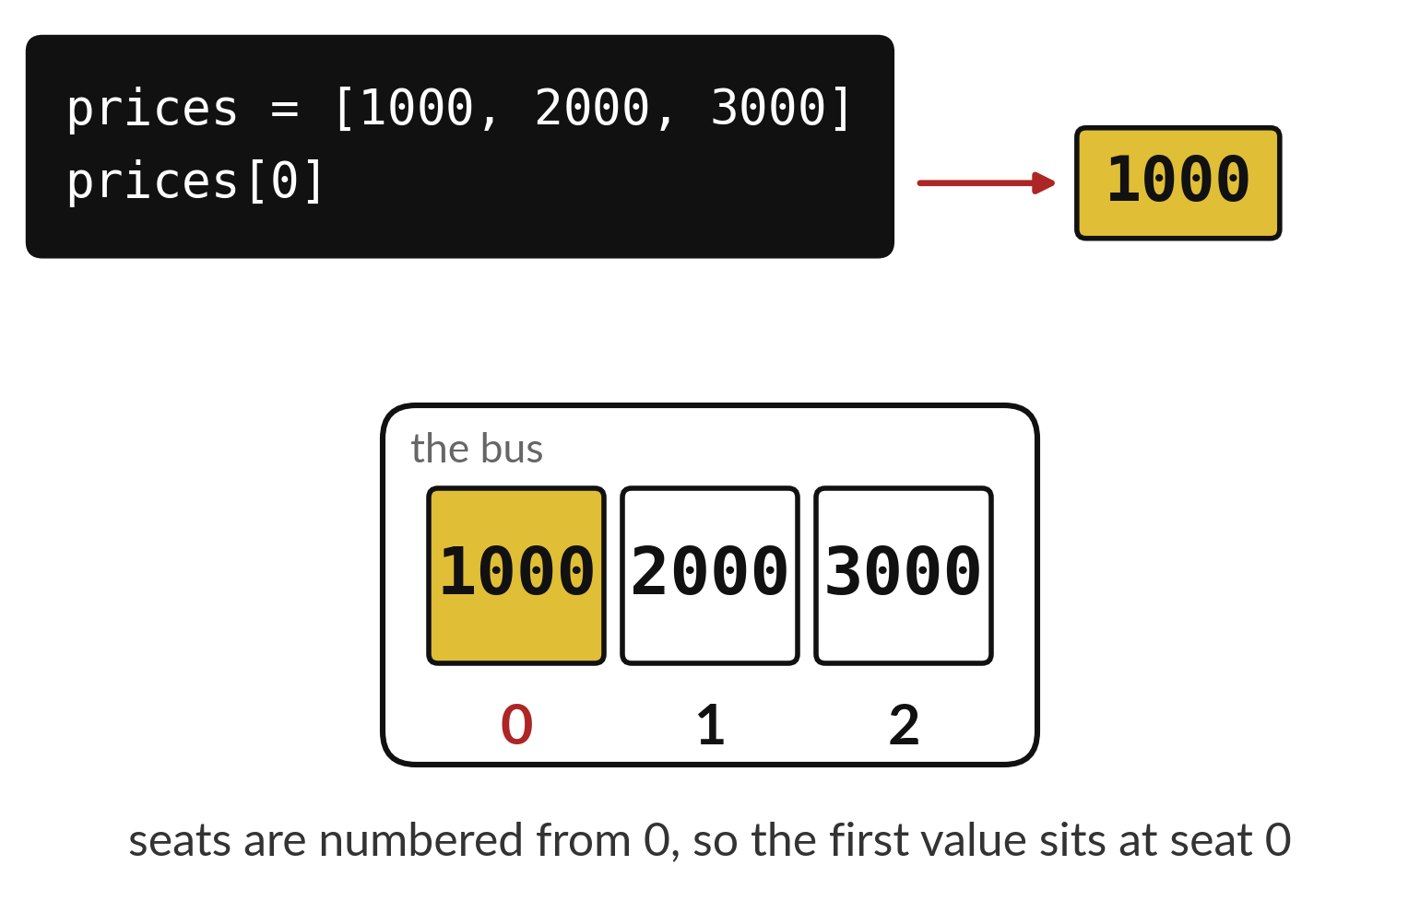
A list numbers its seats from zero
A list keeps values in order.
The first seat is number 0.
Square brackets pick one seat.
Notes:
Imagine a bus where every seat has a number painted on it. A list is like that. The values sit in order, and each seat has a number called an index. The surprise is that counting starts at zero.
So prices with a zero in brackets gives the first price, one thousand. What would prices with a two in brackets give?

Slide 7
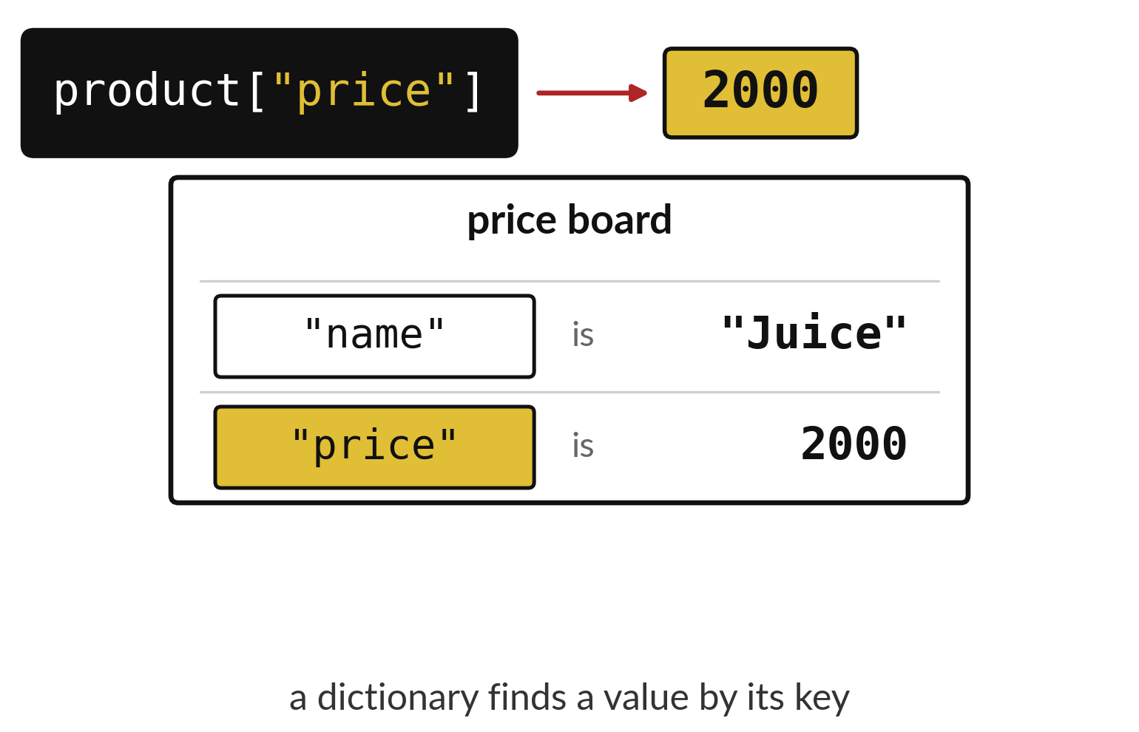
A dictionary finds a value by its key
Each key has a value beside it.
Ask for the key to get its value.
A list uses seat numbers, a dictionary uses names.
Notes:
A dictionary is a board of labelled facts. This board describes one product. It has a name and a price. You do not ask for the second row. You ask for price, and the board answers two thousand. The name you ask for is called the key.
If you ask for a key that is not on the board, Python stops with a KeyError. Which small spelling slip would cause that?

Slide 8

Predict: Lists and dictionaries
prices = [1000, 2000, 3000]
product = {"name": "Juice", "price": 2000}
first = prices[0]
juice_price = product["price"]
print(first)
print(juice_price)
print(len(prices))
Predict what prints. Which number is prices[0]?
Write your guess on paper before we run it.
Notes:
A tuck shop keeps three prices in a list and one product in a dictionary.
Now your guess. Predict what prints. Which number is prices[0]? Jot it on paper before anyone speaks.

Slide 9
Run it: Lists and dictionaries
1000
2000
3
The cell prints 1000, 2000 and 3.
Square brackets after a list give the item at that index, and the first index is 0.
Square brackets after a dictionary give the value for that key.
len counts the items in a list.
Notes:
Watch the output as it appears. Match each line of the output with the line of code that made it.
The cell prints 1000, 2000 and 3. Square brackets after a list give the item at that index, and the first index is 0. Square brackets after a dictionary give the value for that key. len counts the items in a list.
Tell the person next to you whether your guess matched.

Slide 10

Investigate: Lists and dictionaries
1. Why is prices[0] the first price?
2. What happens if you ask for prices[3]?
Notes:
Now we look closely at lists and dictionaries. I have two questions for you.
Question one. Why is prices[0] the first price? Write your answer in one line before we compare.
Here is how I would answer it. Python counts positions from 0.
Question two. What happens if you ask for prices[3]? Say it quietly to yourself before anyone answers.
What I would say is this. An IndexError. The list has positions 0, 1 and 2 only.

Slide 11
Modify: change one thing
Print the last price using its index.
Then tell your neighbour what changed and how you know.
prices = [1000, 2000, 3000]
product = {
"name": "Juice", "price": 2000
}
first = prices[0]
juice_price = product["price"]
print(first)
print(juice_price)
print(len(prices))
Notes:
Your hands on the keyboard now. Print the last price using its index. Run it, then tell someone what you saw.
What you should find: prices[2] gives 3000.

Slide 12

Break
15 minutes away from your screen
Stand up. Drink some water. Tell someone what you guessed in the first half.
Notes:
Break time. 15 minutes away from your screens. Stand up, drink some water and tell someone what you guessed in the first half.
When we come back we start the second idea.

Slide 13
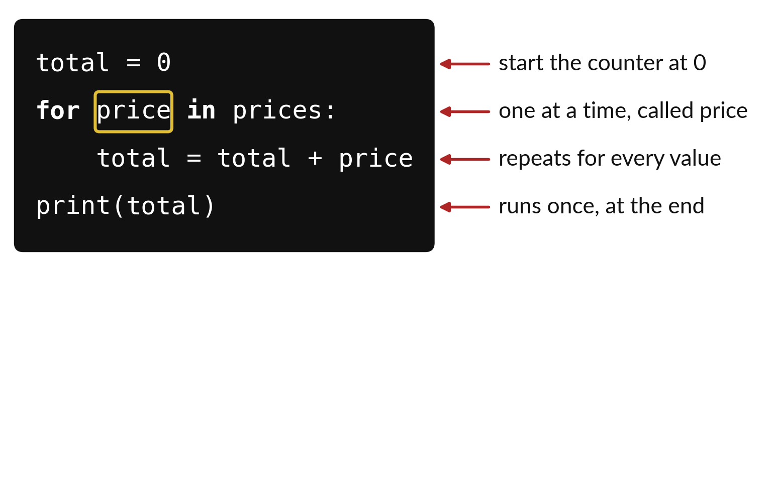
A loop repeats the same lines for every item
price stands for one item at a time.
The indented lines repeat for every item.
The last line runs once, after the loop.
Notes:
A loop is a way of saying do this for each one. The second line takes the prices one at a time and calls the current one price. Everything indented below it is the work that repeats. The last line has no indent, so it waits until the loop has finished.
Say the code in plain English to your neighbour: for each price, add it to the total. Then say what the last line does.

Slide 14
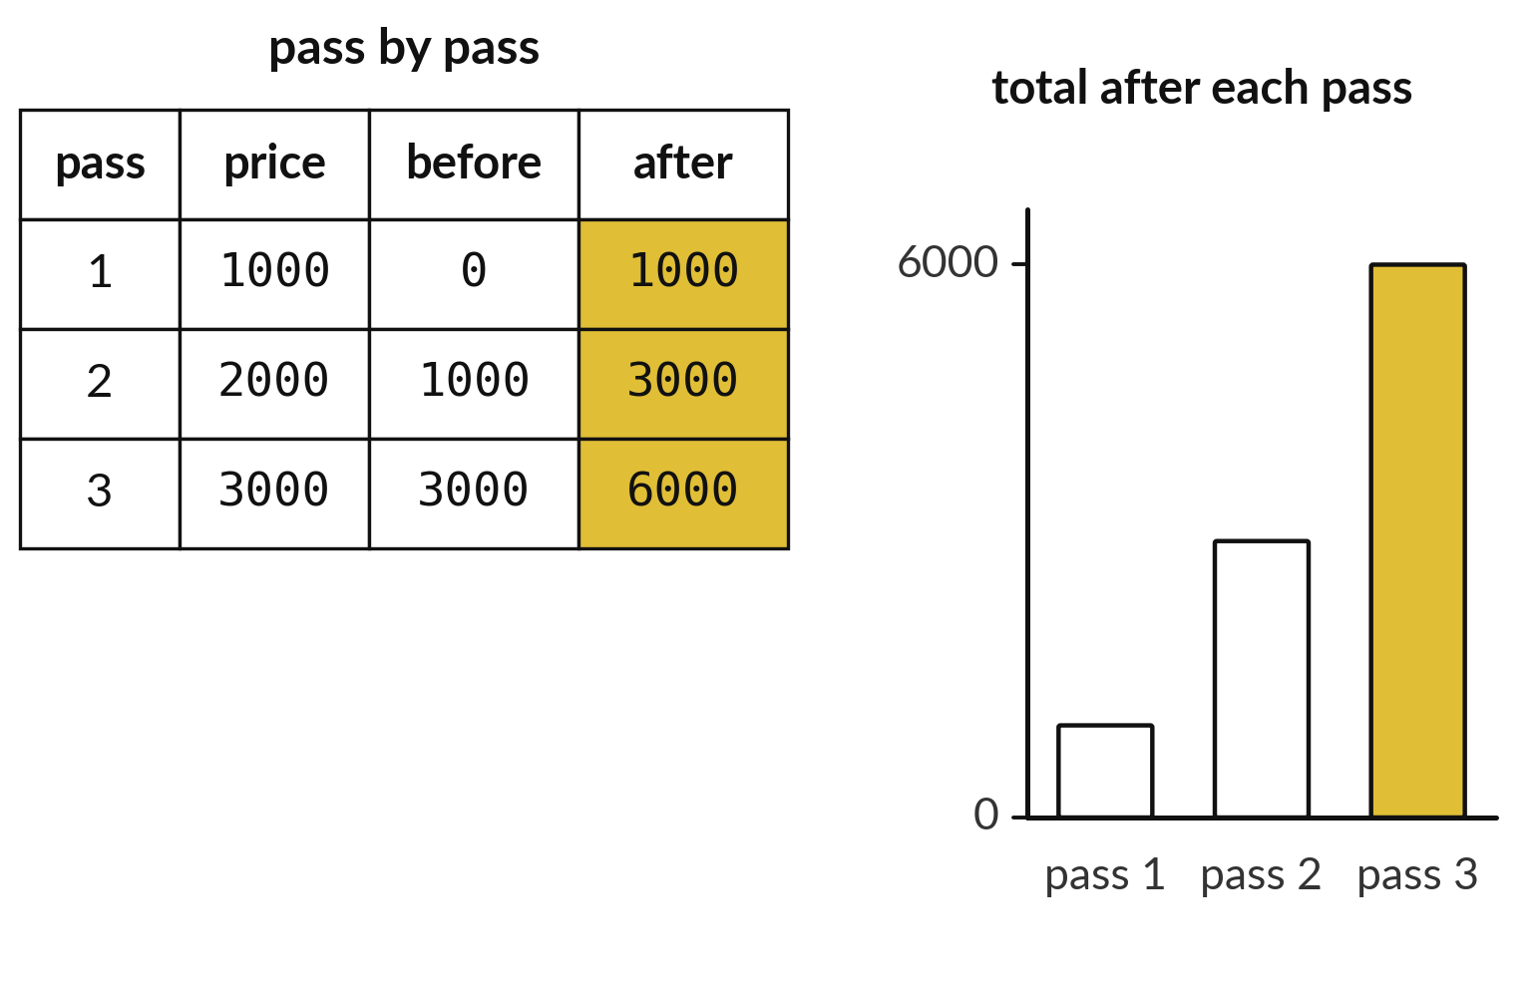
The running total grows one item at a time
Each pass adds the current price.
The total after one pass is the total before the next.
The last total is the answer.
Notes:
This table follows the loop pass by pass. On pass one the total is zero and we add one thousand. On pass two the total is one thousand and we add two thousand. On pass three we add three thousand and reach six thousand.
The bars on the right show the growth. Cover the last row and predict the final total before you look.

Slide 15
Predict: A loop that adds
prices = [1000, 2000, 3000]
total = 0
for price in prices:
print(price * 2)
total = total + price
print(total)
Predict the four numbers printed.
Write your guess on paper before we run it.
Notes:
Read this code slowly first, quietly, in your head.
This is the part where you decide. Predict the four numbers printed. Guess on paper first. Surprises are useful.

Slide 16
Run it: A loop that adds
2000
4000
6000
6000
The cell prints 2000, 4000, 6000 and then 6000.
for price in prices takes one item at a time and runs the indented lines for it.
total starts at 0 and grows by the item each pass: 1000, then 3000, then 6000.
Notes:
Let us see what happens. Match each line of the output with the line of code that made it.
The cell prints 2000, 4000, 6000 and then 6000. for price in prices takes one item at a time and runs the indented lines for it. total starts at 0 and grows by the item each pass: 1000, then 3000, then 6000.
Which line of the output matches which line of the code? Point to each pair.

Slide 17
Investigate: A loop that adds
1. What is total after the second pass?
2. What goes wrong if total = 0 is moved inside the loop?
prices = [1000, 2000, 3000]
total = 0
for price in prices:
print(price * 2)
total = total + price
print(total)
Notes:
Now we look closely at A loop that adds. I have two questions for you.
Question one. What is total after the second pass? Say it quietly to yourself before anyone answers.
What I would say is this. 3000, which is 1000 plus 2000.
Question two. What goes wrong if total = 0 is moved inside the loop? Give it thirty seconds and then we will hear a few answers.
Let me answer it. total restarts at 0 on every pass, so only the last item remains.

Slide 18
Modify: change one thing
Change the list to [1500, 2500] and run the loop again.
Then tell your neighbour what changed and how you know.
prices = [1000, 2000, 3000]
total = 0
for price in prices:
print(price * 2)
total = total + price
print(total)
Notes:
Change one thing and watch what happens. Change the list to [1500, 2500] and run the loop again. After you run it, say in one sentence what changed and how you checked.
You should see this. The final total is 4000.

Slide 19
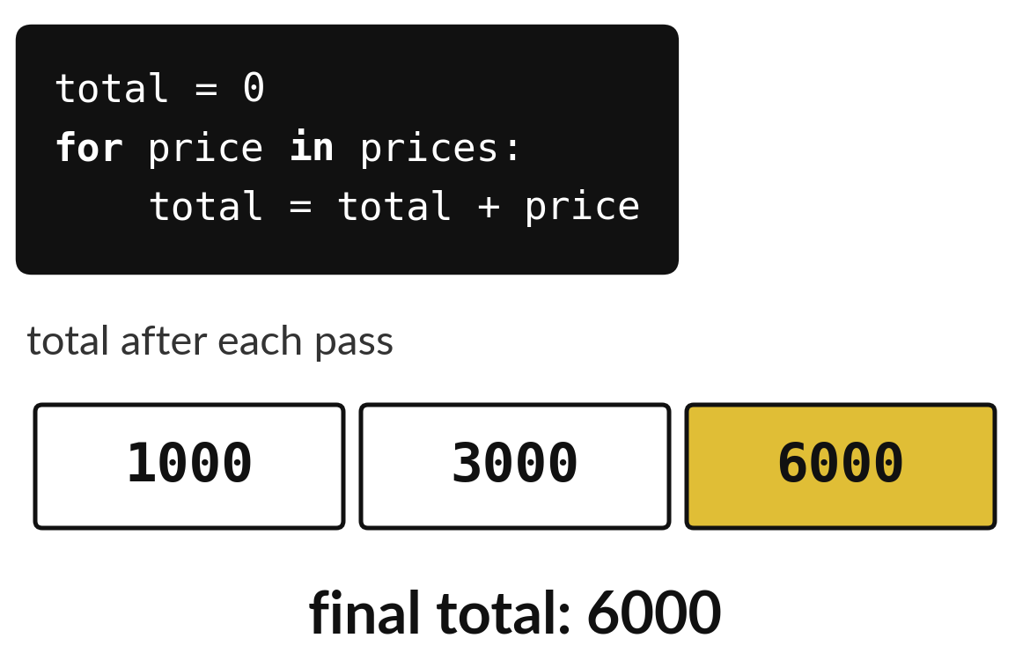
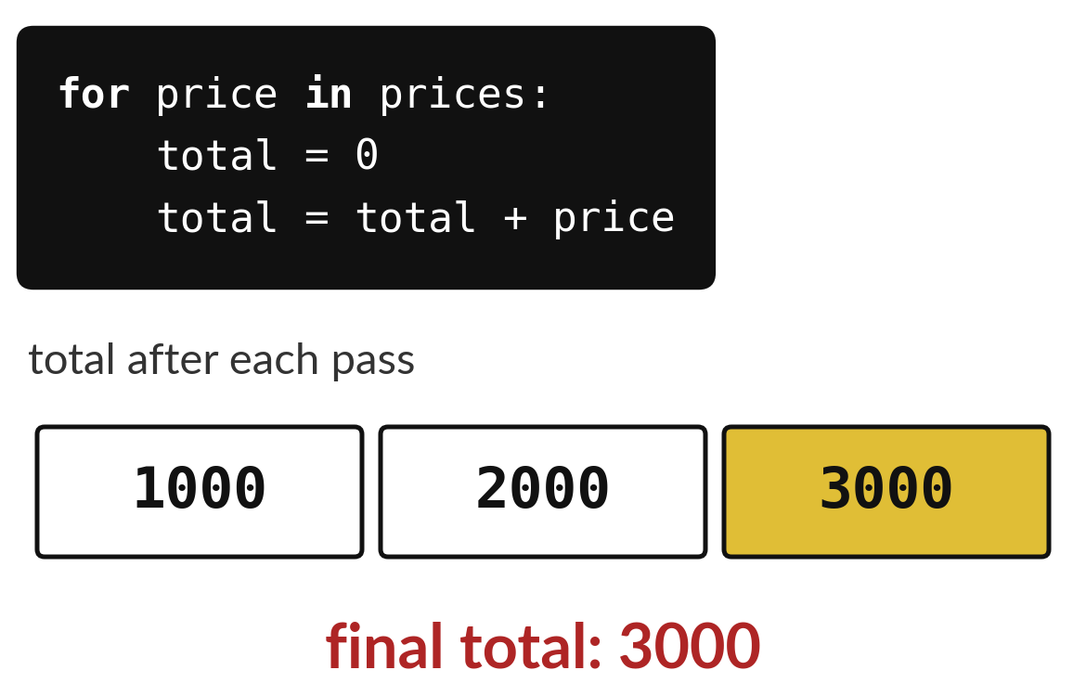
Where the counter starts decides the answer
Counter set to 0 once, before the loop: the total keeps growing.
Counter set to 0 inside the loop: it restarts every pass.
Notes:
One line moved and the answer changed completely. On the left the counter is set to zero once, before the loop, and the total reaches six thousand. On the right the zero sits inside the loop, so it resets on every pass and ends with just the last price.
If your total looks like only the last value, look for a line that resets it inside the loop.

Slide 20

Make: your own version
Make the list [2, 4, 6] and print each value plus 1 with a loop. Make a dictionary with the keys name and stock and print the stock. Then loop over the eight petal lengths 1.4, 1.4, 4.7, 4.5, 4.9, 6.0, 5.1, 5.9 and count how many are below 2.5.
Save it as ML05. Write two sentences: what you changed and how you checked it.
Notes:
This task is yours. Run your code after every step so you can see where a problem begins. If you get stuck for a few minutes, read your error message, check the error card, and then ask me.
Save it as ML05. I will come round to each of you and ask what you changed and how you checked it.

Slide 21

Two errors you may meet today
It means: You asked for a position the list does not have.
Fix: A list of 3 items has positions 0, 1 and 2.
IndexError: list index out of range
It means: The dictionary has no key spelled like that.
Fix: Check the exact spelling and capital letters of the key.
KeyError: 'price'
Notes:
Here are two errors from this session, so you recognise them when they appear.
This is the first one. You will see: IndexError: list index out of range. It means this: you asked for a position the list does not have. To fix it, A list of 3 items has positions 0, 1 and 2.
The next one. You will see: KeyError: 'price'. It means this: the dictionary has no key spelled like that. To fix it, check the exact spelling and capital letters of the key.
When you are stuck, read the last line of the message first.

Slide 22

Finish this sentence in your notebook
A loop repeats the same lines for every item, and a total that starts at 0 grows each pass.
Then save your notebook, close it and open it again to check it saved.
Notes:
Last step. Our question for today was: How do I repeat one calculation for every item in a list?
Finish this sentence in your notebook, in your own words. A loop repeats the same lines for every item, and a total that starts at 0 grows each pass.
Then save your notebook, close it and open it again to check it saved.

