Slide 1
Charts that show what the numbers say
How do I show which item earns most, and how sales vary, in a picture?
Machine Learning | Session 11 of 24 | Week 4, Clean, chart, question
Holiday Data and AI Camp | The National ICT Innovation Hub, Nakawa
Notes:
Good to see you. Today is session 11 and our topic is charts that show what the numbers say.
By the end of today you will be able to draw a labelled bar chart, a histogram and a box plot, and write one finding and one limitation.
We will answer one question: How do I show which item earns most, and how sales vary, in a picture?

Slide 2
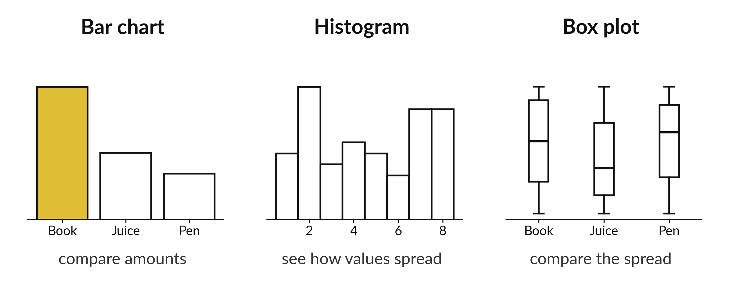
How do I show which item earns
most, and how sales vary, in a picture?
Notes:
Here are three charts of the same shop. A bar chart compares amounts. A histogram shows how values are spread. A box plot compares the spread of several groups. Each chart answers a different question, so choosing the right one is half the job. Today you draw all three and write one careful sentence about each.

Slide 3

Three hours, mostly doing
Most of our time is spent doing, in small steps, with a guess before every run.
Notes:
Here is how the 3 hours go. Each bar is as long as the time we spend on that part.
First, 10 minutes. Recall. Then, 50 minutes. Block A. After that, 15 minutes. Break away from screens. Next, 50 minutes. Block B. Then, 40 minutes. Make. Then, 15 minutes. Exit ticket, save, and an individual check with each learner.
Notice how much of the time is yours. You listen for a short while and then you do. That is on purpose, because you learn this by doing it.

Slide 4

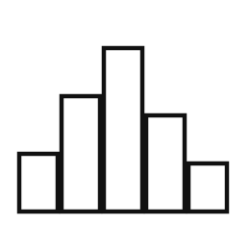

Words for today (1 of 2)
bar chart
Bars compare a number across categories.
Stacks of coins, one stack per item.
histogram
Bars show how many values fall in each range.
Sorting pupils into groups by height.
box plot
A box shows the middle half of the values, with a line at the median.
A summary of a class's marks in one picture.
Notes:
First the words, because every one of them is used in the code later.
bar chart. Bars compare a number across categories. You have seen this before. Stacks of coins, one stack per item.
histogram. Bars show how many values fall in each range. Sorting pupils into groups by height.
box plot. A box shows the middle half of the values, with a line at the median. Think of a shop. A summary of a class's marks in one picture.

Slide 5

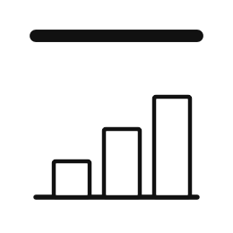

Words for today (2 of 2)
axis label
Words that name what an axis measures, with its unit.
The heading on a column in a register.
title
One line saying what the chart shows.
The heading of a notice.
finding
A claim a chart supports, with a number.
Book earns the most money: UGX 297000.
Notes:
Here are the rest of today's words.
axis label. Words that name what an axis measures, with its unit. Imagine it like this. The heading on a column in a register.
title. One line saying what the chart shows. An example from everyday life. The heading of a notice.
finding. A claim a chart supports, with a number. Here is a way to see it. Book earns the most money: UGX 297000.

Slide 6
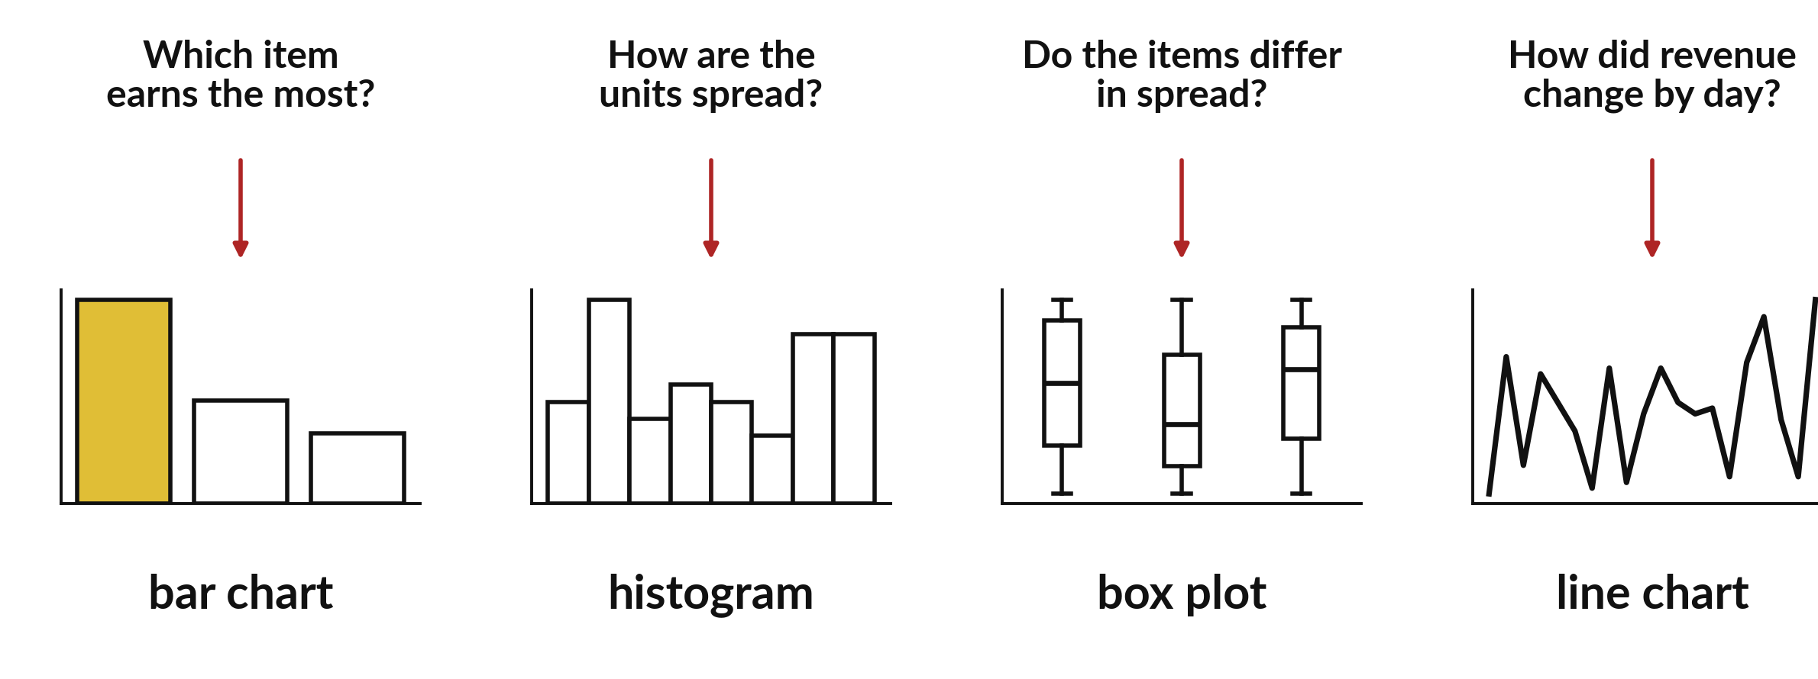
Match the chart to the question you are asking
Which is largest? Use a bar chart. How are values spread? Use a histogram. Do groups differ in spread? Use a box plot.
Notes:
Do not start with the chart. Start with the question. If you ask which item earns the most, you want bars. If you ask how the units in a sale are spread, you want a histogram. If you want to compare groups, a box plot puts them side by side.
Look at the three questions and say which chart you would choose for each.

Slide 7
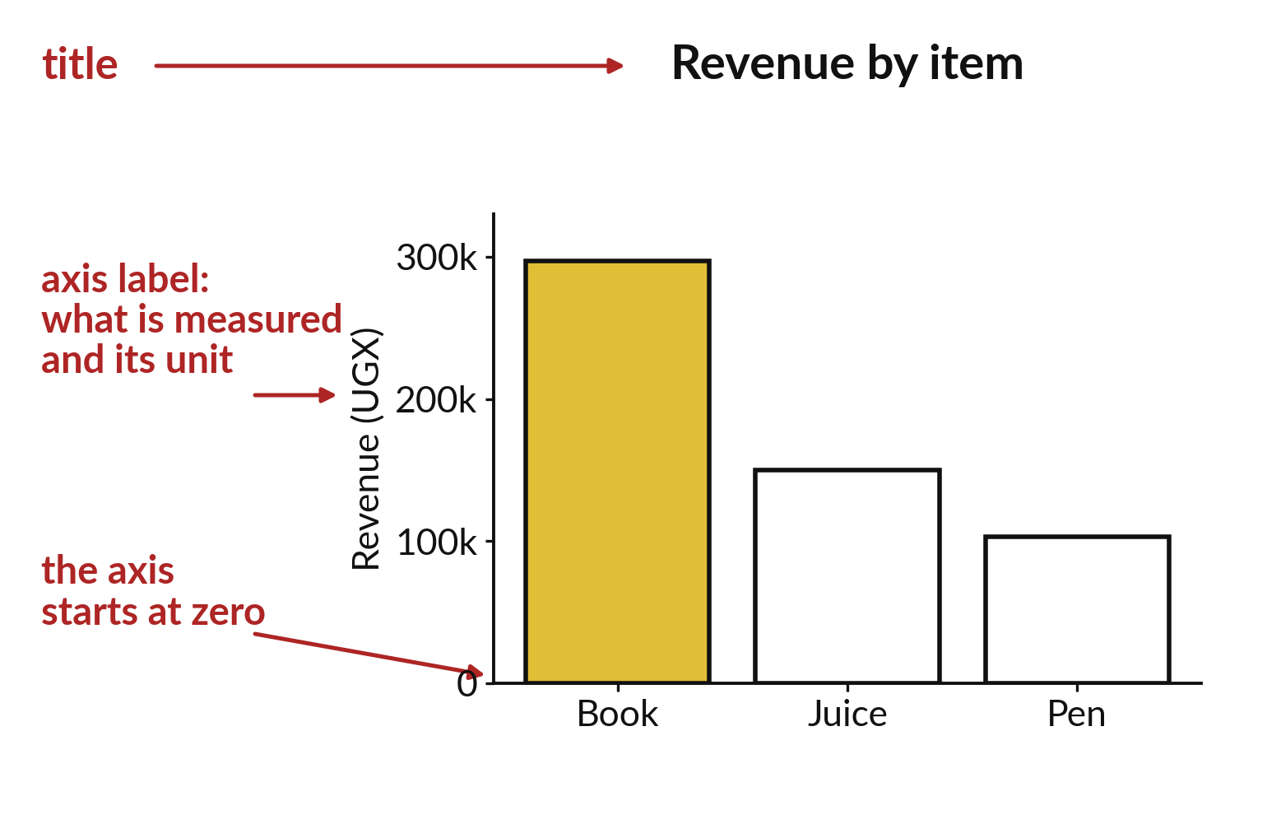
A chart needs a title, axis labels and a zero start
The title says what the chart shows.
Axis labels give the unit.
Bars start at zero.
Notes:
Every chart needs a title, and each axis needs a label with its unit. Bars must start at zero. If they start higher, a small difference looks enormous.
Find the axis label and the zero line in the picture. Could a stranger read this chart without asking you anything?

Slide 8

Predict: A bar chart of revenue
import matplotlib.pyplot as plt
import pandas as pd
shop = pd.read_csv("camp_shop.csv")
shop["revenue_ugx"] = shop["units"] * shop["unit_price_ugx"]
totals = shop.groupby("item")["revenue_ugx"].sum()
plt.bar(totals.index, totals.values)
plt.ylabel("Revenue (UGX)")
plt.title("Revenue by item in the practice shop")
plt.ylim(bottom=0)
plt.show()
Predict which bar will be tallest and roughly how tall.
Write your guess on paper before we run it.
Notes:
Chart the revenue of each item from the practice shop. Label the axis with its unit.
This is the part where you decide. Predict which bar will be tallest and roughly how tall. Put it on paper first. We will check it together in a moment.

Slide 9
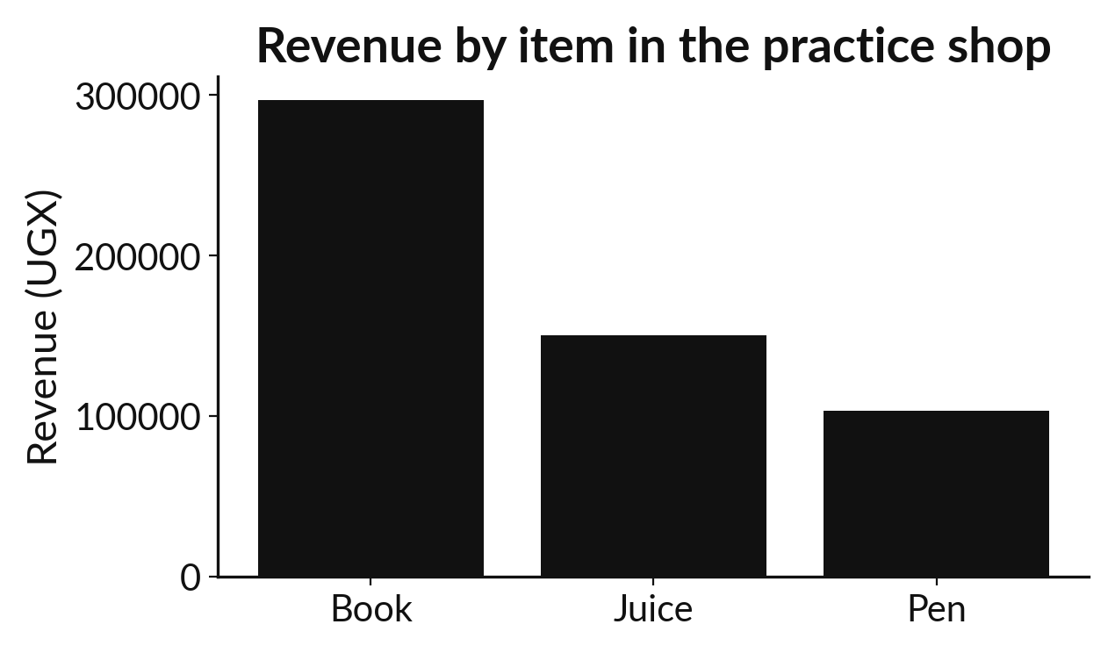
Run it: A bar chart of revenue
Three bars appear.
Book is tallest at 297000, then Juice at 150000 and Pen at 103000.
plt is the chart tool from matplotlib.
ylabel and title add words, and ylim(bottom=0) starts the axis at zero so bar heights are fair.
Notes:
Let us see what happens. Match each line of the output with the line of code that made it.
Three bars appear. Book is tallest at 297000, then Juice at 150000 and Pen at 103000. plt is the chart tool from matplotlib. ylabel and title add words, and ylim(bottom=0) starts the axis at zero so bar heights are fair. One finding is: Book earns the most, UGX 297000 of 550000. One limitation is: the data is invented and has no costs.
Which line of the output matches which line of the code? Point to each pair.

Slide 10

Investigate: A bar chart of revenue
1. Why must a bar chart start at zero?
2. Does the chart tell us why Book earns most?
Notes:
Now we look closely at A bar chart of revenue. I have two questions for you.
Question one. Why must a bar chart start at zero? Talk it over with your neighbour for a minute.
What I would say is this. A bar's height should match its size. A cut-off axis exaggerates small differences.
Question two. Does the chart tell us why Book earns most? Think about it for a moment, then tell the person next to you.
Let me answer it. No. It shows the totals only; the reason is a separate question.

Slide 11

Modify: change one thing
Chart total units instead of revenue.
Then tell your neighbour what changed and how you know.
Notes:
Change one thing and watch what happens. Chart total units instead of revenue. When you have run it, tell your neighbour what changed and how you know.
Here is what happens. Pen is now tallest, with 103 units.

Slide 12

Break
15 minutes away from your screen
Stand up. Drink some water. Tell someone what you guessed in the first half.
Notes:
Break time. 15 minutes away from your screens. Stand up, drink some water and tell someone what you guessed in the first half.
When we come back we start the second idea.

Slide 13
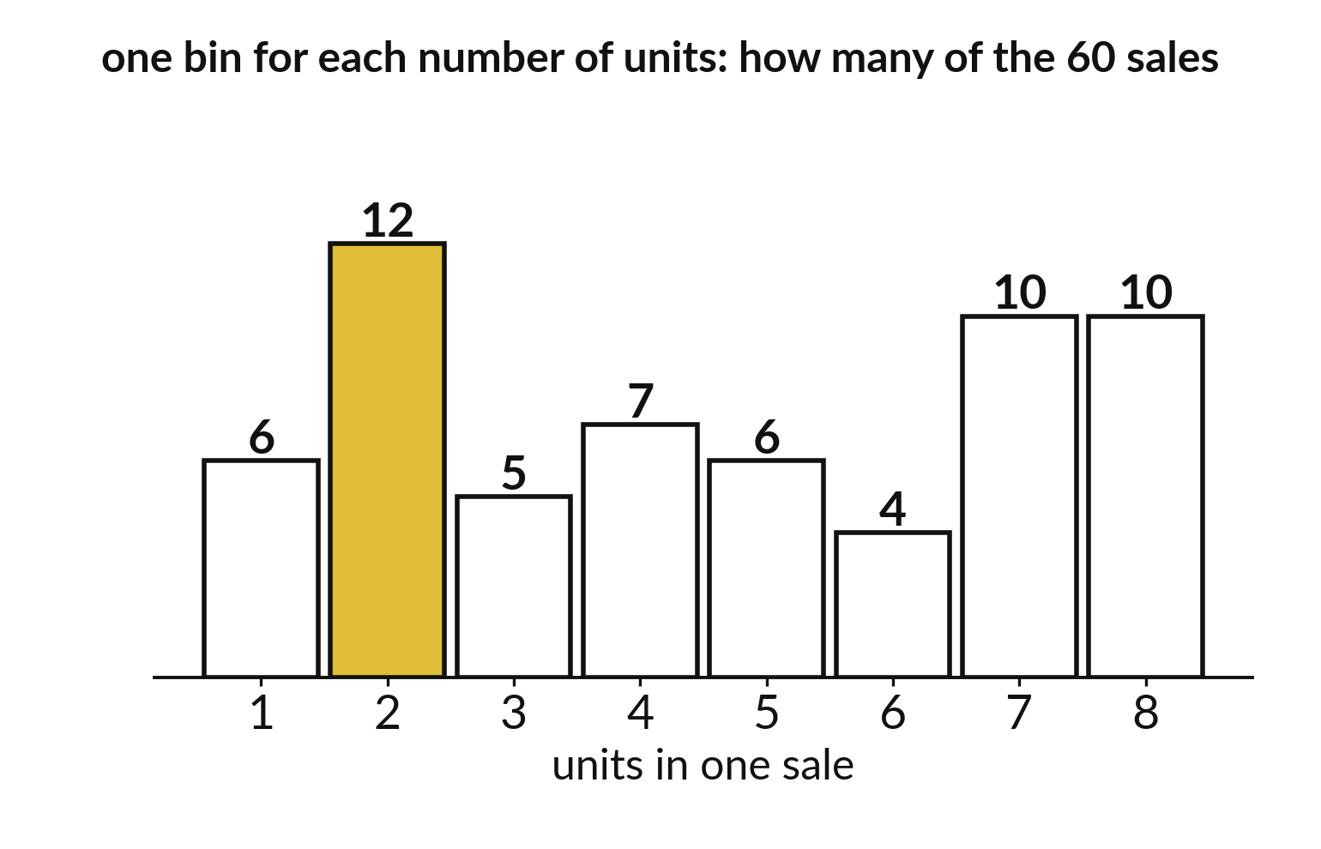
A histogram counts how
many values fall in each bin
Each bar is a bin.
The height counts the sales in it.
Change the bins and the shape changes.
Notes:
A histogram cuts the number line into bins and counts how many values land in each. The taller the bar, the more sales had that number of units.
The shape depends on the bins you choose, so try two or three settings before you describe it.

Slide 14
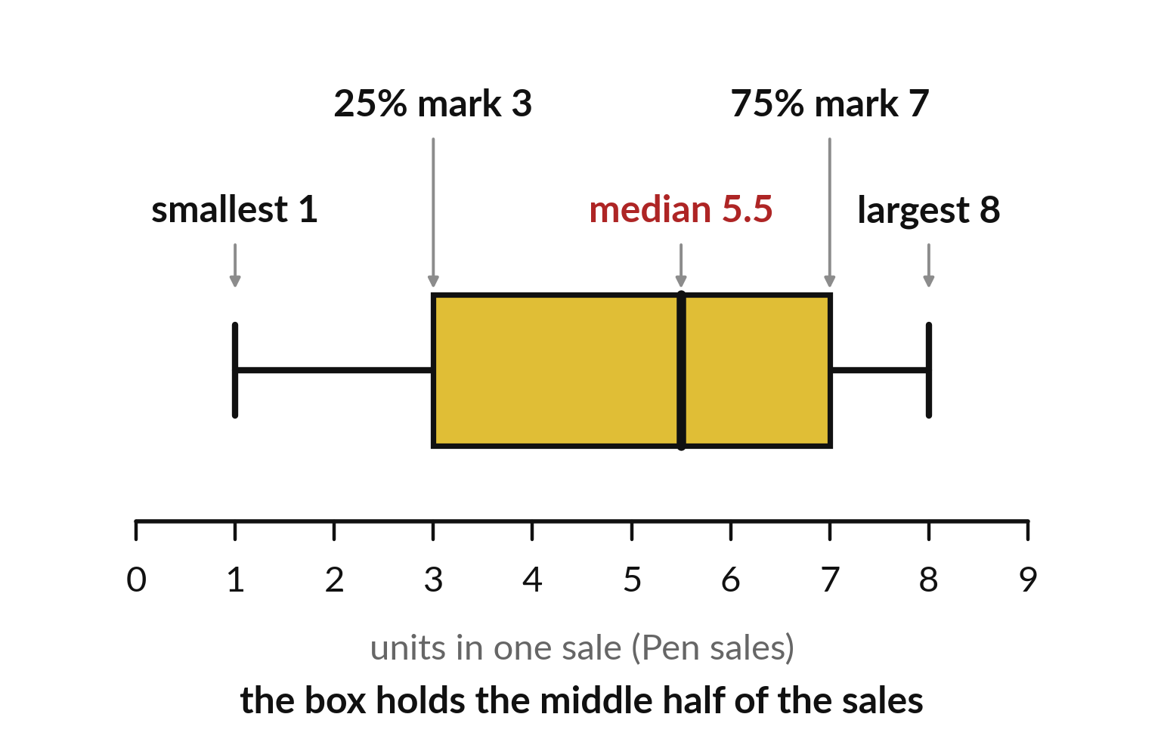
A box holds the middle half of the values
The line in the box is the median.
The box spans the middle half.
The whiskers show the rest of the spread.
Notes:
A box plot packs the spread of a column into one small drawing. The line inside the box is the median. The box itself holds the middle half of the values. The whiskers reach out towards the smallest and largest.
Compare two boxes. Which one has the higher median, and which one is more spread out?

Slide 15
Predict: A histogram and a box plot
import seaborn as sns
sns.histplot(data=shop, x="units", discrete=True)
plt.title("Units per sale")
plt.show()
sns.boxplot(data=shop, x="item", y="units")
plt.title("Units per sale for each item")
plt.show()
medians = shop.groupby("item")["units"].median()
Predict which item has the lowest median units.
Write your guess on paper before we run it.
Notes:
seaborn draws statistical charts and builds on matplotlib. Draw how units vary and how they differ by item.
Make a prediction. Predict which item has the lowest median units. Put your guess on paper now, even if you are unsure.

Slide 16
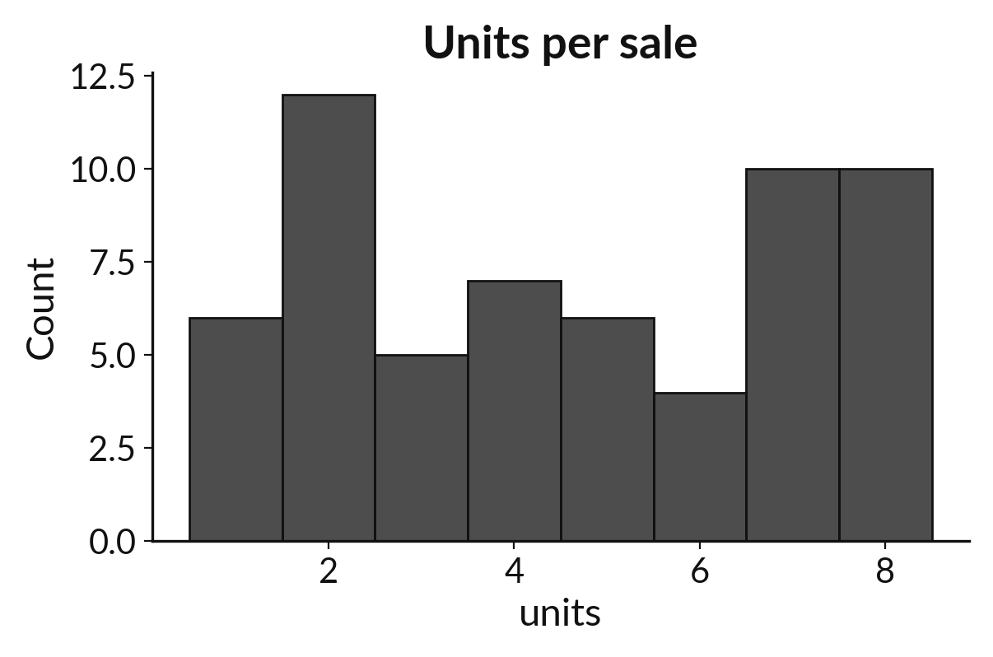
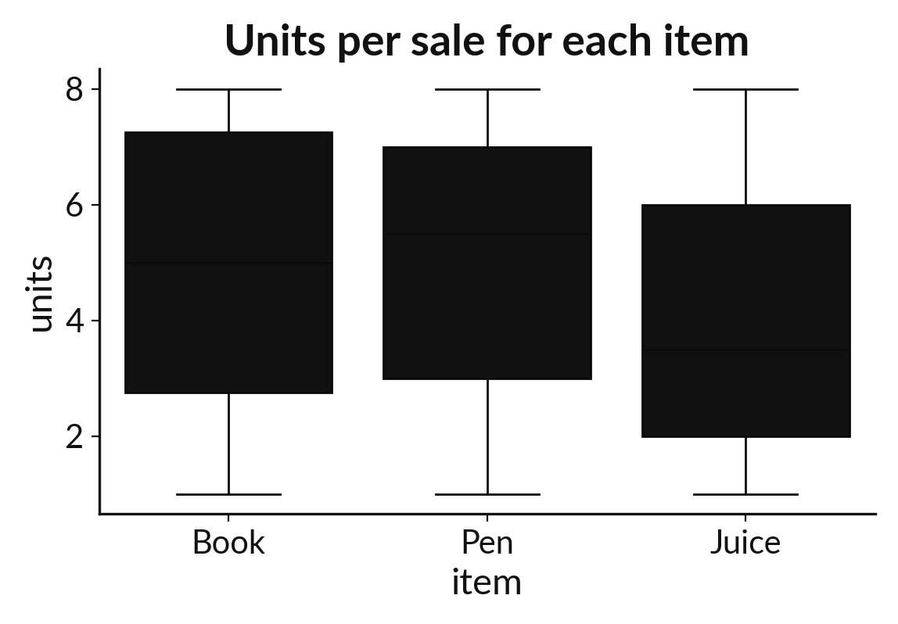
Run it: A histogram and a box plot
The histogram counts sales for each number of units and shows how they spread from 1 to 8. The box plot shows one box per item with a line at its median. Juice has the lowest median, 3.5 units, while Book has 5.0 and Pen 5.5.
Notes:
Running it now. Match each line of the output with the line of code that made it.
The histogram counts sales for each number of units and shows how they spread from 1 to 8. The box plot shows one box per item with a line at its median. Juice has the lowest median, 3.5 units, while Book has 5.0 and Pen 5.5. seaborn plots read straight from the table, which saves writing the grouping yourself.
Keep your guess. We use it in the next step.

Slide 17
Investigate: A histogram and a box plot
1. What does the line inside a box mean?
2. Which chart shows how many sales had exactly 3 units?
Notes:
Now we look closely at A histogram and a box plot. I have two questions for you.
Question one. What does the line inside a box mean? Think about it for a moment, then tell the person next to you.
Let me answer it. The median of that item's units.
Question two. Which chart shows how many sales had exactly 3 units? Have a go in your head first.
The answer is this. The histogram.

Slide 18
Modify: change one thing
Change the histogram so it uses unit_price_ugx instead of units.
Then tell your neighbour what changed and how you know.
Notes:
Make one small change. Change the histogram so it uses unit_price_ugx instead of units. Run it, then tell someone what you saw.
What you should find: Three tall bars appear, one at each price.

Slide 19
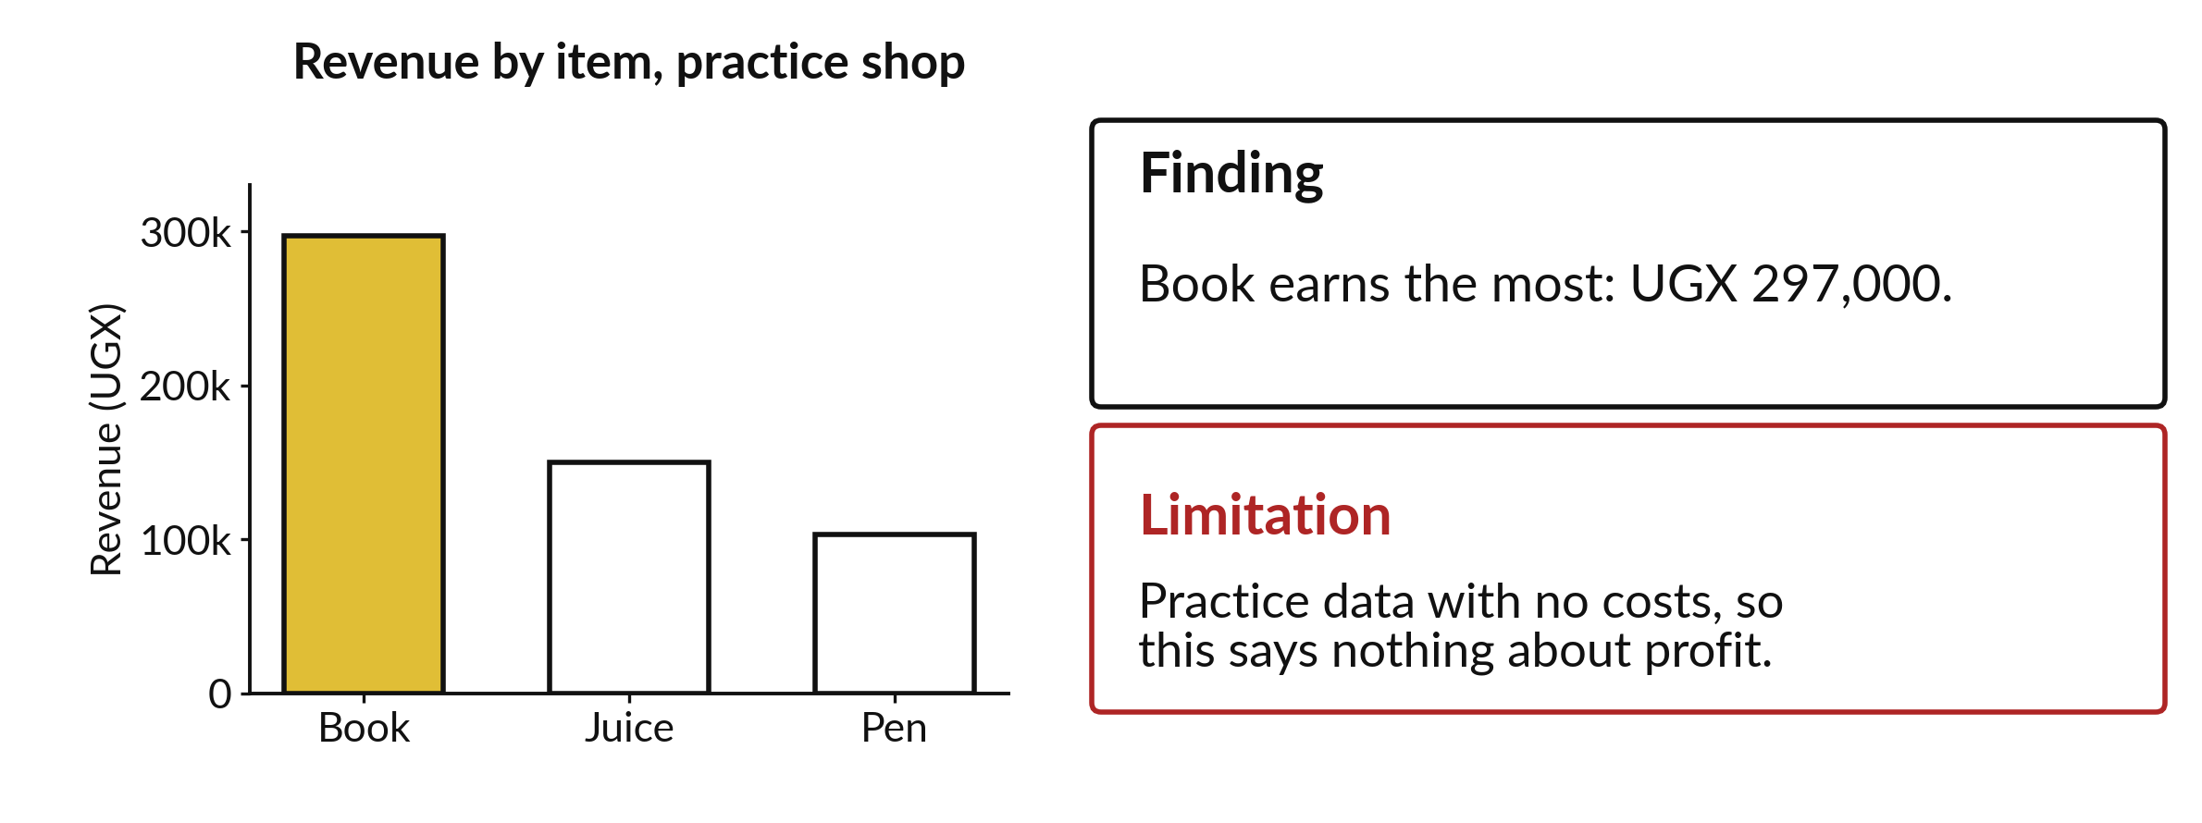
A finding is one careful sentence next to the chart
Say what the chart shows. Quote one number from it. Add one limit.
Notes:
A chart on its own invites guesses. Add one sentence that says what it shows, with a number, and one sentence that says what it cannot show.
Here the practice data has no costs, so we cannot say anything about profit. Write a finding for your own chart in the same shape.

Slide 20

Make: your own version
Make the same bar chart for the values 6, 9 and 4 for Book, Pen and Juice. Write one finding with a number and one limitation. Say which chart type you would use for daily rainfall, and why.
Save it as ML11. Write two sentences: what you changed and how you checked it.
Notes:
This task is yours. Run your code after every step so you can see where a problem begins. If you get stuck for a few minutes, read your error message, check the error card, and then ask me.
Save it as ML11. I will come round to each of you and ask what you changed and how you checked it.

Slide 21

Two errors you may meet today
It means: seaborn was not imported in this session.
Fix: Run import seaborn as sns first.
NameError: name 'sns' is not defined
It means: The cell that draws it has not run, or plt.show() is missing.
Fix: Run the import cell, then run the drawing cell again.
The chart does not appear
Notes:
Here are two errors from this session, so you recognise them when they appear.
This is the first one. You will see: NameError: name 'sns' is not defined. It means this: seaborn was not imported in this session. To fix it, Run import seaborn as sns first.
The next one. You will see: The chart does not appear. It means this: the cell that draws it has not run, or plt.show() is missing. To fix it, Run the import cell, then run the drawing cell again.
When you are stuck, read the last line of the message first.

Slide 22

Finish this sentence in your notebook
A chart needs labels with units, an axis that starts at zero for bars, and one finding with a limitation.
Then save your notebook, close it and open it again to check it saved.
Notes:
Last step. Our question for today was: How do I show which item earns most, and how sales vary, in a picture?
Finish this sentence in your notebook, in your own words. A chart needs labels with units, an axis that starts at zero for bars, and one finding with a limitation.
Then save your notebook, close it and open it again to check it saved.

