Slide 1
Predicting a number with a line
How close does a straight line get to the rents of eight homes?
Machine Learning | Session 14 of 24 | Week 5, Baselines and a line
Holiday Data and AI Camp | The National ICT Innovation Hub, Nakawa
Notes:
Here we go. Today is session 14 and our topic is predicting a number with a line.
By the end of today you will be able to guess a line by hand, measure its error, and compare it with the line scikit-learn fits.
We will answer one question: How close does a straight line get to the rents of eight homes?

Slide 2
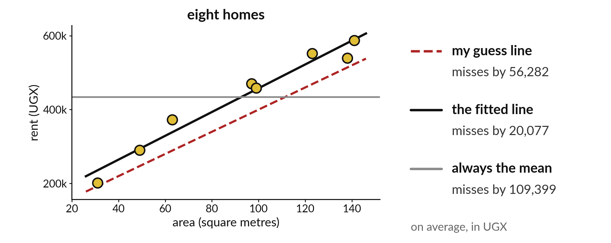
How close does a straight line
get to the rents of eight homes?
Notes:
Eight homes, three lines. The dashed red line is my own guess and it misses by about fifty six thousand shillings on average. The grey flat line is the mean for every home, and it misses by about one hundred and nine thousand. The black line is the one the computer fitted, and it misses by about twenty thousand. Today we find out how a straight line is judged and how a computer finds a better one than we can by eye.

Slide 3

Three hours, mostly doing
Most of our time is spent doing, in small steps, with a guess before every run.
Notes:
Here is how the 3 hours go. Each bar is as long as the time we spend on that part.
First, 10 minutes. Recall. Then, 50 minutes. Block A. After that, 15 minutes. Break away from screens. Next, 50 minutes. Block B. Then, 40 minutes. Make. Then, 15 minutes. Exit ticket, save, and an individual check with each learner.
Notice how much of the time is yours. You listen for a short while and then you do. That is on purpose, because you learn this by doing it.

Slide 4

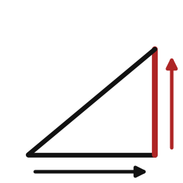
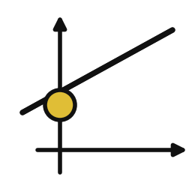
Words for today (1 of 2)
regression
Predicting a number.
Estimating a price.
slope
How much the prediction changes when the input rises by one unit.
Extra rent for every extra square metre.
intercept
The prediction when the input is zero.
The starting fee before any distance is added.
Notes:
First the words, because every one of them is used in the code later.
regression. Predicting a number. Estimating a price.
slope. How much the prediction changes when the input rises by one unit. Think of a shop. Extra rent for every extra square metre.
intercept. The prediction when the input is zero. Imagine it like this. The starting fee before any distance is added.

Slide 5
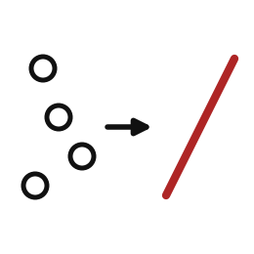
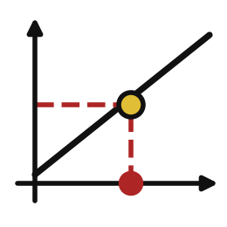
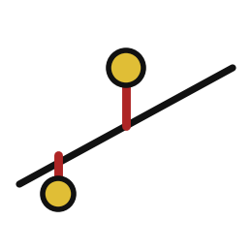
Words for today (2 of 2)
fit
Let the computer find the best slope and intercept from examples.
Practising until the throws land close.
predict
Use the fitted line on a new input.
Reading the answer off the line.
error
The gap between a prediction and the real value.
How far off your estimate was.
Notes:
Here are the rest of today's words.
fit. Let the computer find the best slope and intercept from examples. An example from everyday life. Practising until the throws land close.
predict. Use the fitted line on a new input. Here is a way to see it. Reading the answer off the line.
error. The gap between a prediction and the real value. A small example. How far off your estimate was.

Slide 6
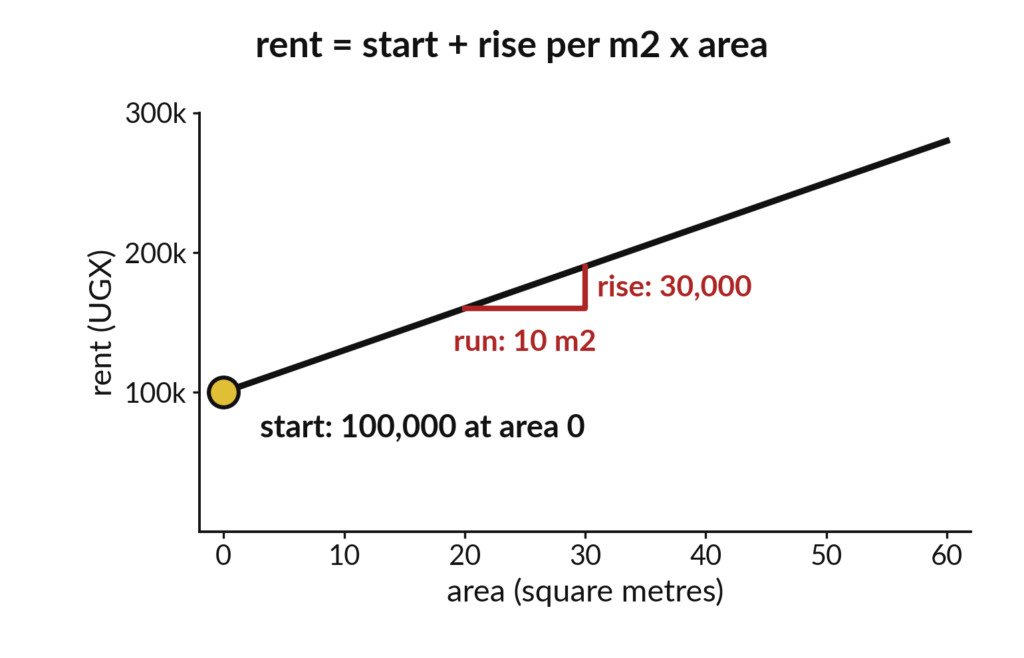
A line has a start and a rise per square metre
The intercept is the start at area zero.
The slope is the rise for each extra square metre.
Rent equals start plus slope times area.
Notes:
A straight line is described by two numbers. The intercept is where the line starts when the area is zero. The slope is how much the rent rises for every extra square metre.
To predict a rent, take the start, then add the slope times the area. Try it for a home of fifty square metres on paper.

Slide 7
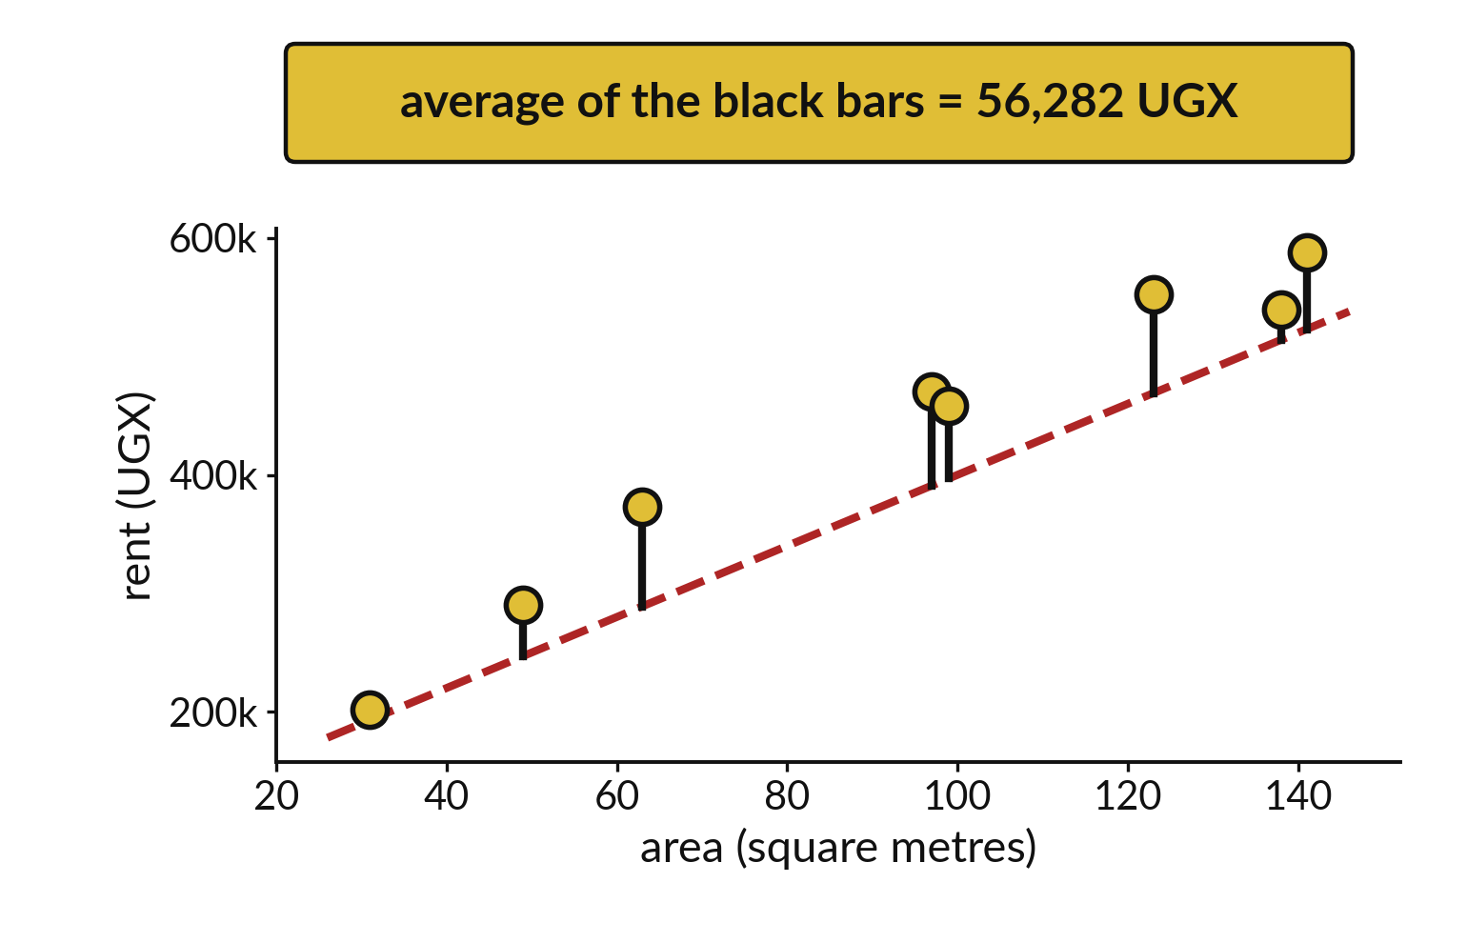
An error is the gap between line and real rent
Each black bar is one miss.
Ignore whether it is above or below.
The average of the bars is the score.
Notes:
For each home we measure how far the line is from the real rent. Those gaps are the errors, drawn here as bars. We ignore whether the line was too high or too low and look only at the size.
The average of the bars is one number that scores the whole line. A smaller number means a better line.

Slide 8

Predict: Guess a line, measure the error
import pandas as pd
homes = pd.read_csv("synthetic_homes.csv").head(8)
guess = 100000 + 3000 * homes["area_m2"]
errors = (homes["rent_ugx"] - guess).abs()
print(errors.mean())
Predict whether the average error will be under UGX 10000 or over UGX 50000.
Write your guess on paper before we run it.
Notes:
Take the first eight homes. Guess that rent is 100000 plus 3000 for every square metre.
Now your guess. Predict whether the average error will be under UGX 10000 or over UGX 50000. Jot it on paper before anyone speaks.

Slide 9
Run it: Guess a line, measure the error
56282.25
The cell prints 56282.25.
Your guess is a straight line with intercept 100000 and slope 3000 shillings per square metre.
On average it misses the real rent by about UGX 56282.
Notes:
Watch the output as it appears. Match each line of the output with the line of code that made it.
The cell prints 56282.25. Your guess is a straight line with intercept 100000 and slope 3000 shillings per square metre. On average it misses the real rent by about UGX 56282. The line ignores rooms, and the intercept is too low, so most guesses are too small.
Tell the person next to you whether your guess matched.

Slide 10
Investigate: Guess a line, measure the error
1. What does a slope of 3000 mean in words?
2. What would you change to lower the error?
import pandas as pd
homes = pd.read_csv(
"synthetic_homes.csv"
).head(8)
guess = 100000 + 3000 * homes[
"area_m2"
]
errors = (
homes["rent_ugx"] - guess
).abs()
print(errors.mean())
Notes:
Now we look closely at guess a line, measure the error. I have two questions for you.
Question one. What does a slope of 3000 mean in words? Write your answer in one line before we compare.
Here is how I would answer it. Every extra square metre adds UGX 3000 to the guess.
Question two. What would you change to lower the error? Say it quietly to yourself before anyone answers.
What I would say is this. Raise the intercept. Most guesses are below the real rent.

Slide 11
Modify: change one thing
Try an intercept of 160000 and print the average error.
Then tell your neighbour what changed and how you know.
import pandas as pd
homes = pd.read_csv(
"synthetic_homes.csv"
).head(8)
guess = 100000 + 3000 * homes[
"area_m2"
]
errors = (
homes["rent_ugx"] - guess
).abs()
print(errors.mean())
Notes:
Your hands on the keyboard now. Try an intercept of 160000 and print the average error. Run it, then tell someone what you saw.
What you should find: The average error falls to about UGX 21822.

Slide 12

Break
15 minutes away from your screen
Stand up. Drink some water. Tell someone what you guessed in the first half.
Notes:
Break time. 15 minutes away from your screens. Stand up, drink some water and tell someone what you guessed in the first half.
When we come back we start the second idea.

Slide 13
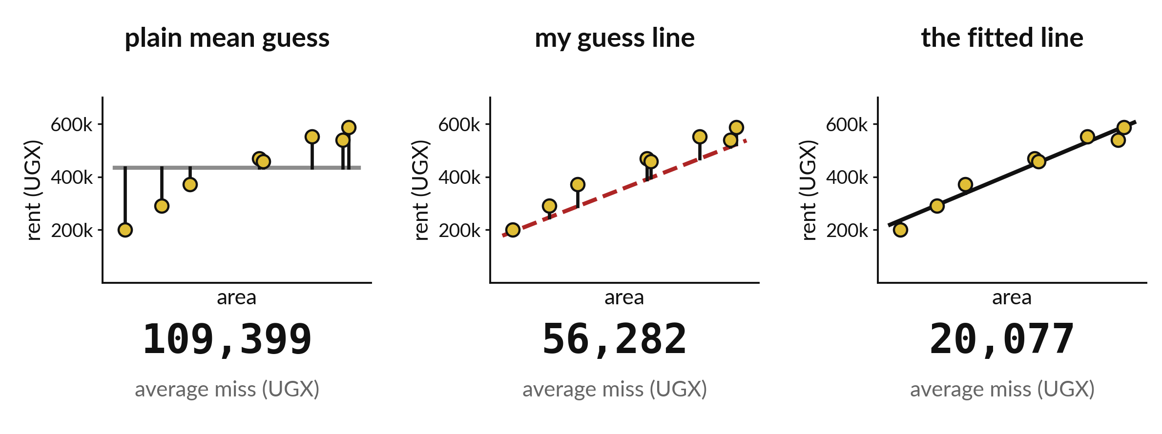
The fitted line beats my guess and the flat mean
Always the mean: 109,399. My hand line: 56,282. The fitted line: 20,077.
Notes:
Here are the three scores side by side. The plain mean guess misses by about a hundred and nine thousand shillings. My hand drawn line misses by about fifty six thousand. The fitted line misses by about twenty thousand.
The computer tries many lines and keeps the one with the smallest average miss.

Slide 14
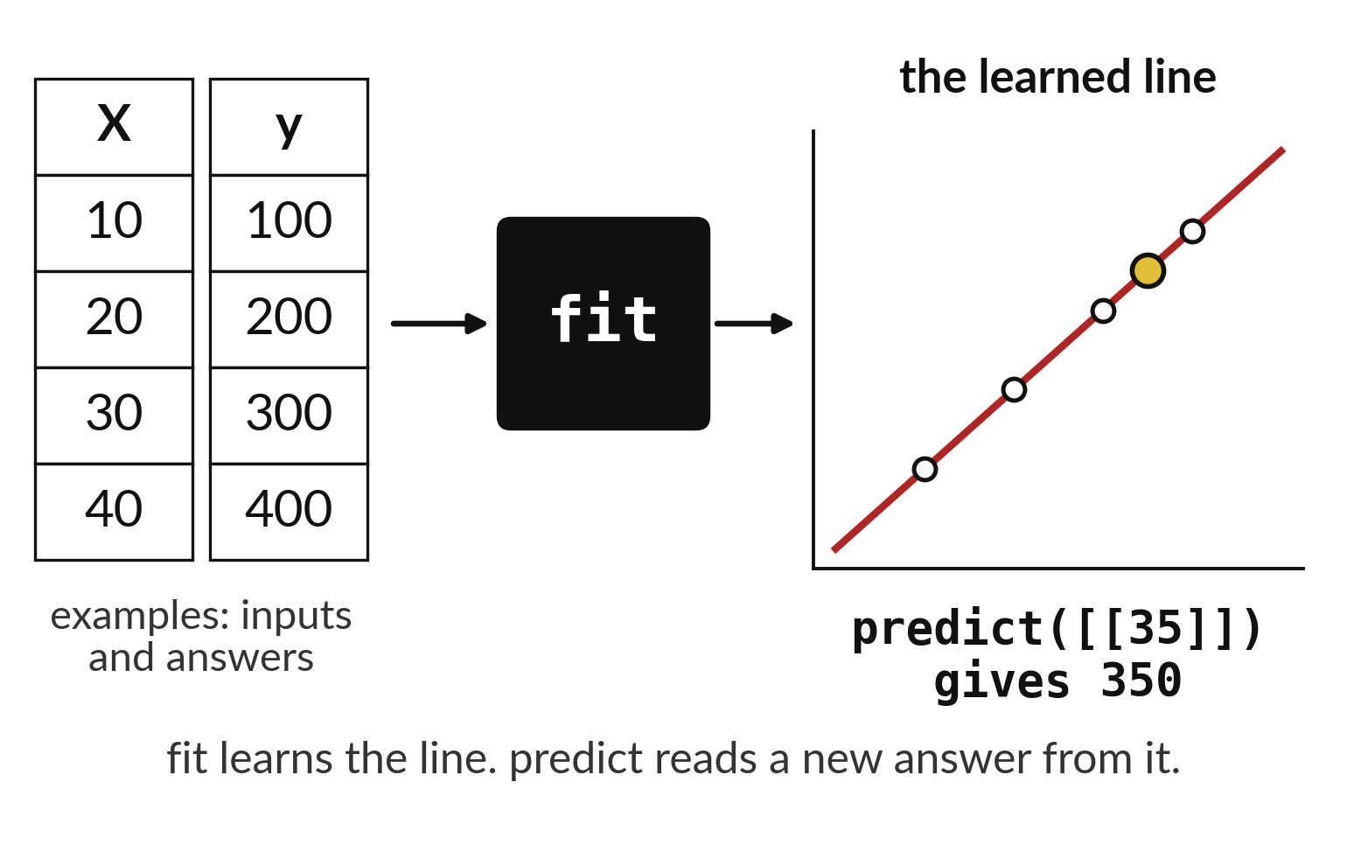
Fit learns the line and predict reads a new answer
Fit takes inputs and answers together.
The result is a learned line.
Predict gives a guess for a new input.
Notes:
There are two steps. Fit shows the model examples, each with its inputs and its true answer, and the model learns a line. Predict gives the learned line a new input, with no answer, and gets a guess back.
Fit is learning. Predict is using what was learned.

Slide 15
Predict: Let scikit-learn fit the line
from sklearn.linear_model import LinearRegression
X = homes[["area_m2"]]
y = homes["rent_ugx"]
model = LinearRegression().fit(X, y)
fit_error = (y - model.predict(X)).abs().mean()
baseline_error = (y - y.mean()).abs().mean()
print(
round(model.coef_[0]), round(model.intercept_),
round(fit_error), round(baseline_error)
)
Predict whether the fitted line's error is smaller or larger than your hand-guessed 56282.
Write your guess on paper before we run it.
Notes:
Ask LinearRegression to find the best slope and intercept for the same eight homes. Compare its error with the baseline.
This is the part where you decide. Predict whether the fitted line's error is smaller or larger than your hand-guessed 56282. Guess on paper first. Surprises are useful.

Slide 16

Run it: Let scikit-learn fit the line
The cell prints 3221, 135838, 20077 and 109399.
The fitted line has slope 3221 and intercept 135838 and misses by about UGX 20077 on these eight homes.
Guessing the mean every time would miss by about UGX 109399.
Notes:
Let us see what happens. Match each line of the output with the line of code that made it.
The cell prints 3221, 135838, 20077 and 109399. The fitted line has slope 3221 and intercept 135838 and misses by about UGX 20077 on these eight homes. Guessing the mean every time would miss by about UGX 109399. fit found the line, and predict will use it on a new input. These errors are measured on the eight homes the line learned from, so they look better than they will on new homes.
Which line of the output matches which line of the code? Point to each pair.

Slide 17

Investigate: Let scikit-learn fit the line
1. Is a smaller error on the training homes proof that the line is good?
2. How much better is the fitted line than the baseline?
Notes:
Now we look closely at let scikit-learn fit the line. I have two questions for you.
Question one. Is a smaller error on the training homes proof that the line is good? Say it quietly to yourself before anyone answers.
What I would say is this. No. The line has seen these homes. A fair test uses new homes, which is next session.
Question two. How much better is the fitted line than the baseline? Give it thirty seconds and then we will hear a few answers.
Let me answer it. Its error is about a fifth of the baseline's.

Slide 18

Modify: change one thing
Predict the rent for a home of 100 square metres.
Then tell your neighbour what changed and how you know.
Notes:
Change one thing and watch what happens. Predict the rent for a home of 100 square metres. After you run it, say in one sentence what changed and how you checked.
You should see this. About UGX 457910.

Slide 19
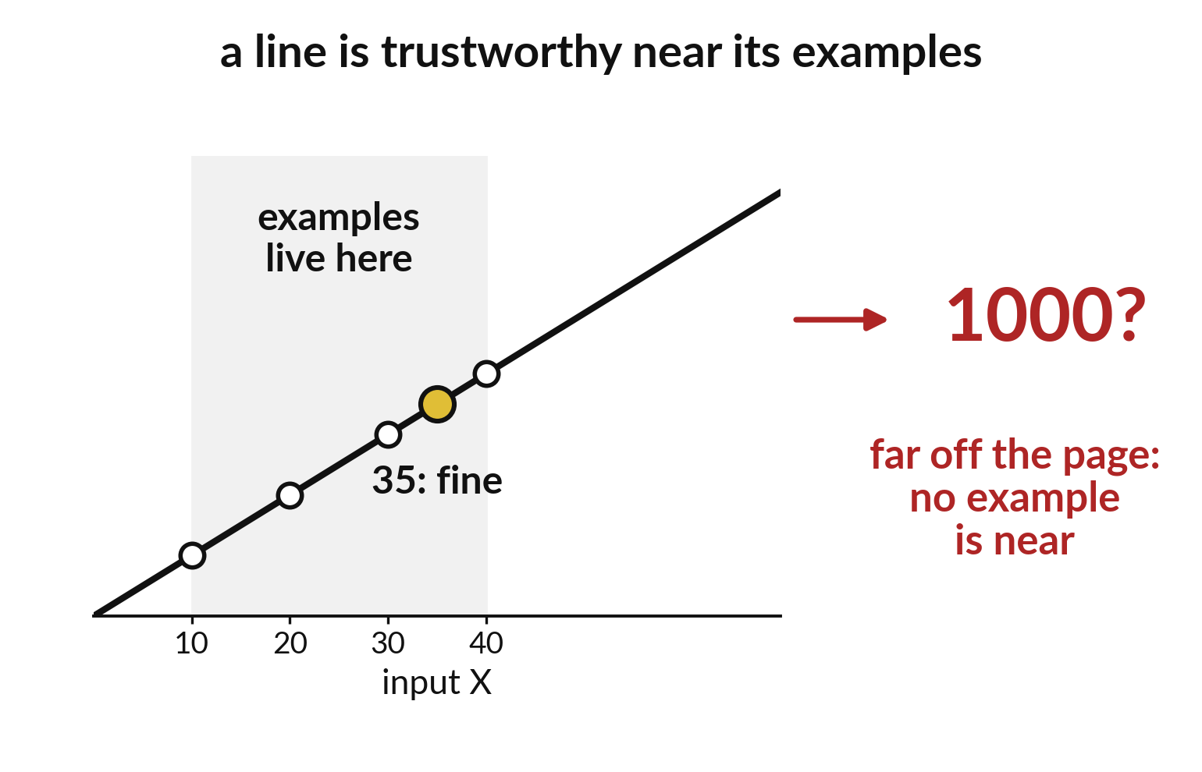
A line is trustworthy near its examples only
Examples live in one region.
Far from them there is no evidence.
Ask for predictions inside the data.
Notes:
A line is drawn from the homes we have. Ask it about a home far outside that range and it still gives an answer, but nothing backs it up.
A number of ten thousand square metres is easy to type and meaningless to trust. Stay inside the range of your examples.

Slide 20

Make: your own version
Use X = [[10], [20], [30], [40]] and y = [100, 200, 300, 400]. Fit a line and predict at 35. Explain in your own words what X, y, fit and predict mean, and why predicting at 1000 is risky.
Save it as ML14. Write two sentences: what you changed and how you checked it.
Notes:
This task is yours. Run your code after every step so you can see where a problem begins. If you get stuck for a few minutes, read your error message, check the error card, and then ask me.
Save it as ML14. I will come round to each of you and ask what you changed and how you checked it.

Slide 21

Two errors you may meet today
It means: The model needs a table of inputs, with rows and columns, and got a flat list.
Fix: Use double brackets, such as [[35]], or select with homes[["area_m2"]].
ValueError: Expected 2D array, got 1D array instead
It means: The prepared camp environment is not active.
Fix: Tell the instructor. Do not install packages.
ModuleNotFoundError: No module named 'sklearn'
Notes:
Here are two errors from this session, so you recognise them when they appear.
This is the first one. You will see: ValueError: Expected 2D array, got 1D array instead. It means this: the model needs a table of inputs, with rows and columns, and got a flat list. To fix it, use double brackets, such as [[35]], or select with homes[["area_m2"]].
The next one. You will see: ModuleNotFoundError: No module named 'sklearn'. It means this: the prepared camp environment is not active. To fix it, tell the instructor. Do not install packages.
When you are stuck, read the last line of the message first.

Slide 22

Finish this sentence in your notebook
A fitted line has a slope and an intercept, and its error on the homes it learned from looks better than its error on new homes.
Then save your notebook, close it and open it again to check it saved.
Notes:
Last step. Our question for today was: How close does a straight line get to the rents of eight homes?
Finish this sentence in your notebook, in your own words. A fitted line has a slope and an intercept, and its error on the homes it learned from looks better than its error on new homes.
Then save your notebook, close it and open it again to check it saved.

