Slide 1
Predicting a category with a decision tree
Does a tree that learned its questions beat my hand-written flower rule?
Machine Learning | Session 16 of 24 | Week 6, Trees and fair tests
Holiday Data and AI Camp | The National ICT Innovation Hub, Nakawa
Notes:
Good to see you. Today is session 16 and our topic is predicting a category with a decision tree.
By the end of today you will be able to train a small decision tree on iris, read its first question, and compare its accuracy with a baseline and with the hand rule from session 4.
We will answer one question: Does a tree that learned its questions beat my hand-written flower rule?

Slide 2
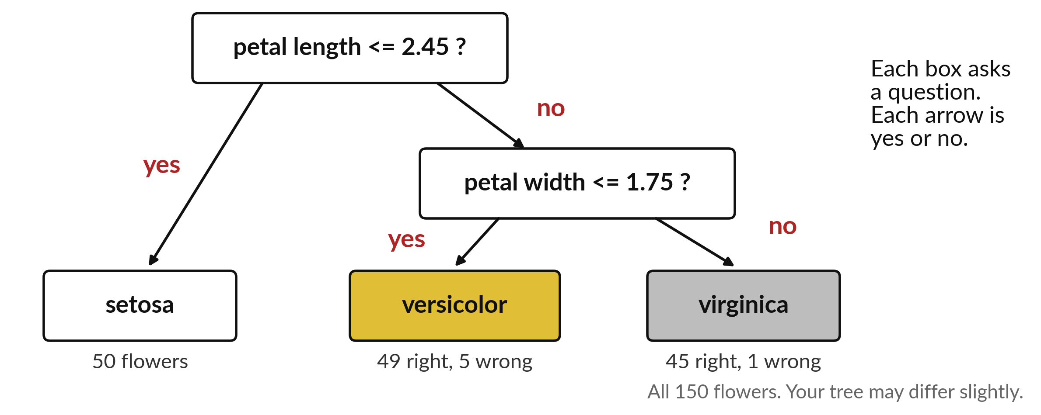
Does a tree that learned its questions
beat my hand-written flower rule?
Notes:
Here is a small decision tree. It asks one question about the petal length. If the petal is short, the flower is a setosa. If not, it asks a second question about the petal width and decides between versicolor and virginica. A tree is a set of questions with yes or no answers. Today we write our own rule for the flowers, let a computer learn its own tree, and see which one does better.

Slide 3

Three hours, mostly doing
Most of our time is spent doing, in small steps, with a guess before every run.
Notes:
Here is how the 3 hours go. Each bar is as long as the time we spend on that part.
First, 10 minutes. Recall. Then, 50 minutes. Block A. After that, 15 minutes. Break away from screens. Next, 50 minutes. Block B. Then, 40 minutes. Make. Then, 15 minutes. Exit ticket, save, and an individual check with each learner.
Notice how much of the time is yours. You listen for a short while and then you do. That is on purpose, because you learn this by doing it.

Slide 4
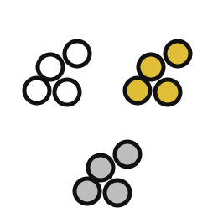
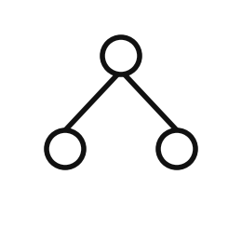

Words for today (1 of 2)
classification
Predicting a category instead of a number.
Deciding whether a fruit is a mango or an orange.
decision tree
A chain of yes or no questions about the features that ends in a category.
A flow chart that sorts the flowers.
class label
The name of a category; its code number is only an identifier.
The species name on a seed packet.
Notes:
Here are the words for today. Listen for the picture that goes with each one.
classification. Predicting a category instead of a number. Picture this. Deciding whether a fruit is a mango or an orange.
decision tree. A chain of yes or no questions about the features that ends in a category. You have seen this before. A flow chart that sorts the flowers.
class label. The name of a category; its code number is only an identifier. The species name on a seed packet.

Slide 5
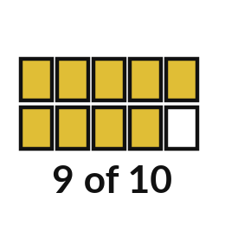
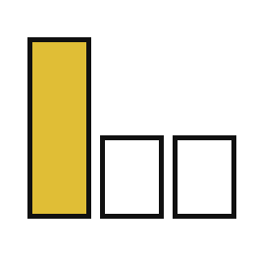
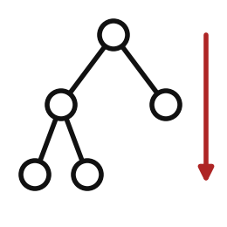
Words for today (2 of 2)
accuracy
The share of predictions that are right.
Marks scored out of the total.
majority baseline
A model that always names the most common category.
Always answering the most popular option.
depth
How many questions in a row the tree may ask.
How many forks a path may take.
Notes:
Two more words to know before we start.
accuracy. The share of predictions that are right. Think of a shop. Marks scored out of the total.
majority baseline. A model that always names the most common category. Imagine it like this. Always answering the most popular option.
depth. How many questions in a row the tree may ask. An example from everyday life. How many forks a path may take.

Slide 6
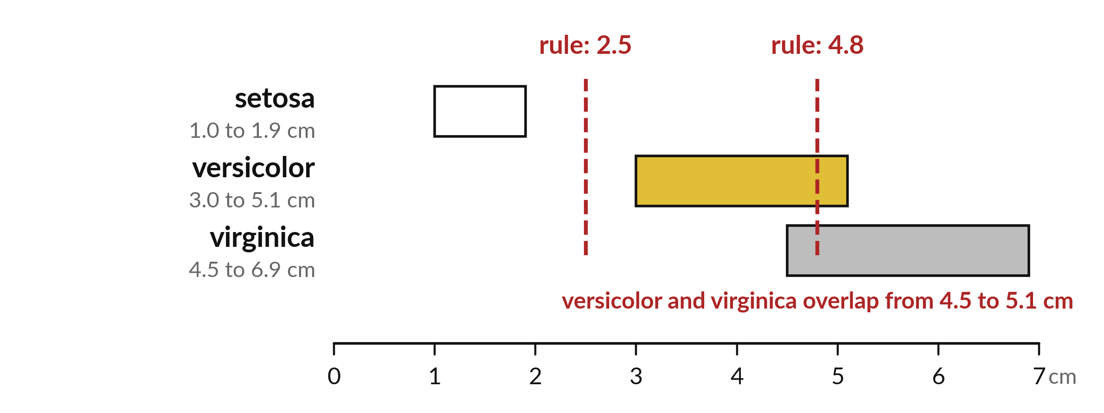
Species overlap in petal length, so one cut fails
Setosa is clearly small. Versicolor and virginica overlap. A good rule needs two cuts.
Notes:
Look at the range of petal lengths for each species. Setosa sits alone at the small end. Versicolor and virginica overlap in the middle. A single cut cannot separate all three.
Where would you place your two cuts?

Slide 7
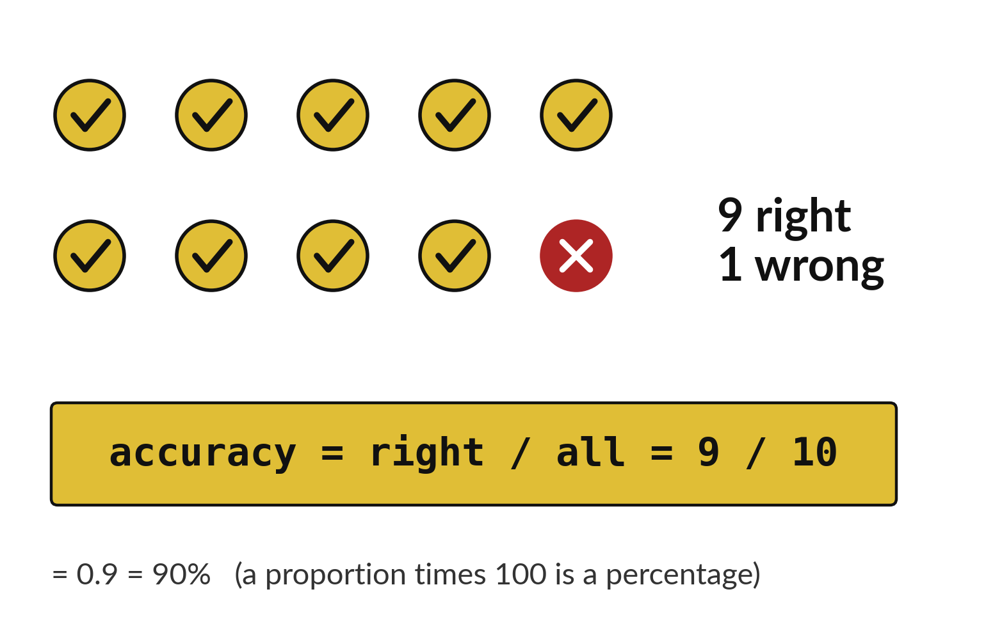
Accuracy counts right answers out of all answers
Nine right out of ten.
Nine divided by ten is 0.9.
As a percentage, that is 90.
Notes:
Accuracy is easy. Count how many answers were right, and divide by how many answers there were. Nine out of ten gives zero point nine, which is ninety percent.
It is the same proportion idea you used on the shop sales.

Slide 8
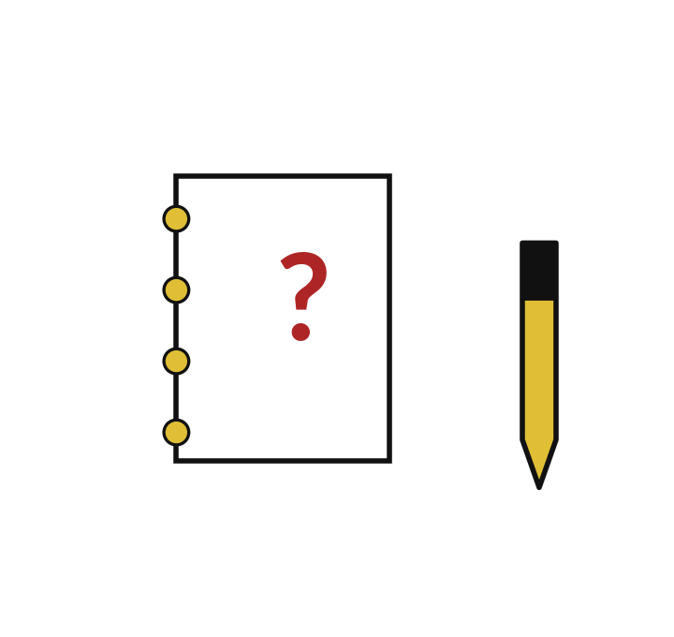
Predict: Train a tree and draw it
Predict whether the tree's accuracy will be above 85% and whether the majority baseline will be above 55%.
Write your guess on paper before we run it.
Notes:
Split the 150 iris flowers, train a tree that may ask two questions in a row, and draw it.
This is the part where you decide. Predict whether the tree's accuracy will be above 85% and whether the majority baseline will be above 55%. Write it on paper. It does not have to be right.

Slide 9

Run it: Train a tree and draw it
The tree scores above 0.85 and the majority baseline scores about a third, because the three species are equally common.
plot_tree draws the questions: the top box asks about a petal measurement, the same kind of question as your hand rule.
Notes:
Let us see what happens. Match each line of the output with the line of code that made it.
The tree scores above 0.85 and the majority baseline scores about a third, because the three species are equally common. plot_tree draws the questions: the top box asks about a petal measurement, the same kind of question as your hand rule. The classes are coded 0, 1 and 2 for setosa, versicolor and virginica. The codes name categories, so species 2 is not twice species 1. Accuracy is correct predictions divided by all predictions.
Which line of the output matches which line of the code? Point to each pair.

Slide 10

Investigate: Train a tree and draw it
1. What does the top box of the drawn tree ask?
2. Why does the baseline score near one third?
3. Why is species code 2 not twice species code 1?
Notes:
Now we look closely at train a tree and draw it. I have three questions for you.
Question one. What does the top box of the drawn tree ask? Give it thirty seconds and then we will hear a few answers.
What I would say is this. A yes or no question about a petal measurement. Read it aloud.
Question two. Why does the baseline score near one third? Talk it over with your neighbour for a minute.
Let me answer it. Each species has about a third of the flowers, so always naming one is right about a third of the time.
Question three. Why is species code 2 not twice species code 1? Think about it for a moment, then tell the person next to you.
The answer is this. The codes are labels. They carry no amounts.

Slide 11

Modify: change one thing
Change max_depth to 1 and run again.
Then tell your neighbour what changed and how you know.
Notes:
Change one thing and watch what happens. Change max_depth to 1 and run again. Then explain to your neighbour what the change did.
The result: The tree has one question and scores lower, about two thirds.

Slide 12

Break
15 minutes away from your screen
Stand up. Drink some water. Tell someone what you guessed in the first half.
Notes:
Break time. 15 minutes away from your screens. Stand up, drink some water and tell someone what you guessed in the first half.
When we come back we start the second idea.

Slide 13
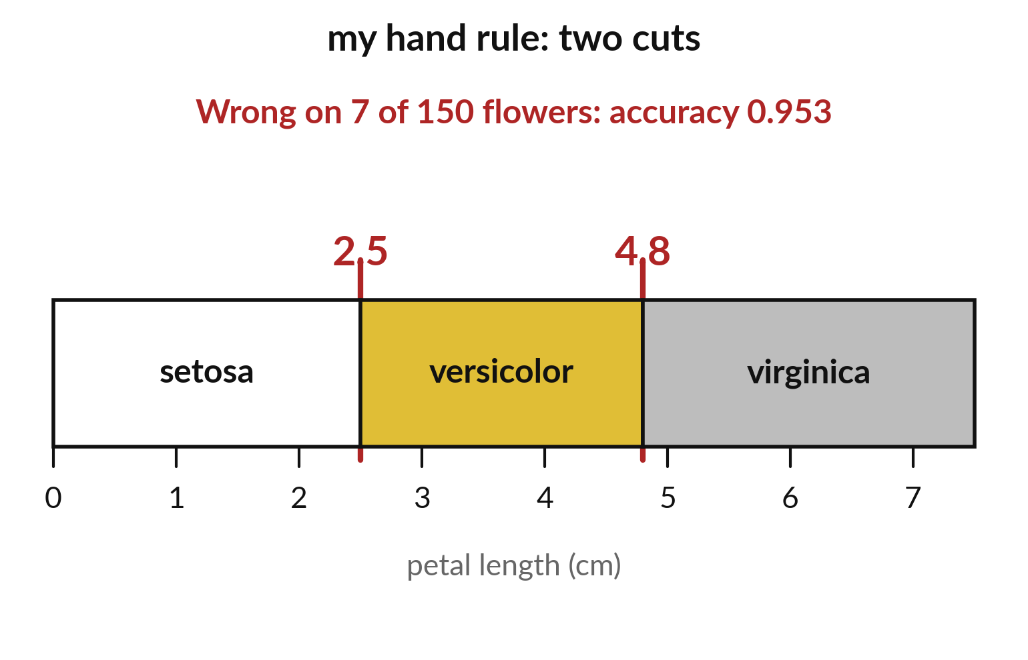
My hand rule cuts the flowers into three zones
Two cuts on petal length.
Each zone gets one species.
Mistakes sit where the species overlap.
Notes:
My own rule makes two cuts on the petal length and gives each zone one species. It is simple to explain. Wrong answers hide where two species overlap.
On all one hundred and fifty flowers this rule is wrong seven times, an accuracy of zero point nine five three.

Slide 14
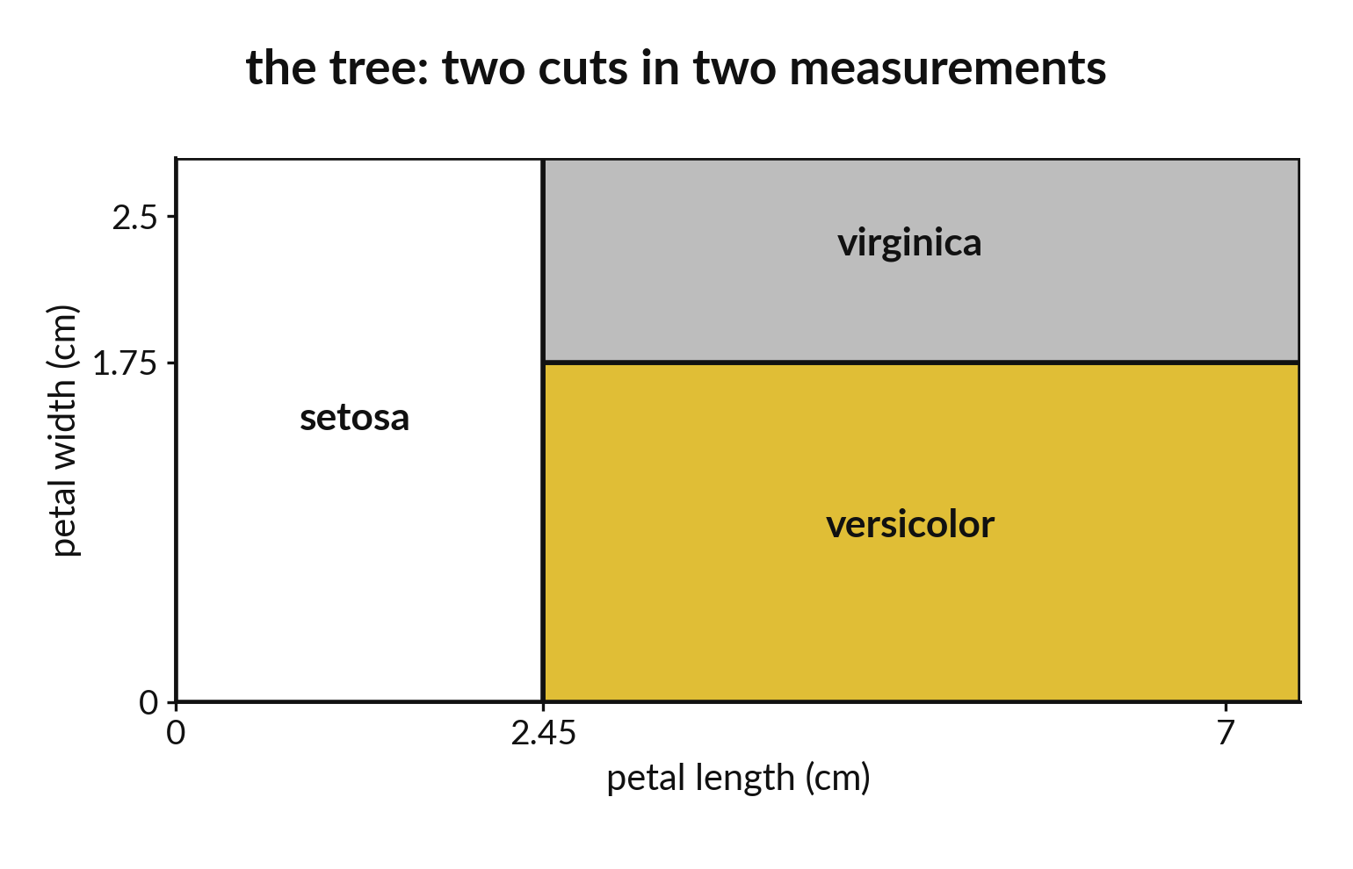
The tree cuts on length and on width
One cut on length, one on width.
The zones are boxes.
The computer chose the cuts itself.
Notes:
The tree also makes two cuts, but one is on petal length and one is on petal width. The computer searched for cuts that separate the species best.
This tree was fitted on all one hundred and fifty flowers and is wrong six times, an accuracy of zero point nine six. Where does it do better than my rule?

Slide 15
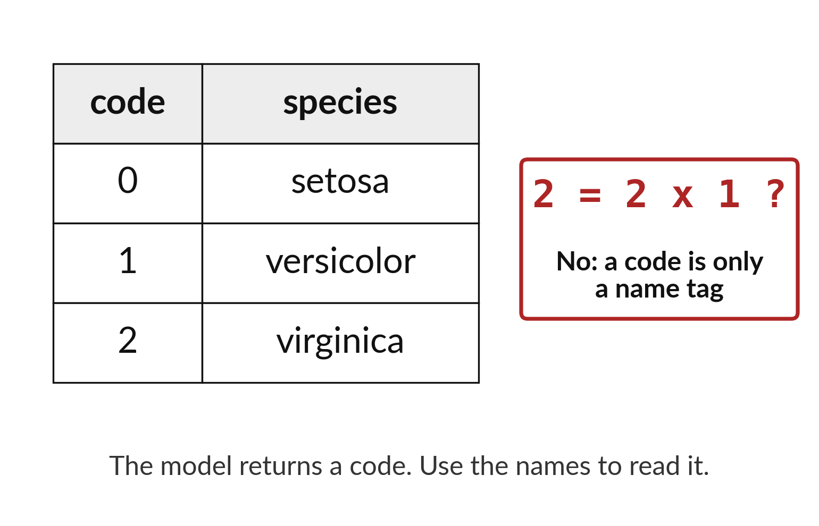
The model returns codes
that we translate to names
The model works with codes 0, 1 and 2.
A code is only a name tag.
Translate it back to a species.
Notes:
Inside the model each species has a number: zero, one or two. The numbers are only name tags. Two is not bigger than zero in any useful sense.
When you read results, translate the codes back into species names so that other people can follow.

Slide 16

Predict: Back to the hand rule
lengths = iris.data[:, 2]
guess = (
(lengths >= 2.5)
.astype(int) + (lengths >= 4.8)
.astype(int)
)
hand_acc = (guess == iris.target).mean()
print(round(hand_acc, 3))
Predict whether your hand rule will score above or below the tree.
Write your guess on paper before we run it.
Notes:
Score your session 4 rule on all 150 flowers. Petal length is column 2 of the data.
Make a prediction. Predict whether your hand rule will score above or below the tree. Put it on paper first. We will check it together in a moment.

Slide 17
Run it: Back to the hand rule
The hand rule scores above 0.9 on all 150 flowers.
Each comparison gives True or False for every flower and astype(int) turns them into 1 and 0.
Adding the two gives 0 for setosa, 1 for versicolor and 2 for virginica.
Notes:
Running it now. Match each line of the output with the line of code that made it.
The hand rule scores above 0.9 on all 150 flowers. Each comparison gives True or False for every flower and astype(int) turns them into 1 and 0. Adding the two gives 0 for setosa, 1 for versicolor and 2 for virginica. Your rule and the tree use the same idea. The tree chose its question and cut-off by itself, and you chose yours by looking at eight flowers.
Keep your guess. We use it in the next step.

Slide 18
Investigate: Back to the hand rule
1. Why does the hand rule use only petal length?
2. Whose score is fairer: the hand rule on all 150 flowers, or the tree on the 38 held-out flowers of a 112 and 38 split?
Notes:
Now we look closely at back to the hand rule. I have two questions for you.
Question one. Why does the hand rule use only petal length? Talk it over with your neighbour for a minute.
Let me answer it. That was the one measurement you looked at. The tree may use any of the four.
Question two. Whose score is fairer: the hand rule on all 150 flowers, or the tree on the 38 held-out flowers of a 112 and 38 split? Think about it for a moment, then tell the person next to you.
The answer is this. Neither is exactly fair. Your rule was designed with a few of these flowers in view, and the tree's test set is small.

Slide 19
Modify: change one thing
Change 4.8 to 5.0 in the rule and score it again.
Then tell your neighbour what changed and how you know.
Notes:
Make one small change. Change 4.8 to 5.0 in the rule and score it again. When you have run it, tell your neighbour what changed and how you know.
Here is what happens. The score changes a little. Check whether it rises or falls.

Slide 20
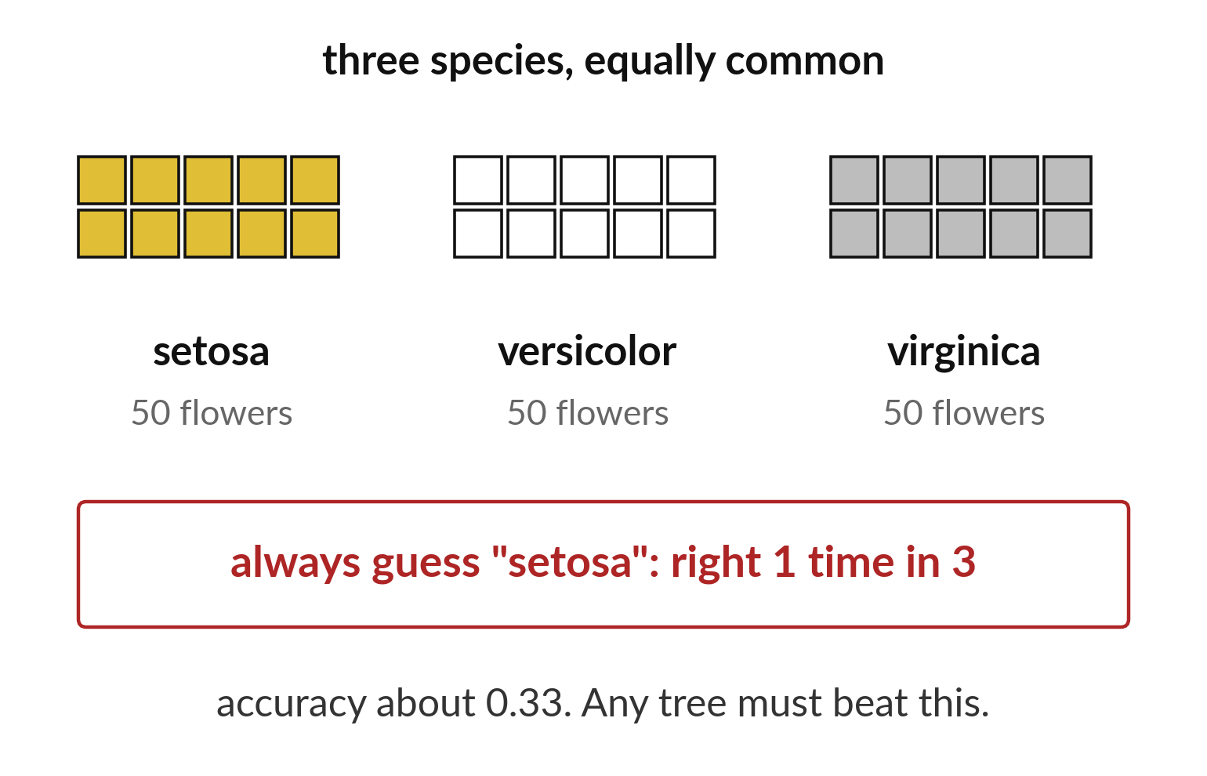
Guessing one species is right one time in three
Three species are equally common.
Guess setosa every time.
Accuracy is about 0.33.
Notes:
The three species are equally common, so a plain guess of one species is right about one time in three. Any tree has to beat that to be worth using.
A score of seventy percent sounds good, but it only means something when we know what a lazy guess would have scored.

Slide 21

Make: your own version
Convert both accuracies to percentages. Name the target and one input. Explain why species code 2 is not twice species code 1.
Save it as ML16. Write two sentences: what you changed and how you checked it.
Notes:
Now you do the real work yourself. Start with the first step. If you get stuck for a few minutes, read your error message, check the error card, and then ask me.
Save it as ML16. I will come round to each of you and ask what you changed and how you checked it.

Slide 22

Two errors you may meet today
It means: A category name was passed where numbers are needed.
Fix: Use iris.target for the labels and iris.data for the inputs.
ValueError: could not convert string to float
It means: The cell that loads iris has not run.
Fix: Run the cells in order from the top.
NameError: name 'iris' is not defined
Notes:
Two things are likely to go wrong today. It helps to know them before they happen.
This is the first one. You will see: ValueError: could not convert string to float. It means this: A category name was passed where numbers are needed. To fix it, use iris.target for the labels and iris.data for the inputs.
The next one. You will see: NameError: name 'iris' is not defined. It means this: the cell that loads iris has not run. To fix it, Run the cells in order from the top.
If you meet one of these, fix it and carry on. It happens to everyone.

Slide 23

Finish this sentence in your notebook
A tree learns its questions from examples and is compared against a baseline and against a rule I wrote.
Then save your notebook, close it and open it again to check it saved.
Notes:
Before we finish, go back to the question we began with: Does a tree that learned its questions beat my hand-written flower rule?
Copy this sentence into your notebook and make it yours. A tree learns its questions from examples and is compared against a baseline and against a rule I wrote.
Then save your notebook, close it and open it again to check it saved.

