Slide 1
Checkpoint two with a locked test
Which tree depth is better, and what does a locked test say about it?
Machine Learning | Session 18 of 24 | Week 6, Trees and fair tests
Holiday Data and AI Camp | The National ICT Innovation Hub, Nakawa
Notes:
Let us begin. Today is session 18 and our topic is checkpoint two with a locked test.
By the end of today you will be able to split data into training, validation and final test, choose a model on validation only, and report one final test result with its limits.
We will answer one question: Which tree depth is better, and what does a locked test say about it?

Slide 2
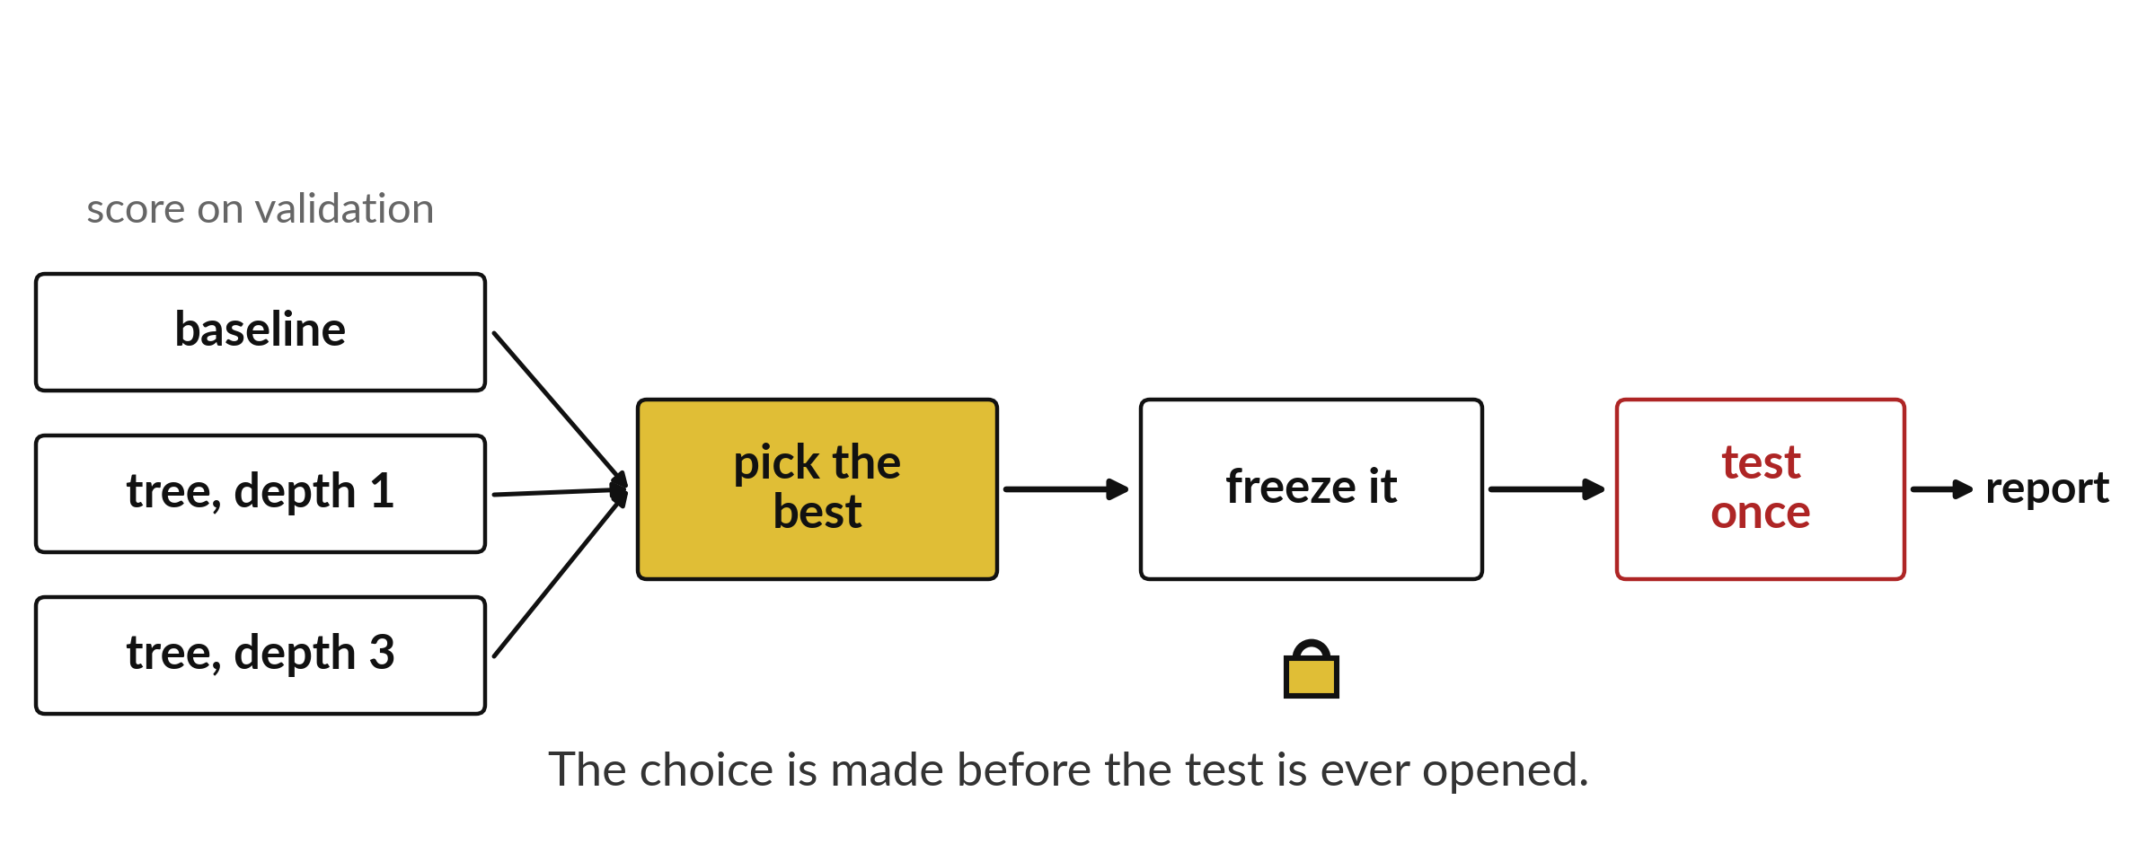
Which tree depth is better, and what
does a locked test say about it?
Notes:
This is the order of work for checkpoint two. Score the baseline and two trees on the validation flowers. Pick the best. Freeze it, so nothing changes any more. Test it once on the locked flowers and report the number. The choice is made before the test is ever opened.

Slide 3
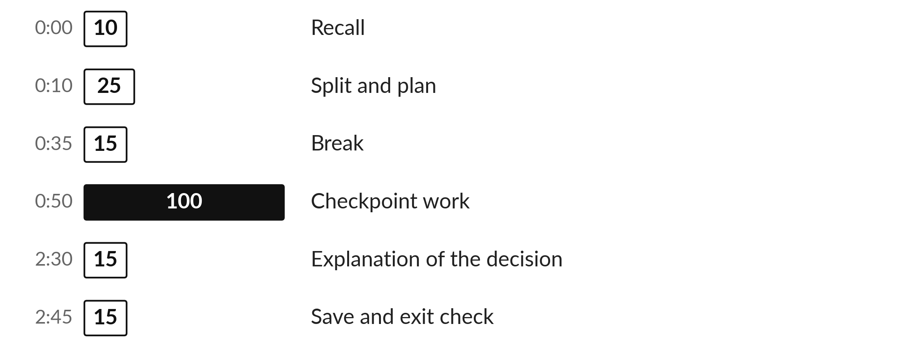
Three hours, mostly doing
Most of our time is spent doing, in small steps, with a guess before every run.
Notes:
Here is how the 3 hours go. Each bar is as long as the time we spend on that part.
First, 10 minutes. Recall. Then, 25 minutes. Split and plan. After that, 15 minutes. Break. Next, 100 minutes. Checkpoint work. Then, 15 minutes. Explanation of the decision. Then, 15 minutes. Save and exit check.
Notice how much of the time is yours. You listen for a short while and then you do. That is on purpose, because you learn this by doing it.

Slide 4
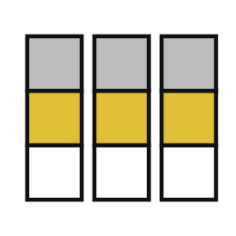
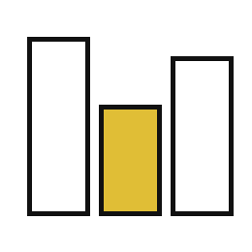
Words for today (1 of 2)
stratify
Keep the share of each category the same in every part.
Making sure every group has some of each village.
validation score
A score on held-out rows used to choose between models.
A mock exam.
Notes:
We need a few words today. For each one I will say what it means and give you something to picture.
stratify. Keep the share of each category the same in every part. Here is a way to see it. Making sure every group has some of each village.
validation score. A score on held-out rows used to choose between models. A small example. A mock exam.

Slide 5


Words for today (2 of 2)
frozen choice
A decision fixed before the final test is run.
Handing in your answer sheet before seeing the memo.
split sizes
How many rows go to training, validation and test.
How the class is divided for the three jobs.
Notes:
More words for today.
frozen choice. A decision fixed before the final test is run. You have seen this before. Handing in your answer sheet before seeing the memo.
split sizes. How many rows go to training, validation and test. How the class is divided for the three jobs.

Slide 6
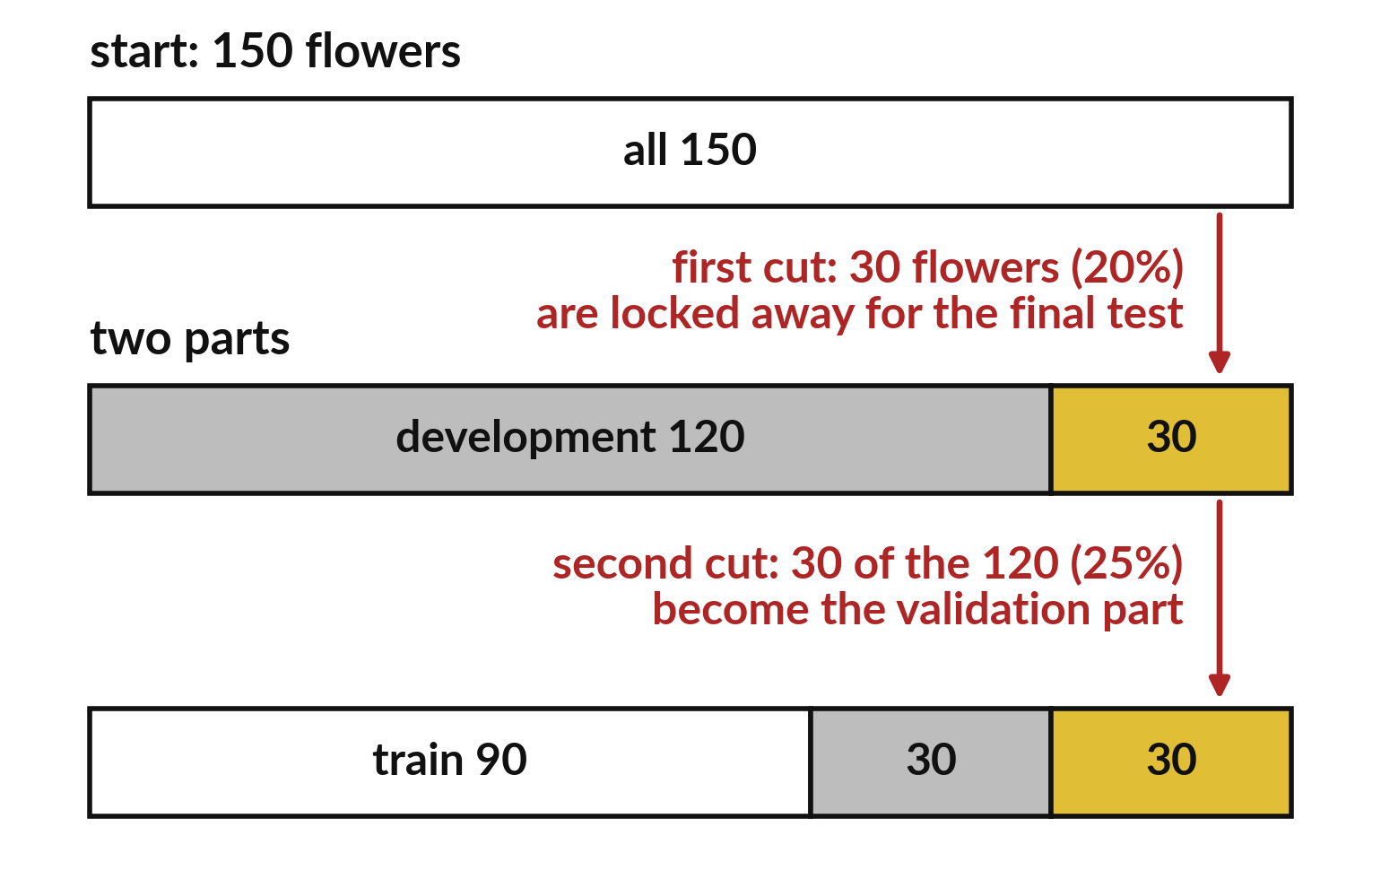
Two cuts turn 150 flowers into 90, 30 and 30
First cut: 30 flowers go to the final test.
Second cut: 30 of the 120 go to validation.
The rest, 90, is for training.
Notes:
Start with all one hundred and fifty flowers. The first cut sets aside thirty for the final test. That leaves a hundred and twenty. The second cut takes thirty of those for validation. Ninety are left for training.
Check that your three sizes add up to a hundred and fifty.

Slide 7
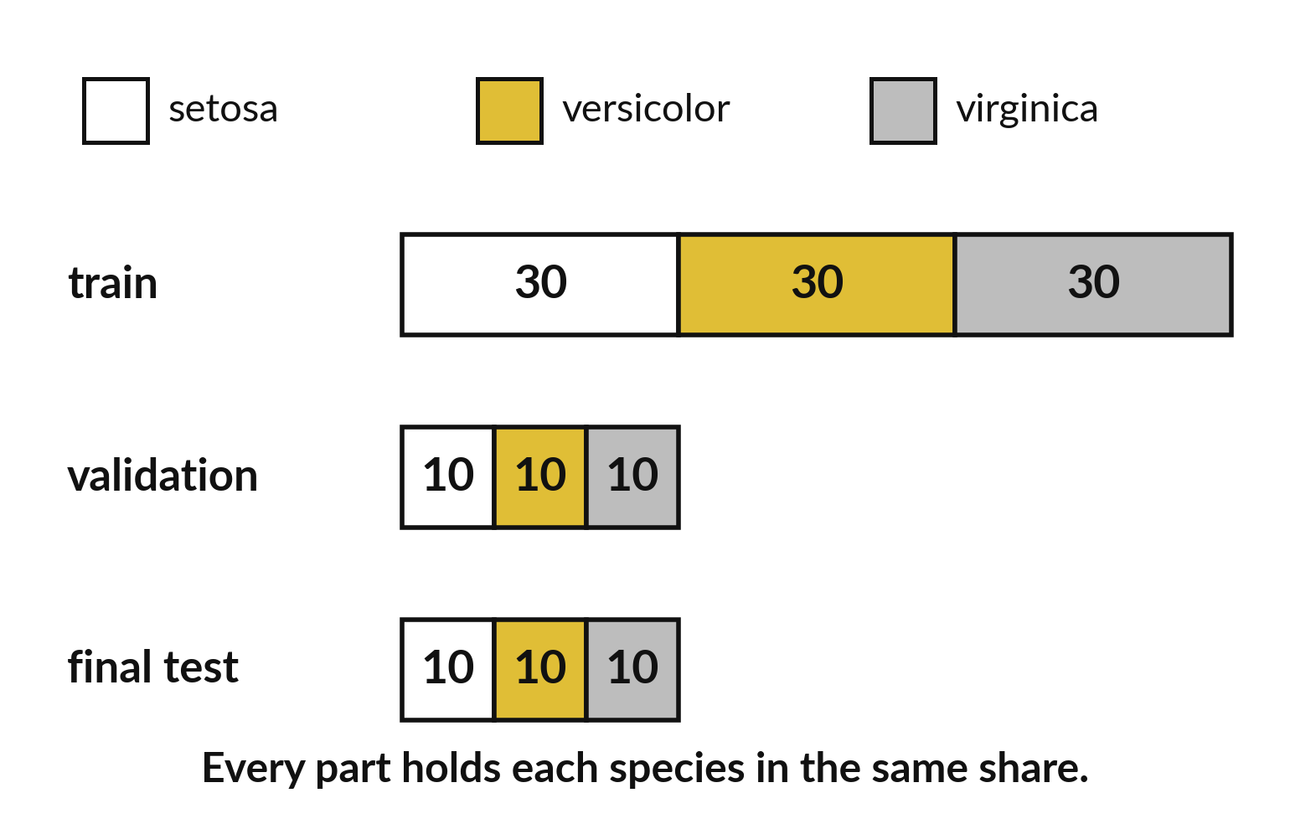
Stratify keeps the same species mix in every part
Each part holds all three species.
The shares match the whole set.
A small part cannot miss a species.
Notes:
A plain shuffle can leave a small part without one of the species by bad luck. Stratify prevents that. Every part gets each species in the same share as the whole.
In this picture each part has the same proportion of the three species.

Slide 8

Predict: A three-way split
from sklearn.datasets import load_iris
from sklearn.model_selection import train_test_split
X, y = load_iris(return_X_y=True)
X_dev, X_test, y_dev, y_test = train_test_split(
X, y, test_size=0.2, random_state=7, stratify=y
)
X_train, X_val, y_train, y_val = train_test_split(
X_dev, y_dev, test_size=0.25, random_state=7,
stratify=y_dev
)
print(len(X_train), len(X_val), len(X_test))
Predict the three sizes. They should add up to 150.
Write your guess on paper before we run it.
Notes:
First lock 20% of the flowers away as the final test, then take a quarter of what remains for validation. stratify keeps each species equally represented in every part.
Make a prediction. Predict the three sizes. They should add up to 150. Put your guess on paper now, even if you are unsure.

Slide 9

Run it: A three-way split
The cell prints 90, 30 and 30.
stratify=y means each species has the same share in every part: 10 of each species in validation and in the final test.
The final test is now locked and must not be used to make any choice.
Notes:
Running it now. Match each line of the output with the line of code that made it.
The cell prints 90, 30 and 30. stratify=y means each species has the same share in every part: 10 of each species in validation and in the final test. The final test is now locked and must not be used to make any choice.
Keep your guess. We use it in the next step.

Slide 10

Investigate: A three-way split
1. Why are the three parts 60%, 20% and 20%?
2. What does stratify do that a plain shuffle does not?
Notes:
Now we look closely at A three-way split. I have two questions for you.
Question one. Why are the three parts 60%, 20% and 20%? Think about it for a moment, then tell the person next to you.
Let me answer it. 20% is locked away first. A quarter of the other 80% is 20% of the total, which leaves 60%.
Question two. What does stratify do that a plain shuffle does not? Have a go in your head first.
The answer is this. It makes sure each part has the same species mix, so a small part is not accidentally missing one.

Slide 11

Modify: change one thing
Print how many flowers of species 0 are in the validation part.
Then tell your neighbour what changed and how you know.
Notes:
Make one small change. Print how many flowers of species 0 are in the validation part. Run it, then tell someone what you saw.
What you should find: Ten.

Slide 12

Break
15 minutes away from your screen
Stand up. Drink some water. Tell someone what you guessed in the first half.
Notes:
Break time. 15 minutes away from your screens. Stand up, drink some water and tell someone what you guessed in the first half.
When we come back we start the second idea.

Slide 13
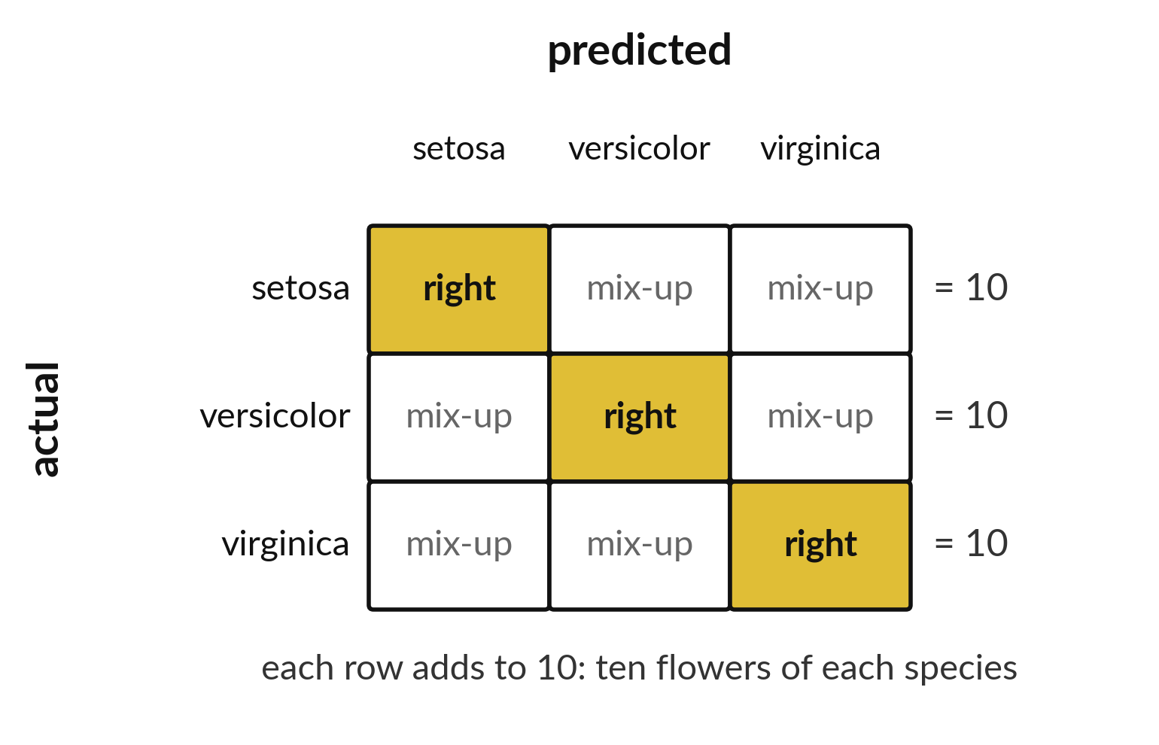
The final test has ten flowers of each species
Each row adds up to ten.
The diagonal holds right answers.
Off the diagonal are the mix-ups.
Notes:
The final test holds thirty flowers, ten of each species, so every row of the confusion matrix adds up to ten. The diagonal cells are the flowers we named correctly. Anything off the diagonal is a mix-up between two species.
Your own matrix will have real numbers in these cells.

Slide 14
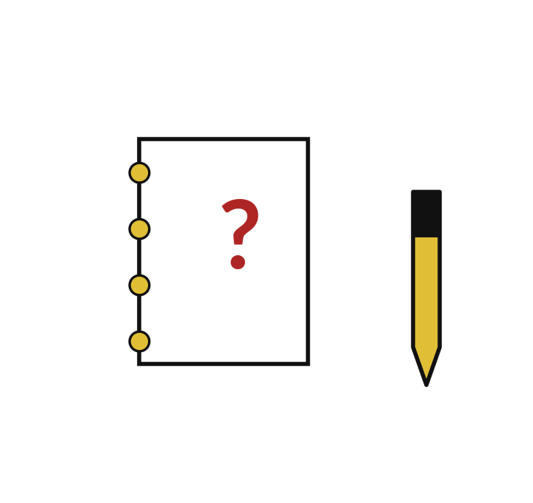
Predict: Choose on validation, test once
Predict which depth wins on validation. Write it down before you run.
Write your guess on paper before we run it.
Notes:
Compare a tree of depth 1 and one of depth 3 on validation only. Freeze the winner.
Time to commit to an answer. Predict which depth wins on validation. Write it down before you run. Write one line on paper. I will give you a minute.

Slide 15
Run it: Choose on validation, test once
The baseline scores exactly one third on validation, because each species is a third.
The deeper tree usually wins on validation.
The choice is made from the validation scores and then frozen.
Notes:
Now we run it. Match each line of the output with the line of code that made it.
The baseline scores exactly one third on validation, because each species is a third. The deeper tree usually wins on validation. The choice is made from the validation scores and then frozen. final_acc is the one honest number: it comes from 30 flowers the choice never saw. The report needs the split sizes, the baseline, both validation scores, the chosen depth, the final accuracy, the confusion matrix and two limitations.
If your guess was off, find the line that surprised you.

Slide 16
Investigate: Choose on validation, test once
1. Which scores did you use to choose the depth?
2. What is one limitation of a final test of 30 flowers?
Notes:
Now we look closely at choose on validation, test once. I have two questions for you.
Question one. Which scores did you use to choose the depth? Have a go in your head first.
The answer is this. The validation scores only.
Question two. What is one limitation of a final test of 30 flowers? Write your answer in one line before we compare.
One flower is more than 3 points of accuracy, so the score is unstable.

Slide 17
Modify: change one thing
Say what you would do if the final test score came out lower than the validation score.
Then tell your neighbour what changed and how you know.
Notes:
Now it is your turn to change something. Say what you would do if the final test score came out lower than the validation score. After you run it, say in one sentence what changed and how you checked.
You should see this. Report it as it is. A lower final score is normal, and changing the choice now would use the test twice.

Slide 18
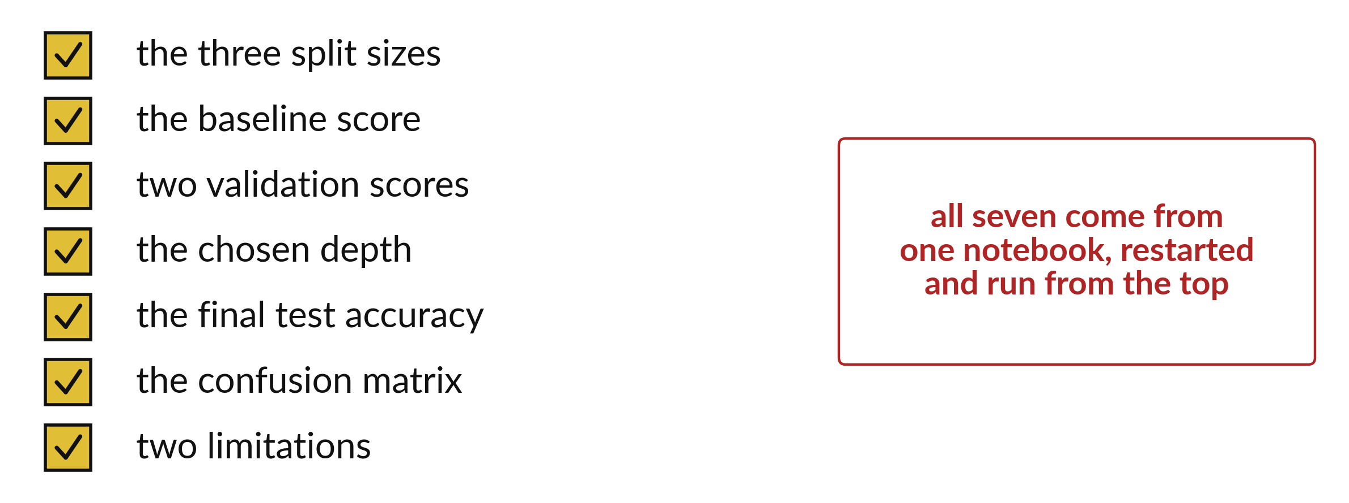
Checkpoint two needs seven pieces of evidence
Report validation and final test apart.
Notes:
Before you hand in checkpoint two, tick these seven items. The three split sizes, the baseline score, two validation scores, the chosen depth, the final test accuracy, the confusion matrix and two limitations.
All of them must come from one notebook that you restarted and ran from the top.

Slide 19

Make: your own version
Submit ML18.ipynb with: the split sizes, the baseline, two validation scores, the chosen depth, the final test accuracy, the confusion matrix and two limitations. Explain your decision without claiming that the highest score proves one depth is best in general.
Save it as ML18. Write two sentences: what you changed and how you checked it.
Notes:
This is your own task for today. Take it one step at a time. If you get stuck for a few minutes, read your error message, check the error card, and then ask me.
Save it as ML18. I will come round to each of you and ask what you changed and how you checked it.

Slide 20

Two errors you may meet today
It means: The final test was used while deciding the depth.
Fix: Mark that result as validation and use the instructor's alternate holdout for the final.
The final accuracy was calculated before the choice
It means: stratify was given labels that are too few.
Fix: Check that y is the full label list.
ValueError: The least populated class in y has only 1 members
Notes:
Everyone meets errors, including me. Two are likely today, so let us meet them now.
This is the first one. You will see: The final accuracy was calculated before the choice. It means this: the final test was used while deciding the depth. To fix it, mark that result as validation and use the instructor's alternate holdout for the final.
The next one. You will see: ValueError: The least populated class in y has only 1 members. It means this: stratify was given labels that are too few. To fix it, check that y is the full label list.
Keep this slide in mind when something stops working.

Slide 21
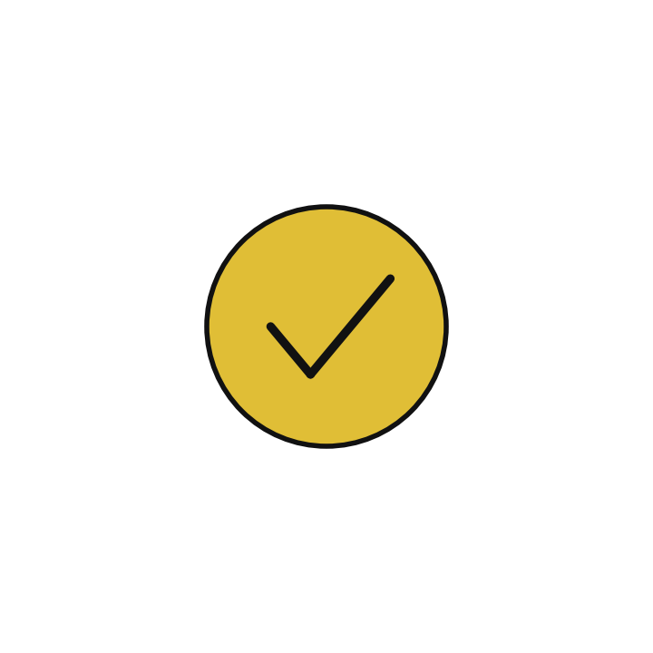
Finish this sentence in your notebook
I choose with validation scores, freeze the choice, then report one final test score with its limits.
Then save your notebook, close it and open it again to check it saved.
Notes:
We are nearly done. Remember the question from the start of the session: Which tree depth is better, and what does a locked test say about it?
Write this sentence in your notebook and finish it your own way. I choose with validation scores, freeze the choice, then report one final test score with its limits.
Then save your notebook, close it and open it again to check it saved.

