Slide 1
Compare, explain and critique
Does my model beat the baseline fairly, and can I defend each input?
Machine Learning | Session 21 of 24 | Week 7, Your project
Holiday Data and AI Camp | The National ICT Innovation Hub, Nakawa
Notes:
Laptops open, please. Today is session 21 and our topic is compare, explain and critique.
By the end of today you will be able to compare candidate models on the same validation rows, explain why one input is excluded, and check a coding assistant's advice with tests.
We will answer one question: Does my model beat the baseline fairly, and can I defend each input?

Slide 2
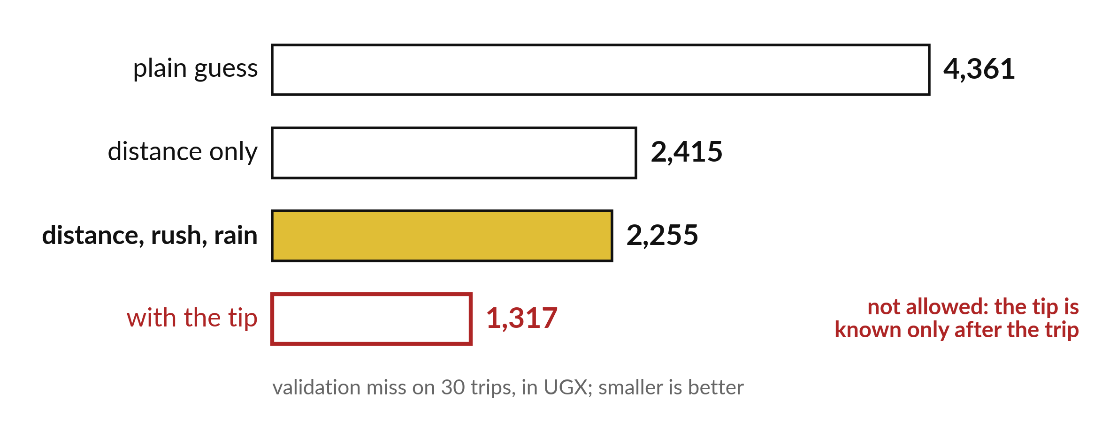
Does my model beat the baseline
fairly, and can I defend each input?
Notes:
Four bars. The plain guess misses by four thousand three hundred and sixty one shillings. Using distance alone brings it to two thousand four hundred and fifteen. Adding rush hour and rain brings it to two thousand two hundred and fifty five. The last bar, which uses the tip, is much shorter, but that model is not allowed. Today you compare candidates fairly and defend every input.

Slide 3
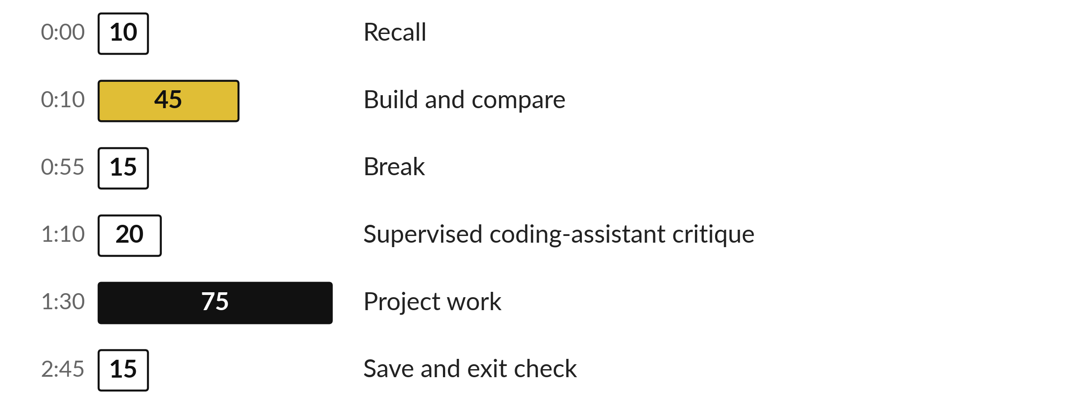
Three hours, mostly doing
Most of our time is spent doing, in small steps, with a guess before every run.
Notes:
Here is how the 3 hours go. Each bar is as long as the time we spend on that part.
First, 10 minutes. Recall. Then, 45 minutes. Build and compare. After that, 15 minutes. Break. Next, 20 minutes. Supervised coding-assistant critique. Then, 75 minutes. Project work. Then, 15 minutes. Save and exit check.
Notice how much of the time is yours. You listen for a short while and then you do. That is on purpose, because you learn this by doing it.

Slide 4



Words for today (1 of 2)
fair comparison
Same rows, same measure, same split for every model.
Every runner on the same track.
candidate model
A model you are considering using.
A player trying out for the team.
validation error
The average miss on validation rows.
The mock exam mark.
Notes:
We need a few words today. For each one I will say what it means and give you something to picture.
fair comparison. Same rows, same measure, same split for every model. Imagine it like this. Every runner on the same track.
candidate model. A model you are considering using. An example from everyday life. A player trying out for the team.
validation error. The average miss on validation rows. Here is a way to see it. The mock exam mark.

Slide 5

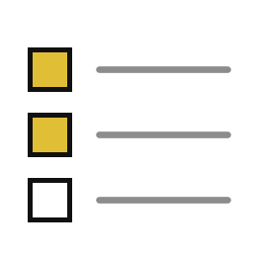
Words for today (2 of 2)
coding assistant
A tool that suggests code or fixes; its advice must be checked.
A friend who sounds sure and is sometimes wrong.
AI use log
A record of any assistance, advice taken or rejected, and tests run.
A signed note of who helped.
Notes:
More words for today.
coding assistant. A tool that suggests code or fixes; its advice must be checked. A small example. A friend who sounds sure and is sometimes wrong.
AI use log. A record of any assistance, advice taken or rejected, and tests run. Picture this. A signed note of who helped.

Slide 6
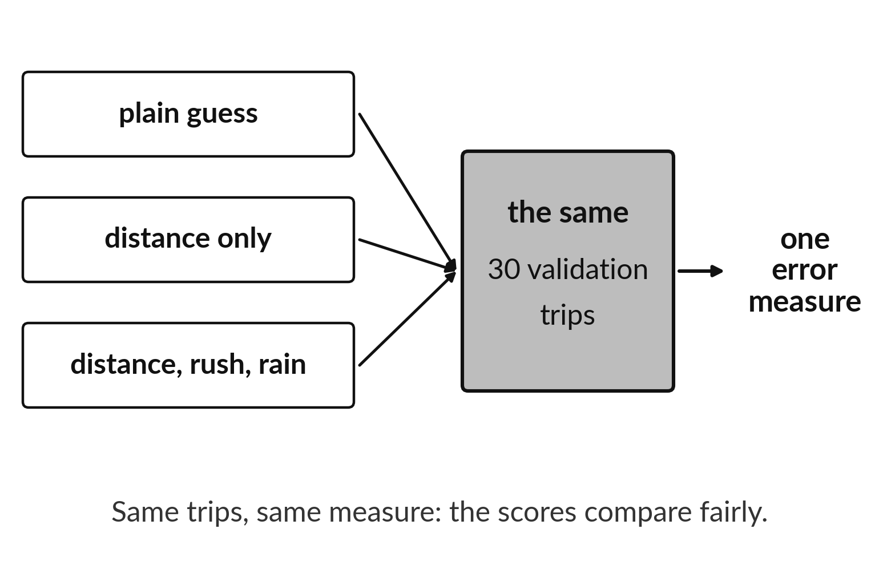
Fair comparison: same trips for every model
Same 30 validation trips.
Same error measure.
Then the scores can be compared.
Notes:
If two models are scored on different trips, a difference in score might come from the trips rather than the models. So every candidate is scored on the same thirty validation trips, with the same error measure.
Then, and only then, a lower number really means a better model.

Slide 7
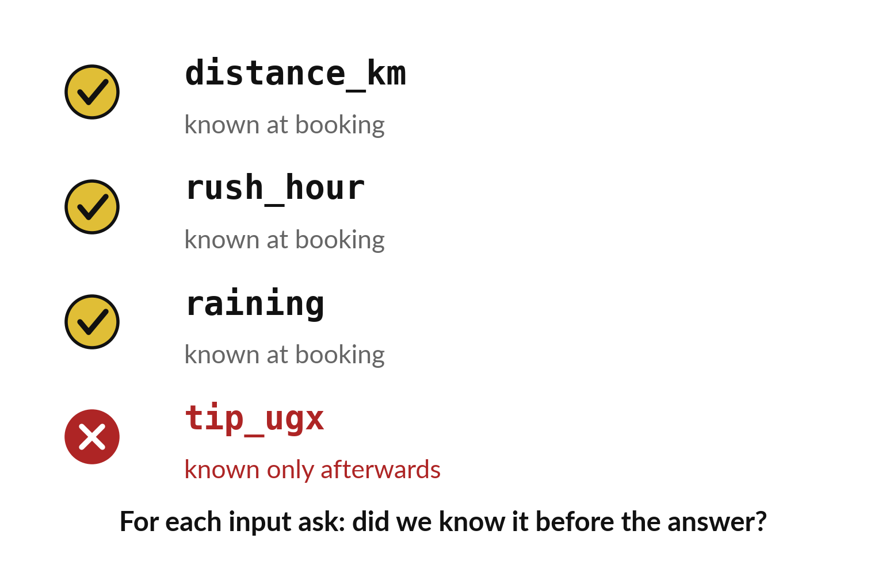
Ask of every input: known before the answer?
Distance, rush hour and rain pass.
The tip fails.
Failing inputs stay out, however good the score.
Notes:
For each input ask one question. Did we know it before the fare was set? Distance, rush hour and rain pass. The tip fails, because it exists only after the trip.
The tip makes the score look wonderful, and that is exactly why it is dangerous.

Slide 8

Predict: A fair comparison
Predict which option has the lowest error, and whether you may use it.
Write your guess on paper before we run it.
Notes:
Compare four options on the same 30 validation trips: the plain guess, distance only, three inputs, and three inputs plus tip. A small function keeps every comparison the same.
Your turn to guess. Predict which option has the lowest error, and whether you may use it. Put your guess on paper now, even if you are unsure.

Slide 9

Run it: A fair comparison
The cell prints 4361, 2415, 2255 and 1317.
The model with the tip has the lowest error, and it must not be used, because the tip is known only after the trip.
Notes:
I will run it, and you compare with your guess. Match each line of the output with the line of code that made it.
The cell prints 4361, 2415, 2255 and 1317. The model with the tip has the lowest error, and it must not be used, because the tip is known only after the trip. Among the allowed models the three-input line wins: it misses by about UGX 2255, against 4361 for the plain guess. Every option used the same split, the same 30 validation trips and the same measure, which is what makes the comparison fair. The final test is untouched.
Check your paper. Were you close?

Slide 10

Investigate: A fair comparison
1. Why is the lowest error not the winner here?
2. What stays the same in a fair comparison?
Notes:
Now we look closely at A fair comparison. I have two questions for you.
Question one. Why is the lowest error not the winner here? Think about it for a moment, then tell the person next to you.
The tip column leaks the answer. A model that cheats scores well and predicts nothing in real use.
Question two. What stays the same in a fair comparison? Have a go in your head first.
Here is how I would answer it. The rows, the split, and the measure of error.

Slide 11

Modify: change one thing
Try distance and raining only, and print the validation error.
Then tell your neighbour what changed and how you know.
Notes:
Time to experiment. Try distance and raining only, and print the validation error. Then explain to your neighbour what the change did.
The result: About UGX 2262, slightly worse than with rush hour too.

Slide 12

Break
15 minutes away from your screen
Stand up. Drink some water. Tell someone what you guessed in the first half.
Notes:
Break time. 15 minutes away from your screens. Stand up, drink some water and tell someone what you guessed in the first half.
When we come back we start the second idea.

Slide 13
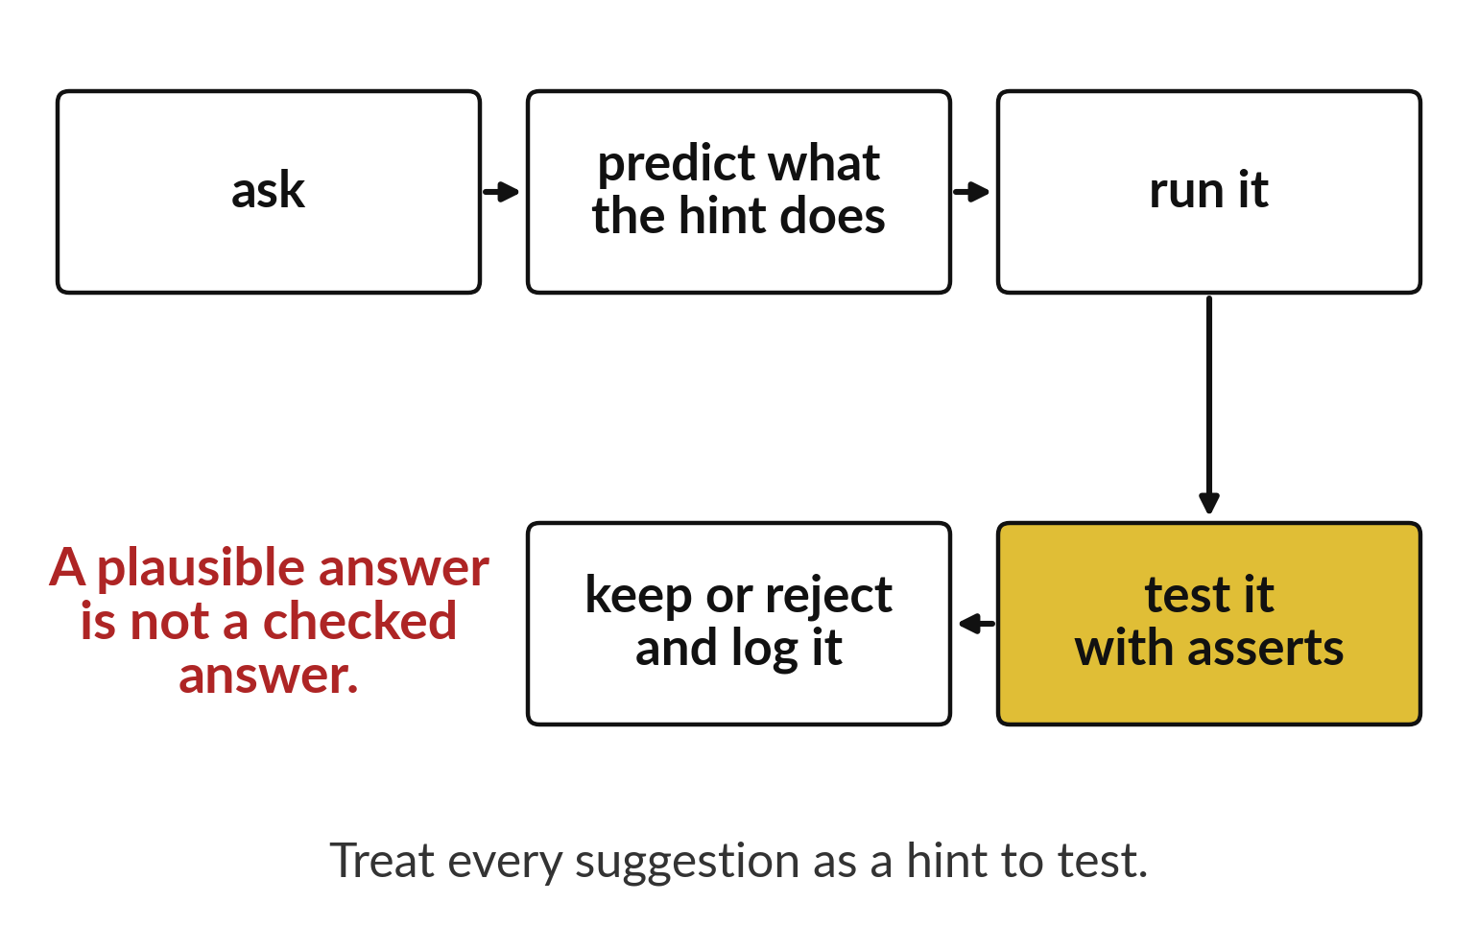
A coding assistant gives plausible code to test
Predict what the hint does.
Run it and test it.
Keep or reject it and log the choice.
Notes:
A coding assistant can suggest code quickly. Its answers sound sure of themselves, and some are wrong. Treat each suggestion as a hint. Predict what it does, run it, test it with a check, then keep it or throw it away and note what you did.
A plausible answer is not a checked answer.

Slide 14
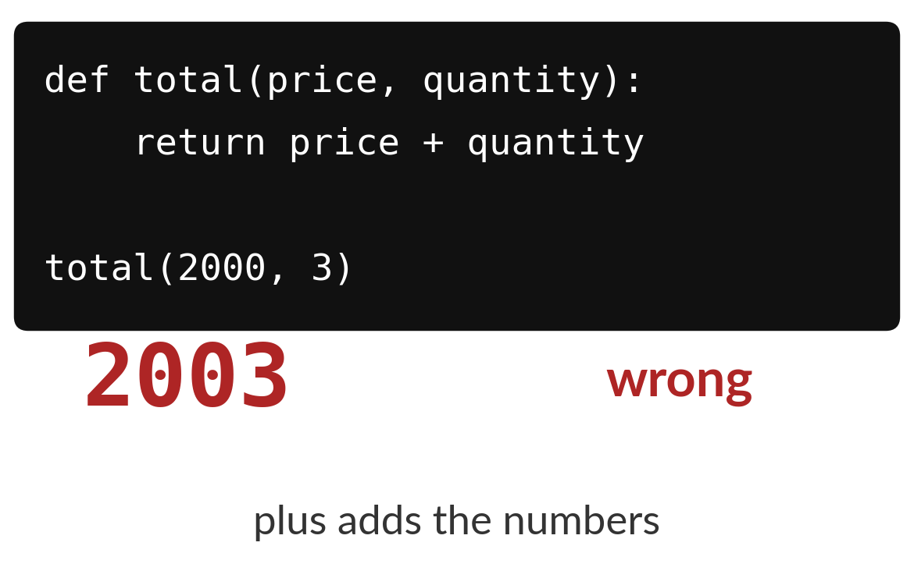
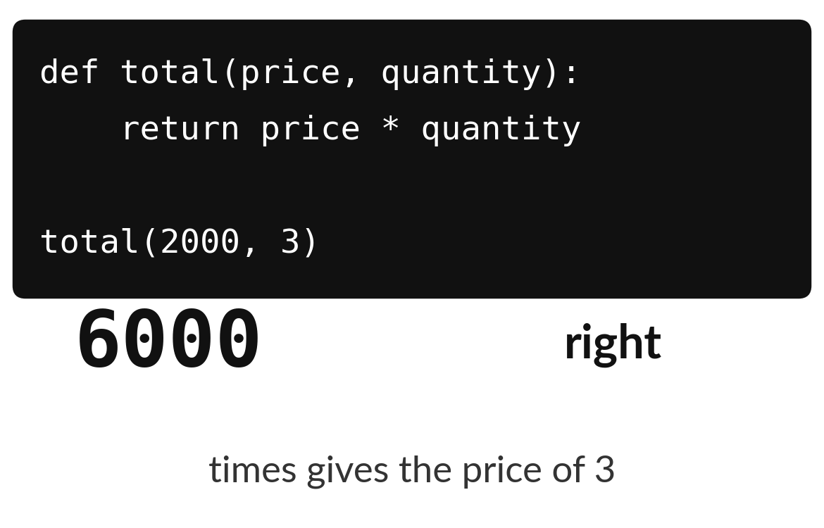
Code that adds instead of multiplying looks fine
The suggested code adds price and quantity: 2003.
The fixed code multiplies them: 6000.
Notes:
Here is a suggestion that looks fine at first glance. The function is meant to give the total for three items at two thousand shillings each. It adds the numbers and returns two thousand and three.
One test with numbers you can work out in your head would have caught it. Run a check before you trust the code.

Slide 15

Predict: Check an assistant's advice
def total(price, quantity):
return price + quantity
buggy_result = total(2000, 3)
print(buggy_result)
def total(price, quantity):
return price * quantity
assert total(2000, 3) == 6000
assert total(1000, 0) == 0
assert total(1000, 1) == 1000
Predict what total(2000, 3) gives with the plus sign, and what it should give.
Write your guess on paper before we run it.
Notes:
A function should multiply a price by a quantity but gives the wrong answer. A tutor shows an assistant's hint, or a teacher-written one, and you test it.
Now your guess. Predict what total(2000, 3) gives with the plus sign, and what it should give. Write one line on paper. I will give you a minute.

Slide 16
Run it: Check an assistant's advice
The first print shows 2003, because plus adds the numbers.
The required answer is 6000, and multiplying fixes it.
The three asserts pass silently.
The tests support this small requirement and do not prove the function is right for every input.
Notes:
Watch the output as it appears. Match each line of the output with the line of code that made it.
The first print shows 2003, because plus adds the numbers. The required answer is 6000, and multiplying fixes it. The three asserts pass silently. The tests support this small requirement and do not prove the function is right for every input. The teacher's hint says to inspect the arithmetic operator and to try total(2000, 3) and total(1000, 0). A claim that every bug in a total function is fixed by changing + to * goes too far: a different bug would need a different repair.
Tell the person next to you whether your guess matched.

Slide 17
Investigate: Check an assistant's advice
1. What is useful in the hint and what is unjustified?
2. Why test with a quantity of 0?
3. What goes in AI_USE_LOG.md?
def total(price, quantity):
return price + quantity
buggy_result = total(2000, 3)
print(buggy_result)
def total(price, quantity):
return price * quantity
assert total(2000, 3) == 6000
assert total(1000, 0) == 0
assert total(1000, 1) == 1000
Notes:
Now we look closely at check an assistant's advice. I have three questions for you.
Question one. What is useful in the hint and what is unjustified? Have a go in your head first.
Here is how I would answer it. Useful: inspect the operator and test with 0. Unjustified: the claim that every bug is fixed by changing + to *.
Question two. Why test with a quantity of 0? Write your answer in one line before we compare.
What I would say is this. A zero quantity must give a total of 0, which catches many mistakes.
Question three. What goes in AI_USE_LOG.md? Say it quietly to yourself before anyone answers.
Let me answer it. The date and tool, your own attempt, the question asked, the reply, what you accepted or rejected and why, and the tests you ran.

Slide 18
Modify: change one thing
Add one more assert of your own and run the cell.
Then tell your neighbour what changed and how you know.
def total(price, quantity):
return price + quantity
buggy_result = total(2000, 3)
print(buggy_result)
def total(price, quantity):
return price * quantity
assert total(2000, 3) == 6000
assert total(1000, 0) == 0
assert total(1000, 1) == 1000
Notes:
Your hands on the keyboard now. Add one more assert of your own and run the cell. When you have run it, tell your neighbour what changed and how you know.
Here is what happens. For example assert total(500, 4) == 2000.

Slide 19
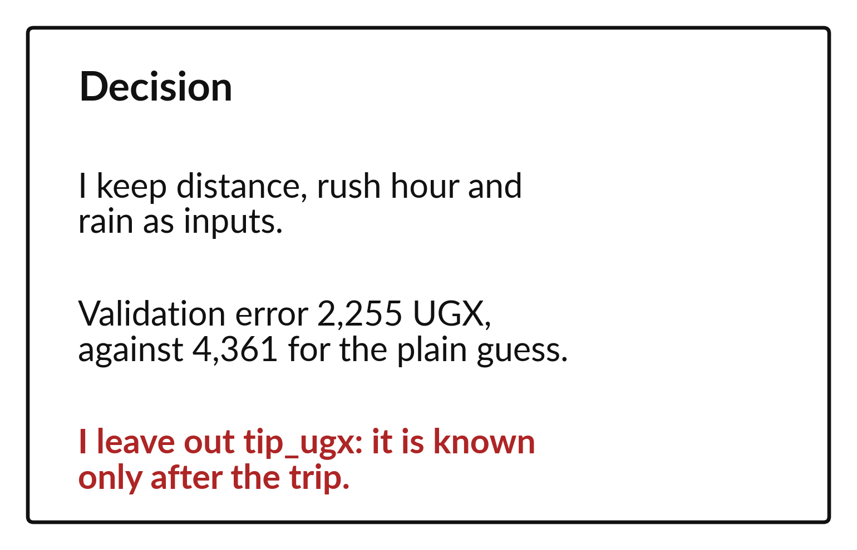
A decision card records what you kept and why
Name the inputs you keep.
Give the validation error.
State what you left out and why.
Notes:
Finish with a decision card. It says which inputs you keep, how well they did on validation compared with the plain guess, and which input you left out and why.
If you can write the card in three lines, you understand your own project.

Slide 20

Make: your own version
Add model code, the validation error and a short decision to project.ipynb. Ask a partner to name your target and baseline from the notebook alone. Record any assistance in AI_USE_LOG.md or write No AI assistance used.
Save it as ML21. Write two sentences: what you changed and how you checked it.
Notes:
This is your own task for today. Take it one step at a time. If you get stuck for a few minutes, read your error message, check the error card, and then ask me.
Save it as ML21. I will come round to each of you and ask what you changed and how you checked it.

Slide 21

Two errors you may meet today
It means: A leakage column made the model look better.
Fix: Remove the column that is only known after the answer.
The with-tip score looks like the best
It means: The split uses different random_state values or none at all.
Fix: Use the same split settings for every model.
The comparison changes every time I run it
Notes:
Everyone meets errors, including me. Two are likely today, so let us meet them now.
This is the first one. You will see: The with-tip score looks like the best. It means this: A leakage column made the model look better. To fix it, remove the column that is only known after the answer.
The next one. You will see: The comparison changes every time I run it. It means this: the split uses different random_state values or none at all. To fix it, use the same split settings for every model.
Keep this slide in mind when something stops working.

Slide 22

Finish this sentence in your notebook
A model counts as better only on the same rows, with the same measure, and without leakage.
Then save your notebook, close it and open it again to check it saved.
Notes:
We are nearly done. Remember the question from the start of the session: Does my model beat the baseline fairly, and can I defend each input?
Write this sentence in your notebook and finish it your own way. A model counts as better only on the same rows, with the same measure, and without leakage.
Then save your notebook, close it and open it again to check it saved.

