Slide 1
Can I trust this model? Overfitting, cross-validation and leakage
How do we know a model that predicts motor winding temperature will still work on a motor it has never seen?
CML3111 | Electrical, Mechatronics, Robotics and Communications | Week 10, class 3 of 4 | Friday 20 November 2026, 11:00 to 14:00
KLAi | International University of East Africa | Jotham Martin Wambi
Notes:
Welcome back. In the first two classes you built models that predict motor winding temperature and models that answer yes or no. Today we ask the question an engineer must always ask: can I trust this?
A score that looks good is not enough. We learn how a model fools us, and how to test it so that it cannot.

Slide 2




Today in one view: what you will leave with
By the end of today you can
Explain underfitting, a good fit and overfitting (the bias-variance trade-off), and tune the hyperparameter max_depth with a validation curve
Work out training error, validation error, the generalisation gap, and a cross-validation mean and standard deviation, by hand
Score a model with K-fold and GroupKFold cross-validation, and report the mean with its standard deviation
Name three kinds of data leakage and use a checklist that blocks them
Notes:
Here is what you can do by the end of today. You can explain underfitting, a good fit and overfitting, the bias-variance trade-off, and you can tune max_depth, a hyperparameter, by looking at a validation curve. You can work out the training error, the validation error, the generalisation gap, and the mean and standard deviation of cross-validation scores, by hand.
You can score a model with K-fold and GroupKFold. And you can name three kinds of data leakage and keep a checklist that blocks them. Nothing is submitted today. At the end I explain how the class counts.

Slide 3
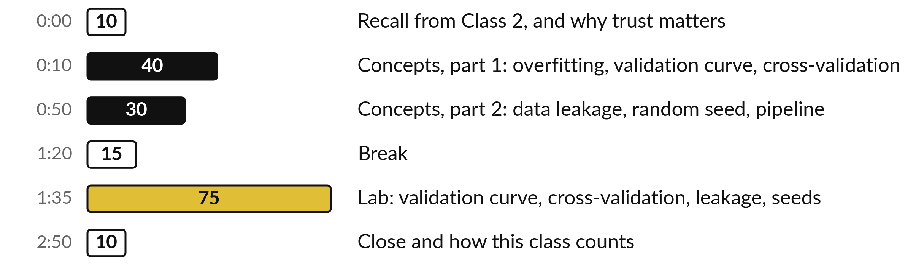
Your three hours: ideas first, then the lab
Concepts first, with no laptops. Then the lab, with the notebook open.
Notes:
We have three hours. The first eighty minutes are concepts only, with no laptop, so you can listen and ask. Then a break. Then the lab, about an hour and a quarter, where you run everything on your own data. The ideas come first and the code comes second.
Here is how the three hours run. First, ten minutes. Recall from Class 2, and why trust matters. Then, forty minutes. Concepts, part 1: overfitting, validation curve, cross-validation. After that, thirty minutes. Concepts, part 2: data leakage, random seed, pipeline. Next, fifteen minutes. Break. Then, 75 minutes. Lab: validation curve, cross-validation, leakage, seeds. Then, ten minutes. Close and how this class counts.

Slide 4

Three questions from last time
1. Why is a majority-class baseline (a model that always predicts no) a poor model, even when its accuracy is about 80 percent?
2. In a confusion matrix, what is a false negative (FN) and what is a false positive (FP)?
3. What happened to recall and false positives when we lowered the decision threshold from 0.5 to 0.3?
Answer aloud first. Then we check together.
Notes:
Three quick questions from Class 2. Answer aloud first, and then we check together. It is a warm-up to bring last time back.
Question one. Why is a majority-class baseline (a model that always predicts no) a poor model, even when its accuracy is about 80 percent? Take a moment.
A good answer: It finds none of the real positive cases, so its recall is 0. Accuracy hides that.
Question two. In a confusion matrix, what is a false negative (FN) and what is a false positive (FP)? Say it to yourself first.
What I hope you said: False negative: the model said no (negative) and the truth was yes (positive). False positive: the model said yes and the truth was no.
Question three. What happened to recall and false positives when we lowered the decision threshold from 0.5 to 0.3? Write a word or two down.
The short answer: Recall rose from 0.67 to 1.00. False positives stayed at 0.
Keep these three in mind, because today builds on them.

Slide 5



Answers to the three questions from Class 2
Question | Short answer
Why is a majority-class baseline (a model that always predicts no) a poor model, even when its accuracy is about 80 percent? | It finds none of the real positive cases, so its recall is 0. Accuracy hides that.
In a confusion matrix, what is a false negative (FN) and what is a false positive (FP)? | False negative: the model said no (negative) and the truth was yes (positive). False positive: the model said yes and the truth was no.
What happened to recall and false positives when we lowered the decision threshold from 0.5 to 0.3? | Recall rose from 0.67 to 1.00. False positives stayed at 0.
Notes:
Here are the answers, so you can check yourself and use this slide to revise. A majority-class baseline, a model that always predicts no, can have a high accuracy, but it finds no real positive case, so its recall is zero. A false negative is a no when the truth was yes, and a false positive is a yes when the truth was no.
When we lowered the decision threshold from 0.5 to 0.3 on the validation rows: Recall rose from 0.67 to 1.00. False positives stayed at 0. Today we ask a different question about the same models: can we trust a score at all?

Slide 6

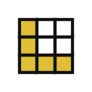



Words we use today
Word | What it means
Overfitting | The model fits the noise in the training set (it nearly memorises it) and does worse on new rows. Underfitting is the opposite: too simple to learn the pattern.
Cross-validation | Scoring a model K times. The rows are cut into K parts called folds. Each fold takes one turn as the validation fold (held-out fold).
Data leakage | Information the model would not have at prediction time (held-out rows, or the target itself) reaches it while it is trained, so the score looks better than it really is.
Bias-variance trade-off | Too simple a model misses the pattern (high bias, underfitting). Too flexible a model chases noise (high variance, overfitting).
Random seed | A fixed number (random_state in scikit-learn) that makes a random choice repeat exactly.
Notes:
Five words for today. Overfitting is when a model fits the noise in its training set and does worse on new rows. Underfitting is the opposite: too simple to learn the pattern. Cross-validation means scoring a model K times. The rows are cut into K parts called folds, and each fold takes one turn as the validation fold, which some books call the held-out fold.
Data leakage is information the model would not have at prediction time, such as held-out rows or the target itself, reaching it while it is trained, so the score looks better than it is. The bias-variance trade-off is the industry name for the balance between too simple and too flexible.
And a random seed, set with random_state, makes a random choice repeat exactly. We use all five before the end.

Slide 7



A model that looks good on paper
can fail on a new machine or site
A model is built from data on four motors and then used on a fifth motor at another site.
A winding temperature warning is based on the model’s prediction.
If the prediction is wrong, a winding burns or a motor stops when it did not need to.
Notes:
Start with a story from your own field. A model is built from data on four motors and then used on a fifth motor at another site. A winding temperature warning is based on the model’s prediction. If the prediction is wrong, a winding burns or a motor stops when it did not need to.
In the office the model looked excellent, so everybody trusted it. The trouble is that the office score came from rows the model had already been trained on, or from a test that was too easy. Today is about checking a model the way real life will check it.
Have you ever trusted a number from a machine or a spreadsheet and then been surprised?

Slide 8
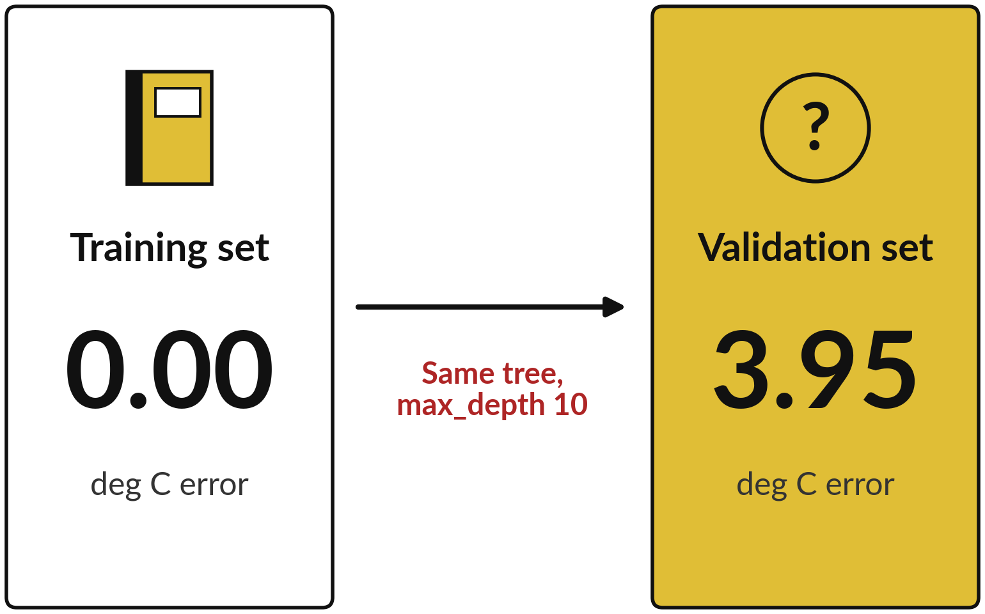
A model must do well on rows it has never seen
Generalisation means doing well on held-out data: rows the model has never seen.
The tree was trained on the training set, so its error there is almost zero.
The validation set was held out. On it the prediction error is far larger. The difference is the generalisation gap.
Notes:
Here is one tree, grown ten questions deep, scored two ways. The training set is the rows it was trained on, and there its error is 0.00 deg C, which is almost perfect. The validation set was held out, and there its error is 3.95 deg C. The difference between the two is called the generalisation gap.
Doing well on held-out rows it has never seen is called generalisation, and it is the only thing we really want. A score on rows the model was trained on tells us about its memory, and a score on new rows tells us about its skill. Which score would you show a client?

Slide 9
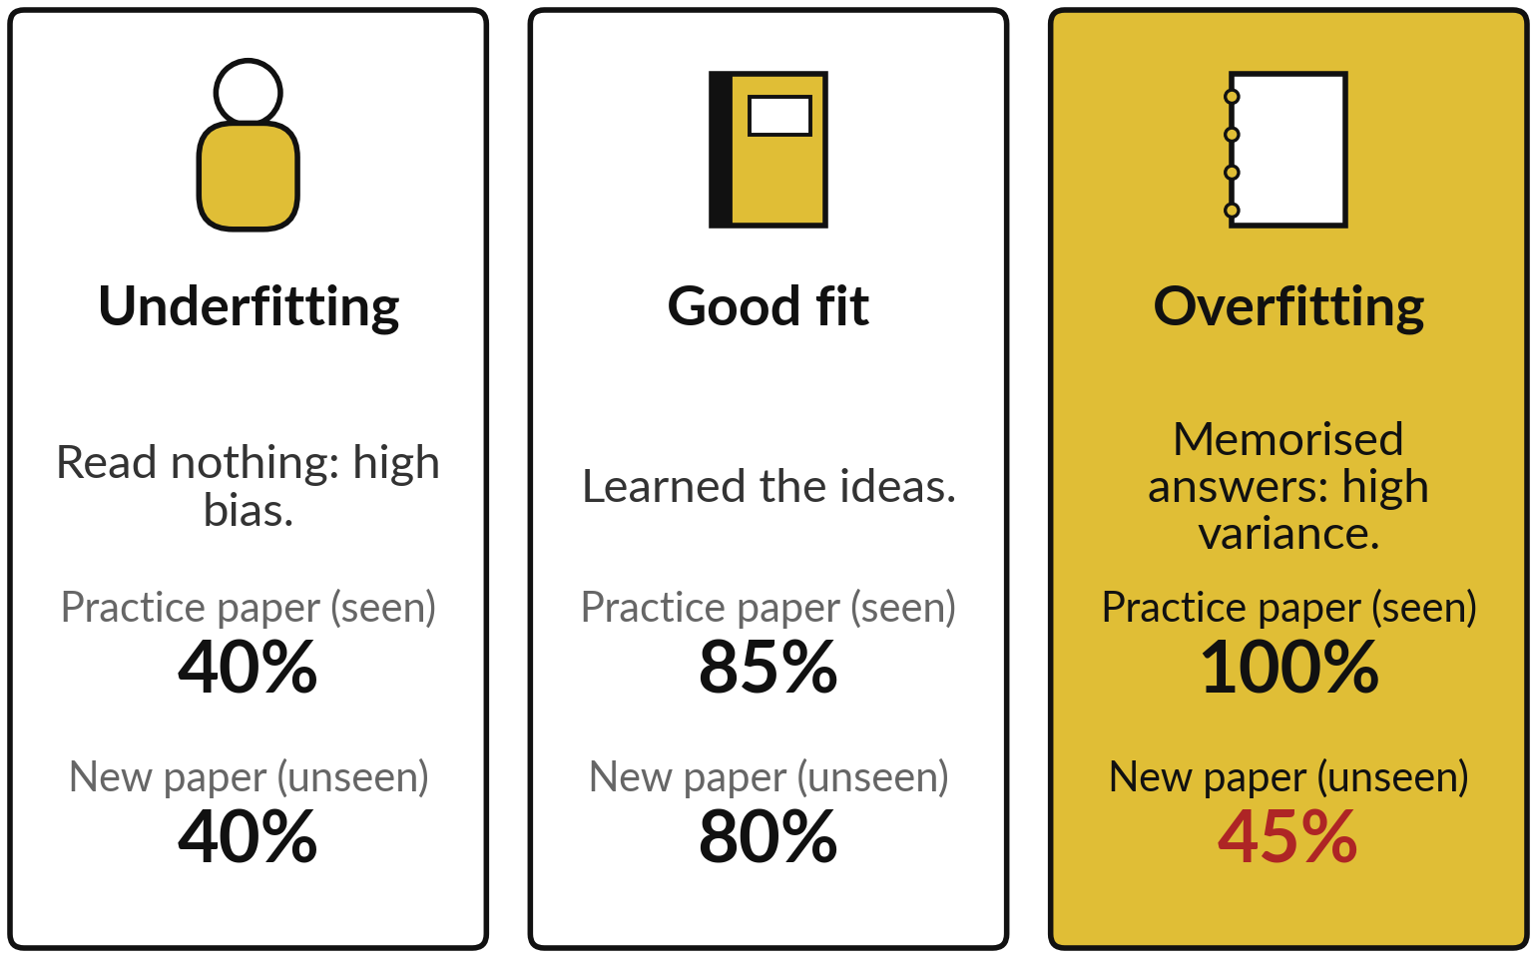
Underfitting, a good fit and
overfitting look like three students
The marks in the picture are illustrative (made up). Each student stands for one kind of model.
Practice paper = training set. New paper = held-out rows.
Bias-variance trade-off: too simple a model misses the pattern, too flexible a model chases noise.
Notes:
Think of three students. The first read nothing, so the practice paper and the new paper both go badly. That is underfitting: a model too simple to learn the pattern, which the industry calls high bias. The second understood the ideas, so the marks are good on both papers.
That is a good fit. The third memorised last year’s answers. Perfect on the practice paper and poor on the new paper. That is overfitting: the model fits the noise, which the industry calls high variance. Balancing the two is the bias-variance trade-off. The practice paper stands for the training set, the new paper for held-out rows, and the marks are made up.
Can you think of someone who passed by memory and then struggled on the job?

Slide 10
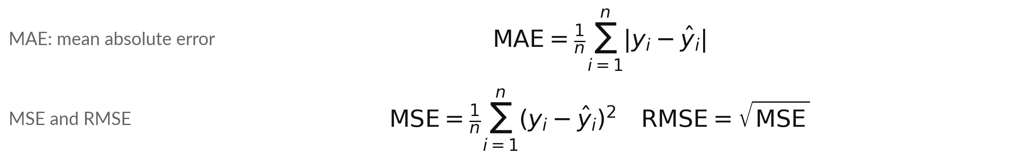
Reminder from Class 1: MAE and
RMSE measure the prediction error
Symbol | What it means | In our data
MAE | The mean size of the error. The bars drop any minus sign | Class 1 model: 0.78 deg C
MSE, RMSE | MSE: mean of the squared errors. RMSE: its square root, in the target unit | Class 1 model: RMSE 0.92 deg C
n, i, y, ŷ | n rows scored; i is the row number; y_i is the actual target of row i; ŷ_i (y-hat) is its prediction | 15 validation rows; motor winding temperature in deg C
Illustrative example (made up): errors of 1, 2 and 3 give MAE = 2, MSE = 4.67 and RMSE = 2.16.
Notes:
Before we use the word MAE all class, here is a reminder from Class 1. For every row, take the actual target and the prediction, and look at the size of the prediction error. The MAE is the mean of those errors, and the bars mean we drop any minus sign.
The RMSE squares each error first, averages, and then takes the square root, so one big error counts for more. Our linear regression model from Class 1 had an MAE of 0.78 deg C and an RMSE of 0.92 deg C on the validation rows. Today we mostly use the MAE.
Why would one very large error matter more to an engineer?

Slide 11
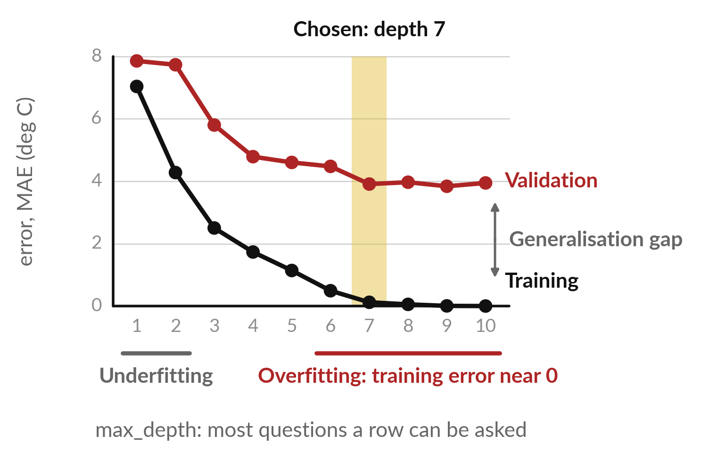
The validation curve: as max_depth grows, training
error keeps falling but validation error stops improving
A validation curve plots both errors against max_depth, a hyperparameter (set before training).
Each dot is one tree. Black: training error. Red: validation error. Between them: the gap.
Depths 1 and 2: both errors high. From depth 6: training error near 0. Gold: chosen depth 7.
Notes:
This is a validation curve from our data. Each point is a tree with a different max_depth, a hyperparameter: a setting we choose before training. The black line is the training error, and it falls all the way to 0.00. At depths 1 and 2 both errors are high: that is underfitting.
From depth 6 up, the training error is near 0: those trees fit the training rows almost exactly, which is overfitting. The red line is the validation error. From depth 7 to depth 10 every validation error is within 5 percent of the lowest, so the red curve is flat there.
The gold band is the depth we choose, depth 7; the next slides show why. In Class 1 you tried depths 1, 2 and 8: this is what you were seeing. Where does the gap start to grow?

Slide 12
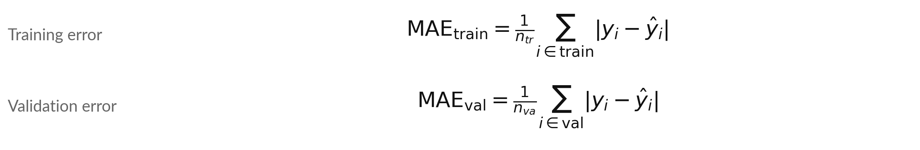
Training error, validation error and the
generalisation gap are short formulas
Symbol | What it means | In our data
MAE | Mean absolute error: the average size of the prediction error. The small label train or val says which rows | Depth 10: 0.00 and 3.95 deg C
n | How many rows. The small label tr means training and va means validation | 58 and 15 rows
i | A row number. The sum adds up the rows of that group | Row 1, row 2, and so on
y, ŷ | The real target of row i, and the model’s prediction for it. The bars | | drop any minus sign | motor winding temperature and the tree’s answer, in deg C
Notes:
Class 1 gave you the MAE. Here it is again, written for two groups of rows. The training error adds up the size of the prediction error on every training row, then divides by the number of training rows. The validation error does the same on the validation rows.
The bars mean the size of the error, so a plus or a minus makes no difference. In our data at depth 10 the training error is 0.00 deg C and the validation error is 3.95 deg C. Which rows is the tree trained on, and which rows does it never see?

Slide 13
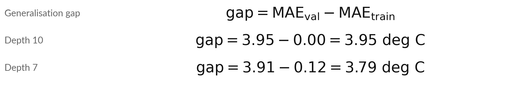
The generalisation gap is the validation
error minus the training error
Symbol | What it means | In our data
gap | Generalisation gap: how much worse the model is on new rows | Depth 10: 3.95 deg C
MAE_val | Validation error, from the formula before | 3.95 deg C at depth 10
MAE_train | Training error, from the formula before | 0.00 deg C at depth 10
Small gap: similar error on new rows. Big gap: overfitting. We choose max_depth by validation error.
Notes:
The generalisation gap is one subtraction: the validation error minus the training error. At depth 10 it is 3.95 minus 0.00, which is 3.95 deg C. At our chosen depth, depth 7, it is 3.91 minus 0.12, which is 3.79 deg C. A small gap says the model does about as well on new rows as on its training set.
A big gap says it is overfitting, fitting the noise in the training set. At depth 7 the gap is large too, so this tree also overfits its training rows. We still choose it, because we choose by the validation error, and no simpler tree does as well on new rows. Next, five depths in one table.

Slide 14
Five depths in one table: leaf nodes,
errors and the generalisation gap
max_depth | Leaf nodes | Training MAE | Validation MAE | Generalisation gap (validation minus training)
1 | 2 | 7.04 | 7.86 | 0.82
2 | 4 | 4.28 | 7.74 | 3.46
4 | 15 | 1.73 | 4.79 | 3.06
7 (chosen) | 47 | 0.12 | 3.91 | 3.79
10 | 58 | 0.00 | 3.95 | 3.95
MAE in deg C. A leaf node is a final node: it holds the prediction. The Class 1 linear regression model scores 0.78 deg C, better than every tree: the target is close to a straight line, and a tree only makes steps.
Notes:
Same numbers as the curve, in a table. Look at the leaf nodes, the final nodes at the bottom of the tree. Every row ends in exactly one leaf node, and the tree gives every row in it the same prediction. At depth 1 there are 2 leaf nodes.
At depth 10 there are 58, for only 58 training rows, so the tree is close to keeping one answer for each row. That is overfitting. The last column is the generalisation gap from the last slide. One more fact for later: the linear regression model from Class 1 scored 0.78 deg C, better than every tree.
Why?
The target rises smoothly, close to a straight line, and a tree can only make steps. So today the tree is our test case for trust. Which depth would you call too deep?

Slide 15
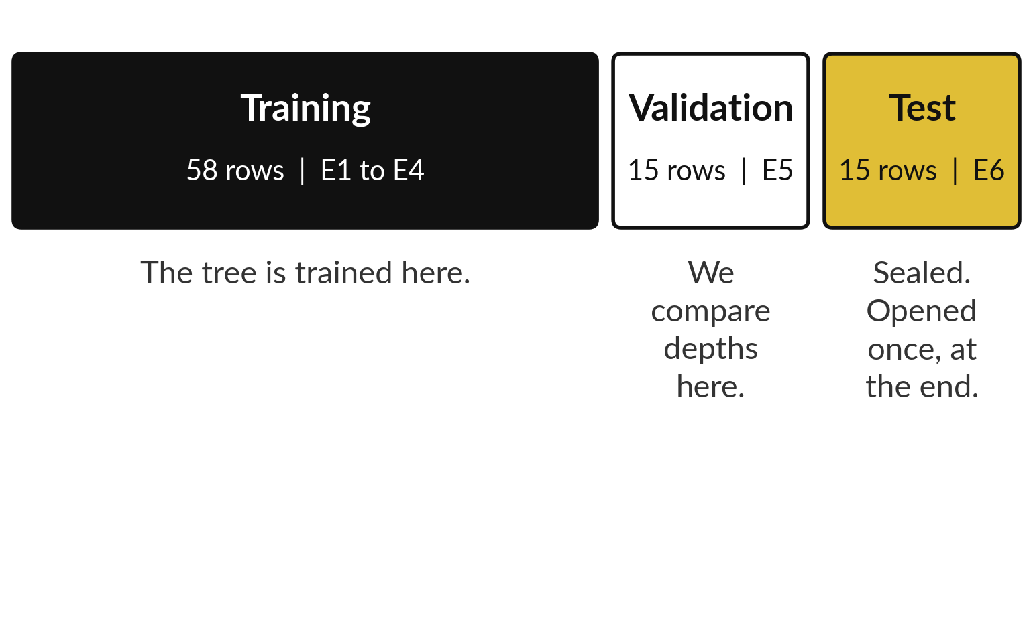
We choose max_depth on the validation
set and keep the test set sealed
Each set is made of whole equipment groups. The picture shows the rows in each set.
Only 15 validation rows, so a score can move by luck. Never tune on the test set.
Test set rule: open it once, after the model and any threshold are chosen. Refit the chosen model on E1 to E5, score it once on E6.
Notes:
How did we choose depth 7?
We looked at the validation set only. The picture shows the three sets: training from groups E1 to E4, validation from group E5, and test from group E6. The test set has one rule. It is opened once, at the very end, after the model and any decision threshold are chosen.
For that final number the chosen model is refitted on all development rows, E1 to E5, and scored once on E6. Class 4 shows this step. The validation set has only 15 rows, so its scores are noisy. We need a rule that does not chase small differences.
Why would the lowest score alone be risky?

Slide 16
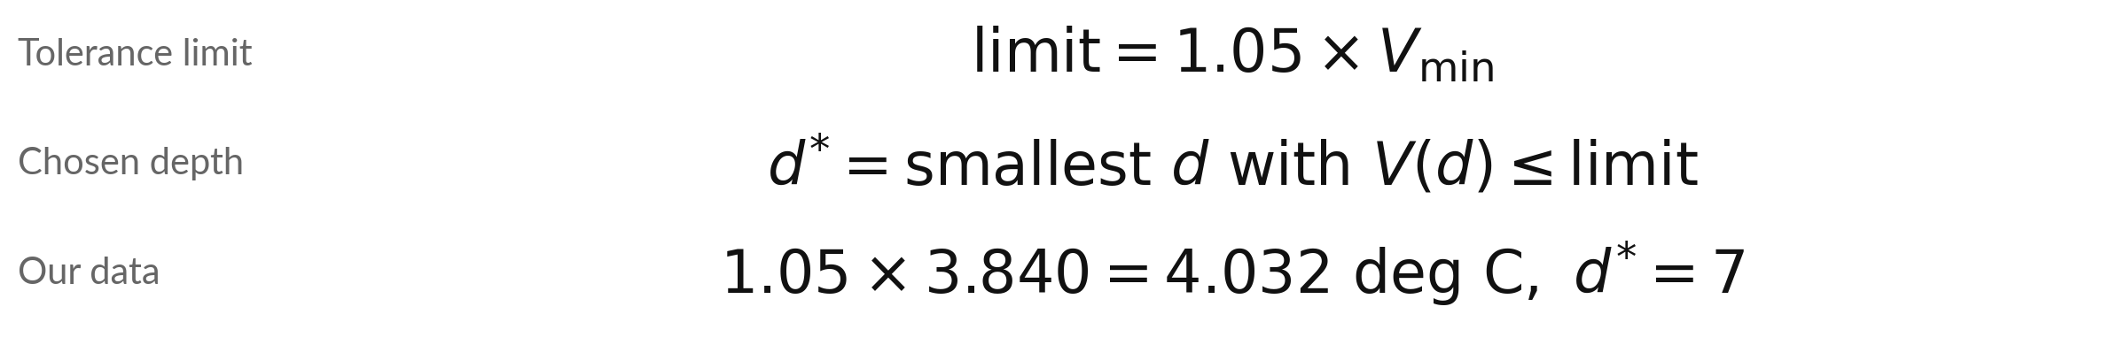
Tuning a hyperparameter: choose the simplest
max_depth within 5 percent of the lowest validation error
Symbol | What it means | In our data
V(d) | Validation MAE of the tree with max_depth d | 7.86 at depth 1, 3.95 at depth 10
V_min | The lowest validation MAE over depths 1 to 10 | 3.840 deg C, at depth 9
limit | The tolerance limit: the lowest value plus 5 percent | 4.032 deg C
d* | The chosen depth: the smallest d that passes | Depths that pass: 7, 8, 9, 10
The passing depths are about equally good, so we take the simplest. d* = chosen max_depth (parsimony).
Notes:
Choosing a hyperparameter such as max_depth is called tuning a hyperparameter. Our rule: find the lowest validation error, V min. For us it is 3.840 deg C, at depth 9. Multiply by 1.05 to get the limit, 4.032 deg C. Any depth at or below the limit passes: 7, 8, 9, 10.
We take the smallest, depth 7, because a simpler tree is easier to explain. That is parsimony. The passing depths are about equally good, so we take the simplest. The 5 percent is our own choice and it is not a law. The chosen depth can also move with the random seed, as we see later.
What would change if we multiplied by 1.00 instead of 1.05?

Slide 17
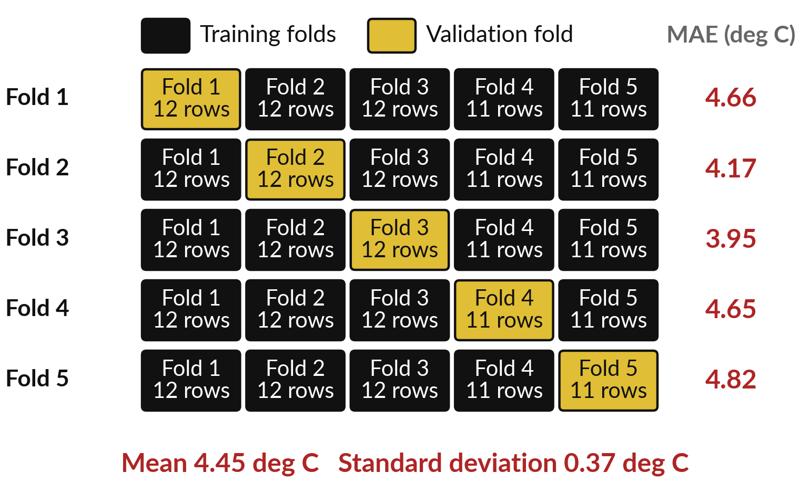
One split can be lucky, so K-fold cross-validation
lets every fold take a turn as the validation fold
K-fold cross-validation cuts the 58 training rows into K = 5 folds (parts of the rows), in the order the rows appear (no shuffle).
In each line, the tree is trained on 4 folds and scored on the gold validation fold.
Rows of E1 to E4 are interleaved: every fold holds all four groups (fold 1: E1 4, E2 4, E3 2, E4 2).
Notes:
A single validation split is one test on one day, and the day may be lucky or unlucky. K-fold cross-validation takes several tests. Cut the 58 training rows into five folds. In the first line of the picture, the tree is trained on folds two to five, and fold one is the validation fold, also called the held-out fold.
Some books call it the test fold, but it is not the sealed test set E6. Here are the five scores for a depth-4 tree, from 3.95 to 4.82 deg C. One warning: the rows of the four groups are interleaved, so every fold holds rows of all four motors.
The model has already met each motor in training. Is that how it will be used on a new motor?

Slide 18
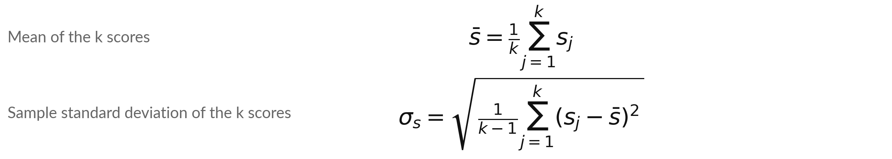
K-fold gives k scores, and we report
their mean and their standard deviation
Symbol | What it means | In our data
s_j | The MAE when fold j is the validation fold (j is the fold number) | 4.66, 4.17, 3.95, 4.65, 4.82 deg C
k | The number of folds, so the number of scores | 5 folds
s̄ | The mean (average) of the k scores (s with a bar) | 4.45 deg C
σ_s | Sample standard deviation: typical distance of a score from the mean. np.std(scores, ddof=1) | 0.37 deg C
Notes:
Two formulas turn the five scores into two numbers. The mean adds up the k scores and divides by k. The standard deviation asks how far each score sits from the average, squares those distances so plus and minus cannot cancel, adds them, divides by k minus 1, and takes the square root.
Dividing by k minus 1 gives the sample standard deviation, the usual choice for a few scores and the one the project asks for. In NumPy you write ddof equals 1, because np.std divides by k unless you say so. Our five scores give a mean of 4.45 deg C and a standard deviation of 0.37 deg C.
A small standard deviation means the folds agree. A large one means the score depends on which fold you ask. First we do it by hand with four easy numbers.

Slide 19
By hand with four illustrative scores: the
mean is 3 and the standard deviation is 0.82
Fold | Score (MAE) | Distance from the mean | Squared distance
1 | 2 | -1 | 1
2 | 3 | 0 | 0
3 | 3 | 0 | 0
4 | 4 | +1 | 1
Mean = (2 + 3 + 3 + 4) / 4 = 3. Sum of the squared distances = 2. Divide by k - 1 = 3: 2 / 3 = 0.67 (the sample variance). The square root of 0.67 is 0.82, the standard deviation. These four scores are illustrative (made up).
Notes:
Let us do it by hand with four illustrative, made-up fold scores: two, three, three and four. The mean is twelve divided by four, which is three. Now the standard deviation. How far is each score from the mean?
Minus one, zero, zero and plus one. Square them, so that plus and minus cannot cancel: one, zero, zero, one. They add up to two. Divide by k minus 1, which is three: two thirds, or 0.67, the sample variance. The square root of 0.67 is 0.82. That number is the standard deviation, the typical distance of a fold score from the mean. Check the 0.82 on your own page.

Slide 20
The same steps on our five real fold scores
give their mean and standard deviation
Fold | Score (MAE, deg C) | Distance from the mean | Squared distance
1 | 4.66 | +0.21 | 0.044
2 | 4.17 | -0.28 | 0.076
3 | 3.95 | -0.50 | 0.249
4 | 4.65 | +0.20 | 0.039
5 | 4.82 | +0.37 | 0.135
Sum | 22.24 | 0.00 | 0.543
Mean = 22.24 / 5 = 4.45 deg C. Sum of squares / (k - 1) = 0.543 / 4 = 0.136. Square root = 0.37 deg C, the standard deviation. Worked from unrounded scores, so the last digit can differ.
Notes:
Now the same steps on the five real scores from our depth-4 tree. The scores add up to 22.24, so the mean is 4.45 deg C. Each score has a distance from that mean, some above and some below, and the distances add up to zero. We square them, and the squares add up to 0.543.
Divide by k minus 1, which is four, to get 0.136, and the square root of that is 0.37 deg C. That is the standard deviation you will see in the notebook. Compare it with the mean. Is it small or large?

Slide 21
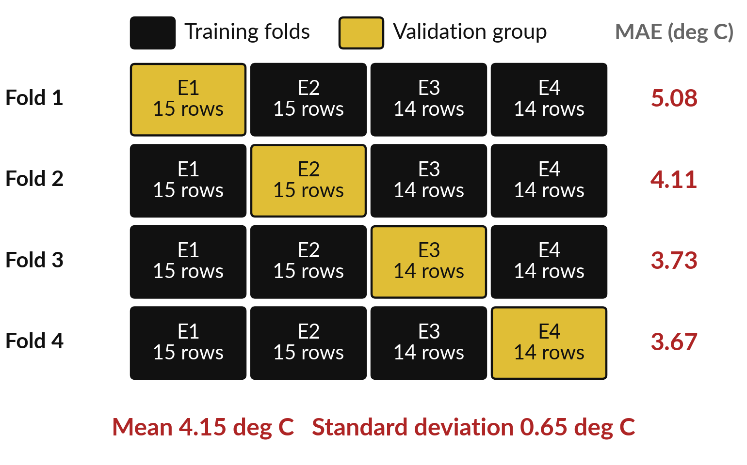
GroupKFold holds out a whole equipment group
in each fold, which is how the model is really used
GroupKFold keeps each group whole: each of E1 to E4 is held out once (scikit-learn picks the order).
Plain K-fold put every motor in every fold. Here the tree trains on three groups and is scored on the fourth, like a new site.
One score per fold; mean and standard deviation as before.
Notes:
Plain K-fold mixes rows from every group, so the model has already seen the same motor while it is trained. In real use a new motor arrives, and nobody has seen it. GroupKFold fixes that by keeping each equipment group whole. In each fold it holds out one group, trains on the other three, and scores the held-out group.
Each of E1 to E4 takes one turn, in an order scikit-learn chooses to balance the fold sizes. The four scores run from 3.67 to 5.08 deg C, with a mean of 4.15. In Class 4 and the project, E5 also takes a turn, giving five folds. Which design looks more like your work?

Slide 22
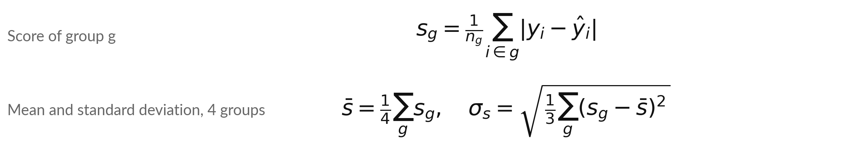
GroupKFold uses the same formulas,
with equipment groups as the folds
Symbol | What it means | In our data
g | The group held out in one fold: E1, E2, E3 or E4 | E1 to E4, one per fold
n_g | Number of rows in group g | E1 15, E2 15, E3 14, E4 14 rows
s_g | MAE on group g, using a tree that was never trained on g | E1 5.08, E2 4.11, E3 3.73, E4 3.67 deg C
s̄, σ_s | Mean of the 4 scores; sample standard deviation (divide by 3) | 4.15 and 0.65 deg C
Notes:
GroupKFold needs no new maths. The score for a group g is the MAE on the rows of that group, using a tree trained on the other three groups that never saw g. Then we take the mean of the four scores and their standard deviation, with the same two formulas as before, with four in place of k, so the standard deviation divides by three.
Our four scores have a mean of 4.15 deg C and a standard deviation of 0.65 deg C. Which group was hardest to predict?

Slide 23


The same max_depth 4 tree gets three
different scores, depending on how we test it
Way of testing | Scores (MAE) | Mean | Standard deviation
Single validation split (group E5) | 4.79 | 4.79 | one score only
K-fold, k = 5 (rows in order, no shuffle) | 3.95 to 4.82 | 4.45 | 0.37
GroupKFold, k = 4 | 3.67 to 5.08 | 4.15 | 0.65
MAE in deg C. The single E5 score is within about one standard deviation of both means: the normal spread from one fold to another. The standard deviation shows how far to trust each mean.
Notes:
Here is the same tree scored three ways. The single split on group E5 says 4.79. Plain K-fold says 4.45, with a standard deviation of 0.37. GroupKFold says 4.15, with a standard deviation of 0.65. The single E5 score is within about one standard deviation of both means: the normal spread from one fold to another.
One split could just as easily have been luckier or unluckier. Report the mean and the standard deviation, and say how the folds were made. Which of the three would you quote to a client, and what would you add?

Slide 24
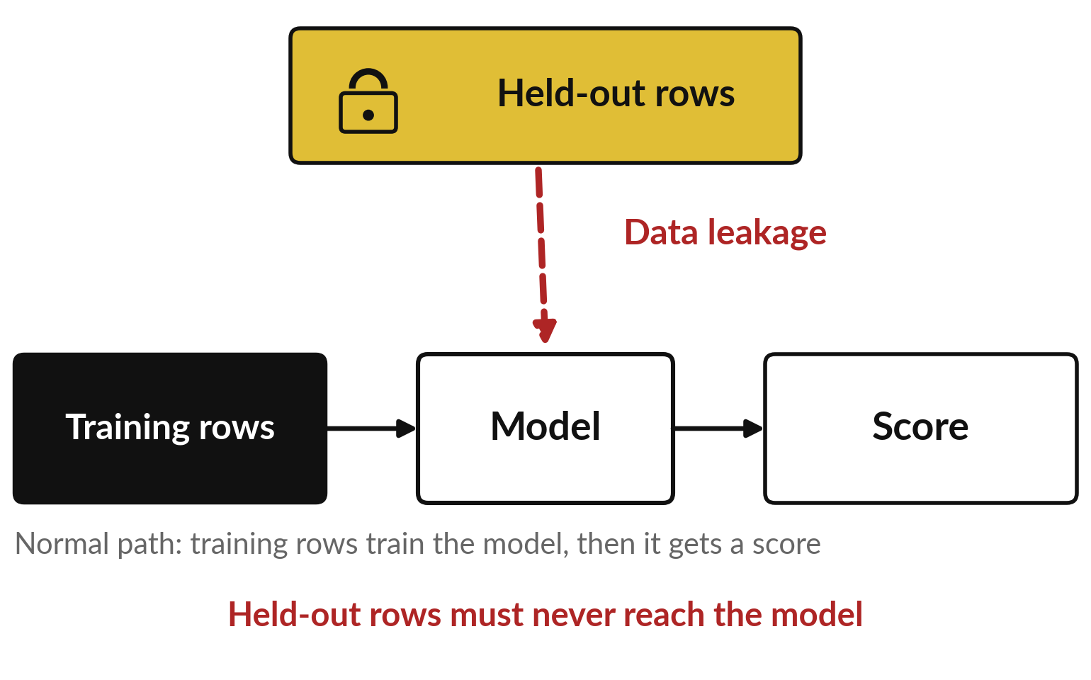
Data leakage is information the model would not
have at prediction time reaching it during training
Data leakage: information the model would not have at prediction time (held-out rows, or the target itself) reaches it while it is trained.
Held-out rows are the validation or test rows. The dashed red arrow is the leakage.
The score looks excellent, then the model fails on real new rows.
Notes:
Now the second big danger. Data leakage means information the model would not have at prediction time, such as held-out rows or the target itself, reaches it while it is trained. The picture shows the normal path along the bottom: the training rows train the model, and then the model gets a score.
The held-out rows are the validation or test rows, and they must stay out of training. If anything from them slips in, along the red arrow, the model has seen the answers. The score then looks excellent, and the model fails on the first real new rows. The worst part is that nothing warns you.
There is no error message, only a score that is too good. Have you seen a result that looked too good to be true?

Slide 25
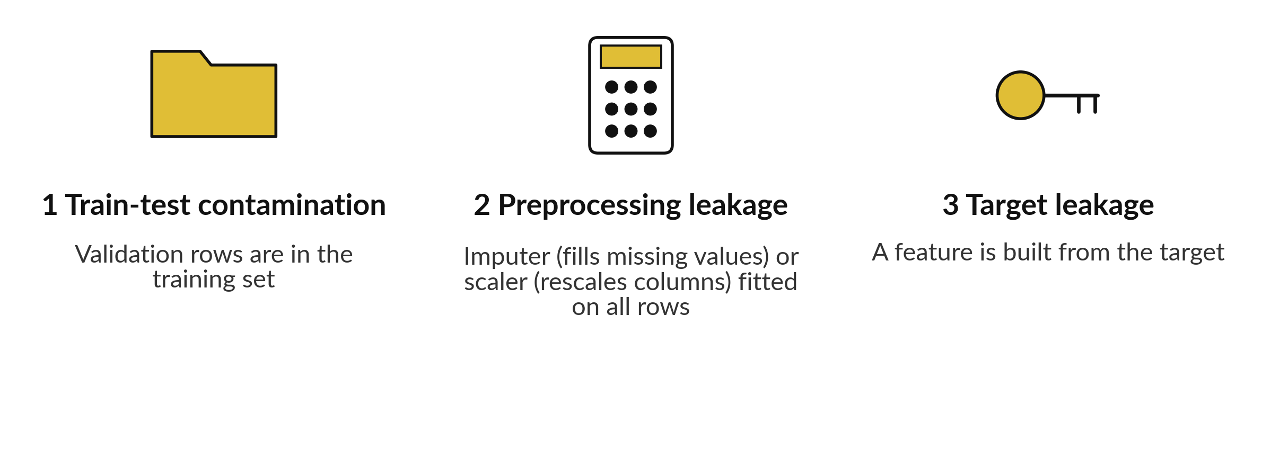
Data leakage comes in three common kinds
All three make the score look too good.
Notes:
Three kinds cover most cases. Train-test contamination: validation rows end up in the training set, for example by joining two files, or by tuning on the test rows again and again. Preprocessing leakage: an imputer, which fills missing values, or a scaler, which rescales columns to a common scale, is fitted on all rows before the split, so the training set carries information about the validation rows.
Target leakage: a feature is computed from the target, such as a column that is only filled in after the failure has happened. We show each one with real numbers.

Slide 26
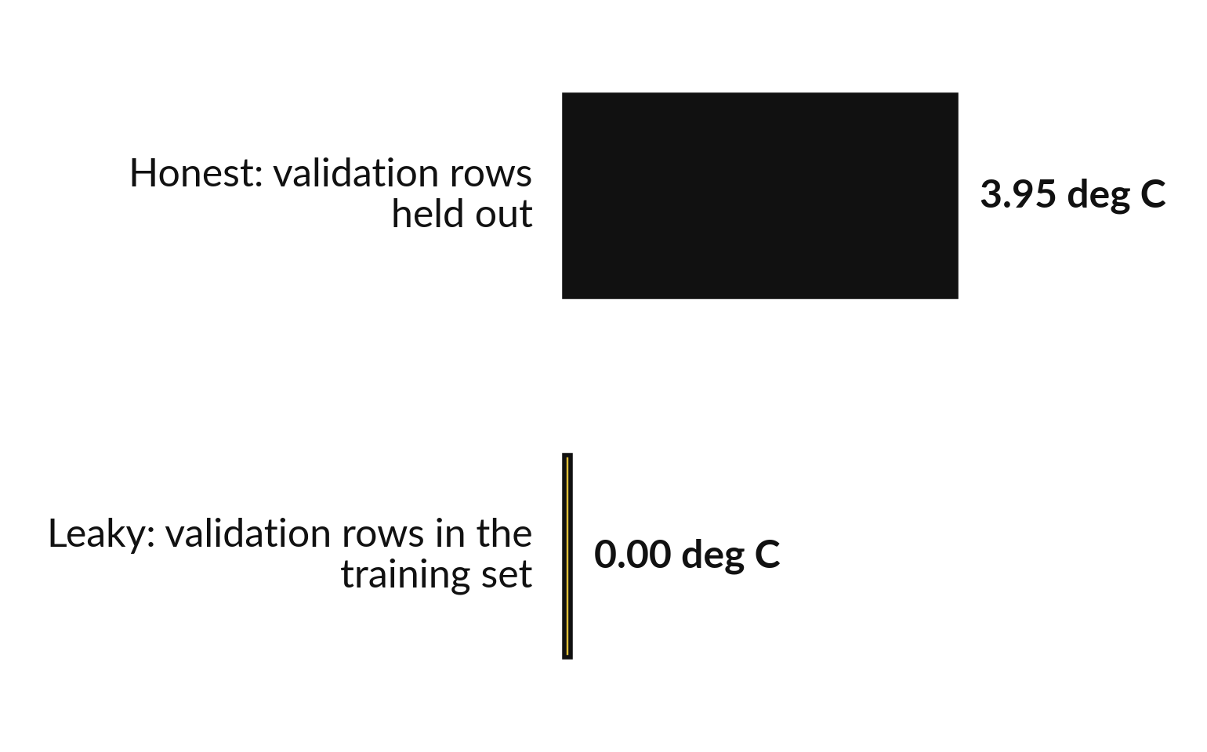
Train-test contamination: validation rows in
the training set make the score look perfect
Same max_depth 10 tree. Only the training set changed.
In the leaky run the tree was already trained on the validation rows, so it reproduces their answers: it has already seen them.
The honest score is the real one.
Notes:
This is the real demonstration from our data. The same tree, depth ten. In the honest version the validation rows are held out, and the validation error is 3.95 deg C. In the leaky version we put the validation rows into the training set first, which is train-test contamination.
The error drops to 0.00. The tree has simply memorised those rows, so the leaky score is perfect and tells us nothing. Nobody would do this on purpose, but a join or a copy and paste can do it quietly. Which of the two scores would predict a new machine?

Slide 27
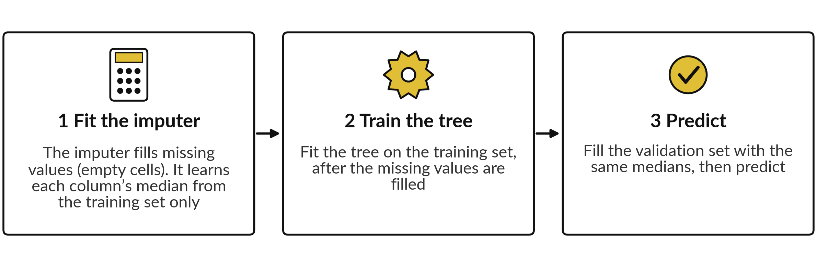
A Pipeline fits the imputer on the training set
only, which prevents preprocessing leakage
Median of ambient_c: 26.07 from the training set, 25.37 from training plus validation rows (73 rows, leakage). Only one value is missing, so the score did not change.
Notes:
Preprocessing leakage is the quiet one. If you fill missing values, or scale columns, using all the rows, the validation rows have helped to decide the fill. In our data the median ambient temperature is 26.07 from the training set and 25.37 from the training and validation rows together.
We tried both, and the validation error did not change, because only one value is missing. So here the habit costs nothing. That is exactly why it is dangerous: a clean score does not prove a clean method. The fix is a Pipeline, which chains the imputer and the tree.
In every fold it fits the imputer on the training folds only, then fills the validation fold with those same numbers.

Slide 28
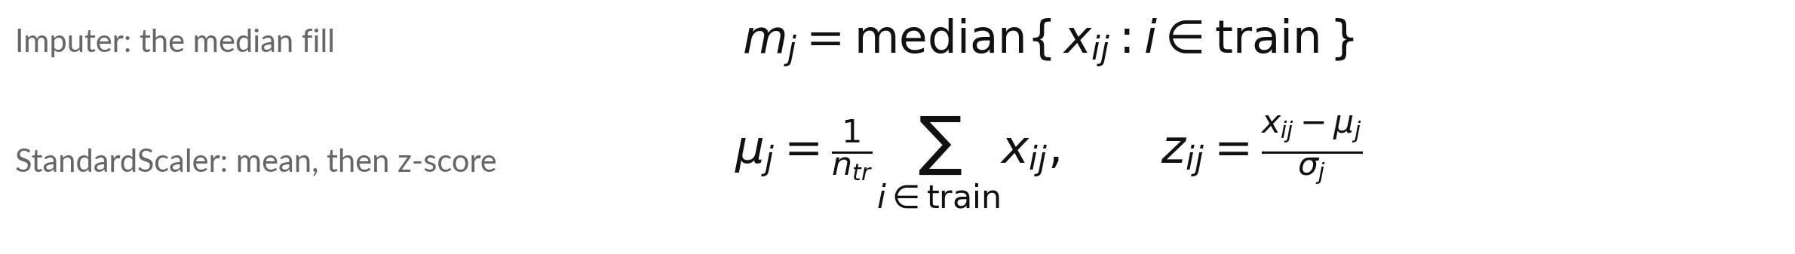
The pipeline rule: fit on the training
set only, then apply the same numbers
Symbol | What it means | In our data
i, j, x_ij, n_tr | Row i, column j, the value x_ij there, n_tr training rows. In preprocessing leakage, i also runs over validation rows | j = 1 load_pct, j = 2 ambient_c; n = 58
m_j | Median of column j over the training rows | ambient_c: 26.07. Training plus validation: 25.37 (leakage)
μ_j, σ_j | Mean and standard deviation of column j, training rows (divide by n_tr, Class 2) | load_pct: 59.89 and 22.73
z_ij | The z-score (standardised value) of row i in column j | Row 1: (59.15 - 59.89) / 22.73 = -0.03
Notes:
Here is the pipeline rule as a formula. The median for column j is taken over the training rows only. The mean and the standard deviation for column j are also taken over the training rows only. Then the same three numbers are applied to every row, including the validation rows.
The leakage is simple to state: if the row number i also runs over the validation rows, the imputer or scaler has seen them. Take row one of our training data. Its load is 59.15. Subtract the mean 59.89, divide by the standard deviation 22.73, and the z-score is -0.03.
Class 2 used this scaler, and the pipeline does it for you inside every fold.

Slide 29
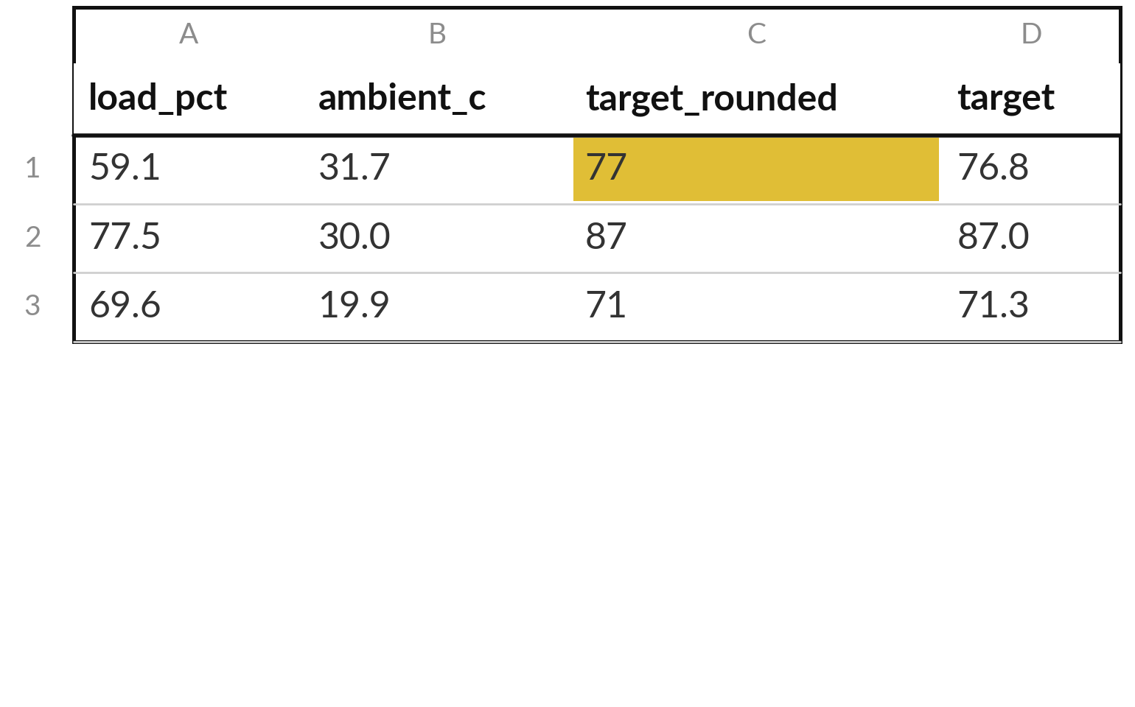
Target leakage: a feature built from the target
gives a great score that cannot be repeated
With that feature a max_depth 4 tree scores 1.09 deg C. With honest features it scores 4.79 deg C.
target_rounded is the target rounded to a whole number. At prediction time the target is unknown.
A feature recorded after the event is also target leakage.
Notes:
This is target leakage. Suppose someone adds a feature that is the target rounded to a whole number. A depth-4 tree with that feature scores 1.09 deg C on the validation rows, against 4.79 without it. It looks like a miracle. But when a new reading arrives, the target is exactly what we do not know yet, so the feature cannot be filled in.
Real examples are a repair code written after the failure, or a daily total computed from the very value we predict. Ask of every feature: will I have this at the moment I need the prediction?

Slide 30


Keep this checklist: five questions
before you trust a score
Was the score measured on held-out data (rows the model never saw)?
Were the imputer and the scaler fitted on the training set only (no preprocessing leakage)?
Is every feature available at the moment you need the prediction, and none built from the target (no target leakage)?
Is the test set (group E6) still sealed, to be opened once after the final choice?
Is the score a cross-validation mean, shown with its standard deviation?
Notes:
Here is the checklist I want you to keep. You will use it again in Class 4 and in the project. One: was the score measured on held-out data, rows the model never saw?
Two: were the imputer and the scaler fitted on the training set only?
Three: is every feature available at the moment you need the prediction, and none built from the target?
Four: is the test set, group E6, still sealed, to be opened once after the final choice?
Five: is the score a cross-validation mean, shown with its standard deviation?
If you can answer yes to all five, you may trust the number a little. If you cannot, find out why before you show it to anyone.

Slide 31
The same code can give different numbers, so we fix
the random seed (random_state) and write it down
random_state (the random seed) | max_depth 10 tree: validation MAE | Shuffled 5-fold: mean MAE | max_depth chosen by the 5 percent rule
1 | 4.70 | 4.83 | 6
17 | 3.95 | 4.35 | 7
99 | 3.85 | 4.13 | 8
MAE in deg C. Only the seed changed. Even the chosen max_depth moves: with 15 validation rows it is partly luck.
Notes:
Random choices sit inside many tools. A tree breaks ties at random, and shuffled folds mix the rows at random. A random seed, which scikit-learn calls random_state, is a number that makes those choices repeat exactly. With the same data and code, the depth-10 tree scores 4.70, 3.95 or 3.85 deg C, depending on the seed.
The last column reruns our tuning rule with each seed. Even the chosen max_depth moves (6, 7, 8): on 15 validation rows the choice is partly luck. That is why we cross-validate. So a number without its seed is only half a result. We use random_state equal to seventeen everywhere.
Why does a colleague need your seed?

Slide 32
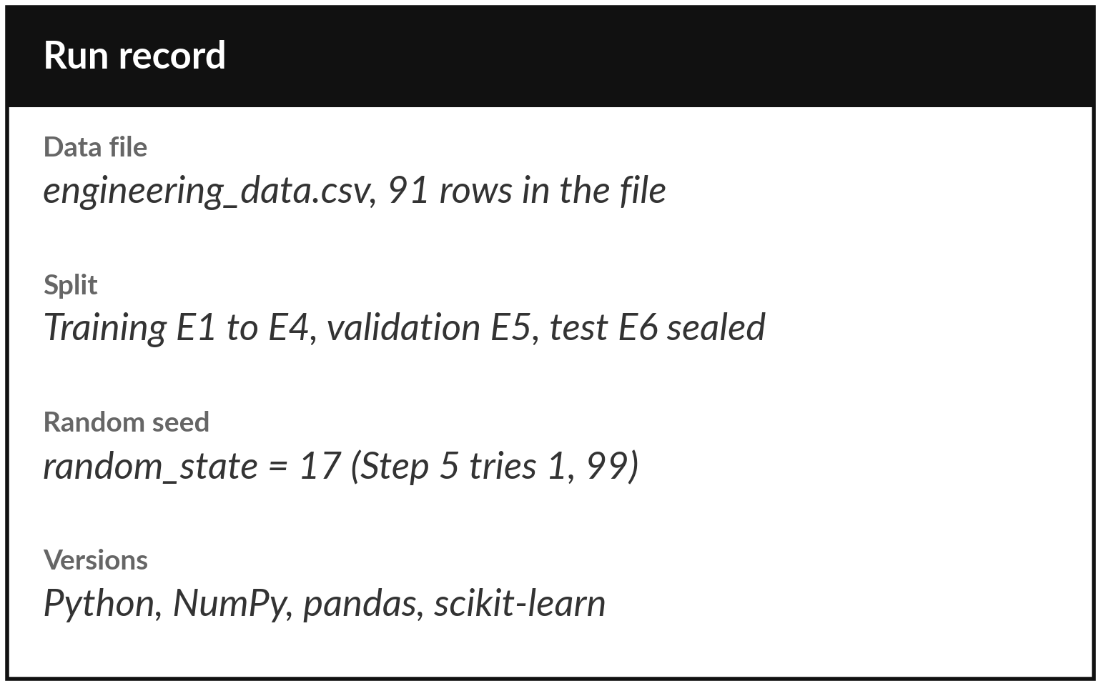
Write down what you ran, so anyone can repeat it
Anyone with this record should get your numbers. After cleaning in Class 1, 88 rows remain: 58, 15, 15.
The notebook prints the record for you.
Paste it under every result you report.
Notes:
Reproducibility means that someone else, or you in six months, can run the same code and get the same numbers. For that you need a short record. Which data file, and how many rows. After cleaning in Class 1, the usable rows are fewer than the rows in the file, and the record says so.
How the rows were split. The random seed. And the versions of Python, NumPy, pandas and scikit-learn, because a new version can change a result slightly. The notebook prints this record in the last step. Paste it under every result you report. It takes ten seconds. Who in your team would need to repeat your numbers?

Slide 33
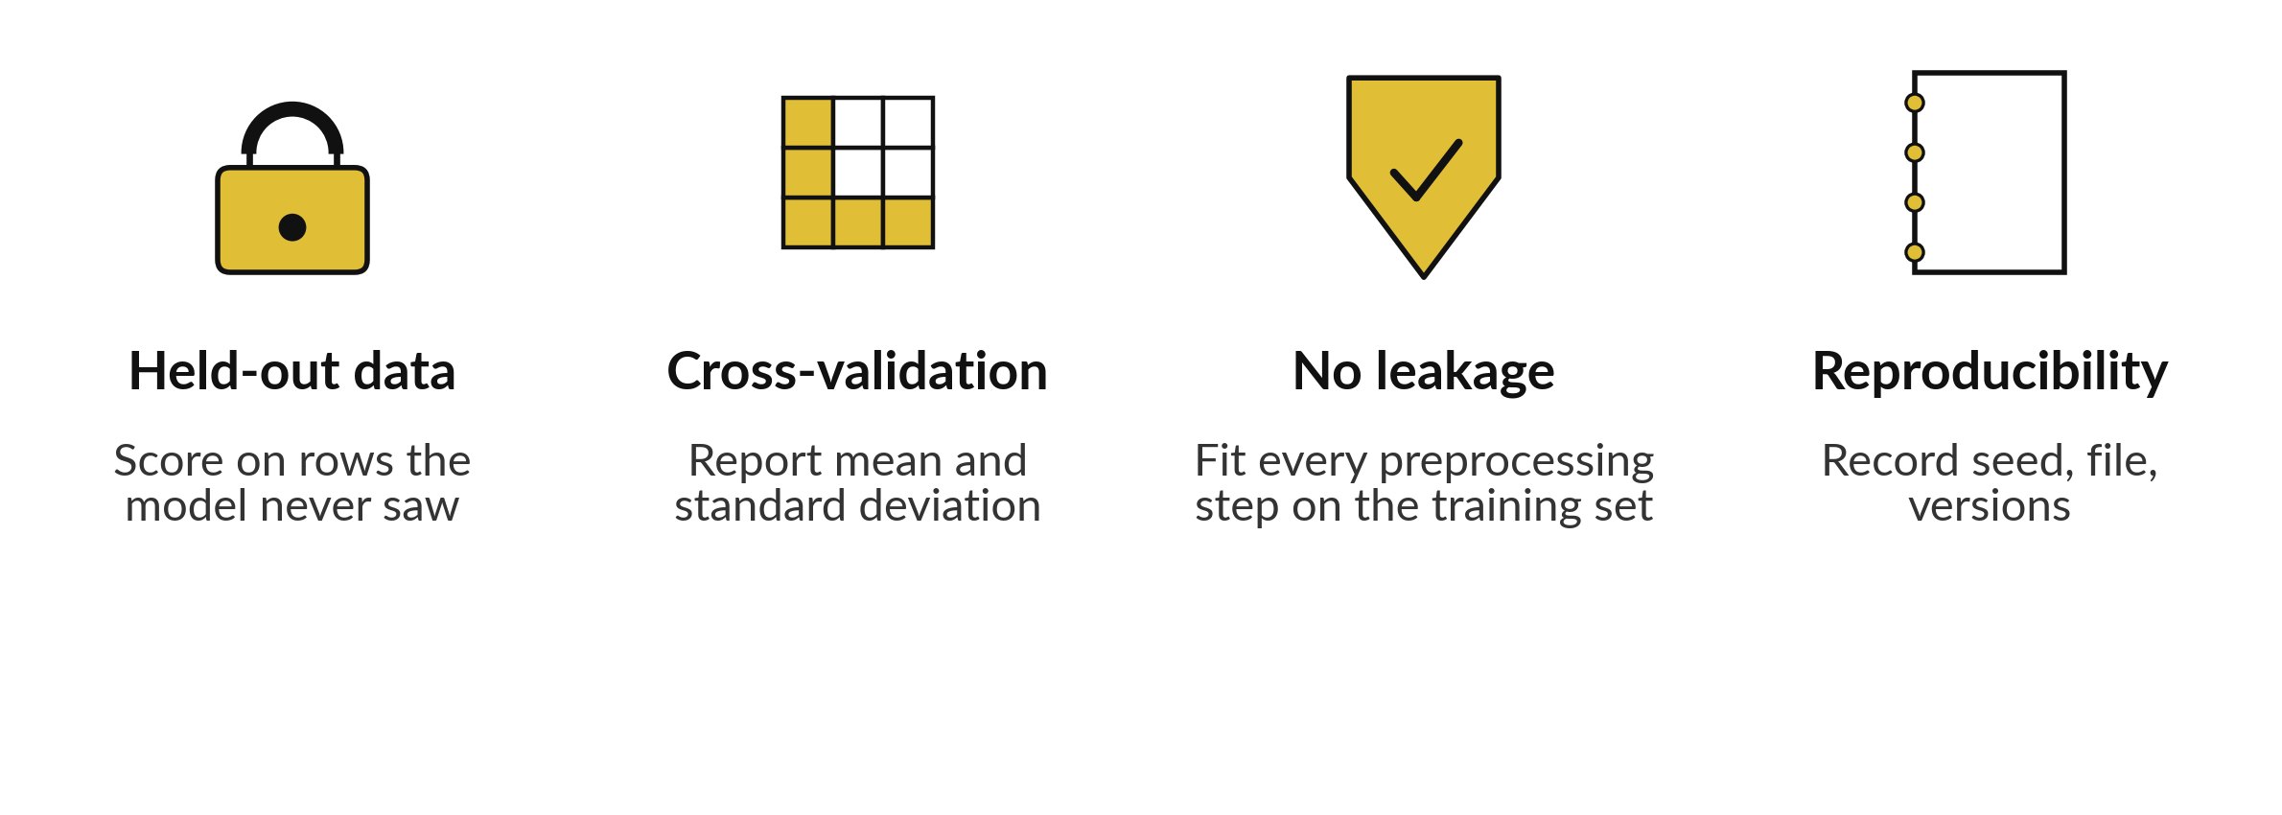
Trust comes from four habits
Next class: features and choosing a model, using these four habits.
Notes:
Let us gather it up in four habits. Score on rows the model never saw. Use cross-validation, so you report a mean with a standard deviation, and GroupKFold when the model will meet new machines. Fit every preprocessing step, the imputer and the scaler, on the training set only.
And keep a record for reproducibility: the random seed, the data file and the versions. With these four habits, a score becomes something you can defend. Before the break, say aloud which habit you are most likely to forget.

Slide 34
Read the workflow before you write it
In plain words
pipeline = make_pipeline(imputer, tree_model)
group_kfold = GroupKFold(n_splits=4)
cv_scores = -cross_val_score(
pipeline, X_train, y_train,
groups=groups, cv=group_kfold,
scoring="neg_mean_absolute_error")
print(cv_scores.mean(), cv_scores.std(ddof=1))
make_pipeline chains the imputer and the tree into one model (a Pipeline).
GroupKFold(n_splits=4): each fold holds out one equipment group.
cross_val_score runs the pipeline on every fold: one score per fold.
The scoring gives the MAE with a minus sign; the minus in front turns it back.
std(ddof=1): sample standard deviation (divide by k - 1).
Notes:
Before the break, here is the workflow in seven lines. First the Pipeline: the imputer and the tree, chained into one model, so the imputer is fitted inside every fold. Then GroupKFold with four splits, so each fold holds out one equipment group, and we pass the group labels with groups.
Then cross_val_score, which runs that pipeline on every fold and returns one score per fold. The scoring name has the word neg in it, because scikit-learn likes bigger to be better, so errors come back negative. We put a minus in front to get the MAE back. Finally we print the mean and the standard deviation, with ddof equals 1 so it divides by k minus 1. In the lab you run it.

Slide 35
Part 2: the lab
Close the slides. Open the notebook. Same steps, your own data.
Notes:
That is the end of the concepts. Everything you need is on the slides you have just seen, and every term is explained again inside the notebook. Please open the notebook now, and keep the slides closed except for the check slides at the end of the deck.
I will walk around. Raise your hand if a cell gives an error. Remember to run the cells in order from the top.

Slide 36
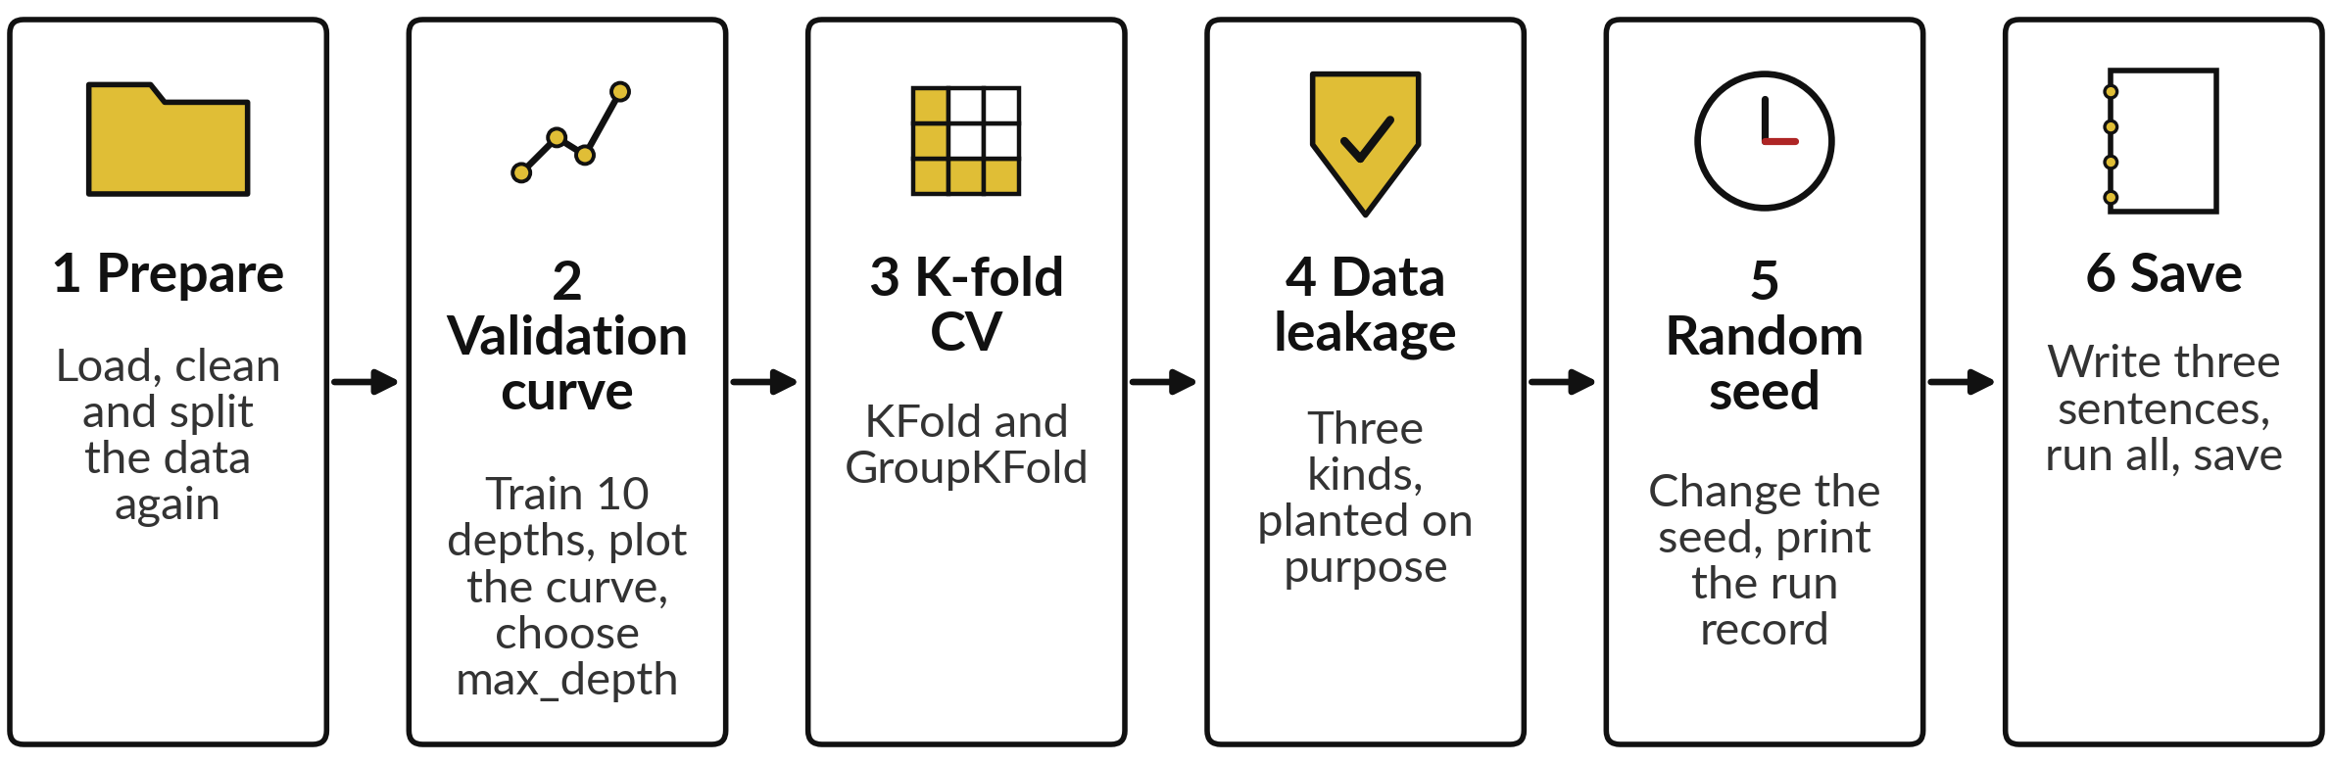
The lab has six steps, and the
first five end with a check
In each step, predict first, run second, then read the output. Each of Steps 1 to 5 ends with a CHECK of the numbers you should see.
Notes:
Here are the six steps. One, prepare the data again, briefly. Two, train trees of depth one to ten, plot the validation curve and choose max_depth using the validation set only. Three, run K-fold and GroupKFold cross-validation and print the mean and the standard deviation. Four, reproduce the three kinds of leakage: contamination, a fill value from all rows, and a feature built from the target.
Five, change the random seed and watch a number move, even the chosen depth, then print the run record. Each of the first five steps ends with a CHECK line. Six is your short conclusion and a save.

Slide 37






Check your numbers against
these before you move on
What you print | You should see
Rows: training, validation, test | 58, 15, 15
Validation MAE at max_depth 1 and at 10 | 7.86 and 3.95 deg C
Chosen max_depth | 7
K-fold, k = 5: mean and standard deviation | 4.45 and 0.37
GroupKFold, k = 4: mean and standard deviation | 4.15 and 0.65
max_depth 10: honest and leaky validation MAE | 3.95 and 0.00
max_depth 10 tree, random_state 1 and 99 | 4.70 and 3.85
MAE in deg C. Standard deviations divide by k - 1 (ddof=1). If your number differs, stop and ask. With another scikit-learn version a difference in the second decimal is fine.
Notes:
Use this table as your checkpoint. If your numbers match, carry on. If they do not, call me over, because every later step builds on the earlier ones. The most common reasons are a cell run out of order, a missing random_state, or a depth typed wrongly. A leaky score of zero point zero zero is correct, because that is the whole point of the demonstration.
Do not edit a number to make it match. Find the cause.

Slide 38




Four problems you will meet,
what they mean and what to do
What you see | What it means | What to do
NameError: X_train | Step 1 was not run | Run all cells from the top, in order
An error that mentions groups | GroupKFold needs the group labels (a groups argument) | Pass groups=groups
All scores are negative | scikit-learn gives errors a minus sign (neg_ scoring: bigger is better) | Put a minus in front: -scores
Numbers differ a little from the slide | The random seed (random_state) is missing or different | Use random_state=17 in every tree, except in Step 5 where the seeds 1 and 99 are tested on purpose
Notes:
Four problems come up most often. A name error on X_train means Step 1 was not run, so run all cells from the top. An error that mentions groups means GroupKFold needs the group labels, so pass groups equals groups. Negative scores are not a bug. scikit-learn gives errors a minus sign so that bigger is better, so put a minus in front.
And if your numbers differ a little from the slide, check that random_state equals seventeen in every tree, except in Step 5, where we try other seeds on purpose. Read the last line of any error first.

Slide 39


How this class counts towards your coursework
Nothing is submitted today. Block 2 (Classes 3 and 4) is practice: it does not count toward your final mark, but you get feedback.
Its assignment has three parts: A9 (validation and trust, today's lab), then A10 (features) and A11 (model recommendation) from Class 4.
The Block 2 assignment closes on Friday 4 December, 11:00 (Kampala time).
The Block 2 quiz opens in the last 20 minutes of Class 4, stays open 24 hours, and covers both classes.
Notes:
A word on how this counts. The block work is practice: it does not count toward your final mark (only A1 to A5, Q1 to Q5, Practical Test 1 and the Week 12 project do), but it is collected and you get feedback. Nothing is submitted today. Block 2 is this class and the next one.
Its assignment has three parts: A9 on validation and trust, which repeats the steps of today's lab, and A10 and A11 on features and on recommending a model, which come from Class 4. All three close on Friday 4 December, 11:00, Kampala time. The Block 2 quiz opens in the last twenty minutes of Class 4, stays open for twenty-four hours, and covers both classes. Keep your saved notebook, because next class we extend it.

Slide 40
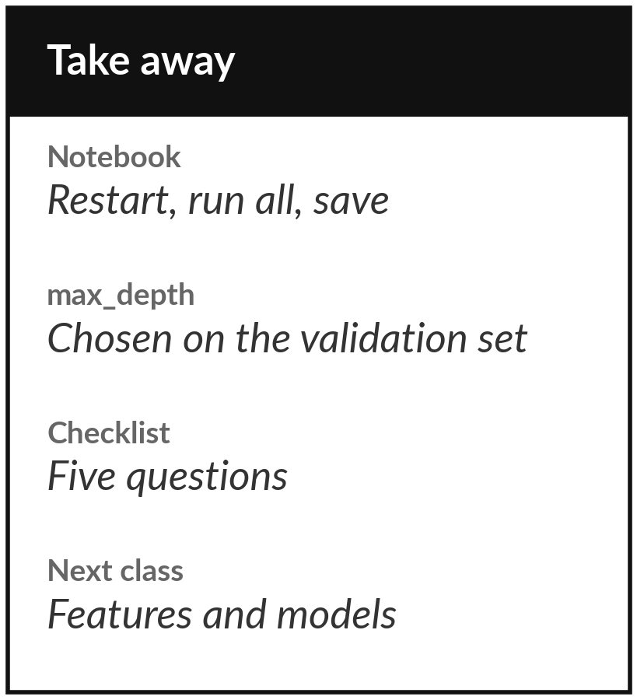
Save the notebook and keep the checklist
What you keep from today
Your saved lab notebook, the chosen max_depth, and the five-question checklist for trusting a score.
Our question today
How do we know a model that predicts motor winding temperature will still work on a motor it has never seen?
Next class
Class 4: features and choosing a model, plus the project brief.
Notes:
Before you go, restart the notebook, run all cells from the top and save it. Keep the max_depth you chose and the checklist, because you will use both again. Next class we look at which columns the model should use and how to choose between models, and I explain how the project sitting works.
If anything today was unclear, write the question down and bring it.
We began with this question: How do we know a model that predicts motor winding temperature will still work on a motor it has never seen? Before you go, say in one sentence what you can now say about it.

