Slide 1
CML3113
AI, machine learning
and the engineering problem
Introduction to Machine Learning in Mining & Petroleum Engineering
WEEK 1 · Fri 11 September 2026
Friday 08:00–11:00 · Room 105 · IUEA Faculty of Engineering · Semester 1, 2026/27
Notes:
Begin with a decision engineers make: estimate a quantity or identify a condition from observations. Today introduces the ideas using the embedded tables and illustrations; no CSV download or Python is needed. A prediction is an estimate, not proof that an action is safe.

Slide 2
YOUR LECTURER
JW
Jotham Martin Wambi
Data scientist and ML engineer · Founding engineer, Magentiq AI Labs
Background
Some of what I have built
Incoming PhD student (April 2027)
Osaka Metropolitan University, Japan
Law Lens
Language models over Ugandan law, fully traceable.
Master of Technology Management
Yamaguchi University, Japan
Magentiq AssetGuard
Machine failure predicted from vibration sensors.
BSc IT, Makerere · BA Economics, IUIU
Eight years at Citibank, EY and D'isum Inc, Tokyo
Wearable ECG detection
Eleven cardiac conditions from a live ECG.
Every system on the right uses the pipeline you build from Week 8: split the data, fit a model, then score it.
linkedin.com/in/jothammartinwambi · github.com/Jotham566 · jothammartin.wambi@gmail.com
Notes:
Introduce the tutor’s applied data work briefly. The formal status is incoming PhD student in Applied Informatics at Osaka Metropolitan University, Japan, for April 2027; enrolment has not started. The examples illustrate different applications, not identical model architectures.

Slide 3
LEARNING OBJECTIVES
By the end of today you can…
1
Say what artificial intelligence, machine learning and data science each mean, and how they differ.
2
Explain the difference between writing a rule yourself and letting a computer infer one from examples.
3
Point at a table of data and correctly identify the features and the target.
4
Tell a regression problem from a classification problem, and give an example of each from your own field.
5
Name three problems in exploration, ore and reservoir characterisation, production and equipment health where data could help, and two where it could not.
6
State four things machine learning cannot do, with a reason for each.
7
Describe how this course is assessed and what your project will look like.
Week 1 · AI, machine learning and the engineering problem · nothing here needs prior programming experience
Notes:
Read the outcomes as questions learners should be able to answer by the end. Start with AI and machine learning in ordinary language; features, targets and task types are introduced later. Learners do not need those terms beforehand.

Slide 4
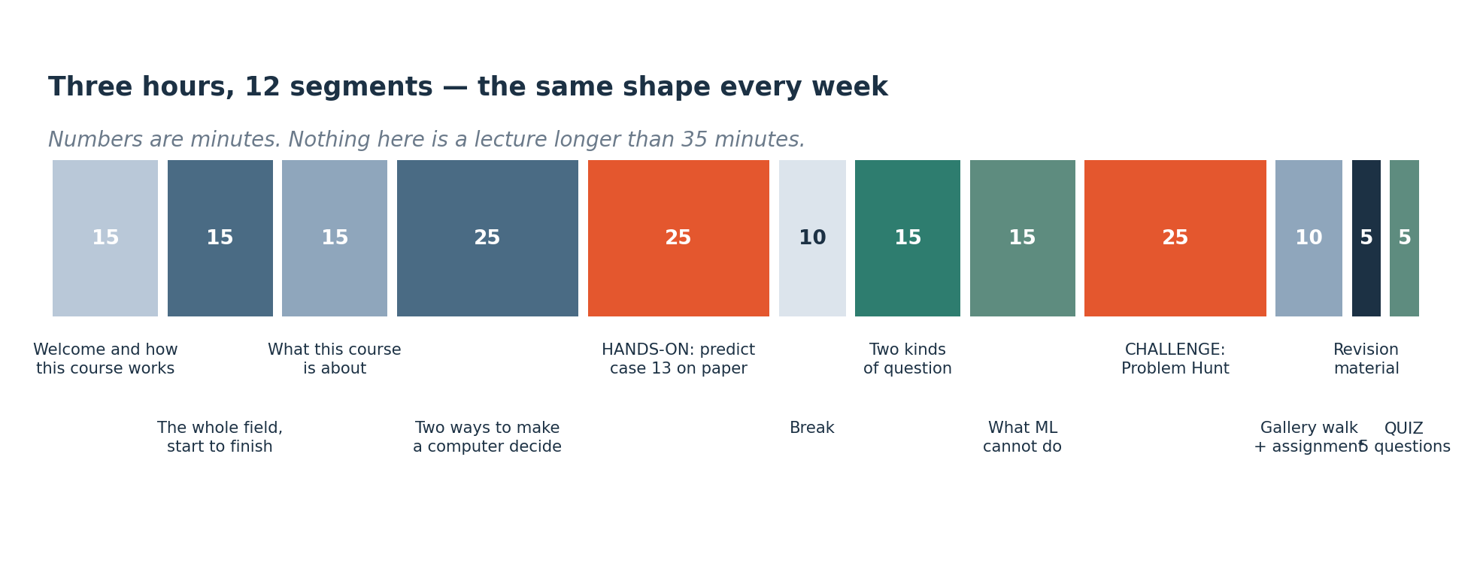
HOW TODAY RUNS
How every session this semester is shaped
Three hours, eleven segments. No block of talking runs longer than 25 minutes, and roughly half of every session is you doing something rather than me saying something.
Notes:
Explain the lesson’s sequence: define the ideas, inspect a worked example, then practise identifying a sensible prediction task. Timings are a guide, not a requirement to rush. The activities can be completed individually.

Slide 5
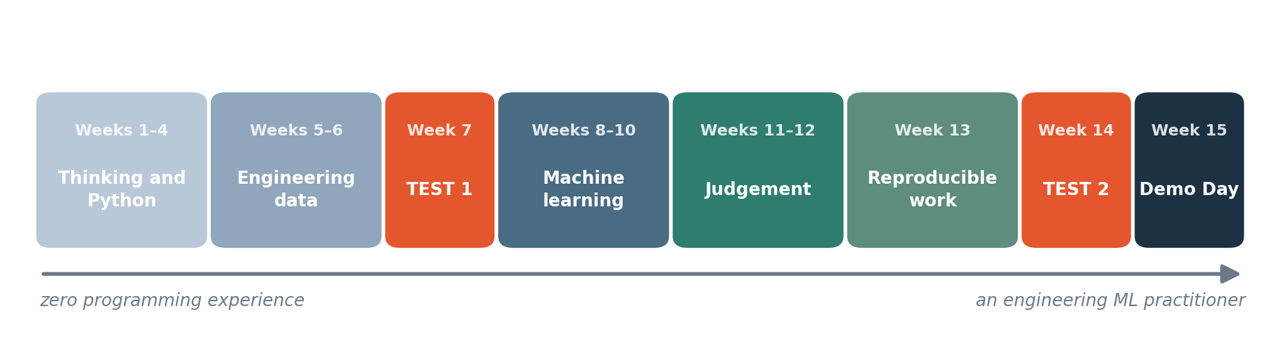
THE SEMESTER
Where this semester goes
Fifteen weeks. Weeks 7 and 14 are practical tests: you are given data you have never seen and asked what you make of it. The project runs from Week 9 to the last session.
Notes:
Follow the semester from setup and Python to tables, cleaning, practical tests and models. Weeks 7 and 14 are test weeks. Test-day downloads and Colab submission follow the current test-entry instructions; do not substitute older offline-test guidance.

Slide 6
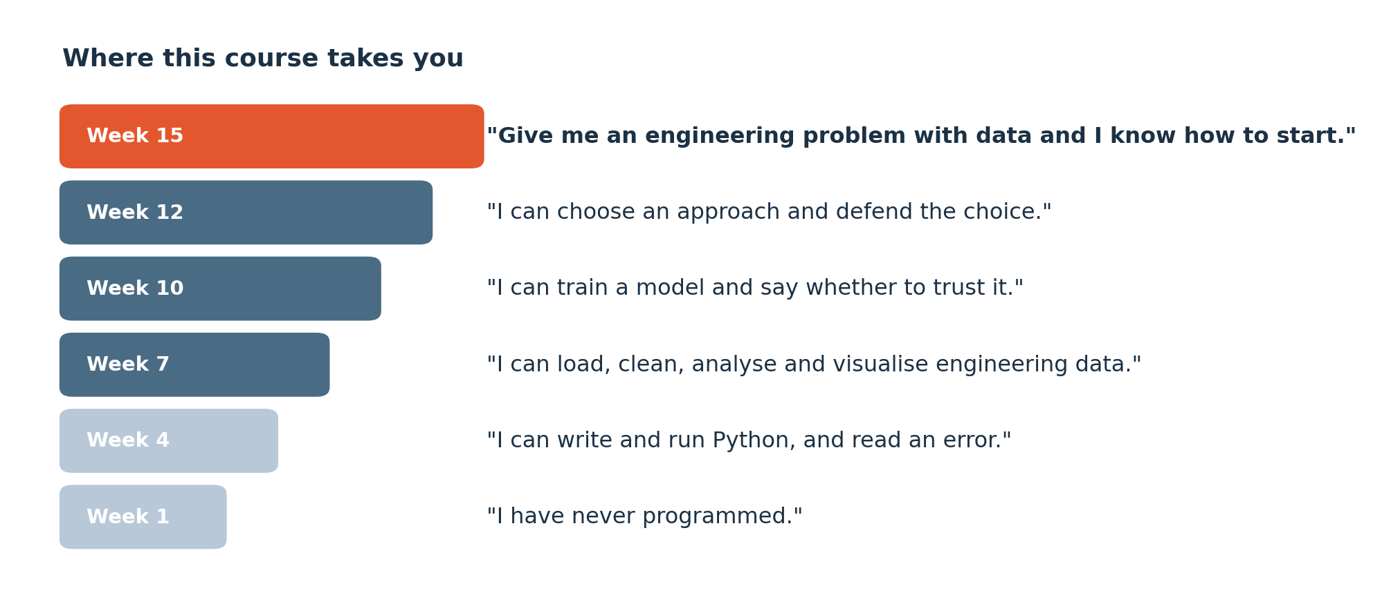
COURSE GOALS
What you will be able to say by December
The course builds from reading data to testing a model. Weekly exercises give you practice at each stage.
Notes:
Connect each course goal to visible evidence: a runnable notebook, a correct summary, a reasoned chart or an evaluated model. Knowing a tool name is not the same as explaining a result. Engineering meaning and units remain part of every calculation.

Slide 7
SEGMENT 1
Welcome, and how this course works
15 MINUTES
Course goals, assessment and weekly work.
Notes:
Introduce how individual work and projects fit together. The next assessment slide supplies the components and weights. Separate weekly tasks from project milestones so students do not confuse one submission with another.

Slide 8
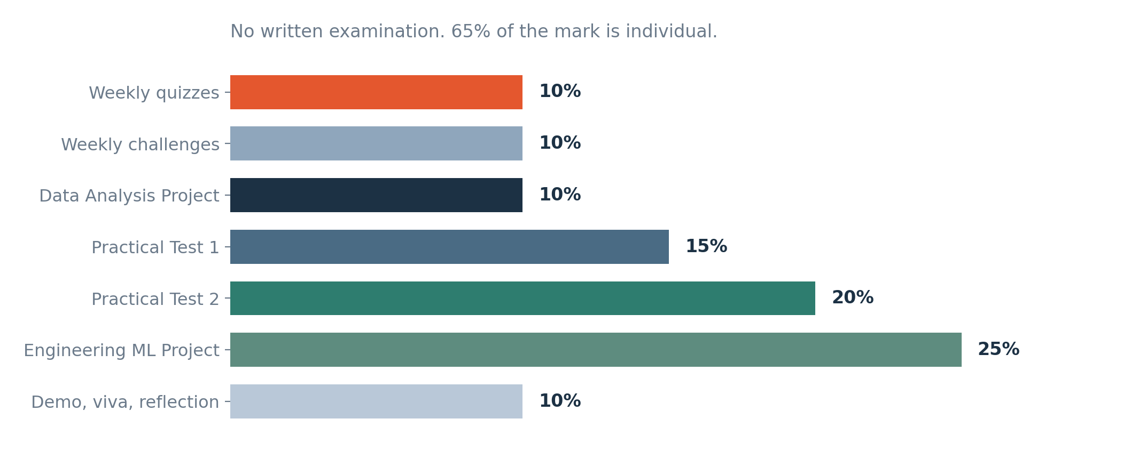
ASSESSMENT
How you are assessed
Assessment includes code, data analysis, models and written explanations. Individual work accounts for 65% of the mark.
Notes:
Walk through the displayed assessment components and add their weights to 100%. Explain which work is individual and which is a project. The current cohort waiver policy overrides old weekly counts: CML3112 and CML3113 have A6 and Quiz 6 waived; CML3111 retains them. Waived tasks do not become zeros.

Slide 9
CLASS EXPECTATIONS
What I expect, and what you can expect back
What I expect from you
What you can expect from me
Attend. There is one three-hour session a week and no lecture to catch up from — the value is in the practical and the challenge, which cannot be read later.
Every rubric published before the work is set. You will never meet a marking scheme for the first time in an assessment.
Do the weekly deliverable every week. Eleven small pieces spread over twelve weeks is manageable; nine of them attempted in December is not.
Download the lesson files before class so you can access the data without a connection.
Feedback on the weekly work within a week, and instant feedback on every quiz.
When asking for help, include the error message, what you tried and what you expected.
Ask how each topic relates to the engineering problem.
When you get stuck, note the step that failed and ask for help.
Notes:
Explain reproducible work as work another person can rerun from the supplied files and instructions. Students should state sources, units and contributions. Asking for help is useful when the learner can show the attempted step and the exact error.

Slide 10
SEGMENT 2
Machine learning topics
15 MINUTES
This roadmap shows Semester 1, Semester 2 and topics outside this course.
Notes:
This is a map of later topics, not an instruction to learn them all today. A roadmap puts tools and ideas in order. Distinguish the topics taught this semester from those deferred to Semester 2.

Slide 11
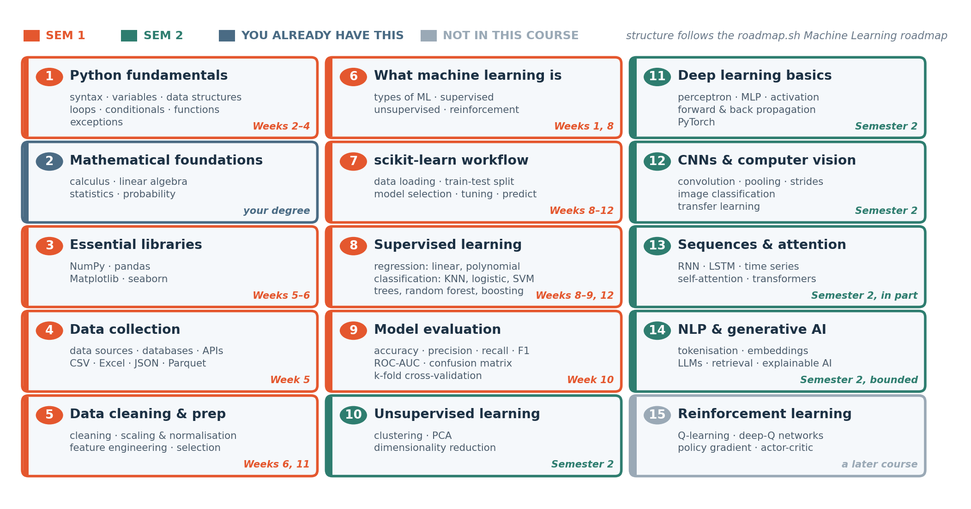
THE TERRITORY
The machine learning roadmap
Fifteen stages, from Python to transformers. Orange is Semester 1. Green is Semester 2. Dark blue is the stage you already have from your engineering degree. Grey is what this course deliberately does not teach. Structure follows the public roadmap.sh Machine Learning roadmap.
Notes:
Follow the highlighted route from Python to data preparation and evaluation. Explain that a roadmap is a curriculum outline. Neural networks and transformers are later topics; no understanding of their internal mathematics is assumed here.

Slide 12
FOUNDATIONS
Mathematics and programming foundations
Mathematics used in machine learning
Programming foundations
The roadmap includes calculus, linear algebra, statistics and probability. Each supports a different part of building or evaluating a model.
Weeks 2–6 introduce Python, data libraries and data preparation through worked examples.
We introduce the mathematics needed for each topic, including averages, matrices and probability. Earlier mathematics courses may help, but each example includes the steps.
Applying engineering knowledge
This course introduces programming through engineering examples.
Engineering knowledge helps you check units, judge whether a result is plausible and recognise limits in the data.
Notes:
Connect each foundation to its purpose. Arithmetic expresses measurements; statistics summarises variability; vectors and matrices arrange inputs; programming repeats a calculation. The course introduces the required operations before its worked examples.

Slide 13
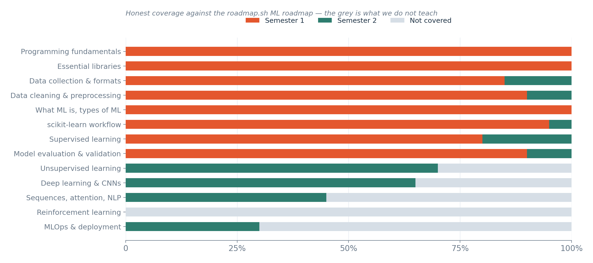
COVERAGE
Topics covered in this course
Grey marks topics outside this course, including reinforcement learning, full MLOps and most advanced language-model topics.
Notes:
Read the coverage boundary literally. Topics outside the highlighted route are not hidden prerequisites for weekly work. Explain MLOps only as operating and monitoring deployed models; the full subject is outside this course.

Slide 14
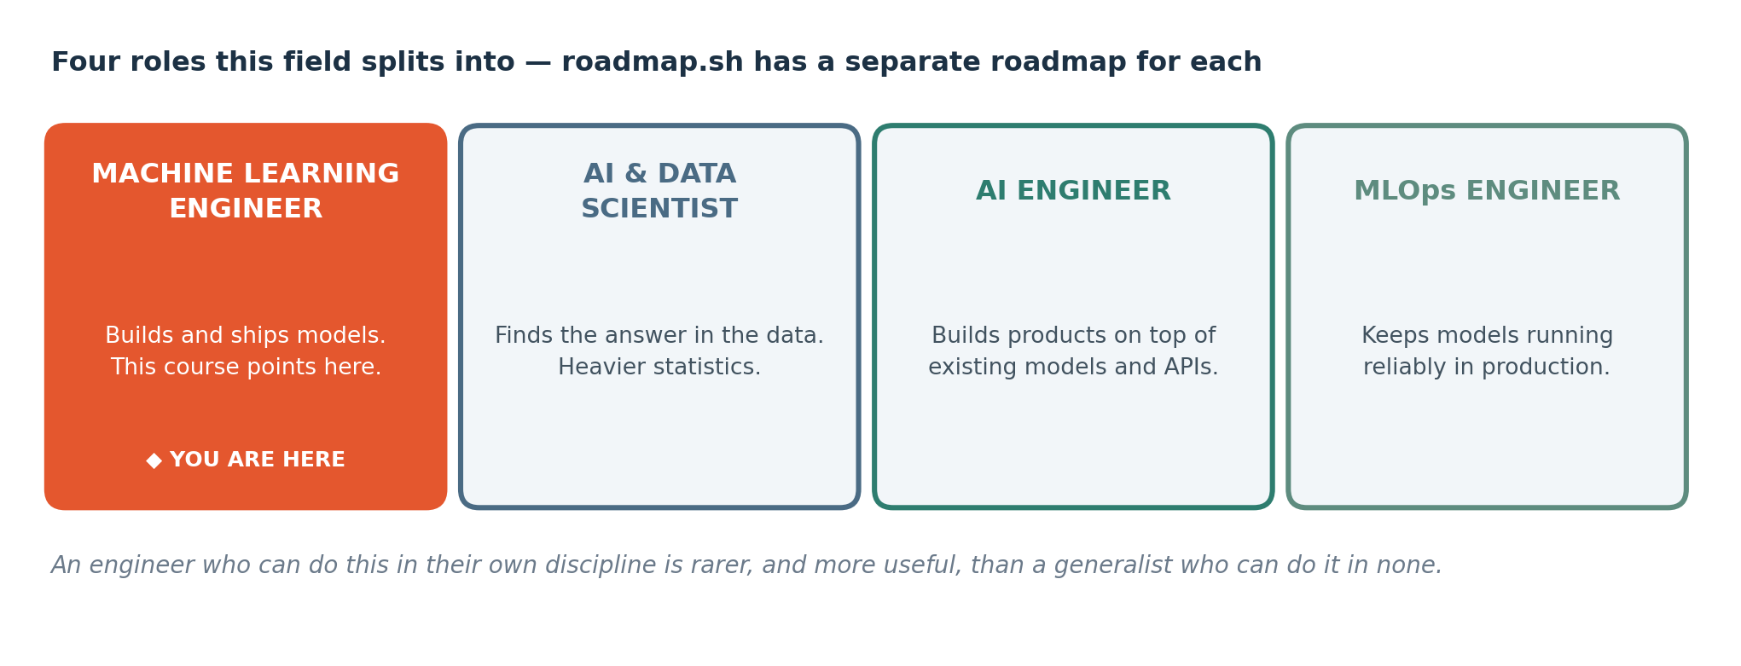
WHERE IT LEADS
Four jobs this field splits into
These are four different roadmaps and four different careers. This course points at the first one, applied inside your own engineering discipline — which is a narrower and more defensible position than competing with computer science graduates on general machine learning.
Notes:
Different roles emphasise different work: analysis explains data, data science investigates questions, ML engineering implements prediction systems, and data engineering supplies reliable data. The course builds introductory skills, not an immediate professional qualification.

Slide 15
SEGMENT 3
Machine learning in engineering
15 MINUTES
Three words people use interchangeably and should not — and where engineering sits among them.
Notes:
Move from job titles to the engineering question shown next. Start with the decision and available observations. Choosing a model before defining the question can produce an impressive score that does not help anyone.

Slide 16
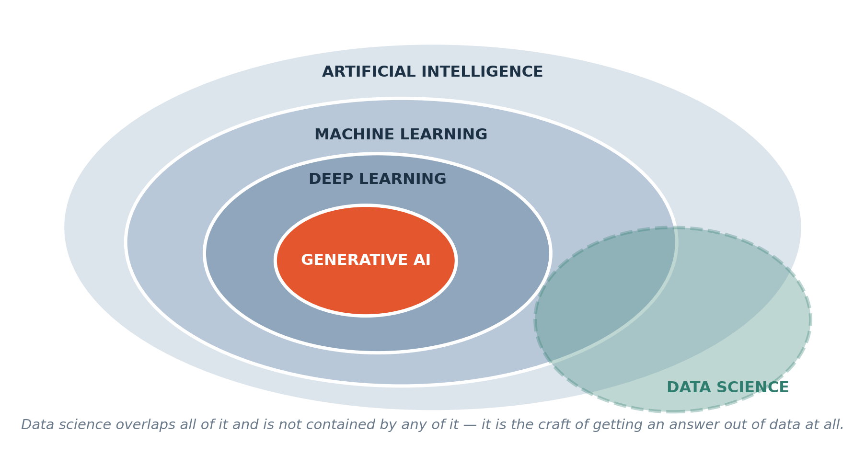
LANGUAGE
The words, and how they nest
Each is contained by the one before it. Data science is the odd one out: it overlaps all of them and is contained by none, because it is the craft of getting an answer out of data at all — finding it, cleaning it, questioning it, presenting it.
Notes:
Explain the nested picture: machine learning is an approach within AI; deep learning is a family within machine learning. Data science overlaps these but also includes finding, checking, summarising and explaining data without training a model.

Slide 17
DEFINITION
Artificial intelligence
Any machine doing something we would call intelligent. It names a goal. Many different techniques aim at it.
FOR EXAMPLE
A chess engine is AI. So is a spam filter. A thermostat is not — it follows one fixed rule with no notion of doing better.
DO NOT CONFUSE WITH
Machine learning, which is one particular way of achieving AI. All machine learning is AI; most AI historically was not machine learning.
Notes:
AI is the broad area of systems performing tasks associated with intelligence. A fixed rule can be part of an AI system; AI does not always mean learning. Avoid implying that the system understands a problem as a person does.

Slide 18
DEFINITION
Machine learning
Getting a computer to work out a rule from examples, instead of you writing the rule yourself.
FOR EXAMPLE
You show it six months of process readings every twenty seconds, each with the assay that came back later. It infers a relationship. You then decide whether to trust it.
DO NOT CONFUSE WITH
Automation. A script that emails a report every Monday is automation and there is no learning in it at all.
Notes:
A learning algorithm uses examples to adjust a model’s settings. We still choose the question, inputs and evaluation. The computer does not automatically discover a valid engineering law or decide whether its own prediction is safe.

Slide 19
DEFINITION
Data science
The craft of getting a trustworthy answer out of data — finding it, cleaning it, questioning it, analysing it and presenting it so somebody can act.
FOR EXAMPLE
Discovering that a third of your assay records are missing, working out whether they are missing at random, and deciding what that does to your conclusion. No model involved.
DO NOT CONFUSE WITH
Machine learning. You will spend far more of this semester on data science than on machine learning, and that ratio matches professional practice.
Notes:
Data science begins before modelling and continues after it. For example, counting missing sensor readings, checking units and explaining a trend are data-science work even if no predictive model is built.

Slide 20
SEGMENT 4
Two ways to make a computer decide
25 MINUTES
Learning patterns from data and using them to make predictions.
Notes:
Contrast a hand-specified rule with a rule fitted from examples. Both take inputs and produce an output; what differs is how the mapping is obtained. An established equation can be the better option when its assumptions apply.

Slide 21
THE QUESTION THIS COURSE STARTS FROM
"The silica assay takes an hour to come back from the laboratory. Can we know it now, from the process variables we already measure?"
Hold onto that question. In twenty minutes you are going to answer a version of it yourself, on paper, with no computer and no formula.
Notes:
Identify the outcome, the information available beforehand, and the time at which a prediction would be useful. If an input is known only after the outcome, it cannot support that advance prediction. The following paper example illustrates the reasoning with small embedded data.

Slide 22
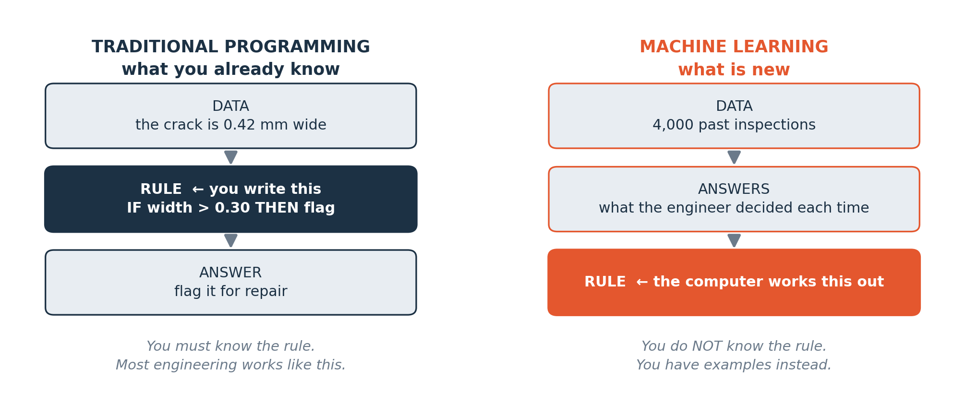
THE ACTUAL IDEA
Traditional programming, and machine learning
On the left, a rule specified by a person: you work out the rule and write it down. On the right, the new way: you do not know the rule, but you have examples of inputs and the answers that followed, and the computer works out a rule from them.
Notes:
Trace the diagrams left to right. In conventional programming, a person supplies the rule. In supervised learning, past inputs and observed outcomes help an algorithm fit a rule. Then that fitted rule predicts outcomes for new inputs. Do not assume students have programmed before.

Slide 23
CHOOSING
When to write the rule, and when to learn it from data
Write the rule yourself when…
Let the computer infer the rule when…
A code of practice, a datasheet or a validated equation already gives you the answer.
Nobody knows the rule, or it involves many variables interacting.
The relationship is simple and well understood.
You have a reasonable quantity of past examples where you know both the inputs and the outcome.
You must be able to explain the decision to a client or a regulator line by line.
An early estimate can help with planning if its error is small enough for the decision.
You have little or no historical data.
You can test the inferred rule against cases it has never seen.
Notes:
Explain the decision criteria one by one. Known equations still require valid units and assumptions. Learning from examples requires enough relevant data and evaluation on separate cases. Interpretability is a requirement to examine, not proof that every learned model is unexplainable.

Slide 24
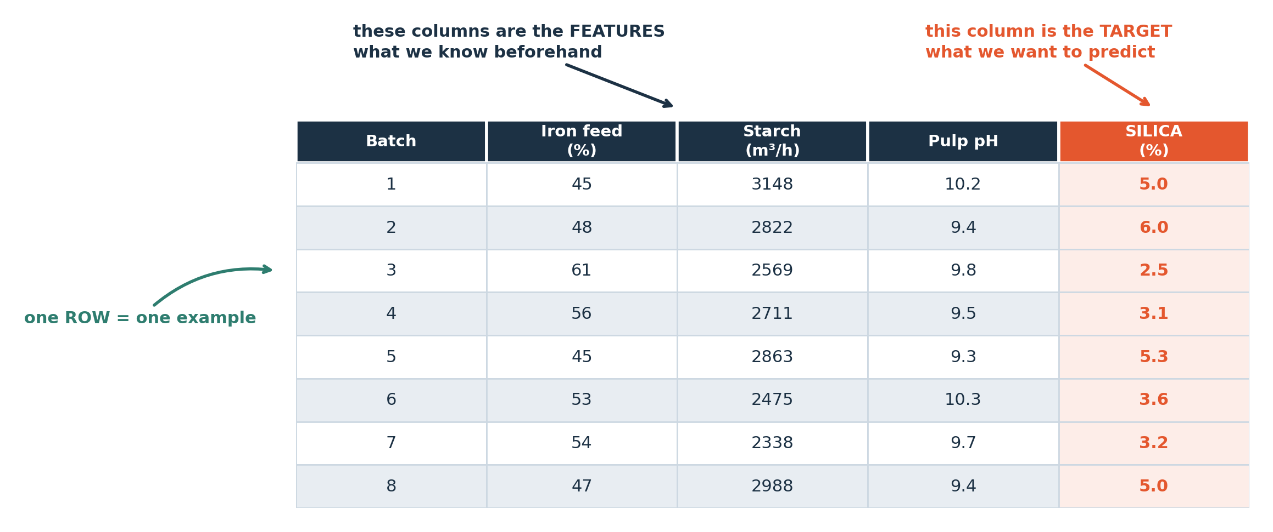
THE VOCABULARY
Data, features and targets
In this example, each row describes one case. Feature columns contain the inputs available before prediction. The target column contains the value to predict.
Notes:
Point to one complete row: it represents one observation. Read its column names and units before using any numbers. Identify candidate inputs available at prediction time, then the outcome to predict. The embedded table is the learning aid here; it is not a file students must locate.

Slide 25
DEFINITION
Feature, and target
A FEATURE is a column you know before the outcome — an input. The TARGET is the column you want to predict. One row containing all of them is one EXAMPLE.
FOR EXAMPLE
In the table you just saw, iron feed grade, starch flow and pulp pH are the features. Silica in the concentrate is the target.
DO NOT CONFUSE WITH
A target is not the same as a cause. Starch flow is associated with concentrate quality; the model learns the association and knows nothing about surface chemistry.
Notes:
A feature is an input chosen for prediction; the target is the answer being predicted. Not every earlier measurement is useful, and an identifier may be only a label. Association means two quantities vary together; it does not establish that changing one causes the other.

Slide 26
CHECK YOUR UNDERSTANDING
Can you answer these?
A
In a table of froth flotation process data records, is silica in the concentrate a feature or the target?
B
You want to predict how long a pump will run before it fails. You have a column recording the repair that was carried out afterwards. Should it be a feature? Why or why not?
C
Give one example from your own discipline of a problem where you already know the rule, so machine learning would be the wrong tool.
Answers are on the next slide — try first, then look.
Notes:
Let students identify the target and exclude the post-outcome repair information. The reason is timing: information unavailable when predicting would leak the answer. A valid fixed formula is an acceptable alternative to ML. The next slide explains these answers.

Slide 27
ANSWERS
How did you do?
A
Feature or target?
The target. It is the thing you want to predict. Measurements available beforehand are candidate features.
B
The repair column?
No. The repair is recorded after the failure, so it is unavailable at prediction time. Including it would give misleading test results. This is data leakage.
C
A rule you already know?
Anything with a formula or a code threshold: Contained metal is tonnage times grade. That is arithmetic; there is nothing to predict. If a validated equation exists, use the equation.
Notes:
Explain why the target is the requested outcome, not simply the last column. The repair-after-failure column is excluded because it would not be available beforehand. For electrical examples, Ohm’s law is V = IR; DC electrical power is P = VI. They are different relationships with different assumptions.

Slide 28
SEGMENT 5
Hands on: predict case 13
25 MINUTES
Use the twelve rows of data to predict a value for the new case. Write your prediction and explain which rows helped you choose it.
Notes:
Use the twelve embedded observations as known examples. Case 13 is withheld from the pattern-finding step. This is an individual paper exercise to practise prediction reasoning; it is not a requirement to write or train a model yet.

Slide 29
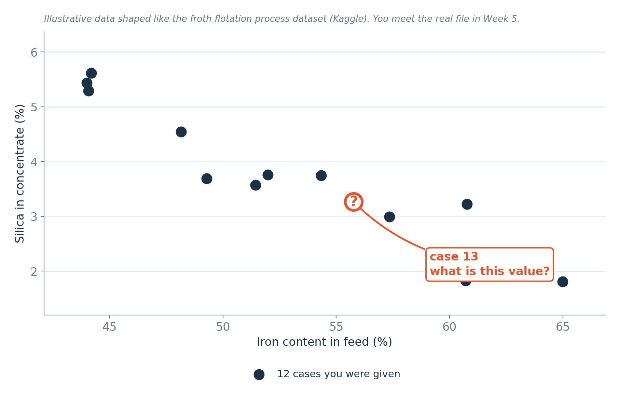
INDIVIDUAL PRACTICE · 15 MINUTES
Your task
Twelve cases show their inputs and measured outcomes. Case 13 shows only its inputs. Predict its outcome and write one sentence explaining your choice.
Notes:
Read the table’s headings and units first. Select similar known cases, make an estimate for case 13 and record a reason before the reveal. There is no requirement to form a team in class. The goal is an explained estimate, not guessing the exact measured answer.

Slide 30
WORKED EXAMPLE
Reading the pattern from twelve cases
One approach is to compare cases with similar inputs. Follow the steps below.
1
Look down the columns and ask which one seems to move with the outcome. Ignore the others for now.
2
Find the two cases whose value of that column sits either side of case 13's value.
3
Look at their outcomes. Case 13's answer is probably between them.
4
Adjust for anything else you noticed — a second column that also seems to matter.
5
Write the number down, and write why. Then ask: how confident am I, and what would change my mind?
You used a pattern in known examples to predict an unknown value. Comparing that prediction with the measured value tells you how large the error was.
Notes:
Work through the five visible steps using the actual table. Interpolation estimates between neighbouring observations; it does not guarantee that the outcome lies between theirs. Explain why a second input may matter. Keep a record of the estimate before showing the measured outcome.

Slide 31
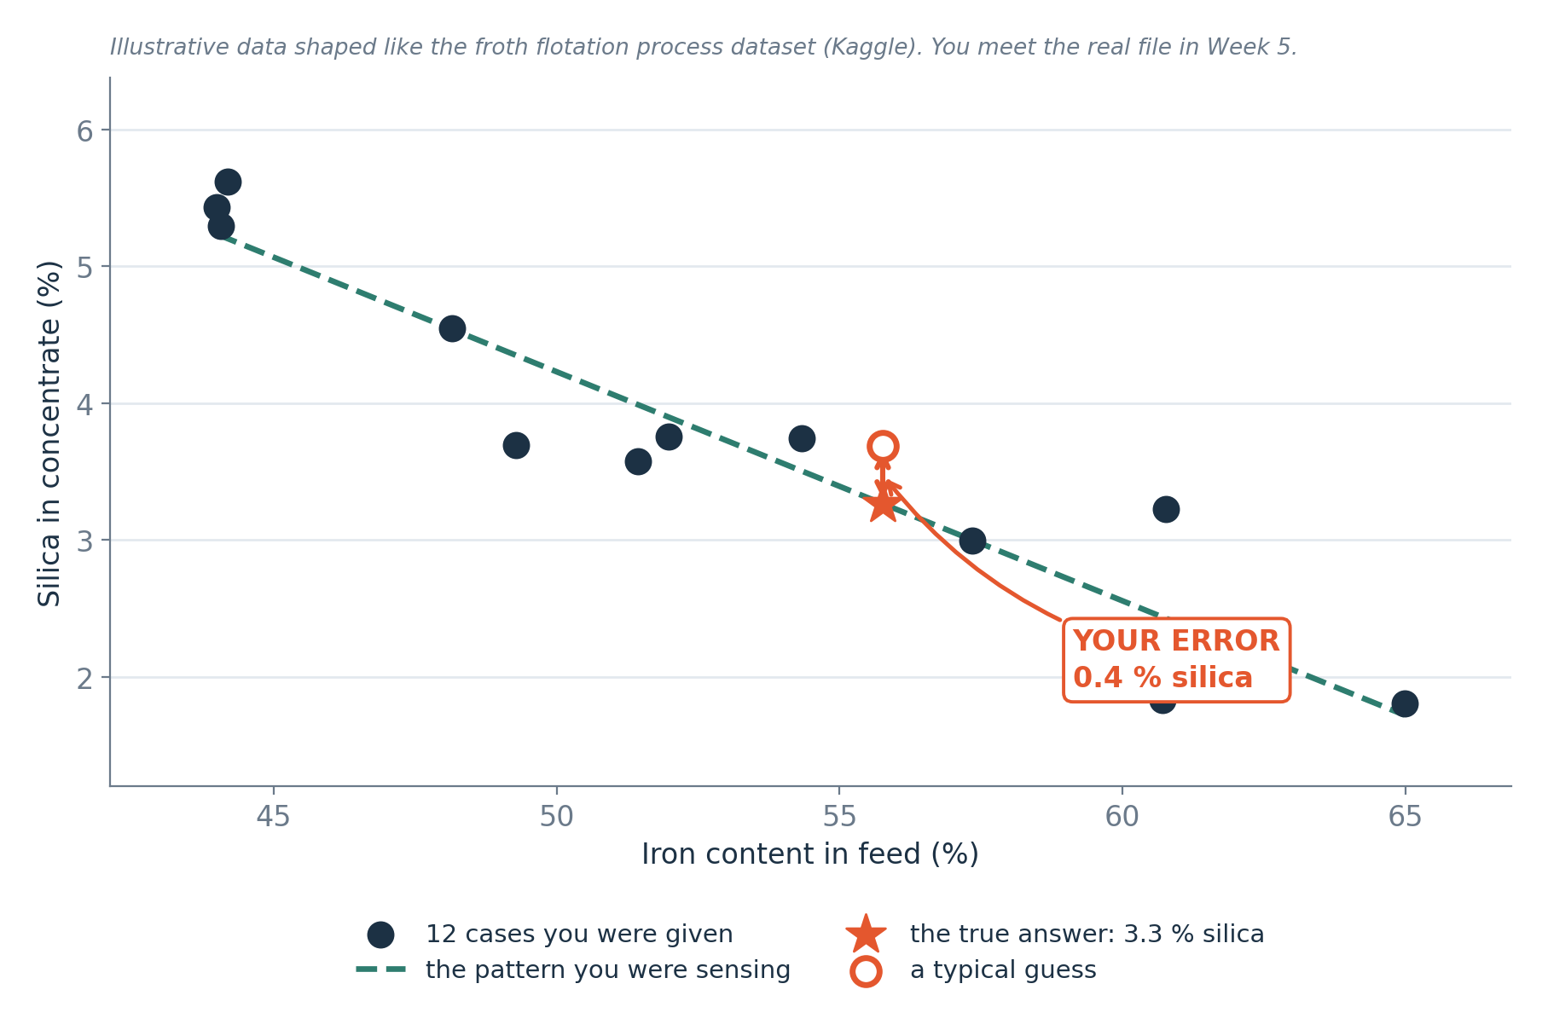
THE REVEAL
The answer, and your error
The star marks the measured value. Its distance from your prediction is the prediction error. The dashed line shows a possible pattern in the data.
Notes:
Read the star as the withheld observation and compare it with the previously recorded estimate. State the chosen signed-error convention before subtracting, and retain the measurement’s unit. Absolute error measures size without direction. One held-out case is not enough to establish reliable performance.

Slide 32
NAMING IT
Steps in a prediction task
What you called it
What it is called
You looked at the table.
You explored the data. That is Weeks 5 and 6.
You noticed which columns seemed to matter.
You selected features. That is Week 11.
You worked out a rough rule in your head.
You proposed a rule. Python models follow in Week 8.
You applied it to a case you had not seen.
You predicted a value for a case that was not used to find the pattern.
You compared your prediction with the measured value.
You measured the prediction error. Week 10 covers model evaluation.
Notes:
Map the paper actions to later computing steps without claiming a computer was trained today. Looking at patterns is exploration; choosing columns is feature selection; an algorithm later fits model parameters. Separate evaluation asks whether the fitted rule works on observations it did not learn from.

Slide 33
Break
10 minutes
Take a short break. No computer is needed for the remaining introductory examples.
Notes:
Pause before introducing task types. No code or download is required for the second half of this introductory lesson.

Slide 34
SEGMENT 6
Two kinds of question
15 MINUTES
Predicting a number, and predicting a category. Almost everything in this course is one or the other.
Notes:
Explain that the kind of answer determines the task. An estimated amount is a regression target; a choice among categories is classification. Categories can be represented by numeric codes such as 0 and 1, so digits alone do not determine the task.

Slide 35
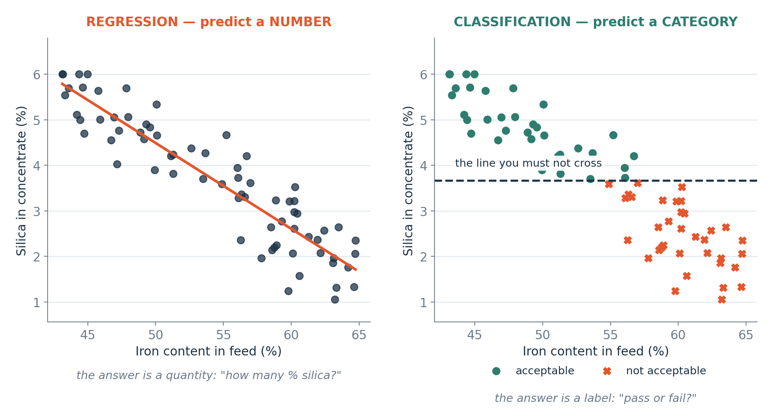
THE TWO SHAPES
Regression and classification
Left: the answer is a number on a continuous scale, so we fit a line through the cases. Right: the answer is one of a small set of labels, so we look for a boundary that separates them. The data can be the same; the question is what changes.
Notes:
The line is one possible regression model, not the definition of regression. Curved relationships are also possible. The boundary illustrates classification; it separates predicted categories. The same inputs may support different tasks depending on the target we define.

Slide 36
DEFINITION
Regression, and classification
REGRESSION predicts a number on a continuous scale. CLASSIFICATION predicts which of a small number of categories a case belongs to.
FOR EXAMPLE
Regression: how many % silica? Classification: ore or waste; or lithology: sandstone, shale, limestone.
DO NOT CONFUSE WITH
Ask what the answer means. Estimating a quantity is regression; choosing a category is classification. Categories may use numeric codes.
Notes:
Ask what the output means, not only how it is written. A quantity such as torque or days is regression; a class such as failure/no failure is classification. A label encoded as 0 or 1 is still a category. Regression can also predict quantities without physical units.

Slide 37
CHECK YOUR UNDERSTANDING
Can you answer these?
A
You want to predict how many days until a component needs replacing. Regression or classification?
B
You want to predict whether a sample passes or fails specification. Which one?
C
You want to predict which of five fault types a machine has. Which one — and what makes it different from the previous question?
Answers are on the next slide — try first, then look.
Notes:
Days until replacement is a numerical quantity. Pass/fail has two classes. Five fault types give multiclass classification. Identify the target meaning before choosing a method; students can answer without knowing a model algorithm.

Slide 38
ANSWERS
How did you do?
A
Days until replacement?
Regression. The answer is a number with a unit — days.
B
Pass or fail?
Classification. Two categories, so it is called binary classification.
C
Which of five fault types?
Still classification, but multiclass rather than binary. Difficulty depends on the data. Week 9 examines which categories are confused, beyond a single accuracy score.
Notes:
Explain binary as two categories and multiclass as more than two. More classes do not automatically make every dataset harder; difficulty also depends on their separation, examples and error costs. A confusion table will later reveal which categories are mixed up.

Slide 39
SEGMENT 7
What machine learning cannot do
15 MINUTES
Four limitations to consider when using machine learning.
Notes:
Introduce four reasons a prediction may not be useful. A model returning an answer is not evidence of data quality, a real predictive relationship or safe operation.

Slide 40
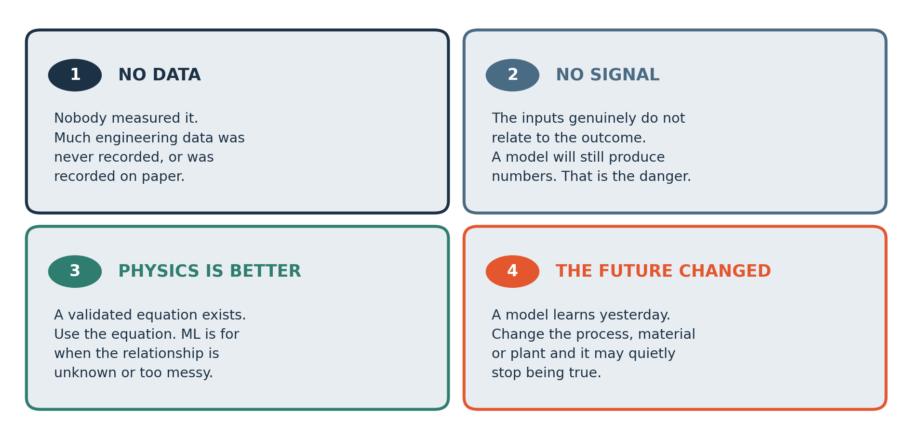
THE LIMITS
Four limits, and none of them go away
A model can produce a prediction even when the data are unsuitable. Check whether the inputs and evaluation support its intended use.
Notes:
Walk through the four limits on the diagram: inadequate observations, weak or irrelevant inputs, a better known equation, and changes between past and current conditions. Explain that these are questions to investigate rather than universal claims about every plant or dataset.

Slide 41
MADE CONCRETE
The same four limits, in your own discipline
1 · No data
3 · Physics is better
Blast fragmentation was judged by eye for decades. There is no dataset of it.
Contained metal is tonnage times grade. That is arithmetic; there is nothing to predict. Do not use a model where an equation will do.
2 · No signal
The shift supervisor's name does not cause recovery to change. A model given that column will still find a pattern in it.
4 · The future changed
A model trained on one ore body will not transfer to the next bench when the mineralogy changes.
Why this matters for the rest of the course
Every project in Week 9 has to survive these four questions before it is approved. A team that cannot answer them has not defined an engineering problem yet — it has picked a technique and gone looking for somewhere to use it.
Notes:
Treat each engineering situation as an illustrative scenario. Missing historical observations prevent learning that relationship from those observations. A superficially correlated label may fail elsewhere. A validated physical equation can be preferable. Changed equipment or materials can invalidate an old evaluation.

Slide 42
SEGMENT 8
Challenge: the Problem Hunt
30 MINUTES
Read the problem and identify the information available. Use the worked example to plan your first step.
Notes:
Introduce the Problem Hunt as practice defining a question before choosing a technique. It supports the A1 brief; it does not create another graded upload.

Slide 43
CHALLENGE
Problem Hunt
List three problems from exploration, ore and reservoir characterisation, production and equipment health where data might help.
Classify each problem: predict a number, predict a category or use another method. Explain your choice.
Use the worked example as a guide. Write down your assumptions and explain your answer.
Work these questions in order
What do you want to predict?
What would the answer let somebody DO?
Who measures that, and how often?
How would you know if you were wrong?
Would a rule you already know do this better?
What does a mistake cost here?
Notes:
Work through one candidate: specify the outcome, potential measurements, who records them, the decision helped and the cost of error. Then identify two other candidates. A good answer may conclude that an established rule is better than ML.

Slide 44
TEAMS
How your team works, all semester
Project teams of four or five
Individual accountability is built in
Sixty-five per cent of the mark is individual. Your team keeps a contribution log, and it is checked against the repository history.
You will do two projects together: a data analysis project due Week 8, and the Engineering ML Project from Week 9 to Week 15.
In Week 15, each student submits an individual written defence and reflection according to the published brief.
Roles rotate at every milestone
Project roles: data analysis, modelling, engineering review, documentation and presentation. Rotate roles so each member practises different skills.
Sign the team charter before you leave
Names, contact details, a weekly meeting slot, and what you will do if somebody stops contributing. Agreeing that now is much easier than agreeing it in November.
Notes:
Project teamwork is separate from today’s individual exercises. Explain rotating roles and the contribution log as specific records of who produced and explained each part. Individual written defence and reflection follow the current Week 15 brief; do not promise an unannounced live examination.

Slide 45
SEGMENT 9
Review your examples and Assignment A1
10 MINUTES
Check your candidate problems, then review A1 and the preparation for Week 2.
Notes:
Review one candidate problem against the visible questions, then explain the A1 submission checklist. Do not require a gallery walk or peer boards. The assignment should be understandable to someone revising alone.

Slide 46
ASSIGNMENT
Before Week 2
Assignment A1 — use the current form deadline
Also before next week
Create a GitHub account.
Three candidate machine learning problems from your own discipline.
Create a Google account if you do not have one — we work in Google Colab from Week 2.
For each: state inputs, target, data source and one limitation.
Watch the video on the next slide.
Do NOT install anything.
Choose one problem and dataset. Explain why it is feasible.
Week 2 needs a browser only.
Sign and hand in your team charter.
Marks: framing 6, data 8, judgement 6. Submit one DOCX or text PDF.
Notes:
A1 asks for one report covering three candidate problems and a justified choice of one. For each, identify inputs, target where appropriate, a possible data source and a limitation. Use the current form deadline. Account setup is preparation for Week 2, not a second report.

Slide 47
VIDEO
Watch this before Week 2
PRE-WORK
IBM Technology
AI, Machine Learning, Deep Learning and Generative AI Explained
https://www.youtube.com/watch?v=qYNweeDHiyU
Runtime: under 10 minutes
WATCH FOR
Compare the video’s definitions with the diagram in this lesson. Note any terms that the speaker uses differently.
Notes:
The video is supplementary. Ask students to compare its definitions of AI, ML and deep learning with the lesson. Preview it before class; availability and suggested excerpt timings may change. Students can use the preceding explanations if the video is unavailable.

Slide 48
SEGMENT 10
Revision material
5 MINUTES
Everything from here on is for you to study from. Summary, self-test with answers, glossary and a one-page reference.
Notes:
Explain how to revise: attempt the self-test before reading its answers, then use the glossary to clarify unfamiliar terms. The reference slides summarise this lesson; they do not introduce additional submission requirements.

Slide 49
MODULE SUMMARY
What you should take away
Artificial intelligence is a goal; machine learning is one way of reaching it; data science is the craft of getting a trustworthy answer out of data at all.
In traditional programming you write the rule. In machine learning you supply examples and the computer infers the rule — and you then have to decide whether to trust it.
The supervised tables used here have one row per example, candidate input columns and an observed target. Other datasets can have different structures.
Regression predicts a number with a unit. Classification predicts which of a small set of categories a case belongs to. The same data can pose either question.
A model learns association. It does not learn cause, and a good fit is no evidence of a mechanism.
Check for missing data, weak predictive patterns, better physical models and changes in operating conditions.
A prediction alone does not show that a model is useful. Check the data, errors and limits of the intended use.
Notes:
Recap the chain: engineering question, suitable observations, candidate inputs and target, method choice, evaluation and limitations. The row-and-column description applies to the supervised tables used here, not every possible dataset. Images, text and unlabelled data can have other structures.

Slide 50
CHECK YOUR UNDERSTANDING
Self-test — try these before you look
A
A colleague says 'we should use AI for this'. What three questions would you ask before agreeing?
B
You have a table of 500 past pump repairs. Which columns are features and which is the target — and what tells you?
C
Give one problem from your discipline that is regression, and one that is classification.
D
Why is a very good fit on data the model has already seen NOT evidence that the model is any good?
E
Your model predicts silica in the concentrate to within a few percentage points. Name one thing you would still need to know before acting on it.
Answers on the next slide. Do not look until you have written something for each.
Notes:
Students should justify each answer. Features depend on what is known at prediction time. A score on training data can reflect memorisation. Before acting on a prediction, examine the error tolerance, operating conditions and consequences of mistakes.

Slide 51
ANSWERS
How did you do?
A
Three questions before agreeing to 'use AI'?
D
Why is a good fit on seen data not evidence?
What value do you want to predict? Which recorded data can help? Is an established equation suitable? Resolve these questions before choosing a model.
A model may memorise its training examples. Evaluate it on separate examples to check whether it predicts new cases well.
B
Features and target in a repair table?
E
What else before acting?
The target is whatever you want to predict — say time to next failure. Features are everything known BEFORE that: operating hours, load, temperature. The test is timing: anything only known afterwards cannot be a feature.
How large the error is in engineering terms and whether that is tolerable; what it costs when the model is wrong; and whether today's conditions still resemble the data it learned from.
C
One of each from your discipline?
Regression: any quantity with a unit — silica in the concentrate in percentage points. Classification: ore or waste; or lithology: sandstone, shale, limestone.
Notes:
Use each answer to explain the reason. The target is determined by the question. Candidate features must be available beforehand and then checked for usefulness. Separate evaluation tests generalisation, but also needs relevant cases and protection against leakage.

Slide 52
GLOSSARY
Every word we used today (1 of 3)
Artificial intelligence
Dataset
Any machine doing something we would call intelligent. A goal that many techniques aim at.
A collection of data. In this lesson we use tables of observations.
Example (or row, or observation)
Machine learning
One recorded case. A supervised training example includes its observed target.
Inferring a rule from examples instead of writing it yourself.
Feature
A column known before the outcome. An input to the prediction.
Deep learning
Machine learning using large neural networks. Semester 2.
Target (or label)
Data science
The column you are trying to predict.
The craft of getting a trustworthy answer out of data — finding, cleaning, questioning, analysing, presenting.
Notes:
Define the terms in the context of today’s table. A dataset is a collection of data; it need not always be a table. An observation is one case; a target is needed for a supervised labelled example but may be missing for a new case awaiting prediction.

Slide 53
GLOSSARY
Every word we used today (2 of 3)
Regression
Prediction
Predicting a number on a continuous scale.
The model's answer for a case.
Classification
Error
Predicting which of a small set of categories a case belongs to.
Prediction error is the difference between the predicted and measured values.
Binary classification
Unseen data
Classification with exactly two categories, such as pass or fail.
Cases not used to fit the model. They must also be relevant and free from leakage.
Multi-class classification
Classification with three or more categories.
Notes:
Differentiate prediction, observed value and error. Binary and multiclass refer to the number of categories, not to how category labels are stored. Unseen cases must also be relevant to intended use; an unrelated held-out set is not automatically a fair evaluation.

Slide 54
GLOSSARY
Every word we used today (3 of 3)
Data leakage
Accidentally giving the model information it would not have in real use — usually something only known after the outcome. Week 10.
Generalisation
Whether a rule learned from past cases still works on new ones.
Association vs cause
A model learns which columns move together. It knows nothing about mechanism.
Notes:
Give a timing example for leakage: a repair recorded after failure is unavailable when predicting failure. Generalisation concerns new cases. Association alone does not establish causation; causal conclusions need additional assumptions or study design.

Slide 55
CHEAT SHEET — KEEP THIS SLIDE
Eight questions to ask about any data problem
1 · What exactly am I predicting?
5 · Would a rule or an equation do this better?
Name the target column and its unit. A descriptive analysis question may not need a prediction target.
If a code of practice or a validated formula answers it, use that instead.
2 · Is it a number or a category?
6 · How will I know if I am wrong?
Does the answer estimate a quantity or choose a category? Numeric class codes are still categories.
You need cases the model has never seen. Decide now how you will hold some back.
3 · What do I know beforehand?
7 · What does being wrong cost?
List the features. Check every one: would I really have this before the outcome?
A false alarm and a missed failure are not equally bad. That asymmetry decides which model you pick.
4 · Where does the data come from?
8 · Do today's conditions still resemble the data?
Who measured it, how often, over what period, and is it actually kept anywhere?
If the process, material or plant has changed, the model may be quietly obsolete.
Notes:
Use the eight questions as a decision checklist. A prediction task needs an outcome, but descriptive data analysis can answer questions without a target. Check availability, evaluation and consequences before committing to a model.

Slide 56

END-OF-SESSION QUIZ · WEEK 1
Five questions,
five minutes
Features and target read off a table, regression told from classification, and one of the four limits applied to a case.
Enter your own Student Registration Number exactly as recorded.
One attempt, from the Google account you are signed in to.
Open for 24 hours from lecturer activation, then it closes.
Tap View score and read the feedback after submitting.
Quiz category: 10%. Best nine of eleven count; Quiz 6 is waived.
Notes:
Explain the difference between estimated completion time and availability: the quiz may take about five minutes, while its response window is 24 hours from lecturer activation. Use the cohort’s current quiz policy and the active link. The course’s quiz category remains 10% even where Quiz 6 is waived.

Slide 57
THE ONE THING TO REMEMBER
You have practised
prediction reasoning.
Today you used twelve rows of data to make a prediction and measure its error. Later lessons use Python to repeat these calculations on larger datasets.
Next week: Colab notebooks and version control. Bring a laptop with a browser.
Notes:
Close accurately: today learners practised reasoning from observations, making a prediction and checking error. Later Python lessons fit and evaluate models computationally. Bring a laptop and browser for Week 2; the introductory paper example is not an extra upload.

