Slide 1
CML3111
Python as an
engineering calculator
Variables, decisions, functions — and reading errors
WEEK 3 · Fri 25 September 2026
Friday 11:00–14:00 · Room 115 · IUEA Faculty of Engineering · Semester 1, 2026/27
Notes:
Everything today runs on formulas you already know from your own programme. The syntax rides along on familiar content, which is why this week works even though it is your first real programming session.

Slide 2
LEARNING OBJECTIVES
By the end of today you can…
1
Explain what the equals sign actually does in Python, and why it is not equality.
2
Use integers, floats, strings and booleans, and say what goes wrong when they are mixed.
3
Write a function with parameters, a docstring, stated units and a return value.
4
Turn a formula from your own discipline into a function, and test it against a value you already know.
5
Write conditional logic that encodes an engineering decision rule.
6
Read a Python traceback and name the line and the cause.
7
Recognise a wrong answer that produced no error at all — and say how you would have caught it.
Week 3 · Python as an engineering calculator · nothing here needs prior programming experience
Notes:
The last objective is the one this whole week is built around. It matters more than any piece of syntax, and it comes back in Week 10 when a leaking model reports a beautiful score.

Slide 3
SEGMENT 1
Where we got to
10 MINUTES
You can run code and put it on GitHub. Today you make it calculate something you care about.
Notes:
Ten minutes of recall, then the new material. You can already run code and push it to GitHub; today it starts calculating something from your own discipline.

Slide 4
CHECK YOUR UNDERSTANDING
Two minutes: what stuck from Week 2?
A
What does Restart and Run All do, and why would you bother?
B
A cell shows [7] and the cell above it shows [3]. Should you trust the notebook's final answer?
C
Which Git command tells you what has changed and where it currently is?
Answers next slide.
Notes:
If the first question feels shaky, the Week 2 deck has a cheat-sheet slide with Restart and Run All on it. Get that habit settled before Week 5, when submitted notebooks start being run from a clean start by a program rather than by you.

Slide 5
ANSWERS
How did you do?
A
Restart and Run All?
Clears the kernel and runs every cell from the top in order. It is the only honest test that your notebook produces its results from nothing but itself.
B
[7] above [3]?
No. They were run out of order, so the kernel's memory does not match what the notebook looks like.
C
Which command?
git status. Run it constantly until it is automatic.
Notes:
All three of these are Week 2 material and all three get used today. git status especially: run it before and after everything for the first fortnight, until you stop having to think about it.

Slide 6
SEGMENT 2
Why write down a formula you already know?
15 MINUTES
A fair question, and it deserves a real answer before you spend three hours on it.
Notes:
The objection in this segment is a fair one and it gets a real answer. For a single calculation a calculator is faster, and the case for writing the formula down begins as soon as there is more than one calculation to do.

Slide 7
TODAY STARTS WITH AN OBJECTION
"You already know power is voltage times current. Why write it as code?"
For one motor, a calculator is faster. The answer is what happens when it is not one motor.
Notes:
Try answering the objection yourself before you turn the page. The commonest answer, 'because you can do it lots of times', is exactly right, and the four reasons on the next slide expand it into something you can use in an argument with a colleague.

Slide 8
WHY BOTHER
Four honest reasons, and one that matters more than the others
1 · You will do it four hundred times
3 · It is testable
Not once. Once per motor, per hour of data. From Week 5 the same formula is applied to a column of ten thousand rows in one line.
You can feed it a case where you already know the answer and confirm it agrees. You cannot test a calculation you did in your head.
2 · It is inspectable
4 · When the standard changes, you fix one line
A number on a calculator screen carries no record of how it was produced. A function states its inputs, its units and its logic, and anyone can check it — including you, in six months.
Not forty spreadsheets, of which you will find thirty-eight.
And the one that matters most
From Week 8 the computer starts working out relationships you did not give it. You will not be able to check that work unless you are already fluent at expressing relationships yourself. This week is the foundation for trusting — or refusing to trust — a model later.
Notes:
Reason three is the habit that matters most: feed the function a case whose answer you already know and confirm it agrees. Every practical from here on is marked partly on that, so it is worth building now. The last reason is why this week exists at all — from Week 8 the computer starts working out relationships you never supplied, and you cannot check that work without being fluent at expressing relationships yourself.

Slide 9
SEGMENT 3
Variables and types
25 MINUTES
Two ideas, and the second one causes more beginner bugs than anything else in this course.
Notes:
Twenty-five minutes on two ideas. The second one, types, causes more beginner bugs than anything else in this course, and it is learned by writing code rather than by reading about it.

Slide 10
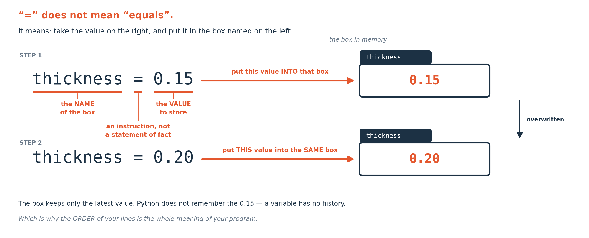
VARIABLES
What the equals sign actually does
It is not equality. It means: work out the value on the right, then put it into the box named on the left. Assign to the same name again and the old value is simply gone.
Notes:
This is the single most common early misunderstanding, and it matters because `readings = readings + 5` is nonsense as an equation and perfectly sensible as an instruction.
Read it right to left: take what is in readings, add five, put the result back.

Slide 11
DEFINITION
The four types you need this week
An INT is a whole number. A FLOAT has a decimal point. A STR is text, in quotes. A BOOL is True or False. Python decides which you have from how you wrote it.
FOR EXAMPLE
thickness = 0.25 is a float. count = 12 is an int. name = "Bridge 4" is a string. passed = True is a boolean.
DO NOT CONFUSE WITH
What the value looks like on screen. "12" with quotes is text and you cannot do arithmetic with it — which is exactly the error you will hit in Week 4 when you read a file.
Notes:
The last line is a forward reference on purpose. Everything read from a file arrives as text until you convert it, and meeting that idea now makes Week 4's crash make sense rather than feel arbitrary.

Slide 12
WHAT GOES WRONG
Three arithmetic traps, and how to see them coming
Integer division
Floats are approximations
In Python 3, 7 / 2 is 3.5 — a float, as you would expect. But 7 // 2 is 3, because the double slash throws the remainder away. Use it deliberately or not at all.
0.1 + 0.2 prints 0.30000000000000004. That is not a bug; it is what binary fractions do, in every language, and it is why you compare with a tolerance rather than with equals when it matters.
Operator precedence
Python follows the same rules you already use: brackets, then powers, then multiply and divide, then add and subtract. a + b / 2 is not (a + b) / 2. When in doubt, put the brackets in — they cost nothing and they document your intent.
And the trap that is not arithmetic at all
Units. Python has no idea whether 0.25 is metres or millimetres. It will multiply revolutions per minute and radians per second together without a murmur and hand you a confident wrong answer. Write the unit in a comment beside every value you define — every single one — and you will catch most of these before they happen.
Notes:
The float behaviour is worth being precise about. 0.1 + 0.2 printing 0.30000000000000004 is the same phenomenon as a third having no exact decimal form, and it happens in every language that stores numbers in binary. The units point is the one that will actually cost you marks: Python has no idea what unit your number is in and it will never ask.

Slide 13
SEGMENT 4
Turning your formula into a function
25 MINUTES
Everybody types. We build mechanical_power together, line by line.
Notes:
Twenty-five minutes with everyone typing. The function is built one line at a time, with the unit of every value written down as it is defined. That ordering is the habit being taught, and it is what the function-library practical is marked against.

Slide 14
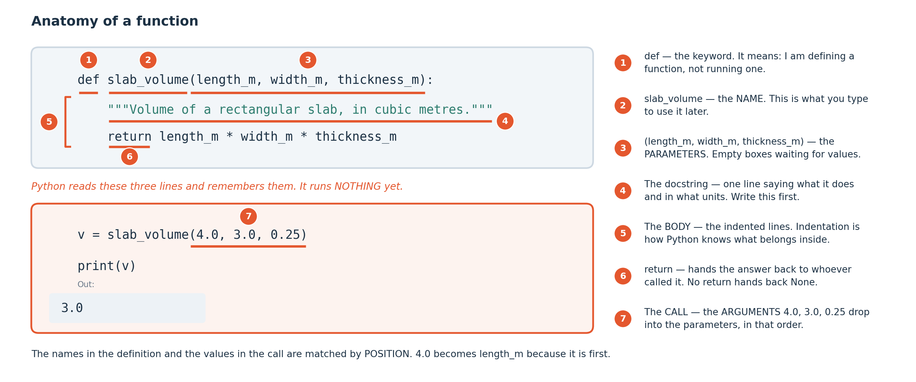
ANATOMY
The parts of a function
Six parts, and one thing worth noticing: nothing happens when Python reads the definition. The recipe is only written down. It runs when you call it.
Notes:
The definition-versus-call distinction accounts for a large share of 'my code does nothing' reports. A beginner writes a perfect function, never calls it, and concludes Python is broken.
The docstring — the text in triple quotes — is not decoration. It is where you state what the function does and what units it expects, and it is marked in this course.

Slide 15
WORKED EXAMPLE
Turning a formula into a function, step by step
The reasoning, before we type anything. This is the routine to use for every formula you convert for the rest of the course.
1
Write the formula down in words first, with its units. What goes in, what comes out, and in what unit is the answer?
2
Decide what varies and what does not. The things that vary become parameters; the things that do not can stay as values you define once.
3
Name it for what it does. mechanical_power tells a reader what comes back; calc does not.
4
Write the docstring before the body. If you cannot say in one line what it returns and in what unit, you are not ready to write it.
5
Write the body as a single return statement wherever you can. One formula, one line.
6
Test it against a value you already know — from your notes, a worked example, or by hand. If you cannot state the expected answer, you cannot tell whether the function is right.
Step 6 is the one that gets skipped, and it is the one that catches every bug in the Wrong Answer Hunt later today.
Notes:
Step 1 sounds trivial and is not. Most beginner function bugs come from starting to type before deciding what the function is for, and they surface as wrong answers rather than as syntax errors. Step 4, writing the docstring first, works the way a specification does: a requirement you cannot state clearly produces a confused implementation.

Slide 16
OPEN COLAB — NEW NOTEBOOK
LIVE CODING
mechanical_power — type this with me
def mechanical_power(torque_nm, rpm):
"""Shaft power in watts from torque and rotational speed."""
return torque_nm * rpm * 2 * 3.14159 / 60.0
voltage = 240.0 # volts
current = 12.5 # amperes
torque = 8.5 # newton metres
speed = 1450.0 # revolutions per minute
p_in = voltage * current
p_out = mechanical_power(torque, speed)
print(f"in {p_in:.0f} W, out {p_out:.0f} W, "
f"efficiency {100 * p_out / p_in:.1f} %")
NOW BREAK IT ON PURPOSE
Delete the / 60.0 from the function. Efficiency comes back as about 2,600 per cent. You spot that instantly because you know a motor cannot exceed a hundred per cent. Python knows nothing at all about motors.
Notes:
Expected output:
in 3000 W, out 1291 W, efficiency 43.0 %
Every value has its unit in a comment beside it. That comment is the only defence you have against the trap in the box below the code.

Slide 17
DEFINITION
return and print
RETURN hands a value back to whoever called the function, so it can be used. PRINT puts characters on the screen and hands back nothing.
FOR EXAMPLE
result = mechanical_power(8.5, 1450) only works because the function returns. If it printed instead, volume would hold None and the next line would fail.
DO NOT CONFUSE WITH
Each other — and this is the commonest structural mistake in beginner code. A function that prints gives you something to look at. A function that returns gives you something to work with.
Notes:
From Week 5 you will apply your functions to a whole column of data at once. A printing function is useless for that: it would print ten thousand lines and produce no column.
A function may of course do both, but if it only prints, it is a dead end.

Slide 18
CHECK YOUR UNDERSTANDING
Two minutes: check the foundations
A
thickness = 0.25, then thickness = 0.30. What is in thickness now, and what happened to 0.25?
B
You need to work out whether 7 divided by 2 should be 3.5 or 3 in your calculation. Which operator gives which?
C
Why write the unit in a comment beside every value, when Python ignores comments entirely?
Answers next slide. Write something for each first.
Notes:
Three questions on the foundations before the break. Question C is the one to dwell on, because it is the theme of the whole week and the answer is on the next slide.

Slide 19
ANSWERS
How did you do?
A
thickness after two assignments?
0.30. The 0.25 is gone entirely — assignment replaces, it does not accumulate. There is no history in a variable.
B
7 / 2 versus 7 // 2?
A single slash gives 3.5, a float. A double slash gives 3, throwing the remainder away. Use // only when you actually want whole units — a number of bags, a number of bars — and never by accident.
C
Why comment the units?
Because Python ignores them and you do not. The computer will happily multiply millimetres by metres and hand you a confident answer that is wrong by a factor of a thousand. The comment is for the only part of the system that can catch that: you.
Notes:
Answer C is the sentence to carry for the rest of the semester. Python ignores your unit comments and you do not, and the comment exists for the only part of the system able to catch a factor-of-a-thousand error, which is you.

Slide 20
Break
10 minutes
Stretch, and talk to someone you have not worked with. Be back on time: the longest working block of the session is next.
Notes:
Ten minutes. The practical after the break is the long one, at 35 minutes.

Slide 21
SEGMENT 5
Encoding a decision rule
15 MINUTES
You already write engineering decision rules. An 'if' statement is just notation for them.
Notes:
Fifteen minutes. You already write engineering decision rules — thresholds out of a code of practice, pass and fail bands, alarm set points — and an if-statement is notation for what you already do. This is the left-hand column from Week 1: the rule you write yourself.

Slide 22
READ IT BEFORE YOU RUN IT
LIVE CODING
A rule you already know, written down
def temp_action(winding_c, ambient_c):
"""Return the protective action for this winding temperature."""
rise = winding_c - ambient_c
if winding_c > 155:
return "trip"
elif winding_c > 130:
return "alarm"
elif rise > 80:
return "investigate cooling"
else:
return "normal"
NOW BREAK IT ON PURPOSE
Change the first threshold to be larger than the second and run it. Nothing errors, and some inputs now return the wrong action because the first branch catches them. Order matters in an if-chain, and getting it wrong is silent.
Notes:
The 130 and 155 degree limits come from the insulation class on the motor's datasheet. No data is needed to write this rule, which puts it in the left-hand column of the Week 1 diagram.
An if-chain is checked top to bottom and stops at the first match. That is why the strictest condition goes first — reverse them and the strict branch becomes unreachable.
else is the catch-all. Leave it out and a case that matches nothing returns None, which will confuse you later.

Slide 23
SEGMENT 6
Reading an error
15 MINUTES
Errors are the most useful output Python produces. Most beginners do not read them at all.
Notes:
Fifteen minutes on reading tracebacks. Most beginners do not read them at all, which is expensive, because the message usually names both the type of problem and the line it happened on.

Slide 24
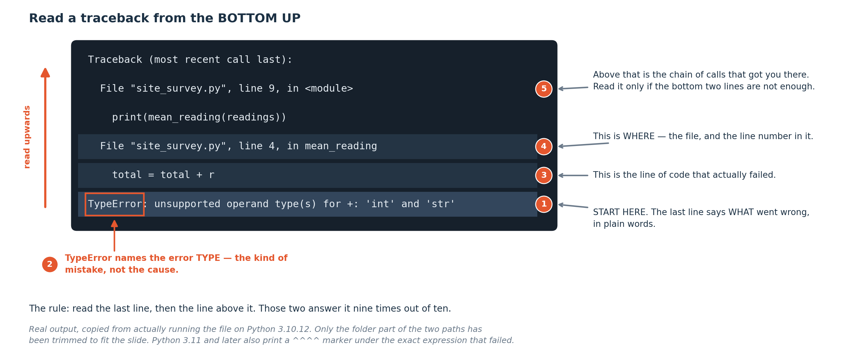
TRACEBACKS
The anatomy of a traceback
Read the last line first. It names the error type and what Python actually wanted. Then look up one line for the code that failed, and at the line number for where it is.
Notes:
The word 'traceback' means it is tracing back through the calls that led to the problem. For your code this week it will usually be two or three lines long.
This exact error — adding text to a number — is the one you will hit in Week 4 when you read a file, because everything read from a file arrives as text.

Slide 25
FIVE NAMES, AND ONE WITHOUT
The five errors you will actually meet this week
NameError
IndentationError
You used a name Python has never seen. Usually a typo, or a cell you did not run.
The spacing at the start of a line is wrong. Python uses indentation to decide what is inside what.
TypeError
ZeroDivisionError
You did something to a value its type does not allow — most often arithmetic on text.
Exactly what it says. Usually a variable you expected to have a value and which is zero.
SyntaxError
And the one with no name
Python could not even read the line. Look for a missing bracket, quote or colon, and check the line ABOVE the one it blames.
No error at all, and the answer is wrong. Python cannot help you here. This is what the next segment is about, and it is the whole point of the week.
Notes:
One trap in that list: a SyntaxError often points at the line after the real problem. An unclosed bracket is reported on the next line down, so when Python blames a line that looks perfect, check the line above it. The last entry on the slide has no name and no error message, and the next segment is about it.

Slide 26
WORKED EXAMPLE
Working through an error you have never seen before
You will meet errors this course never mentioned. This is the routine, and it works on all of them.
1
Read the LAST line. It names the error type and what Python actually wanted. Everything above it is context.
2
Read the line of your code that it quotes. Not the line you think is wrong — the line Python says failed.
3
Say out loud what you expected that line to be working with. 'I expected width to be a number.' Often the error is already obvious at this point.
4
Check that assumption. Print the thing just before the failing line: print(width), print(type(width)). Most bugs die here.
5
If it is still unclear, search the exact error message — the last line, in quotes, without your variable names. Somebody has had it before.
6
If you use an AI assistant, paste the error AND your code and ask it to explain the cause. Do not ask it to rewrite your function — you will learn nothing and you have to be able to explain what you submit.
Step 4 is where most bugs are actually found: print the thing, look at it, and check it is what you assumed.
Notes:
print(type(x)) is the most underused diagnostic available to a beginner. It answers 'is this a number or is it text?', which is the cause of a large share of first-year errors.
On step 6 — the course policy is that AI assistants are permitted and taught in coursework, with a short declaration of what you asked and what you changed, and prohibited in the two practical tests, which run offline. You are marked on what you can explain.

Slide 27
SEGMENT 7
Practical: a function library for your own discipline
35 MINUTES
Five functions from your own field, each with units stated and each tested against a value you already know.
Notes:
Thirty-five minutes building five functions from your own field. The expected value comes first: work out by hand what each function should return before you run it. A formula you cannot state an expected answer for is a formula you have not understood yet, and syntax help will not repair that.

Slide 28
PRACTICAL — 35 MINUTES
What to build
Five functions, and what each one needs
Suggested formulas
A name that says what it does.
• Ohm's law and electrical power • Three-phase real power with a power factor • Motor torque, and revolutions per minute converted to radians per second • Gear ratio and output speed
A docstring stating what it returns and in what unit.
The unit of every parameter, in a comment.
A return value — not a print.
• Decibel conversion for a power ratio • RC time constant, and root-mean-square of a sampled signal
Two test values with the answer you expect, worked out by hand or from your notes.
CORE: five working functions.
STRETCH: make one refuse a physically impossible input with a clear message.
Notes:
Return rather than print. A function that returns hands back a value you can go on to use, and a printing function only gives you something to read. From Week 5 you will feed these into columns of data, and a printing function is useless for that.
The two test values are the marked part. If you cannot say what answer to expect, you cannot tell whether you got it.

Slide 29
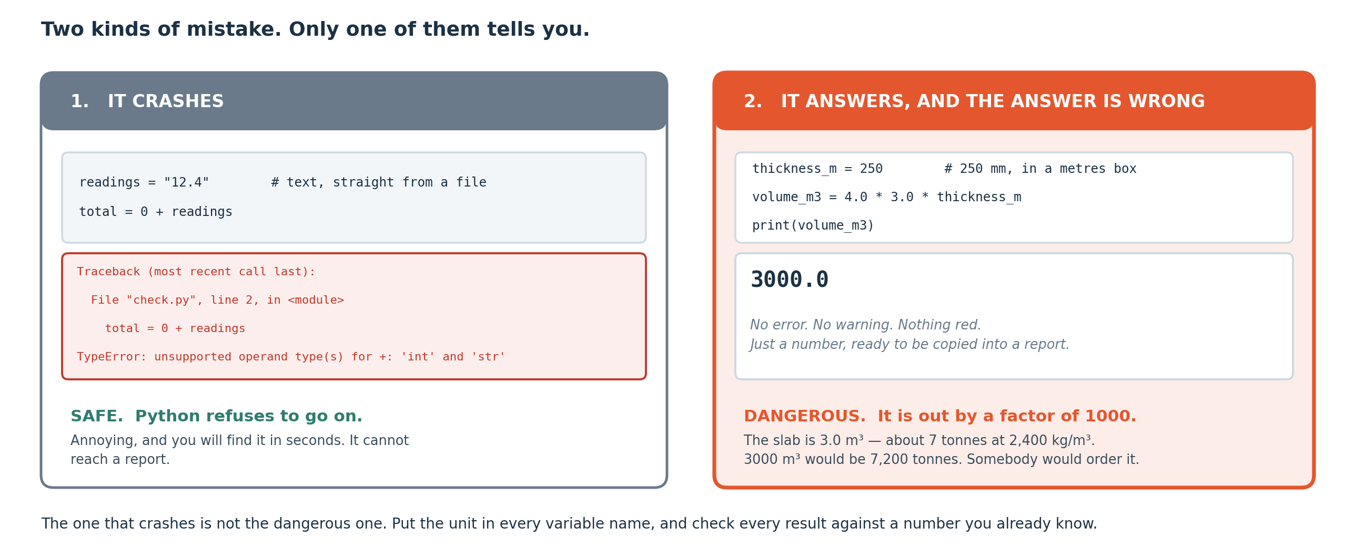
THE POINT OF THIS WEEK
Two kinds of wrong
On the left, Python stops and tells you. On the right, it says nothing and the answer is wrong by a factor of a thousand. Only one of these is dangerous.
Notes:
An error is a gift. It is Python refusing to guess, and telling you exactly where it stopped.
A silent wrong answer is the real hazard, and it is the one you will meet again in Week 10 when a model with a data leak reports a near-perfect score. The habit that protects you is the same in both cases: know roughly what the answer should be BEFORE you compute it, and check the one you got against the one you expected.

Slide 30
CHALLENGE
Wrong Answer Hunt
Six functions. All six run without any error. All six return the wrong answer.
Find every one, name the cause, and fix it. Twenty-five minutes, in teams, no hints from me.
Work these questions in order:
→ Is that answer even the right size?
→ Did the order of operations do what you meant?
→ What unit is that in?
→ Has something been divided twice?
→ What happens at the boundary value?
→ Would you sign your name under this number?
Notes:
All six functions run cleanly and all six are wrong, which is the entire point. The belief that code which runs is code which is correct is the most dangerous thing to carry out of a first month of programming, and it is fatal in Week 10 when a leaking model reports a near-perfect score. Work the six questions on the slide in order — the first two, right size and right unit, catch most of them.

Slide 31
ASSIGNMENT
Before Week 4
Assignment A3 — due at the start of Week 4
Looking ahead
Your function library: five documented, tested functions, in a notebook in your repository.
Next week you stop calculating one thing at a time.
Each one needs its docstring, its units, and its two test values with the expected answers shown in the output.
You get a file with a few hundred rows in it and a question you cannot answer by hand.
Every session ends with a five-question quiz worth one per cent. Two of the five show code that runs and returns a wrong answer.
Plus one short paragraph: which of the six Wrong Answer Hunt bugs would you have been most likely to write yourself, and what will you do differently?
Restart and Run All before you submit.
Notes:
The reflection paragraph carries real weight. Naming the bug you would most likely have written yourself makes you measurably less likely to write it. It is also the best preparation there is for the weekly quiz, where two of the five questions show code that runs and returns a wrong answer, so there is nothing to memorise for it and doing A3 honestly is the preparation.

Slide 32
SEGMENT 8
Revision material
5 MINUTES
Summary, self-test with answers, glossary and a one-page reference.
Notes:
Everything past this slide is revision material: a summary, a self-test with worked answers, a twenty-term glossary and a one-page reference on writing a function you can defend.

Slide 33
MODULE SUMMARY
What you should take away
The equals sign is an instruction: work out the right-hand side and put the result in the box named on the left.
Values have types. Text that looks like a number is still text, and arithmetic on it raises a TypeError — which is exactly what happens when you read a file.
A function is a named recipe. Nothing happens when Python reads the definition; it runs when you call it.
A docstring and a unit comment on every parameter are part of the function. Python does not know what unit your number is in.
An if-chain is checked top to bottom and stops at the first match, so the strictest condition goes first.
Read a traceback from the last line up. It names the error type and what Python wanted.
The dangerous failure is the one with no error message. Know roughly what the answer should be before you compute it — that is the only defence, and it is the habit this week exists to build.
Notes:
Seven statements covering the session. The last one is what this week exists for, and knowing the rough size of the answer before you compute it is the only defence against a wrong result that produces no error.

Slide 34
CHECK YOUR UNDERSTANDING
Self-test — write something for each before you look
A
What does x = x + 1 mean, given that it is nonsense as an equation?
B
Why does "12" + 3 fail, and what would you write instead?
C
You wrote a function and ran the cell. Nothing printed and no error appeared. What is the most likely explanation?
D
Your if-chain tests width > 0.30 before width > 0.50 . What goes wrong, and will Python warn you?
E
You compute a beam moment and get 4.2. What is the first question you should ask, before anything else?
Answers on the next slide.
Notes:
Question E has one intended answer and it is the theme of the week. Anything that notices the missing unit is right.

Slide 35
ANSWERS
How did you do?
A
What does x = x + 1 mean?
D
if-chain in the wrong order?
Take whatever is currently in x, add one, and put the result back into x. Read it right to left. As an instruction it is entirely sensible; as an equation it would be false.
The 0.30 branch catches everything above 0.30, including everything above 0.50, so the 0.50 branch can never run. Python will not warn you — it is valid code that returns the wrong action. Put the strictest condition first.
B
Why does "12" + 3 fail?
Because "12" is text. Python will not guess a conversion, so it raises a TypeError. Write int("12") + 3 or float("12") + 3 to convert it first — which is exactly what you will do to every value you read from a file next week.
E
Beam moment of 4.2?
In what unit? 4.2 newton-metres and 4.2 kilonewton-metres are a factor of a thousand apart, and only one of them is plausible. Always ask for the unit before you ask whether the number is right.
C
Nothing printed, no error?
You defined the function but never called it. Defining writes the recipe down; calling runs it. Add a line that calls it and prints or uses the result.
Notes:
Answer E is the sentence to carry all semester: ask for the unit before you ask whether the number is right. It comes back in Week 8, when model errors have to be reported in physical units rather than as a bare score.

Slide 36
GLOSSARY — KEEP THIS SLIDE
Every word we used today
Variable
Parameter / argument
A name that holds a value. Assigning to it again replaces what was there.
The name in the definition is the parameter; the value you pass in is the argument.
Assignment (=)
return
Work out the right-hand side, put the result in the name on the left.
Hands a value back to whoever called the function. Not the same as print.
int
Docstring
A whole number: 12.
The text in triple quotes just inside a function, saying what it does and in what units.
float
A number with a decimal point: 0.25. Stored approximately, which is why 0.1 + 0.2 is not exactly 0.3.
Conditional (if / elif / else)
Checked top to bottom, stops at the first match. else is the catch-all.
str (string)
Boolean expression
Text, in quotes: "Bridge 4". Arithmetic on it raises a TypeError.
Something that evaluates to True or False: width > 0.30.
bool
Traceback
True or False.
The error report. Read the last line first.
Type conversion
NameError
Turning one type into another: int("12"), float("0.25"), str(12).
A name Python has not seen. Usually a typo or an unrun cell.
Operator precedence
TypeError
The order operations happen in. Brackets first. When in doubt, add brackets.
An operation the value's type does not allow. Most often arithmetic on text.
// (floor division)
SyntaxError
Divide and throw the remainder away. 7 // 2 is 3.
Python could not read the line. Check the line above too.
Function
Silent wrong answer
A named recipe. Defined with def, run when called.
No error, wrong result. The dangerous one. Know the expected magnitude first.
Notes:
Twenty terms. The last one has no Python keyword attached to it and is the most important on the list.

Slide 37
CHEAT SHEET — KEEP THIS SLIDE
One-page reference — writing a function you can defend
Name it for what it does
Test it against something you already know
mechanical_power tells a reader what comes back.
Two values, worked out by hand or taken from your notes. If you cannot say what to expect, you cannot tell whether you got it.
State the units, always
In the docstring for what comes out, in a comment for everything that goes in. Python does not know and will not warn you.
Put the strictest condition first
An if-chain stops at the first match. Reverse them and a branch becomes unreachable, silently.
Return, do not print
A returned value can be used. A printed one can only be looked at.
Before you believe a number
Ask its unit. Ask its rough magnitude. Ask whether you would sign your name under it.
When it breaks
Last line of the traceback first. Then the line number. Then what you actually typed.
Notes:
Photograph this slide. Every practical from here on is marked against some subset of these seven habits, and the units line accounts for more lost marks than the rest put together.

Slide 38
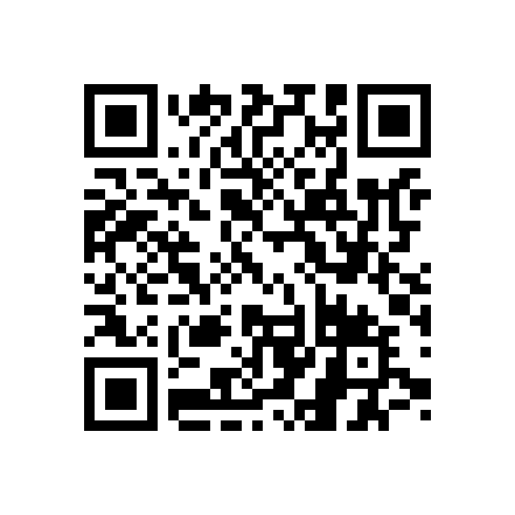
END-OF-SESSION QUIZ · WEEK 3
Five questions,
five minutes
A unit error that returns a plausible number, a function that prints instead of returning, and one traceback.
Scan the code. First box is your registration number, off your card.
One attempt, from the Google account you are signed in to.
Open for 48 hours if the network fails, then it closes itself.
One per cent each. Tap View score and read the feedback.
Twelve this semester, best ten count. No resits.
Notes:
The last five minutes of every teaching session. Five questions, one per cent, and you see your score as you submit.
Nothing on it can be answered without reading what it shows you, so there is nothing to revise for it beyond having done the session. Twelve run across the semester and the best ten count.

Slide 39
THE ONE THING TO REMEMBER
Six functions ran cleanly
and returned wrong answers.
Six functions today produced confident, plausible, wrong answers and Python raised no objection at all. Your engineering judgement caught what the computer could not — and that is the thing this course is really training.
Next week: a few hundred rows, a question you cannot answer by hand, and your first unguided investigation.
Notes:
Six functions today produced confident, plausible, wrong answers and Python raised no objection to any of them. Your own engineering judgement caught what the computer could not. Watch for the same pattern in Week 8, when a model reports a good score, and in Week 10, when one reports an impossible one.

