Slide 1
CML3113
Where the work
actually happens
Colab, notebooks and version control
WEEK 2 · Fri 18 September 2026
Friday 08:00–11:00 · Room 105 · IUEA Faculty of Engineering · Semester 1, 2026/27
Notes:
Today you stop reading about this and start doing it. By the end of the session you will have run your own code, seen its output, and put it somewhere a marker can find it.
You need three things: a browser, a Google account and a GitHub account. You do not need to install anything at all — that is deliberate.

Slide 2
LEARNING OBJECTIVES
By the end of today you can…
1
Open a notebook in Google Colab and run code in it without installing anything.
2
Explain what a cell is, what the execution counter means, and what the kernel holds.
3
Predict what happens when a cell is run twice, and say why that matters.
4
Use Restart and Run All, and say what problem it solves.
5
Explain what Git records that a backup does not.
6
Create a repository, commit your work and push it, ending with a live URL.
7
Read four different error messages and name the cause of each in one sentence.
Week 2 · Colab, notebooks and version control · nothing here needs prior programming experience
Notes:
Seven objectives, and the fourth is the one that will save you the most time all semester.

Slide 3
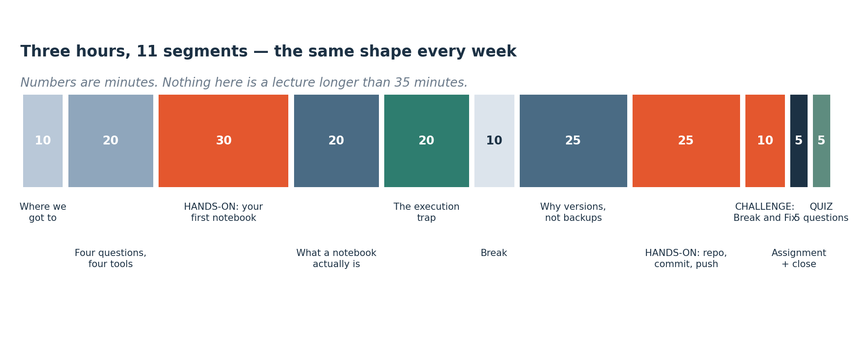
HOW TODAY RUNS
How today runs
The same eleven-segment shape as last week. Today is heavier on practical work than any session so far — you will be typing for well over half of it.
Notes:
The same eleven-segment shape as Week 1, with more keyboard time than any session so far. The break falls at the midpoint, straight after the execution-trap segment.

Slide 4
SEGMENT 1
Where we got to, and where we are going
10 MINUTES
A2 is due at the start of next week, and by the end of today you will already have most of it.
Notes:
Ten minutes of recall before any new material. A2 is due at the start of Week 3, and by the end of today most of it is already built.

Slide 5
CHECK YOUR UNDERSTANDING
Two minutes: what stuck from Week 1?
A
Last week you predicted case 13 from twelve examples. What was the name for the twelve columns you were given, and what was the name for the value you predicted?
B
You want to predict how many days until a pump needs servicing. Regression or classification?
C
Name one of the four limits — one thing machine learning cannot do.
Answers next slide. Ask a neighbour first — that is faster than waiting for me.
Notes:
These three answers are the vocabulary the rest of the semester assumes. If you cannot answer them, the Week 1 deck's glossary slide has all of it in one place.

Slide 6
ANSWERS
How did you do?
A
The twelve columns, and the value?
The columns you were given are the FEATURES. The value you predicted is the TARGET. One row with both is one EXAMPLE.
B
Days until servicing?
Regression — the answer is a number with a unit. If it were 'service due or not' it would be classification.
C
One of the four limits?
No data · no signal · physics is simply better · the future stopped resembling the past. Any one of those.
Notes:
Features, target, example: those three words are the vocabulary every later week assumes. If the first question was hard, the Week 1 deck's data-table figure and glossary slide have all of it in one place, and half an hour on them this evening is worth more than anything else you could revise.

Slide 7
SEGMENT 2
Four questions, four tools
20 MINUTES
Nobody memorises tools. You need to know which one answers which question — and each of today's four answers a different one.
Notes:
Each of today's four tools answers a different question, and the question is the part to remember. Meeting ten libraries in three weeks and retaining none is the standard way an introductory data course fails; knowing which question each tool answers is what stops it happening to you.

Slide 8
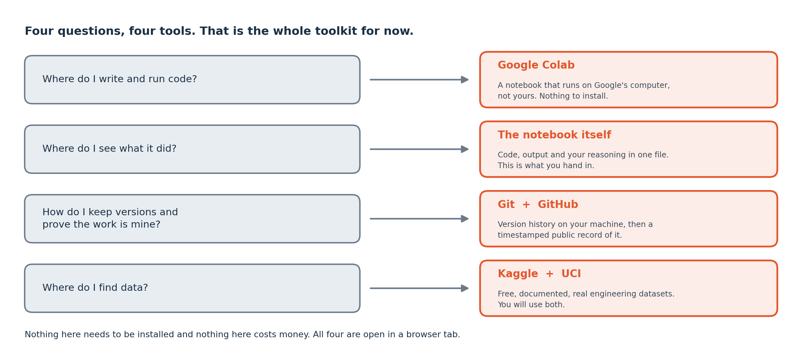
THE TOOL MAP
The four questions
Four separate problems, four separate tools. You will use all four every week for the rest of the year, and you will not need a fifth this semester.
Notes:
Read it as four questions rather than four products. The question is the durable part — the tool that answers it will change during your career, and the question will not.

Slide 9
DEFINITION
Google Colab
A notebook that runs in your browser, on Google's computers. Python and every library this course needs are already installed on it.
FOR EXAMPLE
You open colab.research.google.com, sign in with a Google account, and you are running Python about fifteen seconds later. Nothing is installed on your own machine.
DO NOT CONFUSE WITH
A website that teaches Python. Colab is not a tutorial — it is the real tool, and professional engineers use it for exactly this kind of work.
Notes:
The reason this course uses Colab is bandwidth and time. A hundred students installing Python, an editor and five libraries over one campus connection does not work; it has to be attempted to be believed.
The honest limitation: Colab needs an internet connection. That is why the two practical tests in Weeks 7 and 14 are sat offline on lab machines instead, and why the Setup Guide still exists for anyone who wants a local installation.

Slide 10
SEGMENT 3
Your first notebook
30 MINUTES
Everybody types. This is not a demonstration you watch — open a browser now.
Notes:
Thirty minutes with your hands on the keyboard. Open a browser now — this segment does not work as something you watch.

Slide 11
OPEN COLAB — NEW NOTEBOOK — TYPE THIS
LIVE CODING
Three cells
# Cell 1 - press Shift and Enter together to run it
print("Hello from CML3113")
print(2 + 2)
# Cell 2 - a variable is a name for a value
readings = 12
print(f"I have {readings} readings")
# Cell 3 - run THIS one three times and watch both numbers
readings = readings + 5
print(f"readings is now {readings}")
NOW BREAK IT ON PURPOSE
Run cell 3 three times and watch the number it prints. You have not changed a single character, so an unchanging cell giving a changing answer is worth explaining. Hold that thought — it is the whole of the block on execution order.
Notes:
Three cells, and each teaches one thing. Cell 1: code runs and produces output underneath it. Cell 2: a name can hold a value, and that value survives into the next cell. Cell 3: running the same cell twice is not the same as running it once.
The f in front of a string is what lets you put a variable inside the text — anything in {curly braces} is replaced by that variable's value.

Slide 12
TROUBLESHOOTING
The three things that go wrong in the first ten minutes
You pressed Enter instead of Shift and Enter
Colab asks you to sign in, or to connect
Enter gives you a new line inside the cell. Shift and Enter runs it. This catches almost everybody once.
Sign in with your Google account. 'Connect' means Colab is allocating you a machine and takes a few seconds — it is normal and it is not an error.
Nothing appears underneath the cell
Either the cell has no print in it, or it has not finished running. A cell that is still running shows a spinning circle to its left instead of a number.
And one thing that is not a problem
A warning in yellow is not an error. Errors are red and they stop the cell. Yellow means Python is telling you something and carrying on regardless.
If you are stuck for more than five minutes
Put your hand up. Do not sit quietly and do not restart your laptop hoping. Say three things: what you were trying to do, what you typed, and what it said back.
Notes:
Every item on this slide came from a real beginner making that mistake in a real first session. Shift-and-Enter alone accounts for a large share of the first ten minutes. Keep the slide in view while you work rather than reading it once, because it answers most of what goes wrong before you have to ask anybody.

Slide 13
DEFINITION
Markdown cell
A cell holding text rather than code. It is where you write down what you are doing and why, in among the code that does it.
FOR EXAMPLE
A heading saying 'Question 3: does fly ash change strength?', then the code that answers it, then a sentence saying what the answer was. Anyone reading it — including you in November — can follow the reasoning.
DO NOT CONFUSE WITH
A comment. A comment explains one line to someone reading the code; a markdown cell explains the reasoning to someone reading the document.
Notes:
This is what makes a notebook better than a script for data work: the reasoning lives beside the calculation instead of in a separate report nobody updates.
In Colab, press the + Text button instead of + Code. A # at the start of a line makes it a heading; ** around words makes them bold.
From Week 5 your submitted notebooks are marked partly on whether a reader can follow them, so this is not optional polish.

Slide 14
CHECK YOUR UNDERSTANDING
Thirty seconds: check you are with me
A
You press Enter at the end of a line in a code cell and nothing runs. Why?
B
You wrote print("hello") in a cell and ran it. Where does the word hello appear?
C
Your neighbour's cell 3 says 27 and yours says 17. Neither of you has changed the code. Who is wrong?
Answers next slide. Do not look yet.
Notes:
Three quick questions to confirm you are still with the session. Question C is the interesting one: two people running identical code and getting different numbers is a real property of notebooks, and the execution-order block explains why.

Slide 15
ANSWERS
How did you do?
A
Enter did nothing?
Enter adds a new line inside the cell. Shift and Enter together runs it. This catches almost everybody once.
B
Where does 'hello' appear?
Directly underneath that cell, in the output area. Not in a separate window — a notebook keeps the code and its output together, which is the whole point of it.
C
27 versus 17 — who is wrong?
Neither. They have run the cell a different number of times. That is not a difference of opinion, it is a property of how notebooks work — and it is the subject of the execution-order block.
Notes:
Answer C sets up the next segment. Two notebooks holding identical code can hold different values, because the kernel remembers how many times each cell has been run and the screen does not show you that history. Neither person is wrong; the notebook is simply not telling you everything it knows.

Slide 16
SEGMENT 4
What a notebook actually is
20 MINUTES
You have used one for half an hour. Now here is what is underneath it, because the next segment depends on understanding this.
Notes:
Twenty minutes away from the keyboard, and the only concept block in the session. The execution-order block depends on it, because the execution trap only makes sense once you know what the kernel is holding on your behalf.

Slide 17
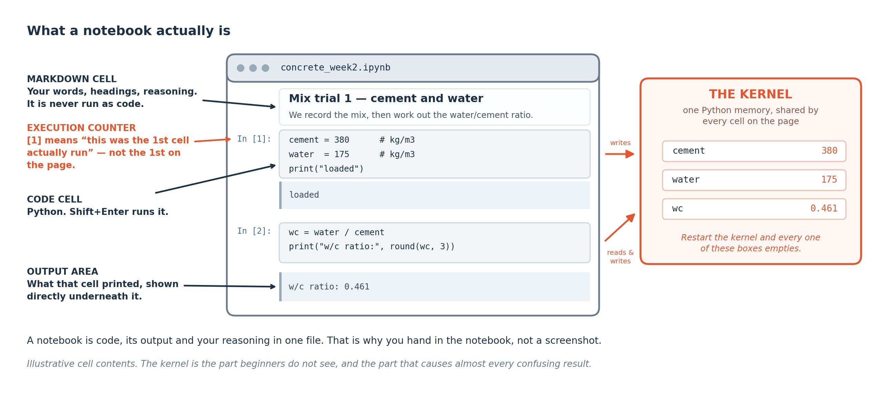
ANATOMY
The anatomy of a notebook
Cells hold either text or code. Code cells produce output directly beneath them. The number in brackets counts how many pieces of code you have run since the notebook started. All the cells share one memory, called the kernel.
Notes:
The kernel is the part worth understanding properly. It is a single Python session sitting behind the whole notebook, so a variable made in cell 2 is available in cell 7 because both cells are talking to that one session. The cells themselves have no connection to each other.
This is also why a notebook can lie to you. The kernel remembers everything you have run in the order you ran it, and that order need not match the order the cells appear on screen.

Slide 18
DEFINITION
Cell, kernel, and the execution counter
A CELL is one block of text or code. The KERNEL is the single Python session that all cells share. The EXECUTION COUNTER is the number in brackets beside a code cell, showing the order in which things were actually run.
FOR EXAMPLE
If the cell at the top of your notebook shows [7] and the one below it shows [3], you ran them out of order — and any answer that depends on both is suspect.
DO NOT CONFUSE WITH
The order the cells appear on screen. That is a layout; the counter is the truth.
Notes:
Watch the execution counter. It is the single most useful diagnostic in a notebook and almost no beginner looks at it.
A notebook where the counters run 1, 2, 3, 4 top to bottom is a notebook you can trust. Anything else needs checking.

Slide 19
SEGMENT 5
The trap, and the habit that saves you
20 MINUTES
The most common way a notebook gives a confident wrong answer — and the one keystroke that prevents it.
Notes:
Twenty minutes on the most common way a notebook produces a confident wrong answer, and on the one menu item that prevents it. If you take a single habit out of Week 2, take this one.

Slide 20

THE EXECUTION TRAP
The same cell, run three times
The code never changed. Not one character. The answer went 17, then 22, then 27, because the cell adds five to whatever is already in the box and puts it back. Restart and Run All takes it back to 17.
Notes:
This is why `readings = readings + 5` behaves the way it does: the right-hand side is worked out first, using whatever is currently in readings, and the result is then put back into readings. Run it three times and you have added fifteen.
The habit: **Restart and Run All** before you believe any answer. It clears the kernel and runs every cell from the top in order, which is exactly what your marker's machine will do.
From Week 5 your submitted work is graded by a program that does precisely this from a clean start. If your notebook only works in the order you happened to click, it does not work.

Slide 21
CHECK YOUR UNDERSTANDING
Can you answer these?
A
A notebook's cells show, top to bottom, the counters [4], [1], [5], [2]. What does that tell you, and would you trust its final answer?
B
You run Restart and Run All and the notebook now fails on cell 6 with an error, though it 'worked' five minutes ago. What was almost certainly true before you restarted?
C
Why is Restart and Run All a better test than just re-running the one cell you changed?
Answers are on the next slide — try first, then look.
Notes:
Question B is the one to take slowly. It is the realisation that 'it worked' can be an illusion produced by execution order, and that restarting is what turns the claim into evidence.

Slide 22
ANSWERS
How did you do?
A
Counters [4], [1], [5], [2]?
They were run out of order, so the kernel's memory does not match what the notebook looks like. Do not trust the final answer until you have restarted and run all.
B
It fails after restarting?
Cell 6 was depending on something created by a cell that has since been changed or deleted — or on a cell further down that you happened to run earlier. It never actually worked from a clean start; the kernel was just still holding the leftovers.
C
Why restart rather than re-run one cell?
Because re-running one cell keeps everything else the kernel is holding, including things that no longer exist anywhere in your code. Only a restart proves the notebook can produce its results from nothing but itself — which is what reproducibility means.
Notes:
Answer B describes the most common way submitted work loses marks: the notebook ran for you and then failed for the marker. Every automated grader and every colleague runs code from a clean start, which is the whole reason the restart habit is asked for here.

Slide 23
WORKED EXAMPLE
Diagnosing a notebook from its counters
The reasoning, step by step. A classmate says their notebook 'stopped working' and shows you this: the cells read, top to bottom, [2], [7], [3], and cell 4 is blank.
1
Read the counters: 2, then 7, then 3. Not run top to bottom.
2
Cell 4 is blank, so it never ran. Anything needing it will fail.
3
[7] before [3] means they jumped down and came back up. The kernel keeps the last write to each name.
4
The only useful question: does this notebook produce its results from nothing but itself?
5
Restart and Run All. Whatever breaks now is a real problem you can fix.
The diagnosis is almost never 'the notebook is broken'. It is 'the notebook was never run in the order it is written in', and the fix is one menu item.
Notes:
This is the diagnostic routine to use for the rest of your degree. Counters out of order, or a blank counter, mean the notebook and the kernel disagree, and the kernel is what actually ran.
Step 4 is the question that matters. A result you cannot reproduce from a clean start is indistinguishable from a coincidence, which is why reproducibility gets treated as an engineering requirement in this course.

Slide 24
Break
10 minutes
Stretch, and talk to someone you have not worked with. Be back on time: the longest working block of the session is next.
Notes:
Ten minutes. Git comes after the break and it needs you awake.

Slide 25
SEGMENT 6
What version control gives you
25 MINUTES
What Git records that a copy of a folder does not — and why this course submits everything through it.
Notes:
Twenty-five minutes on what Git records that a copied folder does not. The commands come later; this segment is about the problem they solve, because Git treated as ceremony never gets used voluntarily.

Slide 26
VERSION CONTROL
The problem Git actually solves
What a backup gives you
What it gives a team of five
Yesterday's version of the file. One version, and only if you remembered.
Five people editing the same project without overwriting each other, and a record of who did which part.
What you actually need, repeatedly
Which is why it is in this course at all
Which lines changed between Tuesday and Thursday. Who changed them. Why — because a good message says why. And the ability to go back to the version that worked, without having kept a folder called 'final_v3_REAL_final'.
Sixty-five per cent of your mark is individual, and two of your assessments are team projects. The commit history is how a team mark becomes an individual one. It is not administrative — it is the evidence that you did your share.
And it is what industry uses
Every engineering software team on earth. Learning it now costs you twenty minutes; not learning it costs you a first job interview.
Notes:
The 'final_v3_REAL_final' folder is a problem everybody recognises, and Git is the tool built for it. The assessment consequence is the part to take seriously: your commit history is the evidence of which part of a team project you did, and sixty-five per cent of your mark is individual.

Slide 27
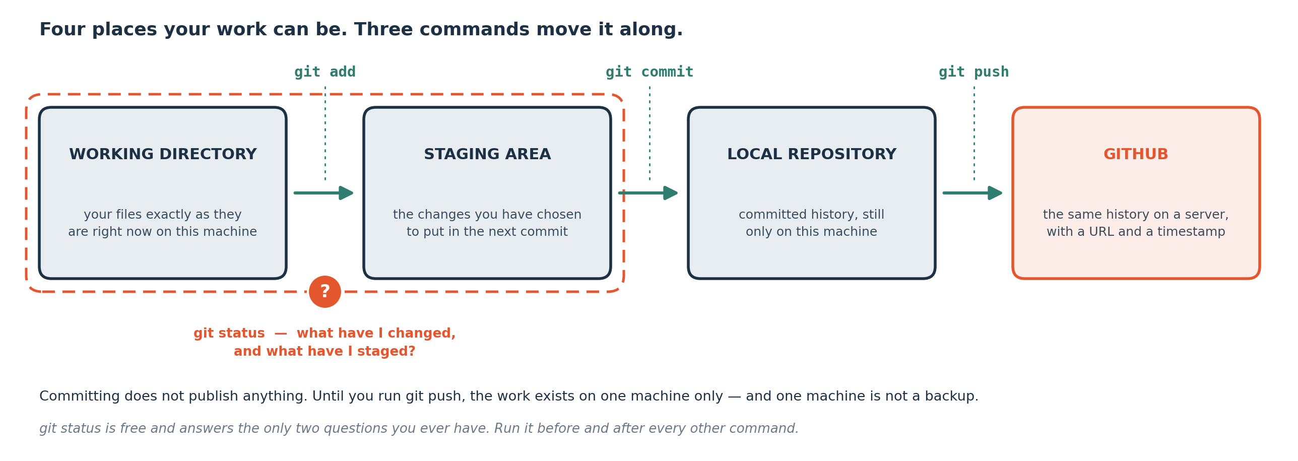
THE FOUR STATES
The four places your work can be
Your files move left to right through four states, and one command moves them between each. git status tells you where things currently are — run it constantly until it becomes automatic.
Notes:
Most Git confusion comes from not knowing which of these four places a file is in. The diagram is worth photographing.
The staging area feels like a pointless extra step until the first time you want to commit two of the five files you changed. That is what it is for.

Slide 28
DEFINITION
Repository, commit, and push
A REPOSITORY is a project folder whose entire history Git is tracking. A COMMIT is one recorded snapshot with a message saying what changed. To PUSH is to send your commits to GitHub so they exist somewhere other than your laptop.
FOR EXAMPLE
git commit -m "Add reagent-to-feed ratio column" records a snapshot with that message. Six weeks later that message is the only thing that tells you what you did.
DO NOT CONFUSE WITH
Saving. Saving overwrites; committing adds a version and keeps every earlier one.
Notes:
Commit messages matter more than beginners expect. 'update', 'fix' and 'stuff' are worthless in November. A message should say what changed and, where it is not obvious, why.

Slide 29
SEGMENT 7
Doing it: repository, commit, push
25 MINUTES
Whole room in lockstep. Everyone finishes with a live URL, and that URL is your A2 submission.
Notes:
Twenty-five minutes with the whole room in step. You leave this segment with a live GitHub URL, and that URL is your A2 submission.

Slide 30
COLAB: FILE → SAVE A COPY IN GITHUB
LIVE CODING
From Colab to GitHub
# The menu route, which is what we use today:
# File -> Save a copy in GitHub
# choose "Create a new repository"
# name it exactly as given on the next slide
# write a commit message, then OK
# The command route, for when you work locally later:
git status # what have I changed?
git add . # mark it all ready
git commit -m "First commit" # record it, with a message
git push # send it to GitHub
NOW BREAK IT ON PURPOSE
Run git status BEFORE and AFTER git add. The same filenames move from red to green, which is the staging area doing its one job: holding the changes you have chosen for the next commit.
Notes:
Colab can save straight to GitHub from the File menu, which is why today needs no command line at all. The four commands are shown because you will need them from Week 13, when the project has to be reproducible, and because every job you apply for expects them.

Slide 31
WHAT YOU OWE ME
Assignment A2 — Proof of Life
Due at the start of Week 3
Before you submit
One thing: a link to a GitHub repository.
Restart and Run All.
It must contain the notebook you built today, run from top to bottom with its outputs visible, and a README.
It must finish with no errors.
Save with the outputs showing.
The README needs four short things: your name, student number and course code; one engineering problem from your own discipline that you think data could help with; one sentence on what data that would need; and one sentence on what you had to fix today, or 'nothing' if it worked first time.
Repository name: cml3113-yourstudentnumber Paste the URL where I tell you.
Marked pass / merit / redo.
That last sentence carries marks.
Notes:
The honesty sentence is the part that is actually useful. What went wrong for you tells me where this session needs fixing, and being able to say plainly what broke and how you fixed it is a professional skill this course keeps asking for.
Redo is not a penalty. It means come to office hours this week, because Week 3 assumes a working setup.

Slide 32
THE README
What makes a README worth reading
It is the front door of your repository
One sentence on what you had to fix today, or 'nothing' if it worked first time.
It is the first thing a marker, a colleague or a future employer sees. An empty one says the work was not finished even when it was.
What a good README is not
Long. Six sentences is plenty for A2. By Week 13 yours will also say how to run the project and what the results were, and it will still fit on one screen.
Four things, for A2
Your name, student number and course code.
One engineering problem from your own discipline that you think data could help with. Real and yours.
Why the honesty sentence carries marks
What went wrong for you tells me where this session needs fixing, and being able to say plainly what broke and how you fixed it is a professional skill this course keeps asking for.
One sentence on what data that would need: who measures it, how often, and whether anyone keeps it.
Notes:
README files are written in markdown — the same format as the text cells you just used. A # makes a heading and ** makes bold.

Slide 33
CHALLENGE
Break and Fix
Four notebooks are shared with you. Every one is broken. In your team, diagnose each and write the cause in ONE sentence.
Three of them throw an error. One does not — it runs cleanly and gives a wrong answer. That fourth one is the one that matters.
Work these questions in order:
→ What does the LAST line of the error say?
→ Which cells ran, and in what order?
→ What was it looking for?
→ Is the answer even plausible?
→ Where did it look?
→ How would you have caught this yourself?
Notes:
Three of the four notebooks throw an error and one does not. The fourth runs cleanly and returns a wrong answer, and it deserves your last three minutes. An error tells you something is wrong and roughly where; a clean wrong answer tells you nothing at all, and it is the failure that costs a model in Week 10 and marks in the Week 14 test. Work the six questions in order rather than guessing, and pay attention to which cells ran and in what order.

Slide 34
QUIZ AND ASSIGNMENT
Before you leave the room
This week's quiz — five minutes, and it counts for one per cent
A QR code goes up, you answer five questions on your phone, and you see your score immediately. One of the five asks you to read your own setup output, so it also tells me who is not ready before Week 3 starts depending on it.
Assignment A2 — due at the start of Week 3
Your repository URL. Restart and Run All before you submit.
Notes:
Answer the setup question honestly. 'I could not get that far' is worth more to me than a guess, and it is not the question that carries the mark.

Slide 35
SEGMENT 8
Revision material
5 MINUTES
Everything from here is for you to study from — summary, self-test with answers, glossary and a one-page reference.
Notes:
Everything past this slide is revision material: a summary, a self-test with worked answers, an eighteen-term glossary and a one-page command reference. It is written to be studied from during the week.

Slide 36
MODULE SUMMARY
What you should take away
Google Colab runs Python in your browser on Google's computers. Nothing is installed on your machine, and it needs an internet connection.
A notebook is made of cells. Code cells produce output beneath them; the number in brackets shows the order things were actually run.
All cells share one kernel — a single Python session. That is why a variable made in one cell exists in another, and why order matters.
Running the same cell twice is not the same as running it once. Restart and Run All is the only honest test of a notebook.
Git records every version, what changed, and who changed it. A backup gives you yesterday's file; Git gives you the history.
Four states, four commands: working directory, git add, staging, git commit, local repository, git push, GitHub. git status tells you where you are.
Three of today's four broken notebooks announced their problem. The fourth did not, and that is the kind you have to catch yourself.
Notes:
Seven statements covering the whole session. The fourth and the seventh are the two that carry into every later week: Restart and Run All as the only honest test, and the broken notebook that never announces itself.

Slide 37
CHECK YOUR UNDERSTANDING
Self-test — write something for each before you look
A
A classmate says their notebook 'worked yesterday' but fails today. What is the first thing you would ask them to do, and why?
B
What does the number in brackets beside a code cell tell you that the cell's position on the page does not?
C
You changed five files but only want to record two of them. Which Git command lets you choose, and which state do the two files move into?
D
Why does this course submit work through GitHub rather than by email?
E
Colab needs an internet connection. Given that, how are the Week 7 and Week 14 practical tests run, and why?
Answers on the next slide.
Notes:
Question E is worth thinking about properly. It is the trade-off at the centre of how this course is set up.

Slide 38
ANSWERS
How did you do?
A
'It worked yesterday'?
D
Why GitHub rather than email?
Restart and Run All. Almost always the kernel was holding something from a cell that has since changed or been deleted, so it never really worked from a clean start.
Because it records who did what and when, which is how a team mark becomes an individual one; because the grading tools collect work from repositories automatically; and because it is what every engineering employer expects you to have used.
B
What the counter tells you?
The order in which cells were actually executed. Position on the page is only a layout — the counter is what the kernel actually did, and the two can disagree.
E
Colab needs internet — so how are the tests run?
Offline, on laboratory machines with a local Python installation and no network. That is deliberate: it makes the no-AI-assistance rule actually enforceable rather than a request, and it certifies what you can do unaided. It is also why the Student Setup Guide still exists.
C
Recording two of five files?
git add, naming just those two files rather than using a dot. They move into the staging area, and only staged files go into the next commit.
Notes:
Answer E is the trade-off at the centre of how this course is set up. Colab removes every installation problem and needs a connection to work; the offline lab machines make the no-AI rule in the two tests enforceable rather than a request. Both compromises are deliberate, and they are why the Student Setup Guide still exists for anyone who wants a local installation.

Slide 39
GLOSSARY — KEEP THIS SLIDE
Every word we used today
Google Colab
Git
A notebook environment that runs in a browser on Google's computers, with Python and the course libraries already installed.
A tool that records every version of a project, what changed and who changed it.
GitHub
Notebook (.ipynb)
A website that stores Git repositories so your work exists somewhere other than your laptop.
A document made of cells, mixing text, code and the code's output.
Cell
Repository (repo)
One block of a notebook. Either markdown (text) or code.
A project folder whose whole history Git is tracking.
Markdown
Working directory
The simple text format used for the text cells.
Your files as they are right now, changes included.
Kernel
Staging area
The single Python session that all the cells in a notebook share.
The set of changes you have marked as ready to go into the next commit.
Execution counter
Commit
The number in brackets beside a code cell, showing the order cells were run in.
One recorded snapshot, with a message saying what changed.
Restart and Run All
Push
Clear the kernel and run every cell from the top. The only honest test of a notebook.
Send your commits up to GitHub.
Output
git status
Whatever a code cell produced, shown directly beneath it.
Ask Git what has changed and where it currently is. The most useful command on the list.
f-string
Text with holes in it: f"I have {n} readings". Anything in braces is replaced by that variable's value.
README
The file that explains a repository to whoever opens it. Yours is marked.
Notes:
Eighteen terms, and all of them are used every week from now on. If you can define them all by Week 4 you are in good shape — several appear in the weekly quizzes.

Slide 40
CHEAT SHEET — KEEP THIS SLIDE
One-page reference — the commands and the habits
Running code
The four Git commands
Shift and Enter runs a cell. Enter alone just adds a line inside it.
git status — what changed, and where is it?
git add . — mark it all ready
git commit -m "message" — record it
git push — send it to GitHub
Before you believe any answer
Restart and Run All. If it fails, it was never working — the kernel was covering for you.
Writing a commit message
Before you submit anything
Say what changed, and why if it is not obvious. 'Add reagent-to-feed ratio column' is useful in November. 'update' is not.
Restart and Run All, confirm no errors, then save with outputs visible.
Reading an error
Last line first. It names the error type and what Python actually wanted. Then look at the line number.
Asking for help
What you were trying to do, what you typed, what it said back. Those three things, in that order.
Notes:
Photograph this slide. It answers most of what comes up in Weeks 3 to 6, and the four Git commands on it are the same four you will still be using on the project in Week 13.

Slide 41

END-OF-SESSION QUIZ · WEEK 2
Five questions,
five minutes
Out-of-order execution, what Restart and Run All proves, and reading one git status output.
Scan the code. First box is your registration number, off your card.
One attempt, from the Google account you are signed in to.
Open for 48 hours if the network fails, then it closes itself.
One per cent each. Tap View score and read the feedback.
Twelve this semester, best ten count. No resits.
Notes:
The last five minutes of every teaching session. Five questions, one per cent, and you see your score as you submit.
Nothing on it can be answered without reading what it shows you, so there is nothing to revise for it beyond having done the session. Twelve run across the semester and the best ten count.

Slide 42
THE ONE THING TO REMEMBER
Every error today told you
exactly what it needed.
Everything you saw go wrong today has gone wrong for every engineer in this building, including me, this week. The skill is not avoiding errors — it is reading them and carrying on.
Next week: Python as an engineering calculator, using formulas you already know.
Notes:
Everything you saw go wrong today has gone wrong for every engineer in this building, and it will keep happening for the rest of your career. What changes is how long it takes you to read the message and carry on. Next week is Python as an engineering calculator, built on formulas from your own programme.

