Slide 1
CML3113
Many measurements
at once
Collections, loops, files — and your first unguided investigation
WEEK 4 · Fri 2 October 2026
Friday 08:00–11:00 · Room 105 · IUEA Faculty of Engineering · Semester 1, 2026/27
Notes:
Two halves today. The first teaches loops and file reading the hard way, using nothing but standard Python. The second is the first session where you are given a problem and no method.
The hard way is deliberate: sixty lines today become three lines next week, and you will appreciate next week's tool because you earned it.

Slide 2
LEARNING OBJECTIVES
By the end of today you can…
1
Choose between a list and a dictionary for a given engineering record, and justify the choice.
2
Write a loop that does the same thing to every measurement in a collection.
3
Use the accumulator pattern to total, count and average without pandas.
4
Read a CSV file with standard Python and explain why every value arrives as text.
5
Catch an error so a bad row does not stop the whole run — and say when you should NOT catch it.
6
Break an open-ended data question into an ordered sequence of steps before writing any code.
7
Report a finding from a file nobody explained to you, and defend it with evidence.
Week 4 · Collections, loops and files · nothing here needs prior programming experience
Notes:
Objective 7 is the one that matters most and it is the one Practical Test 1 in three weeks' time actually assesses.

Slide 3
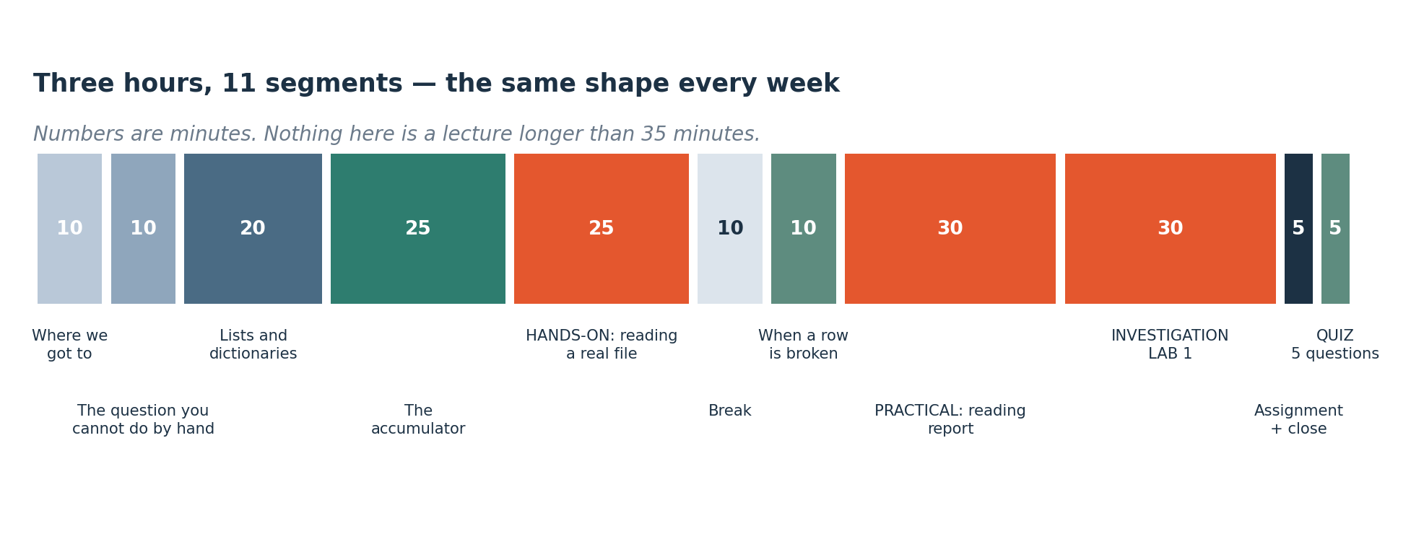
HOW TODAY RUNS
How today runs
The same shape. Today the second half is almost entirely you working, with me asking questions and answering none.
Notes:
The same eleven-segment shape, with the second half given over almost entirely to your own work. Investigation Lab 1, which follows the break, is unguided on purpose: a file, a question and no method, which is the format Practical Test 1 uses in three weeks.

Slide 4
SEGMENT 1
Where we got to
10 MINUTES
You can write a function that calculates one thing. Today: four thousand things.
Notes:
Ten minutes of recall. You can already write a function that calculates one thing; today the same work happens to several hundred values at once.

Slide 5
CHECK YOUR UNDERSTANDING
Two minutes: what stuck from Week 3?
A
What is the difference between return and print, and why does it matter from next week?
B
Your if-chain checks width > 0.30 before width > 0.50. What goes wrong and will Python tell you?
C
You get a beam moment of 4.2 out of your function. What is the first question to ask?
Answers next slide.
Notes:
Three questions from Week 3, all of which get used within the hour. If the third one gives you trouble, the units habit is the one to fix before the practical, because the Investigation Lab will punish it.

Slide 6
ANSWERS
How did you do?
A
return versus print?
Return hands a value back so it can be used; print puts characters on screen and hands back nothing. From next week you apply functions to whole columns, and a printing function produces no column.
B
if-chain in the wrong order?
The 0.30 branch catches everything above 0.50 as well, so the strict branch never runs. Python will not warn you — it is valid code returning the wrong action.
C
A moment of 4.2?
In what unit? Newton-metres and kilonewton-metres are a factor of a thousand apart and only one is plausible.
Notes:
The return-versus-print answer matters most of the three. From next week you feed functions whole columns of data, and a function that only prints hands back nothing you can work with.

Slide 7
SEGMENT 2
The question you cannot answer by hand
10 MINUTES
Your functions work on one value at a time. Here is a file with several hundred.
Notes:
Ten minutes to establish the problem before any solution appears. Your five functions from Week 3 each take one value and the file in front of you has several hundred rows; a loop is what closes that gap.

Slide 8
TODAY'S QUESTION
"There are several hundred readings in this file. What is the average, and how many are outside the limit?"
You cannot do this by hand, and the five functions you wrote last week do not help — they each take one value. You need a way to say: do this same thing to every single one.
Notes:
Work out roughly how long that file would take by hand before you read on. Then note that you will do this every week for the rest of the course, on files a thousand times bigger than this one.

Slide 9
SEGMENT 3
Two ways to hold many values
20 MINUTES
A list keeps them in order. A dictionary keeps them by name. Almost every engineering record is one or the other.
Notes:
Twenty minutes on lists and dictionaries. Almost every engineering record you meet is naturally one or the other, and choosing correctly saves you from a class of bug that is very hard to see later.

Slide 10
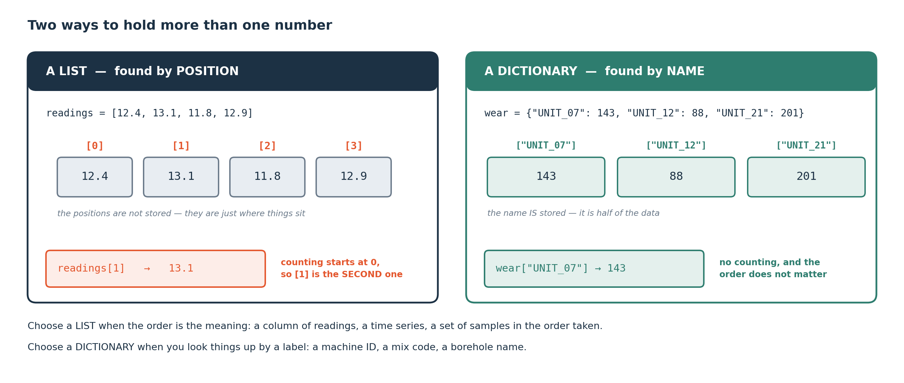
COLLECTIONS
Lists and dictionaries
A list is accessed by position, counting from zero. A dictionary is accessed by a label you chose. Use a list when order is the meaningful thing; use a dictionary when the label is.
Notes:
Counting from zero surprises everyone once: the first item is [0] and the last item of a twelve-item list is [11]. Ask for [12] and you get an IndexError.
Most engineering records are naturally dictionaries — a reading belongs to HOLE_114, and position 43 means nothing to anybody reading your code. Next week's DataFrame is essentially a table of both: rows in order, columns by name.

Slide 11
DEFINITION
List, dictionary, and index
A LIST is an ordered sequence, written in square brackets. A DICTIONARY maps labels to values, written in curly braces. An INDEX is the position or the label you use to get one item out.
FOR EXAMPLE
readings = [12.4, 13.1, 11.8] is a list; readings[0] is 12.4. readings = {"HOLE_114": 78.2} is a dictionary; readings["HOLE_114"] is 78.2.
DO NOT CONFUSE WITH
Each other. If you find yourself remembering that position 3 means the pH reading, you wanted a dictionary.
Notes:
The 'do not confuse with' line is the practical test for choosing between them. Any time you are keeping a mental note of what a position means, the label belongs in the code instead.

Slide 12
SEGMENT 4
The accumulator
25 MINUTES
One pattern, and it is most of what you will write today.
Notes:
Twenty-five minutes on one pattern, and it is most of what you write today. The file reading in the file-reading block becomes mechanical once the accumulator is clear, so this is the block to concentrate on.

Slide 13
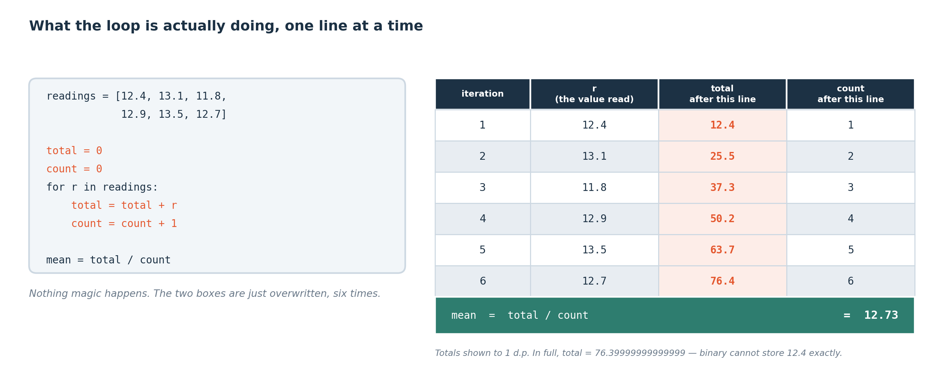
THE ACCUMULATOR
A loop, traced step by step
There is no magic in a loop. It takes each value in turn and updates a running total and a running count. The table shows exactly what is in each variable after every step.
Notes:
The accumulator pattern is: start a variable at zero BEFORE the loop, add to it INSIDE the loop, use it AFTER the loop. Three positions, and getting them wrong is the classic bug.
total = total + value reads right to left, exactly as in Week 3: take what is in total, add value, put it back.

Slide 14
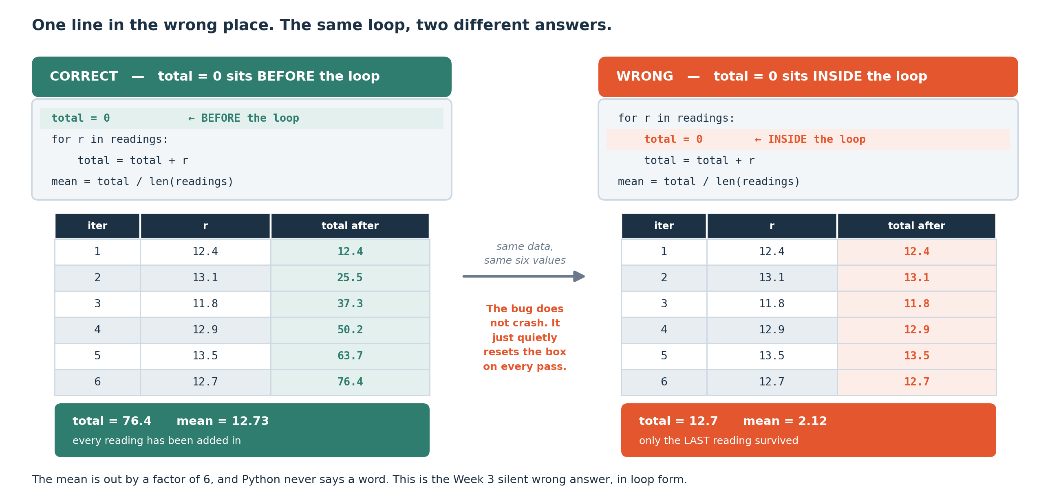
A SILENT WRONG ANSWER
The bug that gets everybody once
The same loop, with total = 0 in the right place and in the wrong place. On the right it is reset every time round, so at the end it holds only the last value — and the mean is wrong by a factor of the number of rows. No error appears.
Notes:
This is a Week 3 lesson in a new costume: it runs, and the answer is wrong. The only defence is knowing roughly what the answer should be.
The tell is that the 'total' comes out suspiciously close to a single reading rather than to hundreds of them. If your total of three hundred readings looks like one reading, you have this bug.

Slide 15
DEFINITION
Loop, iteration, and the three positions
A LOOP runs the same block once for every item in a collection. One pass is an ITERATION. An accumulator needs three positions: started BEFORE the loop, updated INSIDE it, used AFTER it.
FOR EXAMPLE
total = 0 sits before. total = total + value sits inside, indented. print(total) sits after, un-indented. The indentation is what tells Python which lines are inside.
DO NOT CONFUSE WITH
Repeating code by copying it. A loop written for twelve readings works unchanged for twelve thousand; twelve copied lines do not.
Notes:
Indentation in Python is syntax. The lines indented under the for statement run inside the loop and the lines left un-indented run outside it, so shifting one line by four spaces changes what the program does. That single shift is exactly the accumulator bug on the previous slide.

Slide 16
CHECK YOUR UNDERSTANDING
Two minutes: check the foundations
A
readings = [12.4, 13.1, 11.8]. What is readings[0], and what happens if you ask for readings[3]?
B
You have one reading for each of forty named drill holes. List or dictionary, and why?
C
In an accumulator loop, where must total = 0 go, and what happens if it goes one line lower?
Answers next slide. Write something for each first.
Notes:
Three questions on the foundations before the file reading starts. Question C is the accumulator bug again; if it is not solid, go back to the previous figure, because everything after the break depends on it.

Slide 17
ANSWERS
How did you do?
A
readings[0], and readings[3]?
readings[0] is 12.4 — counting starts at zero, so the first item is [0]. readings[3] raises an IndexError, because a three-item list only has positions 0, 1 and 2.
B
Forty named drill holes?
A dictionary, keyed by name. With a list you would have to remember that position 17 means HOLE_114, which is exactly the situation a dictionary exists to prevent.
C
Where does total = 0 go?
Before the loop, un-indented. One line lower — indented, inside the loop — it resets on every iteration, so at the end it holds only the last value. No error appears, and the mean comes out wrong by a factor of the number of rows.
Notes:
Answer C is worth reading twice. Moving total = 0 one line lower puts it inside the loop, so it resets on every iteration and the mean comes out wrong by a factor of the number of rows, with no error message anywhere. This exact bug appears in the quiz at the end of the session.

Slide 18
SEGMENT 5
Reading a real file
25 MINUTES
Everybody types. And yes, this is deliberately more work than it needs to be.
Notes:
Twenty-five minutes with everyone typing, and it is deliberately more work than it needs to be. Next week the same job takes three lines of pandas. Doing it the long way once is what lets you diagnose those three lines when they misbehave.

Slide 19
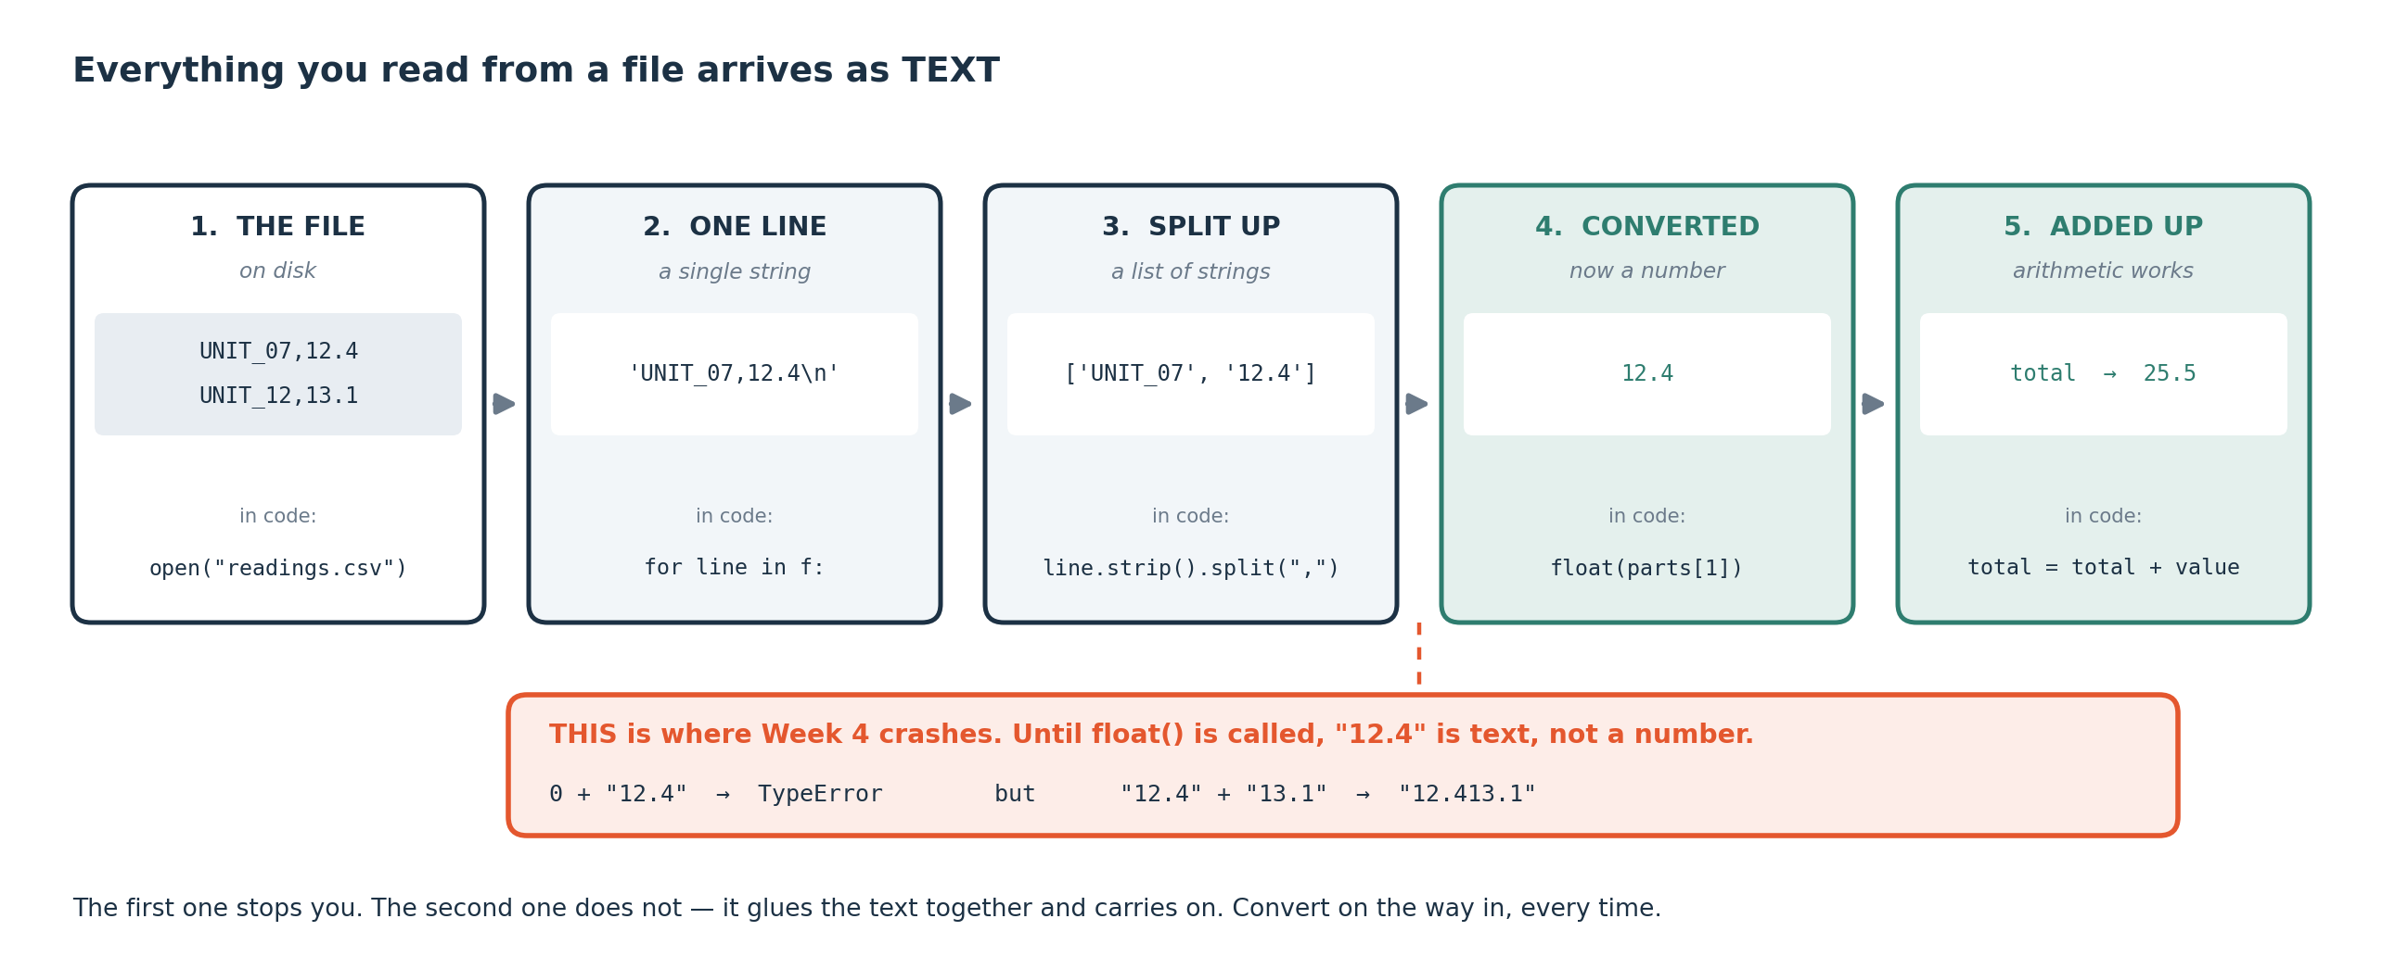
THE PIPELINE
What happens when you read a file
A file on disk is characters. Reading it gives you text, one line at a time. Splitting gives you fields — still text. Only float() turns a field into a number you can do arithmetic with.
Notes:
This is the single most useful thing to understand about data files, and it is the cause of the TypeError you met in Week 3. A file has no idea what a number is. Everything arrives as text until you convert it.
Next week pandas does the conversion for you, and it will sometimes get it wrong — usually when one row has a stray unit in it. You will only be able to diagnose that because you did it by hand today.

Slide 20
OPEN COLAB — UPLOAD THE FILE FIRST
LIVE CODING
Reading drill_shift_log.csv
import csv
total = 0.0 # BEFORE the loop
count = 0
over_limit = 0
with open("drill_shift_log.csv") as f:
for row in csv.DictReader(f):
value = float(row["rate_of_penetration"]) # text -> number
total = total + value # INSIDE the loop
count = count + 1
if value > 8.0:
over_limit = over_limit + 1
print(f"mean {total / count:.2f} over {count} rows") # AFTER
print(f"{over_limit} above 8.0 m/h")
NOW BREAK IT ON PURPOSE
Delete the float() and run it. You get a TypeError about adding a string to a float — the same error as Week 3, now with a reason: everything read from a file is text. Then move total = 0.0 inside the loop and watch the mean collapse to the last value, with no error at all.
Notes:
csv.DictReader gives you each row as a dictionary keyed by the column headings, which is why row["value"] works. That is also why a typo in a column name gives a KeyError rather than silently returning nothing.
The with block closes the file for you when it finishes, even if something goes wrong inside it. Use it every time.

Slide 21
Break
10 minutes
Stretch, and talk to someone you have not worked with. Be back on time: the longest working block of the session is next.
Notes:
Ten minutes. The Investigation Lab after the break is unguided and it needs you fresh.

Slide 22
SEGMENT 6
When a row is broken
10 MINUTES
Real files have bad rows. You have two choices and they are not equally good.
Notes:
Ten minutes on what to do with a row that cannot be read. There are two choices, and the part usually skipped is knowing when catching the error is the wrong answer.

Slide 23
ADD THIS TO YOUR LOOP
LIVE CODING
Catching an error, and counting it
try:
value = float(row["rate_of_penetration"])
except ValueError:
skipped = skipped + 1 # count it, do not hide it
continue # move to the next row
# ... and at the end, always report it:
print(f"skipped {skipped} rows that could not be read")
NOW BREAK IT ON PURPOSE
Replace the except body with just 'pass'. It runs, no error, and you have silently thrown away an unknown number of rows. Your mean is now computed on a subset you cannot describe. This is worse than crashing.
Notes:
try and except let you carry on past a bad row instead of stopping, which is often the right call — one malformed row in three hundred should not end the run.
Catching an error silently is a serious mistake. Skip forty rows without counting them and your answer describes 260 readings out of 300, and you can say nothing about the forty you dropped; they may all be the extreme ones. Count what you skip and report the count every time.
When should you leave it uncaught? When the failure means your assumption about the data is wrong. If every row fails you have the wrong file or the wrong column name, and a crash tells you that in one second.

Slide 24
PRACTICAL — 30 MINUTES
Practical: build a reading report
What to build
The file you are given
A script that reads drill_shift_log.csv and reports:
drill_shift_log.csv 300 rows.
Columns: hole_id depth_m rate_of_penetration bit_type operator_id downtime_min downtime_reason
mean rate of penetration per bit type; total downtime per reason code; and the number of rows skipped because a field was blank
CORE: it runs, and the numbers are right.
STRETCH: survive a file with a blank line, a stray unit in a numeric column, and a duplicated header row — which is exactly what Week 6 formalises.
Notes:
The skipped-row count is part of the deliverable. A report that does not say how much data it ignored leaves the reader unable to judge it.

Slide 25
WORKED EXAMPLE
Decomposing a question before you write any code
You are about to be handed a file and told to find something interesting. That is not a coding problem, it is a thinking problem, and this is the routine.
1
Read the column names and say out loud what each one probably is, and in what unit. If you cannot guess, that column is your first question.
2
Ask what this file is a record OF. Somebody collected it for a reason — what decision was it collected to support?
3
Pick one column you could imagine an engineer caring about, and say why you picked it.
4
Ask the smallest possible question about it: what is its range, and does anything look impossible? Answer that before anything ambitious.
5
Now ask a comparison question: does that column differ between groups — between machines, operators, dates, materials? Comparisons are where findings live.
6
Before you believe the answer: could something else explain it? Name one alternative, and say what evidence would rule it out.
Steps 1 to 4 take five minutes and will stop you from spending twenty minutes on the wrong column. Step 6 is the difference between a finding and a coincidence.
Notes:
This routine is what Practical Test 1 assesses in three weeks. The subject of that test is what to do when nobody has told you what to do; the pandas syntax carries a small part of the marks.
Step 2 is the one beginners skip and the one that most often produces the interesting question. Data is never collected by accident, so asking what decision it was collected to support tells you what it can answer.

Slide 26
CHALLENGE
Investigation Lab 1 — find something interesting
Your team gets drill_shift_log.csv — 300 rows, and no column dictionary.
No suggested method. No worked example. No help from me.
Twenty-five minutes and one instruction: find something interesting, and be ready to defend it with evidence from the data.
Work these questions in order:
→ What are you trying to find?
→ Is that a real pattern or a coincidence?
→ Why did you choose that column?
→ What would change your mind?
→ What does that number mean physically?
→ What is the engineer supposed to DO about it?
Notes:
This is the first fully unguided activity of the semester and it sets the pattern for the rest of them: a file, a question and no method. Marks go to the evidence you can show, so a team that finds nothing and can say what it ruled out and how has done real work. Most real investigations end that way.
Work the six questions on the slide in order, and expect to give a sixty-second findings pitch at the end.

Slide 27
QUIZ AND ASSIGNMENT
Before you leave the room
This week's quiz — five minutes, and it counts
Five questions on this session. QR code on the screen, answers on your phone, score and an explanation immediately. Worth one per cent. There are twelve across the semester and the best ten count, so a missed session costs you nothing and there are no resits to arrange.
Assignment A4 — due at the start of Week 5
Your reading report script, including the skipped-row count, plus 150 words on the most interesting thing you found in the Investigation Lab and why an engineer should care about it.
Notes:
The quiz format matters more than its content: two of the five questions show code that runs cleanly and returns a wrong answer and ask for the cause, one shows a traceback, one gives you an output to interpret, and one sets a constraint. There is nothing to memorise and revising definitions will not help — doing A3 properly was the preparation. A4 is due at the start of Week 5, and the skipped-row count is part of the deliverable.

Slide 28
MODULE SUMMARY
What you should take away
A list holds values in order and is accessed by position, counting from zero. A dictionary holds them by label. Most engineering records are dictionaries.
The accumulator pattern has three positions: start at zero before the loop, add inside it, use the result after it. Getting the first one wrong is silent.
Everything read from a file arrives as text. float() or int() converts it, and forgetting to is the TypeError you met in Week 3.
csv.DictReader gives each row as a dictionary keyed by the column headings.
try and except let you survive a bad row — but count what you skipped and report the count. 'except: pass' throws away data you cannot describe.
Crash rather than catch when the error means your assumption about the file is wrong.
Given a file and no instructions, the method is: decide what you are looking for, choose a column and say why, check whether the pattern is real, and say what would change your mind.
Notes:
Seven statements covering the session. The second and the fifth carry the most weight later: the three positions of an accumulator, and counting what you skipped.

Slide 29
CHECK YOUR UNDERSTANDING
Self-test — write something for each before you look
A
You total 300 readings and the total comes out at 41.7, while a single typical reading is about 40. What has almost certainly happened?
B
Your loop crashes on row 84 with a ValueError. Give one good reason to catch it and one good reason not to.
C
Why does row["value"] give you text rather than a number, when the file clearly contains numbers?
D
You skipped 40 of 300 rows and reported a mean. What is wrong with the sentence 'the mean reading is 41.2'?
E
In the Investigation Lab you found a pattern. What is the minimum you must be able to say before you call it a finding?
Answers on the next slide.
Notes:
Question A is the accumulator bug seen from the magnitude alone, which is how you will actually catch it.

Slide 30
ANSWERS
How did you do?
A
Total of 41.7 for 300 readings?
D
Skipped 40 of 300?
total = 0 is inside the loop instead of before it, so it resets every time round and holds only the last value. The tell is that a total of hundreds of readings looks like one reading.
It is the mean of 260 readings, not 300, and you cannot describe the 40 you dropped — they may all be the extreme ones. State the count and the proportion every time: 'mean 41.2 over 260 of 300 rows; 40 rows could not be read.'
B
Catch it, or not?
E
Minimum before calling it a finding?
Catch it if one malformed row in three hundred should not stop the run — count it and report it. Do NOT catch it if the failure means your assumption is wrong: if every row fails you have the wrong file or the wrong column name, and crashing tells you that immediately.
What you looked at, what the pattern is in physical terms, what else could explain it, and what would change your mind. Without the last two you have a coincidence.
C
Why is row["value"] text?
Because a file stores characters. It has no type information at all. Python hands you exactly what is written there and leaves the conversion to you.
Notes:
Answer E is the standard Practical Test 1 marks against in three weeks: what you looked at, what the pattern is in physical terms, what else could explain it, and what would change your mind. Without the last two you have a coincidence.

Slide 31
GLOSSARY — KEEP THIS SLIDE
Every word we used today
List
csv.DictReader
An ordered sequence in square brackets. Accessed by position, counting from zero.
Reads a CSV, giving each row as a dictionary keyed by the column headings.
Dictionary (dict)
float() / int()
Labels mapped to values, in curly braces. Accessed by label.
Convert text to a number. Everything read from a file needs this.
Index
ValueError
The position or label used to get one item out.
The right type of operation on a value it cannot handle — float("abc").
IndexError
TypeError
You asked a list for a position it does not have.
An operation the type does not allow — "12" + 3.
KeyError
try / except
You asked a dictionary for a label it does not have. Usually a typo in a column name.
Attempt something; if it raises a named error, handle it instead of stopping.
Loop (for)
continue
Do the same thing to every item in a collection.
Skip the rest of this pass and move to the next item.
Accumulator
except: pass
A variable that builds up a result across a loop. Start it BEFORE the loop.
Catching an error and doing nothing. Throws away data you cannot describe. Do not.
Iteration
Decomposition
One pass through the loop body.
Breaking a question into an ordered sequence of steps before writing code.
open() and with
Evidence
Open a file. The with block closes it for you, even if something fails inside.
The numbers from the data that support your claim. A finding without it is a guess.
Notes:
Eighteen terms. Five of them are error names, and being able to recognise an error by name is most of what makes a beginner faster.

Slide 32
CHEAT SHEET — KEEP THIS SLIDE
One-page reference — reading a file without pandas
The three positions of an accumulator
Never write except: pass
total = 0 before the loop. total = total + value inside it. print(total) after it.
Count it, or let it crash. Silence is the one option that is always wrong.
Every value from a file is text
Sanity-check by magnitude
float(row["rate_of_penetration"]). Forget it and you get a TypeError.
Does the total look like hundreds of readings or like one? Does the mean look like a typical value? That single check catches the accumulator bug every time.
Always count what you skipped
And always report it, as a count and a proportion. A mean without that is a mean of something you cannot describe.
Given a file and no instructions
What am I looking for · which column and why · is the pattern real · what would change my mind · what should an engineer do about it.
Before you submit
Restart and Run All. Report the skipped count. State the units.
Notes:
Photograph this slide. The magnitude check is the line that will save you most often — a total of three hundred readings that looks like a single reading is the accumulator bug every time.

Slide 33
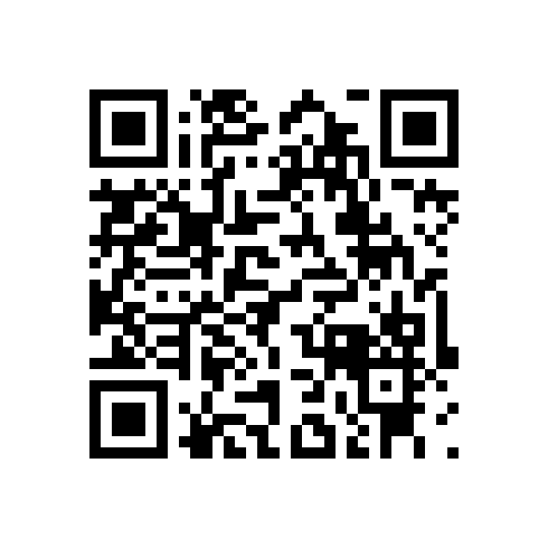
END-OF-SESSION QUIZ · WEEK 4
Five questions,
five minutes
An accumulator reset inside the loop, a range off by one, and a skipped-row count nobody reported.
Scan the code. First box is your registration number, off your card.
One attempt, from the Google account you are signed in to.
Open for 48 hours if the network fails, then it closes itself.
One per cent each. Tap View score and read the feedback.
Twelve this semester, best ten count. No resits.
Notes:
The last five minutes of every teaching session. Five questions, one per cent, and you see your score as you submit.
Nothing on it can be answered without reading what it shows you, so there is nothing to revise for it beyond having done the session. Twelve run across the semester and the best ten count.

Slide 34
THE ONE THING TO REMEMBER
You just investigated a file
nobody explained to you.
Four weeks ago most of you had never written a line of code. Next week the same work takes three lines instead of sixty, and the datasets stop being teaching files and start being real.
Next week: pandas, and how to find data you can actually trust.
Notes:
Four weeks ago most of you had never written a line of code, and you have just investigated a file that nobody explained to you. Next week is a real step up in pace: the same work takes three lines instead of sixty, and the datasets stop being teaching files.
This cohort does NOT meet next week — Friday 9 October is Independence Day. The Week 5 material reaches you as a recording of the Tuesday session plus the notebook, published by Wednesday 7 October, with a 45-minute online clinic that week, and Week 6 opens with a 30-minute consolidation of it.

