Slide 1
Open a notebook and read your first table
What does one week of sales in a small shop look like?
Python for Data Analysis | Session 1 of 24 | Week 1, Meet the data
Holiday Data and AI Camp | The National ICT Innovation Hub, Nakawa
Notes:
Welcome back. Today is session 1 and our topic is open a notebook and read your first table.
By the end of today you will be able to open, run, save and reopen a notebook, and read a table of shop sales into it.
We will answer one question: What does one week of sales in a small shop look like?

Slide 2
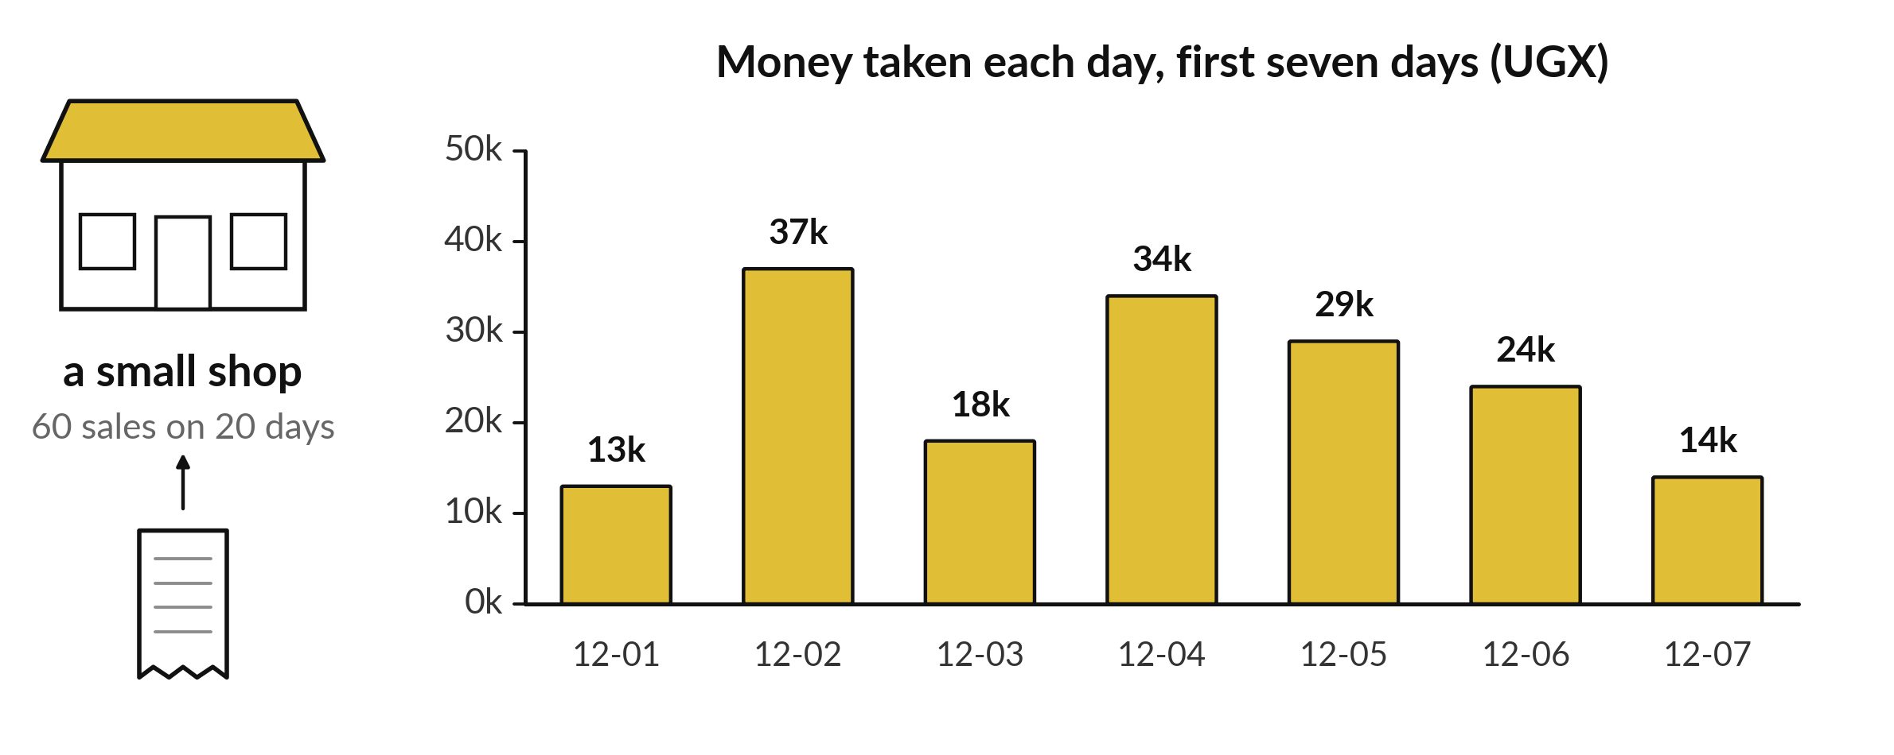
What does one week of sales
in a small shop look like?
Notes:
Picture a small shop. Every sale goes onto a till roll, one line at a time. At the end of the week the owner asks a simple question: which days were busy and which were quiet? Look at the bars. Each bar adds up one day of sales. Today we open a notebook and read the table of sixty sales that these bars come from. By the end of the session you will be able to open a table like this yourself and look at it.

Slide 3
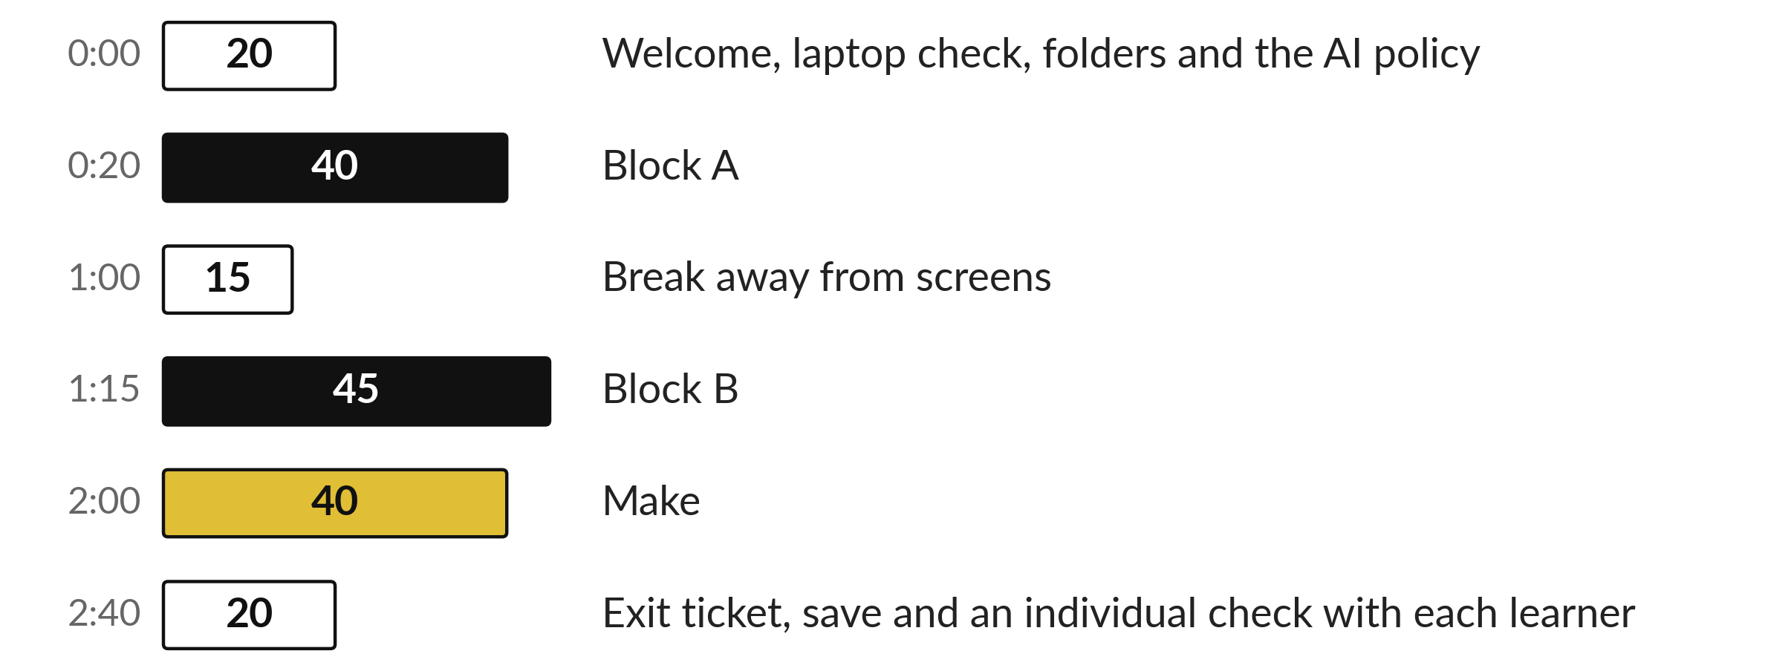
Three hours, mostly doing
Most of our time is spent doing, in small steps, with a guess before every run.
Notes:
Here is how the 3 hours go. Each bar is as long as the time we spend on that part.
First, 20 minutes. Welcome, laptop check, folders and the AI policy. Then, 40 minutes. Block A. After that, 15 minutes. Break away from screens. Next, 45 minutes. Block B. Then, 40 minutes. Make. Then, 20 minutes. Exit ticket, save and an individual check with each learner.
Notice how much of the time is yours. You listen for a short while and then you do. That is on purpose, because you learn this by doing it.

Slide 4
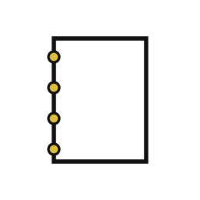


Words for today (1 of 2)
notebook
A page where you write instructions for the computer and see the answers under them.
An exercise book that answers back.
cell
One box in a notebook. A text cell explains. A code cell runs.
One paragraph on a page of the exercise book.
run
Tell the computer to carry out the code in a cell. Click the cell and press Shift and Enter.
Handing in a question and waiting for the answer.
Notes:
First the words, because every one of them is used in the code later.
notebook. A page where you write instructions for the computer and see the answers under them. An exercise book that answers back.
cell. One box in a notebook. A text cell explains. A code cell runs. Think of a shop. One paragraph on a page of the exercise book.
run. Tell the computer to carry out the code in a cell. Click the cell and press Shift and Enter. Imagine it like this. Handing in a question and waiting for the answer.

Slide 5
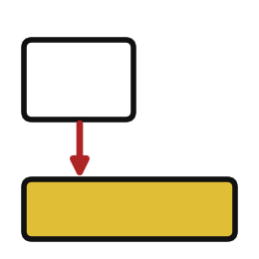


Words for today (2 of 2)
output
What a cell shows after it runs.
The answer written under the question.
file
A saved piece of work with a name, such as camp_shop.csv.
A page stored in a folder.
table
Information arranged in rows and columns.
The sales page of a shop register.
Notes:
Here are the rest of today's words.
output. What a cell shows after it runs. An example from everyday life. The answer written under the question.
file. A saved piece of work with a name, such as camp_shop.csv. Here is a way to see it. A page stored in a folder.
table. Information arranged in rows and columns. A small example. The sales page of a shop register.

Slide 6
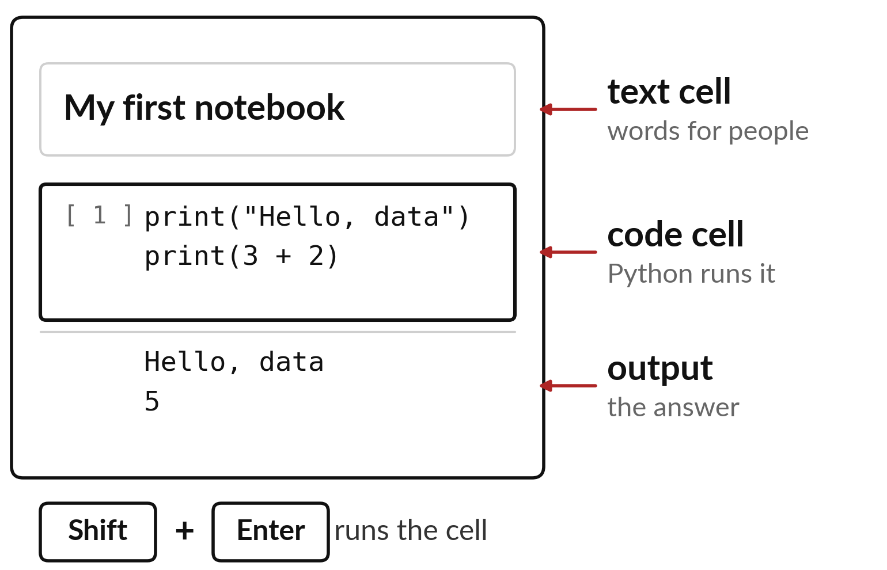
A notebook has text cells, code cells and output
Text cells hold words for people.
Code cells hold instructions for Python.
Shift and Enter runs the cell you clicked.
Notes:
This is the page we will work on for the whole camp. It is called a notebook. A notebook is built from boxes called cells. A text cell holds words, like a heading or a note to yourself. A code cell holds instructions that Python can carry out. When you click a code cell and press Shift and Enter together, Python runs it and the answer appears right underneath. That answer is called the output.
Find the three parts on the picture. Which one does Python read, and which one is only for people?

Slide 7
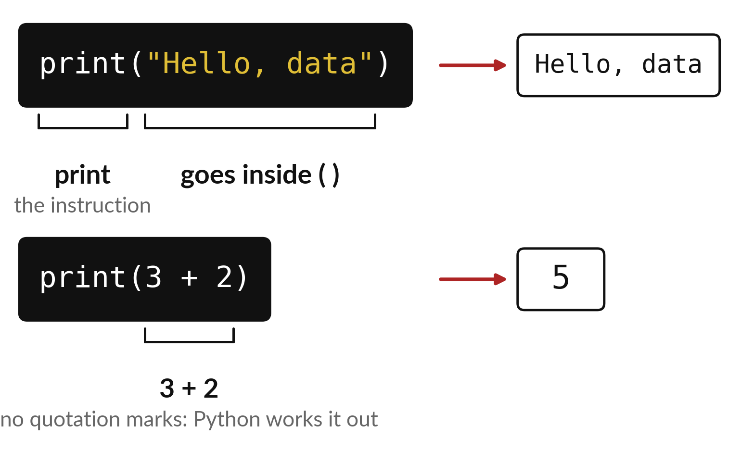
print shows whatever sits inside its brackets
Words go between quotation marks.
Without quotation marks Python works it out.
The result shows up under the cell.
Notes:
Your first instruction is print. The word tells Python to show something, and the brackets hold what to show. Look at the first line. Hello, data sits between quotation marks, so Python treats it as plain words and shows them exactly as they are. Now look at the second line. There are no quotation marks, so Python sees a sum, works out three plus two and shows five.
Before we run them, what do you expect to see under each cell? Write it down.

Slide 8
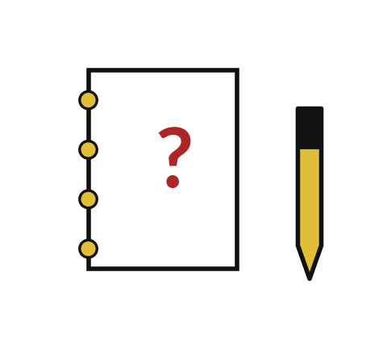
Predict: Run your first cell
print("Hello, data")
print(3 + 2)
Predict the two lines that will appear under the cell.
Write your guess on paper before we run it.
Notes:
Read AI_USE_POLICY.md with your instructor now. It explains when AI tools are used in this camp and when they are not.
Time to commit to an answer. Predict the two lines that will appear under the cell. Jot it on paper before anyone speaks.

Slide 9
Run it: Run your first cell
Hello, data
5
The output is Hello, data on the first line and 5 on the second.
Text sits between matching quotation marks.
A number such as 3 is an amount.
Notes:
Now we run it. Match each line of the output with the line of code that made it.
The output is Hello, data on the first line and 5 on the second. Text sits between matching quotation marks. A number such as 3 is an amount.
If your guess was off, find the line that surprised you.

Slide 10
Investigate: Run your first cell
1. Why does the first line keep its quotation marks in the code and lose them in the output?
2. What would print(3 + 2) show if the 3 were written as "3"?
print("Hello, data")
print(3 + 2)
Notes:
Now we look closely at Run your first cell. I have two questions for you.
Question one. Why does the first line keep its quotation marks in the code and lose them in the output? Write your answer in one line before we compare.
The answer is this. The quotation marks tell Python that the words are text. They are part of the instruction and not part of the message.
Question two. What would print(3 + 2) show if the 3 were written as "3"? Say it quietly to yourself before anyone answers.
It would stop with an error, because Python cannot add text to a number.

Slide 11
Modify: change one thing
Change Hello, data to your nickname and run the cell again.
Then tell your neighbour what changed and how you know.
print("Hello, data")
print(3 + 2)
Notes:
Now it is your turn to change something. Change Hello, data to your nickname and run the cell again. Run it, then tell someone what you saw.
What you should find: The first line now shows the nickname.

Slide 12

Break
15 minutes away from your screen
Stand up. Drink some water. Tell someone what you guessed in the first half.
Notes:
Break time. 15 minutes away from your screens. Stand up, drink some water and tell someone what you guessed in the first half.
When we come back we start the second idea.

Slide 13
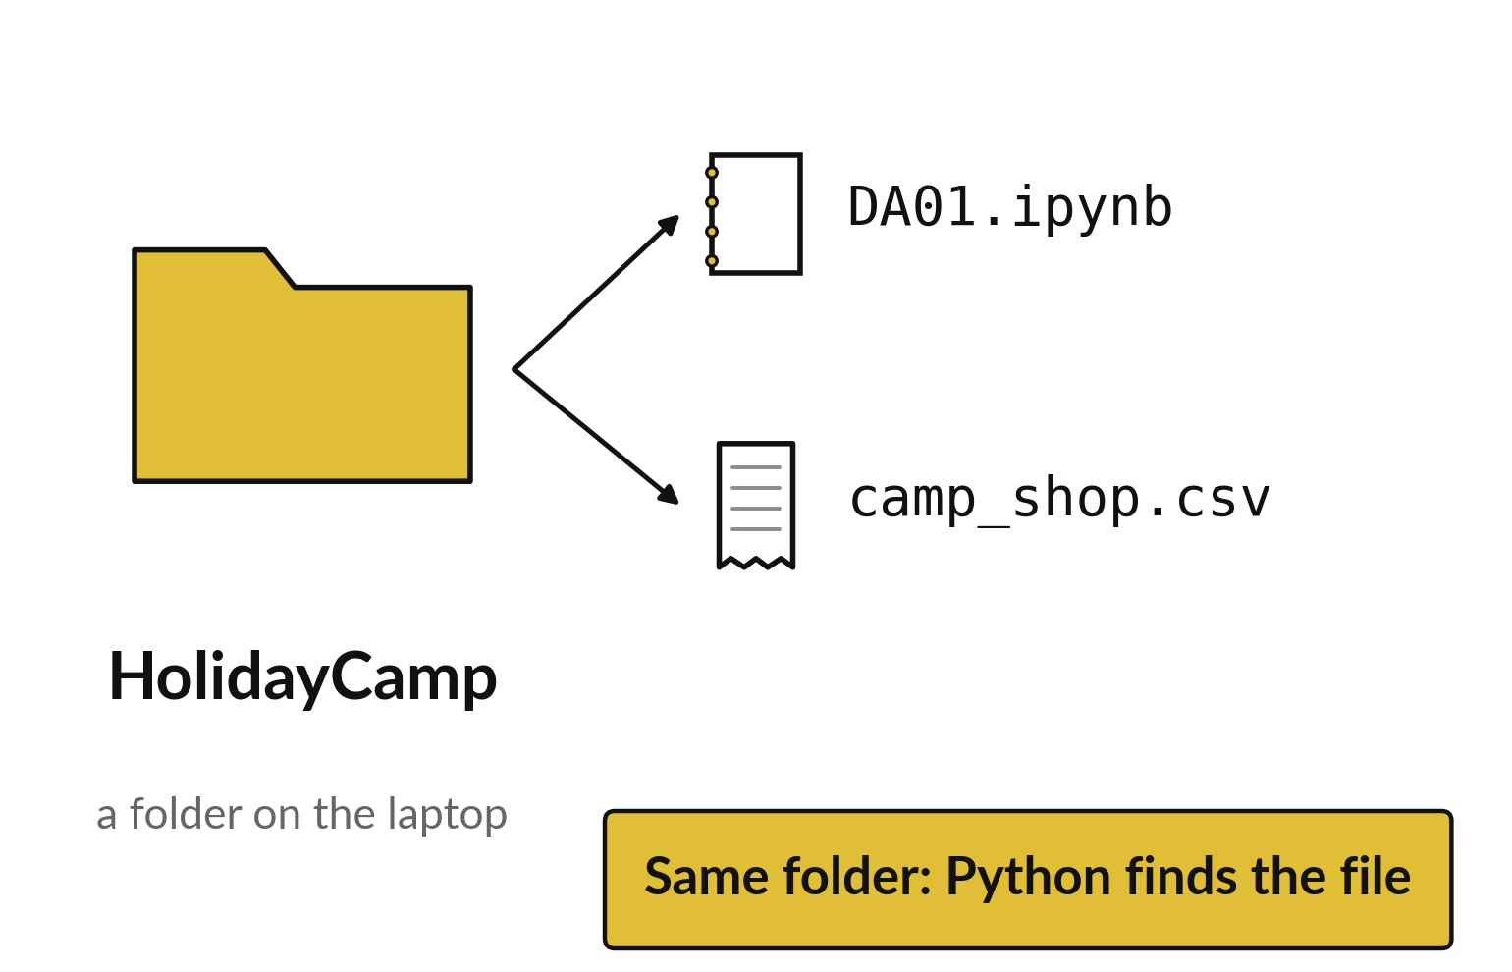
The notebook finds a data file in its own folder
A file is saved work with a name.
A folder keeps files together.
Keep the notebook and the data side by side.
Notes:
Now we move to the data. A file is a piece of saved work with a name, and a folder is a place that keeps files together. Our notebook is a file and the shop sales are a file, so each one needs a home. When Python looks for camp_shop.csv it first looks in the same folder as the notebook. If the two sit side by side, it finds the data straight away.
Before you open the notebook today, check where your camp folder is, and tell me what files are inside it.

Slide 14
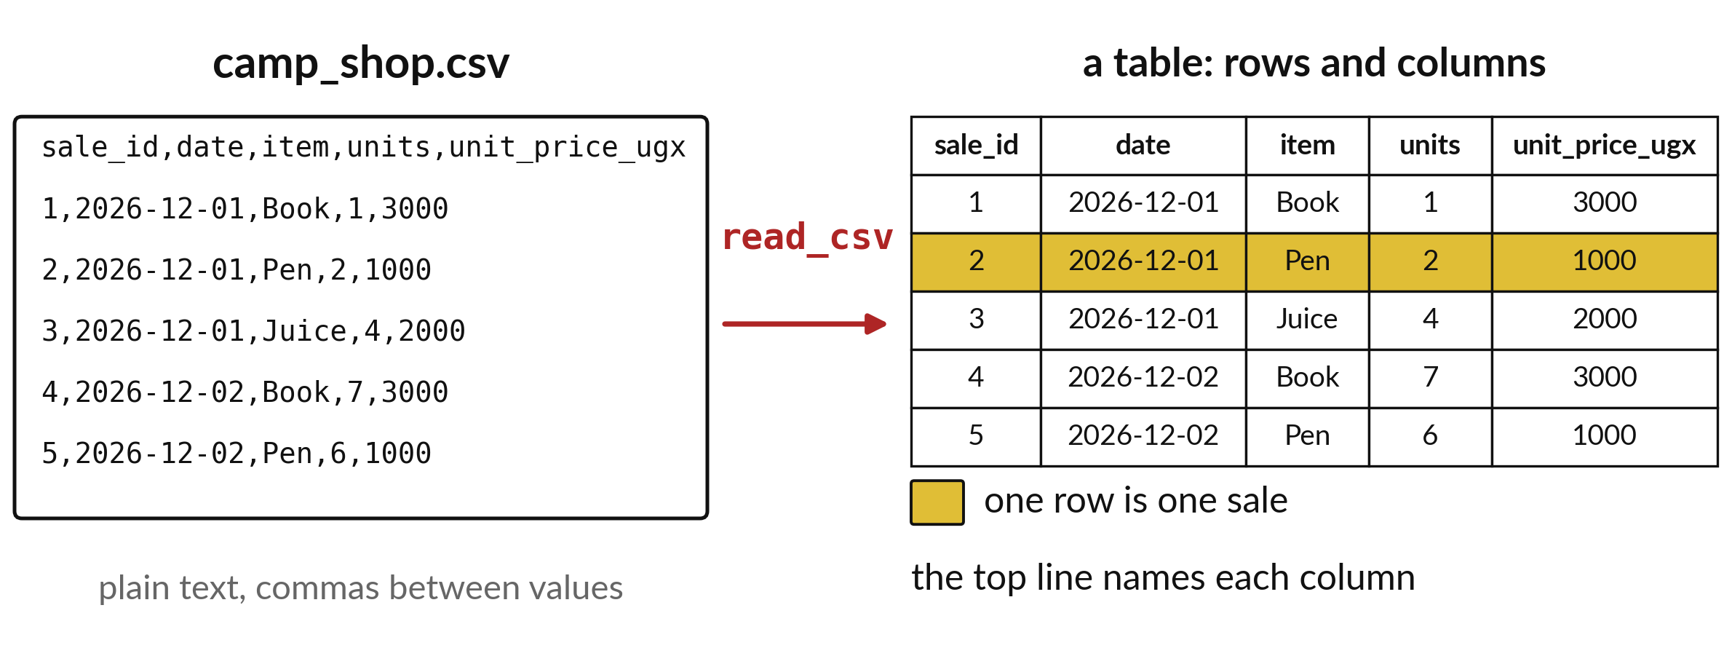
read_csv turns a text file into a table
Each row is one sale and each column is one kind of fact.
Notes:
On the left is the file exactly as it is stored. It is plain text, with commas between the values. It is hard to read, and nobody wants to count sales that way. The instruction read_csv reads the file and builds a table for us. The first line of the file becomes the column names. Every other line becomes one row.
The gold row is sale number two: two pens at one thousand shillings each. Find the same numbers in the text on the left.

Slide 15
Predict: Read the shop table
import pandas as pd
shop = pd.read_csv("camp_shop.csv")
print(shop.head())
Predict how many rows the table shows and which columns it has.
Write your guess on paper before we run it.
Notes:
The file camp_shop.csv holds 60 sales from a practice shop. It has to sit in the same folder as this notebook.
Your turn to guess. Predict how many rows the table shows and which columns it has. Guess on paper first. Surprises are useful.

Slide 16

Run it: Read the shop table
The output shows the first five sales as a table.
The columns are sale_id, date, item, units and unit_price_ugx.
Sale 1 is one Book at 3000 shillings.
Notes:
I will run it, and you compare with your guess. Match each line of the output with the line of code that made it.
The output shows the first five sales as a table. The columns are sale_id, date, item, units and unit_price_ugx. Sale 1 is one Book at 3000 shillings.
Check your paper. Were you close?

Slide 17

Investigate: Read the shop table
1. How many columns does the table have, and what does each one record?
2. Why does the first row show a sale of only 1 unit while the fourth shows 7?
Notes:
Now we look closely at read the shop table. I have two questions for you.
Question one. How many columns does the table have, and what does each one record? Say it quietly to yourself before anyone answers.
Five. The sale number, the date, the item sold, the units sold and the price of one unit in Uganda shillings.
Question two. Why does the first row show a sale of only 1 unit while the fourth shows 7? Give it thirty seconds and then we will hear a few answers.
Here is how I would answer it. Different customers buy different amounts. The table records each sale as it happened.

Slide 18

Modify: change one thing
Change head() to head(10) and run it again.
Then tell your neighbour what changed and how you know.
Notes:
Time to experiment. Change head() to head(10) and run it again. After you run it, say in one sentence what changed and how you checked.
You should see this. Ten rows appear.

Slide 19
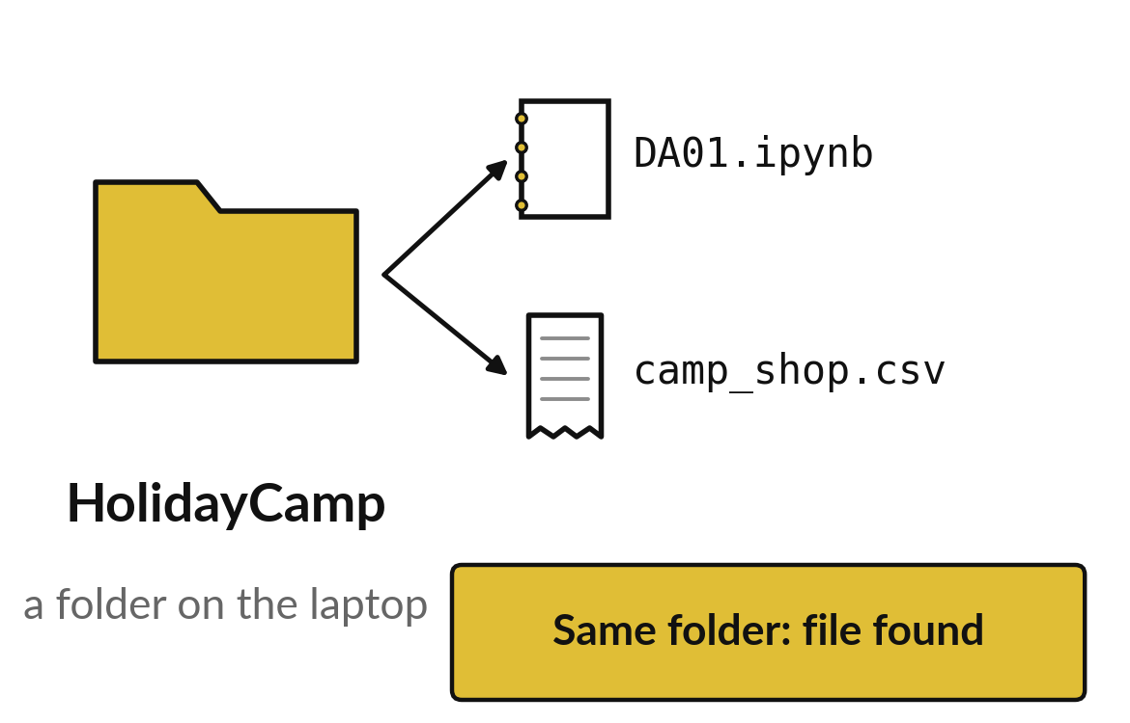
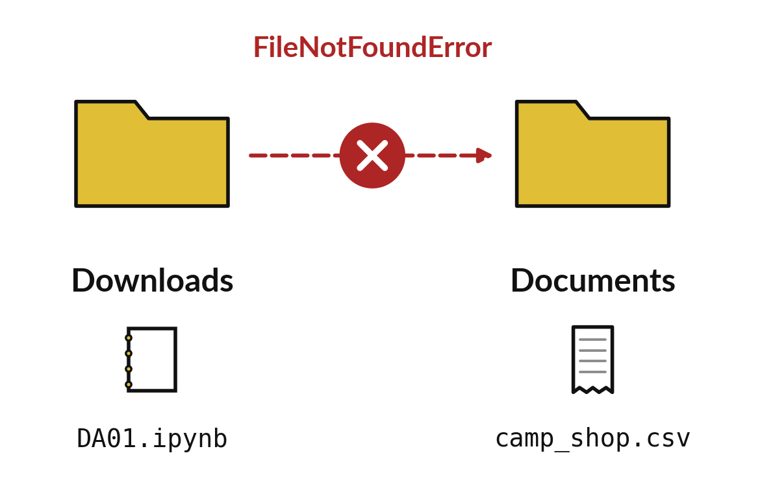
A file Python cannot find is a folder problem
Notebook and data side by side: Python finds the file.
Notebook in one folder, data in another: FileNotFoundError.
Notes:
Here is the most common problem on day one. On the left, the notebook and the data are in the same folder and everything works. On the right, the notebook is in Downloads and the data is in Documents, so Python looks in the wrong place and stops with a FileNotFoundError.
Notice that the message is not about your code at all. The fix is to move one file so the two sit together. If this happens to you, show me before you try anything else.

Slide 20

Make: your own version
In a new code cell show your nickname and the result of 7 + 4. Then show the first three rows of the shop table with head(3). Save the notebook as DA01.ipynb, close it and open it again.
Save it as DA01. Write two sentences: what you changed and how you checked it.
Notes:
This task is yours. Run your code after every step so you can see where a problem begins. If you get stuck for a few minutes, read your error message, check the error card, and then ask me.
Save it as DA01. I will come round to each of you and ask what you changed and how you checked it.

Slide 21

Two errors you may meet today
It means: A curly quotation mark was pasted in. Python only accepts straight quotation marks.
Fix: Delete the quotation marks and type them again from the keyboard.
SyntaxError: invalid character
It means: The notebook cannot find the file because it sits in a different folder.
Fix: Move the notebook into the folder that holds camp_shop.csv, or ask the instructor to help.
FileNotFoundError: camp_shop.csv
Notes:
Here are two errors from this session, so you recognise them when they appear.
This is the first one. You will see: SyntaxError: invalid character. It means this: A curly quotation mark was pasted in. Python only accepts straight quotation marks. To fix it, delete the quotation marks and type them again from the keyboard.
The next one. You will see: FileNotFoundError: camp_shop.csv. It means this: the notebook cannot find the file because it sits in a different folder. To fix it, move the notebook into the folder that holds camp_shop.csv, or ask the instructor to help.
When you are stuck, read the last line of the message first.

Slide 22

Finish this sentence in your notebook
I can run a cell, read its output, and open a table of sales in a notebook.
Then save your notebook, close it and open it again to check it saved.
Notes:
Last step. Our question for today was: What does one week of sales in a small shop look like?
Finish this sentence in your notebook, in your own words. I can run a cell, read its output, and open a table of sales in a notebook.
Then save your notebook, close it and open it again to check it saved.

