Slide 1
Conditions and decisions
Is this sale big enough to count as a large order?
Python for Data Analysis | Session 4 of 24 | Week 2, Python you need
Holiday Data and AI Camp | The National ICT Innovation Hub, Nakawa
Notes:
Let us begin. Today is session 4 and our topic is conditions and decisions.
By the end of today you will be able to write a decision that gives a different answer for True and False, and test it at the edge.
We will answer one question: Is this sale big enough to count as a large order?

Slide 2
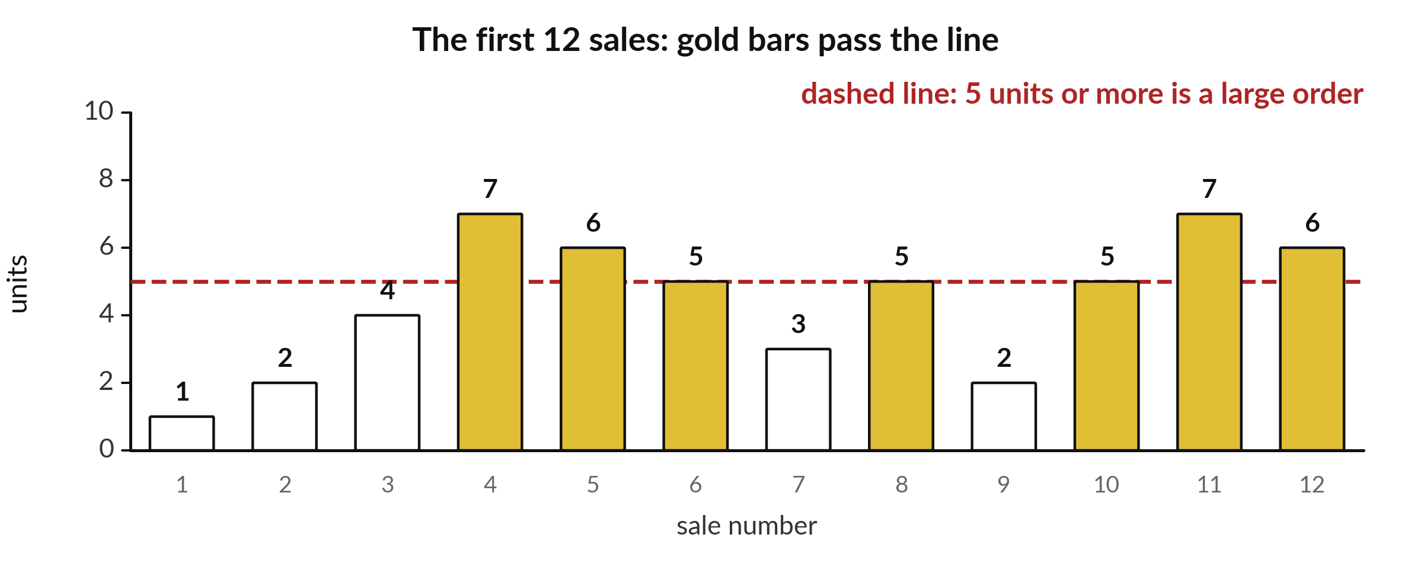
Is this sale big enough to count as a large order?
Notes:
Here are the units sold in the first twelve sales. A shopkeeper wants to treat any sale of five or more units as a large order. The dashed line marks that rule, and the gold bars are the ones that pass it. Looking at the bars takes a second. Python has no eyes, so we have to give it the rule in words it understands. Today we learn how to write that rule.

Slide 3

Three hours, mostly doing
Most of our time is spent doing, in small steps, with a guess before every run.
Notes:
Here is how the 3 hours go. Each bar is as long as the time we spend on that part.
First, 10 minutes. Recall. Then, 50 minutes. Block A. After that, 15 minutes. Break away from screens. Next, 50 minutes. Block B. Then, 40 minutes. Make. Then, 15 minutes. Exit ticket, save, and an individual check with each learner.
Notice how much of the time is yours. You listen for a short while and then you do. That is on purpose, because you learn this by doing it.

Slide 4



Words for today (1 of 2)
comparison
A question that gives True or False, such as units >= 5.
Asking whether a pupil is tall enough to ride.
Boolean
A value that is either True or False.
A light that is on or off.
if
Run the indented lines only when the condition is True.
Enter only if you have a ticket.
Notes:
First the words, because every one of them is used in the code later.
comparison. A question that gives True or False, such as units >= 5. Think of a shop. Asking whether a pupil is tall enough to ride.
Boolean. A value that is either True or False. Imagine it like this. A light that is on or off.
if. Run the indented lines only when the condition is True. An example from everyday life. Enter only if you have a ticket.

Slide 5



Words for today (2 of 2)
else
Run these lines when the condition is False.
Otherwise, go to the queue.
indentation
Four spaces at the start of a line show which lines belong to the if.
The inside of a bracket in a sentence.
and, or
and needs both conditions True. or needs at least one.
Entry needs a ticket and an ID. A discount needs a student card or a coupon.
Notes:
Here are the rest of today's words.
else. Run these lines when the condition is False. Here is a way to see it. Otherwise, go to the queue.
indentation. Four spaces at the start of a line show which lines belong to the if. A small example. The inside of a bracket in a sentence.
and, or. and needs both conditions True. or needs at least one. Picture this. Entry needs a ticket and an ID. A discount needs a student card or a coupon.

Slide 6
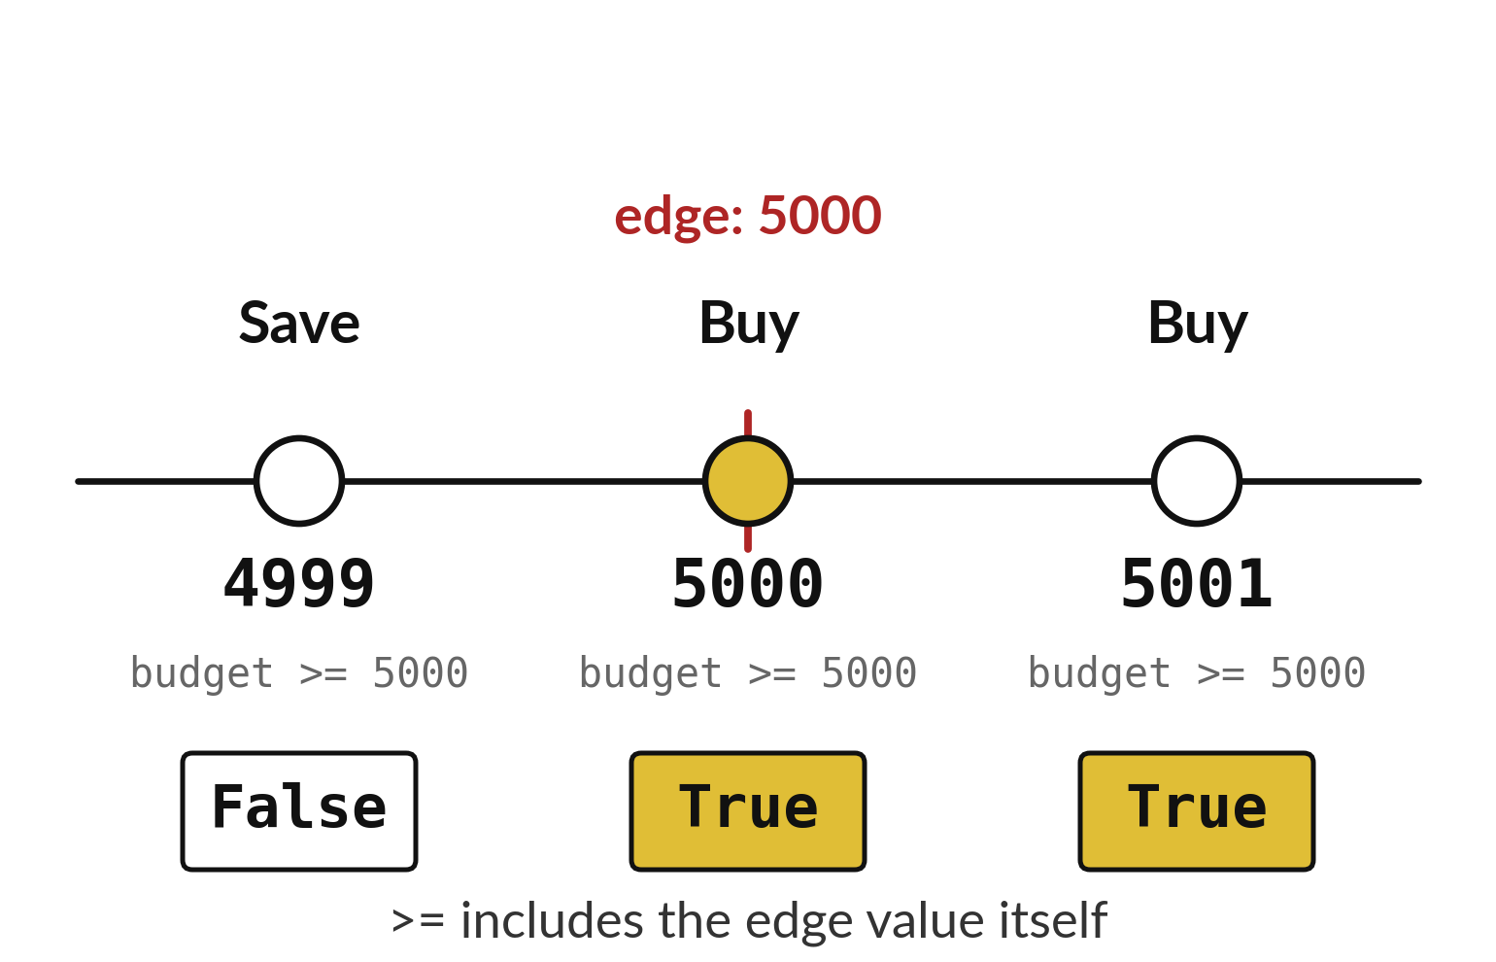
A comparison answers True or False
Three budgets meet the same rule.
The edge value counts when you write >=.
Always test just below, on and just above the edge.
Notes:
A comparison is a question that can only be answered with True or False. The ticket costs five thousand. Is the budget at least five thousand? With four thousand nine hundred and ninety nine the answer is False. With exactly five thousand it is True, because the symbol greater than or equal to includes the edge itself. With five thousand and one it is also True.
The edge is where mistakes hide, so we always test just below it, on it and just above it. Which of the three would you have forgotten to test?

Slide 7
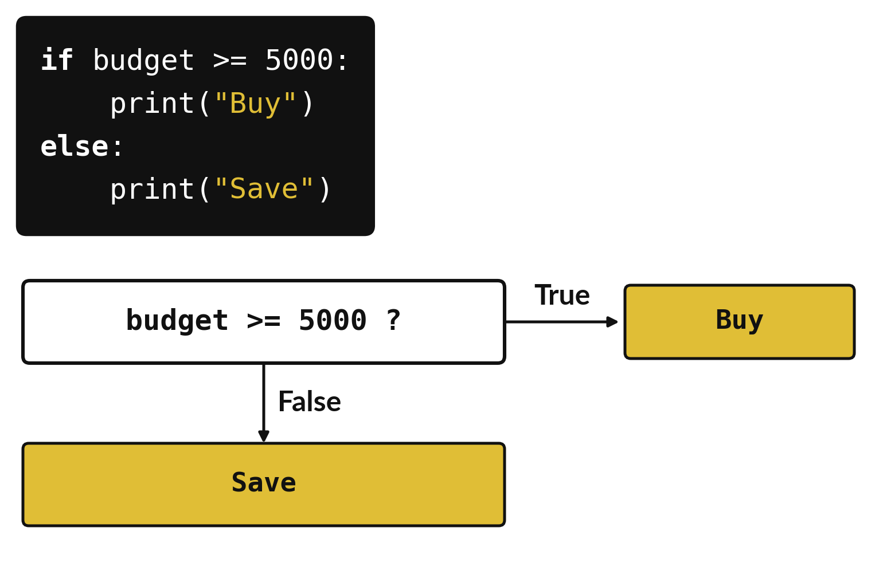
An if sends the program down one of two paths
True follows the if lines.
False follows the else lines.
Only one path runs each time.
Notes:
The if instruction is a fork in the road. Python asks the question in the box. If the answer is True it takes the path to Buy. If the answer is False it goes down to Save. It never does both. The code above the flow chart is the same decision written for Python.
Trace the path with a budget of four thousand nine hundred and ninety nine. Which box do you reach?

Slide 8
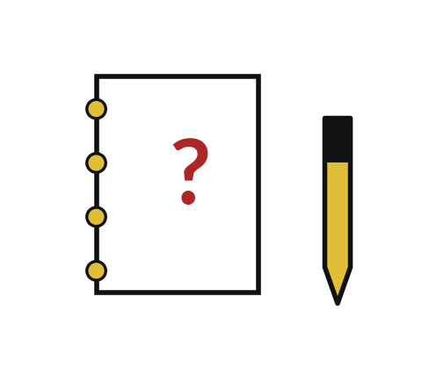
Predict: Compare and decide
budget = 5000
print(budget >= 5000)
if budget >= 5000:
print("Buy")
else:
print("Save")
Predict what prints for a budget of 4999, then for 5000, then for 5001.
Write your guess on paper before we run it.
Notes:
A comparison asks a question. == asks whether two values are equal.
Make a prediction. Predict what prints for a budget of 4999, then for 5000, then for 5001. Put it on paper first. We will check it together in a moment.

Slide 9
Run it: Compare and decide
True
Buy
The cell prints True and then Buy.
With a budget of 4999 the comparison is False and the cell prints Save.
5000 and 5001 both print Buy, because >= includes the edge value.
Notes:
Running it now. Match each line of the output with the line of code that made it.
The cell prints True and then Buy. With a budget of 4999 the comparison is False and the cell prints Save. 5000 and 5001 both print Buy, because >= includes the edge value.
Keep your guess. We use it in the next step.

Slide 10
Investigate: Compare and decide
1. Why does 5000 print Buy?
2. What is the difference between = and ==?
budget = 5000
print(budget >= 5000)
if budget >= 5000:
print("Buy")
else:
print("Save")
Notes:
Now we look closely at compare and decide. I have two questions for you.
Question one. Why does 5000 print Buy? Talk it over with your neighbour for a minute.
Let me answer it. >= means greater than or equal to, so the edge value passes.
Question two. What is the difference between = and ==? Think about it for a moment, then tell the person next to you.
The answer is this. = stores a value under a name. == asks whether two values are equal.

Slide 11
Modify: change one thing
Set budget to 4999 and run the cell again.
Then tell your neighbour what changed and how you know.
budget = 5000
print(budget >= 5000)
if budget >= 5000:
print("Buy")
else:
print("Save")
Notes:
Make one small change. Set budget to 4999 and run the cell again. After you run it, say in one sentence what changed and how you checked.
You should see this. It prints Save.

Slide 12

Break
15 minutes away from your screen
Stand up. Drink some water. Tell someone what you guessed in the first half.
Notes:
Break time. 15 minutes away from your screens. Stand up, drink some water and tell someone what you guessed in the first half.
When we come back we start the second idea.

Slide 13
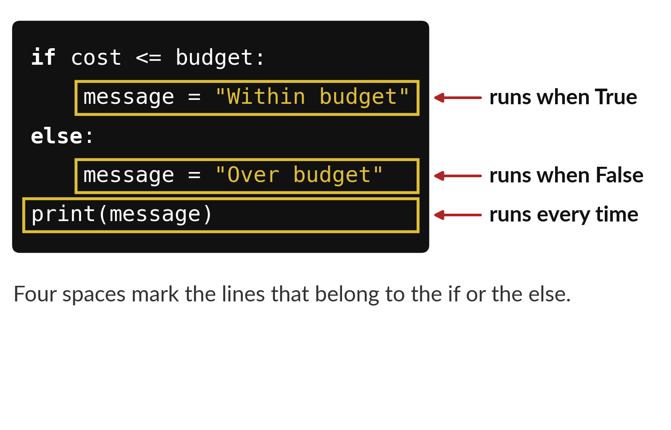
Four spaces show which lines belong to the if
Lines pushed in by four spaces belong to the if or else.
The unindented line runs every time.
A colon ends each if and else line.
Notes:
Python uses spaces to understand your code. The two lines that start with four spaces belong to the if and the else above them. They are inside the fork. The last line has no spaces, so it sits outside the fork and runs every time, whichever path was taken.
If you forget the spaces, Python stops with an IndentationError. Check the gold boxes and tell me which lines run when the answer is True.

Slide 14
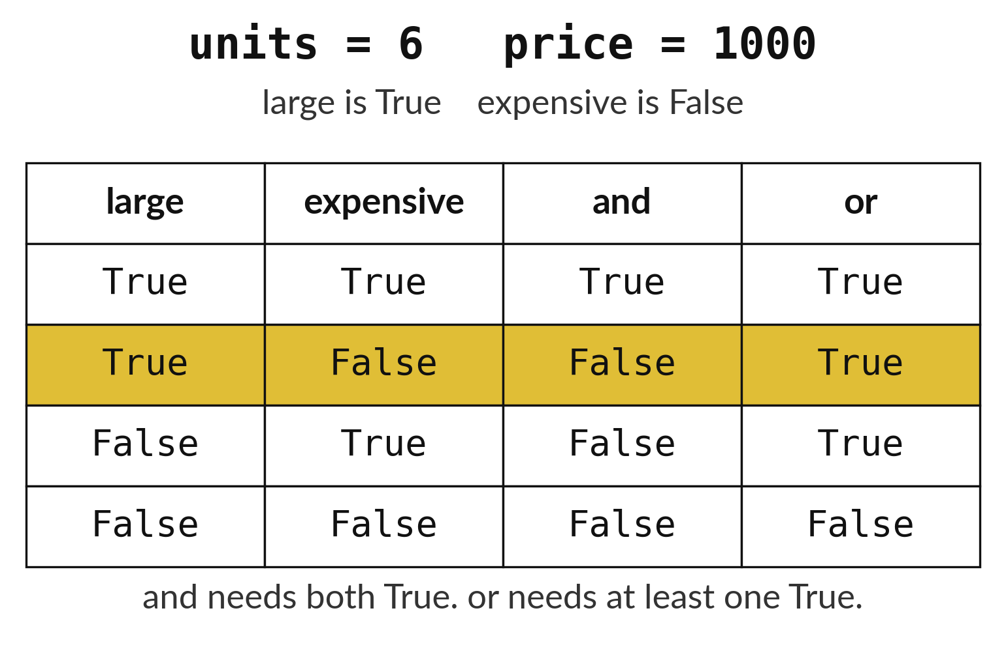
and needs both conditions, or needs just one
and is True only when both sides are True.
or is True when at least one side is True.
The gold row is the sale we are testing.
Notes:
Sometimes one question is not enough. A sale can be large, expensive, both or neither. The word and joins two questions and is True only when both are True. The word or is True when at least one is True.
Our example has six units at one thousand shillings. It is large but not expensive, so and gives False and or gives True. Find the gold row. Why does and fail there?

Slide 15
Predict: Two conditions together
units = 6
price = 1000
large = units >= 5
expensive = price >= 2000
print(large and expensive)
print(large or expensive)
if large and expensive:
print("Large and expensive")
elif large:
print("Large only")
else:
print("Small")
Predict the answer for 6 units of an item at 1000 shillings, for both rules.
Write your guess on paper before we run it.
Notes:
A large order needs 5 units or more. An expensive item costs 2000 shillings or more.
Time to commit to an answer. Predict the answer for 6 units of an item at 1000 shillings, for both rules. Put your guess on paper now, even if you are unsure.

Slide 16
Run it: Two conditions together
False
True
Large only
The cell prints False, then True, then Large only.
The order is large and not expensive, so and gives False and or gives True.
elif means else if: it tests a second condition when the first is False.
Notes:
Now we run it. Match each line of the output with the line of code that made it.
The cell prints False, then True, then Large only. The order is large and not expensive, so and gives False and or gives True. elif means else if: it tests a second condition when the first is False.
If your guess was off, find the line that surprised you.

Slide 17

Investigate: Two conditions together
1. Why is the answer to large and expensive False?
2. Which branch runs for 3 units at 2500 shillings?
Notes:
Now we look closely at two conditions together. I have two questions for you.
Question one. Why is the answer to large and expensive False? Think about it for a moment, then tell the person next to you.
The answer is this. and needs both conditions True. The price is 1000, which is under 2000.
Question two. Which branch runs for 3 units at 2500 shillings? Have a go in your head first.
Neither if nor elif, so else runs and it prints Small.

Slide 18
Modify: change one thing
Change the price to 2500 and run the cell again.
Then tell your neighbour what changed and how you know.
units = 6
price = 1000
large = units >= 5
expensive = price >= 2000
print(large and expensive)
print(large or expensive)
if large and expensive:
print("Large and expensive")
elif large:
print("Large only")
else:
print("Small")
Notes:
Now it is your turn to change something. Change the price to 2500 and run the cell again. Then explain to your neighbour what the change did.
The result: It prints Large and expensive.

Slide 19
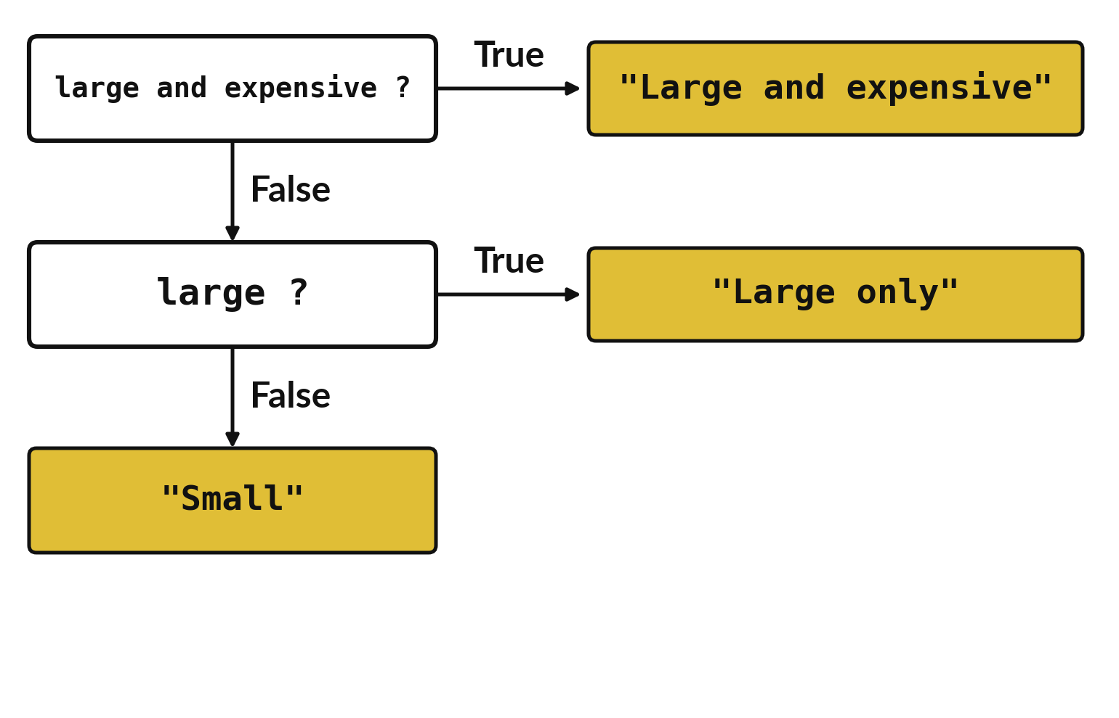
An elif adds a second
question after a False answer
Python asks the questions from the top down.
It stops at the first True answer.
else catches everything that is left.
Notes:
Real decisions often have more than two outcomes. This ladder asks its first question. If the answer is True we stop and report a large and expensive sale. If it is False we drop to the next question. Only when every question has said False do we reach the last box. That last box is the else.
Run the ladder in your head for six units at one thousand shillings. Which outcome do you reach?

Slide 20

Make: your own version
Write a decision for a ticket that costs 5000. Print "Buy" if the budget is at least 5000 and otherwise print "Save". Test 4999, 5000 and 5001.
Save it as DA04. Write two sentences: what you changed and how you checked it.
Notes:
This task is yours. Run your code after every step so you can see where a problem begins. If you get stuck for a few minutes, read your error message, check the error card, and then ask me.
Save it as DA04. I will come round to each of you and ask what you changed and how you checked it.

Slide 21

Two errors you may meet today
It means: The line under if or else has no spaces in front of it.
Fix: Add four spaces to every line that belongs to the if.
IndentationError: expected an indented block
It means: A single = was used where a question needs ==.
Fix: Use == or >= to ask a question. Use = only to store a value.
SyntaxError: invalid syntax at if budget = 5000
Notes:
Here are two errors from this session, so you recognise them when they appear.
This is the first one. You will see: IndentationError: expected an indented block. It means this: the line under if or else has no spaces in front of it. To fix it, add four spaces to every line that belongs to the if.
The next one. You will see: SyntaxError: invalid syntax at if budget = 5000. It means this: A single = was used where a question needs ==. To fix it, use == or >= to ask a question. Use = only to store a value.
When you are stuck, read the last line of the message first.

Slide 22

Finish this sentence in your notebook
A comparison gives True or False, and an if runs its indented lines only when it is True.
Then save your notebook, close it and open it again to check it saved.
Notes:
Last step. Our question for today was: Is this sale big enough to count as a large order?
Finish this sentence in your notebook, in your own words. A comparison gives True or False, and an if runs its indented lines only when it is True.
Then save your notebook, close it and open it again to check it saved.

