Slide 1
Select, filter and calculate a revenue column
How much money did the practice shop take in, and where did it come from?
Python for Data Analysis | Session 8 of 24 | Week 3, Tables in pandas
Holiday Data and AI Camp | The National ICT Innovation Hub, Nakawa
Notes:
Laptops open, please. Today is session 8 and our topic is select, filter and calculate a revenue column.
By the end of today you will be able to pick a column, keep the rows that meet a condition, and add a revenue column.
We will answer one question: How much money did the practice shop take in, and where did it come from?

Slide 2
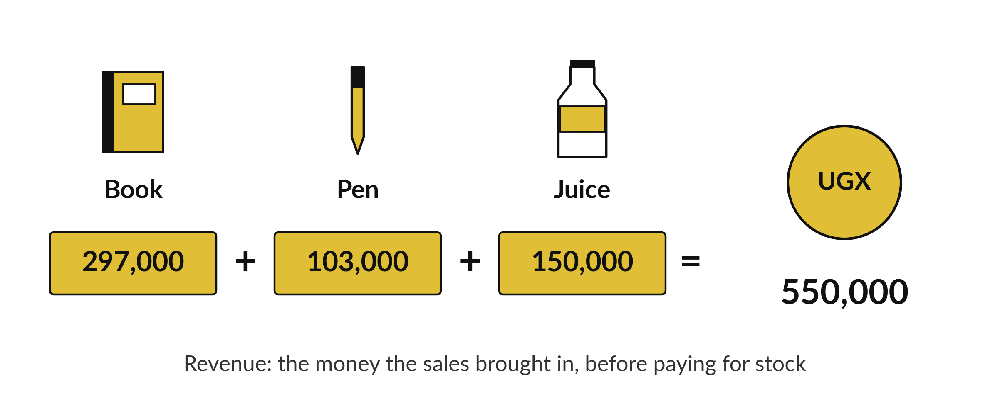
How much money did the practice shop
take in, and where did it come from?
Notes:
A practice shop sold pens, books and juice over sixty sales. At the end of the period the owner wants two numbers. How much money did the shop take in, and which item brought it in? The table does not have a money column yet. It has units and a price, and money is units times price. Today we select the columns we need, filter the rows we want, and calculate the money column ourselves.

Slide 3

Three hours, mostly doing
Most of our time is spent doing, in small steps, with a guess before every run.
Notes:
Here is how the 3 hours go. Each bar is as long as the time we spend on that part.
First, 10 minutes. Recall. Then, 50 minutes. Block A. After that, 15 minutes. Break away from screens. Next, 50 minutes. Block B. Then, 40 minutes. Make. Then, 15 minutes. Exit ticket, save, and an individual check with each learner.
Notice how much of the time is yours. You listen for a short while and then you do. That is on purpose, because you learn this by doing it.

Slide 4



Words for today (1 of 2)
select
Name a column in square brackets to look only at it.
Reading only the price strip of the register.
filter
Keep only the rows where a comparison is True.
Picking out the sales of 5 units or more.
mask
A column of True and False values, one for each row, that a filter uses.
A ticked list beside the register.
Notes:
We need a few words today. For each one I will say what it means and give you something to picture.
select. Name a column in square brackets to look only at it. A small example. Reading only the price strip of the register.
filter. Keep only the rows where a comparison is True. Picture this. Picking out the sales of 5 units or more.
mask. A column of True and False values, one for each row, that a filter uses. You have seen this before. A ticked list beside the register.

Slide 5



Words for today (2 of 2)
new column
A column worked out from other columns and added to the table.
Multiplying units by price on every line.
revenue
Money received from sales: units times price. It is not profit.
The takings before paying for stock.
sum
All the values added together.
Adding up the day's takings.
Notes:
More words for today.
new column. A column worked out from other columns and added to the table. Multiplying units by price on every line.
revenue. Money received from sales: units times price. It is not profit. Think of a shop. The takings before paying for stock.
sum. All the values added together. Imagine it like this. Adding up the day's takings.

Slide 6
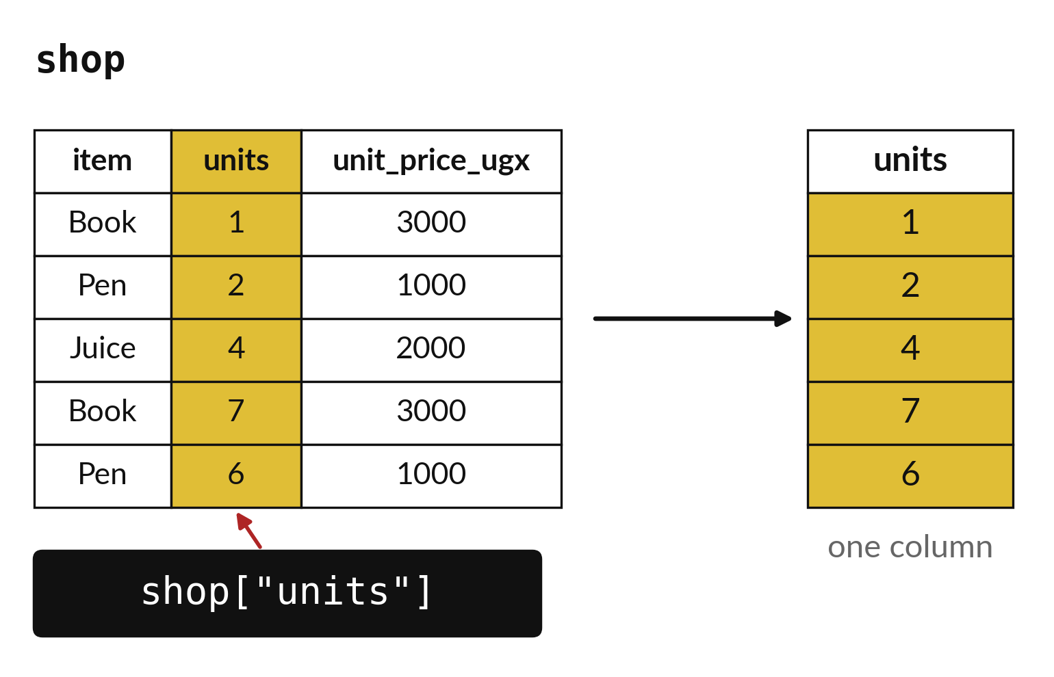
Square brackets and a name select one column
One name gives one column.
A list of names gives a smaller table.
The name must match the header exactly.
Notes:
To look at one column, write the table name and then the column name inside square brackets. In quotation marks, because the name is text. You get back that single column and nothing else. If you want two columns, put the names in a list, which means a second pair of square brackets inside the first.
The spelling has to match the header exactly. Units with a capital letter is a different name from units without one. That is where the KeyError in your errors list comes from.

Slide 7
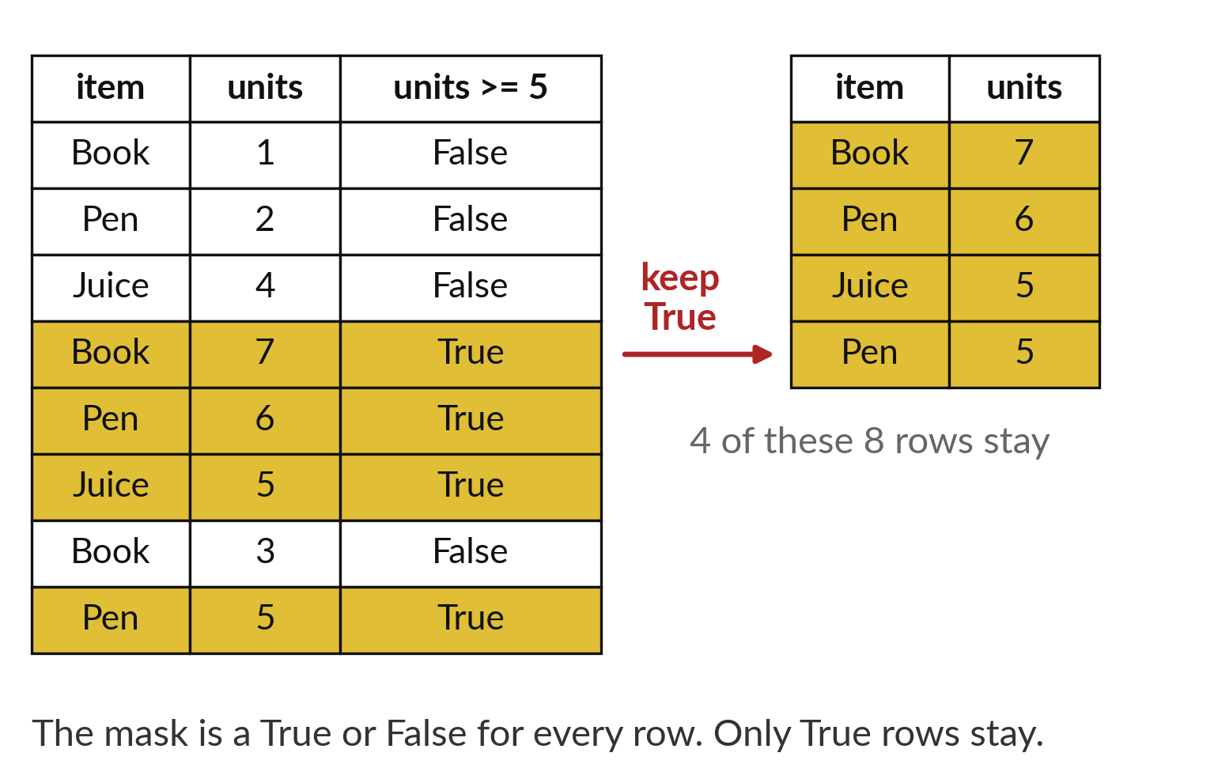
A filter keeps only the rows
where the mask says True
A comparison gives True or False for every row.
That column of True and False is the mask.
Only the True rows survive.
Notes:
Filtering has two steps, and they happen in one line. First Python compares every row with your rule, for example item equals Pen. That gives a column of True and False answers, one for each row. We call that column the mask. Then the table keeps the rows where the mask is True and drops the rest.
Look at the gold rows. They are the ones the mask let through. How many rows will be left if the mask has four True answers?

Slide 8

Predict: Select and filter
import pandas as pd
shop = pd.read_csv("camp_shop.csv")
units = shop["units"]
big = shop[shop["units"] >= 5]
print(len(big))
print(units.sum())
Predict how many of the 60 sales have 5 units or more.
Write your guess on paper before we run it.
Notes:
Read the practice shop. Square brackets with a column name select one column.
Your turn to guess. Predict how many of the 60 sales have 5 units or more. Guess on paper first. Surprises are useful.

Slide 9
Run it: Select and filter
30
277
The cell prints 30 and then 277.
shop["units"] selects one column.
The comparison gives True or False for every row, and only the True rows stay.
All 60 sales together sold 277 units.
Notes:
I will run it, and you compare with your guess. Match each line of the output with the line of code that made it.
The cell prints 30 and then 277. shop["units"] selects one column. The comparison gives True or False for every row, and only the True rows stay. All 60 sales together sold 277 units.
Check your paper. Were you close?

Slide 10

Investigate: Select and filter
1. Is the filter deleting the other 30 rows?
2. Why can the sum of units not tell us the money earned?
Notes:
Now we look closely at select and filter. I have two questions for you.
Question one. Is the filter deleting the other 30 rows? Say it quietly to yourself before anyone answers.
No. big is a new, smaller table. shop still has all 60 rows.
Question two. Why can the sum of units not tell us the money earned? Give it thirty seconds and then we will hear a few answers.
Here is how I would answer it. The three items have different prices, so units and money are different quantities.

Slide 11

Modify: change one thing
Filter the Juice sales with 5 units or more and count them.
Then tell your neighbour what changed and how you know.
Notes:
Time to experiment. Filter the Juice sales with 5 units or more and count them. After you run it, say in one sentence what changed and how you checked.
You should see this. Seven sales.

Slide 12

Break
15 minutes away from your screen
Stand up. Drink some water. Tell someone what you guessed in the first half.
Notes:
Break time. 15 minutes away from your screens. Stand up, drink some water and tell someone what you guessed in the first half.
When we come back we start the second idea.

Slide 13
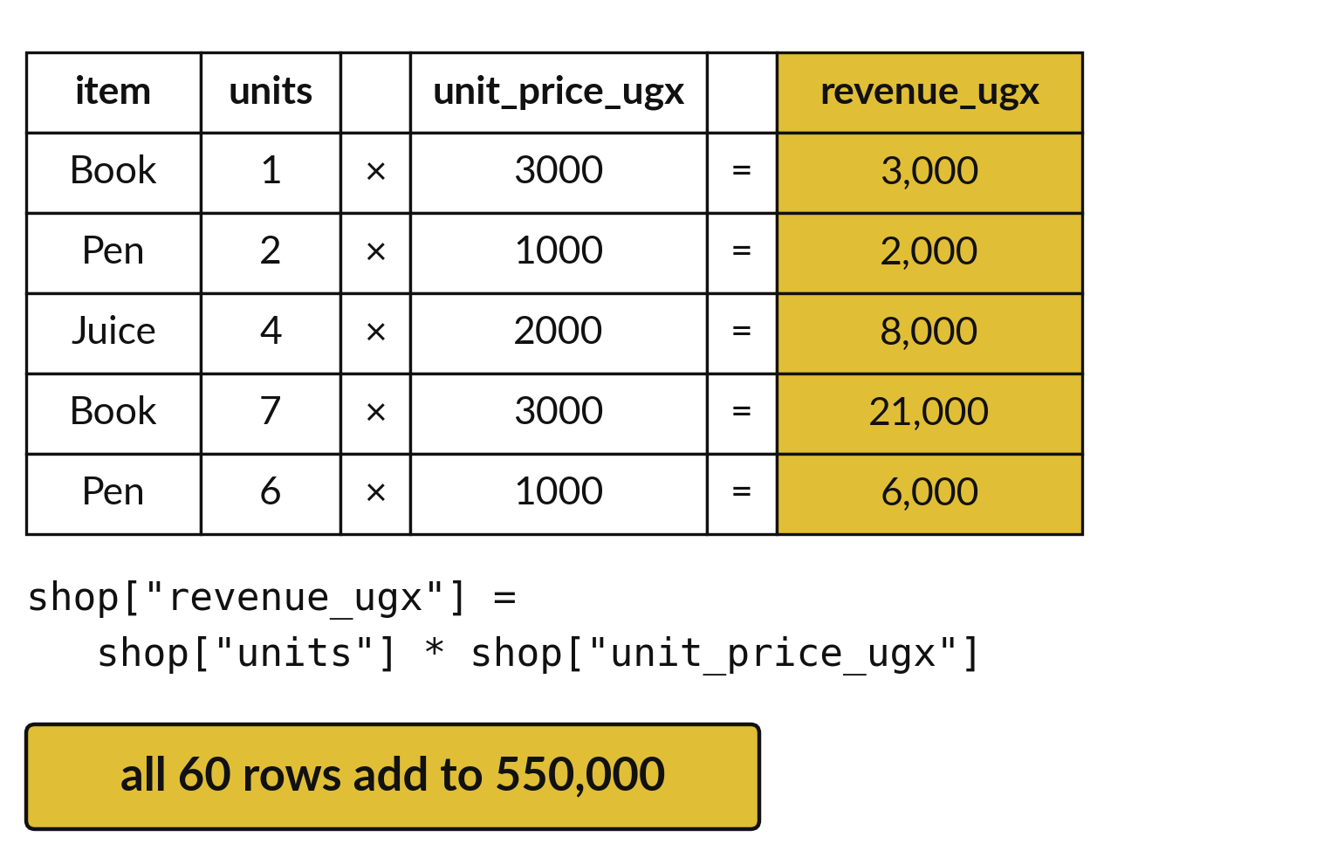
A new column is calculated for every row at once
Write the new column name on the left.
Calculate on the right from existing columns.
Every row gets its own answer.
Notes:
Here we make the money column. On the left of the equals sign we write a name that does not exist yet, revenue underscore ugx. On the right we multiply the units column by the price column. Python does the multiplication row by row, so each sale gets its own revenue, and the new column joins the table.
Check the first gold row by hand. Units times price should match the revenue in the new column.

Slide 14
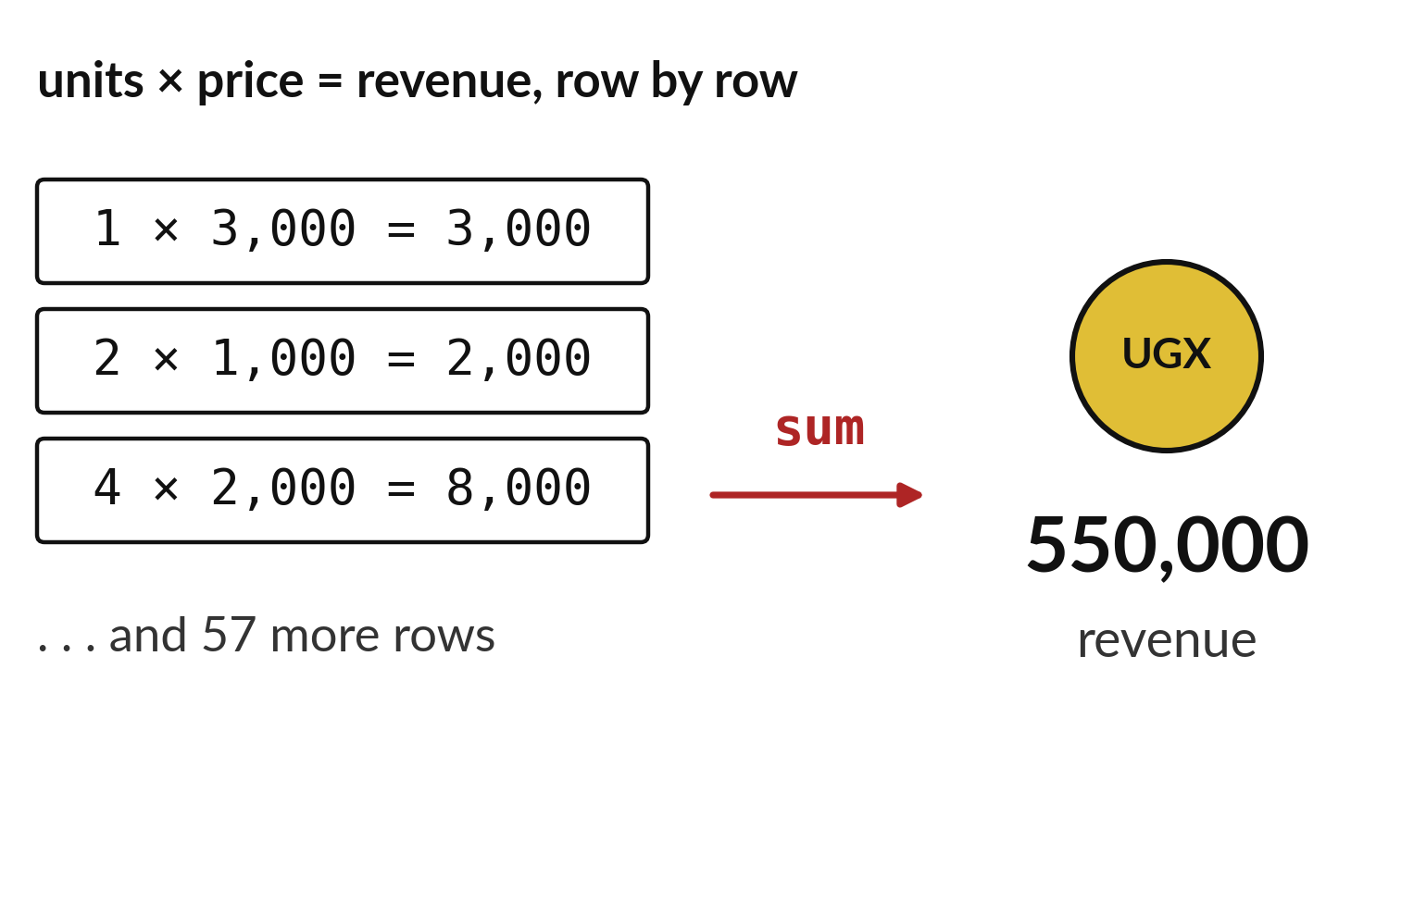
Revenue is units times
price, summed over all sales
Revenue for one sale is units times price.
Add the column to get total revenue.
The practice shop took in 550,000 shillings.
Notes:
Revenue is the money that came in from selling. For one sale it is the units multiplied by the price of one unit. To get the shop total we add up the whole revenue column, and pandas does that with sum. For the practice shop the answer is five hundred and fifty thousand shillings, from two hundred and seventy seven units.
Notice that the answer is one number. We started with sixty rows and boiled them down to a single total.

Slide 15

Predict: A new revenue column
shop["revenue_ugx"] = shop["units"] * shop["unit_price_ugx"]
print(shop.head(3))
print(shop["revenue_ugx"].sum())
Predict the total revenue, using the item prices 3000, 1000 and 2000.
Write your guess on paper before we run it.
Notes:
Assigning to a new column name creates the column. Multiplying two columns multiplies their matching rows.
Now your guess. Predict the total revenue, using the item prices 3000, 1000 and 2000. Write it on paper. It does not have to be right.

Slide 16

Run it: A new revenue column
The first three revenues are 3000, 2000 and 8000.
The total revenue is 550000 shillings.
This is money taken in.
There is no cost column, so profit cannot be worked out.
Notes:
Watch the output as it appears. Match each line of the output with the line of code that made it.
The first three revenues are 3000, 2000 and 8000. The total revenue is 550000 shillings. This is money taken in. There is no cost column, so profit cannot be worked out.
Tell the person next to you whether your guess matched.

Slide 17
Investigate: A new revenue column
1. Why is revenue not profit?
2. Does the new column change camp_shop.csv?
Notes:
Now we look closely at A new revenue column. I have two questions for you.
Question one. Why is revenue not profit? Give it thirty seconds and then we will hear a few answers.
Here is how I would answer it. Profit is revenue minus the cost of the goods. The table has no cost.
Question two. Does the new column change camp_shop.csv? Talk it over with your neighbour for a minute.
What I would say is this. No. It exists only in the notebook until you save it.

Slide 18
Modify: change one thing
Find the revenue of the Book sales only.
Then tell your neighbour what changed and how you know.
shop["revenue_ugx"] = shop[
"units"
] * shop["unit_price_ugx"]
print(shop.head(3))
print(shop["revenue_ugx"].sum())
Notes:
Your hands on the keyboard now. Find the revenue of the Book sales only. Then explain to your neighbour what the change did.
The result: 297000.

Slide 19
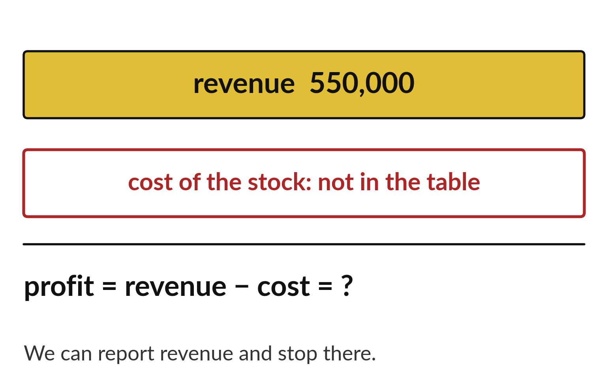
Revenue is not profit, because
the table has no costs
Profit is revenue minus what the shop paid.
Our table has no cost column.
We can say revenue and stop there.
Notes:
It is tempting to call the total our profit. It is not. Profit is the money left after the shop pays for stock, rent and wages. Our table only records what customers paid. It has no cost column, so the profit is unknown, and any number we gave for it would be a guess.
This is the first limitation you will write in your own reports. Say what the data shows, and say what it cannot show.

Slide 20
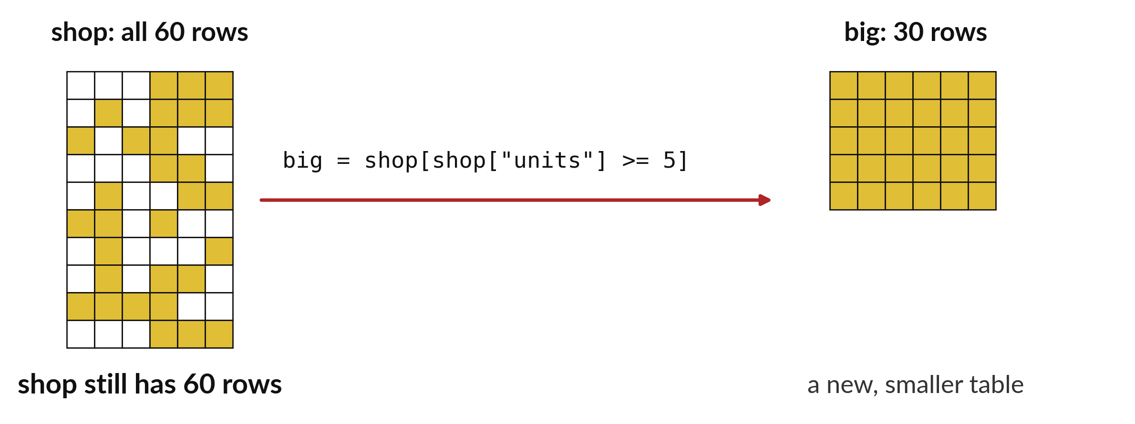
A filtered table is a copy of the original
Save the filtered rows under a new name before you change them.
Notes:
When you filter, you get a smaller table. It is a copy. The original table still holds all sixty rows and is safe. Give the copy its own name, such as pens, and you can change it without touching the original.
If you ever see a warning about setting a value on a copy of a slice, this is the reason. Make the copy on purpose, with copy, and the warning goes away.

Slide 21

Make: your own version
Keep the Pen sales that have 4 units or more. Count them and add up the revenue they bring in. Say why the count and the revenue are different quantities.
Save it as DA08. Write two sentences: what you changed and how you checked it.
Notes:
This is your own task for today. Take it one step at a time. If you get stuck for a few minutes, read your error message, check the error card, and then ask me.
Save it as DA08. I will come round to each of you and ask what you changed and how you checked it.

Slide 22

Two errors you may meet today
It means: The column name is spelled differently from the header.
Fix: Print list(shop.columns) and copy the exact name.
KeyError: 'unit'
It means: The comparison matched no rows, often because of a typing slip in a text value.
Fix: Check the spelling and capital letters of the value you compare with.
The filter returns an empty table
Notes:
Everyone meets errors, including me. Two are likely today, so let us meet them now.
This is the first one. You will see: KeyError: 'unit'. It means this: the column name is spelled differently from the header. To fix it, print list(shop.columns) and copy the exact name.
The next one. You will see: The filter returns an empty table. It means this: the comparison matched no rows, often because of a typing slip in a text value. To fix it, check the spelling and capital letters of the value you compare with.
Keep this slide in mind when something stops working.

Slide 23

Finish this sentence in your notebook
A filter keeps the rows I ask for, and a new column adds a calculation to every row.
Then save your notebook, close it and open it again to check it saved.
Notes:
We are nearly done. Remember the question from the start of the session: How much money did the practice shop take in, and where did it come from?
Write this sentence in your notebook and finish it your own way. A filter keeps the rows I ask for, and a new column adds a calculation to every row.
Then save your notebook, close it and open it again to check it saved.

