Slide 1
Cleaning without hiding evidence
What is wrong with the raw Sunrise sales file, and how many rows does each problem touch?
Python for Data Analysis | Session 10 of 24 | Week 4, Clean and chart
Holiday Data and AI Camp | The National ICT Innovation Hub, Nakawa
Notes:
Welcome back. Today is session 10 and our topic is cleaning without hiding evidence.
By the end of today you will be able to find missing values and duplicates, remove the duplicates on a copy, and save a cleaning log that says what you did.
We will answer one question: What is wrong with the raw Sunrise sales file, and how many rows does each problem touch?

Slide 2
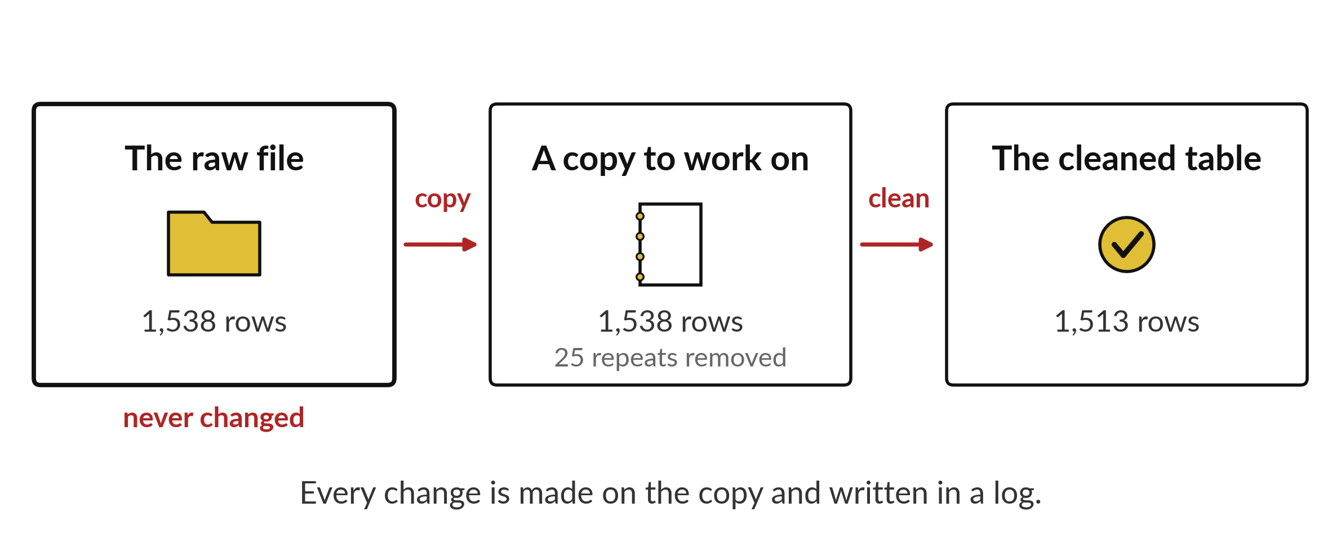
What is wrong with the raw Sunrise sales file,
and how many rows does each problem touch?
Notes:
This is the raw export of the Sunrise sales, exactly as the shop system produced it. It has one thousand five hundred and thirty eight rows. Some rows are repeated. Some cells are empty. Some dates are written in a different style from the others. Before we can trust any total, we need to know what is wrong and how many rows each problem touches. Today we count the faults and write them down, and we do not delete anything in secret.

Slide 3

Three hours, mostly doing
Most of our time is spent doing, in small steps, with a guess before every run.
Notes:
Here is how the 3 hours go. Each bar is as long as the time we spend on that part.
First, 10 minutes. Recall. Then, 50 minutes. Block A. After that, 15 minutes. Break away from screens. Next, 50 minutes. Block B. Then, 40 minutes. Make. Then, 15 minutes. Exit ticket, save, and an individual check with each learner.
Notice how much of the time is yours. You listen for a short while and then you do. That is on purpose, because you learn this by doing it.

Slide 4



Words for today (1 of 2)
raw data
The file exactly as it arrived. You never overwrite it.
The original receipt book.
missing value
A cell with nothing recorded. It is not the same as zero.
A blank in the register.
duplicate
A row that repeats another row exactly.
The same sale written twice.
Notes:
First the words, because every one of them is used in the code later.
raw data. The file exactly as it arrived. You never overwrite it. The original receipt book.
missing value. A cell with nothing recorded. It is not the same as zero. Think of a shop. A blank in the register.
duplicate. A row that repeats another row exactly. Imagine it like this. The same sale written twice.

Slide 5



Words for today (2 of 2)
data type
How a column is stored: whole number, decimal or text.
Whether a box holds numbers or words.
copy
A separate table to work on, so the raw table stays untouched.
A photocopy of the receipt book.
cleaning log
A record of each problem found and what was done about it.
The tailor's note of every change to a uniform.
Notes:
Here are the rest of today's words.
data type. How a column is stored: whole number, decimal or text. An example from everyday life. Whether a box holds numbers or words.
copy. A separate table to work on, so the raw table stays untouched. Here is a way to see it. A photocopy of the receipt book.
cleaning log. A record of each problem found and what was done about it. A small example. The tailor's note of every change to a uniform.

Slide 6
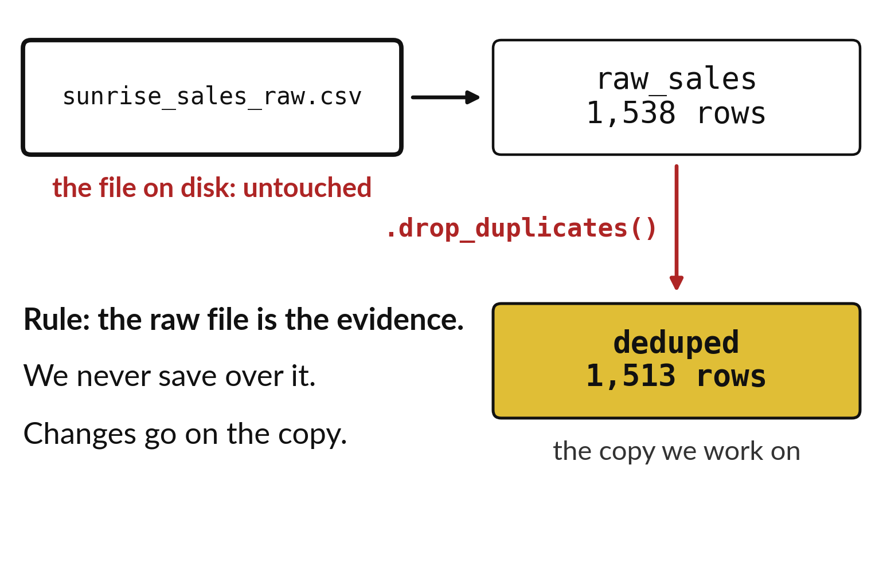
Keep the raw file untouched and clean a copy
The raw file is the evidence.
Work on a copy with a new name.
You can always start again from the raw file.
Notes:
The first rule of cleaning is to protect the original. The raw file is your evidence of what the shop system really produced. We read it once, make a copy inside Python, and do all the changes on the copy. The file on disk never changes.
If a step goes wrong, we throw the copy away and start again from the raw file. If we had changed the original, we could not do that.

Slide 7
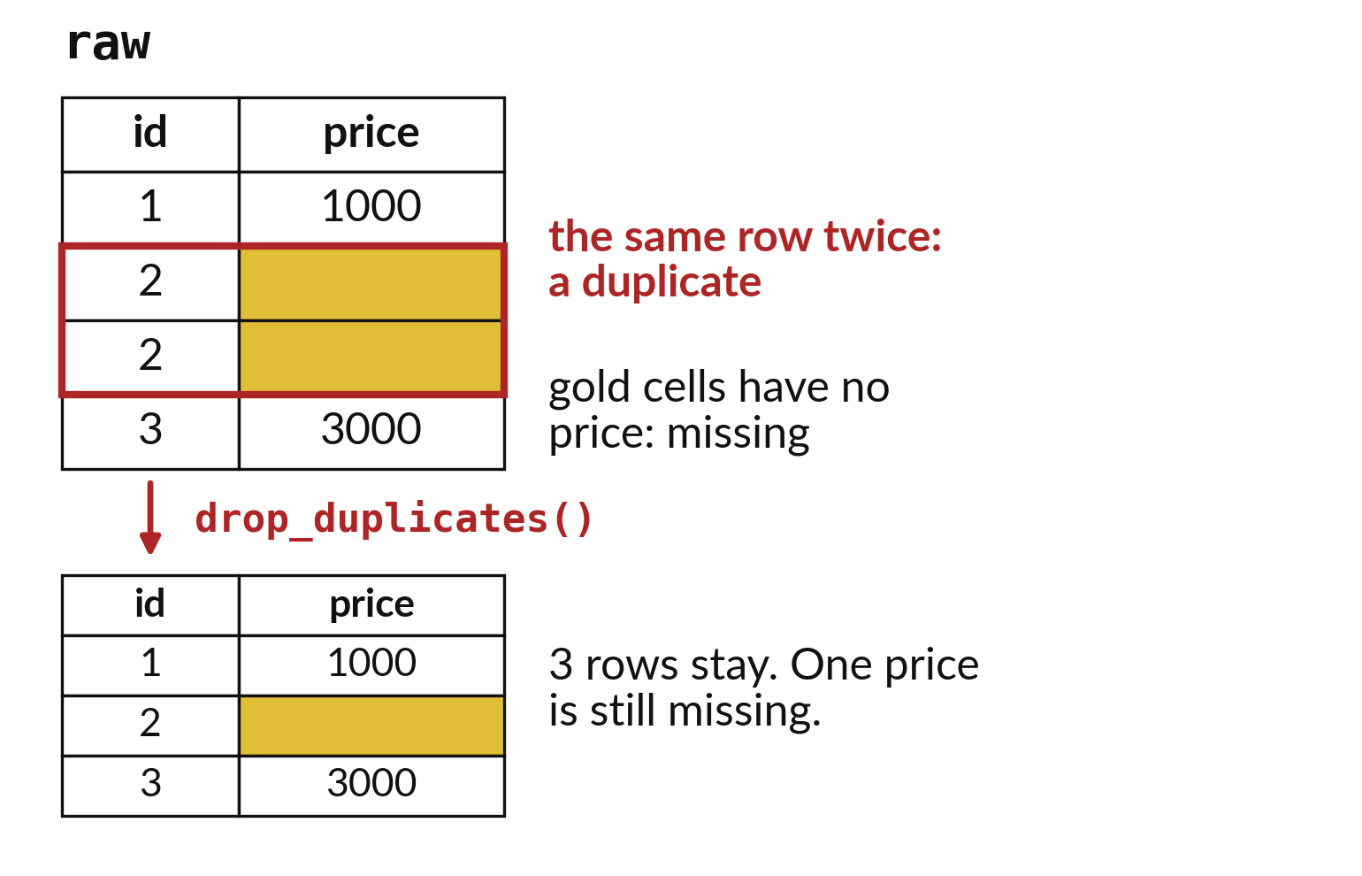
Missing values and repeated
rows are two problems
A missing value is an empty cell.
A duplicate is a row that appears twice.
Each problem needs its own check.
Notes:
Two faults look alike but they are not the same. A missing value is a cell with nothing in it, so we do not know the answer. A duplicate is a whole row that appears more than once, which means a sale could be counted twice. pandas has a separate check for each one, and each gives you a count.
Look at the gold cells on the picture. Which are missing, and which row has been repeated?

Slide 8

Predict: Missing values and
duplicates in a small table
import pandas as pd
raw = pd.DataFrame(
{"id": [1, 2, 2, 3], "price": [1000, None, None, 3000]}
)
clean = raw.drop_duplicates().copy()
print(raw["price"].isna().sum())
print(len(clean))
print(clean["price"].mean())
Predict how many missing prices there are and how many rows stay after the duplicate is removed.
Write your guess on paper before we run it.
Notes:
Keep the raw table unchanged and work on a copy. isna marks missing cells True.
Time to commit to an answer. Predict how many missing prices there are and how many rows stay after the duplicate is removed. Jot it on paper before anyone speaks.

Slide 9
Run it: Missing values and
duplicates in a small table
2
3
2000.0
The raw table has 2 missing prices.
After the duplicate row is removed, 3 rows stay and one price is still missing.
The mean of the two known prices is 2000.
The missing price is unknown and is not free.
Notes:
Now we run it. Match each line of the output with the line of code that made it.
The raw table has 2 missing prices. After the duplicate row is removed, 3 rows stay and one price is still missing. The mean of the two known prices is 2000. The missing price is unknown and is not free.
If your guess was off, find the line that surprised you.

Slide 10

Investigate: Missing values
and duplicates in a small table
1. Why would replacing the missing price with 0 change the meaning?
2. Could two identical rows be real separate sales?
Notes:
Now we look closely at missing values and duplicates in a small table. I have two questions for you.
Question one. Why would replacing the missing price with 0 change the meaning? Write your answer in one line before we compare.
The answer is this. Zero says the item was free. The truth is that nobody recorded the price.
Question two. Could two identical rows be real separate sales? Say it quietly to yourself before anyone answers.
Yes, if two customers bought the same thing. Here the repeated id shows it is a copy.

Slide 11

Modify: change one thing
Count how many rows in clean still have a missing price.
Then tell your neighbour what changed and how you know.
Notes:
Now it is your turn to change something. Count how many rows in clean still have a missing price. Run it, then tell someone what you saw.
What you should find: One.

Slide 12

Break
15 minutes away from your screen
Stand up. Drink some water. Tell someone what you guessed in the first half.
Notes:
Break time. 15 minutes away from your screens. Stand up, drink some water and tell someone what you guessed in the first half.
When we come back we start the second idea.

Slide 13
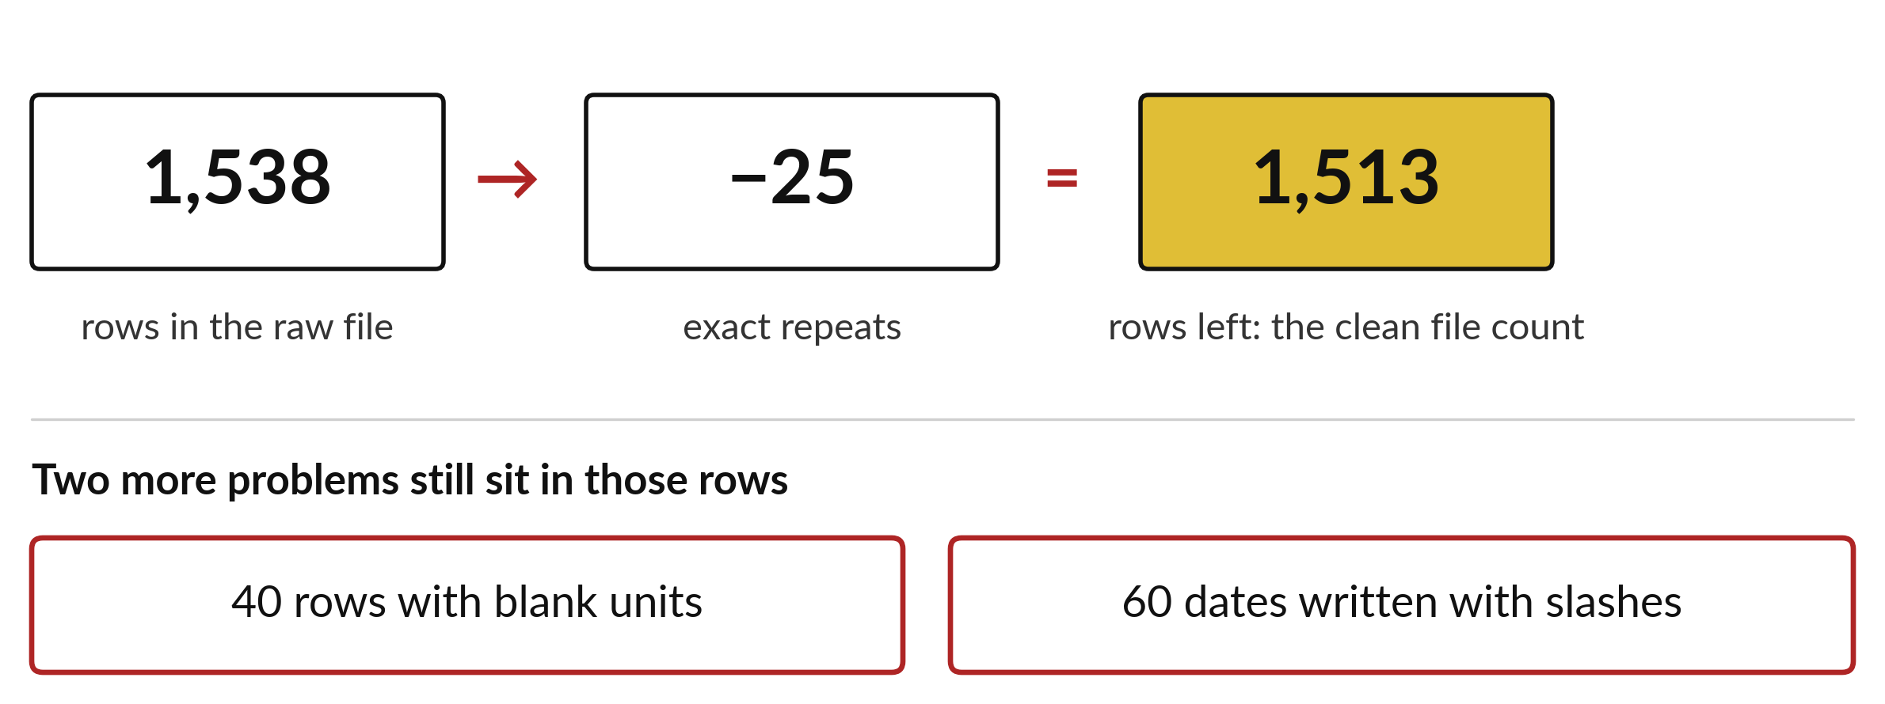
Counting each fault shows how big the clean-up is
25 repeated rows, 40 blank units, 60 slash dates, 12 units written as words.
Notes:
We counted every fault in the raw file. Twenty five rows are exact repeats. Forty rows have a blank in the units column. Sixty dates use slashes instead of the standard style, and twelve units are written as words, like two or three, instead of digits.
These counts go into the cleaning log. Anyone who reads our report can see how much the file needed, and they can judge for themselves whether we were careful.

Slide 14
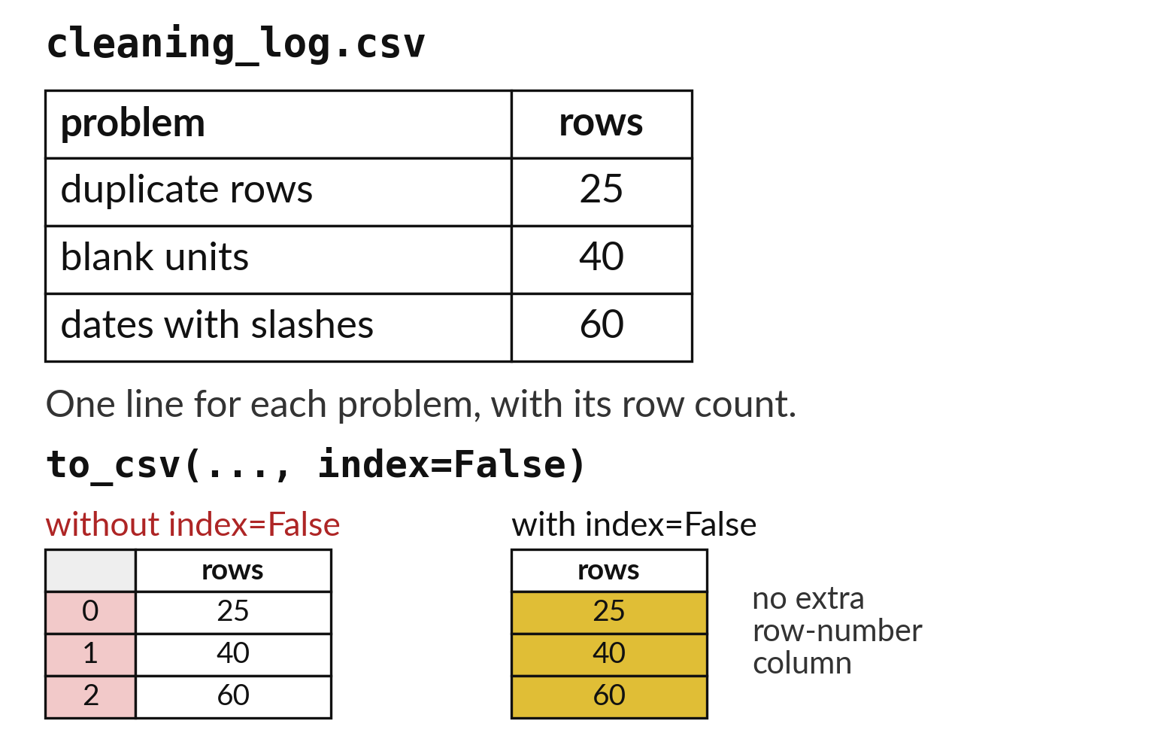
A cleaning log records what
changed and how much
One line for each step.
Each line states the rows before and after.
The log is saved with to_csv.
Notes:
A cleaning log is a small table. Each line says what we did, how many rows we had before and how many we had after. Reading it from top to bottom, you can follow the file from the raw state to the clean state without having to guess.
We save it as a CSV so it travels with the project. The log is what lets a stranger trust the clean table.

Slide 15

Predict: The raw Sunrise file (1 of 2)
raw_sales = pd.read_csv("sunrise_sales_raw.csv")
print(raw_sales.shape)
print(raw_sales.duplicated().sum())
deduped = raw_sales.drop_duplicates()
Read the first part of the code. 4 lines. Say what each one does.
The second part comes next.
Notes:
Read this first part of the code with me before we run anything. ['sunrise_sales_raw.csv is the Sunrise sales as an untidy export.', 'Count the problems.', 'to_csv saves a table to a file.', 'index=False stops pandas adding an extra column of row numbers.']

Slide 16
Predict: The raw Sunrise file (2 of 2)
print(deduped.shape)
print(deduped["units"].isna().sum())
log = pd.DataFrame(
{
"problem": ["duplicate rows", "blank units"],
"rows": [raw_sales.duplicated().sum(), deduped["units"].isna().sum()]
}
)
log.to_csv("cleaning_log.csv", index=False)
print(pd.read_csv("cleaning_log.csv"))
Predict how many duplicate rows the file holds. The clean version has 1513 sales.
Write your guess on paper before we run it.
Notes:
sunrise_sales_raw.csv is the Sunrise sales as an untidy export. Count the problems.
Your turn to guess. Predict how many duplicate rows the file holds. The clean version has 1513 sales. Guess on paper first. Surprises are useful.

Slide 17
Run it: The raw Sunrise file
(1538, 6)
25
(1513, 6)
40
problem rows
0 duplicate rows 25
1 blank units 40
The raw file has 1538 rows.
25 are exact duplicates, so removing them leaves 1513, the same as the clean file.
40 rows have blank units.
The log table is saved and read back with two lines: 25 duplicate rows and 40 blank-unit rows.
Notes:
I will run it, and you compare with your guess. Match each line of the output with the line of code that made it.
The raw file has 1538 rows. 25 are exact duplicates, so removing them leaves 1513, the same as the clean file. 40 rows have blank units. The log table is saved and read back with two lines: 25 duplicate rows and 40 blank-unit rows.
Check your paper. Were you close?

Slide 18
Investigate: The raw Sunrise file
1. Why does the cleaned row count of 1513 match the clean file?
2. Why not fill the 40 blank units with the mean?
Notes:
Now we look closely at the raw Sunrise file. I have two questions for you.
Question one. Why does the cleaned row count of 1513 match the clean file? Say it quietly to yourself before anyone answers.
The 25 extra rows were exact copies. Removing them restores the original count.
Question two. Why not fill the 40 blank units with the mean? Give it thirty seconds and then we will hear a few answers.
Here is how I would answer it. It would invent sales that nobody recorded. We decide in session 16 how to report them.

Slide 19
Modify: change one thing
Count the rows whose date is written with slashes, and add them to the log.
Then tell your neighbour what changed and how you know.
Notes:
Time to experiment. Count the rows whose date is written with slashes, and add them to the log. After you run it, say in one sentence what changed and how you checked.
You should see this. 60 rows.

Slide 20
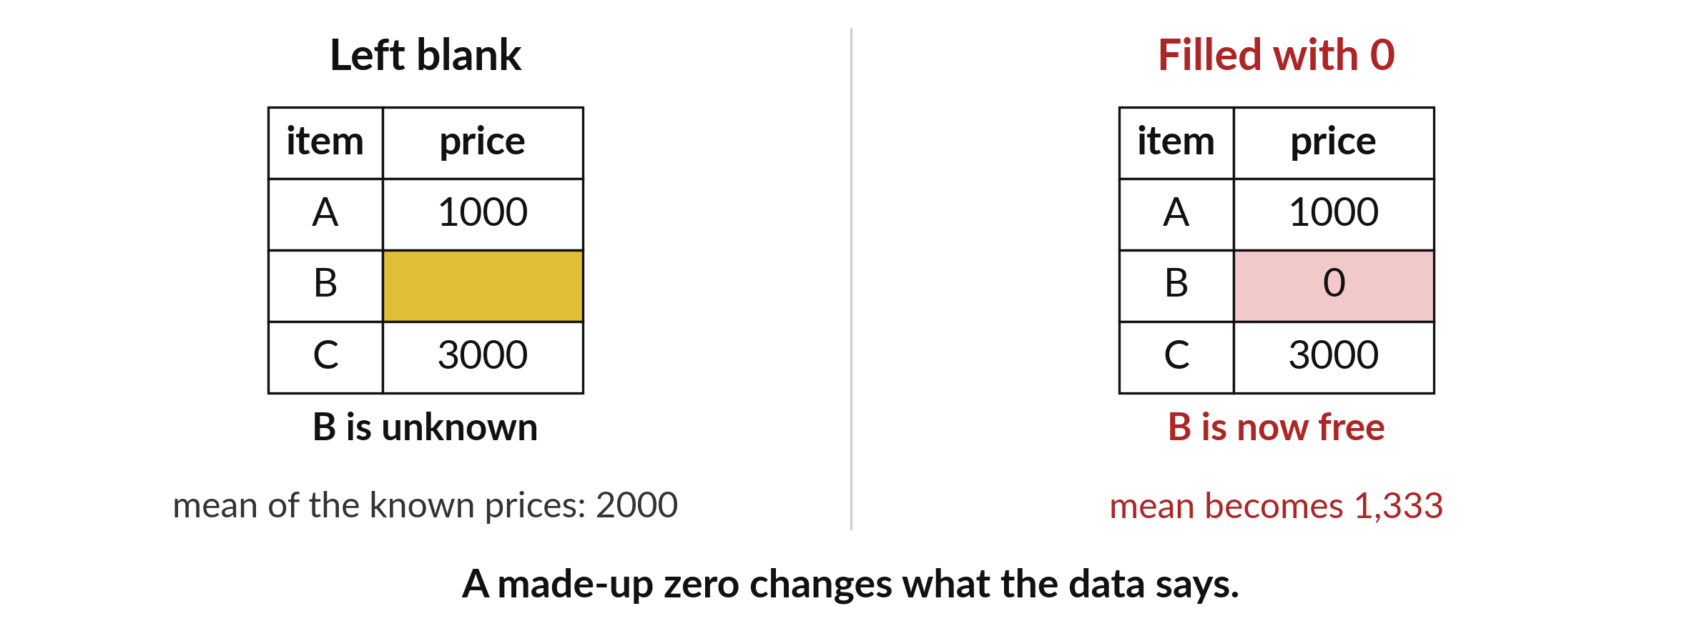
A zero is a fact and a blank is an unknown
Filling a blank with zero changes the totals and the averages.
Notes:
It is tempting to replace every blank price with zero, so that the table looks complete. That is a mistake. A zero says the item was free. A blank says we do not know the price.
If we turn blanks into zeros, the average price drops, the totals drop, and nobody can tell that it happened. Leave the blank, count it, write it in the log, and decide on purpose what to do.

Slide 21

Make: your own version
Write a cleaning log for the four-row table in Block A: four raw rows, one duplicate removed, one price still missing. Save it as a CSV with to_csv. Write one sentence on why replacing the missing price with zero would change what the data says.
Save it as DA10. Write two sentences: what you changed and how you checked it.
Notes:
This task is yours. Run your code after every step so you can see where a problem begins. If you get stuck for a few minutes, read your error message, check the error card, and then ask me.
Save it as DA10. I will come round to each of you and ask what you changed and how you checked it.

Slide 22

Two errors you may meet today
It means: You changed a slice of another table, so pandas is not sure which table you meant.
Fix: Make a real copy with .copy() before you change a table.
SettingWithCopyWarning
It means: A step removed or added rows without you noticing.
Fix: Print len() after every step and write the numbers in the log.
Row counts differ between steps
Notes:
Here are two errors from this session, so you recognise them when they appear.
This is the first one. You will see: SettingWithCopyWarning. It means this: you changed a slice of another table, so pandas is not sure which table you meant. To fix it, Make a real copy with .copy() before you change a table.
The next one. You will see: Row counts differ between steps. It means this: A step removed or added rows without you noticing. To fix it, print len() after every step and write the numbers in the log.
When you are stuck, read the last line of the message first.

Slide 23

Finish this sentence in your notebook
I keep the raw file untouched, work on a copy, and write down every change I make.
Then save your notebook, close it and open it again to check it saved.
Notes:
Last step. Our question for today was: What is wrong with the raw Sunrise sales file, and how many rows does each problem touch?
Finish this sentence in your notebook, in your own words. I keep the raw file untouched, work on a copy, and write down every change I make.
Then save your notebook, close it and open it again to check it saved.

