Slide 1
Charts that say what the numbers say
Which chart shows this comparison most clearly?
Python for Data Analysis | Session 11 of 24 | Week 4, Clean and chart
Holiday Data and AI Camp | The National ICT Innovation Hub, Nakawa
Notes:
Good to see you. Today is session 11 and our topic is charts that say what the numbers say.
By the end of today you will be able to draw a bar chart, a line chart, a histogram and a scatter plot with labelled axes, and state one finding and one limit for each.
We will answer one question: Which chart shows this comparison most clearly?

Slide 2
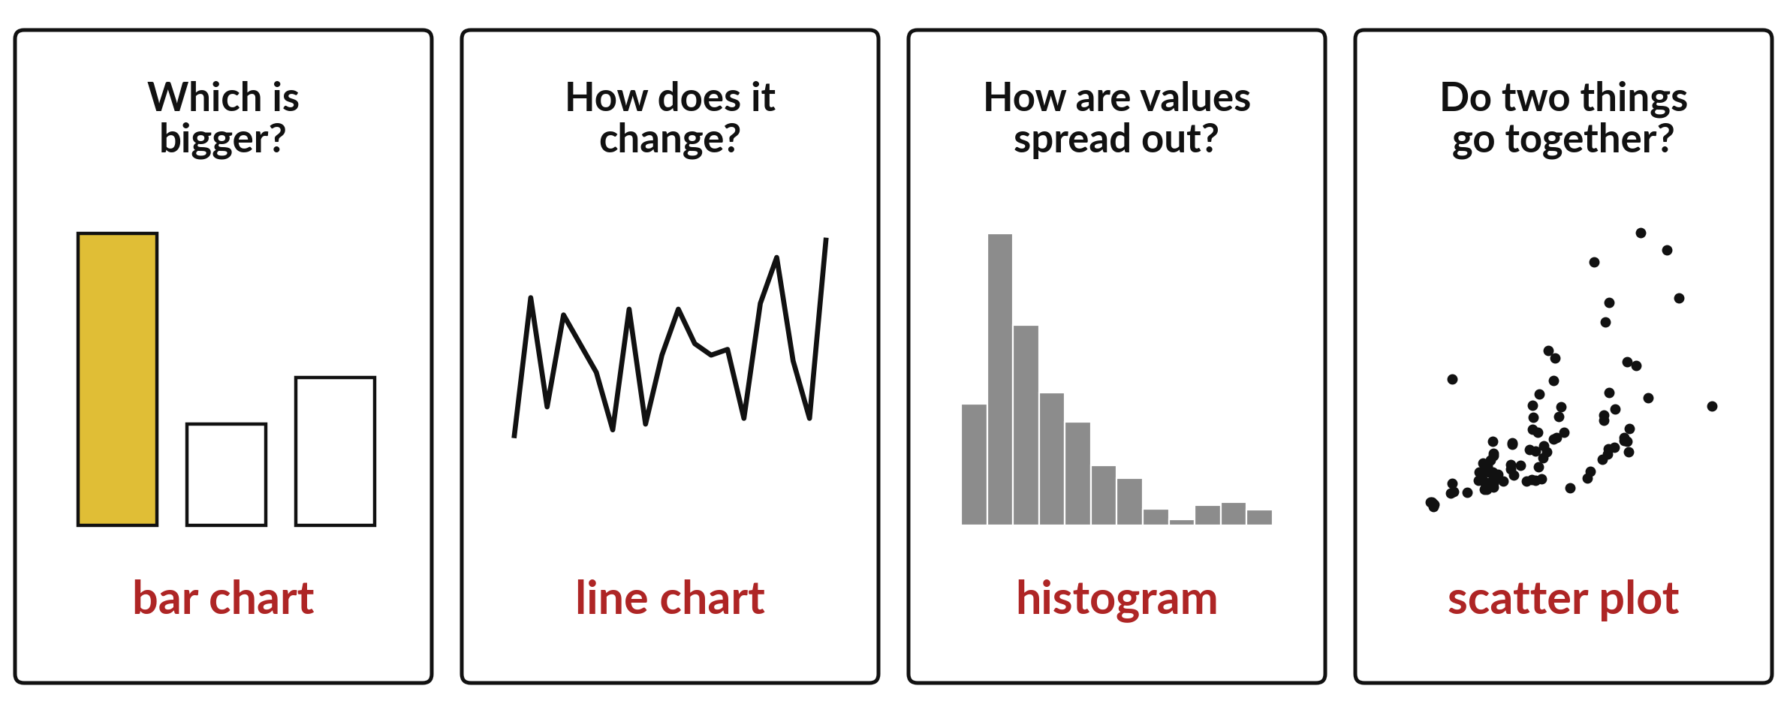
Which chart shows this comparison most clearly?
Notes:
Here are four kinds of question, and the chart that answers each one. Which is bigger? A bar chart. How does something change? A line chart. How are values spread out? A histogram. Do two things go together? A scatter plot. The right chart depends on the comparison you want the reader to make. Today we meet these four charts and practise choosing among them.

Slide 3

Three hours, mostly doing
Most of our time is spent doing, in small steps, with a guess before every run.
Notes:
Here is how the 3 hours go. Each bar is as long as the time we spend on that part.
First, 10 minutes. Recall. Then, 50 minutes. Block A. After that, 15 minutes. Break away from screens. Next, 50 minutes. Block B. Then, 40 minutes. Make. Then, 15 minutes. Exit ticket, save, and an individual check with each learner.
Notice how much of the time is yours. You listen for a short while and then you do. That is on purpose, because you learn this by doing it.

Slide 4

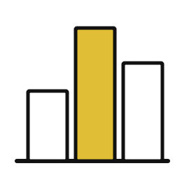
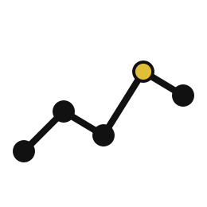
Words for today (1 of 2)
matplotlib
The library that draws charts. We load it as plt.
A pen and a ruler for drawing.
bar chart
Bars compare amounts between categories.
Piles of stock side by side.
line chart
A line shows how one thing changes over ordered dates.
A temperature record.
Notes:
We need a few words today. For each one I will say what it means and give you something to picture.
matplotlib. The library that draws charts. We load it as plt. An example from everyday life. A pen and a ruler for drawing.
bar chart. Bars compare amounts between categories. Here is a way to see it. Piles of stock side by side.
line chart. A line shows how one thing changes over ordered dates. A small example. A temperature record.

Slide 5
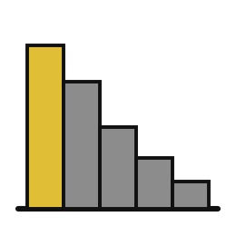

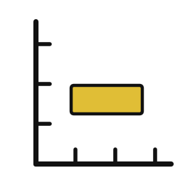
Words for today (2 of 2)
histogram
Bars show how many values fall in each range.
Counting pupils in each height band.
scatter plot
Dots show how two numbers go together.
Each pupil as a dot by height and age.
axis label
The words along an axis that name the quantity and its unit.
The heading of a column.
Notes:
More words for today.
histogram. Bars show how many values fall in each range. Picture this. Counting pupils in each height band.
scatter plot. Dots show how two numbers go together. You have seen this before. Each pupil as a dot by height and age.
axis label. The words along an axis that name the quantity and its unit. The heading of a column.

Slide 6
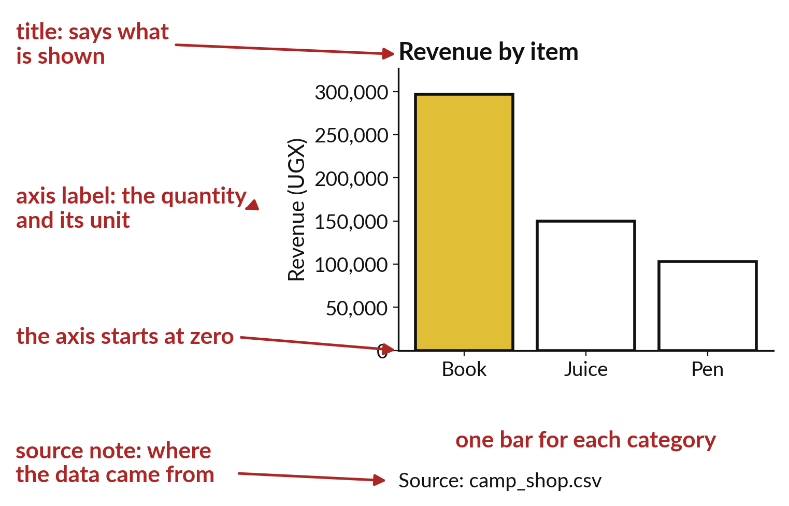
A chart needs a title, labelled axes and a source
The title states what is shown.
Each axis says what it measures and the unit.
A note names the data source.
Notes:
Look at the parts of a chart. The title tells the reader what they are looking at. Each axis has a label, and the label includes the unit, such as shillings or units sold. At the bottom a small note names where the data came from, which for us is the invented Sunrise Shops data.
A reader who gets all of that does not need you standing next to the chart. Check your own charts for all three before you show them.

Slide 7
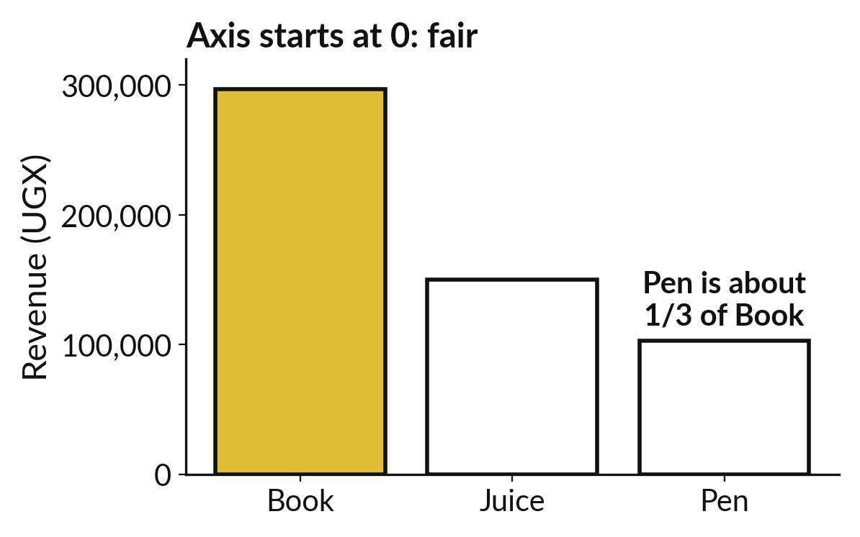
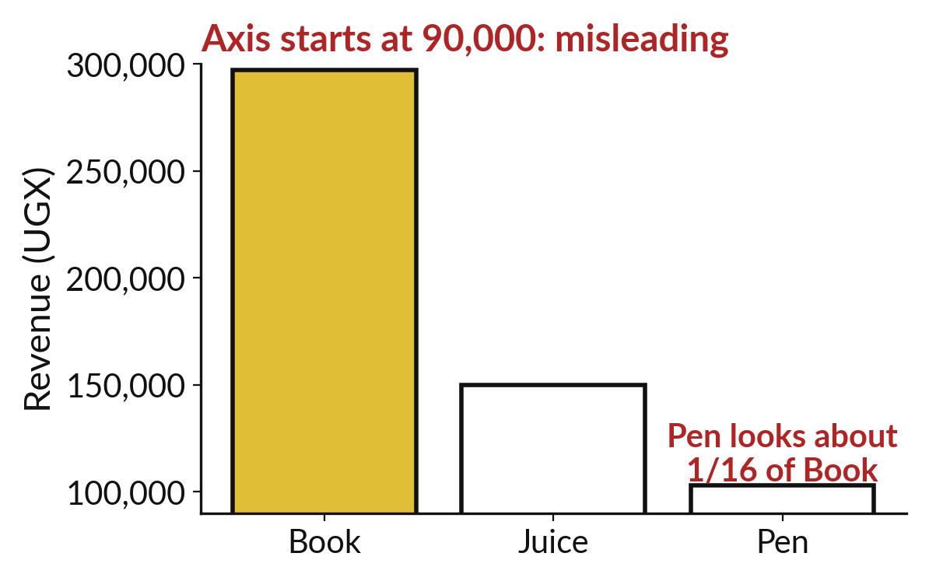
Cutting the axis makes a small gap look huge
The axis starts at zero: the bars are fairly compared.
The axis starts higher up: the gap looks bigger than it is.
Notes:
Both pictures show the same three numbers. On the left the vertical axis starts at zero, so a bar twice as tall means twice as much. On the right the axis starts partway up, and the tallest bar looks several times bigger than the shortest, even though the numbers have not changed.
For bar charts we always start the axis at zero. A reader should be able to trust the heights.

Slide 8

Predict: Bar and line charts (1 of 2)
import pandas as pd
import matplotlib.pyplot as plt
shop = pd.read_csv("camp_shop.csv")
shop["revenue_ugx"] = shop["units"] * shop["unit_price_ugx"]
by_item = shop.groupby("item")["revenue_ugx"].sum()
plt.bar(by_item.index, by_item.values)
plt.ylabel("Revenue (UGX)")
plt.title("Revenue by item, practice shop")
plt.ylim(bottom=0)
plt.show()
Read the first part of the code. 10 lines. Say what each one does.
The second part comes next.
Notes:
Read this first part of the code with me before we run anything. ['plt.bar draws one bar for each category.', 'A bar chart starts its value axis at zero, because the length of a bar stands for the amount.', 'plt.plot joins points in order, which suits dates.']

Slide 9
Predict: Bar and line charts (2 of 2)
by_date = shop.groupby("date")["revenue_ugx"].sum()
plt.plot(by_date.index, by_date.values)
plt.ylabel("Revenue (UGX)")
plt.xticks(rotation=90)
plt.show()
Predict which of the three bars will be tallest.
Write your guess on paper before we run it.
Notes:
plt.bar draws one bar for each category. A bar chart starts its value axis at zero, because the length of a bar stands for the amount.
This is the part where you decide. Predict which of the three bars will be tallest. Guess on paper first. Surprises are useful.

Slide 10
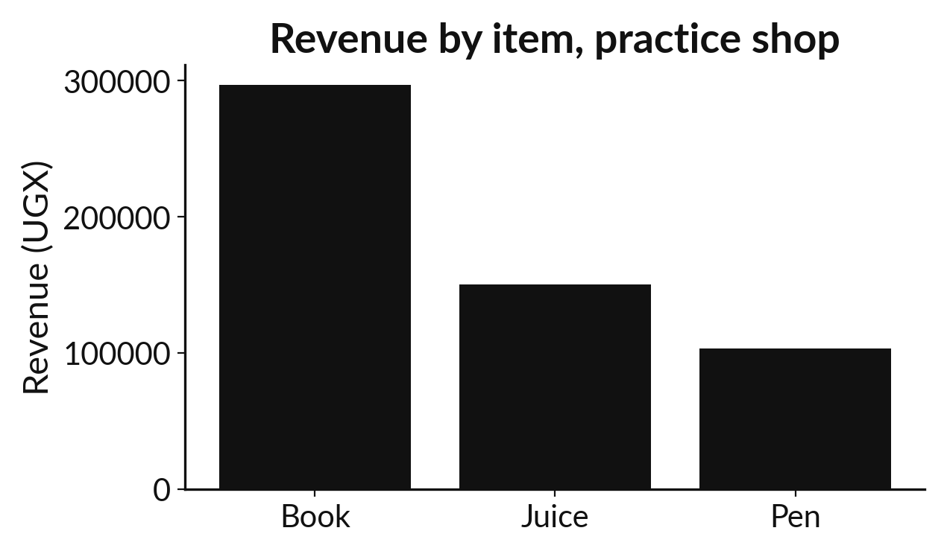
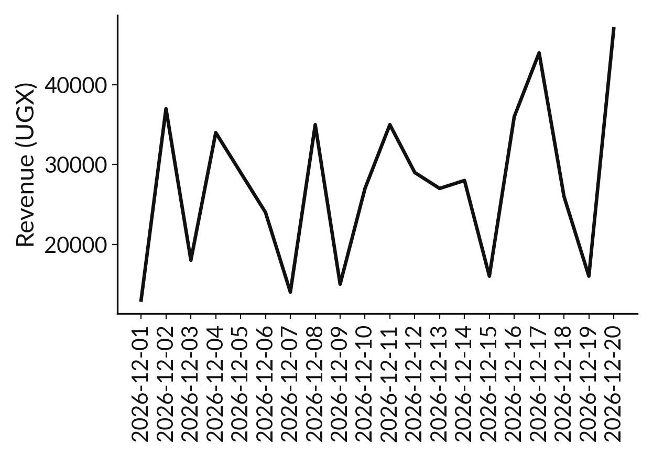
Run it: Bar and line charts
The first chart has three bars. Book is tallest at 297000, then Juice and Pen. The second chart is a line of 20 daily revenues, with the highest point on 2026-12-20. Every axis says what it measures and the bar chart starts at zero.
Notes:
Let us see what happens. Match each line of the output with the line of code that made it.
The first chart has three bars. Book is tallest at 297000, then Juice and Pen. The second chart is a line of 20 daily revenues, with the highest point on 2026-12-20. Every axis says what it measures and the bar chart starts at zero.
Which line of the output matches which line of the code? Point to each pair.

Slide 11

Investigate: Bar and line charts
1. Why does the bar chart start at zero?
2. Why use a line for dates and bars for items?
Notes:
Now we look closely at bar and line charts. I have two questions for you.
Question one. Why does the bar chart start at zero? Say it quietly to yourself before anyone answers.
What I would say is this. The length of the bar stands for the amount. A cut-off axis makes small differences look huge.
Question two. Why use a line for dates and bars for items? Give it thirty seconds and then we will hear a few answers.
Let me answer it. Dates have an order, so a line shows change. Items have no order, so separate bars are fairer.

Slide 12

Modify: change one thing
Draw the bar chart of units by item and add its label.
Then tell your neighbour what changed and how you know.
Notes:
Change one thing and watch what happens. Draw the bar chart of units by item and add its label. When you have run it, tell your neighbour what changed and how you know.
Here is what happens. Pen is tallest with 103 units.

Slide 13

Break
15 minutes away from your screen
Stand up. Drink some water. Tell someone what you guessed in the first half.
Notes:
Break time. 15 minutes away from your screens. Stand up, drink some water and tell someone what you guessed in the first half.
When we come back we start the second idea.

Slide 14
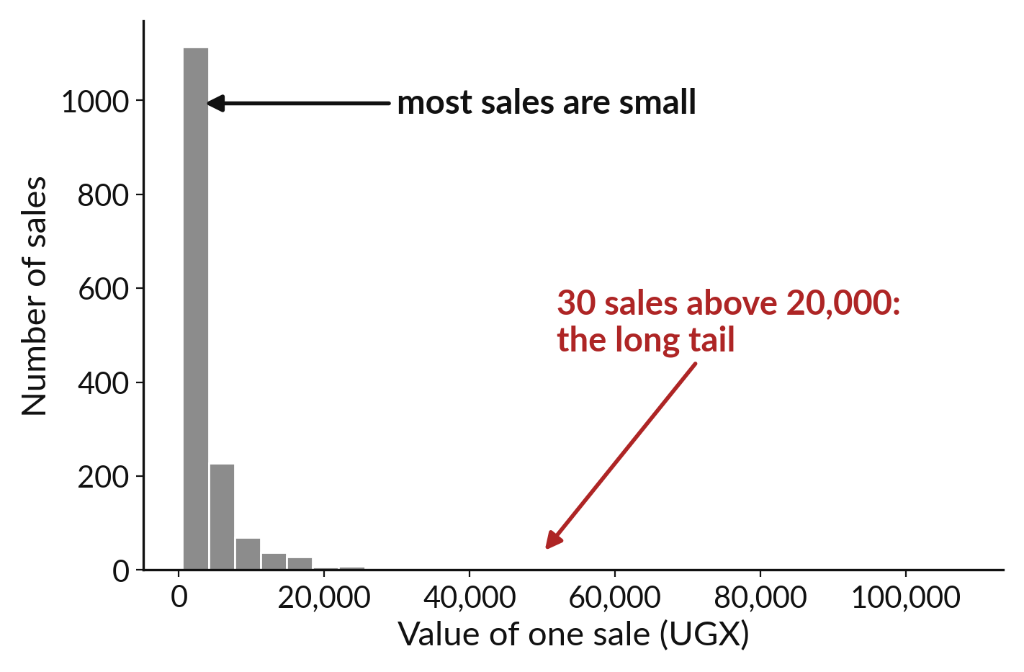
A histogram counts how
many values fall in each range
Each bar is a range of values.
Its height counts the sales in that range.
A long tail shows a few very large values.
Notes:
A bar chart compares groups. A histogram shows the spread of one column of numbers. We cut the values into ranges, and each bar counts how many values land in a range. On this one, most sales are small, so the tall bars are on the left, and a few large sales stretch out a thin tail to the right.
Which range holds the most sales, and where does the tail end?

Slide 15
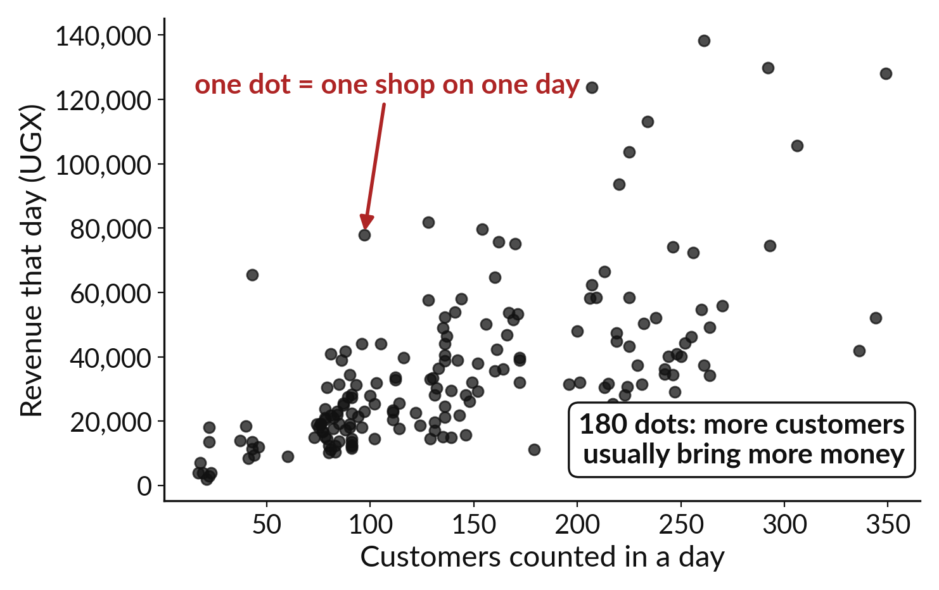
A scatter plot shows one dot for each pair
One dot is one day.
Across is customers, up is revenue.
A pattern in the dots shows a link.
Notes:
A scatter plot compares two columns. Each dot is one row. How far across it sits shows the first value, and how far up it sits shows the second. Here one dot is one day, with customers counted across the bottom and revenue up the side. The dots drift upward from left to right, so busier days tend to bring in more money.
We say tend to, because the dots do not sit on a perfect line.

Slide 16
Predict: Histogram and scatter plot (1 of 2)
sunrise = pd.read_csv("sunrise_sales.csv")
sunrise["line_value"] = sunrise["units"] * sunrise["unit_price_ugx"]
plt.hist(sunrise["line_value"], bins=30)
plt.xlabel("Value of one sale (UGX)")
plt.ylabel("Number of sales")
plt.show()
Read the first part of the code. 6 lines. Say what each one does.
The second part comes next.
Notes:
Read this first part of the code with me before we run anything. ['A histogram shows how the values are spread.', 'A scatter plot puts two numbers on the two axes.', 'These two charts use the Sunrise Shops tables.']

Slide 17
Predict: Histogram and scatter plot (2 of 2)
daily = pd.read_csv("sunrise_daily_summary.csv")
plt.scatter(daily["customers_counted"], daily["revenue_ugx"])
plt.xlabel("Customers counted in a day")
plt.ylabel("Revenue that day (UGX)")
plt.show()
Predict the shape of the histogram of sale values: balanced, or bunched at the low end with a long tail?
Write your guess on paper before we run it.
Notes:
A histogram shows how the values are spread. A scatter plot puts two numbers on the two axes.
Make a prediction. Predict the shape of the histogram of sale values: balanced, or bunched at the low end with a long tail? Write it on paper. It does not have to be right.

Slide 18
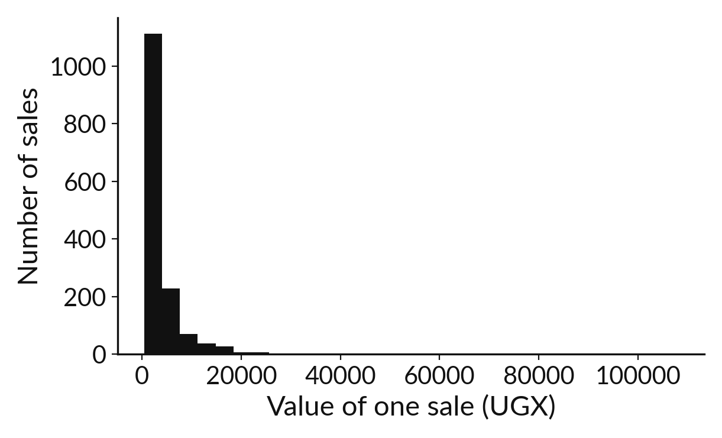
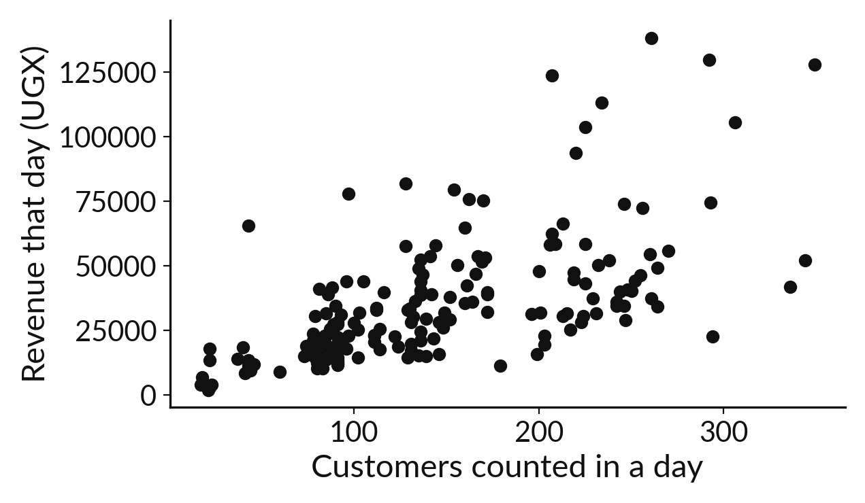
Run it: Histogram and scatter plot
The histogram is bunched at the low end with a long tail to the right, because most sales are small and a few are very large. The scatter plot has 180 dots, one for each shop and day.
Notes:
Running it now. Match each line of the output with the line of code that made it.
The histogram is bunched at the low end with a long tail to the right, because most sales are small and a few are very large. The scatter plot has 180 dots, one for each shop and day. More customers usually mean more revenue, but the dots are scattered, so the link is not exact.
Keep your guess. We use it in the next step.

Slide 19
Investigate: Histogram and scatter plot
1. What does the long tail in the histogram tell us?
2. Does the scatter plot show that customers cause revenue?
Notes:
Now we look closely at histogram and scatter plot. I have two questions for you.
Question one. What does the long tail in the histogram tell us? Give it thirty seconds and then we will hear a few answers.
Let me answer it. A few sales are far larger than the rest. That is why the mean is above the median.
Question two. Does the scatter plot show that customers cause revenue? Talk it over with your neighbour for a minute.
The answer is this. It shows that they go together. It does not prove cause. That needs more evidence.

Slide 20
Modify: change one thing
Change bins=30 to bins=10 and describe what the histogram loses.
Then tell your neighbour what changed and how you know.
Notes:
Make one small change. Change bins=30 to bins=10 and describe what the histogram loses. Run it, then tell someone what you saw.
What you should find: It hides detail in the long tail.

Slide 21
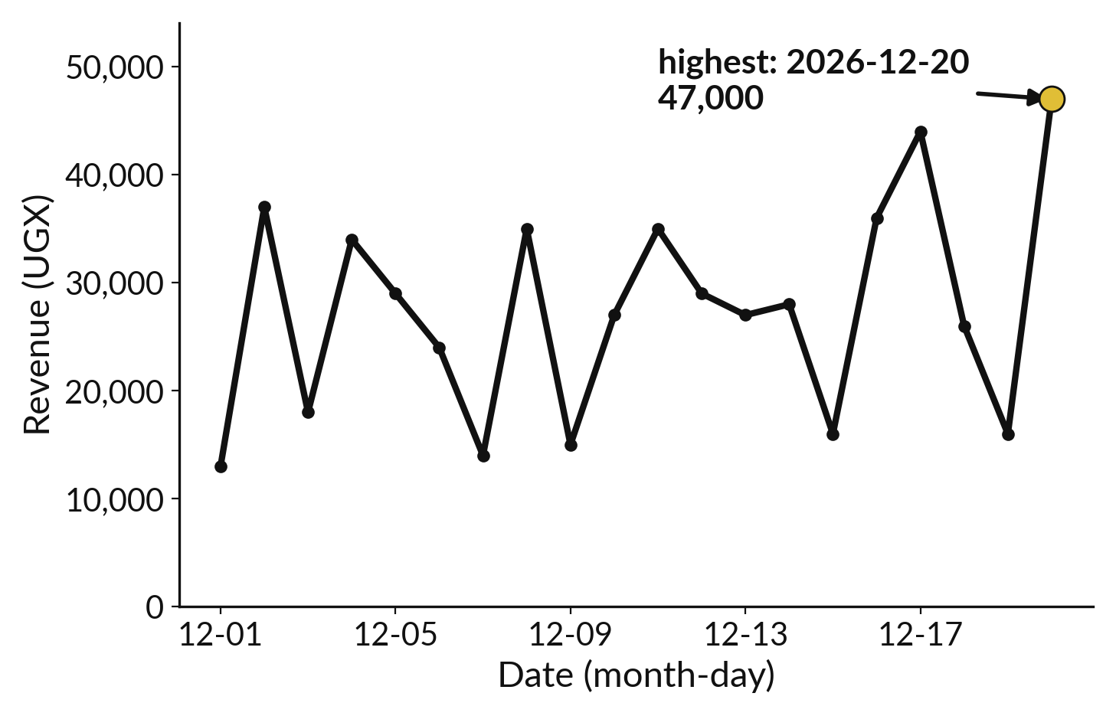
A line chart joins values over time
Time runs along the bottom.
The line joins one day to the next.
Crowded date labels can be rotated or thinned.
Notes:
A line chart is the right choice when the horizontal axis is time. The line joins each day to the next, so the eye follows the rise and the fall. If the dates are crowded and overlap, rotate them or show fewer of them. That fixes the second item in your errors list.
Use a line only when the order matters. Joining three shops with a line would suggest they follow each other, and they do not.

Slide 22

Make: your own version
Chart the Sunrise revenue by branch. Use a dictionary to turn the ids 1, 2 and 3 into the names Central Market, Campus Gate and Roadside. Label the axis, start it at zero and write one finding and one limitation.
Save it as DA11. Write two sentences: what you changed and how you checked it.
Notes:
This is your own task for today. Take it one step at a time. If you get stuck for a few minutes, read your error message, check the error card, and then ask me.
Save it as DA11. I will come round to each of you and ask what you changed and how you checked it.

Slide 23

Two errors you may meet today
It means: plt.show() ran before the data was added, or the data was empty.
Fix: Run the cell that creates the table first and print its length.
The chart appears empty
It means: There are too many labels to fit side by side.
Fix: Rotate them with plt.xticks(rotation=90) or plot fewer dates.
The labels on the dates overlap
Notes:
Everyone meets errors, including me. Two are likely today, so let us meet them now.
This is the first one. You will see: The chart appears empty. It means this: plt.show() ran before the data was added, or the data was empty. To fix it, Run the cell that creates the table first and print its length.
The next one. You will see: The labels on the dates overlap. It means this: there are too many labels to fit side by side. To fix it, rotate them with plt.xticks(rotation=90) or plot fewer dates.
Keep this slide in mind when something stops working.

Slide 24

Finish this sentence in your notebook
I choose the chart by the question, label its axes, and say what it cannot show.
Then save your notebook, close it and open it again to check it saved.
Notes:
We are nearly done. Remember the question from the start of the session: Which chart shows this comparison most clearly?
Write this sentence in your notebook and finish it your own way. I choose the chart by the question, label its axes, and say what it cannot show.
Then save your notebook, close it and open it again to check it saved.

