Slide 1
Checkpoint one: load, summarise, chart and explain
What do the Sunrise Shops sales tell us about the three shops?
Python for Data Analysis | Session 12 of 24 | Week 4, Clean and chart
Holiday Data and AI Camp | The National ICT Innovation Hub, Nakawa
Notes:
Laptops open, please. Today is session 12 and our topic is checkpoint one: load, summarise, chart and explain.
By the end of today you will be able to read a table, check it, summarise it, chart it and explain two findings and one limit, from a restarted notebook.
We will answer one question: What do the Sunrise Shops sales tell us about the three shops?

Slide 2
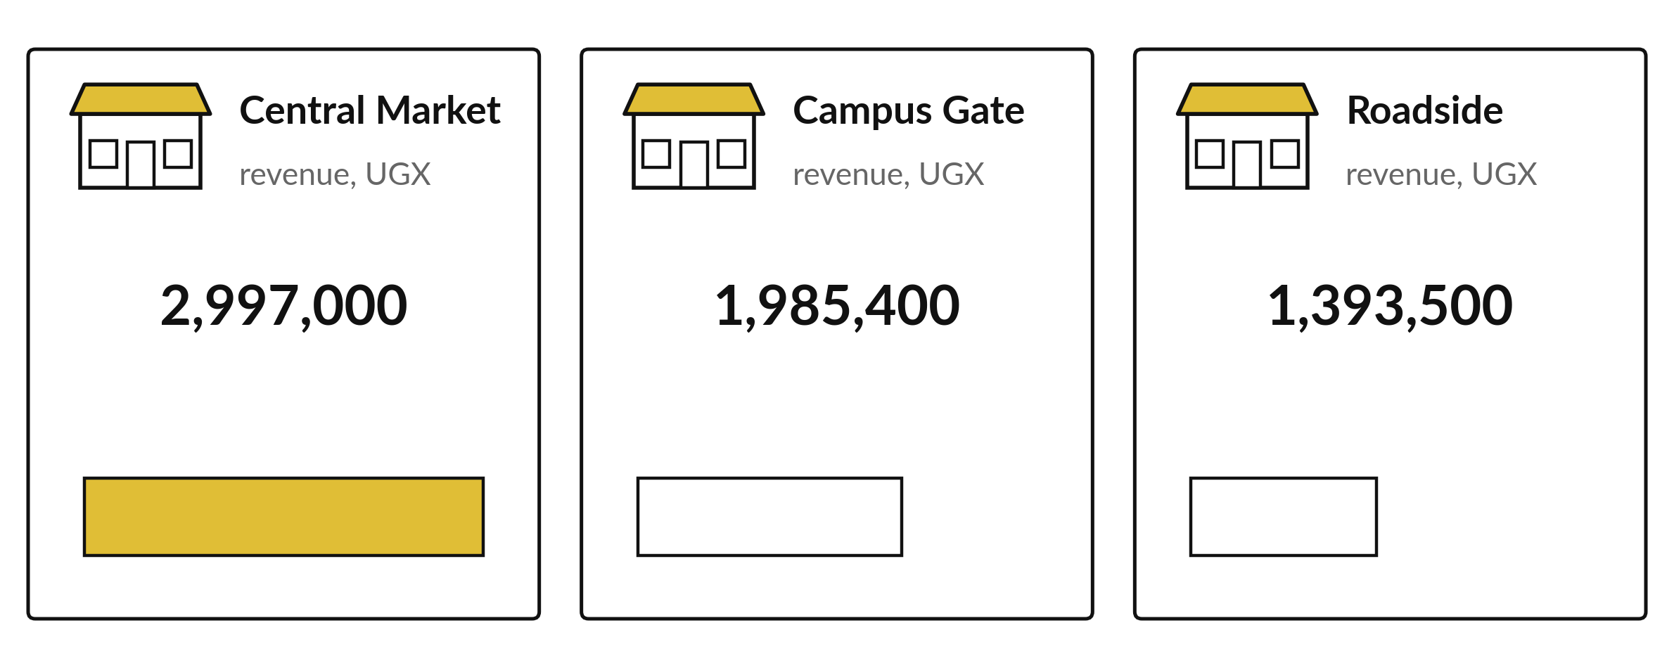
What do the Sunrise Shops sales
tell us about the three shops?
Notes:
This is the first checkpoint. You have the Sunrise sales, one thousand five hundred and thirteen rows, and you have the tools to load, summarise and chart them. The question is a big one. What do the sales tell us about the three shops? Today you answer it on your own, in a notebook that someone else can restart and rerun, and I will mark what you wrote, and how you checked it.

Slide 3
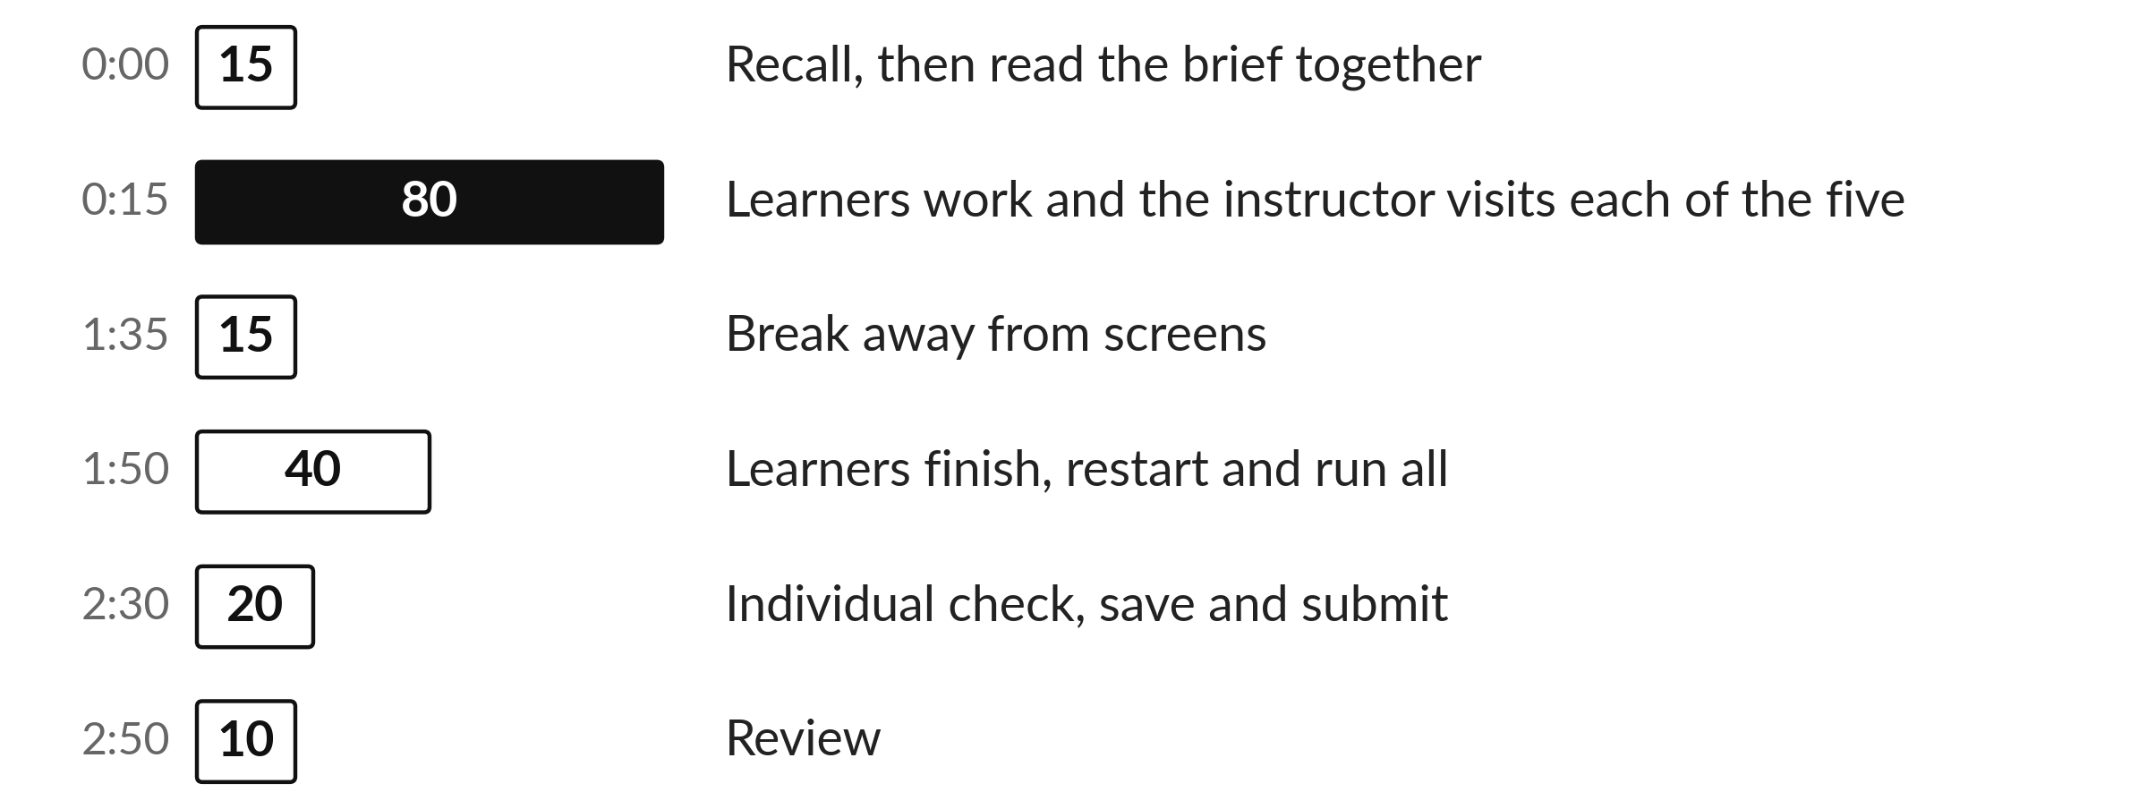
Today's plan in minutes
Today is your own work. I visit each of you and answer questions on the brief.
Notes:
Here is how the 3 hours go. Each bar is as long as the time we spend on that part.
First, 15 minutes. Recall, then read the brief together. Then, 80 minutes. Learners work and the instructor visits each of the five. After that, 15 minutes. Break away from screens. Next, 40 minutes. Learners finish, restart and run all. Then, 20 minutes. Individual check, save and submit. Then, 10 minutes. Review.
Today is your own work. I visit each of you and answer questions on the brief. Ask me now if any part of the plan is unclear.

Slide 4
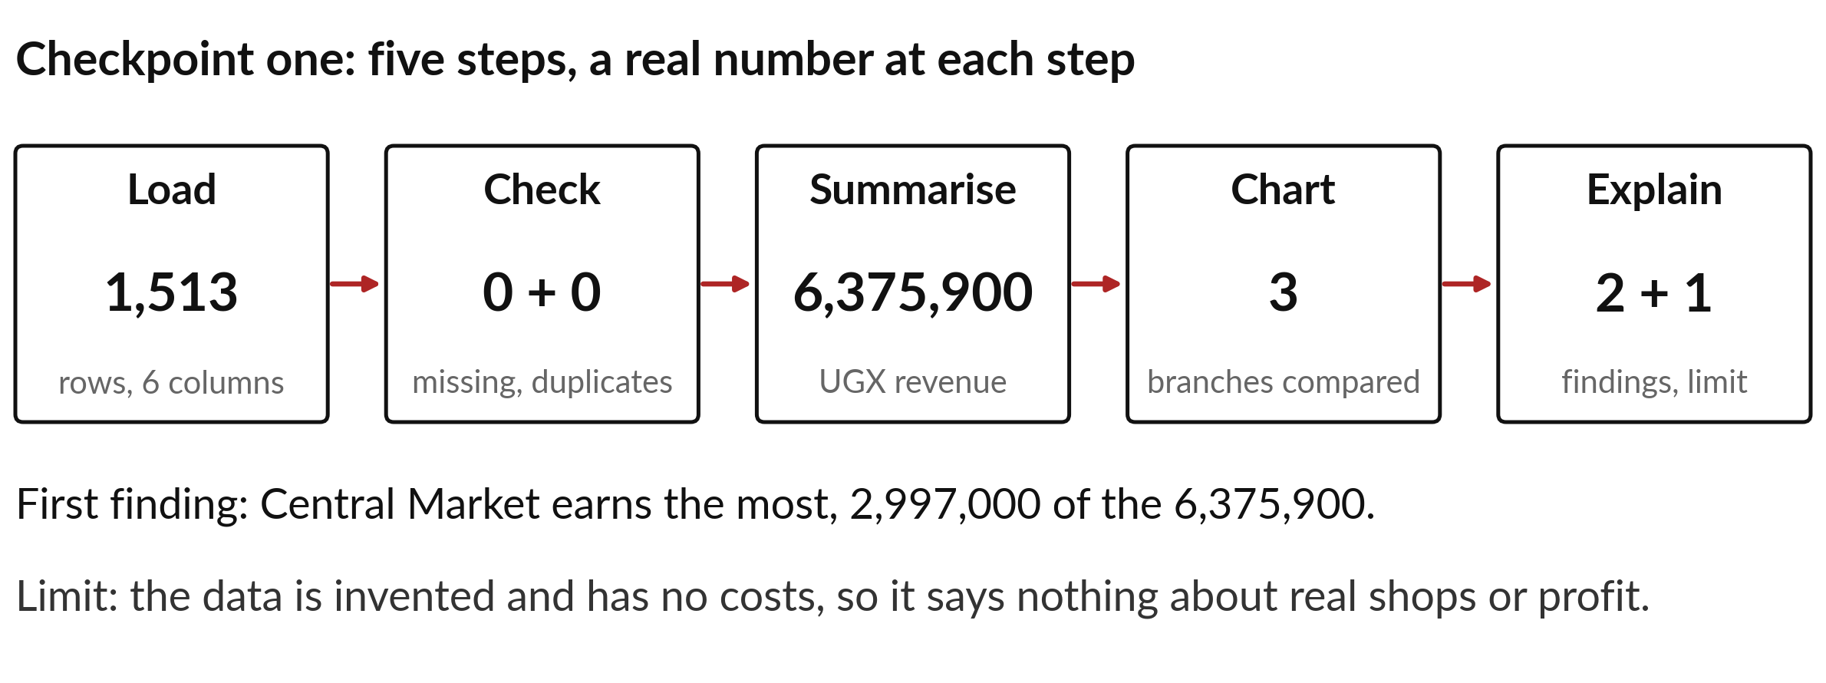
Checkpoint one has five steps, from file to finding
Load, check, total, chart, then write what you found.
Notes:
The checkpoint has a clear order. We load the file. We check it, looking for missing values and repeats. We total the revenue and group it by branch. We draw a chart. And only then do we write what we found.
Keep the steps in this order in your notebook. If the order is clear, the marking is easy, and so is the rerun.

Slide 5
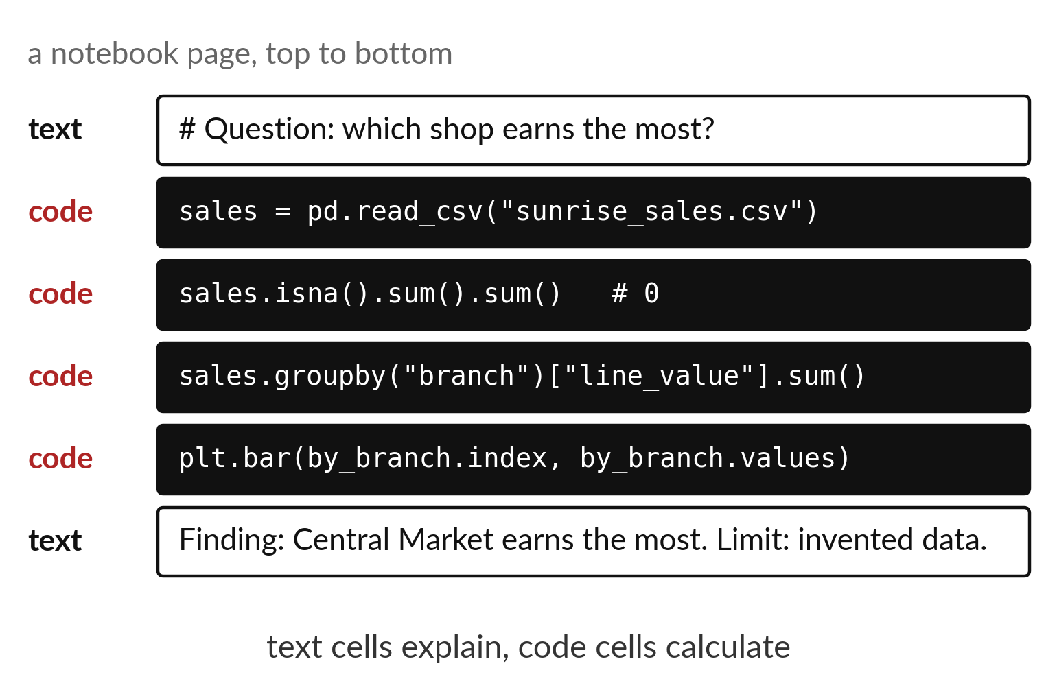
A notebook that reads top
to bottom is easy to rerun
A heading names each step.
Code sits below its heading.
A sentence under the output says what it shows.
Notes:
Here is a layout that works. Each step begins with a heading in a text cell. Under it comes the code, and under the code comes the output. Then you add one sentence in your own words that says what the output means.
When the notebook reads like this, a reader can follow it without asking you anything.

Slide 6
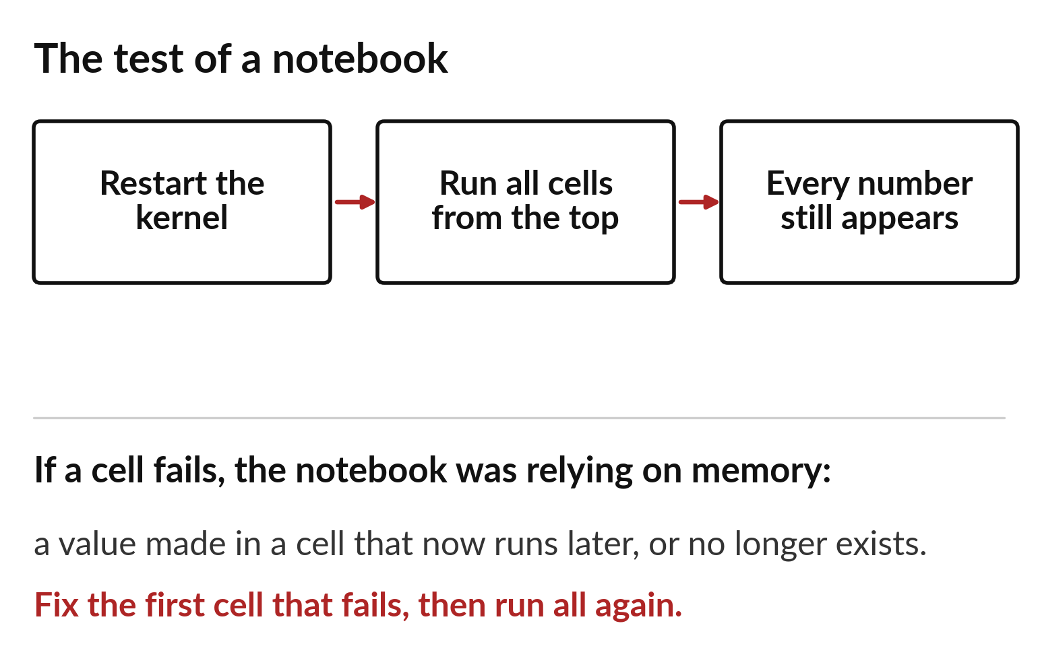
Restart and run all before
you trust a single number
Restart the kernel to clear the memory.
Run all cells from the top.
Compare every number with your notes.
Notes:
A notebook can hide a mistake. You might have run a cell, changed it, and forgotten that a later cell still uses the old value. The test is simple. Restart the kernel, which clears everything Python remembers, and run all the cells from the top. If every number comes out the same, the notebook is honest.
Do this at the end of the checkpoint. If a number changes, find the first cell that differs.

Slide 7
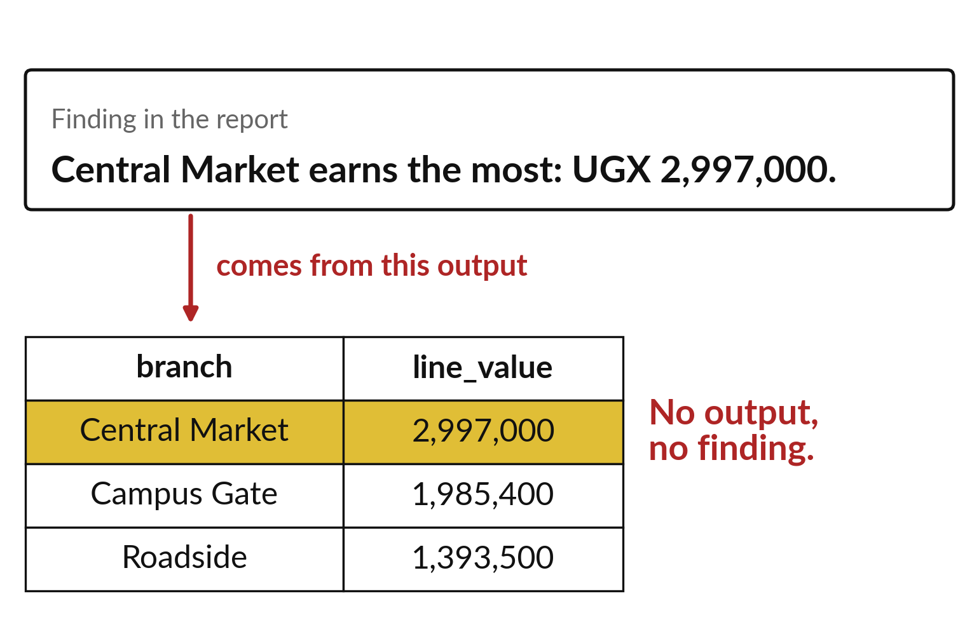
Every finding points back to its output cell
Write the number exactly as the output shows it.
Name the cell that produced it.
The total should match 6,375,900.
Notes:
A finding is a sentence with a number in it. Each one needs a trail back to the cell that produced the number. For example, the total revenue of six million three hundred and seventy five thousand nine hundred comes from the cell that sums the line value column.
If a number in your sentences does not match any output, fix the sentence or find the mistake. Both are better than leaving them different.

Slide 8

Make: your own version (1 of 2)
In DA12.ipynb use sunrise_sales.csv. 1) Report the number of rows and the total revenue. 2) Check for missing values and duplicates and report the counts. 3) Total the revenue by branch with names from a dictionary and sort the result.
Notes:
Now you do the real work yourself. Start with the first step. If you get stuck for a few minutes, read your error message, check the error card, and then ask me.
Save it as DA12. I will come round to each of you and ask what you changed and how you checked it.
The rest of the brief is on the next slide.

Slide 9
Make: your own version (2 of 2)
4) Draw one labelled chart. 5) Write two findings and one limitation in text cells. Restart the kernel, run all cells from the top, save and submit DA12.ipynb with a short report.pdf or report.docx through the route in START_HERE.md.
Save it as DA12. Write two sentences: what you changed and how you checked it.
Notes:
Here is the rest of the brief. Take your time, and save your work as you go, because a saved file is the only thing I can mark.

Slide 10

Two errors you may meet today
It means: A cell relies on a value that was created in a cell that no longer runs first.
Fix: Restart the kernel and run all cells from the top. Fix the first cell that fails.
The numbers differ after a restart
It means: A filter, copy or merge changed the number of rows.
Fix: Print len() after each step and find where the count changes.
The total does not match 6375900
Notes:
Two things are likely to go wrong today. It helps to know them before they happen.
This is the first one. You will see: The numbers differ after a restart. It means this: A cell relies on a value that was created in a cell that no longer runs first. To fix it, restart the kernel and run all cells from the top. Fix the first cell that fails.
The next one. You will see: The total does not match 6375900. It means this: A filter, copy or merge changed the number of rows. To fix it, print len() after each step and find where the count changes.
If you meet one of these, fix it and carry on. It happens to everyone.

Slide 11

Finish this sentence in your notebook
My notebook reruns from the top and every number in my findings appears in an output.
Then save your notebook, close it and open it again to check it saved.
Notes:
Before we finish, go back to the question we began with: What do the Sunrise Shops sales tell us about the three shops?
Copy this sentence into your notebook and make it yours. My notebook reruns from the top and every number in my findings appears in an output.
Then save your notebook, close it and open it again to check it saved.

