Slide 1
Merging two tables and the fan-out trap
Which product category earns the most, and can we trust the merge that tells us?
Python for Data Analysis | Session 17 of 24 | Week 6, Messy data and two tables
Holiday Data and AI Camp | The National ICT Innovation Hub, Nakawa
Notes:
Laptops open, please. Today is session 17 and our topic is merging two tables and the fan-out trap.
By the end of today you will be able to merge two tables on a key, check the row count before and after, and spot a duplicated key that inflates a total.
We will answer one question: Which product category earns the most, and can we trust the merge that tells us?

Slide 2
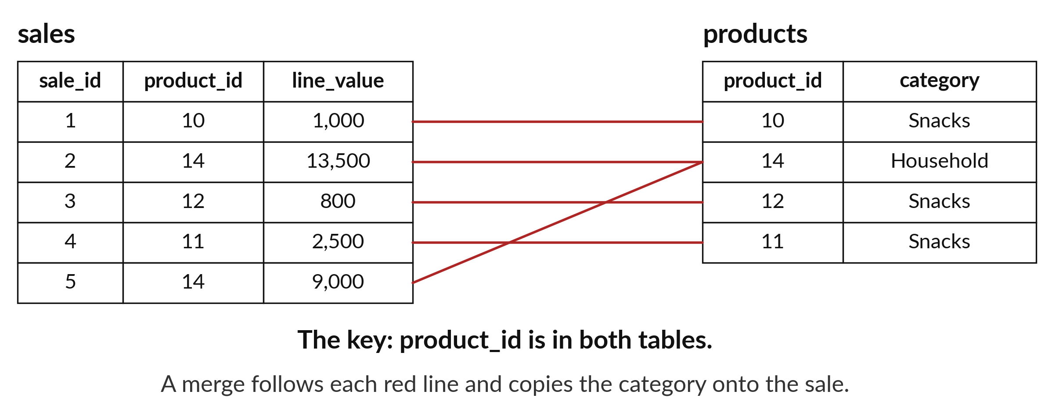
Which product category earns the most,
and can we trust the merge that tells us?
Notes:
Which product category earns the most, and can we trust the table that tells us? The sales table lists products by an id number. The category lives in a different table, the products table. To answer the question we have to join the two tables together with a merge. A merge is powerful, and it can also go wrong without any error message. Today you learn to merge, and to check the merge before you believe it.

Slide 3

Three hours, mostly doing
Most of our time is spent doing, in small steps, with a guess before every run.
Notes:
Here is how the 3 hours go. Each bar is as long as the time we spend on that part.
First, 10 minutes. Recall. Then, 50 minutes. Block A. After that, 15 minutes. Break away from screens. Next, 50 minutes. Block B. Then, 40 minutes. Make. Then, 15 minutes. Exit ticket, save, and an individual check with each learner.
Notice how much of the time is yours. You listen for a short while and then you do. That is on purpose, because you learn this by doing it.

Slide 4



Words for today (1 of 2)
merge key
A column that identifies a row and is shared by two tables, such as product_id.
The item number on both the price board and the receipt.
merge
Join two tables by matching their key columns.
Matching each receipt with its line on the price board.
left merge
Keep every row of the first table, even when nothing matches.
Keep every receipt, even for a missing price board line.
Notes:
We need a few words today. For each one I will say what it means and give you something to picture.
merge key. A column that identifies a row and is shared by two tables, such as product_id. A small example. The item number on both the price board and the receipt.
merge. Join two tables by matching their key columns. Picture this. Matching each receipt with its line on the price board.
left merge. Keep every row of the first table, even when nothing matches. You have seen this before. Keep every receipt, even for a missing price board line.

Slide 5


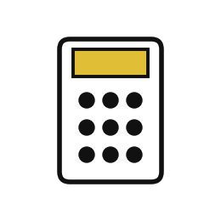
Words for today (2 of 2)
unique
Appears once only. A key must be unique in the table it looks up.
One item number per product.
fan-out
A merge that makes extra rows because a key appears twice, and inflates every total.
One receipt copied for every duplicated price line.
reconcile
Check that two routes to the same total agree, or explain why not.
Counting the cash tin and the receipts and comparing them.
Notes:
More words for today.
unique. Appears once only. A key must be unique in the table it looks up. One item number per product.
fan-out. A merge that makes extra rows because a key appears twice, and inflates every total. Think of a shop. One receipt copied for every duplicated price line.
reconcile. Check that two routes to the same total agree, or explain why not. Imagine it like this. Counting the cash tin and the receipts and comparing them.

Slide 6
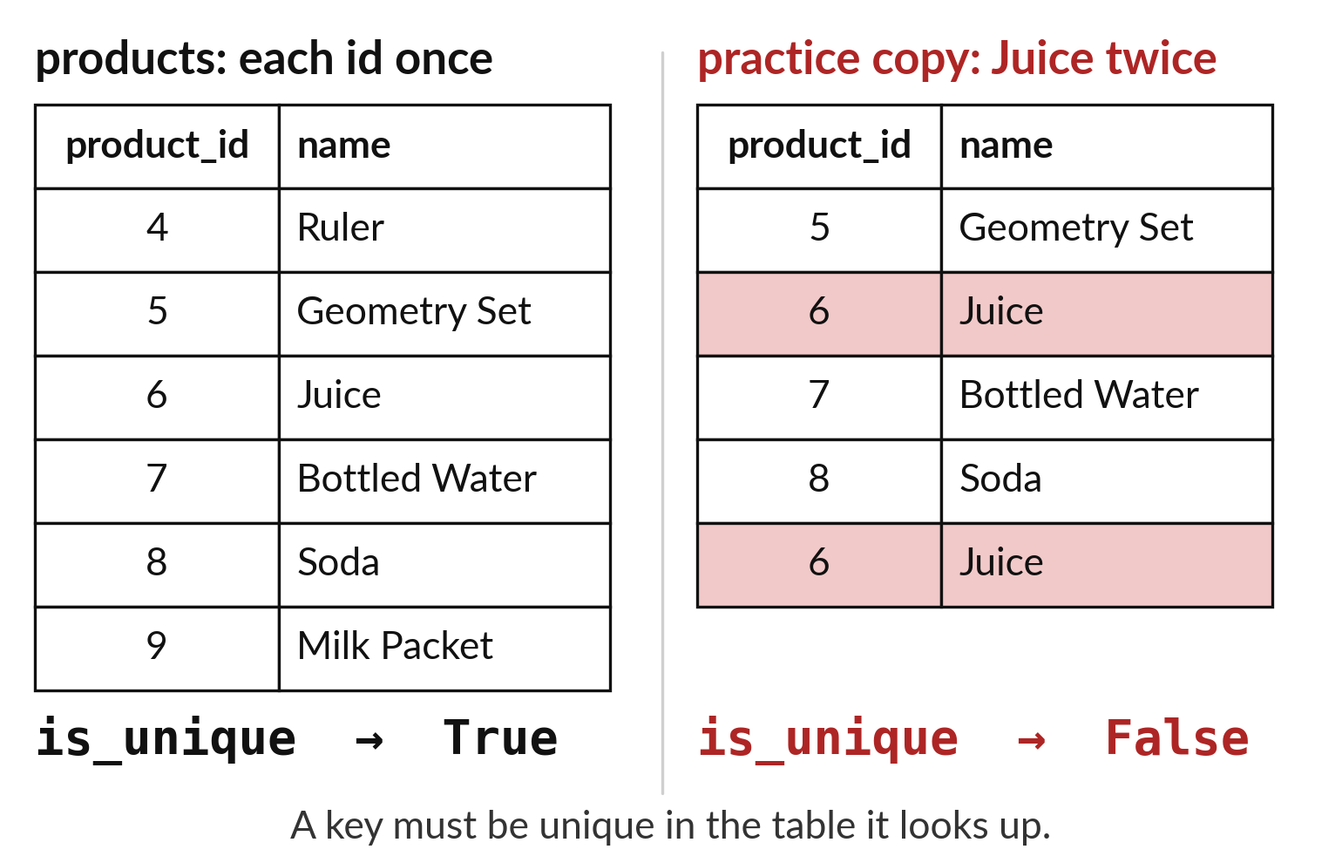
A merge key must pick out exactly one row
The key is the column both tables share.
In the lookup table each key appears once.
A repeated key causes trouble.
Notes:
To join two tables we need a column they share, and we call it the merge key. For sales and products the key is the product id. The products table works like a phone book. Each id should appear once, so that each lookup gives exactly one answer.
Count the ids on the picture. Does any id appear twice? If it does, the merge cannot decide which row to attach.

Slide 7
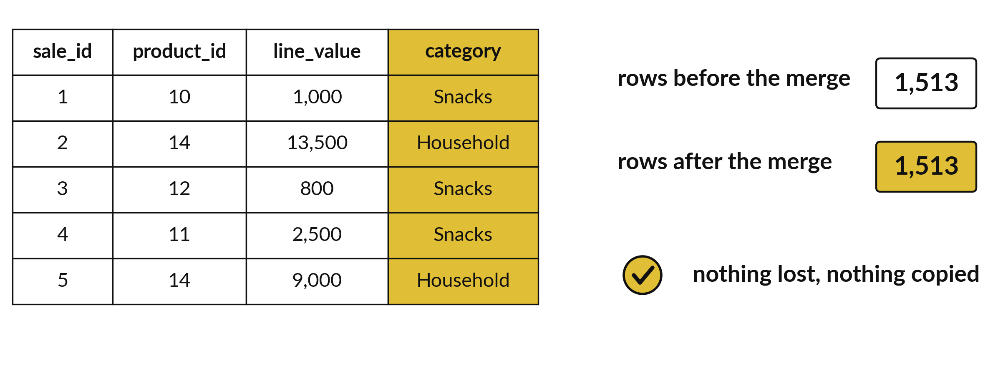
A left merge keeps every sale and adds columns
1,513 sales go in and 1,513 rows come out.
Notes:
A left merge keeps every row from the left table, the sales, and attaches the matching columns from the right table, the products. If a sale has no match it stays, with empty cells for the new columns.
Because every sale is kept once, the number of rows that comes out should equal the number that went in. One thousand five hundred and thirteen in, one thousand five hundred and thirteen out. That is the first check.

Slide 8

Predict: A merge you can trust
Predict the row count after the merge and which category earns the most.
Write your guess on paper before we run it.
Notes:
sales.csv holds the product_id of each sale. products.csv says which category each product belongs to.
Your turn to guess. Predict the row count after the merge and which category earns the most. Guess on paper first. Surprises are useful.

Slide 9
Run it: A merge you can trust
True
1513 1513
category
Household 2082700
Drinks 1863200
Stationery 1686500
Snacks 743500
Name: line_value, dtype: int64
6375900
The key is unique (True).
Both tables have 1513 rows.
The categories rank Household 2082700, Drinks 1863200, Stationery 1686500 and Snacks 743500, and they add to 6375900.
The count and the total both match the true values, so the merge is safe.
Notes:
I will run it, and you compare with your guess. Match each line of the output with the line of code that made it.
The key is unique (True). Both tables have 1513 rows. The categories rank Household 2082700, Drinks 1863200, Stationery 1686500 and Snacks 743500, and they add to 6375900. The count and the total both match the true values, so the merge is safe.
Check your paper. Were you close?

Slide 10

Investigate: A merge you can trust
1. Why check that product_id is unique before merging?
2. How do you know the merge did not lose or add rows?
Notes:
Now we look closely at A merge you can trust. I have two questions for you.
Question one. Why check that product_id is unique before merging? Say it quietly to yourself before anyone answers.
If a product appeared twice, every sale of it would be copied twice.
Question two. How do you know the merge did not lose or add rows? Give it thirty seconds and then we will hear a few answers.
Here is how I would answer it. The row count is 1513 before and after, and the category totals add to the overall total.

Slide 11

Modify: change one thing
Show the category with the lowest revenue.
Then tell your neighbour what changed and how you know.
Notes:
Time to experiment. Show the category with the lowest revenue. After you run it, say in one sentence what changed and how you checked.
You should see this. Snacks with 743500.

Slide 12

Break
15 minutes away from your screen
Stand up. Drink some water. Tell someone what you guessed in the first half.
Notes:
Break time. 15 minutes away from your screens. Stand up, drink some water and tell someone what you guessed in the first half.
When we come back we start the second idea.

Slide 13
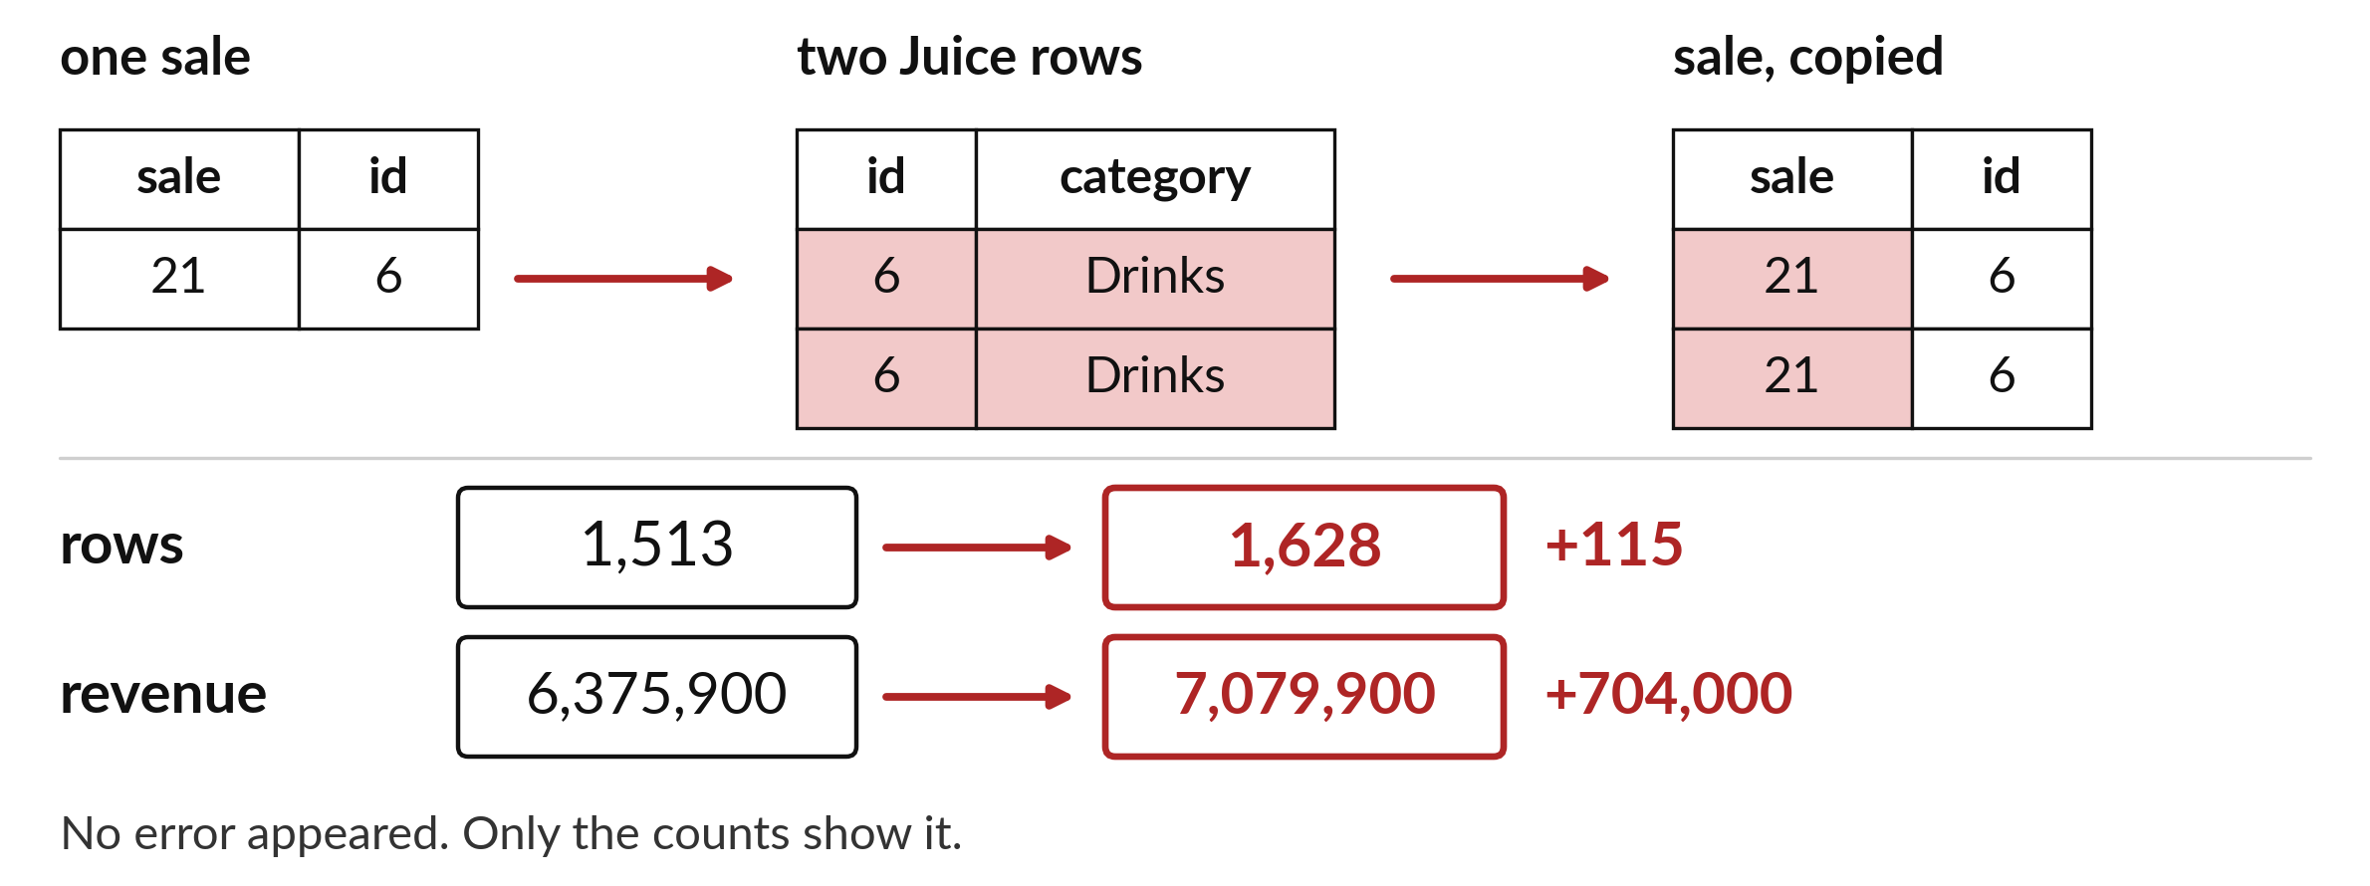
Repeated keys give 1,628 rows instead of 1,513
The revenue grows from 6,375,900 to 7,079,900, which is 704,000 too much.
Notes:
Here is the trap. If the products table lists one product twice, every sale of that product is attached to both copies, so the sale appears twice. We call this a fan-out. The merged table grows to one thousand six hundred and twenty eight rows, and the revenue climbs to seven million seventy nine thousand nine hundred shillings. That is seven hundred and four thousand too much.
No error appears. The only warning is that the numbers have changed, and that is why we check.

Slide 14
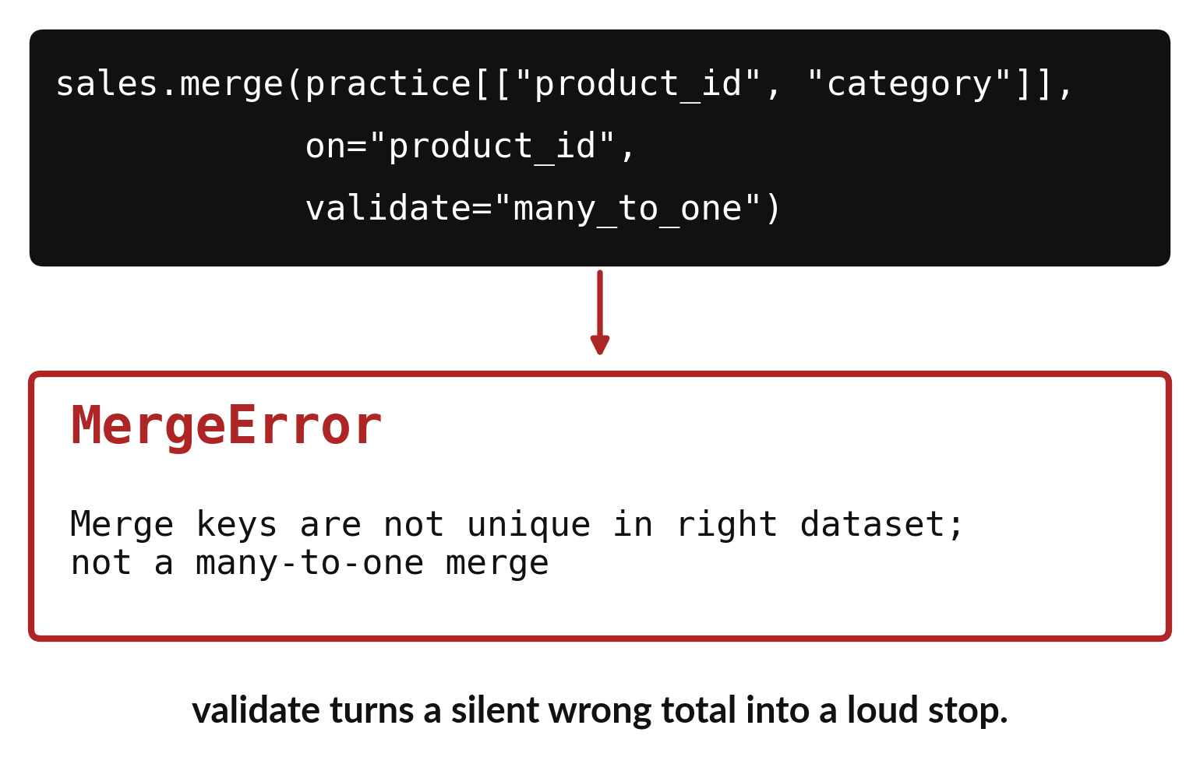
A merge check stops a bad
merge before it spreads
Tell pandas how the keys should match.
If the keys break the rule, pandas stops with a MergeError.
Fix the lookup table, then merge again.
Notes:
pandas can check the merge for us. When we merge we tell it the shape we expect, which here is many sales to one product. If a key turns out to repeat, pandas stops at once with a MergeError, instead of quietly multiplying our rows.
An error that stops you is a gift. Read the message, fix the products table, and run the merge again.

Slide 15

Predict: The fan-out trap
practice = pd.read_csv("sunrise_products_practice.csv")
print(practice["product_id"].is_unique)
bad = sales.merge(
practice[["product_id", "category"]], on="product_id",
how="left"
)
print(len(bad), bad["line_value"].sum())
print(bad["line_value"].sum() - sales["line_value"].sum())
print(practice[practice.duplicated("product_id", keep=False)])
Predict what happens to the row count and the total revenue.
Write your guess on paper before we run it.
Notes:
sunrise_products_practice.csv is a copy of the products table with one product listed twice. Merge with it and watch the totals.
Now your guess. Predict what happens to the row count and the total revenue. Write it on paper. It does not have to be right.

Slide 16
Run it: The fan-out trap
False
1628 7079900
704000
product_id name category
5 6 Juice Drinks
15 6 Juice Drinks
The key is not unique (False).
The merged table has 1628 rows, which is 115 too many, and the total is 7079900, which is 704000 too high.
The duplicate is Juice with product_id 6.
Python raised no error.
Notes:
Watch the output as it appears. Match each line of the output with the line of code that made it.
The key is not unique (False). The merged table has 1628 rows, which is 115 too many, and the total is 7079900, which is 704000 too high. The duplicate is Juice with product_id 6. Python raised no error. Only the check of the row count and total finds it.
Tell the person next to you whether your guess matched.

Slide 17
Investigate: The fan-out trap
1. Why did Python not warn us?
2. What two numbers give the problem away?
Notes:
Now we look closely at the fan-out trap. I have two questions for you.
Question one. Why did Python not warn us? Give it thirty seconds and then we will hear a few answers.
Here is how I would answer it. A merge with a repeated key is legal. It simply copies the matching rows.
Question two. What two numbers give the problem away? Talk it over with your neighbour for a minute.
What I would say is this. The row count rose from 1513 to 1628, and the total rose from 6375900 to 7079900.

Slide 18
Modify: change one thing
Ask the merge to check the key by adding validate="many_to_one". Read the result.
Then tell your neighbour what changed and how you know.
Notes:
Your hands on the keyboard now. Ask the merge to check the key by adding validate="many_to_one". Read the result. Then explain to your neighbour what the change did.
The result: pandas stops with a MergeError.

Slide 19
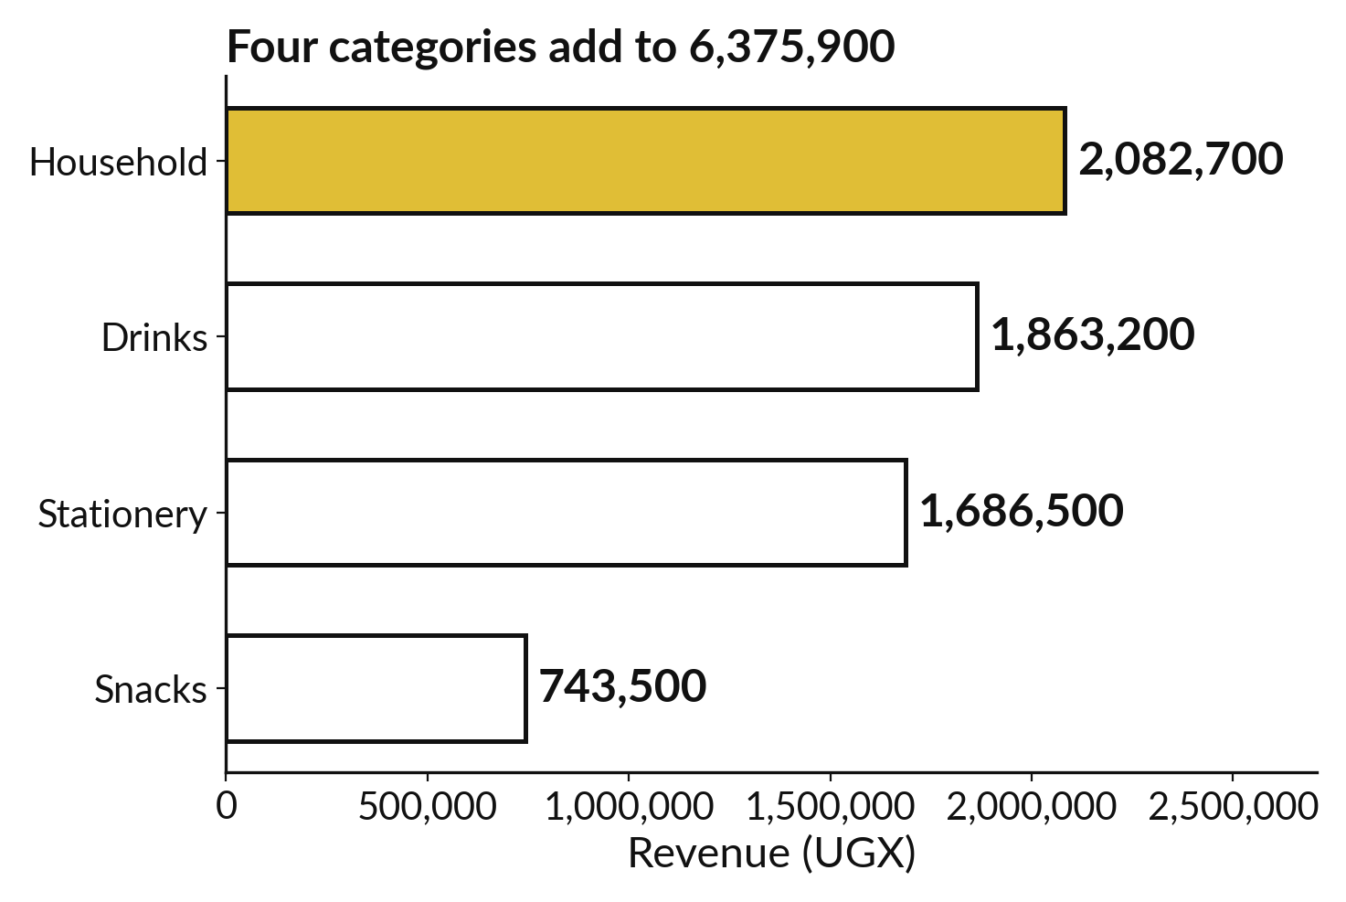
Category totals show which
category earns the most
Household: 2,082,700.
Drinks: 1,863,200 and Stationery: 1,686,500.
Snacks: 743,500.
Notes:
With a safe merge we can finally answer the question. We group the merged table by category and add up the line values. Household leads with two million eighty two thousand seven hundred shillings. Drinks follow with one million eight hundred and sixty three thousand two hundred. Stationery has one million six hundred and eighty six thousand five hundred, and Snacks has seven hundred and forty three thousand five hundred.
Add the four categories. Does the total match the grand total of the sales?

Slide 20
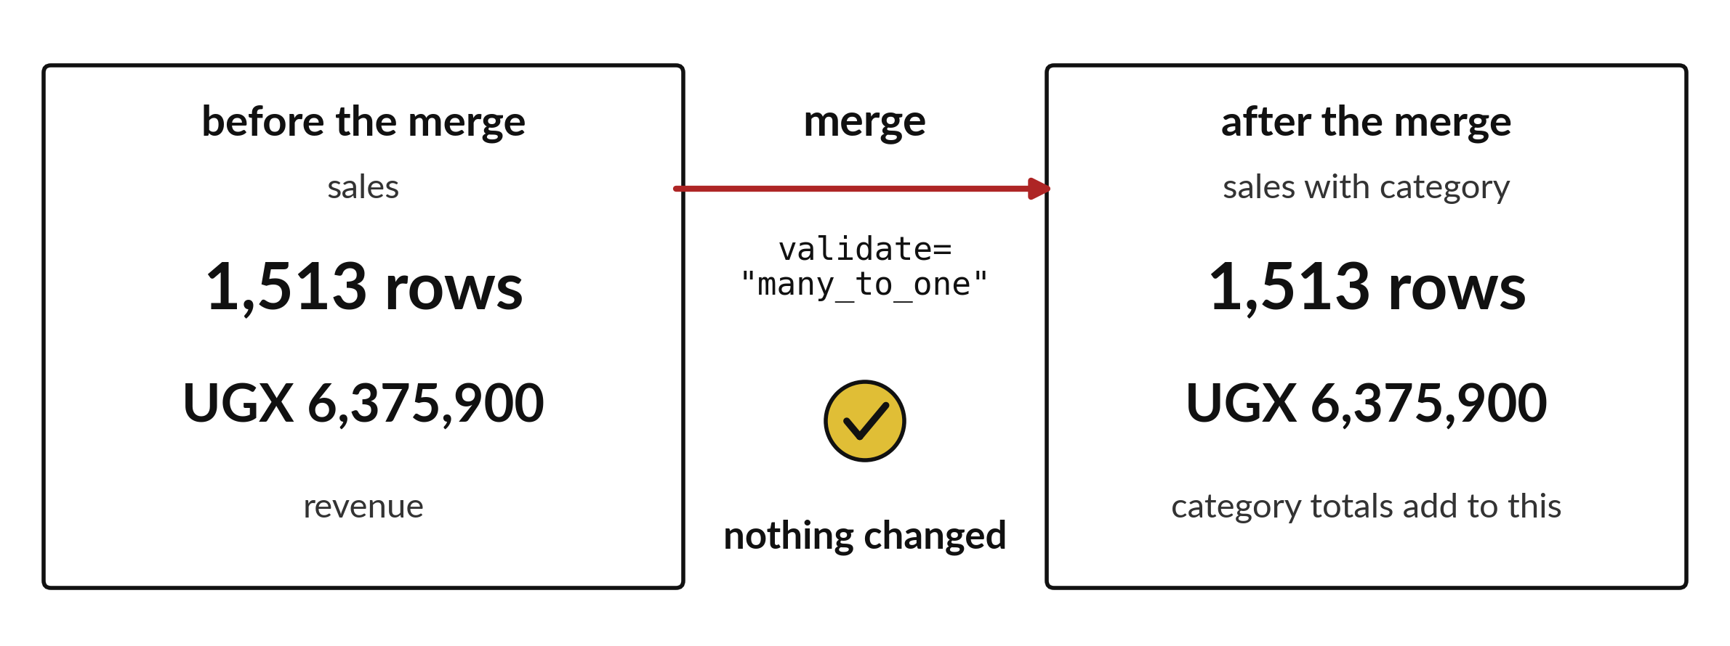
Rows and revenue must match after a merge
Same rows and same revenue before and after means the merge is safe.
Notes:
After every merge we make two checks. First, the number of rows. Second, the total revenue. We compare them with the numbers from before the merge.
If both are the same, we can trust the merge. If either is different, we stop, find the repeated key and fix it. Reconciling means making two sets of numbers agree, and it is a habit worth keeping for your whole career.

Slide 21

Make: your own version
Merge the sales with sunrise_branches.csv on branch_id to get the branch names. Check that the row count is unchanged. Total the revenue by branch name and reconcile it with the totals you found in session 9.
Save it as DA17. Write two sentences: what you changed and how you checked it.
Notes:
This is your own task for today. Take it one step at a time. If you get stuck for a few minutes, read your error message, check the error card, and then ask me.
Save it as DA17. I will come round to each of you and ask what you changed and how you checked it.

Slide 22

Two errors you may meet today
It means: validate found a key that appears more than once in the table you look up.
Fix: Find the repeated key with duplicated, fix the table, and merge again.
pandas.errors.MergeError: Merge keys are not unique
It means: A key appears twice in the second table, so rows were copied.
Fix: Compare len() before and after every merge and check the key is unique.
The merged table has more rows than the sales table
Notes:
Everyone meets errors, including me. Two are likely today, so let us meet them now.
This is the first one. You will see: pandas.errors.MergeError: Merge keys are not unique. It means this: validate found a key that appears more than once in the table you look up. To fix it, find the repeated key with duplicated, fix the table, and merge again.
The next one. You will see: The merged table has more rows than the sales table. It means this: A key appears twice in the second table, so rows were copied. To fix it, compare len() before and after every merge and check the key is unique.
Keep this slide in mind when something stops working.

Slide 23

Finish this sentence in your notebook
I check that a key is unique before I merge, and I compare the row count and the total after.
Then save your notebook, close it and open it again to check it saved.
Notes:
We are nearly done. Remember the question from the start of the session: Which product category earns the most, and can we trust the merge that tells us?
Write this sentence in your notebook and finish it your own way. I check that a key is unique before I merge, and I compare the row count and the total after.
Then save your notebook, close it and open it again to check it saved.

