Slide 1
Build and test the chart report
Does my report answer my questions without a verbal tour?
Python for Data Analysis | Session 21 of 24 | Week 7, Show it
Holiday Data and AI Camp | The National ICT Innovation Hub, Nakawa
Notes:
Laptops open, please. Today is session 21 and our topic is build and test the chart report.
By the end of today you will be able to build a chart report that a stranger reads in 30 seconds, and you can critique a coding assistant's hint with a test.
We will answer one question: Does my report answer my questions without a verbal tour?

Slide 2
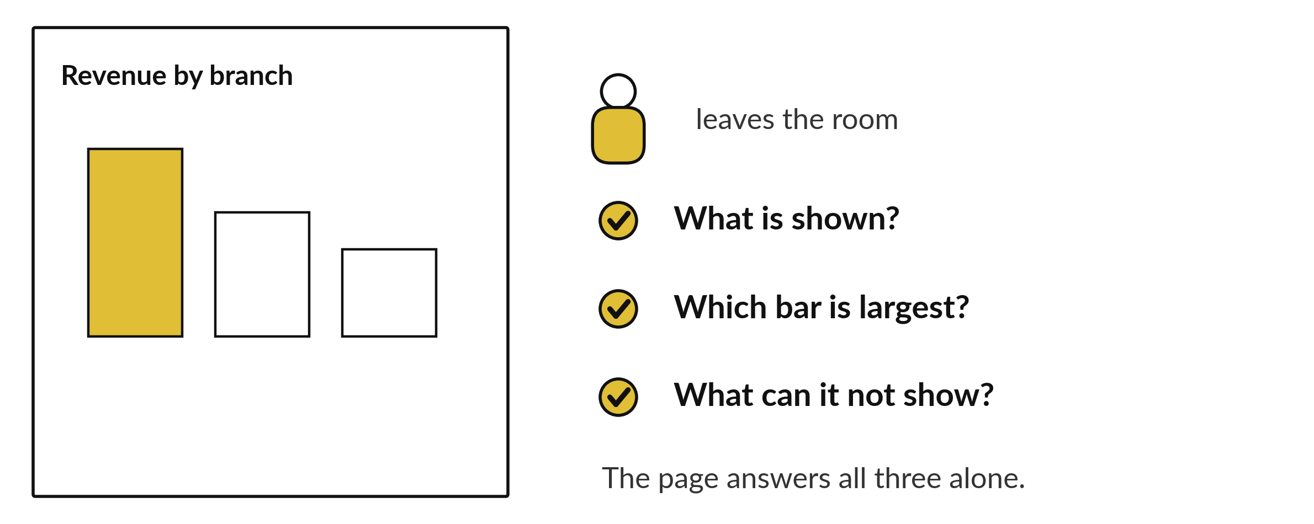
Does my report answer my
questions without a verbal tour?
Notes:
Does my report answer my questions without a verbal tour? Picture handing your report to someone, then leaving the room. Everything they need has to be on the page: what is shown, which bar is largest, and what the data cannot show. Today you build the chart report and then test it on a peer, who will tell you where they hesitated.

Slide 3

Today's plan in minutes
Most of the time is your own build, with a check and a partner.
Notes:
Here is how the 3 hours go. Each bar is as long as the time we spend on that part.
First, 10 minutes. Recall, retrieve yesterday, three questions on paper. Then, 50 minutes. Block A, predict, run, investigate, modify. After that, 15 minutes. Break away from screens. Next, 50 minutes. Block B, predict, run, investigate, modify. Then, 40 minutes. Make, the independent task and the project journal. Then, 15 minutes. Exit ticket, save, and an individual check with each learner.
Most of the time is your own build, with a check and a partner. Ask me now if any part of the plan is unclear.

Slide 4

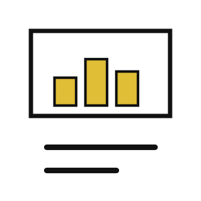

Words for today
chart report
A short notebook of charts, numbers and sentences that answers the project questions.
A news page with pictures and captions.
caption
One sentence under a chart that says what it shows.
The words under a photograph.
data source note
A line that says where the data came from and its limits.
The credit under a map.
Notes:
Here are the words for today. Listen for the picture that goes with each one.
chart report. A short notebook of charts, numbers and sentences that answers the project questions. Picture this. A news page with pictures and captions.
caption. One sentence under a chart that says what it shows. You have seen this before. The words under a photograph.
data source note. A line that says where the data came from and its limits. The credit under a map.

Slide 5
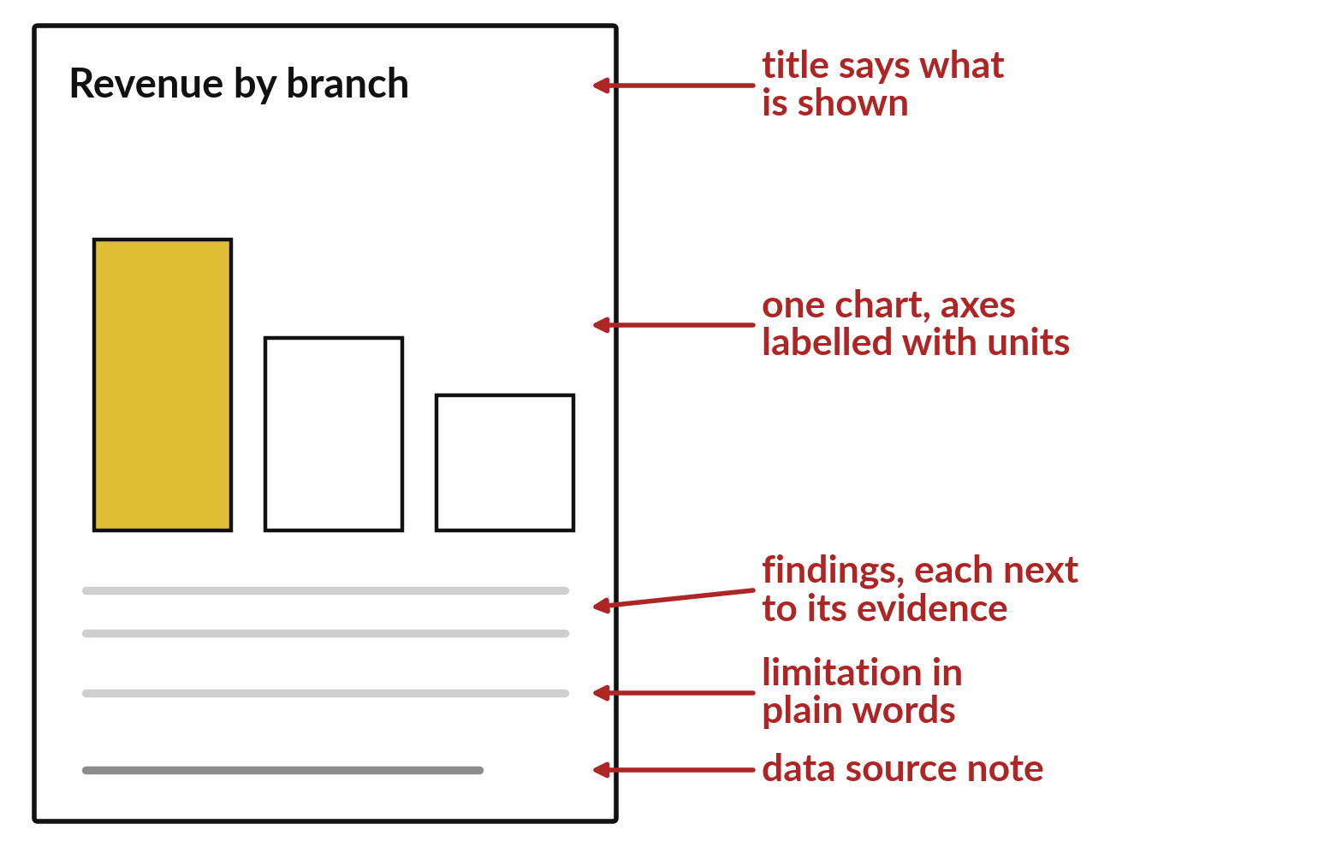
A chart report has a title, chart, findings, limit
Findings sit next to their evidence.
A limitation says what the data cannot show.
A source note names the data.
Notes:
Here is the layout. At the top, a title that says what the chart shows. The chart has labelled axes with units. Beside or below it, two findings, each with its number. Then a limitation in plain words, and finally a note that names the data source.
Few charts, clearly labelled, are better than many crowded ones. Keep the layout the same every time, so a reader knows where to look.

Slide 6
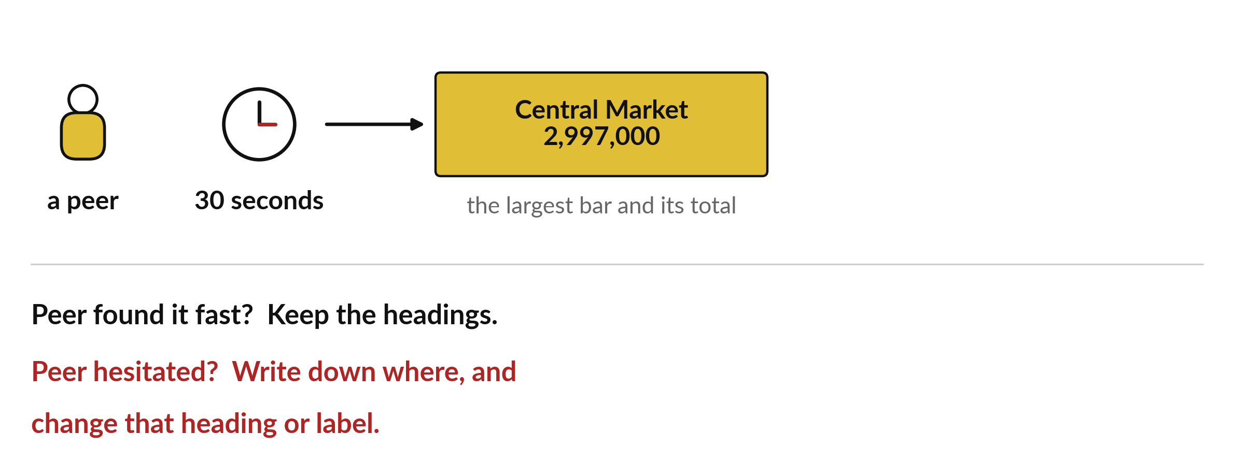
Can a peer find the largest bar in 30 seconds?
Central Market is the largest bar, with 2,997,000.
Notes:
Give your report to a peer for thirty seconds and ask one question: which is the largest bar, and what is its total? If your peer finds it fast, keep your headings. If your peer hesitates, write down where they looked and change that heading or label.
For the Sunrise report the answer is Central Market, with two million nine hundred and ninety seven thousand shillings.

Slide 7
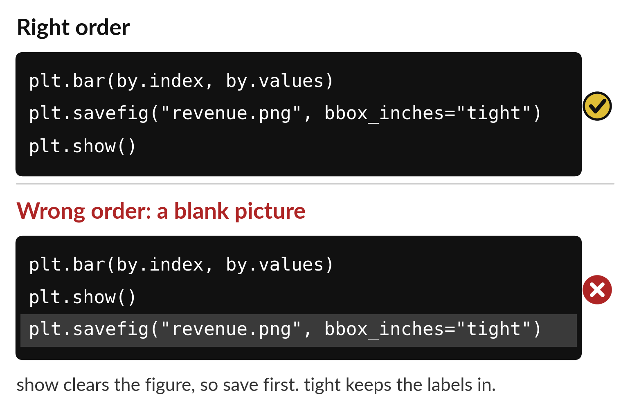
Save the figure before show, or it is blank
Draw the chart.
Save it with bbox inches tight.
Then show it.
Notes:
This is the order that works. First draw the chart. Second, call savefig with a file name. Third, call show. The show instruction clears the figure after it displays it, so a save that comes after is saving an empty page.
Add bbox inches equals tight to the save, and the labels stay inside the picture instead of being cut off at the edge.

Slide 8
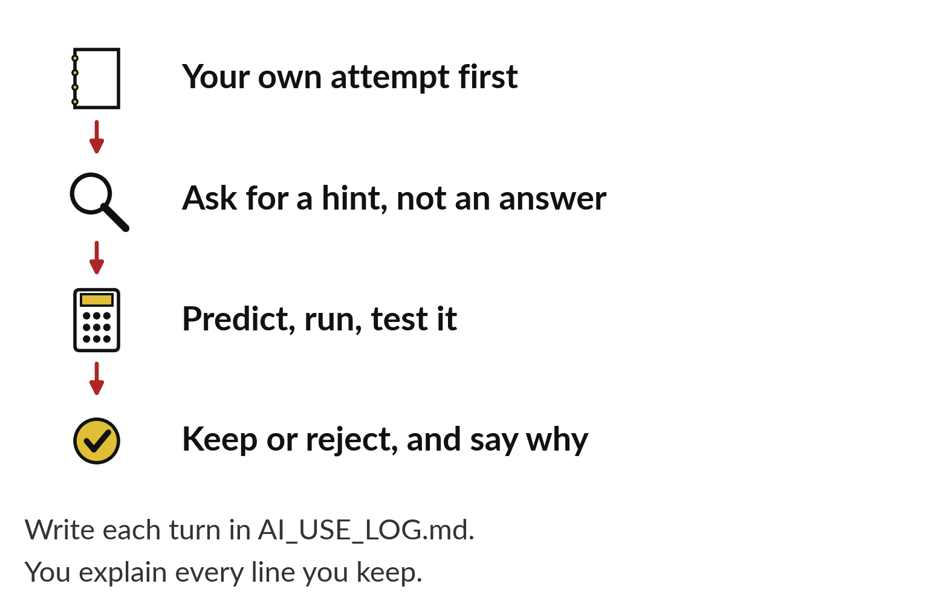
Take hints from an assistant, then test them
Try it yourself first.
Ask for a hint and keep the thinking.
Predict, run and test what comes back.
Notes:
An assistant can help you get unstuck, but only if you keep the thinking. Try the problem yourself first. If you are stuck, ask for a hint. When you get an answer, predict what it will do, run it, and test it against a case you know.
Then decide whether to keep or reject it, and say why. Write each turn in your AI log.

Slide 9

Make: your own version (1 of 2)
Build the chart report. Use few charts, readable labels with units, the covered dates and a visible data source note. Write two findings and one limitation next to their evidence. Give a peer 30 seconds to find the largest category and its total, and record where they hesitate.
Notes:
Now you do the real work yourself. Start with the first step. If you get stuck for a few minutes, read your error message, check the error card, and then ask me.
Save it as DA21. I will come round to each of you and ask what you changed and how you checked it.
The rest of the brief is on the next slide.

Slide 10
Make: your own version (2 of 2)
To put a chart in your report, call plt.savefig("revenue.png", bbox_inches="tight") before plt.show(), then insert the PNG with Insert and Pictures. When the instructor confirms you are ready, spend 20 minutes with AI_CODING_ASSISTANTS_LAB.md: critique a hint on the practice function, run a test and log it in AI_USE_LOG.md.
Save it as DA21. Write two sentences: what you changed and how you checked it.
Notes:
Here is the rest of the brief. Take your time, and save your work as you go, because a saved file is the only thing I can mark.

Slide 11

Two errors you may meet today
It means: The figure was saved without room for the labels.
Fix: Add bbox_inches="tight" to plt.savefig.
The saved picture cuts off the labels
It means: plt.show() ran before plt.savefig, which clears the figure.
Fix: Call plt.savefig before plt.show.
The picture is saved blank
Notes:
Two things are likely to go wrong today. It helps to know them before they happen.
This is the first one. You will see: The saved picture cuts off the labels. It means this: the figure was saved without room for the labels. To fix it, add bbox_inches="tight" to plt.savefig.
The next one. You will see: The picture is saved blank. It means this: plt.show() ran before plt.savefig, which clears the figure. To fix it, call plt.savefig before plt.show.
If you meet one of these, fix it and carry on. It happens to everyone.

Slide 12

Finish this sentence in your notebook
A reader can find my main finding in 30 seconds, and I tested the assistant's advice before I used it.
Then save your notebook, close it and open it again to check it saved.
Notes:
Before we finish, go back to the question we began with: Does my report answer my questions without a verbal tour?
Copy this sentence into your notebook and make it yours. A reader can find my main finding in 30 seconds, and I tested the assistant's advice before I used it.
Then save your notebook, close it and open it again to check it saved.

