Slide 1
Report and handover
Does everything I submit open, rerun and agree with itself?
Python for Data Analysis | Session 22 of 24 | Week 8, Hand over
Holiday Data and AI Camp | The National ICT Innovation Hub, Nakawa
Notes:
Let us begin. Today is session 22 and our topic is report and handover.
By the end of today you will be able to hand over a project that another person can open, rerun and check.
We will answer one question: Does everything I submit open, rerun and agree with itself?

Slide 2
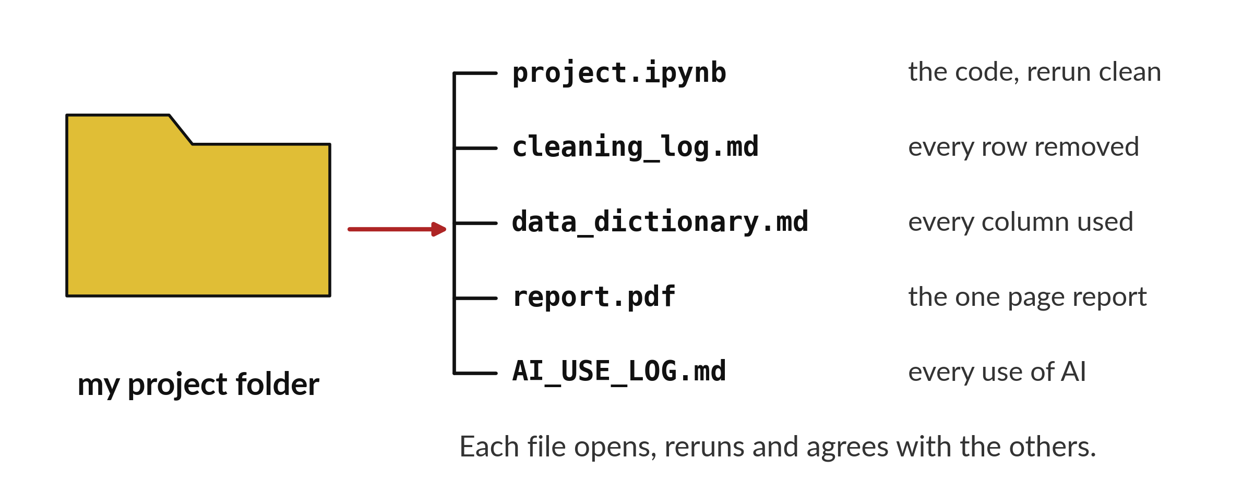
Does everything I submit open,
rerun and agree with itself?
Notes:
Does everything I submit open, rerun and agree with itself? Look at the project folder. The notebook, the cleaning log, the data dictionary, the report and the AI log all have to open, and they all have to tell the same story. Today we check each one against the others, and then we hand the project in. Nothing is handed in until all of them agree.

Slide 3
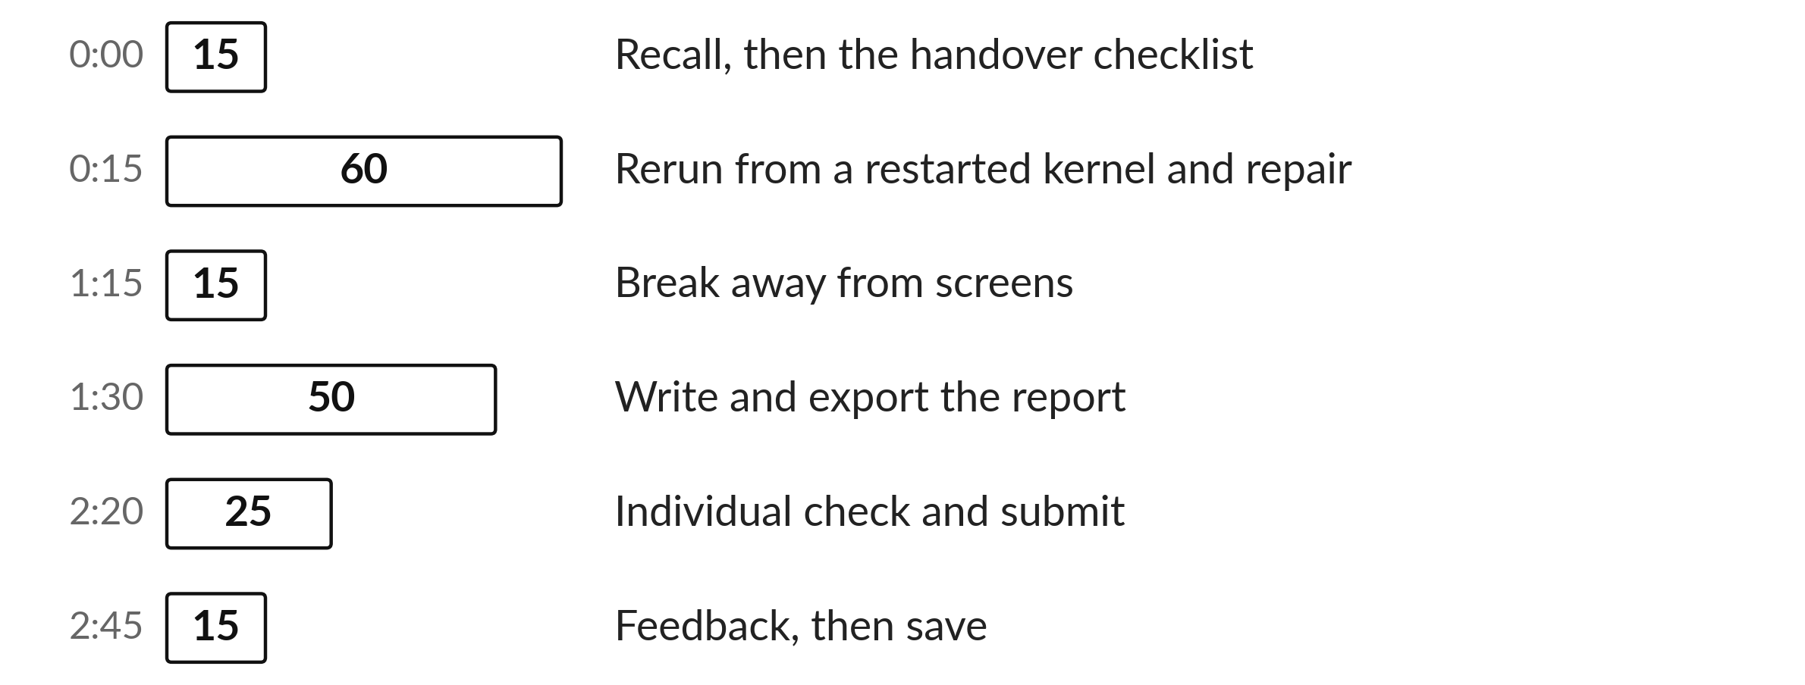
Today's plan in minutes
Most of the time is your own build, with a check and a partner.
Notes:
Here is how the 3 hours go. Each bar is as long as the time we spend on that part.
First, 15 minutes. Recall, then the handover checklist. Then, 60 minutes. Rerun from a restarted kernel and repair. After that, 15 minutes. Break away from screens. Next, 50 minutes. Write and export the report. Then, 25 minutes. Individual check and submit. Then, 15 minutes. Feedback, then save.
Most of the time is your own build, with a check and a partner. Ask me now if any part of the plan is unclear.

Slide 4
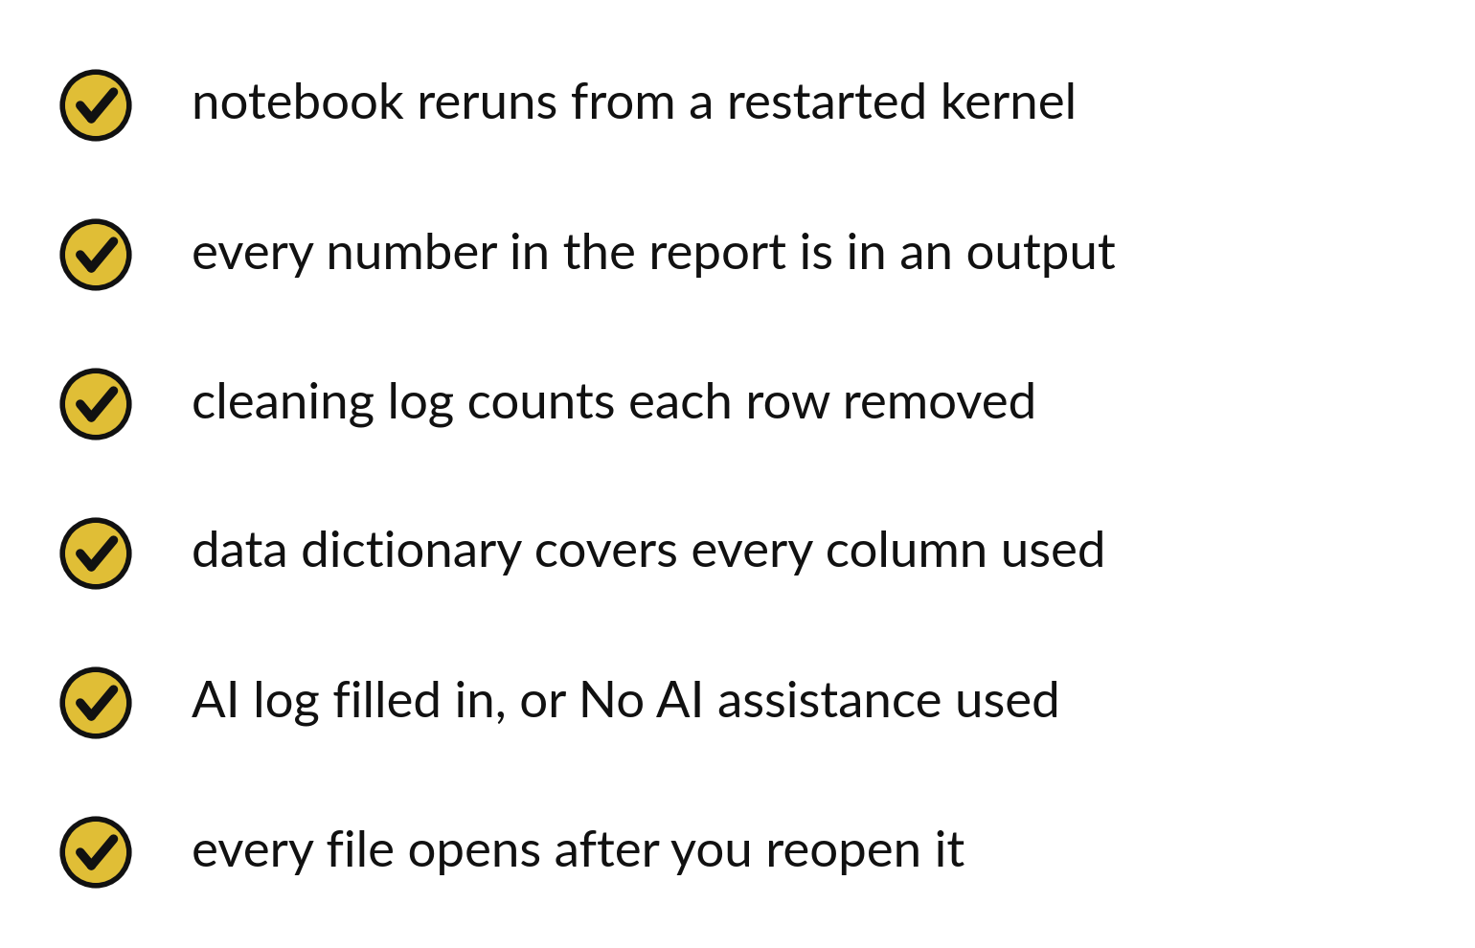
Six checks decide if a project is ready to hand in
The notebook reruns from a restarted kernel.
Every number in the report is in an output.
Every file opens after you reopen it.
Notes:
Here are the six checks. The notebook reruns after a restart. Every number in the report appears in an output cell. The cleaning log counts every row removed. The data dictionary covers every column you used. The AI log is filled in, or it says that no assistance was used. And every file opens after you close it and open it again.
Tick them one at a time. Do not tick a box you have not tested.

Slide 5
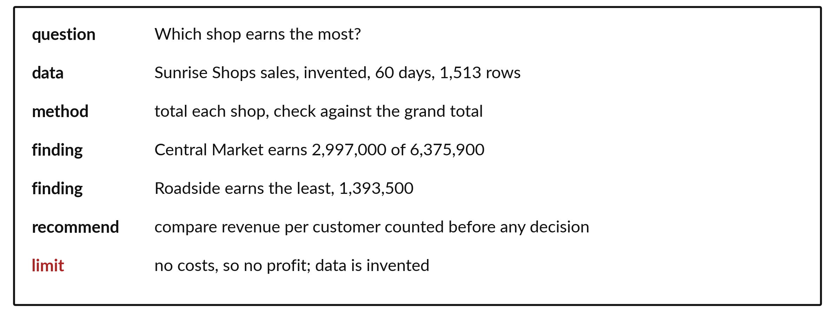
One page holds the question,
method and numbers
Question, data, method, findings, recommendation and limit.
Notes:
The one page report has a fixed order. First the question. Then the data and where it came from. Then the method in a sentence. Then your findings, each with its value. Then one recommendation. In the example it is to compare revenue per customer counted before any decision. Last, the limit.
The limit says there are no costs in the data, so we cannot talk about profit. A good report always closes with what it cannot say.

Slide 6
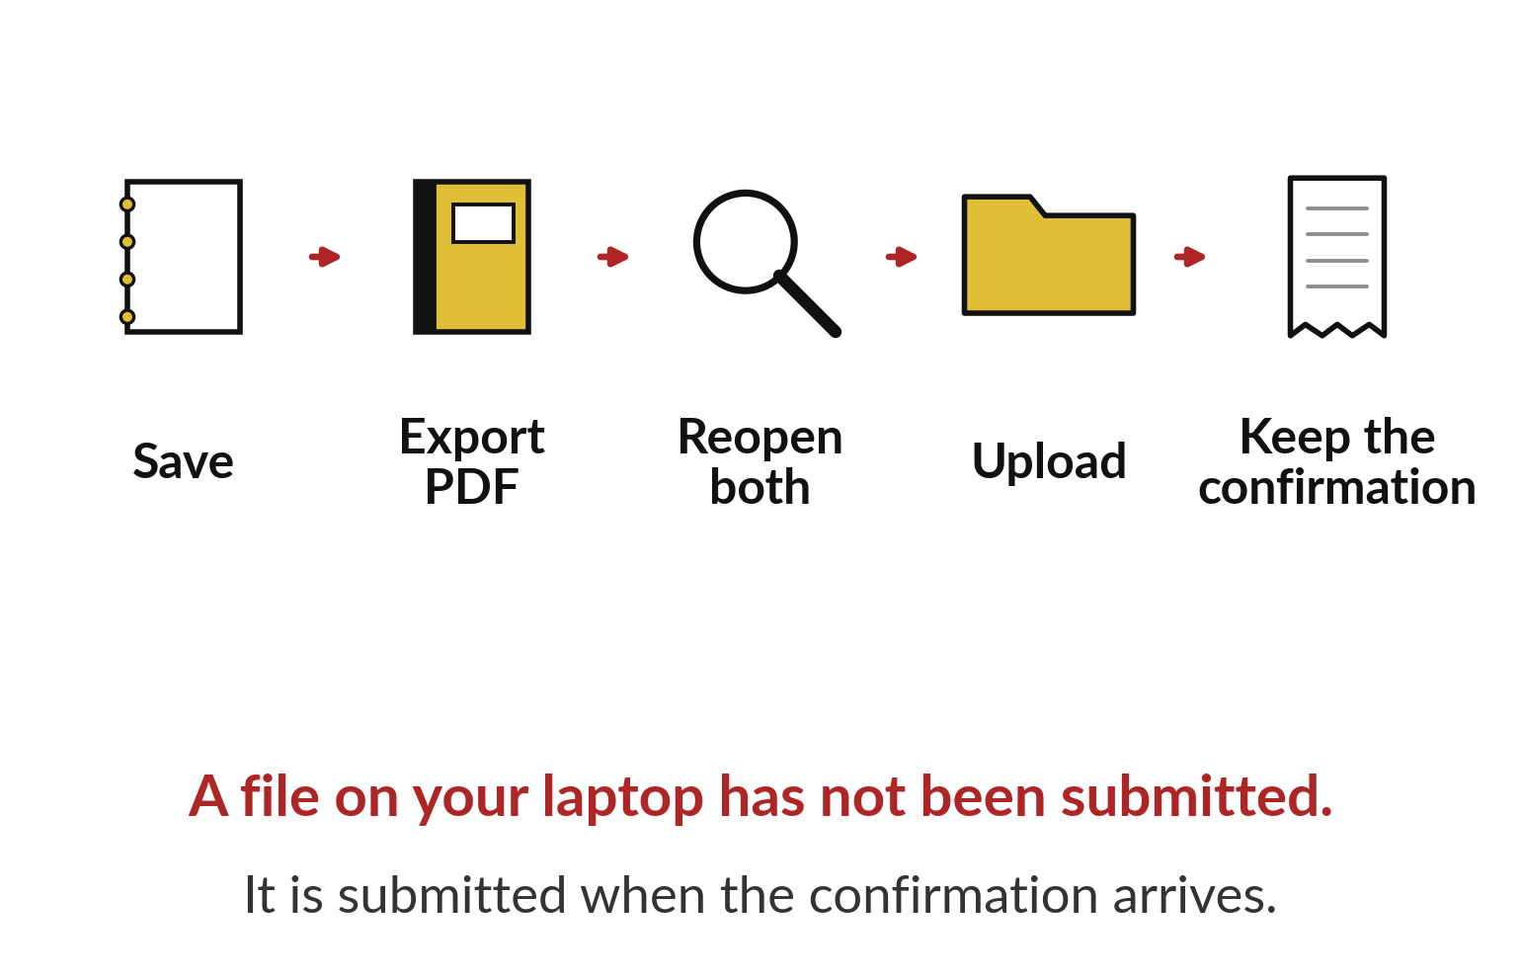
You have submitted when the confirmation arrives
Save, export the PDF and reopen both.
Upload to the folder you were given.
Keep the confirmation.
Notes:
Submitting has a route. Save the notebook. Export the report to PDF. Reopen both files to check they work. Upload them to the place you were told. Then wait for the confirmation and keep it.
A file on your laptop is not a submission. A submission is complete when the confirmation arrives, so do not close the page until it does.

Slide 7

Make: your own version
Restart the kernel and run all cells from the top. Confirm every number in the report appears in an output. Write the one-page report: question, data, method, three findings with their values, one recommendation and one limitation. Export it to PDF and reopen it. Submit project.ipynb, cleaning_log.md, your data dictionary, report.pdf or report.docx and AI_USE_LOG.md together through the route in START_HERE.md. Keep personal information out of every file.
Save it as DA22. Write two sentences: what you changed and how you checked it.
Notes:
This task is yours. Run your code after every step so you can see where a problem begins. If you get stuck for a few minutes, read your error message, check the error card, and then ask me.
Save it as DA22. I will come round to each of you and ask what you changed and how you checked it.

Slide 8

Two errors you may meet today
It means: The sentence was written from memory and not from an output.
Fix: Find the output cell that supports it, or remove the claim.
A claim in the report has no number behind it
It means: The PNG was not saved in the same folder, or the picture was linked and not inserted.
Fix: Insert the saved PNG into the document and export to PDF again.
The report opens but the charts are missing
Notes:
Here are two errors from this session, so you recognise them when they appear.
This is the first one. You will see: A claim in the report has no number behind it. It means this: the sentence was written from memory and not from an output. To fix it, find the output cell that supports it, or remove the claim.
The next one. You will see: The report opens but the charts are missing. It means this: the PNG was not saved in the same folder, or the picture was linked and not inserted. To fix it, insert the saved PNG into the document and export to PDF again.
When you are stuck, read the last line of the message first.

Slide 9

Finish this sentence in your notebook
Everything I submitted opens, reruns and agrees with itself.
Then save your notebook, close it and open it again to check it saved.
Notes:
Last step. Our question for today was: Does everything I submit open, rerun and agree with itself?
Finish this sentence in your notebook, in your own words. Everything I submitted opens, reruns and agrees with itself.
Then save your notebook, close it and open it again to check it saved.

