Slide 1
Explain it to a parent
Can a parent say what I found, how I know, and what the data cannot tell us?
Python for Data Analysis | Session 23 of 24 | Week 8, Hand over
Holiday Data and AI Camp | The National ICT Innovation Hub, Nakawa
Notes:
Here we go. Today is session 23 and our topic is explain it to a parent.
By the end of today you will be able to explain your project to a listener who has never seen code, in five minutes, with a chart and a limit.
We will answer one question: Can a parent say what I found, how I know, and what the data cannot tell us?

Slide 2
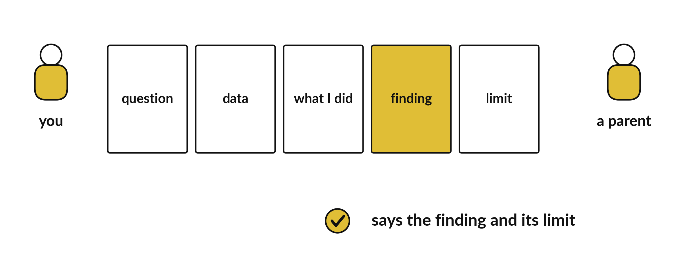
Can a parent say what I found, how I
know, and what the data cannot tell us?
Notes:
Can a parent say what I found, how I know, and what the data cannot tell us? That is the test for your talk. Parents are not data analysts, and they do not need to be. They need to leave knowing one clear finding and trusting it. Today you plan the talk, you rehearse it with a timer, and you prepare for the questions you will be asked.

Slide 3
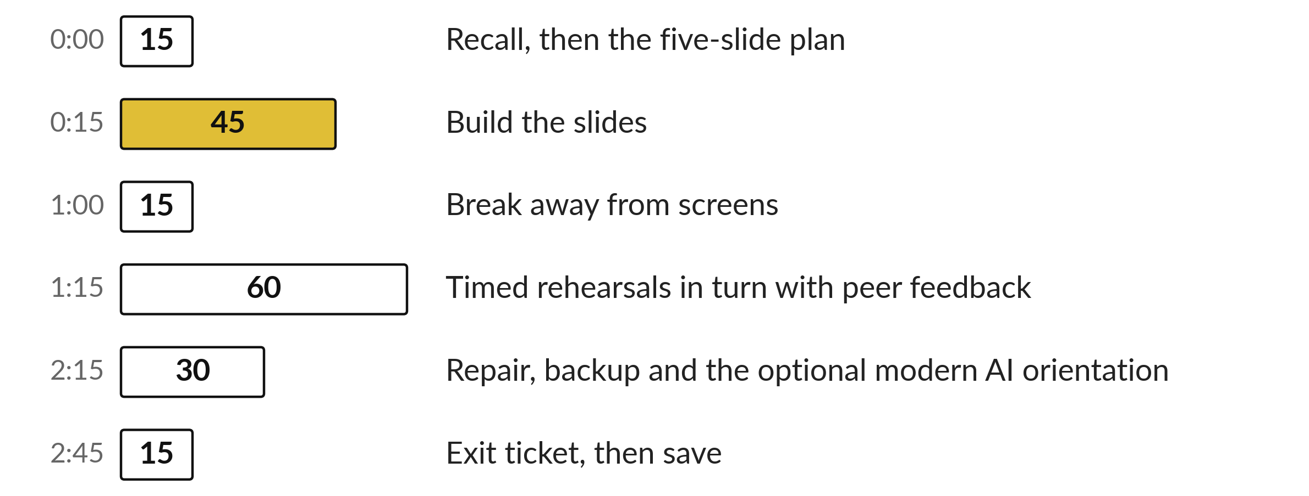
Today's plan in minutes
You build five slides, then rehearse in turn with a timer.
Notes:
Here is how the 3 hours go. Each bar is as long as the time we spend on that part.
First, 15 minutes. Recall, then the five-slide plan. Then, 45 minutes. Build the slides. After that, 15 minutes. Break away from screens. Next, 60 minutes. Timed rehearsals in turn with peer feedback. Then, 30 minutes. Repair, backup and the optional modern AI orientation. Then, 15 minutes. Exit ticket, then save.
You build five slides, then rehearse in turn with a timer. Ask me now if any part of the plan is unclear.

Slide 4
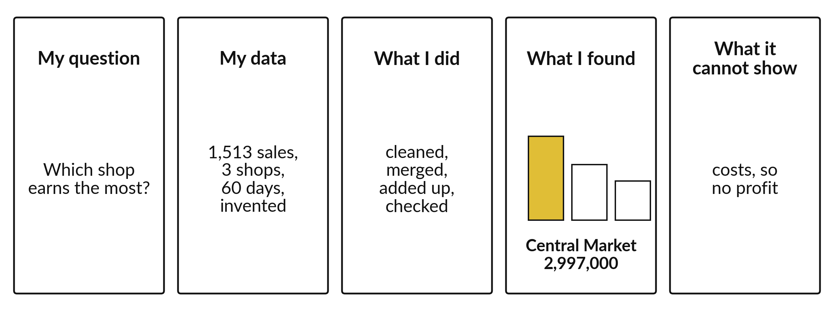
Five slides tell the whole project
One idea on each slide.
Notes:
The storyboard has five frames. My question. My data, with the number of sales, the shops and the days. What I did, in four short words: cleaned, merged, added up and checked. What I found, with one chart. And what it cannot show. One idea on each slide.
If a parent can repeat the finding and the limit after your talk, the talk worked.

Slide 5
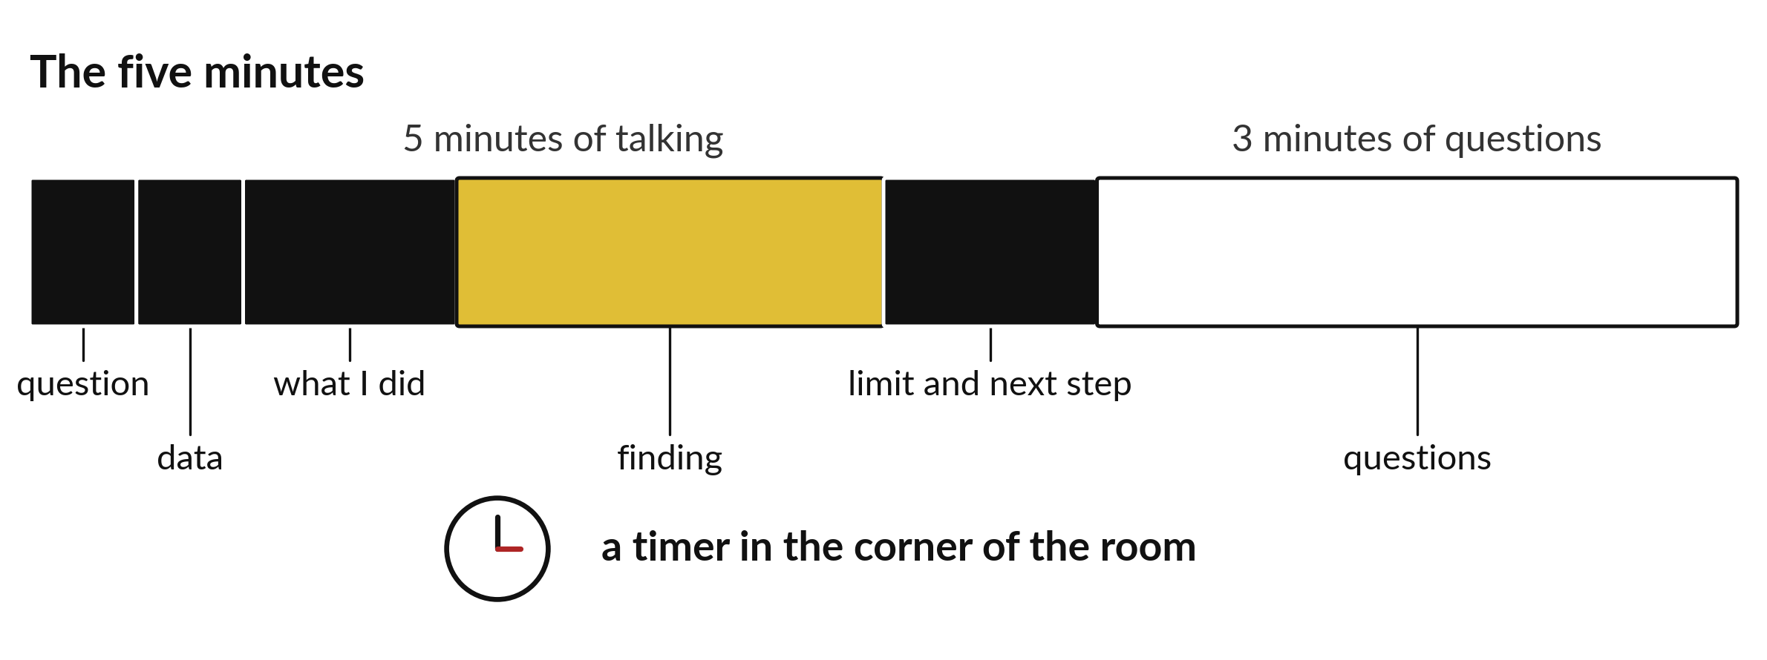
Five minutes of talk and three of questions
Practise twice with a timer.
Notes:
The talk is five minutes, followed by three minutes of questions. Most of your time belongs to the finding. The question and the data get half a minute each. What you did gets one minute. The finding gets two. The limit and the next step get one.
Put a timer in the corner of the room when you practise. If you run over, cut words, and keep the finding.

Slide 6
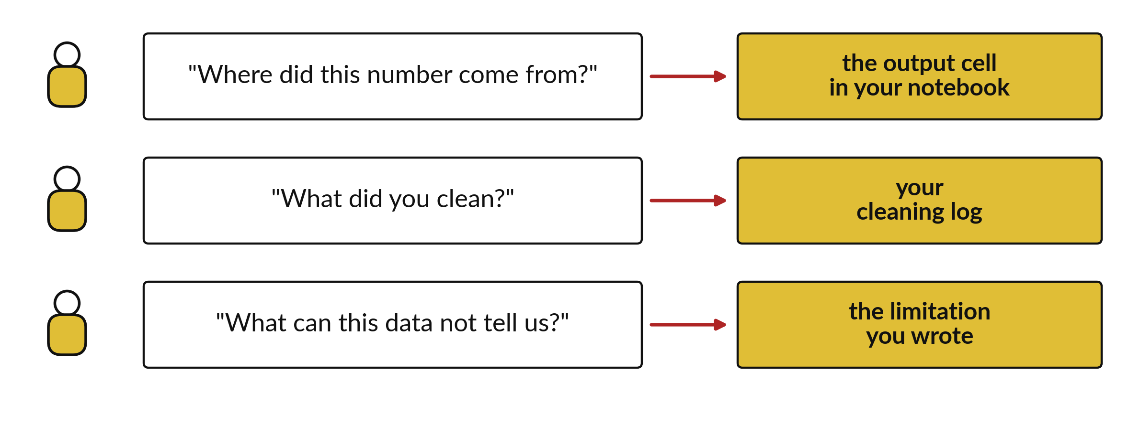
Each parent question points to your evidence
Point to the evidence. Do not read the number from memory.
Notes:
You will get three kinds of question. Where did this number come from? You open the output cell. What did you clean? You show the cleaning log. What can this data not tell us? You read your limitation.
Rehearse all three with a partner. Pointing at evidence is stronger than answering from memory. Practise pointing, not remembering.

Slide 7
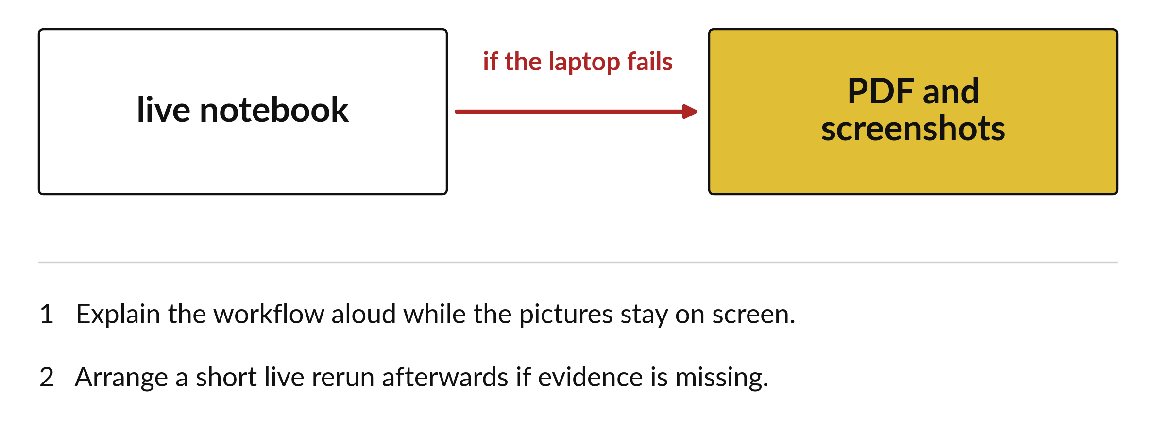
Keep a PDF and screenshots for a laptop failure
Save the backup before the day.
Notes:
Technology fails at the worst moment. The projector might not connect, or the laptop might freeze. So you keep a backup: a PDF of your slides and screenshots of your key outputs.
If the live notebook fails, you explain the workflow aloud while the pictures stay on the screen. Save the backup the day before, and test that it opens.

Slide 8

Make: your own version (1 of 2)
Make five slides: my question; what data I used; what I did; my most useful finding with its chart; the limitation and next step. Save as showcase.pptx and keep a PDF and screenshots as a backup. Rehearse with a timer. Practise answering: where did this number come from, what did you clean, and what can this data not tell us.
Notes:
This is your own task for today. Take it one step at a time. If you get stuck for a few minutes, read your error message, check the error card, and then ask me.
Save it as DA23. I will come round to each of you and ask what you changed and how you checked it.
The rest of the brief is on the next slide.

Slide 9
Make: your own version (2 of 2)
Disclose any help or AI use. Show only invented or approved non-personal data. The instructor may follow the rehearsal with MODERN_AI_ORIENTATION.md, a 20-minute optional introduction with no assignment or mark.
Save it as DA23. Write two sentences: what you changed and how you checked it.
Notes:
Here is the rest of the brief. Take your time, and save your work as you go, because a saved file is the only thing I can mark.

Slide 10

Two errors you may meet today
It means: There are too many slides or too much code on screen.
Fix: Keep one idea per slide and cut the slide that explains the method in detail.
The talk runs over five minutes
It means: The demonstration depends on a live notebook or the internet.
Fix: Use the PDF and the screenshots, and explain the workflow aloud.
The projector fails
Notes:
Everyone meets errors, including me. Two are likely today, so let us meet them now.
This is the first one. You will see: The talk runs over five minutes. It means this: there are too many slides or too much code on screen. To fix it, keep one idea per slide and cut the slide that explains the method in detail.
The next one. You will see: The projector fails. It means this: the demonstration depends on a live notebook or the internet. To fix it, use the PDF and the screenshots, and explain the workflow aloud.
Keep this slide in mind when something stops working.

Slide 11

Finish this sentence in your notebook
I can explain my project in five minutes without jargon and say what it cannot show.
Then save your notebook, close it and open it again to check it saved.
Notes:
We are nearly done. Remember the question from the start of the session: Can a parent say what I found, how I know, and what the data cannot tell us?
Write this sentence in your notebook and finish it your own way. I can explain my project in five minutes without jargon and say what it cannot show.
Then save your notebook, close it and open it again to check it saved.

