Slide 1
Parent showcase and next steps
What can I show and explain, and what will I learn next?
Python for Data Analysis | Session 24 of 24 | Week 8, Hand over
Holiday Data and AI Camp | The National ICT Innovation Hub, Nakawa
Notes:
Welcome back. Today is session 24 and our topic is parent showcase and next steps.
By the end of today you will be able to present your project, answer questions, and change a small part of it live without AI assistance.
We will answer one question: What can I show and explain, and what will I learn next?

Slide 2
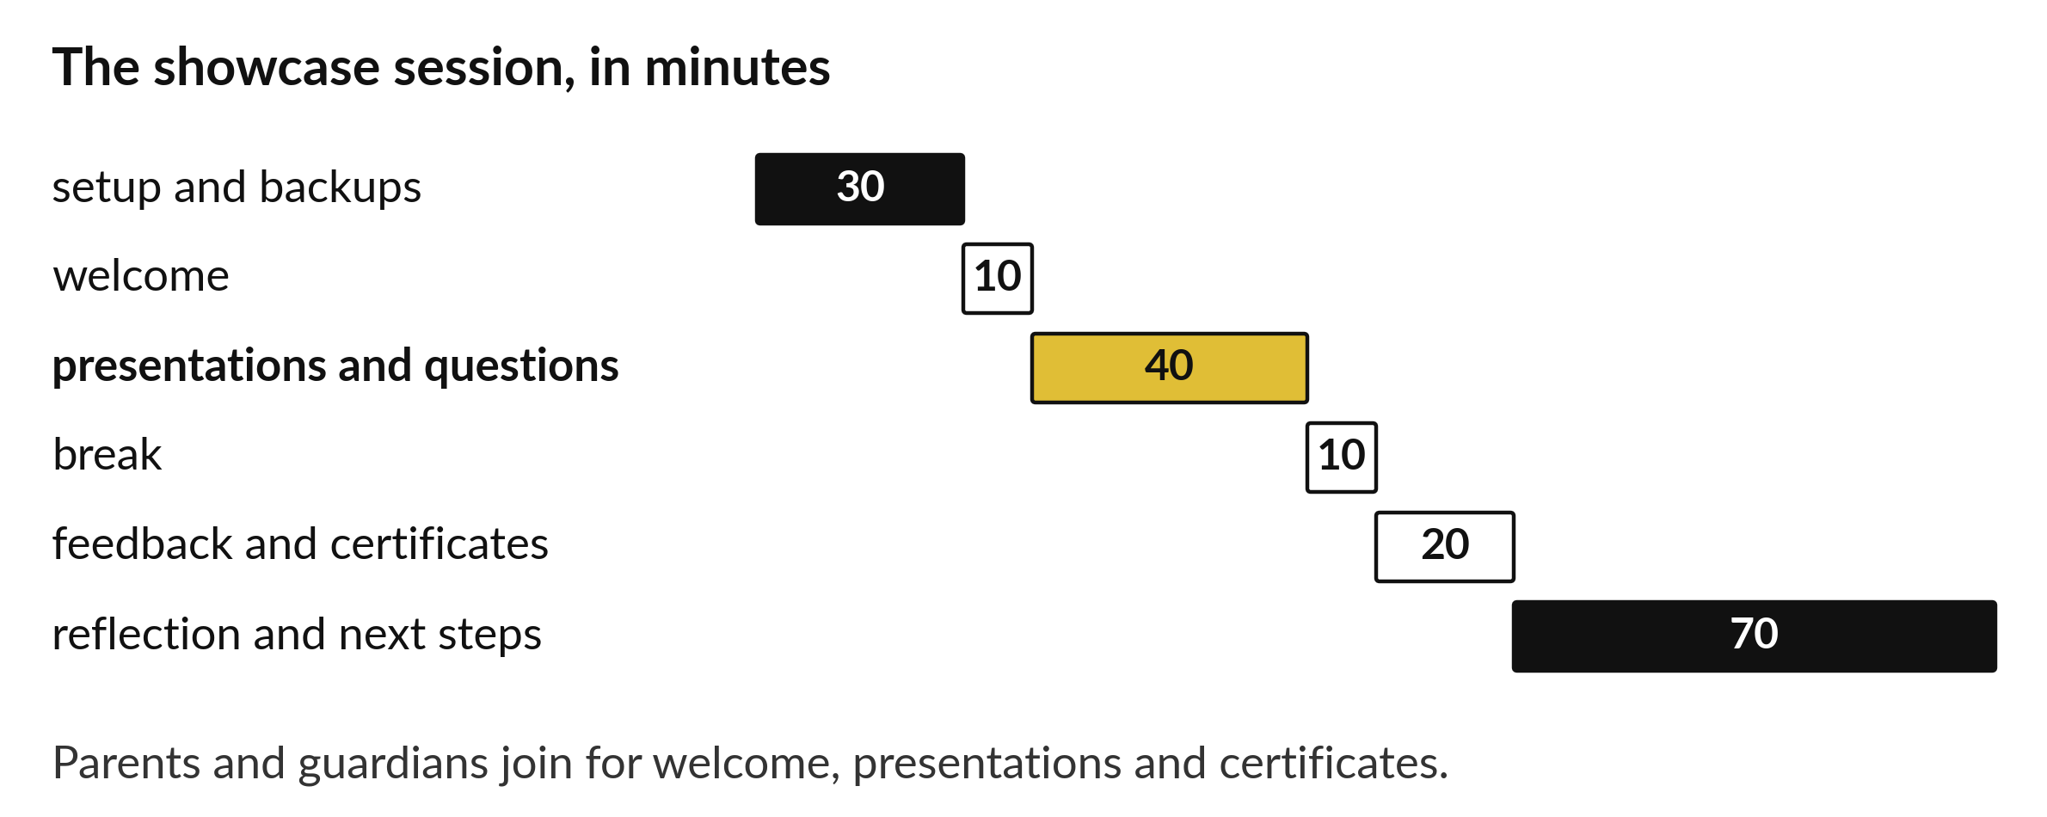
What can I show and explain,
and what will I learn next?
Notes:
What can I show and explain, and what will I learn next? Today is the showcase. Parents and guardians join for the welcome, the presentations and the certificates. You present, you answer questions, and you show that the work is yours. Look at the bars: the presentations are the longest part before the final reflection, and that is where you shine.

Slide 3
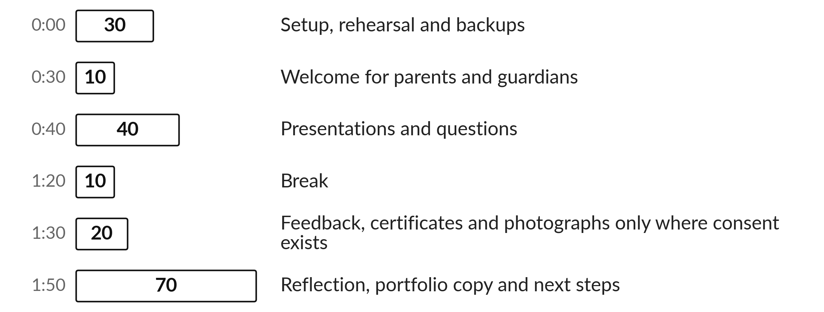
Today's plan in minutes
Your families come to see what you built. You show it and answer questions.
Notes:
Here is how the 3 hours go. Each bar is as long as the time we spend on that part.
First, 30 minutes. Setup, rehearsal and backups. Then, 10 minutes. Welcome for parents and guardians. After that, 40 minutes. Presentations and questions. Next, 10 minutes. Break. Then, 20 minutes. Feedback, certificates and photographs only where consent exists. Then, 70 minutes. Reflection, portfolio copy and next steps.
Your families come to see what you built. You show it and answer questions. Ask me now if any part of the plan is unclear.

Slide 4
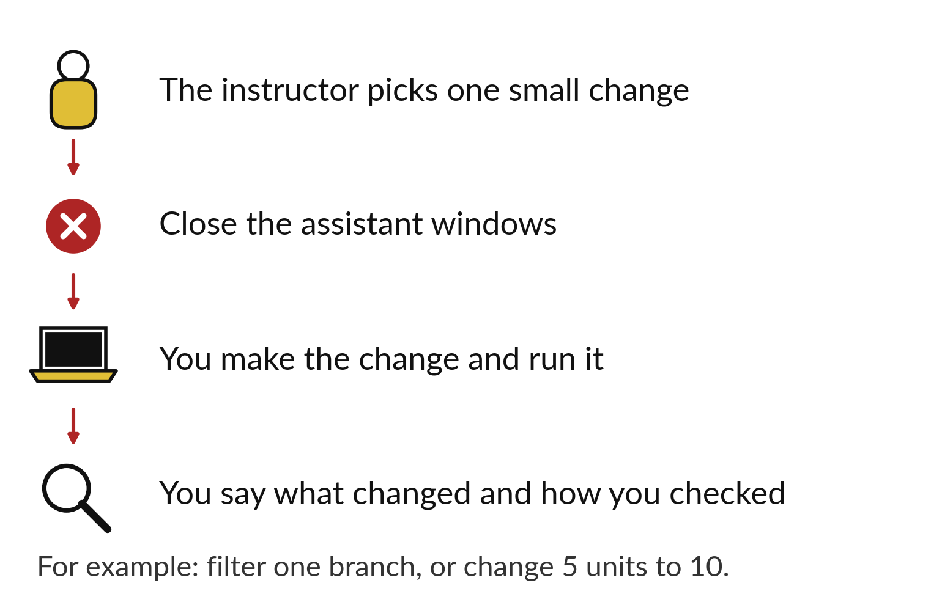
You make one small change unaided
Close the assistant windows first.
Make the change and run it.
Say what changed and how you checked.
Notes:
Part of the showcase is a short live change. The instructor chooses one small change, for example filter one branch, or change five units to ten. You close every assistant window. You make the change, run it, and say what changed and how you checked it.
This is the best proof that you understand your own project. Stay calm, and say your steps aloud as you go.

Slide 5
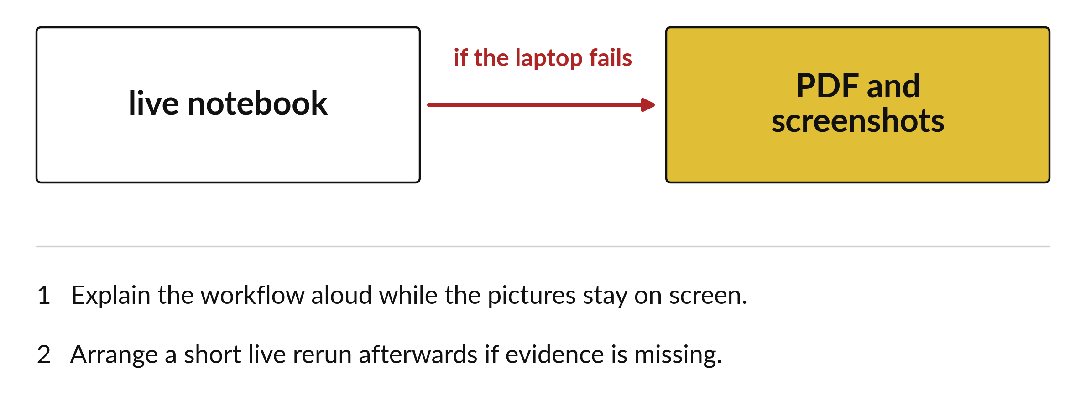
If the notebook will not open, use the PDF backup
The backup is part of the presentation.
Notes:
If the notebook will not open on the day, you stay calm and use the backup. Open the PDF and the screenshots, and explain the workflow from there, step by step, while the pictures stay on the screen.
The instructor can arrange a short live rerun afterwards if evidence is missing. Having a backup is part of doing the job properly.

Slide 6
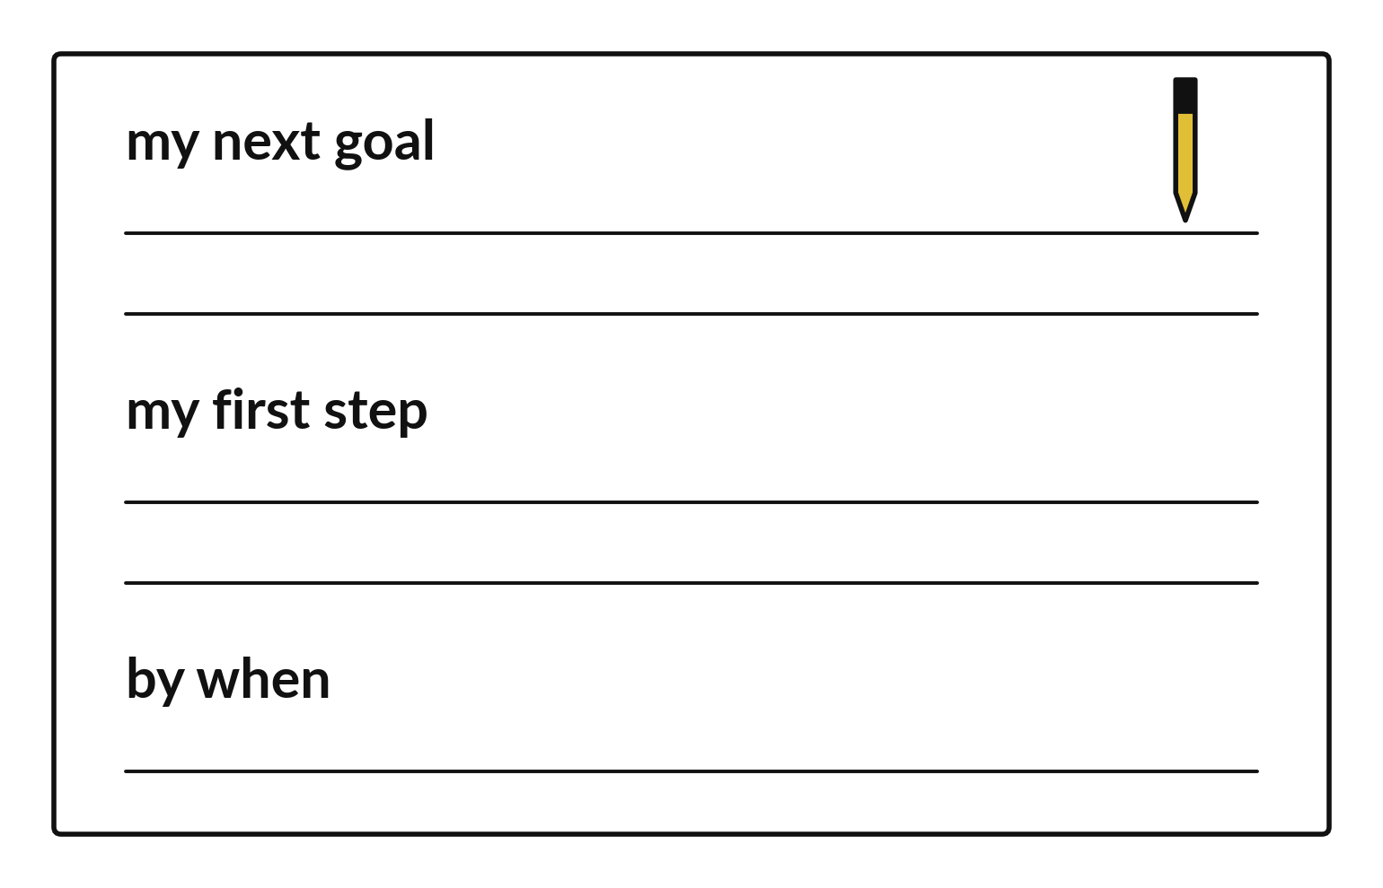
Write your next goal with a first step and a date
One goal in your own words.
One first step you can do this week.
A date to do it by.
Notes:
Finish with a card. Write one goal, for example to analyse real data from a public source. Then write a first step that you can do this week. And write by when. Use your own words and your own handwriting.
Keep the card with your project folder. A goal with a date is far more likely to happen than a wish.

Slide 7

Make: your own version
Present your project for five minutes and answer three minutes of questions. Explain one calculation, one chart and one limitation. The instructor then chooses one small change, and you make it unaided. Close assistant windows and turn off generative suggestions first. Acknowledge any help you had. Choose one next learning goal. Keep your project folder and feedback.
Save it as DA24. Write two sentences: what you changed and how you checked it.
Notes:
Now you do the real work yourself. Start with the first step. If you get stuck for a few minutes, read your error message, check the error card, and then ask me.
Save it as DA24. I will come round to each of you and ask what you changed and how you checked it.

Slide 8

Two errors you may meet today
It means: The file or environment was not tested on the showcase laptop.
Fix: Use the PDF and screenshots, explain the workflow, and arrange a short live rerun afterwards.
The notebook will not open on the day
It means: The student has not traced that line since they wrote it.
Fix: Say what the line is meant to do, then run it on a small input to show it.
A question about the code cannot be answered
Notes:
Two things are likely to go wrong today. It helps to know them before they happen.
This is the first one. You will see: The notebook will not open on the day. It means this: the file or environment was not tested on the showcase laptop. To fix it, use the PDF and screenshots, explain the workflow, and arrange a short live rerun afterwards.
The next one. You will see: A question about the code cannot be answered. It means this: the student has not traced that line since they wrote it. To fix it, say what the line is meant to do, then run it on a small input to show it.
If you meet one of these, fix it and carry on. It happens to everyone.

Slide 9

Finish this sentence in your notebook
I can show my work, explain it, change one part of it, and name what I will learn next.
Then save your notebook, close it and open it again to check it saved.
Notes:
Before we finish, go back to the question we began with: What can I show and explain, and what will I learn next?
Copy this sentence into your notebook and make it yours. I can show my work, explain it, change one part of it, and name what I will learn next.
Then save your notebook, close it and open it again to check it saved.

