Slide 1
Your first instruction and your first prediction
Can a computer guess a rent after seeing 120 homes?
Machine Learning | Session 1 of 24 | Week 1, Python and a first prediction
Holiday Data and AI Camp | The National ICT Innovation Hub, Nakawa
Notes:
Welcome back. Today is session 1 and our topic is your first instruction and your first prediction.
By the end of today you will be able to run, save and reopen a notebook, and you can say what a prediction is using the rent example.
We will answer one question: Can a computer guess a rent after seeing 120 homes?

Slide 2
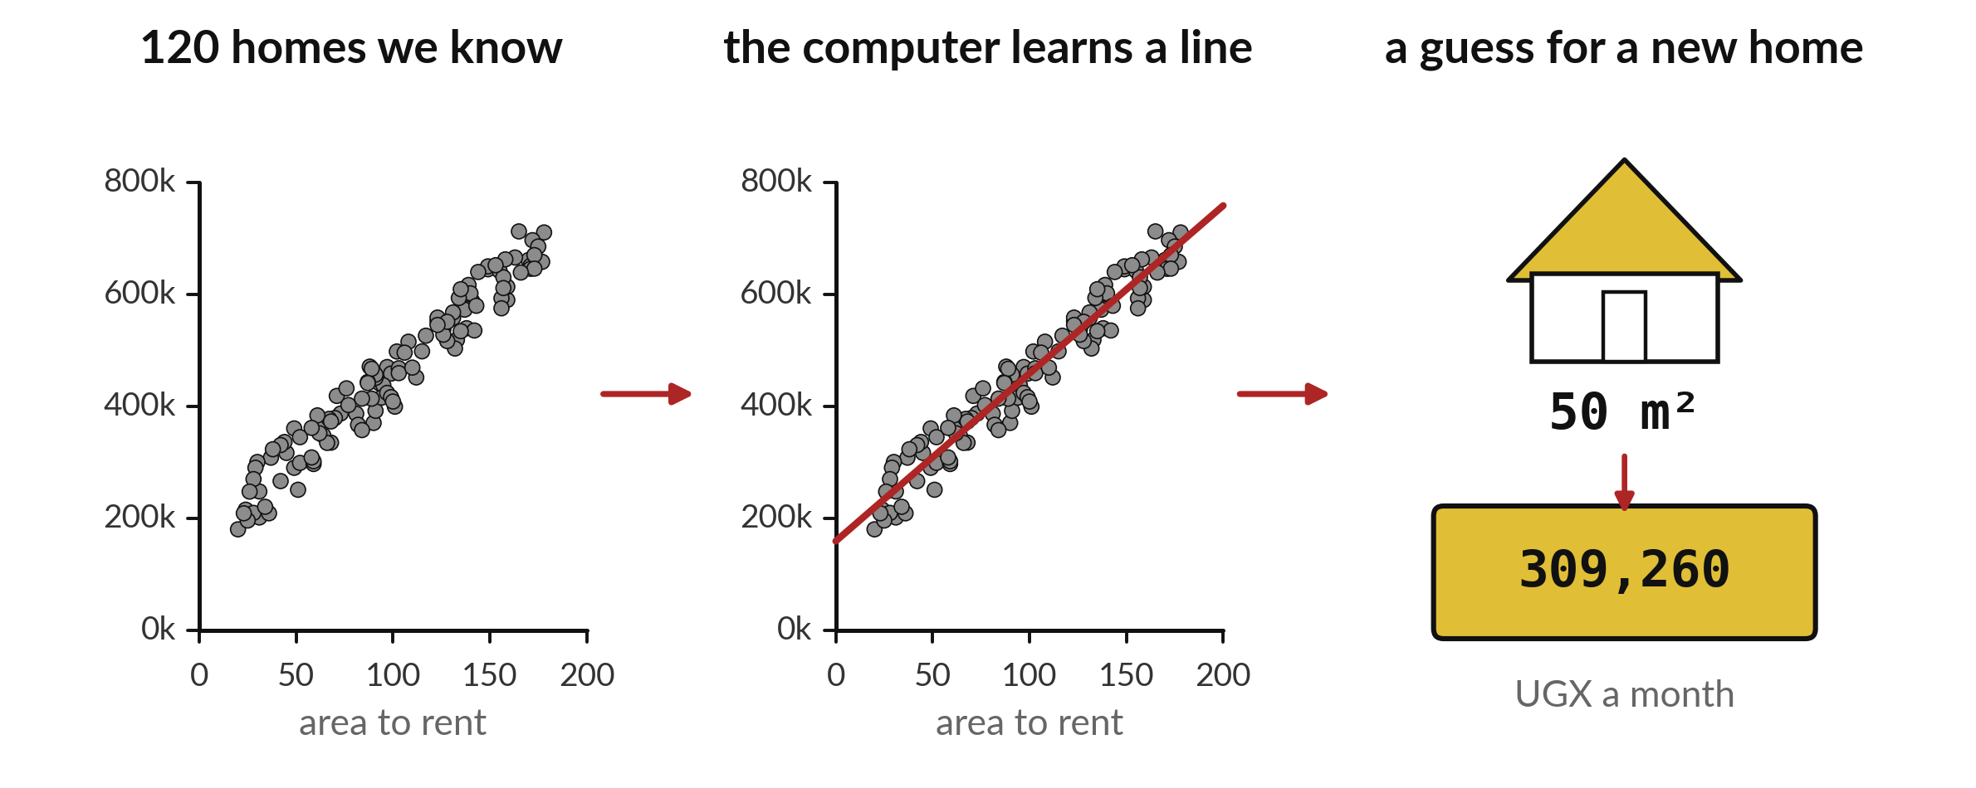
Can a computer guess a rent
after seeing 120 homes?
Notes:
Here is the whole camp in one picture. On the left are one hundred and twenty homes. For each one we know the floor area and the rent. In the middle the computer draws a line through those dots. On the right a new home appears, fifty square metres, and we ask the line to guess its rent. That guess is a prediction. By the end of today you will have run it yourself, in your own notebook. You do not need to understand it yet. Session thirteen opens it up.

Slide 3

Three hours, mostly doing
Most of our time is spent doing, in small steps, with a guess before every run.
Notes:
Here is how the 3 hours go. Each bar is as long as the time we spend on that part.
First, 10 minutes. Recall. Then, 50 minutes. Block A. After that, 15 minutes. Break away from screens. Next, 50 minutes. Block B. Then, 40 minutes. Make. Then, 15 minutes. Exit ticket, save, and an individual check with each learner.
Notice how much of the time is yours. You listen for a short while and then you do. That is on purpose, because you learn this by doing it.

Slide 4

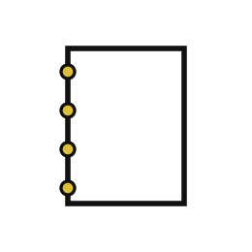

Words for today (1 of 2)
file
A named container for your work on the laptop.
A paper file in a folder at school.
notebook
A page made of text cells that explain and code cells that run.
An exercise book where the answers can run themselves.
code cell
A box where you type Python and press Shift+Enter to run it.
A calculator that sits inside your page.
Notes:
Here are the words for today. Listen for the picture that goes with each one.
file. A named container for your work on the laptop. Here is a way to see it. A paper file in a folder at school.
notebook. A page made of text cells that explain and code cells that run. A small example. An exercise book where the answers can run themselves.
code cell. A box where you type Python and press Shift+Enter to run it. Picture this. A calculator that sits inside your page.

Slide 5
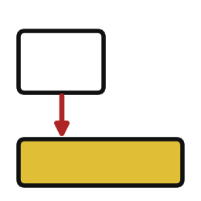


Words for today (2 of 2)
output
What Python shows under a cell after it runs.
The answer a calculator shows after you press equals.
print
A ready-made instruction that shows a value on the screen.
Reading a number out loud.
prediction
A number or label a computer guesses for something it has not seen yet.
A fundi estimating a job before measuring it.
Notes:
Two more words to know before we start.
output. What Python shows under a cell after it runs. You have seen this before. The answer a calculator shows after you press equals.
print. A ready-made instruction that shows a value on the screen. Reading a number out loud.
prediction. A number or label a computer guesses for something it has not seen yet. Think of a shop. A fundi estimating a job before measuring it.

Slide 6
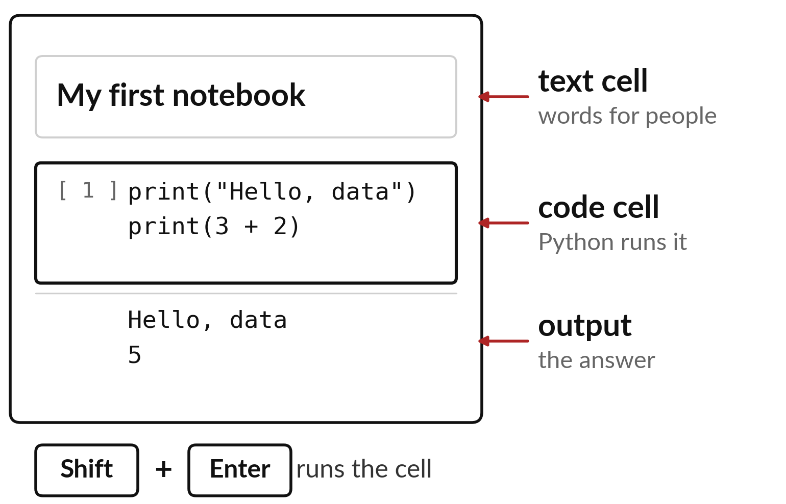
A notebook has text cells, code cells and output
Text cells hold words for people.
Code cells hold instructions for Python.
Shift and Enter runs the cell you clicked.
Notes:
Everything we do this term happens in a notebook. It is a page made of boxes called cells. A text cell holds words, like a title or a note to yourself. A code cell holds instructions for Python. Click a code cell, press Shift and Enter together, and the answer appears underneath it.
Which part of this page can Python read, and which part is only for you?

Slide 7
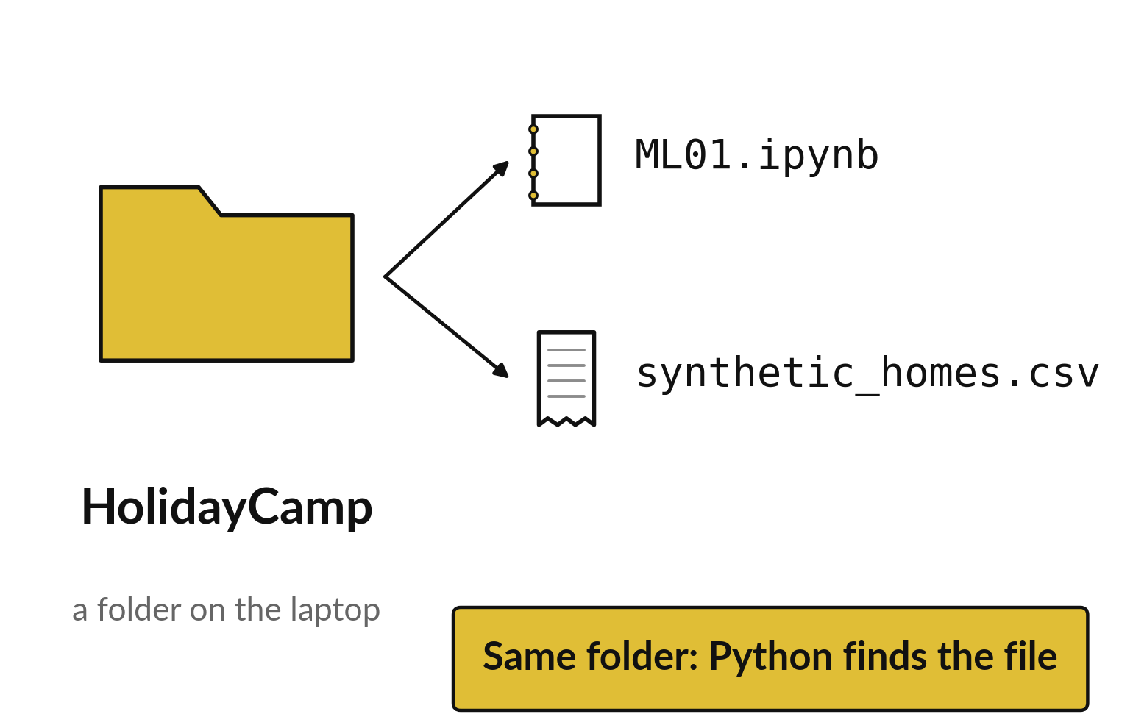
The notebook needs its
data file in the same folder
A file is saved work with a name.
A folder keeps files together.
Keep the notebook and the homes data in one folder.
Notes:
Before we run anything, find your camp folder. Inside it you should see this notebook and a file called synthetic_homes.csv. A file is saved work with a name, and a folder is where files are kept together. Python looks for data files in the same folder as the notebook, so keep them side by side.
Open your folder now and check that both files are there. Put your hand up if one is missing.

Slide 8
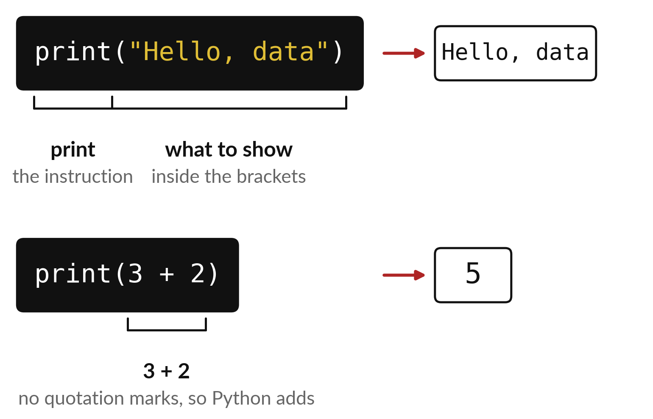
print shows whatever sits inside its brackets
Words go between quotation marks.
A sum with no quotation marks is worked out.
The result appears under the cell.
Notes:
The first instruction you will use is print. It shows something on the screen. Whatever you want shown goes inside the brackets. Words need quotation marks around them, so Hello, data comes out exactly as written. Three plus two has no quotation marks, so Python does the sum and shows five.
Write down what you expect under each cell before you press Shift and Enter. A guess that turns out wrong is useful, because it shows you what to look at.

Slide 9

Predict: Run your first instruction
print("Hello, data")
print(3 + 2)
Write on paper what you think these two lines will show.
Write your guess on paper before we run it.
Notes:
Look at this code with me before we run it.
Time to commit to an answer. Write on paper what you think these two lines will show. Write it on paper. It does not have to be right.

Slide 10
Run it: Run your first instruction
Hello, data
5
The first line shows Hello, data and the second shows 5.
A notebook is a page of text cells and code cells.
Shift+Enter runs a code cell and its output appears underneath.
print is a ready-made instruction, and the brackets hold what it shows.
Notes:
Now we run it. Match each line of the output with the line of code that made it.
The first line shows Hello, data and the second shows 5. A notebook is a page of text cells and code cells. Shift+Enter runs a code cell and its output appears underneath. print is a ready-made instruction, and the brackets hold what it shows.
If your guess was off, find the line that surprised you.

Slide 11
Investigate: Run your first instruction
1. What happens if you click a text cell and press Shift+Enter?
2. Why does Hello, data sit inside quotation marks while 3 + 2 does not?
print("Hello, data")
print(3 + 2)
Notes:
Now we look closely at Run your first instruction. I have two questions for you.
Question one. What happens if you click a text cell and press Shift+Enter? Give it thirty seconds and then we will hear a few answers.
The answer is this. Nothing runs. A text cell only explains; only a code cell runs Python.
Question two. Why does Hello, data sit inside quotation marks while 3 + 2 does not? Talk it over with your neighbour for a minute.
Quotation marks tell Python the characters are text. Without them Python calculates.

Slide 12
Modify: change one thing
Change Hello, data to your own nickname and run the cell again.
Then tell your neighbour what changed and how you know.
print("Hello, data")
print(3 + 2)
Notes:
Now it is your turn to change something. Change Hello, data to your own nickname and run the cell again. Run it, then tell someone what you saw.
What you should find: The first line now shows your nickname.

Slide 13

Break
15 minutes away from your screen
Stand up. Drink some water. Tell someone what you guessed in the first half.
Notes:
Break time. 15 minutes away from your screens. Stand up, drink some water and tell someone what you guessed in the first half.
When we come back we start the second idea.

Slide 14
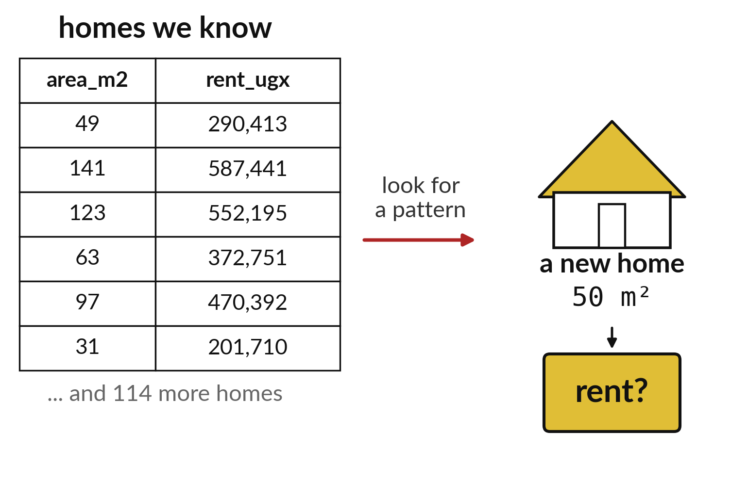
A prediction is a guess about
a home we have not seen
We know the rent of these homes.
The new home has an area but no rent yet.
The computer looks for a pattern to guess it.
Notes:
A prediction is an informed guess about something that has not happened or has not been measured. On the left we have homes whose rents we know. On the right is a new home of fifty square metres, and nobody has told us its rent. The computer studies the homes it knows, looks for a pattern between area and rent, and uses that pattern to guess.
Before we run the model, write your own guess for the rent of a fifty square metre home. We will compare it with the computer.

Slide 15
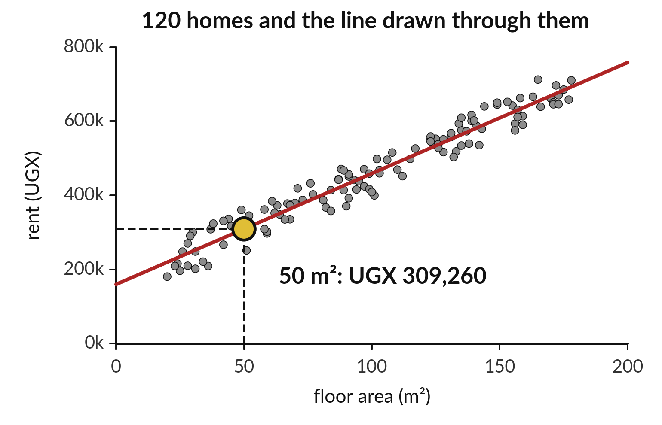
The computer draws a line through 120 homes
Each grey dot is one home.
The red line is the pattern the computer found.
The gold dot is its guess for 50 square metres.
Notes:
Each grey dot is one home, placed by its area across the bottom and its rent up the side. Larger homes cost more, so the dots climb. The computer draws one straight line that runs as close as it can to all the dots.
To guess for a new home, we go up from fifty square metres until we hit the line, then across to the rent axis. That gold dot is the prediction: about three hundred and nine thousand shillings a month. These homes are invented, so the number tells us nothing about real rents.

Slide 16

Predict: Run a ready-made prediction
import pandas as pd
from sklearn.linear_model import LinearRegression
homes = pd.read_csv("synthetic_homes.csv")
model = LinearRegression().fit(
homes[["area_m2"]], homes["rent_ugx"]
)
pred = model.predict(pd.DataFrame({"area_m2": [50]}))[0]
print("Estimated rent for 50 square metres:", round(pred))
Before you run it, write the monthly rent in UGX you expect for a home of 50 square metres.
Write your guess on paper before we run it.
Notes:
This model has looked at 120 invented homes and learned how rent follows floor area. You do not need to understand it yet.
Your turn to guess. Before you run it, write the monthly rent in UGX you expect for a home of 50 square metres. Put it on paper first. We will check it together in a moment.

Slide 17

Run it: Run a ready-made prediction
The model estimates about UGX 309,260 a month.
It drew a line through the 120 homes and read the rent at 50 square metres.
Guessing a number from examples is called regression, and you will build one yourself in session 14.
Notes:
I will run it, and you compare with your guess. Match each line of the output with the line of code that made it.
The model estimates about UGX 309,260 a month. It drew a line through the 120 homes and read the rent at 50 square metres. Guessing a number from examples is called regression, and you will build one yourself in session 14. The homes are invented, so the estimate says nothing about real rents.
Check your paper. Were you close?

Slide 18

Investigate: Run a ready-made prediction
1. The home grows from 50 to 100 square metres. What do you expect the estimate to do?
2. Is the estimate certain?
3. Does this model know anything about Kampala?
Notes:
Now we look closely at Run a ready-made prediction. I have three questions for you.
Question one. The home grows from 50 to 100 square metres. What do you expect the estimate to do? Talk it over with your neighbour for a minute.
It rises. A 50 square metre increase adds about UGX 150,000 here.
Question two. Is the estimate certain? Think about it for a moment, then tell the person next to you.
Here is how I would answer it. No. It is a guess from 120 invented homes and can be wrong for any real home.
Question three. Does this model know anything about Kampala? Have a go in your head first.
What I would say is this. No. It only knows the 120 invented rows in the file.

Slide 19

Modify: change one thing
Change 50 to 100 and run the cell again.
Then tell your neighbour what changed and how you know.
Notes:
Time to experiment. Change 50 to 100 and run the cell again. After you run it, say in one sentence what changed and how you checked.
You should see this. The estimate becomes about UGX 459,084.

Slide 20
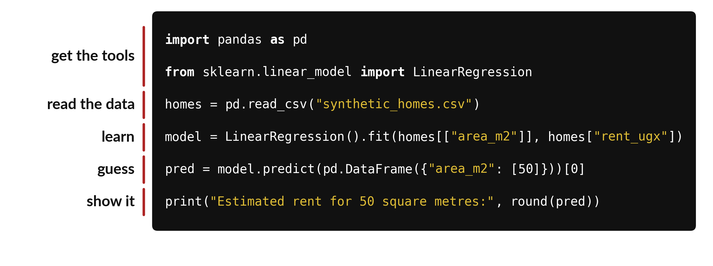
Six lines of code do five jobs
You do not need to understand every word yet.
Notes:
Here is the code you just ran, with the jobs of each line marked on the left. The first two lines fetch the tools we need. The third line reads the homes file. The fourth line is where the learning happens: the computer fits a line to the homes. The fifth line asks that line for a guess at fifty square metres. The last line shows the answer.
In session thirteen we take this apart one job at a time. For now, notice that five jobs fit in six lines.

Slide 21

Make: your own version
In a new code cell print your nickname and the result of 7 + 4. In another cell estimate the rent for 80 square metres. Save as ML01.ipynb, close it and reopen it. With the instructor, read AI_USE_POLICY.md: in weeks 1 to 6 all core work is your own, with no AI-generated solutions.
Save it as ML01. Write two sentences: what you changed and how you checked it.
Notes:
Now you do the real work yourself. Start with the first step. If you get stuck for a few minutes, read your error message, check the error card, and then ask me.
Save it as ML01. I will come round to each of you and ask what you changed and how you checked it.

Slide 22

Two errors you may meet today
It means: A quotation mark is curly, usually from copying out of a document.
Fix: Retype the quote marks with the keyboard so they are straight.
SyntaxError or invalid character
It means: This laptop is not using the prepared camp environment.
Fix: Tell the instructor. Do not install anything yourself.
ModuleNotFoundError: No module named 'sklearn'
Notes:
Two things are likely to go wrong today. It helps to know them before they happen.
This is the first one. You will see: SyntaxError or invalid character. It means this: A quotation mark is curly, usually from copying out of a document. To fix it, retype the quote marks with the keyboard so they are straight.
The next one. You will see: ModuleNotFoundError: No module named 'sklearn'. It means this: this laptop is not using the prepared camp environment. To fix it, tell the instructor. Do not install anything yourself.
If you meet one of these, fix it and carry on. It happens to everyone.

Slide 23

Finish this sentence in your notebook
A prediction is a guess for something not yet seen; the rent model guesses a number from 120 examples.
Then save your notebook, close it and open it again to check it saved.
Notes:
Before we finish, go back to the question we began with: Can a computer guess a rent after seeing 120 homes?
Copy this sentence into your notebook and make it yours. A prediction is a guess for something not yet seen; the rent model guesses a number from 120 examples.
Then save your notebook, close it and open it again to check it saved.

