Slide 1
Functions and checks that fail loudly
How do I turn my flower rule into a reusable tool and test it?
Machine Learning | Session 6 of 24 | Week 2, Python you need
Holiday Data and AI Camp | The National ICT Innovation Hub, Nakawa
Notes:
Welcome back. Today is session 6 and our topic is functions and checks that fail loudly.
By the end of today you will be able to write a function that returns a result, and check it against known answers with assert.
We will answer one question: How do I turn my flower rule into a reusable tool and test it?

Slide 2
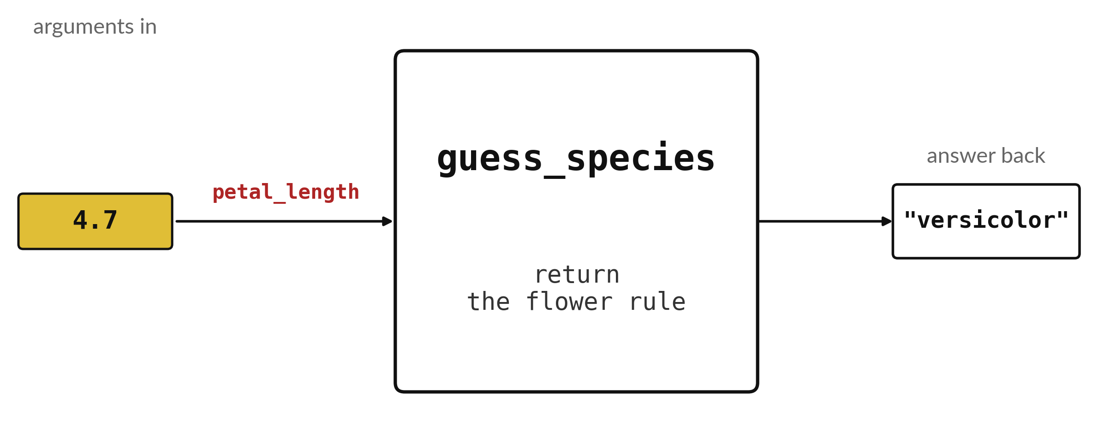
How do I turn my flower rule
into a reusable tool and test it?
Notes:
Last session you wrote a rule that names a flower from its petal length. Every time you wanted to use it, you had to retype the questions. A function packages the rule as a machine. You drop in a petal length, four point seven, and out comes a name. Today you build that machine, and then write the checks that test it on flowers whose names we already know.

Slide 3

Three hours, mostly doing
Most of our time is spent doing, in small steps, with a guess before every run.
Notes:
Here is how the 3 hours go. Each bar is as long as the time we spend on that part.
First, 10 minutes. Recall. Then, 50 minutes. Block A. After that, 15 minutes. Break away from screens. Next, 50 minutes. Block B. Then, 40 minutes. Make. Then, 15 minutes. Exit ticket, save, and an individual check with each learner.
Notice how much of the time is yours. You listen for a short while and then you do. That is on purpose, because you learn this by doing it.

Slide 4
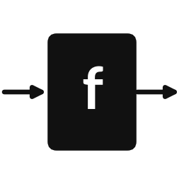

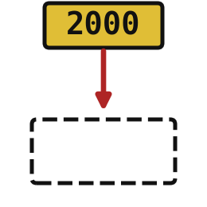
Words for today (1 of 2)
function
A named set of instructions you can use again and again.
A recipe card you reuse.
parameter
The name inside the function for the value it receives.
The blank on a form.
argument
The actual value you give the function when you use it.
What you write in the blank.
Notes:
We need a few words today. For each one I will say what it means and give you something to picture.
function. A named set of instructions you can use again and again. An example from everyday life. A recipe card you reuse.
parameter. The name inside the function for the value it receives. Here is a way to see it. The blank on a form.
argument. The actual value you give the function when you use it. A small example. What you write in the blank.

Slide 5
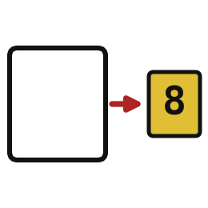
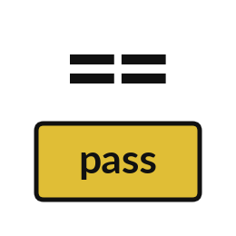

Words for today (2 of 2)
return
Sends a result back so the program can keep it.
Handing over the finished item.
assert
Stops with an error if a statement is false.
A teacher checking that an answer is right.
check
A test with a known right answer.
Weighing a bag of sugar on a trusted scale.
Notes:
More words for today.
return. Sends a result back so the program can keep it. Picture this. Handing over the finished item.
assert. Stops with an error if a statement is false. You have seen this before. A teacher checking that an answer is right.
check. A test with a known right answer. Weighing a bag of sugar on a trusted scale.

Slide 6
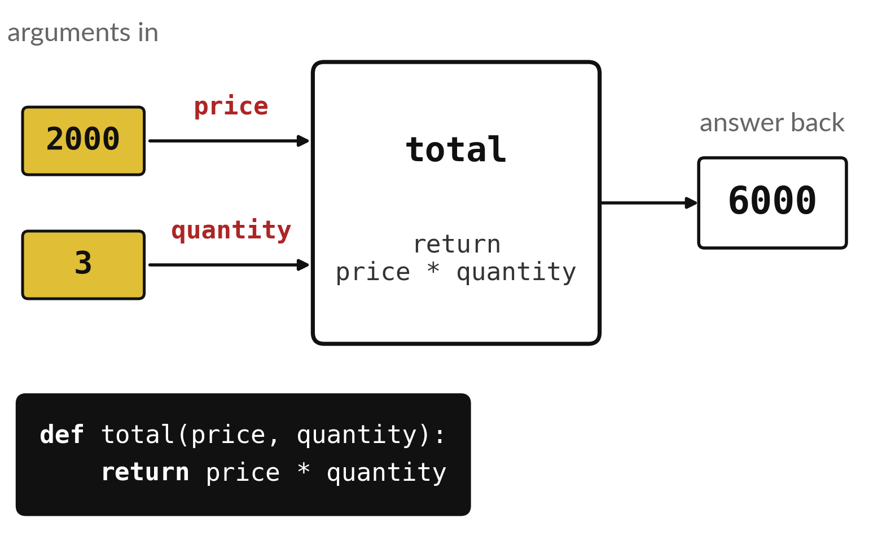
A function is a machine: values in, answer out
The machine has a name.
Each input slot has a name.
The answer comes back out.
Notes:
A function is a machine you build once and use as often as you like. This one is called total. It has two input slots called price and quantity. Drop in two thousand and three, the machine multiplies them, and out comes six thousand. The two lines at the bottom describe the machine to Python.
What would come out if you dropped in one thousand and five?

Slide 7
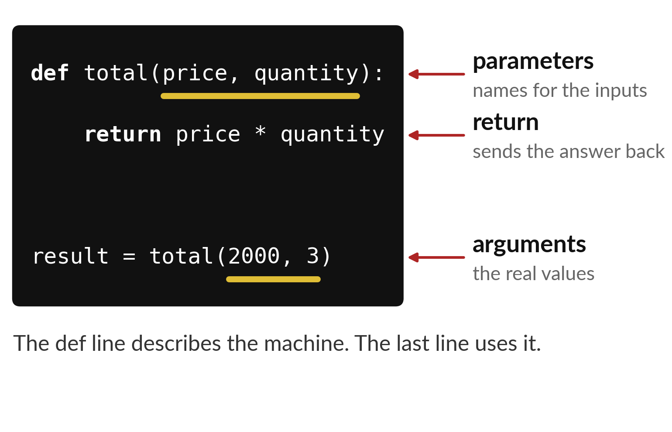
Parameters, arguments and return each have a job
Parameters are the names inside the machine.
Arguments are the real values you give it.
return sends the answer back.
Notes:
The word def starts the description of the machine. The names in brackets on that line are the parameters. They are the labels on the input slots. The word return says what comes out.
Later, when we use the machine, the real values we give it are called arguments. A parameter is the label on the slot. An argument is what you put in the slot. Can you point to each one in the code?

Slide 8
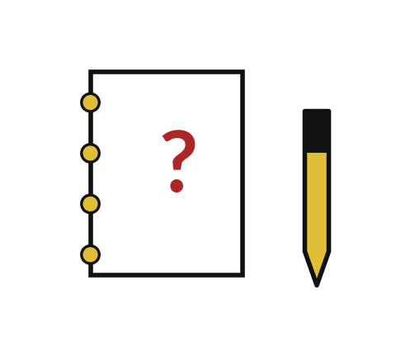
Predict: A function and an assert
def total(price, quantity):
return price * quantity
result = total(2000, 3)
print(result)
assert total(2000, 3) == 6000
Predict what total(2000, 3) gives and what happens when the assert passes.
Write your guess on paper before we run it.
Notes:
A function names a calculation so you can use it again. A passing assert prints nothing.
Time to commit to an answer. Predict what total(2000, 3) gives and what happens when the assert passes. Guess on paper first. Surprises are useful.

Slide 9
Run it: A function and an assert
6000
The cell prints 6000.
def starts the function.
price and quantity are parameters, and the 2000 and 3 you give it are arguments.
return sends the answer back.
assert stops with an error when the statement is false, and a passing assert prints nothing.
Notes:
Now we run it. Match each line of the output with the line of code that made it.
The cell prints 6000. def starts the function. price and quantity are parameters, and the 2000 and 3 you give it are arguments. return sends the answer back. assert stops with an error when the statement is false, and a passing assert prints nothing.
If your guess was off, find the line that surprised you.

Slide 10
Investigate: A function and an assert
1. What is the difference between return and print?
2. What happens if you define total but never call it?
def total(price, quantity):
return price * quantity
result = total(2000, 3)
print(result)
assert total(2000, 3) == 6000
Notes:
Now we look closely at A function and an assert. I have two questions for you.
Question one. What is the difference between return and print? Say it quietly to yourself before anyone answers.
The answer is this. return gives the value back to the program. print only shows it on the screen.
Question two. What happens if you define total but never call it? Give it thirty seconds and then we will hear a few answers.
Nothing runs. Defining a function does not run its lines.

Slide 11
Modify: change one thing
Add an assert that total(1000, 0) equals 0.
Then tell your neighbour what changed and how you know.
def total(price, quantity):
return price * quantity
result = total(2000, 3)
print(result)
assert total(2000, 3) == 6000
Notes:
Now it is your turn to change something. Add an assert that total(1000, 0) equals 0. When you have run it, tell your neighbour what changed and how you know.
Here is what happens. It passes silently, because 1000 times 0 is 0.

Slide 12

Break
15 minutes away from your screen
Stand up. Drink some water. Tell someone what you guessed in the first half.
Notes:
Break time. 15 minutes away from your screens. Stand up, drink some water and tell someone what you guessed in the first half.
When we come back we start the second idea.

Slide 13
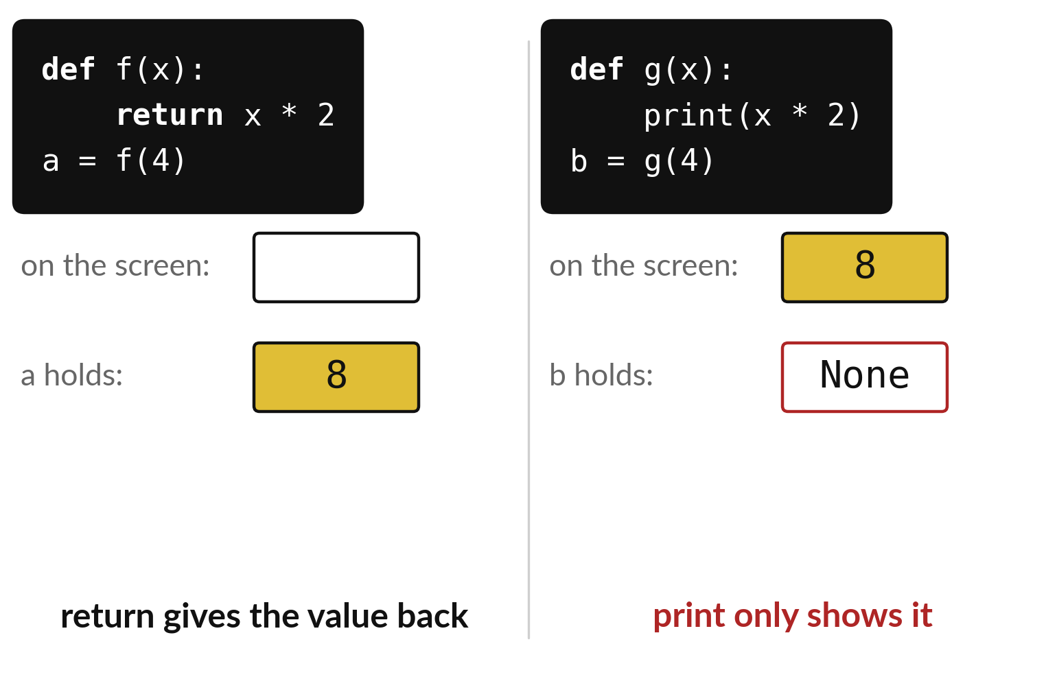
return hands the answer
back, and print only shows it
return gives the value to the rest of the program.
print writes on the screen and gives back nothing.
A function with no return holds None.
Notes:
Two functions that look alike behave differently. On the left, the function returns its answer, so the variable a holds eight and we can use it later. On the right, the function prints. Eight appears on the screen, but nothing is handed back, so the variable b holds None.
If your function shows None where you wanted a number, look for a missing return.

Slide 14
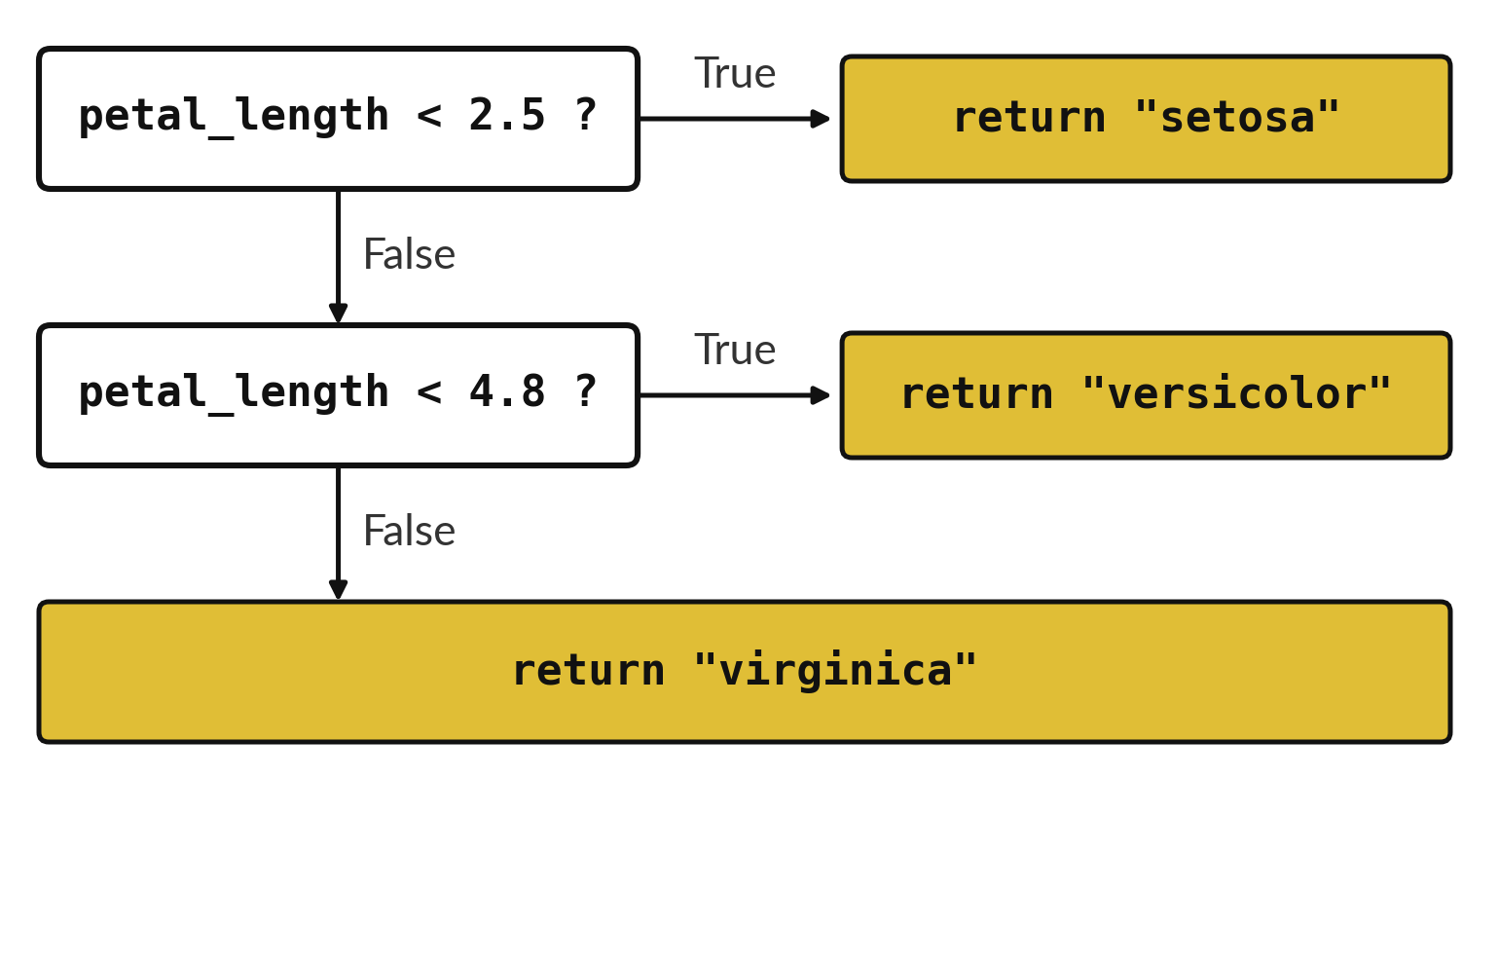
The flower rule becomes a
function of three questions
The function asks the same questions as before.
return ends the function as soon as it runs.
One argument in, one name out.
Notes:
This is last session's ladder, now living inside a function. The questions are the same. The difference is that each box says return, so as soon as one question is True the function hands back that name and stops.
Because it is a function, you can call it for any petal length without retyping the questions. Call it for one point four in your head. What does it hand back?

Slide 15
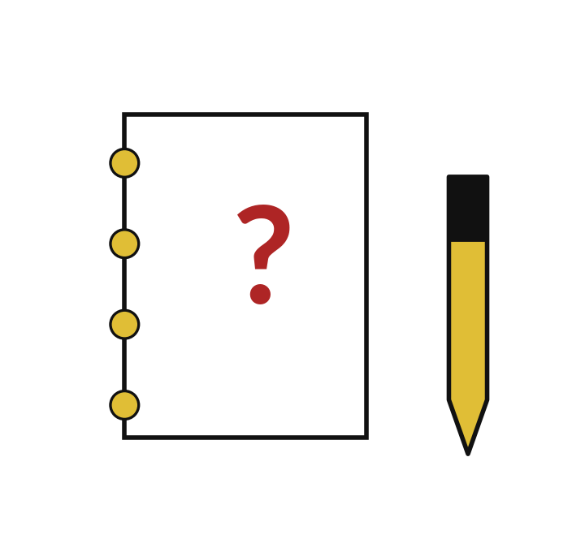
Predict: The flower rule as a function
Predict how many of the eight flowers the function names correctly.
Write your guess on paper before we run it.
Notes:
Your rule from session 4 becomes a function. Three asserts test it, and a loop counts it on eight flowers.
Your turn to guess. Predict how many of the eight flowers the function names correctly. Write it on paper. It does not have to be right.

Slide 16
Run it: The flower rule as a function
7
The cell prints 7.
The three asserts pass without a sound.
Each flower in the list holds a petal length at position 0 and a species at position 1.
The function is right for seven of eight flowers, the same count you found by hand.
Notes:
I will run it, and you compare with your guess. Match each line of the output with the line of code that made it.
The cell prints 7. The three asserts pass without a sound. Each flower in the list holds a petal length at position 0 and a species at position 1. The function is right for seven of eight flowers, the same count you found by hand.
Check your paper. Were you close?

Slide 17

Investigate: The flower rule as a function
1. What does flower[0] give?
2. Why test the function on three known flowers before counting?
Notes:
Now we look closely at the flower rule as a function. I have two questions for you.
Question one. What does flower[0] give? Give it thirty seconds and then we will hear a few answers.
The petal length, because position 0 is the first item.
Question two. Why test the function on three known flowers before counting? Talk it over with your neighbour for a minute.
Here is how I would answer it. If an assert fails you know the rule is broken before you trust any count.

Slide 18

Modify: change one thing
Add the flower [4.9, "versicolor"] again to the list and recount.
Then tell your neighbour what changed and how you know.
Notes:
Time to experiment. Add the flower [4.9, "versicolor"] again to the list and recount. Run it, then tell someone what you saw.
What you should find: The count becomes 7 out of 9, because the 4.9 flower is wrong each time.

Slide 19
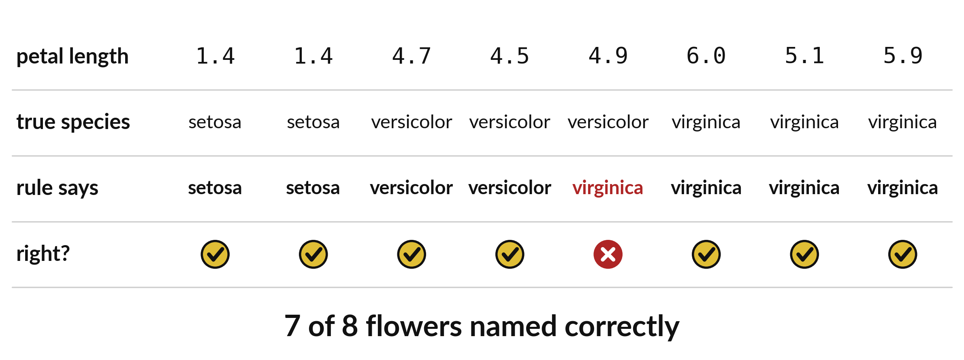
The function names seven of eight flowers right
Checking every flower by loop gives the same count as checking by hand.
Notes:
Here is every flower, scored by the function. The first row is the petal length. The second is the true species. The third is what our function says. The last row shows a tick when they agree.
Seven ticks and one cross. The loop in your notebook counts them for you and prints seven. Does that match the count you made by hand last session?

Slide 20
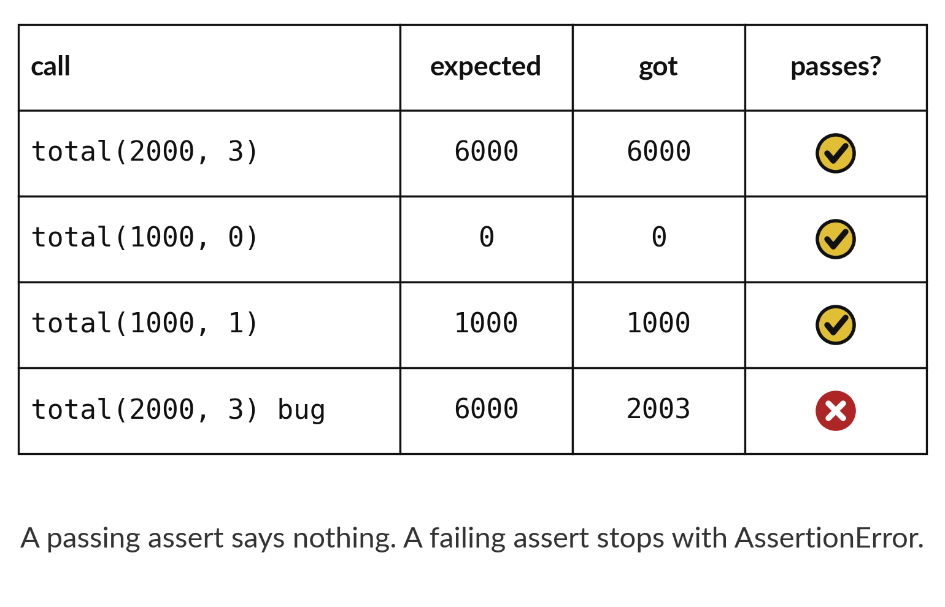
assert tests the machine on known answers
A passing assert prints nothing.
A failing assert stops with AssertionError.
Test the edges, such as zero.
Notes:
Each row is a check. We write down the answer we expect, run the function, and compare. The assert instruction compares for us. When the answers match, it stays silent, and silence means pass.
The last row is a faulty function that adds instead of multiplying. It gives twenty oh three where we expected six thousand, and the assert would stop the program. Why is a zero quantity a good test to include?

Slide 21

Make: your own version
Define double(number) so it returns twice its input. Check double(4), double(0) and double(-2) with assert. Save the notebook and run all cells from the top.
Save it as ML06. Write two sentences: what you changed and how you checked it.
Notes:
This is your own task for today. Take it one step at a time. If you get stuck for a few minutes, read your error message, check the error card, and then ask me.
Save it as ML06. I will come round to each of you and ask what you changed and how you checked it.

Slide 22

Two errors you may meet today
It means: You gave the function fewer values than it has parameters.
Fix: Give one argument for each parameter.
TypeError: total() missing 1 required positional argument
It means: The function has no return line, so nothing came back.
Fix: Add return before the value you want back.
The answer shows None
Notes:
Everyone meets errors, including me. Two are likely today, so let us meet them now.
This is the first one. You will see: TypeError: total() missing 1 required positional argument. It means this: you gave the function fewer values than it has parameters. To fix it, give one argument for each parameter.
The next one. You will see: The answer shows None. It means this: the function has no return line, so nothing came back. To fix it, add return before the value you want back.
Keep this slide in mind when something stops working.

Slide 23

Finish this sentence in your notebook
A function packages a rule, and an assert proves the rule gives a known answer.
Then save your notebook, close it and open it again to check it saved.
Notes:
We are nearly done. Remember the question from the start of the session: How do I turn my flower rule into a reusable tool and test it?
Write this sentence in your notebook and finish it your own way. A function packages a rule, and an assert proves the rule gives a known answer.
Then save your notebook, close it and open it again to check it saved.

