Slide 1
Tables and reading a CSV file
How many sales are in the practice shop file, and what does each one record?
Machine Learning | Session 7 of 24 | Week 3, Tables and statistics
Holiday Data and AI Camp | The National ICT Innovation Hub, Nakawa
Notes:
Good to see you. Today is session 7 and our topic is tables and reading a CSV file.
By the end of today you will be able to read a CSV file into a pandas table and say how many rows and columns it has.
We will answer one question: How many sales are in the practice shop file, and what does each one record?

Slide 2
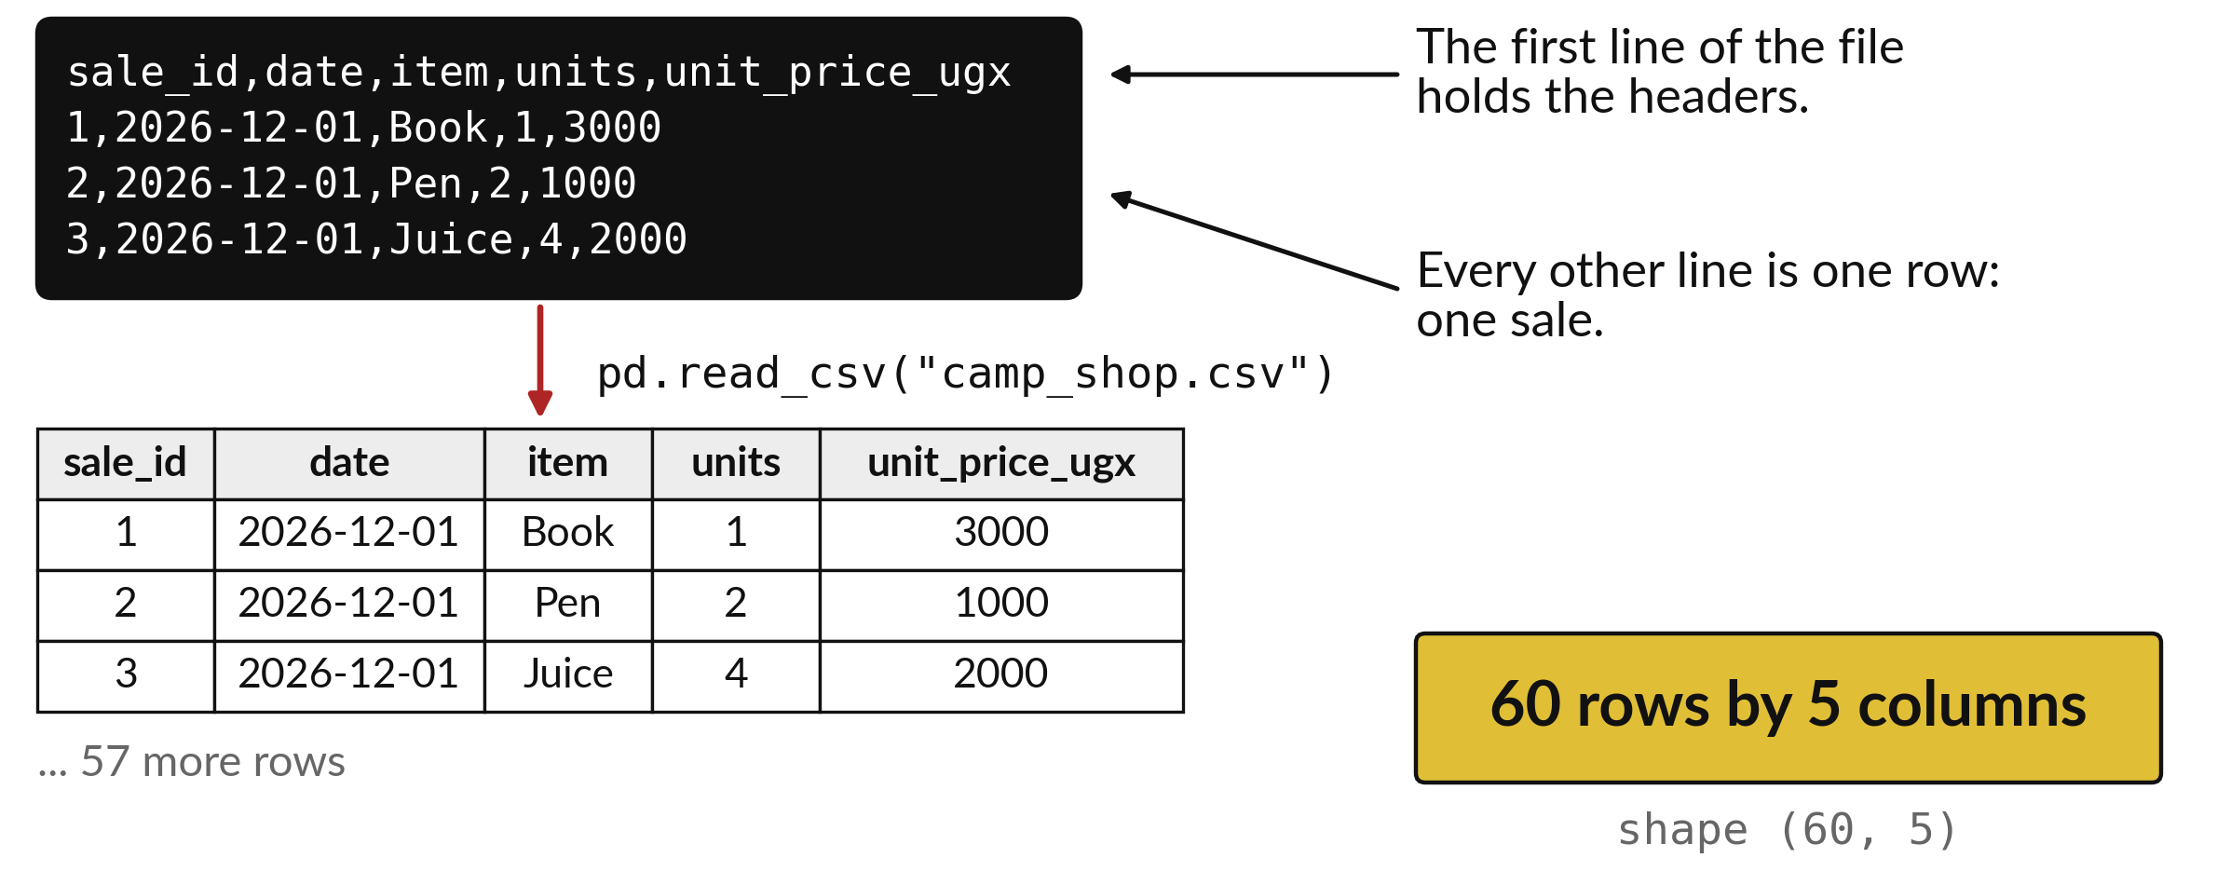
How many sales are in the practice shop
file, and what does each one record?
Notes:
Look at the black box at the top. It is a plain text file, and each line is one sale of a book, a pen or a juice. The first line holds the names of the columns. Python reads that file and turns it into a table with rows and columns. At the bottom right is the size of the table: sixty rows and five columns. Today you learn to read this picture. The question is how many sales are in the file and what each one records.

Slide 3

Three hours, mostly doing
Most of our time is spent doing, in small steps, with a guess before every run.
Notes:
Here is how the 3 hours go. Each bar is as long as the time we spend on that part.
First, 10 minutes. Recall. Then, 50 minutes. Block A. After that, 15 minutes. Break away from screens. Next, 50 minutes. Block B. Then, 40 minutes. Make. Then, 15 minutes. Exit ticket, save, and an individual check with each learner.
Notice how much of the time is yours. You listen for a short while and then you do. That is on purpose, because you learn this by doing it.

Slide 4
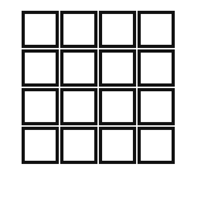


Words for today (1 of 2)
row and column
A row is one record across the table. A column is one kind of fact down the table.
One line of a register and one heading of the register.
header
The name written at the top of each column.
The title above a column in an exercise book.
CSV file
A plain text file where each line is a row and commas split the columns.
A register copied as text.
Notes:
Here are the words for today. Listen for the picture that goes with each one.
row and column. A row is one record across the table. A column is one kind of fact down the table. Picture this. One line of a register and one heading of the register.
header. The name written at the top of each column. You have seen this before. The title above a column in an exercise book.
CSV file. A plain text file where each line is a row and commas split the columns. A register copied as text.

Slide 5


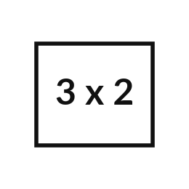
Words for today (2 of 2)
library and import
A library is code other people wrote. import loads it into your notebook.
Borrowing a toolbox from the workshop.
DataFrame
The pandas name for a table inside Python.
A spreadsheet that lives in the notebook.
shape
The number of rows and columns, written as a pair.
Counting how many lines and headings a register has.
Notes:
Two more words to know before we start.
library and import. A library is code other people wrote. import loads it into your notebook. Think of a shop. Borrowing a toolbox from the workshop.
DataFrame. The pandas name for a table inside Python. Imagine it like this. A spreadsheet that lives in the notebook.
shape. The number of rows and columns, written as a pair. An example from everyday life. Counting how many lines and headings a register has.

Slide 6
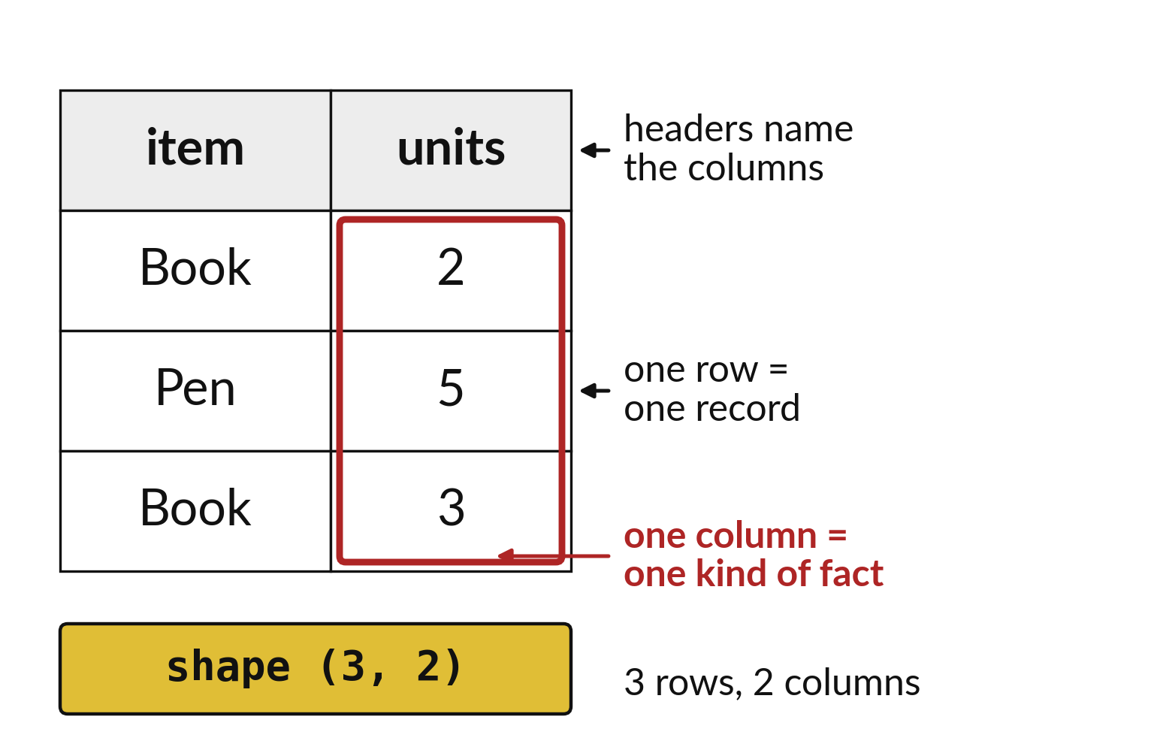
One row is one record, one
column one kind of fact
Headers name the columns.
Each row records one sale.
Every cell sits in one row and one column.
Notes:
A table is a grid. Each row across is one record, so here one row is one sale. Each column down is one kind of fact, such as the item or the number of units. The headers on top name the columns, so you never have to guess what a column holds.
Pick any cell in the picture. Say which row it is in and which column.

Slide 7
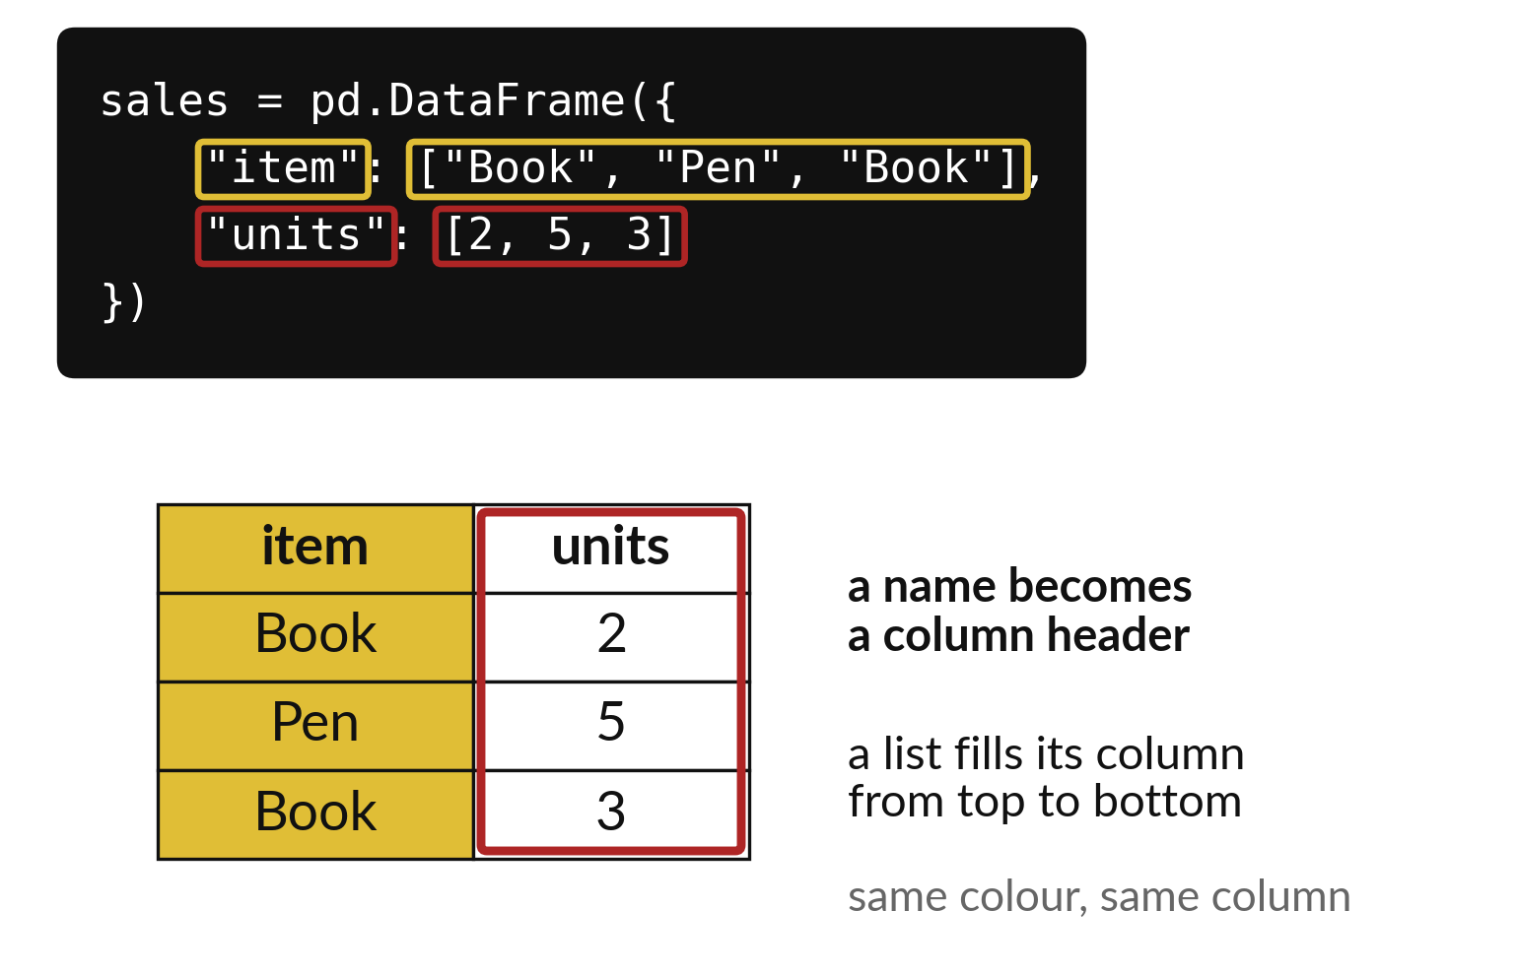
Three short lists become a
table with one line of code
Each list becomes one column.
Python fills in the row numbers.
The table is called a DataFrame.
Notes:
In Python a table is called a DataFrame. You can build a small one by hand. Give it a list for each column, and the first item of every list lands in the first row.
Look at the code and predict how many rows the table will have. Count the items in one list.

Slide 8

Predict: Build a small table
import pandas as pd
sales = pd.DataFrame(
{"item": ["Book", "Pen", "Book"], "units": [2, 5, 3]}
)
print(sales)
print(sales.shape)
Predict how many rows and columns the table has.
Write your guess on paper before we run it.
Notes:
pandas is a library for tables.
This is the part where you decide. Predict how many rows and columns the table has. Write it on paper. It does not have to be right.

Slide 9
Run it: Build a small table
item units
0 Book 2
1 Pen 5
2 Book 3
(3, 2)
The table has 3 rows and 2 columns, so shape prints (3, 2).
The headers are item and units.
import pandas as pd loads the library and gives it the short name pd.
A table made this way is a DataFrame.
Notes:
Let us see what happens. Match each line of the output with the line of code that made it.
The table has 3 rows and 2 columns, so shape prints (3, 2). The headers are item and units. import pandas as pd loads the library and gives it the short name pd. A table made this way is a DataFrame. The dot after sales reaches a property that belongs to that table.
Which line of the output matches which line of the code? Point to each pair.

Slide 10

Investigate: Build a small table
1. What does the first number of shape count?
2. Where do the headers come from?
Notes:
Now we look closely at build a small table. I have two questions for you.
Question one. What does the first number of shape count? Give it thirty seconds and then we will hear a few answers.
What I would say is this. Rows. The second number counts columns.
Question two. Where do the headers come from? Talk it over with your neighbour for a minute.
Let me answer it. From the names in the curly brackets: item and units.

Slide 11
Modify: change one thing
Add a fourth sale, Pen with 4 units, to both lists and run again.
Then tell your neighbour what changed and how you know.
import pandas as pd
sales = pd.DataFrame(
{
"item": [
"Book", "Pen", "Book"
],
"units": [2, 5, 3]
}
)
print(sales)
print(sales.shape)
Notes:
Change one thing and watch what happens. Add a fourth sale, Pen with 4 units, to both lists and run again. Then explain to your neighbour what the change did.
The result: shape becomes (4, 2).

Slide 12

Break
15 minutes away from your screen
Stand up. Drink some water. Tell someone what you guessed in the first half.
Notes:
Break time. 15 minutes away from your screens. Stand up, drink some water and tell someone what you guessed in the first half.
When we come back we start the second idea.

Slide 13
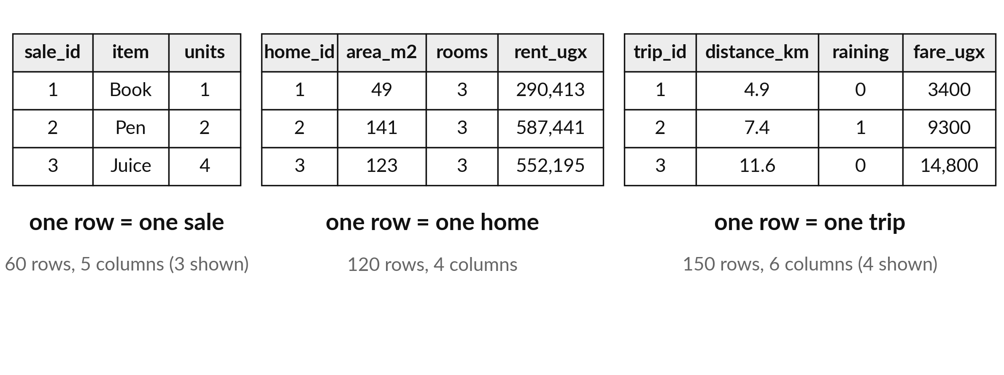
A CSV file is a table written as plain text
One line is one row. Commas separate the columns. Our files hold shop sales and invented homes.
Notes:
A CSV file stores a table as simple text. Each line is one row and a comma separates the columns. Because it is plain text, any program can open it.
This term you will meet three of them. The shop file holds one sale on each row. The homes file holds one home on each row. Both are invented for practice, so they say nothing about real shops or real rents.

Slide 14
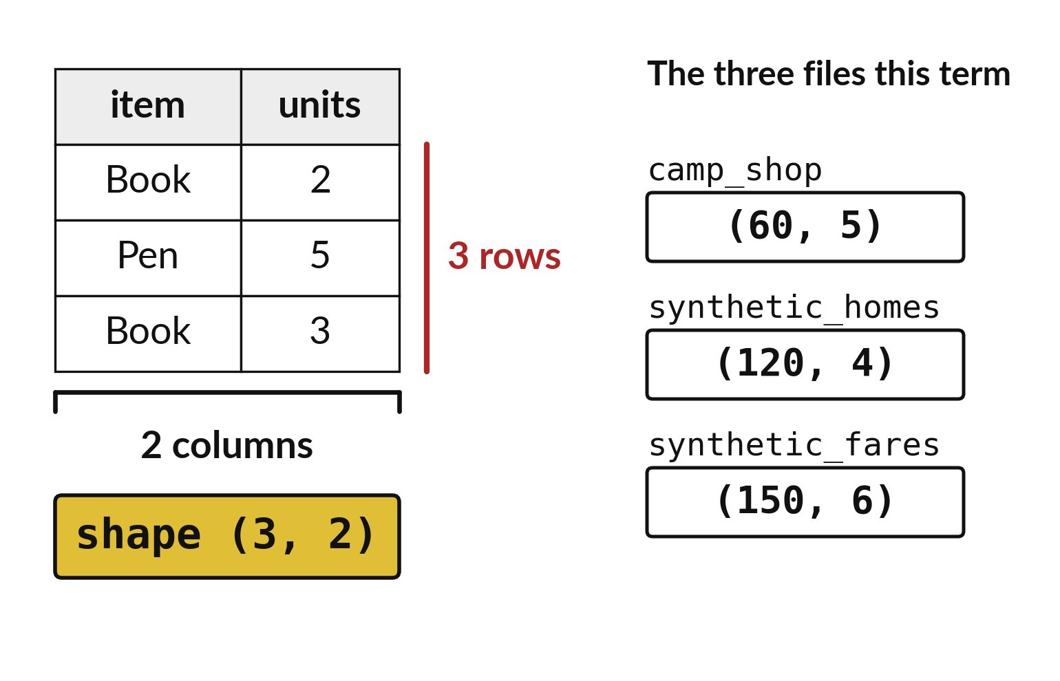
Shape gives rows first and columns second
The shop file has shape 60 by 5.
Check the shape straight after reading a file.
A wrong shape means a wrong file.
Notes:
After you read a file, ask for its shape. It gives two numbers. The first is the number of rows and the second is the number of columns.
For the shop file you should see sixty and five. If you see something else, you may have opened the wrong file, and it is better to find out now than after an hour of work.

Slide 15

Predict: Read the practice shop file
import pandas as pd
shop = pd.read_csv("camp_shop.csv")
print(shop.head())
print(shop.shape)
print(list(shop.columns))
Predict how many rows camp_shop.csv has and which headers it shows.
Write your guess on paper before we run it.
Notes:
camp_shop.csv sits beside your notebook. Read it into a table and look at the first rows.
Make a prediction. Predict how many rows camp_shop.csv has and which headers it shows. Put it on paper first. We will check it together in a moment.

Slide 16

Run it: Read the practice shop file
The table has 60 rows and 5 columns, so shape prints (60, 5).
The headers are sale_id, date, item, units and unit_price_ugx.
read_csv reads the file into a DataFrame and head shows its first five rows.
Notes:
Running it now. Match each line of the output with the line of code that made it.
The table has 60 rows and 5 columns, so shape prints (60, 5). The headers are sale_id, date, item, units and unit_price_ugx. read_csv reads the file into a DataFrame and head shows its first five rows. The unit of money is in the header: unit_price_ugx is in shillings.
Keep your guess. We use it in the next step.

Slide 17
Investigate: Read the practice shop file
1. Why is the unit written in the header name unit_price_ugx?
2. What do the 60 rows stand for?
Notes:
Now we look closely at read the practice shop file. I have two questions for you.
Question one. Why is the unit written in the header name unit_price_ugx? Talk it over with your neighbour for a minute.
Let me answer it. A number without a unit is easy to misread. The header says the price is in shillings.
Question two. What do the 60 rows stand for? Think about it for a moment, then tell the person next to you.
The answer is this. Sixty sales. Each row is one sale.

Slide 18

Modify: change one thing
Show the first 10 rows by writing 10 inside the brackets of head.
Then tell your neighbour what changed and how you know.
Notes:
Make one small change. Show the first 10 rows by writing 10 inside the brackets of head. When you have run it, tell your neighbour what changed and how you know.
Here is what happens. Ten rows print.

Slide 19
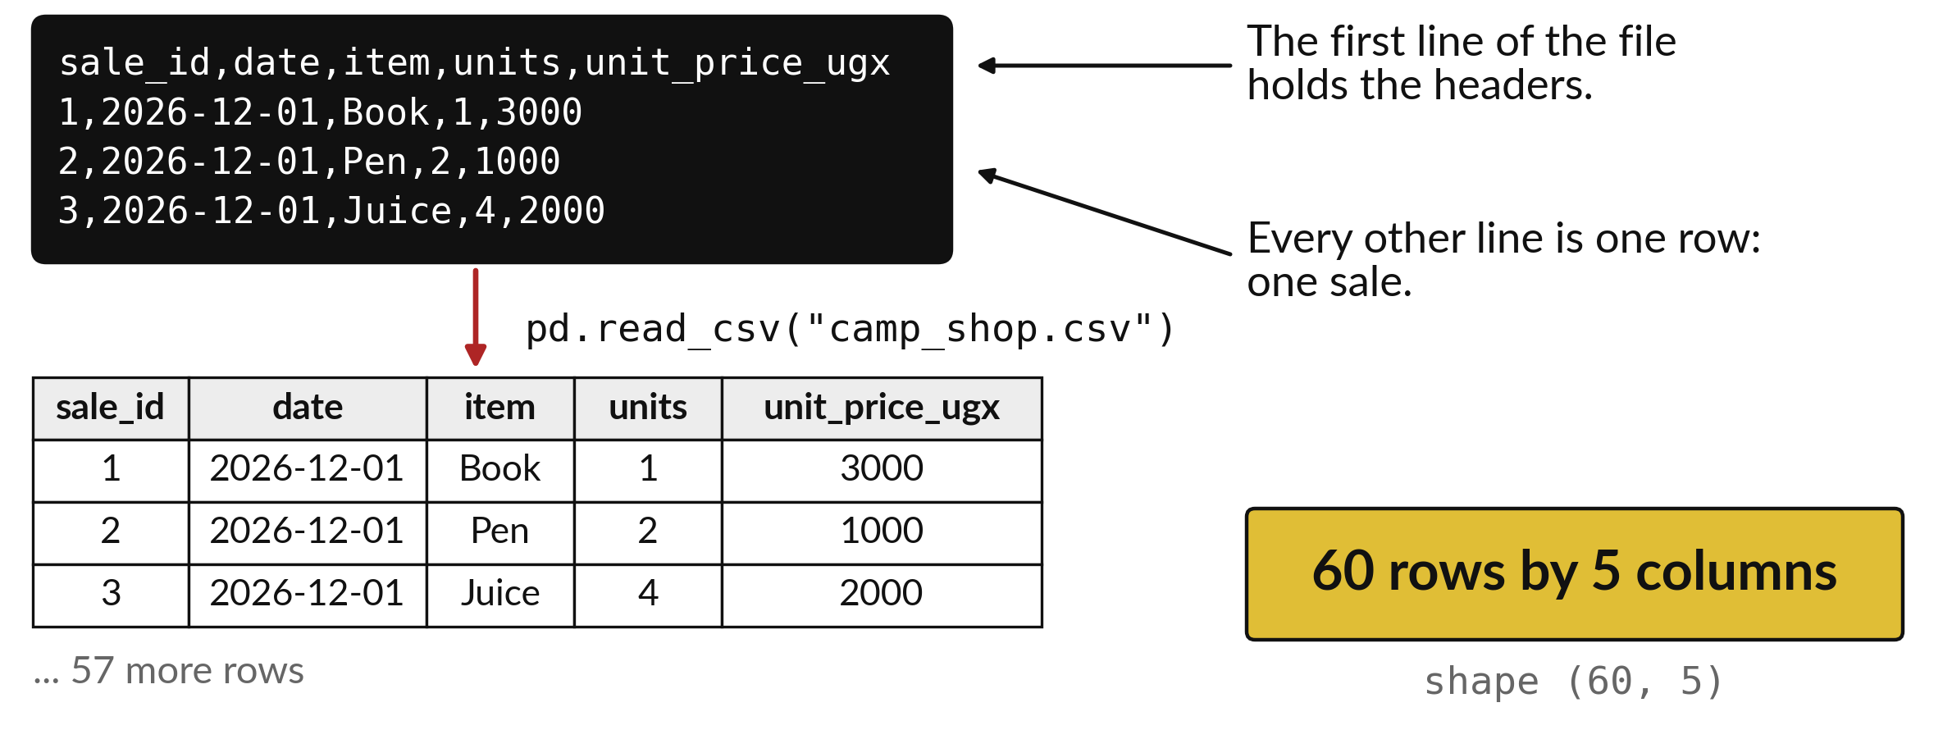
The file, the code and the
table show the same sales
Read the headers first, then the shape.
Notes:
Here is the whole path again. A text file holds the sales. One line of pandas reads it into a table. One more line reports the shape.
In the next session you will ask this table questions, starting with which item earns the most.

Slide 20

Make: your own version
Read synthetic_homes.csv. Show its first rows and its shape. Say what each row stands for and what unit rent_ugx is in.
Save it as ML07. Write two sentences: what you changed and how you checked it.
Notes:
Now you do the real work yourself. Start with the first step. If you get stuck for a few minutes, read your error message, check the error card, and then ask me.
Save it as ML07. I will come round to each of you and ask what you changed and how you checked it.

Slide 21

Two errors you may meet today
It means: The CSV file is not beside the notebook.
Fix: Move the file into the same folder as the notebook, or ask the instructor.
FileNotFoundError: No such file or directory
It means: The prepared camp environment is not active.
Fix: Tell the instructor. Do not install packages.
ModuleNotFoundError: No module named 'pandas'
Notes:
Two things are likely to go wrong today. It helps to know them before they happen.
This is the first one. You will see: FileNotFoundError: No such file or directory. It means this: the CSV file is not beside the notebook. To fix it, move the file into the same folder as the notebook, or ask the instructor.
The next one. You will see: ModuleNotFoundError: No module named 'pandas'. It means this: the prepared camp environment is not active. To fix it, tell the instructor. Do not install packages.
If you meet one of these, fix it and carry on. It happens to everyone.

Slide 22

Finish this sentence in your notebook
A CSV file becomes a table of rows and columns, and shape tells me how big it is.
Then save your notebook, close it and open it again to check it saved.
Notes:
Before we finish, go back to the question we began with: How many sales are in the practice shop file, and what does each one record?
Copy this sentence into your notebook and make it yours. A CSV file becomes a table of rows and columns, and shape tells me how big it is.
Then save your notebook, close it and open it again to check it saved.

