Slide 1
Mean, median, range and proportions
What is a typical number of units in a sale, and how spread out are the sales?
Machine Learning | Session 9 of 24 | Week 3, Tables and statistics
Holiday Data and AI Camp | The National ICT Innovation Hub, Nakawa
Notes:
Let us begin. Today is session 9 and our topic is mean, median, range and proportions.
By the end of today you will be able to calculate the mean, median, range and a proportion, and say which one an extreme value moves most.
We will answer one question: What is a typical number of units in a sale, and how spread out are the sales?

Slide 2
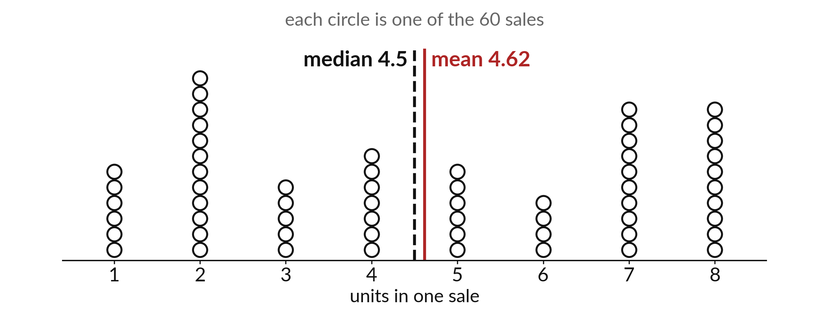
What is a typical number of units in a
sale, and how spread out are the sales?
Notes:
Every circle here is one sale, stacked on the number of units it had. You can see that two units is very common, and so are seven and eight. The dashed line is the median and the red line is the mean. They are almost the same here. Today we ask what a typical sale looks like and how spread out the sales are, and we learn when these two numbers stop agreeing.

Slide 3

Three hours, mostly doing
Most of our time is spent doing, in small steps, with a guess before every run.
Notes:
Here is how the 3 hours go. Each bar is as long as the time we spend on that part.
First, 10 minutes. Recall. Then, 50 minutes. Block A. After that, 15 minutes. Break away from screens. Next, 50 minutes. Block B. Then, 40 minutes. Make. Then, 15 minutes. Exit ticket, save, and an individual check with each learner.
Notice how much of the time is yours. You listen for a short while and then you do. That is on purpose, because you learn this by doing it.

Slide 4
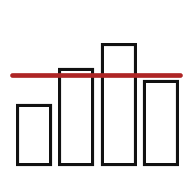
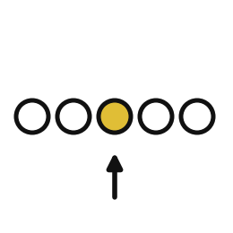
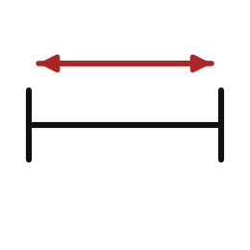
Words for today (1 of 2)
mean
The total shared out equally: add the values and divide by how many.
Sharing a bag of mandazi equally.
median
The middle value once the values are in order.
The pupil standing in the middle of a line sorted by height.
range
The largest value minus the smallest.
The gap between the tallest and the shortest.
Notes:
We need a few words today. For each one I will say what it means and give you something to picture.
mean. The total shared out equally: add the values and divide by how many. Here is a way to see it. Sharing a bag of mandazi equally.
median. The middle value once the values are in order. A small example. The pupil standing in the middle of a line sorted by height.
range. The largest value minus the smallest. Picture this. The gap between the tallest and the shortest.

Slide 5
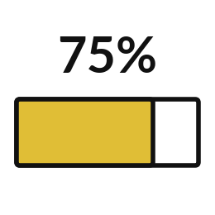
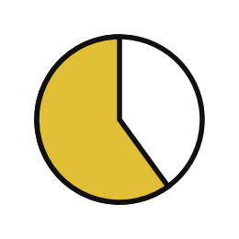

Words for today (2 of 2)
percentile
The value below which a given share of the data falls.
The mark that 75 out of 100 pupils did not beat.
proportion
A part divided by the whole; times 100 it becomes a percentage.
12 pupils out of 20 passed.
outlier
A value far from the rest.
One huge order in a week of small sales.
Notes:
More words for today.
percentile. The value below which a given share of the data falls. You have seen this before. The mark that 75 out of 100 pupils did not beat.
proportion. A part divided by the whole; times 100 it becomes a percentage. 12 pupils out of 20 passed.
outlier. A value far from the rest. Think of a shop. One huge order in a week of small sales.

Slide 6
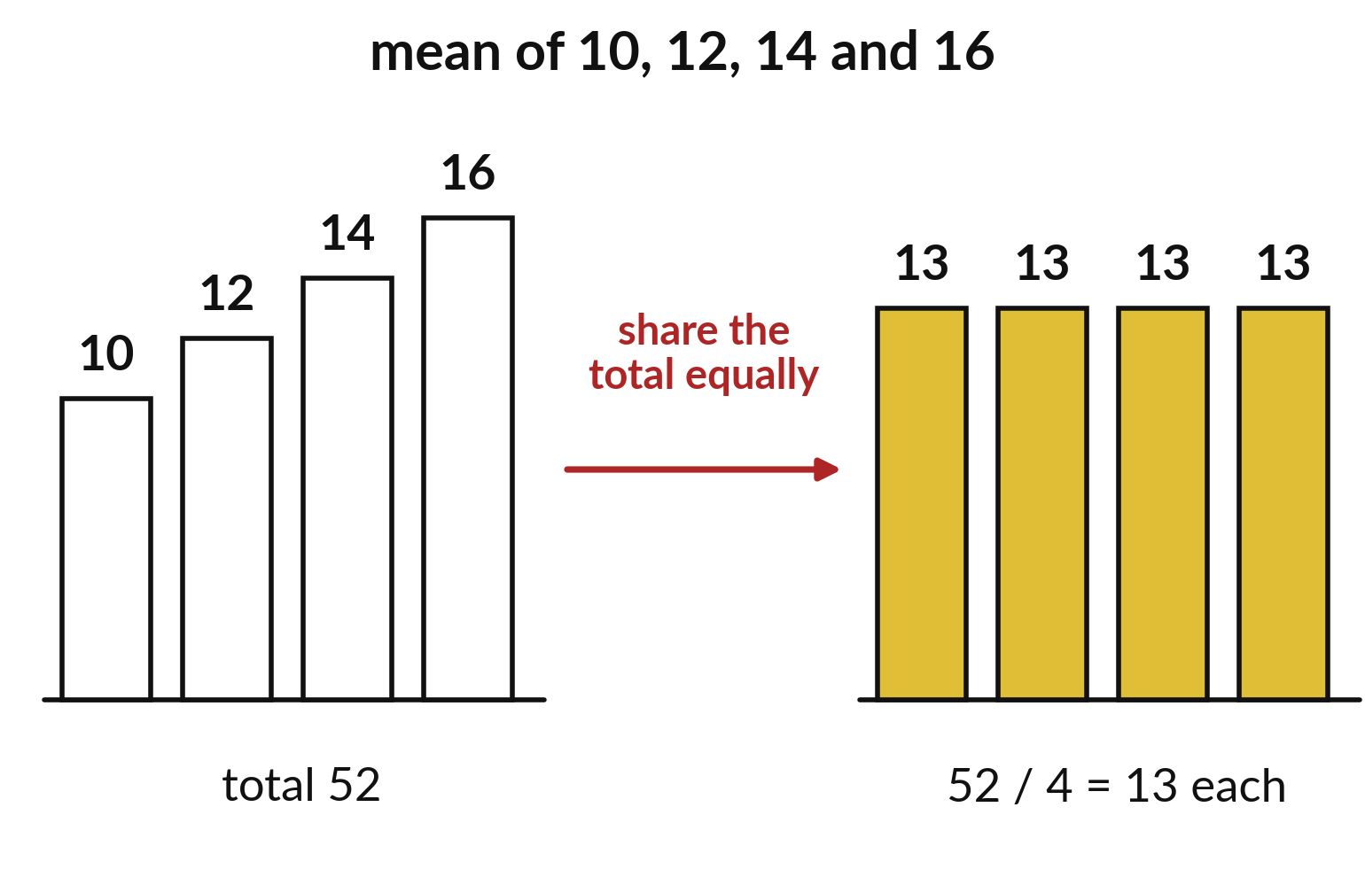
The mean shares the total out equally
Four piles of 10, 12, 14 and 16 add up to 52.
Share 52 among 4 piles and each gets 13.
The mean of all 60 sales is 4.62 units.
Notes:
The mean is the amount each sale would have if the units were shared out equally. Add every value, then divide by how many values there are.
In the picture, four piles hold 10, 12, 14 and 16. That is 52 altogether. Share the 52 equally among the four piles and each one holds 13. That 13 is the mean. For the sixty sales in the shop file the same sum gives four point six two units.

Slide 7
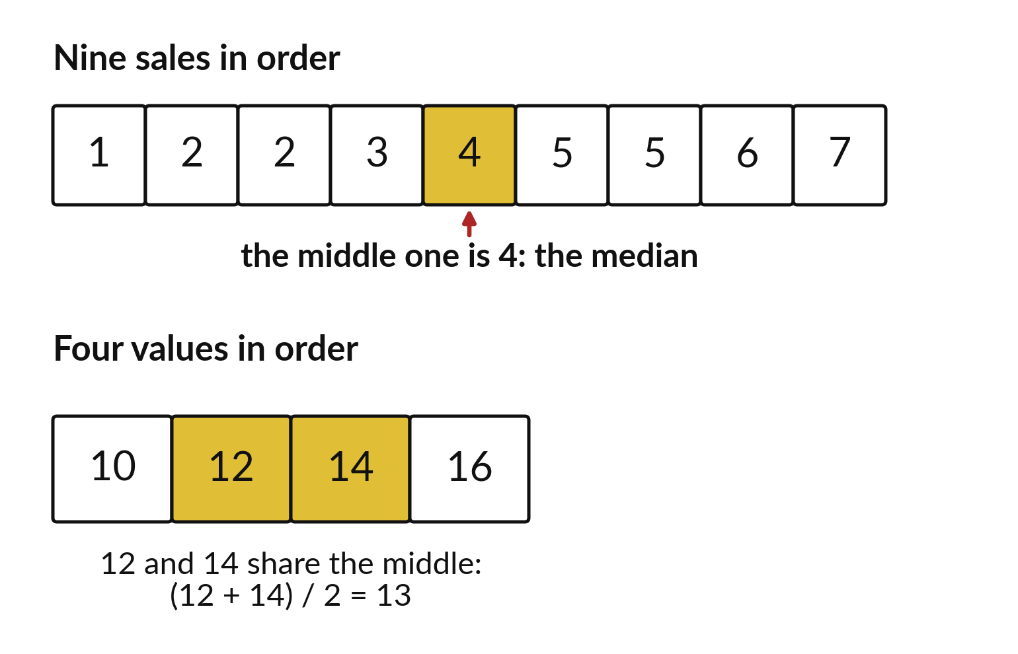
The median is the middle value after sorting
Put the values in order.
Pick the middle one.
With two middle values, take their midpoint.
Notes:
The median is found by sorting the values and taking the one in the middle. With nine values there is one middle value. With an even number there are two, so you take the point halfway between them.
Try it with these values on paper before you look at the answer.

Slide 8

Predict: Typical value and spread
import numpy as np
import pandas as pd
shop = pd.read_csv("camp_shop.csv")
units = shop["units"]
mean_units = units.mean()
median_units = np.median(units)
spread = units.max() - units.min()
p75 = np.percentile(units, 75)
print(mean_units, median_units, spread, p75)
Predict whether the mean or the median of the units column is larger.
Write your guess on paper before we run it.
Notes:
Look at how many units each sale has.
Make a prediction. Predict whether the mean or the median of the units column is larger. Put your guess on paper now, even if you are unsure.

Slide 9
Run it: Typical value and spread
4.616666666666666 4.5 7 7.0
The cell prints about 4.62, 4.5, 7 and 7.0.
The mean is the total of 277 divided by 60 sales.
The median 4.5 sits between the 30th and 31st values in order.
The range is 8 minus 1.
Notes:
Running it now. Match each line of the output with the line of code that made it.
The cell prints about 4.62, 4.5, 7 and 7.0. The mean is the total of 277 divided by 60 sales. The median 4.5 sits between the 30th and 31st values in order. The range is 8 minus 1. The 75th percentile 7 means three quarters of the sales have 7 units or fewer. NumPy is the library behind pandas for numbers, and np is its short name.
Keep your guess. We use it in the next step.

Slide 10

Investigate: Typical value and spread
1. Why is the median 4.5 and not a whole number?
2. What does the 75th percentile tell a shopkeeper?
Notes:
Now we look closely at typical value and spread. I have two questions for you.
Question one. Why is the median 4.5 and not a whole number? Think about it for a moment, then tell the person next to you.
Let me answer it. With 60 values the middle falls between two of them, so it is their average.
Question two. What does the 75th percentile tell a shopkeeper? Have a go in your head first.
The answer is this. Three quarters of the sales had 7 units or fewer. Only 10 of the 60 sales had 8, the most any sale had, so stock for 7 or 8 units at a time.

Slide 11

Modify: change one thing
Find the 25th percentile of units.
Then tell your neighbour what changed and how you know.
Notes:
Make one small change. Find the 25th percentile of units. Run it, then tell someone what you saw.
What you should find: 2.0.

Slide 12

Break
15 minutes away from your screen
Stand up. Drink some water. Tell someone what you guessed in the first half.
Notes:
Break time. 15 minutes away from your screens. Stand up, drink some water and tell someone what you guessed in the first half.
When we come back we start the second idea.

Slide 13
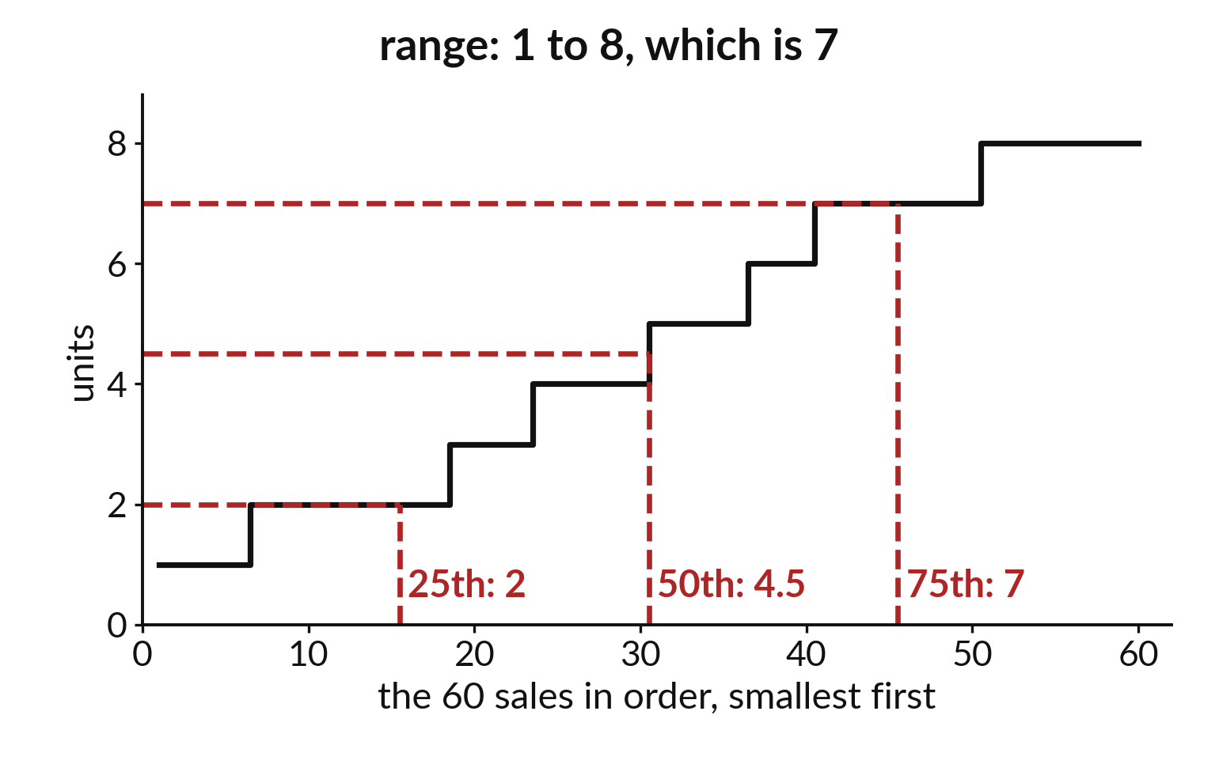
Sorting the sales shows the range and percentiles
The smallest sale has 1 unit and the largest has 8.
The range is 8 minus 1, which is 7.
The 75th percentile is 7 units.
Notes:
Line up the sixty sales from smallest to largest and the staircase shows the whole spread. The smallest sale had one unit. The largest had eight. The range is the difference, which is seven.
The red marks show percentiles. A quarter of the sales sit at 2 units or fewer, half at 4.5 or fewer, and three quarters at 7 or fewer. The range tells you how wide the data is. The percentiles tell you how the values are spread inside it.

Slide 14
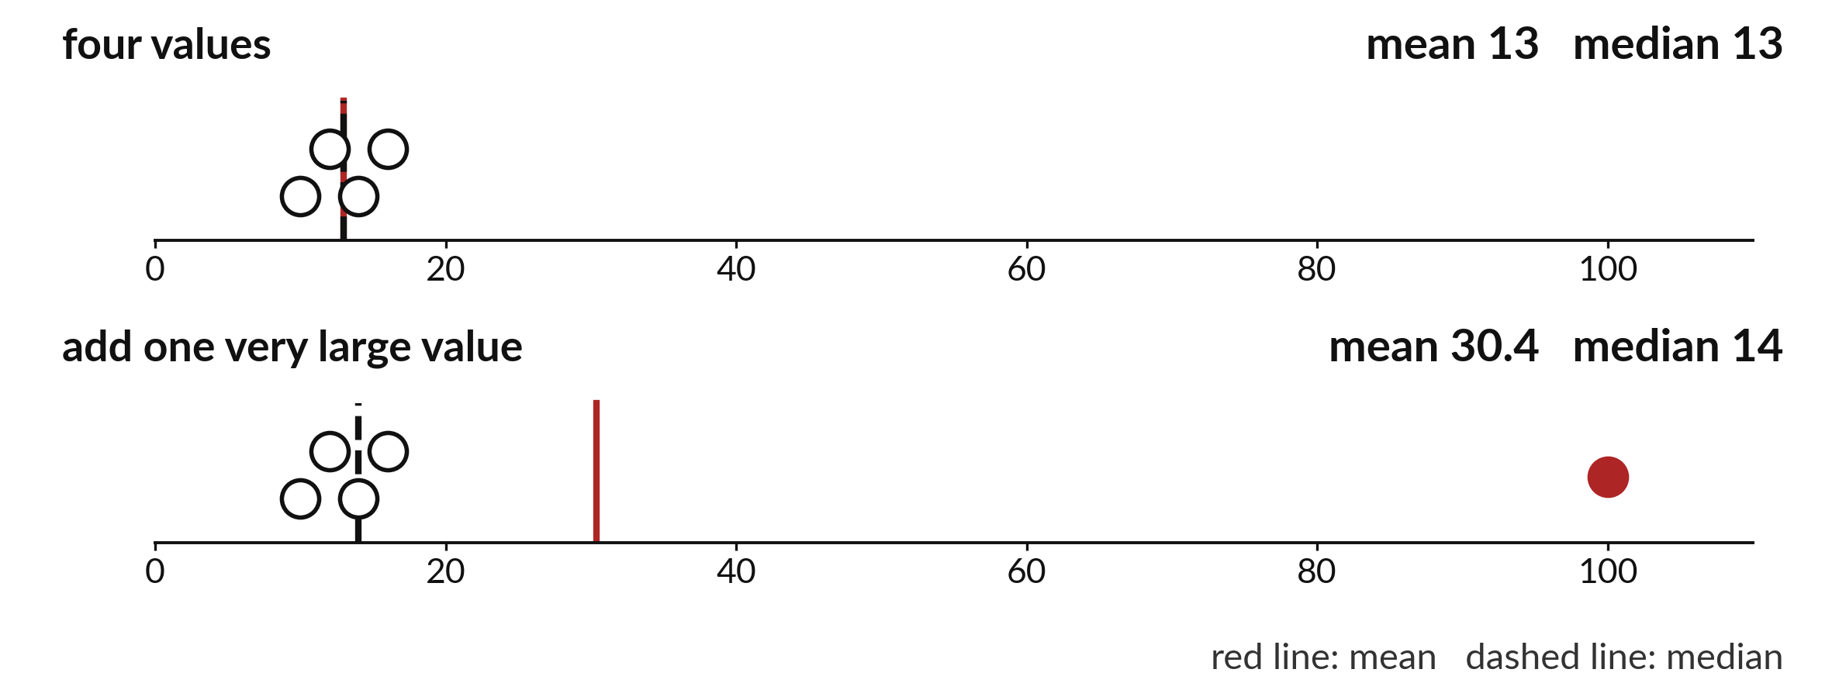
An outlier moves the mean
far more than the median
Add one very large value. The mean jumps from 13 to 30.4. The median moves from 13 to 14.
Notes:
An outlier is a value far away from the rest. Add one huge sale to a small list and watch what happens. The mean leaps from thirteen to thirty point four. The median only moves from thirteen to fourteen.
When a few extreme values are possible, which number would you quote as the typical one?

Slide 15
Predict: One extreme value and a proportion
small = pd.Series([10, 12, 14, 16])
bigger = pd.Series([10, 12, 14, 16, 100])
print(
small.mean(), small.median(), bigger.mean(),
bigger.median()
)
share_big = (units >= 5).sum() / len(units)
print(share_big, share_big * 100)
Predict which moves more when 100 joins the list: the mean or the median.
Write your guess on paper before we run it.
Notes:
Add one very large value to a small list and see what moves. Then count a proportion.
Time to commit to an answer. Predict which moves more when 100 joins the list: the mean or the median. Write one line on paper. I will give you a minute.

Slide 16
Run it: One extreme value and a proportion
13.0 13.0 30.4 14.0
0.5 50.0
The cell prints 13.0, 13.0, 30.4 and 14.0, then 0.5 and 50.0.
The outlier 100 pulls the mean from 13 to 30.4 and moves the median only to 14.
Notes:
Now we run it. Match each line of the output with the line of code that made it.
The cell prints 13.0, 13.0, 30.4 and 14.0, then 0.5 and 50.0. The outlier 100 pulls the mean from 13 to 30.4 and moves the median only to 14. Half of all sales have 5 units or more: 30 out of 60 is the proportion 0.5, which is 50%.
If your guess was off, find the line that surprised you.

Slide 17
Investigate: One extreme value and a proportion
1. Which summary should you quote when one huge sale sits in the data?
2. Why must you name the whole when you give a proportion?
Notes:
Now we look closely at one extreme value and a proportion. I have two questions for you.
Question one. Which summary should you quote when one huge sale sits in the data? Have a go in your head first.
The answer is this. The median, because it hardly moves. Also report the outlier.
Question two. Why must you name the whole when you give a proportion? Write your answer in one line before we compare.
30 out of 60 and 30 out of 300 are very different. The denominator tells what the share is a share of.

Slide 18
Modify: change one thing
Replace 100 with 1000 in bigger and print the mean and the median.
Then tell your neighbour what changed and how you know.
Notes:
Now it is your turn to change something. Replace 100 with 1000 in bigger and print the mean and the median. After you run it, say in one sentence what changed and how you checked.
You should see this. The mean becomes 210.4 and the median stays 14.0.

Slide 19
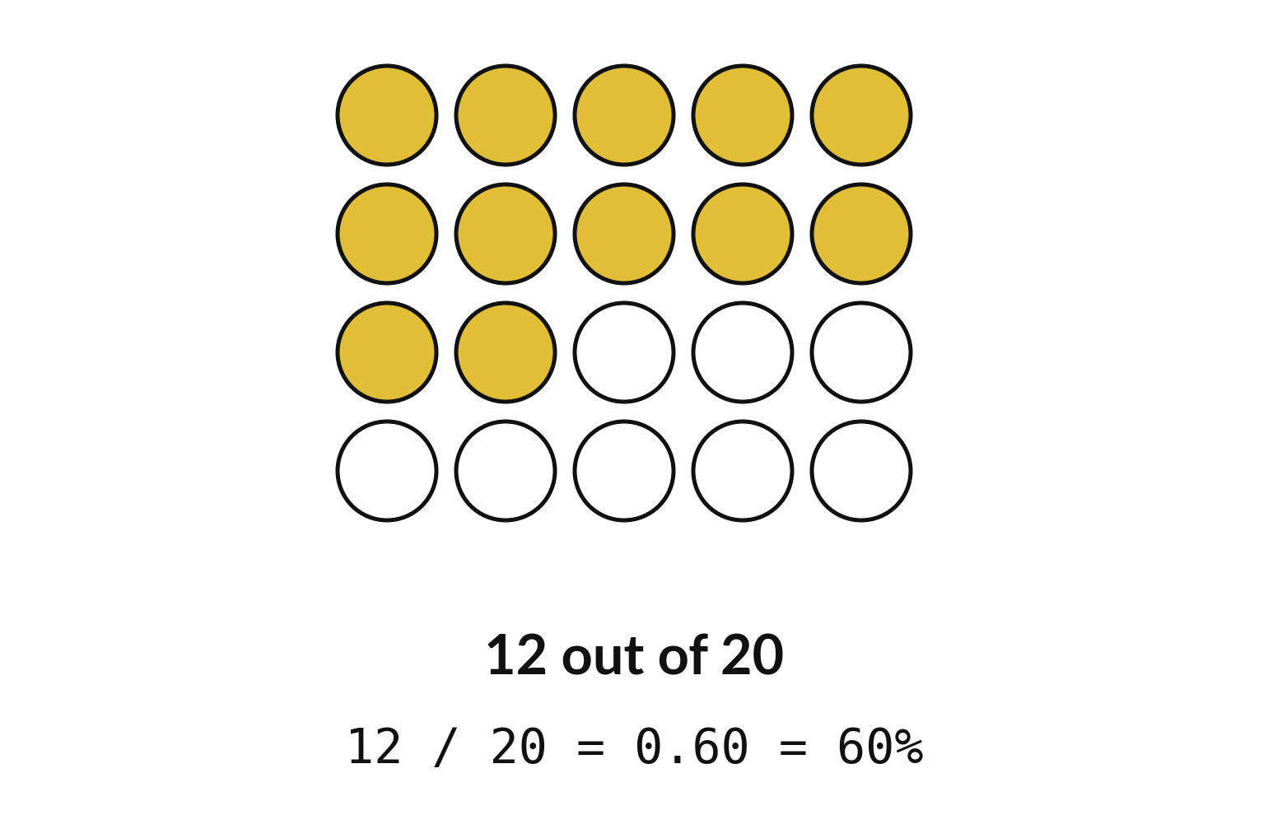
A proportion counts a part against the whole
12 gold counters out of 20.
12 divided by 20 is 0.6.
Times 100, that is 60 percent.
Notes:
A proportion is a part divided by the whole. Twelve of twenty counters are gold, so the proportion is twelve over twenty, which is zero point six. Multiply by a hundred and it becomes sixty percent.
Use the same idea on the shop data: what share of the sales had five units or more?

Slide 20

Make: your own version
Compare 12 successes out of 20 attempts with 15 out of 50. Calculate each percentage and explain why the larger count does not have to mean the better rate.
Save it as ML09. Write two sentences: what you changed and how you checked it.
Notes:
This is your own task for today. Take it one step at a time. If you get stuck for a few minutes, read your error message, check the error card, and then ask me.
Save it as ML09. I will come round to each of you and ask what you changed and how you checked it.

Slide 21

Two errors you may meet today
It means: numpy was not imported in this notebook session.
Fix: Run import numpy as np first.
NameError: name 'np' is not defined
It means: You divided the whole by the part.
Fix: Divide the part by the whole.
The proportion is above 1
Notes:
Everyone meets errors, including me. Two are likely today, so let us meet them now.
This is the first one. You will see: NameError: name 'np' is not defined. It means this: numpy was not imported in this notebook session. To fix it, Run import numpy as np first.
The next one. You will see: The proportion is above 1. It means this: you divided the whole by the part. To fix it, divide the part by the whole.
Keep this slide in mind when something stops working.

Slide 22

Finish this sentence in your notebook
The mean follows an extreme value, the median stays put, and a proportion needs its whole named.
Then save your notebook, close it and open it again to check it saved.
Notes:
We are nearly done. Remember the question from the start of the session: What is a typical number of units in a sale, and how spread out are the sales?
Write this sentence in your notebook and finish it your own way. The mean follows an extreme value, the median stays put, and a proportion needs its whole named.
Then save your notebook, close it and open it again to check it saved.

