Slide 1
Cleaning without hiding evidence
What is wrong with this table, and what did I change?
Machine Learning | Session 10 of 24 | Week 4, Clean, chart, question
Holiday Data and AI Camp | The National ICT Innovation Hub, Nakawa
Notes:
Welcome back. Today is session 10 and our topic is cleaning without hiding evidence.
By the end of today you will be able to count missing values and duplicates, remove an exact duplicate on a copy, and save a cleaning log.
We will answer one question: What is wrong with this table, and what did I change?

Slide 2
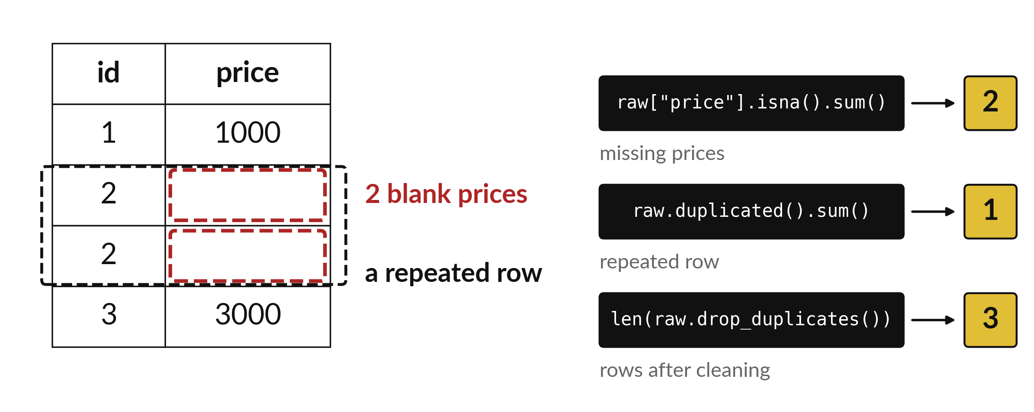
What is wrong with this
table, and what did I change?
Notes:
This is a tiny table with trouble in it. Two prices are blank, and the row for id two appears twice. On the right are three lines of code that count the problems for us. The first counts blank prices, the second counts repeated rows and the third counts the rows left after cleaning. Today you learn to find problems like these and to fix them without hiding what you did.

Slide 3

Three hours, mostly doing
Most of our time is spent doing, in small steps, with a guess before every run.
Notes:
Here is how the 3 hours go. Each bar is as long as the time we spend on that part.
First, 10 minutes. Recall. Then, 50 minutes. Block A. After that, 15 minutes. Break away from screens. Next, 50 minutes. Block B. Then, 40 minutes. Make. Then, 15 minutes. Exit ticket, save, and an individual check with each learner.
Notice how much of the time is yours. You listen for a short while and then you do. That is on purpose, because you learn this by doing it.

Slide 4



Words for today (1 of 2)
missing value
A cell with no recorded value. Its true value is unknown.
A blank in the price column.
duplicate
A row repeated exactly. It may be an accident or a real second sale.
The same receipt copied twice.
raw data
The file as you received it. Keep it unchanged.
The original receipt book.
Notes:
Here are the words for today. Listen for the picture that goes with each one.
missing value. A cell with no recorded value. Its true value is unknown. Here is a way to see it. A blank in the price column.
duplicate. A row repeated exactly. It may be an accident or a real second sale. A small example. The same receipt copied twice.
raw data. The file as you received it. Keep it unchanged. Picture this. The original receipt book.

Slide 5


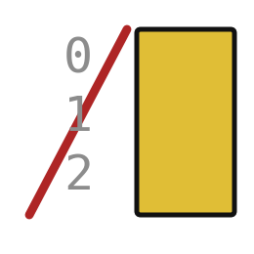
Words for today (2 of 2)
cleaning log
A list of every change made and why.
The marking notes beside a corrected exercise.
to_csv
Saves a table into a CSV file.
Copying the register to a new page.
index=False
Tells to_csv not to write the extra row-number column.
Not copying the page numbers.
Notes:
Two more words to know before we start.
cleaning log. A list of every change made and why. You have seen this before. The marking notes beside a corrected exercise.
to_csv. Saves a table into a CSV file. Copying the register to a new page.
index=False. Tells to_csv not to write the extra row-number column. Think of a shop. Not copying the page numbers.

Slide 6
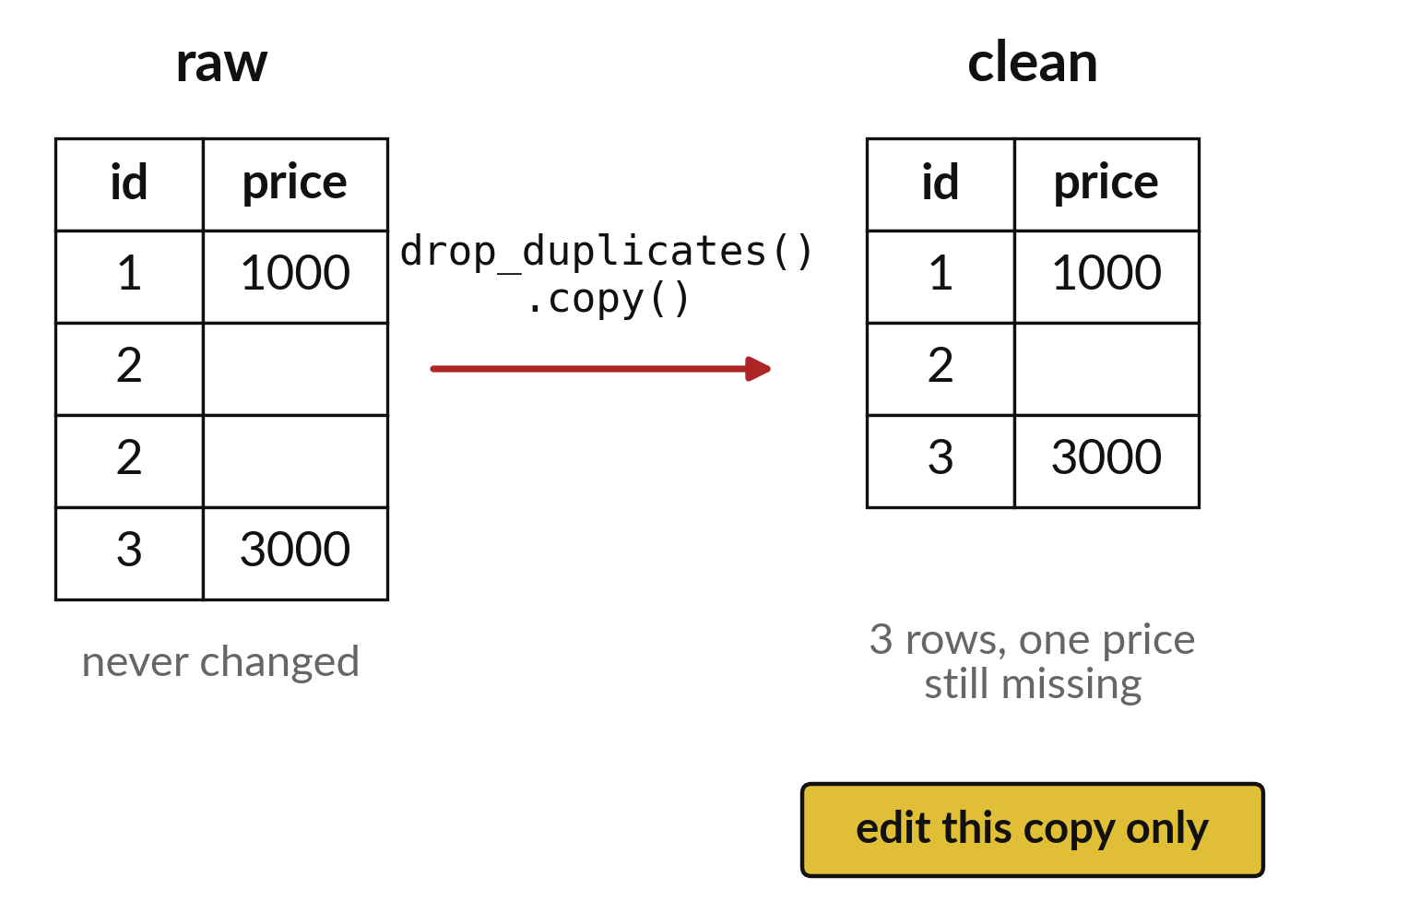
Keep the raw file untouched and clean a copy
Read the raw file once.
Work on a copy with a new name.
The raw file is your proof.
Notes:
Never change the original file. Read it, make a copy in your notebook, and clean the copy. If something goes wrong, the raw file is still there for you to start again.
Why do you think a scientist keeps the original measurements, even after tidying them?

Slide 7
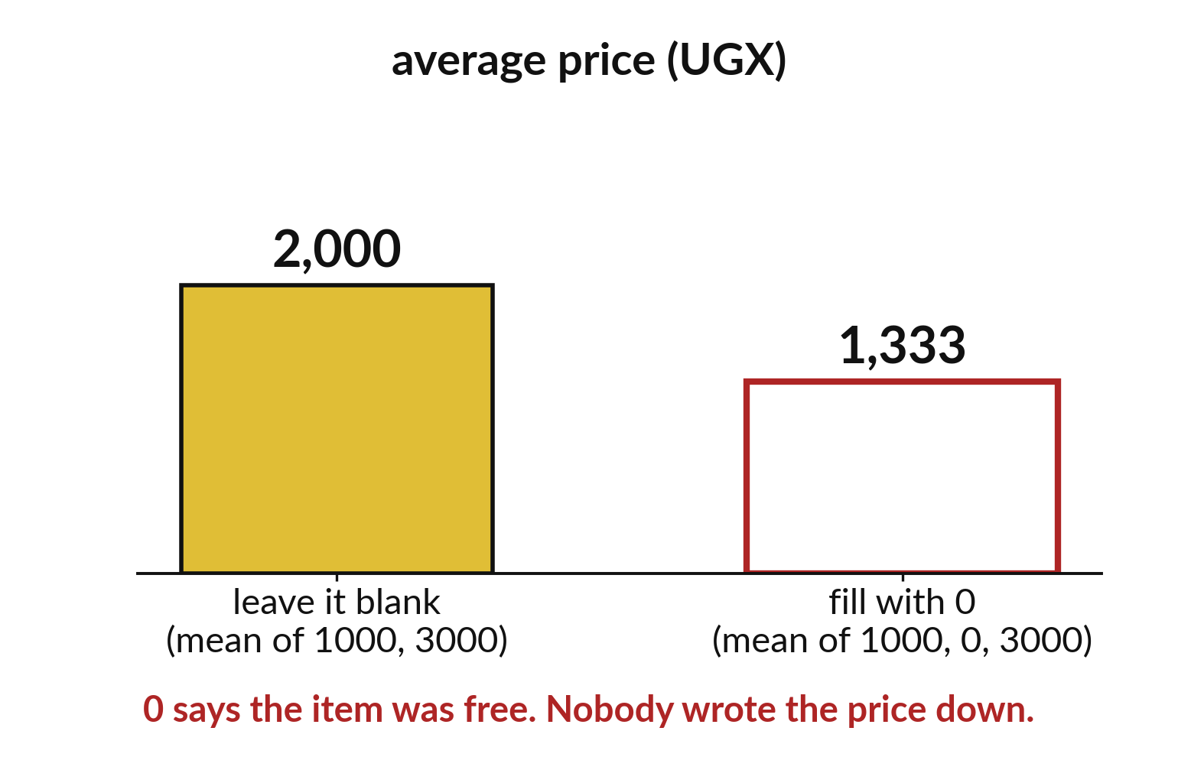
Filling a blank with zero changes the average
Zero says the item was free.
Nobody wrote the price down.
Leaving it blank keeps the mean honest.
Notes:
A missing value is a blank, which is different from a zero. If you replace the blank with zero, the table now says the item cost nothing, and the average price falls.
In the picture the average of the two real prices is two thousand. Fill the blank with zero and the average drops to one thousand three hundred and thirty three.

Slide 8

Predict: Count the problems
import pandas as pd
raw = pd.DataFrame(
{"id": [1, 2, 2, 3], "price": [1000, None, None, 3000]}
)
missing = raw["price"].isna().sum()
dupes = raw.duplicated().sum()
clean = raw.drop_duplicates().copy()
print(missing, dupes, len(clean))
print(clean["price"].mean())
Predict how many missing prices and how many duplicate rows the raw table has.
Write your guess on paper before we run it.
Notes:
A tiny table has two sets of trouble. Count them before you change anything.
Time to commit to an answer. Predict how many missing prices and how many duplicate rows the raw table has. Write it on paper. It does not have to be right.

Slide 9
Run it: Count the problems
2 1 3
2000.0
The cell prints 2, 1 and 3, then 2000.0.
isna marks each blank as True and sum counts them.
duplicated marks the repeated row and drop_duplicates removes it.
copy makes a separate table, so raw stays unchanged.
Notes:
Now we run it. Match each line of the output with the line of code that made it.
The cell prints 2, 1 and 3, then 2000.0. isna marks each blank as True and sum counts them. duplicated marks the repeated row and drop_duplicates removes it. copy makes a separate table, so raw stays unchanged. The mean of 2000.0 uses the two prices that exist and ignores the missing one.
If your guess was off, find the line that surprised you.

Slide 10

Investigate: Count the problems
1. Why do we work on a copy?
2. Why not replace the missing price with 0?
Notes:
Now we look closely at count the problems. I have two questions for you.
Question one. Why do we work on a copy? Give it thirty seconds and then we will hear a few answers.
The answer is this. The raw table is the evidence. If a change is wrong we can start again from it.
Question two. Why not replace the missing price with 0? Talk it over with your neighbour for a minute.
Zero means a free item. A missing price is unknown, and zero would pull the mean down.

Slide 11

Modify: change one thing
Print how many prices are still missing in clean.
Then tell your neighbour what changed and how you know.
Notes:
Now it is your turn to change something. Print how many prices are still missing in clean. Run it, then tell someone what you saw.
What you should find: One price is still missing.

Slide 12

Break
15 minutes away from your screen
Stand up. Drink some water. Tell someone what you guessed in the first half.
Notes:
Break time. 15 minutes away from your screens. Stand up, drink some water and tell someone what you guessed in the first half.
When we come back we start the second idea.

Slide 13
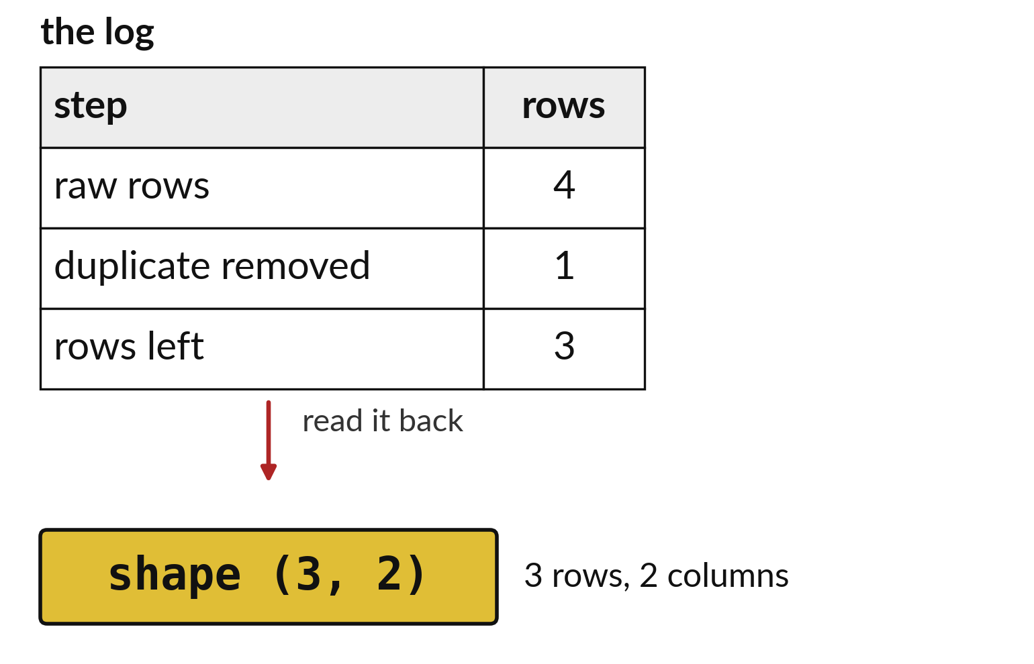
A cleaning log names each
change and its row count
One line per change.
Write how many rows changed.
A reader could repeat each step.
Notes:
The cleaning log is a short table. Each line says what you did, such as removed a duplicate, and how many rows it touched.
Someone reading your log should be able to repeat every step and reach the same table. That is what makes your work trustworthy.

Slide 14
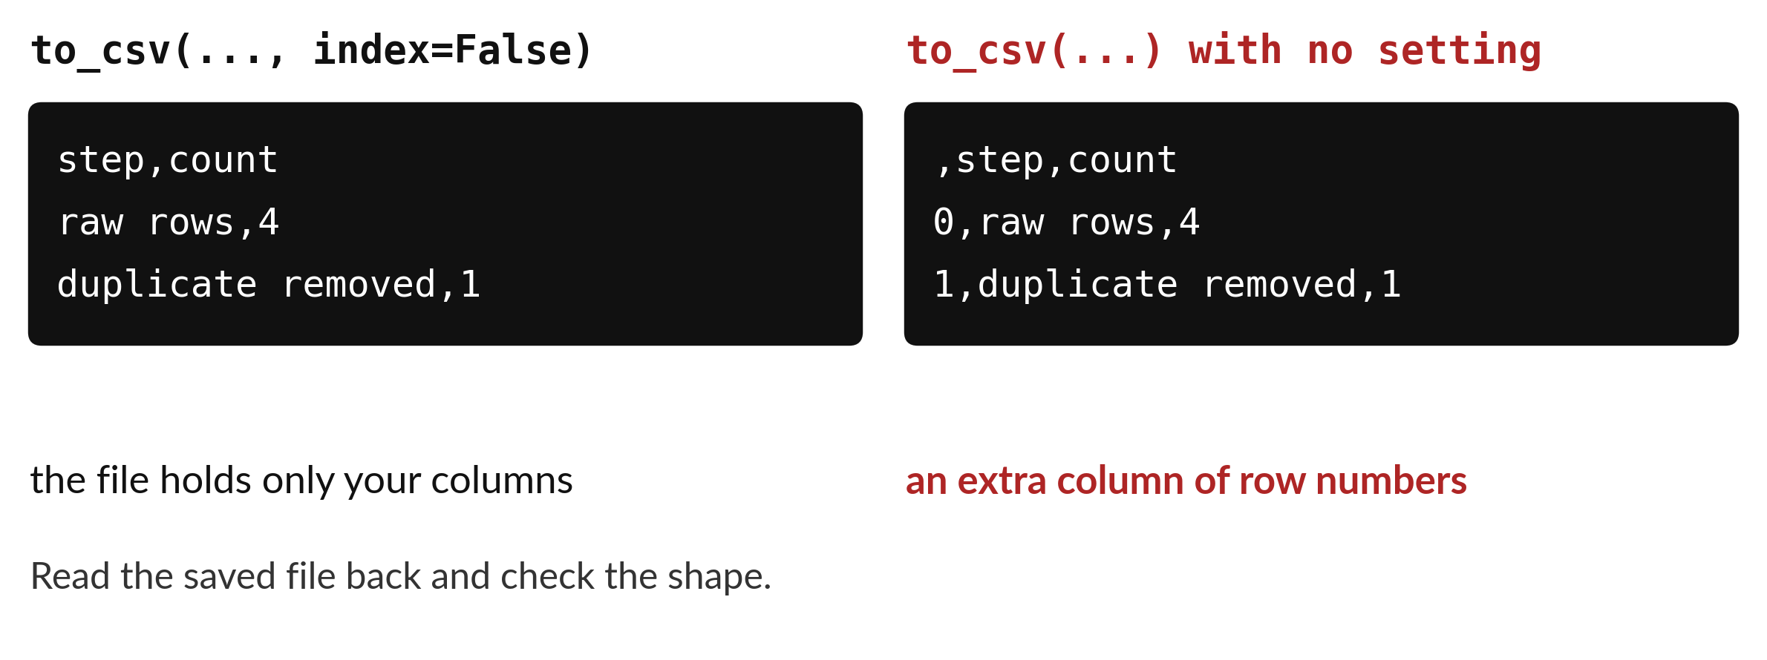
index=False keeps row
numbers out of the saved file
to_csv writes the table to a file. index=False leaves out the extra numbers. Read it back to check.
Notes:
To save the cleaned table, use to underscore csv. Without a small extra setting, Python adds a column of row numbers that nobody asked for. Writing index equals False leaves it out.
After saving, read the file back and look at the shape. If it matches, your save worked.

Slide 15

Predict: Save a cleaning log
log = pd.DataFrame(
{
"step": [
"raw rows", "duplicate removed",
"price still missing"
],
"count": [4, 1, 1]
}
)
log.to_csv("cleaning_log.csv", index=False)
log_back = pd.read_csv("cleaning_log.csv")
print(log_back)
print(log_back.shape)
Predict how many rows and columns the saved log has after you read it back.
Write your guess on paper before we run it.
Notes:
Let us read these lines together before anything runs.
Your turn to guess. Predict how many rows and columns the saved log has after you read it back. Put it on paper first. We will check it together in a moment.

Slide 16
Run it: Save a cleaning log
step count
0 raw rows 4
1 duplicate removed 1
2 price still missing 1
(3, 2)
The log has 3 rows and 2 columns.
to_csv writes the table into cleaning_log.csv.
index=False stops pandas adding a column of row numbers.
Reading the file back proves that it saved.
Notes:
I will run it, and you compare with your guess. Match each line of the output with the line of code that made it.
The log has 3 rows and 2 columns. to_csv writes the table into cleaning_log.csv. index=False stops pandas adding a column of row numbers. Reading the file back proves that it saved. The log lists the raw row count and each change, so a reader can repeat the cleaning.
Check your paper. Were you close?

Slide 17
Investigate: Save a cleaning log
1. What would the log look like with index=False left out?
2. Who is the cleaning log for?
Notes:
Now we look closely at save a cleaning log. I have two questions for you.
Question one. What would the log look like with index=False left out? Talk it over with your neighbour for a minute.
The file would carry an extra unnamed column of row numbers.
Question two. Who is the cleaning log for? Think about it for a moment, then tell the person next to you.
Here is how I would answer it. Anyone who needs to check or repeat your work, including you next week.

Slide 18
Modify: change one thing
Add the step final rows with a count of 3 and save again.
Then tell your neighbour what changed and how you know.
Notes:
Time to experiment. Add the step final rows with a count of 3 and save again. After you run it, say in one sentence what changed and how you checked.
You should see this. The log has 4 rows.

Slide 19

Make: your own version
Write a cleaning log for this table: four raw rows, one removed duplicate and one remaining missing price. Save it as my_log.csv and read it back. Explain why replacing the missing price with 0 would change its meaning.
Save it as ML10. Write two sentences: what you changed and how you checked it.
Notes:
Now you do the real work yourself. Start with the first step. If you get stuck for a few minutes, read your error message, check the error card, and then ask me.
Save it as ML10. I will come round to each of you and ask what you changed and how you checked it.

Slide 20

Two errors you may meet today
It means: to_csv did not run, or ran in another folder.
Fix: Run the to_csv line again and check the file list in Jupyter.
FileNotFoundError when reading the log back
It means: The column name has a different spelling in this table.
Fix: Print list(raw.columns) and copy the exact name.
KeyError: 'price'
Notes:
Two things are likely to go wrong today. It helps to know them before they happen.
This is the first one. You will see: FileNotFoundError when reading the log back. It means this: to_csv did not run, or ran in another folder. To fix it, Run the to_csv line again and check the file list in Jupyter.
The next one. You will see: KeyError: 'price'. It means this: the column name has a different spelling in this table. To fix it, print list(raw.columns) and copy the exact name.
If you meet one of these, fix it and carry on. It happens to everyone.

Slide 21

Finish this sentence in your notebook
Cleaning keeps the raw data safe, counts each problem, and writes down every change in a log.
Then save your notebook, close it and open it again to check it saved.
Notes:
Before we finish, go back to the question we began with: What is wrong with this table, and what did I change?
Copy this sentence into your notebook and make it yours. Cleaning keeps the raw data safe, counts each problem, and writes down every change in a log.
Then save your notebook, close it and open it again to check it saved.

