Slide 1
Checkpoint one and a project question
Can I take a table from a file to a labelled chart and a careful finding on my own?
Machine Learning | Session 12 of 24 | Week 4, Clean, chart, question
Holiday Data and AI Camp | The National ICT Innovation Hub, Nakawa
Notes:
Laptops open, please. Today is session 12 and our topic is checkpoint one and a project question.
By the end of today you will be able to load a table, check it, total it, chart it, write two findings and a limitation, and ask one prediction question a table could answer.
We will answer one question: Can I take a table from a file to a labelled chart and a careful finding on my own?

Slide 2
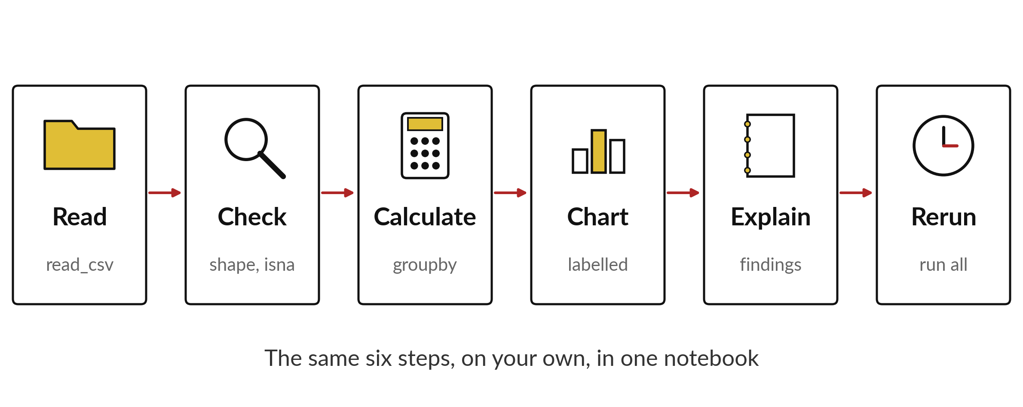
Can I take a table from a file to a labelled
chart and a careful finding on my own?
Notes:
Checkpoint one is these six steps, done on your own in one notebook. Read the file, check it, calculate something, draw a labelled chart, explain what you found, and rerun everything from the top. The notebook must work the same way for anyone who opens it. Today you also choose the question for your project.

Slide 3
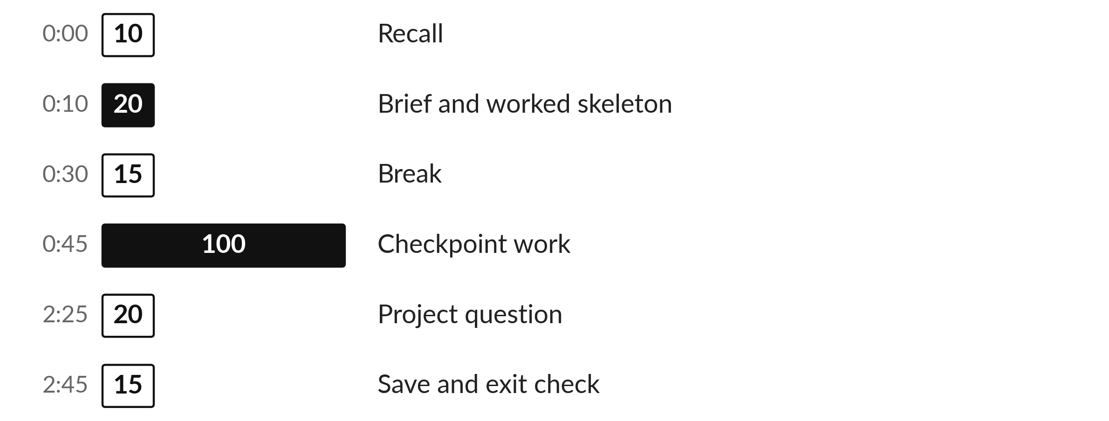
Three hours, mostly doing
Most of our time is spent doing, in small steps, with a guess before every run.
Notes:
Here is how the 3 hours go. Each bar is as long as the time we spend on that part.
First, 10 minutes. Recall. Then, 20 minutes. Brief and worked skeleton. After that, 15 minutes. Break. Next, 100 minutes. Checkpoint work. Then, 20 minutes. Project question. Then, 15 minutes. Save and exit check.
Notice how much of the time is yours. You listen for a short while and then you do. That is on purpose, because you learn this by doing it.

Slide 4



Words for today (1 of 2)
checkpoint
A piece of work that shows what you can do alone so far.
A mid-term test you can rerun.
reproducible
Someone can rerun your notebook from the top and get the same results.
A recipe anyone can follow.
data dictionary
A list of each column with its meaning and unit.
The key at the bottom of a map.
Notes:
We need a few words today. For each one I will say what it means and give you something to picture.
checkpoint. A piece of work that shows what you can do alone so far. Imagine it like this. A mid-term test you can rerun.
reproducible. Someone can rerun your notebook from the top and get the same results. An example from everyday life. A recipe anyone can follow.
data dictionary. A list of each column with its meaning and unit. Here is a way to see it. The key at the bottom of a map.

Slide 5

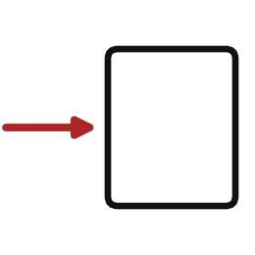
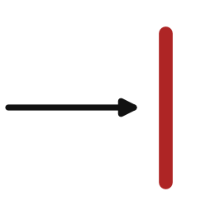
Words for today (2 of 2)
target
The value you want to predict, such as monthly rent.
The number you are guessing.
input
A measurement known before you predict the target.
The clues you are given.
limitation
What the data or method cannot tell you.
The edge of the map.
Notes:
More words for today.
target. The value you want to predict, such as monthly rent. A small example. The number you are guessing.
input. A measurement known before you predict the target. Picture this. The clues you are given.
limitation. What the data or method cannot tell you. You have seen this before. The edge of the map.

Slide 6
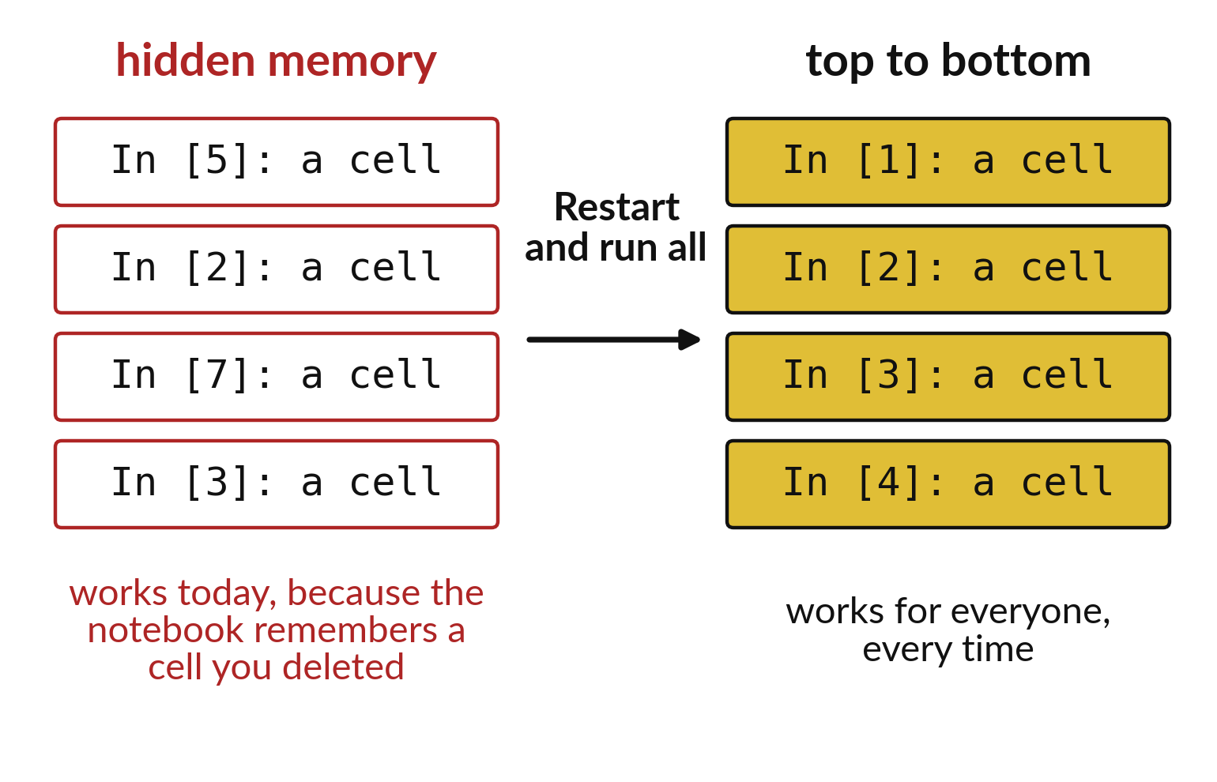
Restart and run all proves a notebook works
A notebook can remember cells you deleted.
Restart clears that memory.
Run all checks every cell in order.
Notes:
A notebook can seem fine because it remembers a cell you have since deleted. On another laptop it fails. Restart and run all clears the memory and runs every cell from the top, so it shows the truth.
Do this before you hand anything in. What do you expect to find?

Slide 7

Predict: The checkpoint skeleton (1 of 2)
import pandas as pd
import matplotlib.pyplot as plt
shop = pd.read_csv("camp_shop.csv")
missing = shop.isna().sum().sum()
shop["revenue_ugx"] = shop["units"] * shop["unit_price_ugx"]
by_item = shop.groupby("item")["revenue_ugx"].sum()
Read the first part of the code. 6 lines. Say what each one does.
The second part comes next.
Notes:
Read this first part of the code with me before we run anything. ['Run the skeleton, then repeat each step in your own notebook, ML12.ipynb, with your own wording.']

Slide 8
Predict: The checkpoint skeleton (2 of 2)
print(shop.shape[0], missing, by_item.sum())
assert by_item.sum() == shop["revenue_ugx"].sum()
plt.bar(by_item.index, by_item.values)
plt.ylabel("Revenue (UGX)")
plt.title("Revenue by item, practice shop")
plt.show()
Predict the row count, the total revenue and the best-selling item by revenue.
Write your guess on paper before we run it.
Notes:
Let us read these lines together before anything runs.
Your turn to guess. Predict the row count, the total revenue and the best-selling item by revenue. Put your guess on paper now, even if you are unsure.

Slide 9
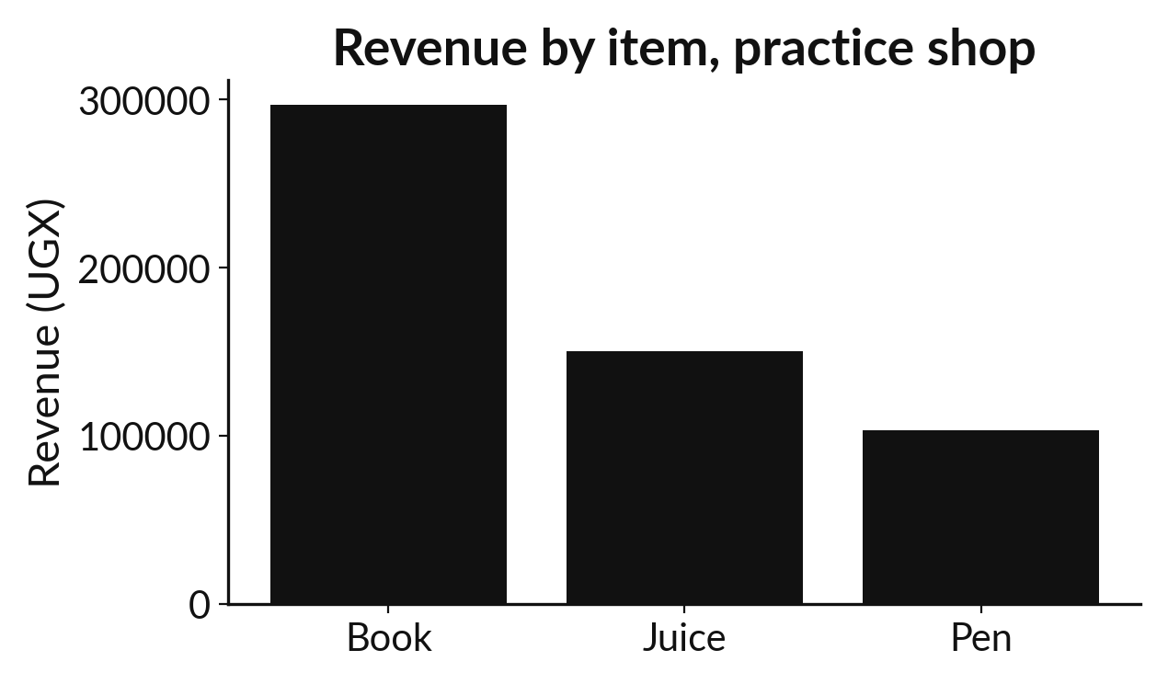
Run it: The checkpoint skeleton
The skeleton prints 60 rows, 0 missing cells and a total revenue of 550000.
The assert passes silently because the item totals add up to the overall total.
The chart shows Book as the tallest bar.
Notes:
I will run it, and you compare with your guess. Match each line of the output with the line of code that made it.
The skeleton prints 60 rows, 0 missing cells and a total revenue of 550000. The assert passes silently because the item totals add up to the overall total. The chart shows Book as the tallest bar. Your checkpoint needs the same steps with your own two findings, one limitation, a missing-value check and a clean rerun from a restarted kernel.
Check your paper. Were you close?

Slide 10

Investigate: The checkpoint skeleton
1. What does the passing assert prove?
2. Why record that there were no missing values?
Notes:
Now we look closely at the checkpoint skeleton. I have two questions for you.
Question one. What does the passing assert prove? Think about it for a moment, then tell the person next to you.
That the grouped totals and the overall total agree.
Question two. Why record that there were no missing values? Have a go in your head first.
Here is how I would answer it. A check that finds nothing is still evidence that you looked.

Slide 11

Modify: change one thing
Add a finding with a number and one limitation as text cells under the chart.
Then tell your neighbour what changed and how you know.
Notes:
Time to experiment. Add a finding with a number and one limitation as text cells under the chart. Then explain to your neighbour what the change did.
The result: For example: Book earns UGX 297000, about 54% of revenue. The data is invented and has no costs.

Slide 12

Break
15 minutes away from your screen
Stand up. Drink some water. Tell someone what you guessed in the first half.
Notes:
Break time. 15 minutes away from your screens. Stand up, drink some water and tell someone what you guessed in the first half.
When we come back we start the second idea.

Slide 13
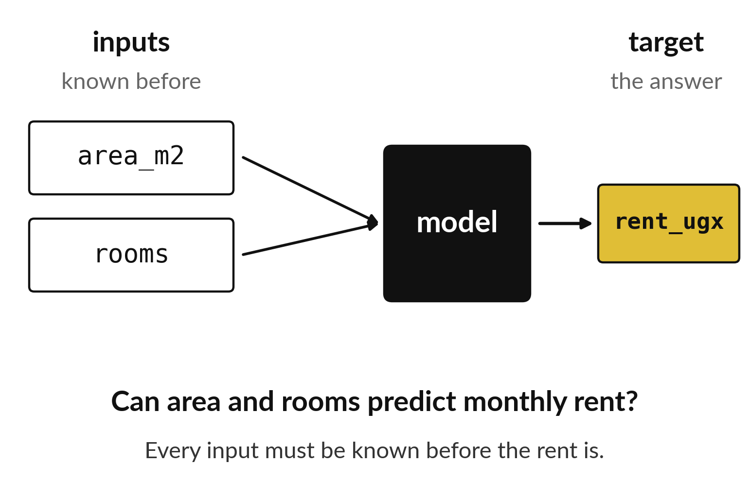
A project question names
an input, a target and a test
The target is the answer you want.
Inputs must be known before the answer.
The question ends with a mark.
Notes:
A good project question says what you will predict and from what. Can area and rooms predict monthly rent? The rent is the target. Area and rooms are the inputs. Every input has to be known before the rent is.
Write your own question in this shape before the end of the session.

Slide 14
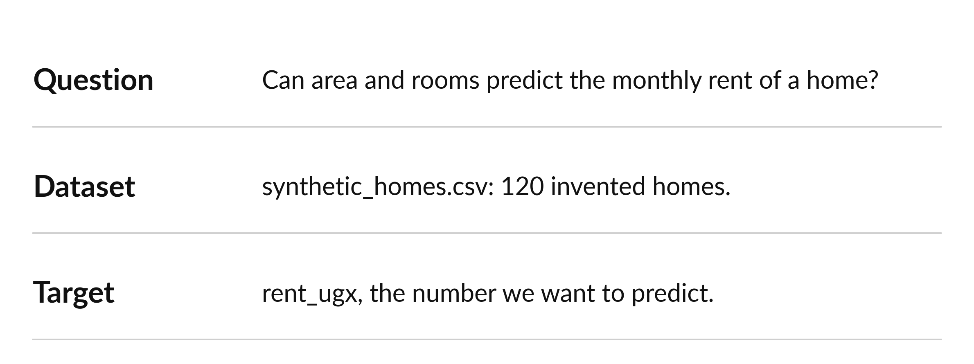
Three sentences set up a project
Sentence one is the question. Sentence two names the data. Sentence three names the target.
Notes:
Your project starts with three short sentences. The question, the data you will use, and the target. If you can write these clearly, you are ready to start.
Read your three sentences to a neighbour. Can they say back what you will predict?

Slide 15
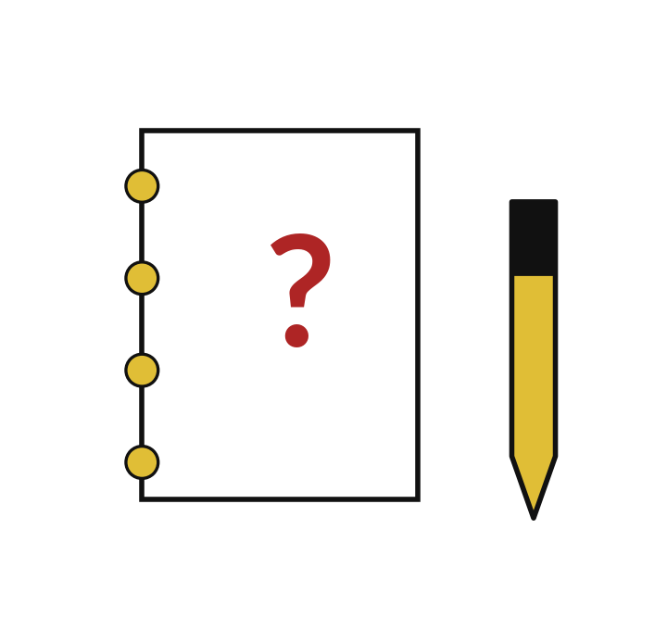
Predict: Write your project question
Before you look at the datasets again, write the question you would most like a model to answer.
Write your guess on paper before we run it.
Notes:
In the last 20 minutes choose a table and write three sentences: the question, the dataset and the target. Model building starts next week.
Now your guess. Before you look at the datasets again, write the question you would most like a model to answer. Write one line on paper. I will give you a minute.

Slide 16

Run it: Write your project question
Your three sentences name a question a table can answer, one supplied dataset (synthetic_homes.csv, synthetic_fares.csv or the iris flowers), and the target to predict.
Inputs must be known before the target is.
Good: predict monthly rent from area and rooms.
Weak: explain why rents are high.
Notes:
Watch the output as it appears. Match each line of the output with the line of code that made it.
Your three sentences name a question a table can answer, one supplied dataset (synthetic_homes.csv, synthetic_fares.csv or the iris flowers), and the target to predict. Inputs must be known before the target is. Good: predict monthly rent from area and rooms. Weak: explain why rents are high.
Tell the person next to you whether your guess matched.

Slide 17

Investigate: Write your project question
1. Which column is the target in synthetic_fares.csv?
2. Why does a prediction question need inputs known beforehand?
Notes:
Now we look closely at write your project question. I have two questions for you.
Question one. Which column is the target in synthetic_fares.csv? Have a go in your head first.
Here is how I would answer it. fare_ugx, the price of the trip.
Question two. Why does a prediction question need inputs known beforehand? Write your answer in one line before we compare.
What I would say is this. A model cannot use information that only exists after the answer.

Slide 18

Modify: change one thing
Rewrite a question that asks why into one that asks for a prediction.
Then tell your neighbour what changed and how you know.
Notes:
Your hands on the keyboard now. Rewrite a question that asks why into one that asks for a prediction. When you have run it, tell your neighbour what changed and how you know.
Here is what happens. Why are rents high becomes: can area and rooms predict monthly rent?

Slide 19
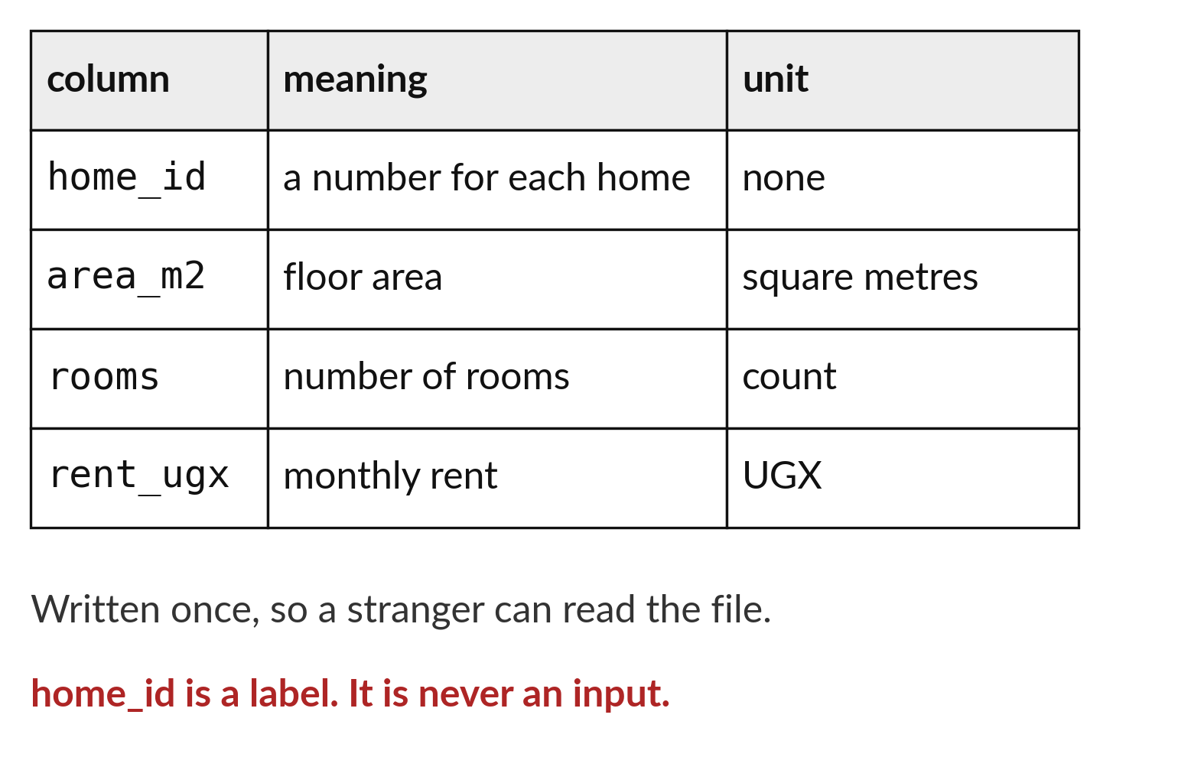
A data dictionary lets a stranger read your file
One line for each column.
Say what each column means.
Mark which column is a label only.
Notes:
A data dictionary is a short list that explains every column. It means someone who has never seen the file can still read it. Note that home underscore id is only a label, so it is never used as an input.
Write the dictionary once, and it saves everybody time later.

Slide 20

Make: your own version
In ML12.ipynb report the row count, the revenue by item, one chart, two findings and one limitation, and record your missing-value check. Run all cells from a restarted kernel and save. Add your three-sentence project question.
Save it as ML12. Write two sentences: what you changed and how you checked it.
Notes:
This is your own task for today. Take it one step at a time. If you get stuck for a few minutes, read your error message, check the error card, and then ask me.
Save it as ML12. I will come round to each of you and ask what you changed and how you checked it.

Slide 21

Two errors you may meet today
It means: A later cell uses a name that an earlier cell created and you deleted.
Fix: Restart the kernel and run all cells from the top to find the missing step.
The notebook works only until I restart it
It means: A filter or a typo dropped rows before grouping.
Fix: Compare the row counts before and after each step.
The totals do not agree
Notes:
Everyone meets errors, including me. Two are likely today, so let us meet them now.
This is the first one. You will see: The notebook works only until I restart it. It means this: A later cell uses a name that an earlier cell created and you deleted. To fix it, restart the kernel and run all cells from the top to find the missing step.
The next one. You will see: The totals do not agree. It means this: A filter or a typo dropped rows before grouping. To fix it, compare the row counts before and after each step.
Keep this slide in mind when something stops working.

Slide 22

Finish this sentence in your notebook
A checkpoint is a table taken from file to chart to careful finding that anyone can rerun.
Then save your notebook, close it and open it again to check it saved.
Notes:
We are nearly done. Remember the question from the start of the session: Can I take a table from a file to a labelled chart and a careful finding on my own?
Write this sentence in your notebook and finish it your own way. A checkpoint is a table taken from file to chart to careful finding that anyone can rerun.
Then save your notebook, close it and open it again to check it saved.

