Slide 1
Features, targets and an honest baseline
What did the session 1 model learn from, and how well would a plain guess do?
Machine Learning | Session 13 of 24 | Week 5, Baselines and a line
Holiday Data and AI Camp | The National ICT Innovation Hub, Nakawa
Notes:
Let us begin. Today is session 13 and our topic is features, targets and an honest baseline.
By the end of today you will be able to name the features and the target in a table, and calculate a baseline error that any model must beat.
We will answer one question: What did the session 1 model learn from, and how well would a plain guess do?

Slide 2
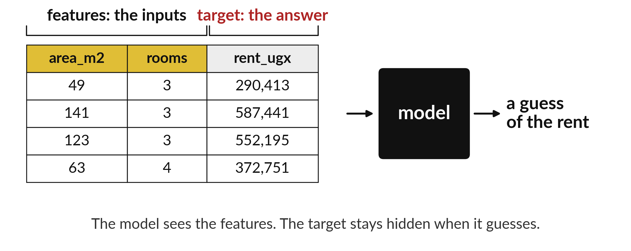
What did the session 1 model learn from,
and how well would a plain guess do?
Notes:
Look at the table. The first two columns, area and rooms, are the features. They are what the model is allowed to see. The last column, the rent, is the target. It is the answer we want. The model sees the features and guesses the rent. Today we ask what the session one model learned from, and how well a plain guess would have done without any model at all.

Slide 3

Three hours, mostly doing
Most of our time is spent doing, in small steps, with a guess before every run.
Notes:
Here is how the 3 hours go. Each bar is as long as the time we spend on that part.
First, 10 minutes. Recall. Then, 50 minutes. Block A. After that, 15 minutes. Break away from screens. Next, 50 minutes. Block B. Then, 40 minutes. Make. Then, 15 minutes. Exit ticket, save, and an individual check with each learner.
Notice how much of the time is yours. You listen for a short while and then you do. That is on purpose, because you learn this by doing it.

Slide 4
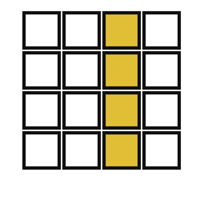
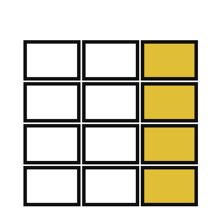
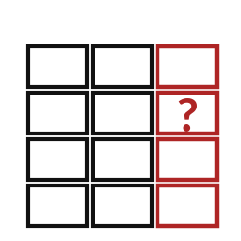
Words for today (1 of 2)
feature
An input known before you predict.
The clues in a puzzle.
training data
The examples the model learns from.
The worked examples in a textbook.
test data
Examples held back to check the model on things it has not seen.
The exam paper.
Notes:
Here are the words for today. Listen for the picture that goes with each one.
feature. An input known before you predict. A small example. The clues in a puzzle.
training data. The examples the model learns from. Picture this. The worked examples in a textbook.
test data. Examples held back to check the model on things it has not seen. You have seen this before. The exam paper.

Slide 5

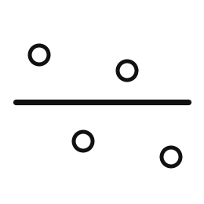
Words for today (2 of 2)
leakage
Using information that would not be known at prediction time.
Seeing the exam answers before the exam.
baseline
A simple guess a model must beat, such as the training mean.
Guessing that every home costs the average rent.
Notes:
Two more words to know before we start.
leakage. Using information that would not be known at prediction time. Seeing the exam answers before the exam.
baseline. A simple guess a model must beat, such as the training mean. Think of a shop. Guessing that every home costs the average rent.

Slide 6
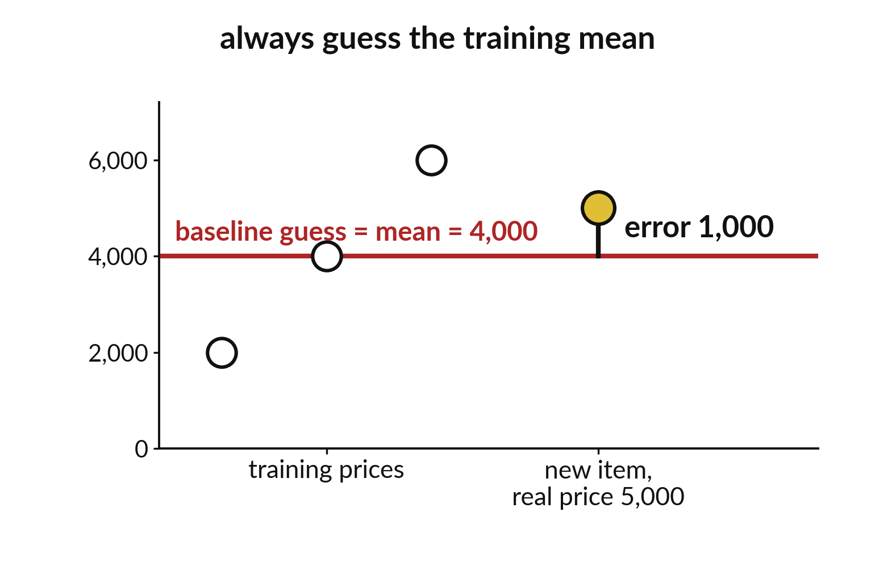
A baseline is the plain guess
every model must beat
Always guess the mean of the training rents.
No model is used.
Beat this or the model adds nothing.
Notes:
Before we trust a model, we try the laziest guess possible. Guess the same number for every home, the average rent of the training homes. That is the baseline.
If a model cannot do better than this plain guess, it has learned nothing useful. How wrong do you expect the plain guess to be?

Slide 7
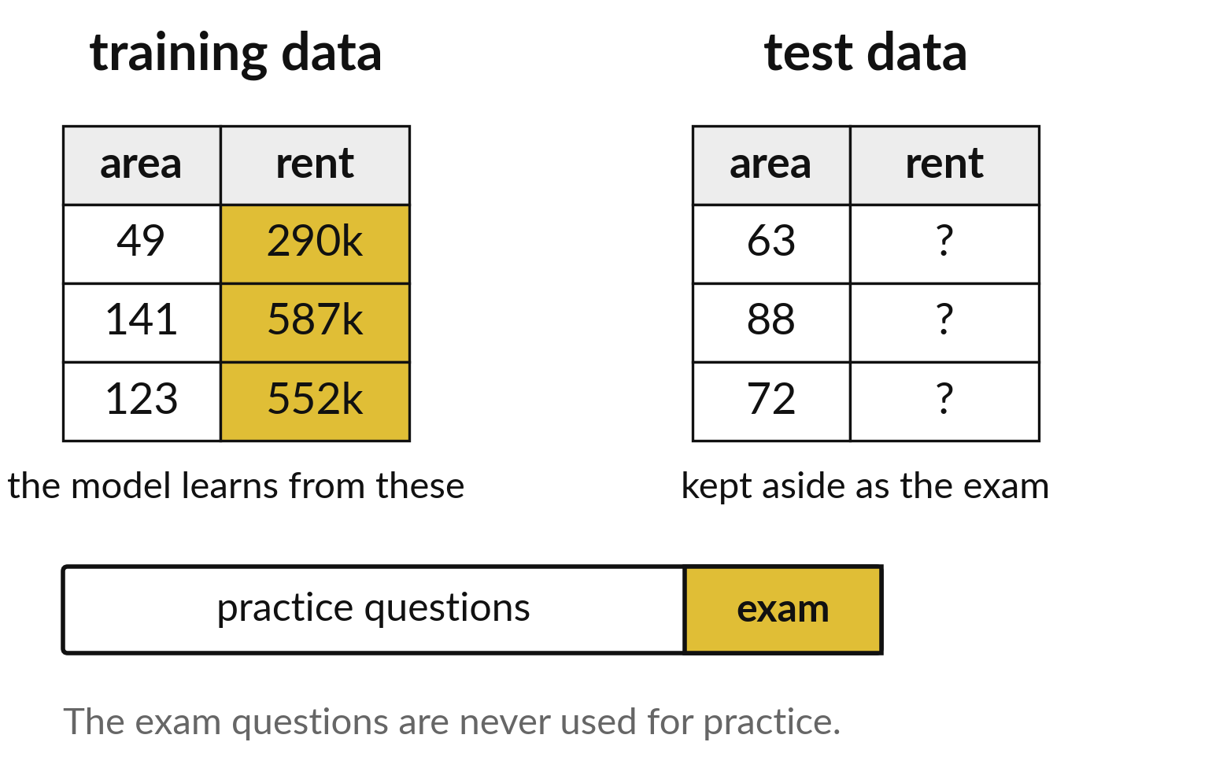
Practice and exam questions must be different
Training data is the practice.
Test data is the exam.
A model must never practise on the exam.
Notes:
A student who has seen the exam questions in advance scores well and proves nothing. A model is the same. It learns from the training data. We check it on test data it has never seen.
Why would a perfect score on the practice questions not tell us much?

Slide 8

Predict: The baseline guess
train_prices = [2000, 4000, 6000]
baseline = sum(train_prices) / len(train_prices)
actual = 5000
error = abs(actual - baseline)
print(baseline, error)
Training prices are 2000, 4000 and 6000. Predict the baseline guess and its error when the real price is 5000.
Write your guess on paper before we run it.
Notes:
A baseline uses no features at all. It guesses the average of the training targets every time.
Make a prediction. Training prices are 2000, 4000 and 6000. Predict the baseline guess and its error when the real price is 5000. Write one line on paper. I will give you a minute.

Slide 9
Run it: The baseline guess
4000.0 1000.0
The cell prints 4000.0 and 1000.0.
The training mean 4000.0 is the baseline guess.
abs removes the minus sign, so the error is the distance between the guess and the real value, 1000 shillings.
Notes:
Running it now. Match each line of the output with the line of code that made it.
The cell prints 4000.0 and 1000.0. The training mean 4000.0 is the baseline guess. abs removes the minus sign, so the error is the distance between the guess and the real value, 1000 shillings. A model is worth using only if its errors on unseen examples are smaller than the baseline's.
Keep your guess. We use it in the next step.

Slide 10

Investigate: The baseline guess
1. Why must the baseline use only training prices?
2. What would the baseline guess be for every new price?
Notes:
Now we look closely at the baseline guess. I have two questions for you.
Question one. Why must the baseline use only training prices? Have a go in your head first.
Let me answer it. Test prices are answers the model has not seen. Using them would be a form of leakage.
Question two. What would the baseline guess be for every new price? Write your answer in one line before we compare.
The answer is this. 4000.0, the same number each time.

Slide 11

Modify: change one thing
Change the actual price to 3000 and recalculate the error.
Then tell your neighbour what changed and how you know.
Notes:
Make one small change. Change the actual price to 3000 and recalculate the error. After you run it, say in one sentence what changed and how you checked.
You should see this. The error is 1000.0 again, because 3000 is also 1000 below 4000.

Slide 12

Break
15 minutes away from your screen
Stand up. Drink some water. Tell someone what you guessed in the first half.
Notes:
Break time. 15 minutes away from your screens. Stand up, drink some water and tell someone what you guessed in the first half.
When we come back we start the second idea.

Slide 13
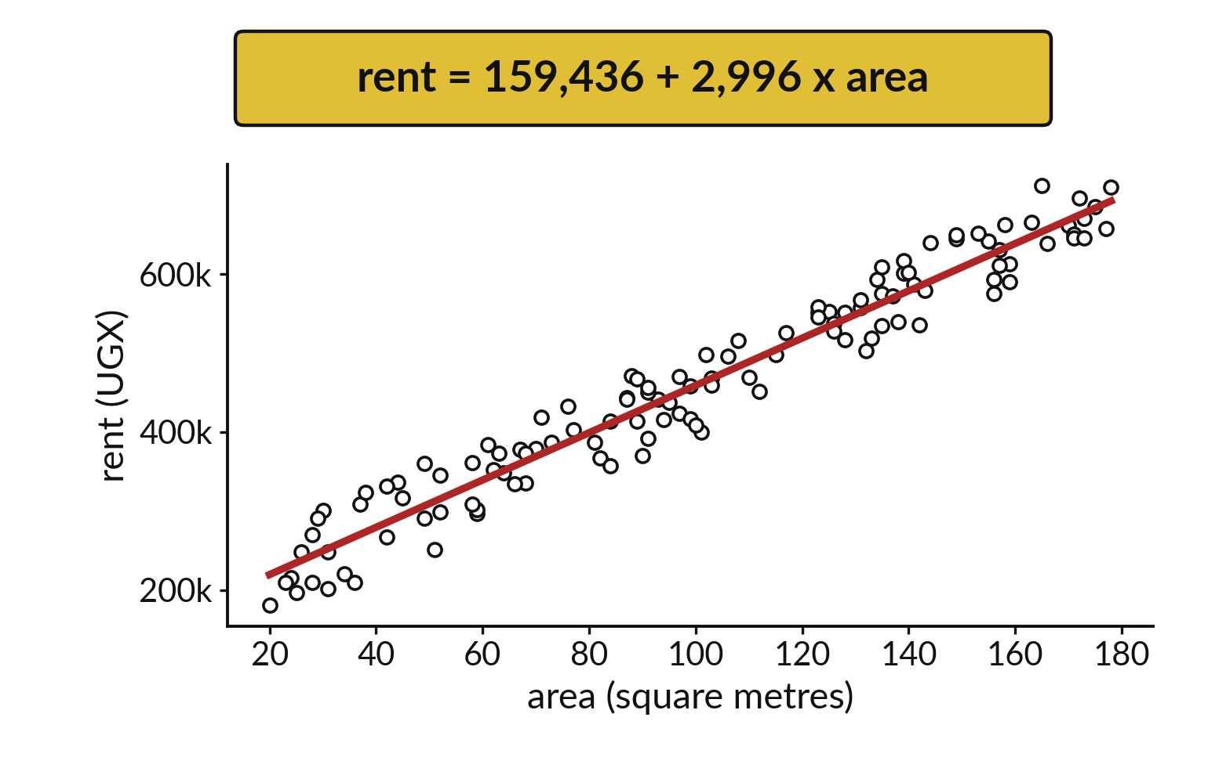
The learned line rises as the area grows
Each dot is one home.
The line is what the model learned.
It is a rule that stands in for the list of homes.
Notes:
Open the session one model and look inside. It is a line through the homes. Give it an area and it reads off a rent. It keeps a rule instead of a list of the homes it saw.
Point to where a fifty square metre home would land on the line.

Slide 14
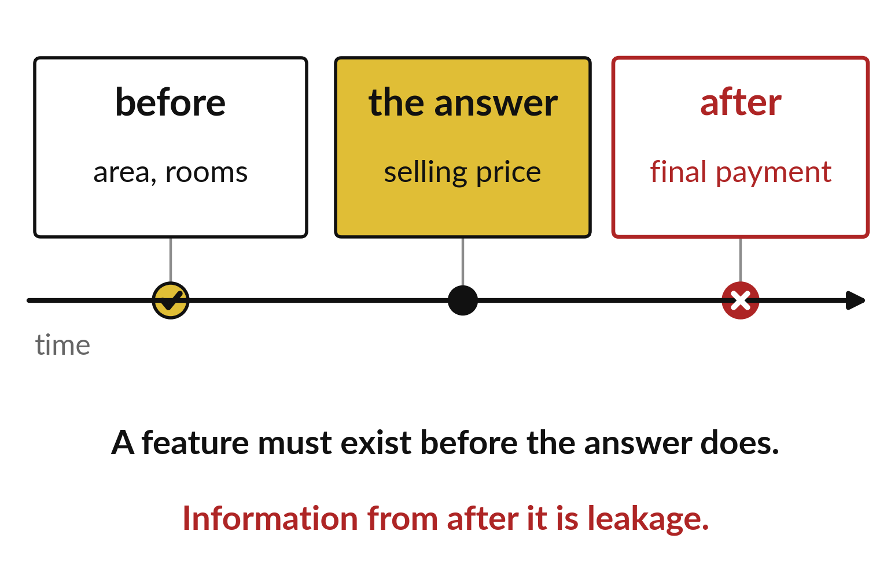
A feature must exist before the answer does
Area is known before the rent is set.
Information from after the rent is leakage.
Leakage makes a model look too good.
Notes:
A feature is only fair if we would have it before we need the answer. The area of a home is known before the rent is set. A figure written down after the rent was agreed is information from the future.
Using such a column is called leakage. It makes a model look brilliant on paper and useless in real life.

Slide 15
Predict: Open the session 1 model
import pandas as pd
from sklearn.linear_model import LinearRegression
homes = pd.read_csv("synthetic_homes.csv")
X = homes[["area_m2"]]
y = homes["rent_ugx"]
model = LinearRegression().fit(X, y)
slope = model.coef_[0]
intercept = model.intercept_
print(round(slope), round(intercept))
Name the feature and the target in this code before you run it.
Write your guess on paper before we run it.
Notes:
The model from session 1 had one feature and one target. Print what it learned.
Time to commit to an answer. Name the feature and the target in this code before you run it. Jot it on paper before anyone speaks.

Slide 16

Run it: Open the session 1 model
The cell prints 2996 and 159436.
The feature is area_m2, kept in X.
The target is rent_ugx, kept in y.
fit looked at all 120 homes and found a line: rent is about 159436 shillings plus 2996 shillings for each square metre.
Notes:
Now we run it. Match each line of the output with the line of code that made it.
The cell prints 2996 and 159436. The feature is area_m2, kept in X. The target is rent_ugx, kept in y. fit looked at all 120 homes and found a line: rent is about 159436 shillings plus 2996 shillings for each square metre. That model was scored on nothing at all. Judging it on the same homes it learned from would flatter it, so next session we keep some homes back.
If your guess was off, find the line that surprised you.

Slide 17
Investigate: Open the session 1 model
1. Which of these is the feature and which is the target?
2. Why is it unfair to test the model on the same 120 homes?
Notes:
Now we look closely at open the session 1 model. I have two questions for you.
Question one. Which of these is the feature and which is the target? Write your answer in one line before we compare.
The answer is this. area_m2 is the feature, rent_ugx is the target.
Question two. Why is it unfair to test the model on the same 120 homes? Say it quietly to yourself before anyone answers.
It has already seen their answers. A fair test needs homes it has not seen.

Slide 18
Modify: change one thing
Add rooms as a second feature and print the two slopes.
Then tell your neighbour what changed and how you know.
Notes:
Now it is your turn to change something. Add rooms as a second feature and print the two slopes. Then explain to your neighbour what the change did.
The result: About 2992 shillings per square metre and 19345 shillings per room.

Slide 19

Make: your own version
For training values [2000, 4000, 6000], find the baseline guess for a new item. If its real value is 5000, calculate the absolute error. Name one leaked feature if you were predicting a selling price.
Save it as ML13. Write two sentences: what you changed and how you checked it.
Notes:
Now you do the real work yourself. Start with the first step. If you get stuck for a few minutes, read your error message, check the error card, and then ask me.
Save it as ML13. I will come round to each of you and ask what you changed and how you checked it.

Slide 20

Two errors you may meet today
It means: The cell that creates X has not run yet.
Fix: Run the cells in order from the top.
NameError: name 'X' is not defined
It means: The column is called area_m2 in this file.
Fix: Print homes.columns and copy the exact name.
KeyError: 'area'
Notes:
Two things are likely to go wrong today. It helps to know them before they happen.
This is the first one. You will see: NameError: name 'X' is not defined. It means this: the cell that creates X has not run yet. To fix it, Run the cells in order from the top.
The next one. You will see: KeyError: 'area'. It means this: the column is called area_m2 in this file. To fix it, print homes.columns and copy the exact name.
If you meet one of these, fix it and carry on. It happens to everyone.

Slide 21

Finish this sentence in your notebook
A model is useful only if its error on unseen examples is smaller than the baseline's error.
Then save your notebook, close it and open it again to check it saved.
Notes:
Before we finish, go back to the question we began with: What did the session 1 model learn from, and how well would a plain guess do?
Copy this sentence into your notebook and make it yours. A model is useful only if its error on unseen examples is smaller than the baseline's error.
Then save your notebook, close it and open it again to check it saved.

