Slide 1
A complete regression experiment
Does the rent model beat a plain guess on homes it has never seen?
Machine Learning | Session 15 of 24 | Week 5, Baselines and a line
Holiday Data and AI Camp | The National ICT Innovation Hub, Nakawa
Notes:
Welcome back. Today is session 15 and our topic is A complete regression experiment.
By the end of today you will be able to split data, fit a model and a baseline on the training part, and compare their errors on held-out homes.
We will answer one question: Does the rent model beat a plain guess on homes it has never seen?

Slide 2
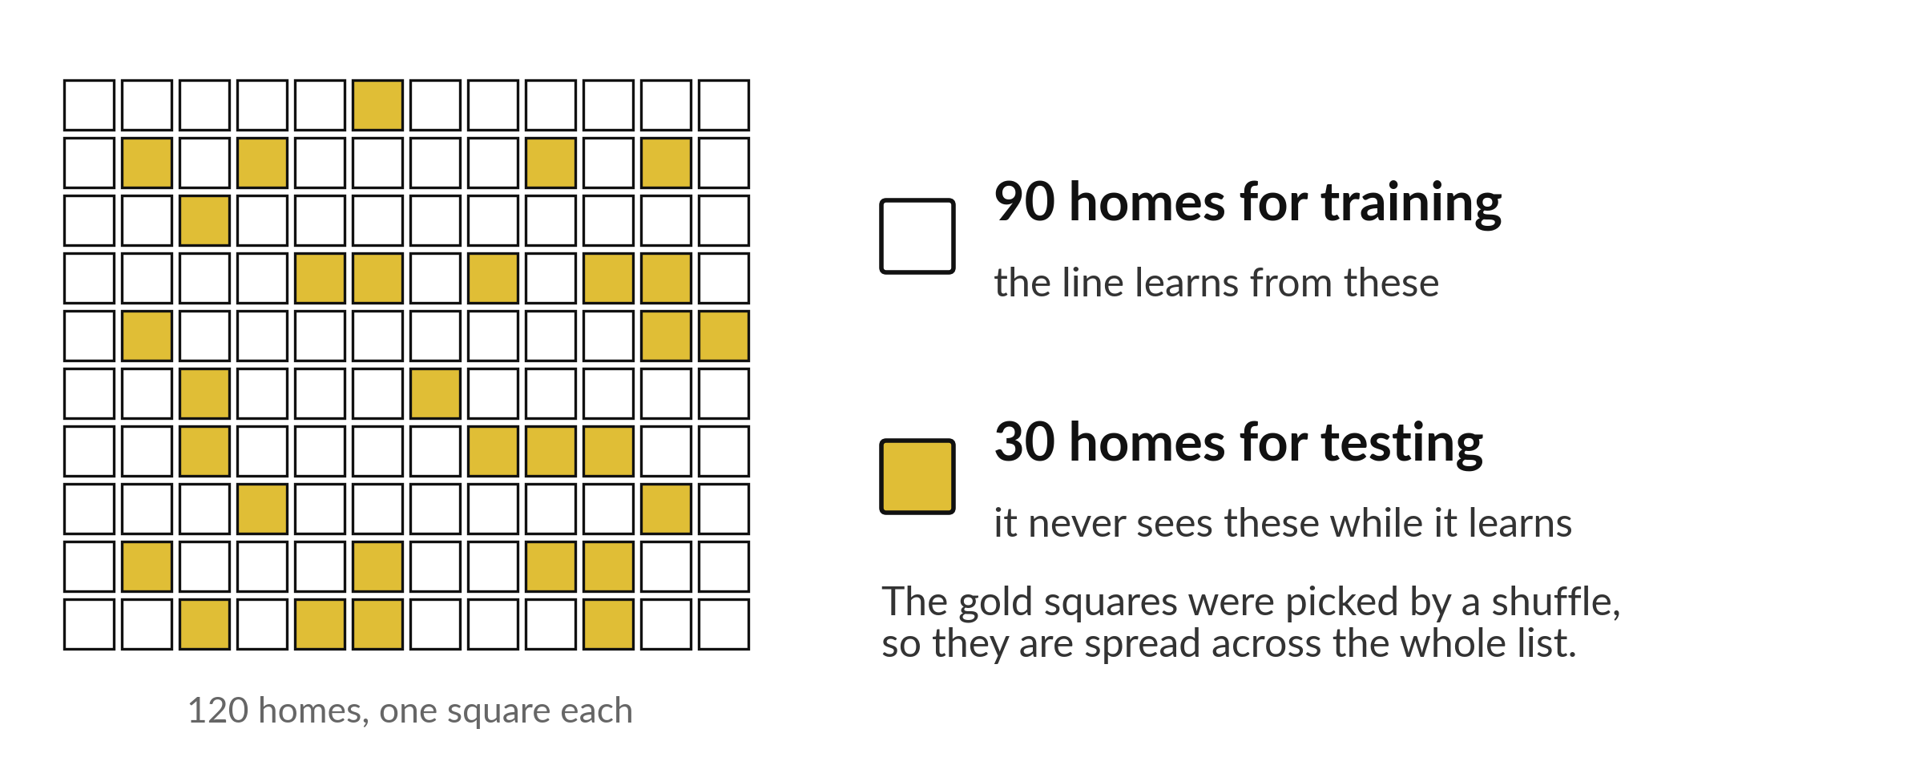
Does the rent model beat a plain
guess on homes it has never seen?
Notes:
Each square is one of our one hundred and twenty homes. Ninety of them, the white squares, are for training. The thirty gold squares are for testing, and the model never sees them while it learns. A shuffle chose the gold squares, which is why they are spread out. Today the question is whether the rent model beats a plain guess on homes it has never seen.

Slide 3

Three hours, mostly doing
Most of our time is spent doing, in small steps, with a guess before every run.
Notes:
Here is how the 3 hours go. Each bar is as long as the time we spend on that part.
First, 10 minutes. Recall. Then, 50 minutes. Block A. After that, 15 minutes. Break away from screens. Next, 50 minutes. Block B. Then, 40 minutes. Make. Then, 15 minutes. Exit ticket, save, and an individual check with each learner.
Notice how much of the time is yours. You listen for a short while and then you do. That is on purpose, because you learn this by doing it.

Slide 4

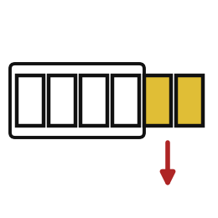

Words for today (1 of 2)
train and test split
Divide the rows into homes to learn from and homes to test on.
Practice questions and the real exam.
held-out records
The rows kept back and never used to fit.
The exam paper kept in a locked cupboard.
test_size
The share of rows kept back for testing.
One quarter of the class sits the check.
Notes:
We need a few words today. For each one I will say what it means and give you something to picture.
train and test split. Divide the rows into homes to learn from and homes to test on. An example from everyday life. Practice questions and the real exam.
held-out records. The rows kept back and never used to fit. Here is a way to see it. The exam paper kept in a locked cupboard.
test_size. The share of rows kept back for testing. A small example. One quarter of the class sits the check.

Slide 5

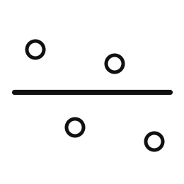
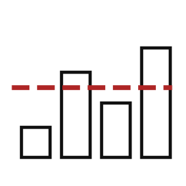
Words for today (2 of 2)
random_state
A number that makes the shuffle repeatable.
Giving everyone the same shuffled deck.
baseline model
A model that guesses the training mean every time.
The average guess.
mean absolute error
The average size of the misses, in the target's own unit.
The average distance of your darts from the bullseye.
Notes:
More words for today.
random_state. A number that makes the shuffle repeatable. Picture this. Giving everyone the same shuffled deck.
baseline model. A model that guesses the training mean every time. You have seen this before. The average guess.
mean absolute error. The average size of the misses, in the target's own unit. The average distance of your darts from the bullseye.

Slide 6
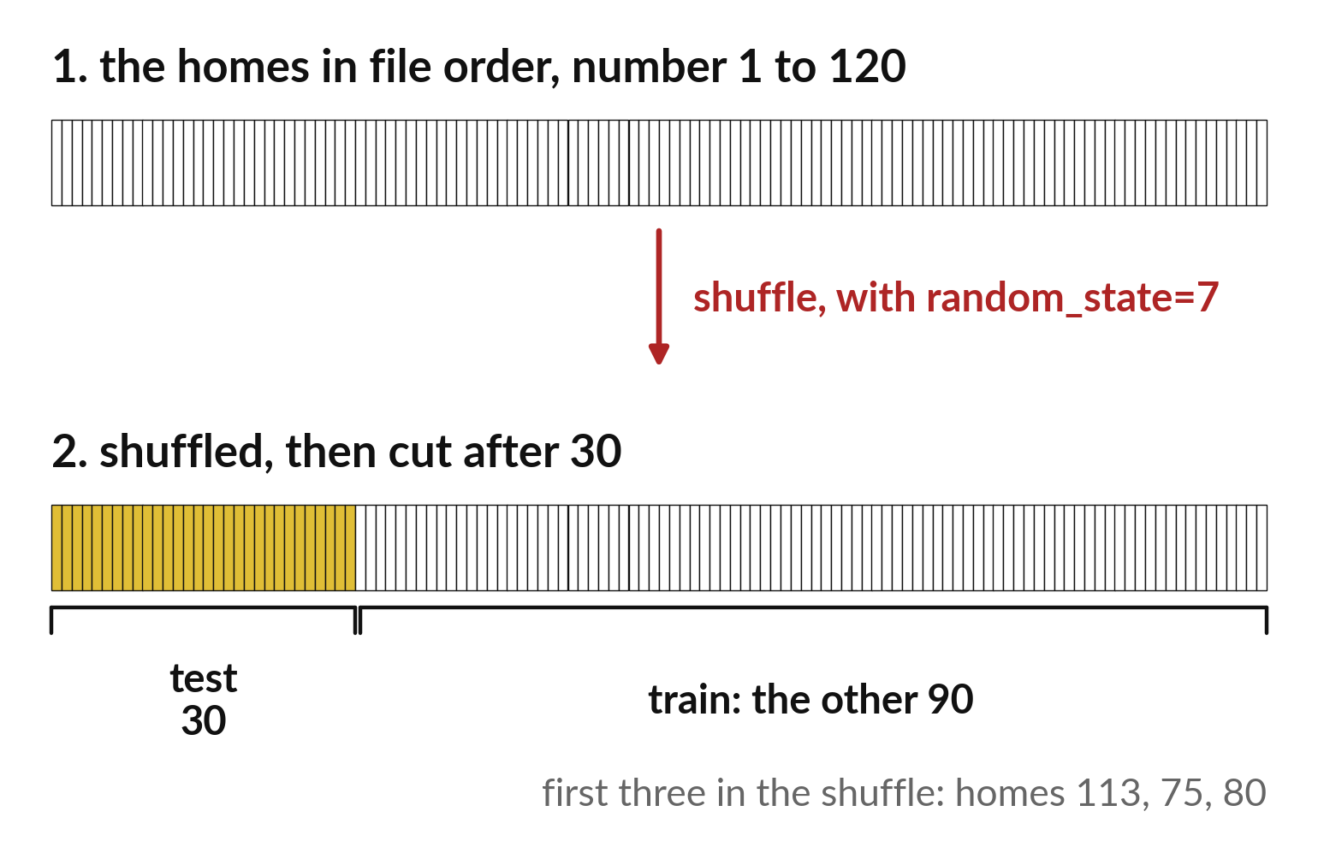
Shuffle first, then cut, for a fair test sample
The file is in order of home number.
Shuffle with random_state 7.
Cut after 30 for the test part.
Notes:
The homes in the file are in order. If we cut the file in the middle, one part might hold all the small homes. So we shuffle first, then cut off thirty homes for the test.
A random state of seven makes the shuffle the same every time, so your result matches mine.

Slide 7
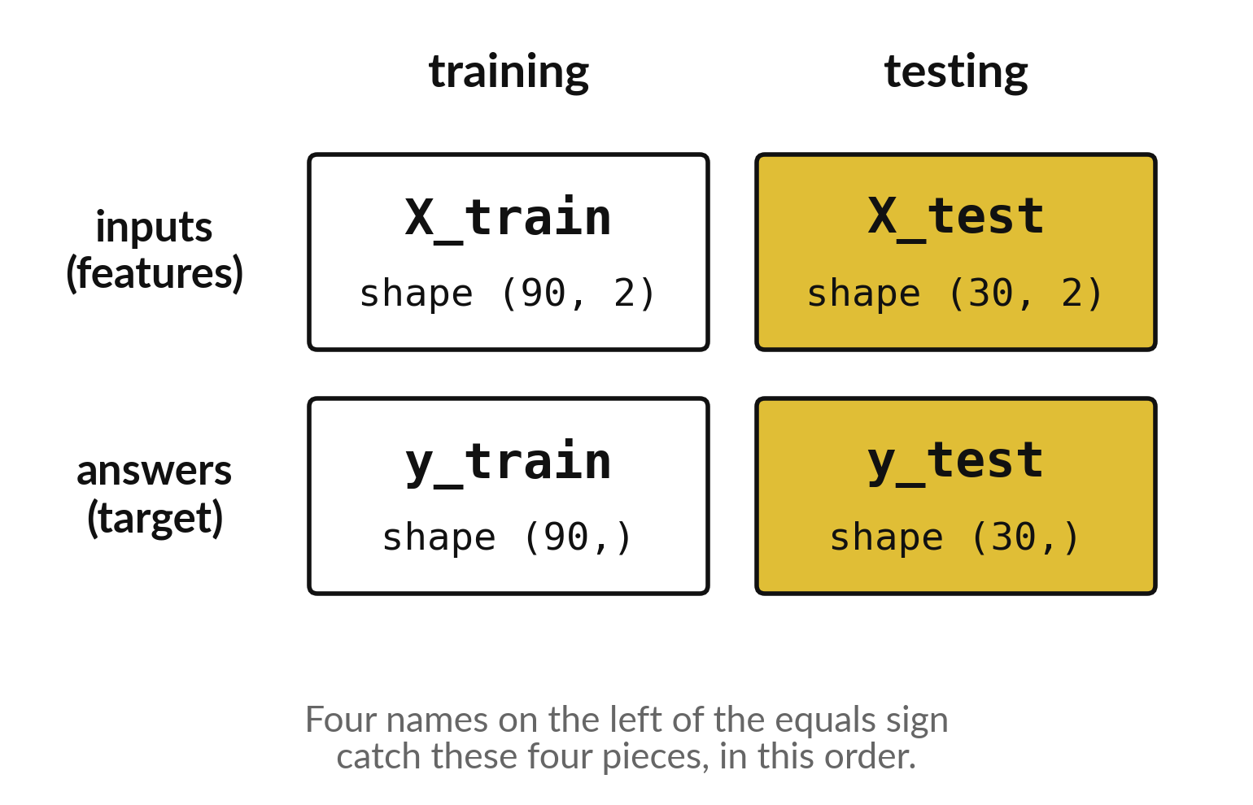
Four names catch the four pieces the split returns
Training inputs and training answers.
Test inputs and test answers.
The order matters.
Notes:
The split hands back four pieces: the training inputs, the test inputs, the training answers and the test answers. You catch them in four names on the left of the equals sign, in that order.
Swap two names and your code runs, but it quietly learns from the wrong thing. Check the order every time.

Slide 8

Predict: Split the homes
import pandas as pd
from sklearn.model_selection import train_test_split
homes = pd.read_csv("synthetic_homes.csv")
X = homes[["area_m2", "rooms"]]
y = homes["rent_ugx"]
X_train, X_test, y_train, y_test = train_test_split(
X, y, test_size=0.25, random_state=7
)
print(len(X_train), len(X_test))
Predict how many homes go to training and how many to testing.
Write your guess on paper before we run it.
Notes:
Keep a quarter of the 120 homes back. The model must never see them while it learns.
Time to commit to an answer. Predict how many homes go to training and how many to testing. Guess on paper first. Surprises are useful.

Slide 9

Run it: Split the homes
The cell prints 90 and 30.
The four names on the left receive training inputs, test inputs, training targets and test targets, in that order.
random_state=7 fixes the shuffle so everyone gets the same split.
Notes:
Now we run it. Match each line of the output with the line of code that made it.
The cell prints 90 and 30. The four names on the left receive training inputs, test inputs, training targets and test targets, in that order. random_state=7 fixes the shuffle so everyone gets the same split.
If your guess was off, find the line that surprised you.

Slide 10

Investigate: Split the homes
1. Why do we shuffle before splitting?
2. Which of the four names would hold the answers you must not peek at?
Notes:
Now we look closely at split the homes. I have two questions for you.
Question one. Why do we shuffle before splitting? Say it quietly to yourself before anyone answers.
The answer is this. The file may be in an order that puts similar homes together. A shuffle gives both parts a fair mix.
Question two. Which of the four names would hold the answers you must not peek at? Give it thirty seconds and then we will hear a few answers.
y_test.

Slide 11

Modify: change one thing
Change test_size to 0.2 and run the split again.
Then tell your neighbour what changed and how you know.
Notes:
Now it is your turn to change something. Change test_size to 0.2 and run the split again. When you have run it, tell your neighbour what changed and how you know.
Here is what happens. 96 homes train and 24 test.

Slide 12

Break
15 minutes away from your screen
Stand up. Drink some water. Tell someone what you guessed in the first half.
Notes:
Break time. 15 minutes away from your screens. Stand up, drink some water and tell someone what you guessed in the first half.
When we come back we start the second idea.

Slide 13
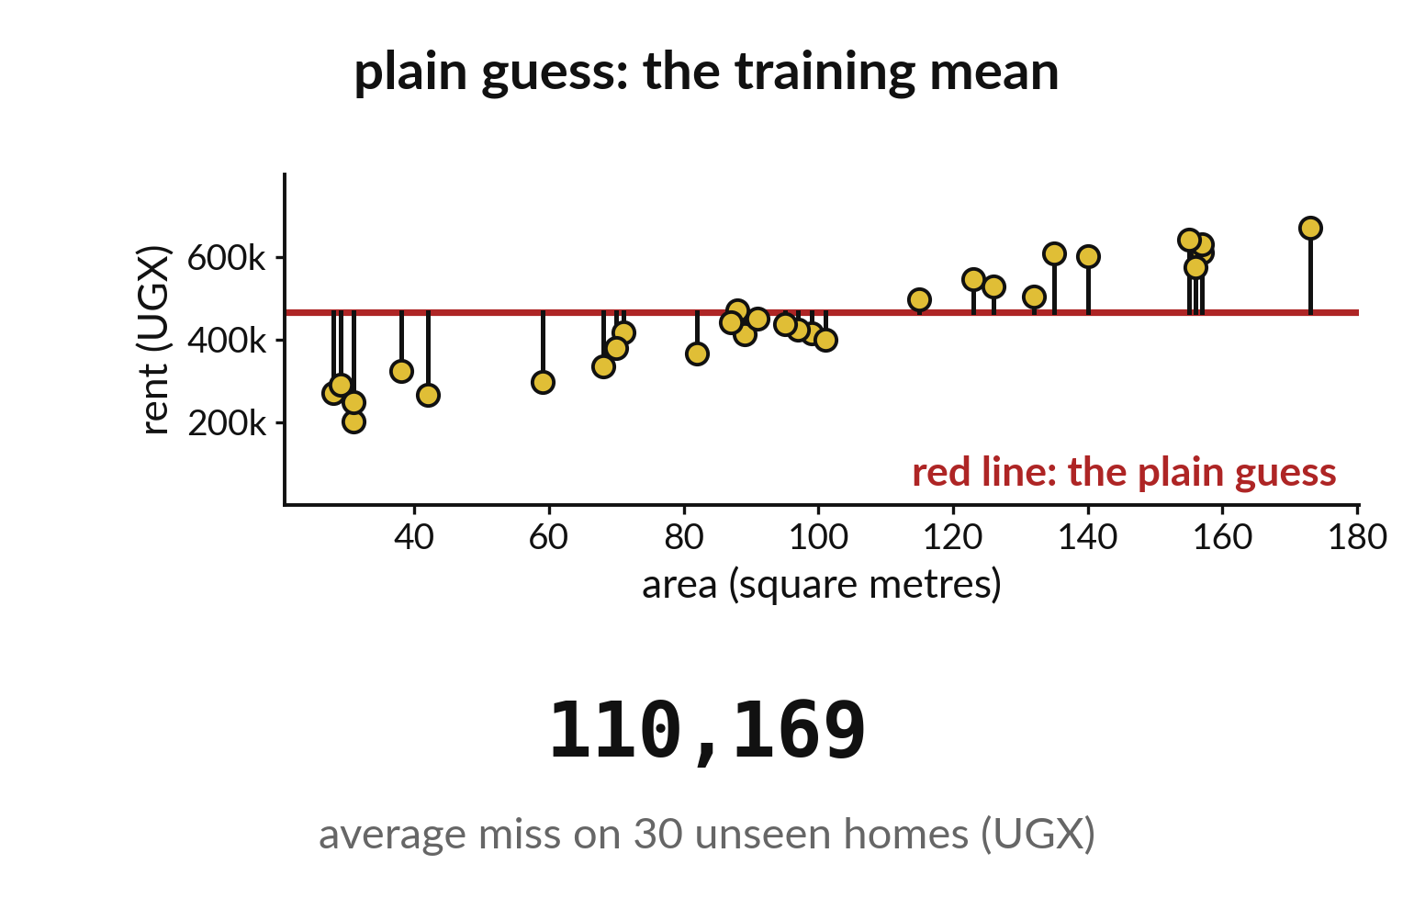
The plain guess misses by about 110,000 shillings
Guess the training mean for each test home.
Measure the average miss.
The baseline misses by 110,169.
Notes:
First we score the plain guess. Take the mean rent of the training homes, guess it for each of the thirty test homes, and average the misses. The answer is about one hundred and ten thousand shillings.
That is the number the model has to beat.

Slide 14
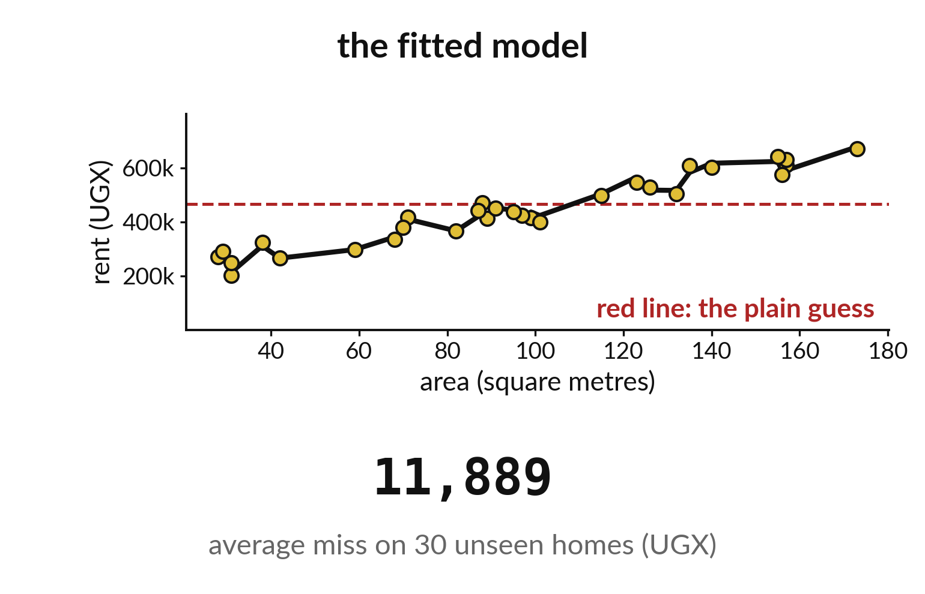
The fitted model misses by about 12,000 shillings
Same thirty test homes.
The model misses by 11,889.
About nine times closer than the plain guess.
Notes:
Now the model. It learned from the ninety training homes and has never seen the thirty test homes. Its average miss is about eleven thousand eight hundred and eighty nine shillings.
Compared with a hundred and ten thousand for the plain guess, that is roughly nine times closer.

Slide 15

Predict: Baseline against model
from sklearn.dummy import DummyRegressor
from sklearn.linear_model import LinearRegression
from sklearn.metrics import mean_absolute_error
baseline = DummyRegressor(strategy="mean").fit(
X_train, y_train
)
model = LinearRegression().fit(X_train, y_train)
baseline_mae = mean_absolute_error(
y_test, baseline.predict(X_test)
)
model_mae = mean_absolute_error(
y_test, model.predict(X_test)
)
print(round(baseline_mae), round(model_mae))
Predict whether the model's average miss will be smaller than the baseline's, and by roughly how much.
Write your guess on paper before we run it.
Notes:
Fit a mean-guess baseline and a line on the 90 training homes. Measure both on the 30 held-out homes.
Your turn to guess. Predict whether the model's average miss will be smaller than the baseline's, and by roughly how much. Write it on paper. It does not have to be right.

Slide 16
Run it: Baseline against model
The cell prints 110169 and 11889.
The baseline misses by about UGX 110169 and the model by about UGX 11889, so on these 30 held-out homes the model is far better.
Mean absolute error averages the misses and uses the unit of the target, shillings.
Notes:
I will run it, and you compare with your guess. Match each line of the output with the line of code that made it.
The cell prints 110169 and 11889. The baseline misses by about UGX 110169 and the model by about UGX 11889, so on these 30 held-out homes the model is far better. Mean absolute error averages the misses and uses the unit of the target, shillings. The model wins by this much because the homes were generated from a formula, which makes them easy to learn. Real data would not be so kind.
Check your paper. Were you close?

Slide 17
Investigate: Baseline against model
1. What does a mean absolute error of 11889 mean in words?
2. Why is this result no evidence about real rents?
Notes:
Now we look closely at baseline against model. I have two questions for you.
Question one. What does a mean absolute error of 11889 mean in words? Give it thirty seconds and then we will hear a few answers.
On average the model's rent estimate is about UGX 11889 away from the real rent.
Question two. Why is this result no evidence about real rents? Talk it over with your neighbour for a minute.
Here is how I would answer it. The homes are invented from a neat formula, so any line fits them well.

Slide 18
Modify: change one thing
Fit a model using only area_m2 and print its error.
Then tell your neighbour what changed and how you know.
Notes:
Time to experiment. Fit a model using only area_m2 and print its error. Run it, then tell someone what you saw.
What you should find: About UGX 28272, worse than with rooms too.

Slide 19
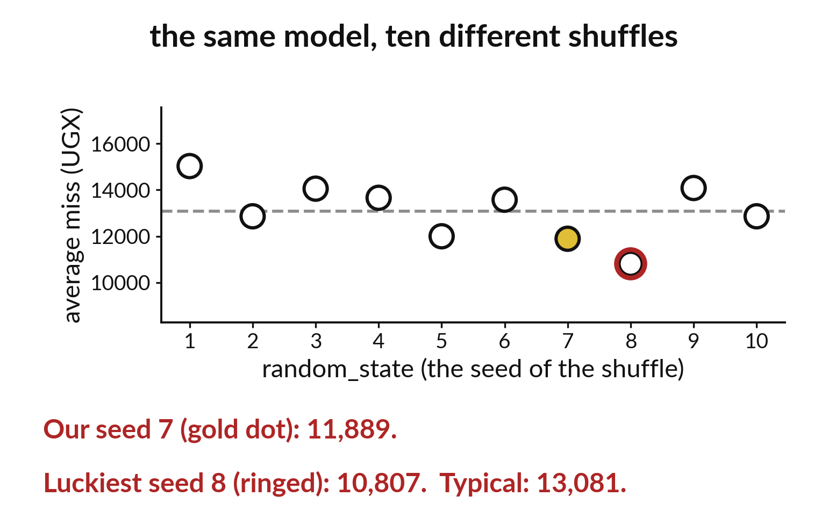
Ten shuffles give ten slightly different scores
Each shuffle picks different test homes.
The scores stay in the same region.
Report the seed you used.
Notes:
Change the random state and a different set of homes lands in the test part, so the score changes a little. Ten shuffles give ten nearby numbers.
That is why we report which seed we used, and why we should be careful about reading too much into small differences.

Slide 20

Make: your own version
Run the experiment, record the two errors, and say whether the model beats the baseline on the held-out homes. Keep the split as it is. Do not keep changing random_state to get a better score.
Save it as ML15. Write two sentences: what you changed and how you checked it.
Notes:
This is your own task for today. Take it one step at a time. If you get stuck for a few minutes, read your error message, check the error card, and then ask me.
Save it as ML15. I will come round to each of you and ask what you changed and how you checked it.

Slide 21

Two errors you may meet today
It means: The column name is spelled differently from the header.
Fix: Print homes.columns and copy the exact name.
KeyError: "['rooms'] not in index"
It means: The model and baseline were scored on the same predictions, or the wrong table was used.
Fix: Check that each uses its own predict call on X_test.
The two errors are the same
Notes:
Everyone meets errors, including me. Two are likely today, so let us meet them now.
This is the first one. You will see: KeyError: "['rooms'] not in index". It means this: the column name is spelled differently from the header. To fix it, print homes.columns and copy the exact name.
The next one. You will see: The two errors are the same. It means this: the model and baseline were scored on the same predictions, or the wrong table was used. To fix it, check that each uses its own predict call on X_test.
Keep this slide in mind when something stops working.

Slide 22

Finish this sentence in your notebook
On held-out homes the model's average miss is about a tenth of the baseline's, and this holds only for these invented homes.
Then save your notebook, close it and open it again to check it saved.
Notes:
We are nearly done. Remember the question from the start of the session: Does the rent model beat a plain guess on homes it has never seen?
Write this sentence in your notebook and finish it your own way. On held-out homes the model's average miss is about a tenth of the baseline's, and this holds only for these invented homes.
Then save your notebook, close it and open it again to check it saved.

