Slide 1
Mistakes, overfitting and fair comparisons
When is a very high score a warning sign?
Machine Learning | Session 17 of 24 | Week 6, Trees and fair tests
Holiday Data and AI Camp | The National ICT Innovation Hub, Nakawa
Notes:
Laptops open, please. Today is session 17 and our topic is mistakes, overfitting and fair comparisons.
By the end of today you will be able to read a confusion matrix, spot an overfitted tree from its training and test scores, and explain why the final test must stay locked.
We will answer one question: When is a very high score a warning sign?

Slide 2
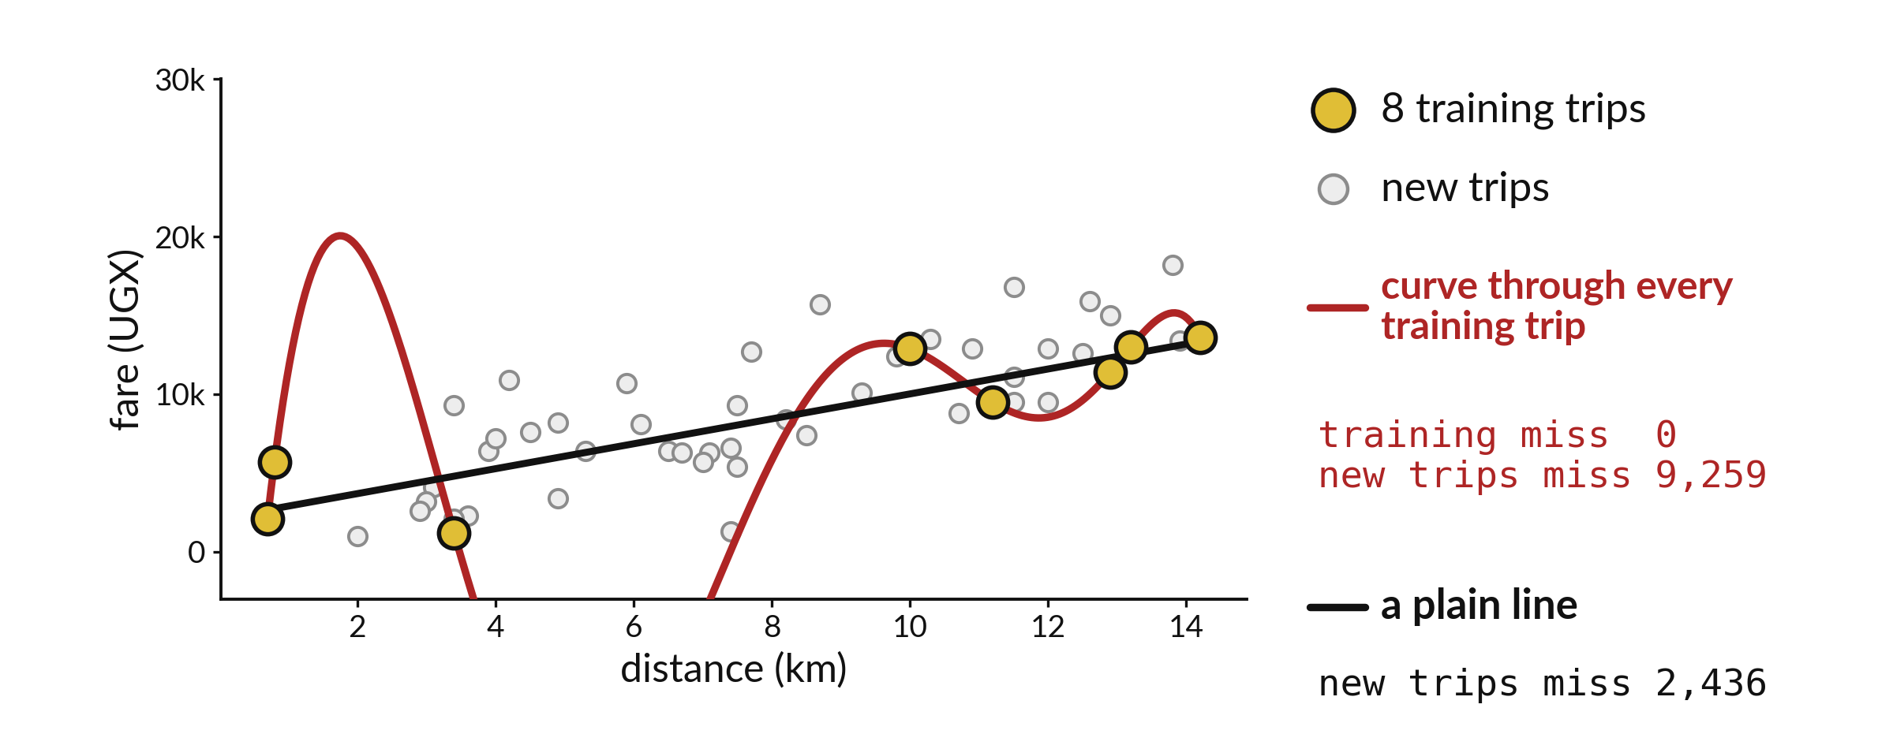
When is a very high score a warning sign?
Notes:
The gold dots are eight training trips. The red curve passes through every one of them, so on training data it misses by nothing at all. The white dots are trips it has never seen, and there the red curve misses by more than nine thousand shillings. The plain black line is much better, at about two and a half thousand. Today we learn why a very high score is sometimes a warning sign.

Slide 3

Three hours, mostly doing
Most of our time is spent doing, in small steps, with a guess before every run.
Notes:
Here is how the 3 hours go. Each bar is as long as the time we spend on that part.
First, 10 minutes. Recall. Then, 50 minutes. Block A. After that, 15 minutes. Break away from screens. Next, 50 minutes. Block B. Then, 40 minutes. Make. Then, 15 minutes. Exit ticket, save, and an individual check with each learner.
Notice how much of the time is yours. You listen for a short while and then you do. That is on purpose, because you learn this by doing it.

Slide 4
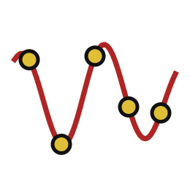
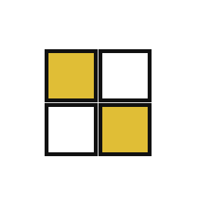
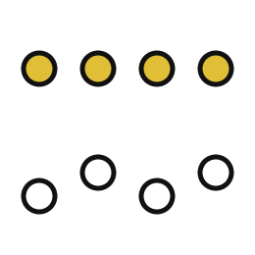
Words for today (1 of 2)
overfitting
Learning the quirks of the training examples so well that new examples are predicted worse.
Memorising last year's exam instead of learning the subject.
confusion matrix
A table that counts actual categories against predicted categories.
A mark sheet of right and wrong answers by question type.
actual and predicted
Rows show what really happened; columns show what the model said.
The real result against the guess.
Notes:
First the words, because every one of them is used in the code later.
overfitting. Learning the quirks of the training examples so well that new examples are predicted worse. Think of a shop. Memorising last year's exam instead of learning the subject.
confusion matrix. A table that counts actual categories against predicted categories. Imagine it like this. A mark sheet of right and wrong answers by question type.
actual and predicted. Rows show what really happened; columns show what the model said. An example from everyday life. The real result against the guess.

Slide 5


Words for today (2 of 2)
validation records
Held-out rows used to choose between models.
The practice test used to decide how to revise.
final test
The last check, run once after every choice is made.
The real exam.
locked test
A test set no choice has ever been based on.
An exam paper no student has seen.
Notes:
Here are the rest of today's words.
validation records. Held-out rows used to choose between models. Here is a way to see it. The practice test used to decide how to revise.
final test. The last check, run once after every choice is made. A small example. The real exam.
locked test. A test set no choice has ever been based on. Picture this. An exam paper no student has seen.

Slide 6
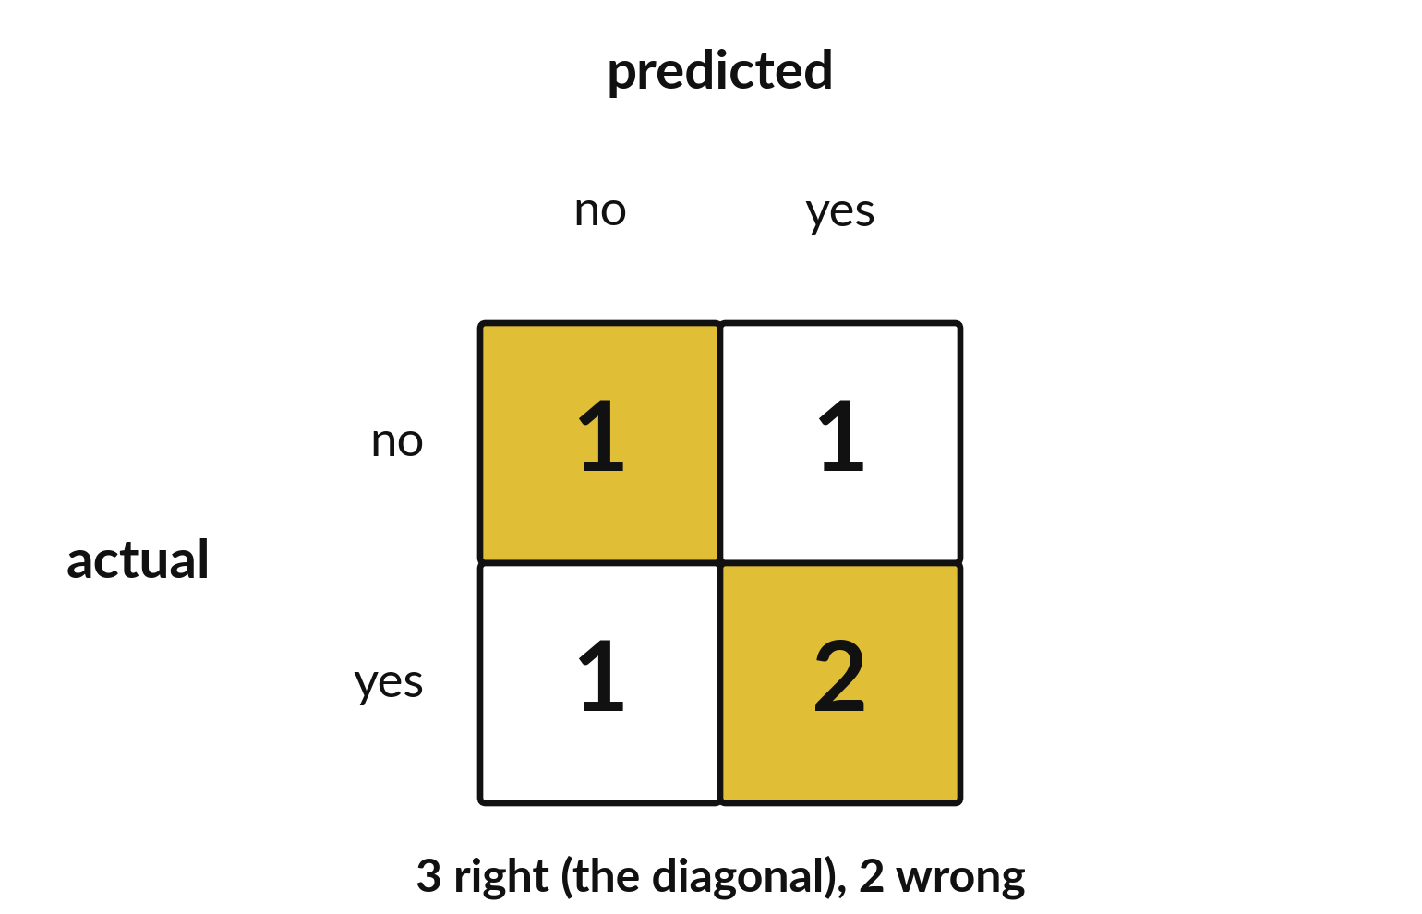
A confusion matrix shows
where the answers went
Rows are what was true.
Columns are what we said.
The diagonal holds the right answers.
Notes:
Accuracy is one number. A confusion matrix shows the detail. Each row is what was true. Each column is what we said. The diagonal, from top left to bottom right, holds the answers we got right.
In this small example three answers are on the diagonal and two are off it.

Slide 7
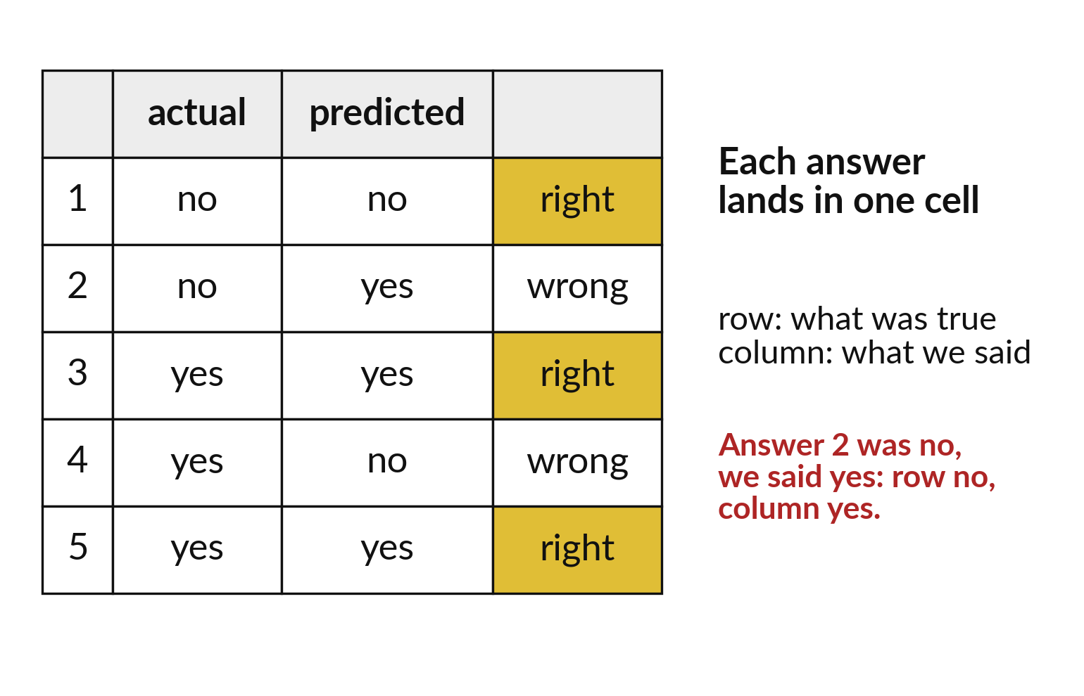
Read one answer at a time to find its cell
Find the row for what was true.
Find the column for what we said.
The answer lands where they meet.
Notes:
To place an answer, find the row for the truth and the column for what we said. The two meet in one cell.
Answer two was no, and we said yes. Go along the row for no, down the column for yes, and put a mark where they cross.

Slide 8
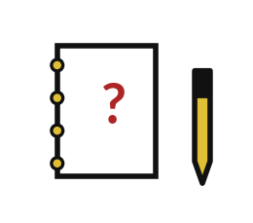
Predict: Read a confusion matrix
from sklearn.metrics import confusion_matrix, ConfusionMatrixDisplay
import matplotlib.pyplot as plt
actual = [0, 0, 1, 1, 1]
predicted = [0, 1, 1, 0, 1]
matrix = confusion_matrix(actual, predicted, labels=[0, 1])
print(matrix)
ConfusionMatrixDisplay(
matrix, display_labels=["no", "yes"]
).plot()
plt.show()
The matrix will have two rows and two columns. Predict which cells hold the correct answers.
Write your guess on paper before we run it.
Notes:
A model guessed five yes or no answers. Count the matches.
Your turn to guess. The matrix will have two rows and two columns. Predict which cells hold the correct answers. Put it on paper first. We will check it together in a moment.

Slide 9

Run it: Read a confusion matrix
The cell prints [[1 1] [1 2]].
Rows are the actual answers and columns are the predicted answers.
The top-left cell is an actual no predicted no, and the bottom-right is an actual yes predicted yes.
Notes:
I will run it, and you compare with your guess. Match each line of the output with the line of code that made it.
The cell prints [[1 1] [1 2]]. Rows are the actual answers and columns are the predicted answers. The top-left cell is an actual no predicted no, and the bottom-right is an actual yes predicted yes. The correct answers are on the diagonal: 1 plus 2 is 3 out of 5. ConfusionMatrixDisplay draws the table as a picture.
Check your paper. Were you close?

Slide 10

Investigate: Read a confusion matrix
1. Which cell counts an actual yes that the model called no?
2. Why read the axis labels before the numbers?
Notes:
Now we look closely at read a confusion matrix. I have two questions for you.
Question one. Which cell counts an actual yes that the model called no? Talk it over with your neighbour for a minute.
The bottom-left cell. It holds 1.
Question two. Why read the axis labels before the numbers? Think about it for a moment, then tell the person next to you.
Here is how I would answer it. If you mix up rows and columns you will swap the two kinds of mistake.

Slide 11

Modify: change one thing
Calculate the accuracy from the matrix.
Then tell your neighbour what changed and how you know.
Notes:
Time to experiment. Calculate the accuracy from the matrix. After you run it, say in one sentence what changed and how you checked.
You should see this. 3 divided by 5 is 0.6, or 60%.

Slide 12

Break
15 minutes away from your screen
Stand up. Drink some water. Tell someone what you guessed in the first half.
Notes:
Break time. 15 minutes away from your screens. Stand up, drink some water and tell someone what you guessed in the first half.
When we come back we start the second idea.

Slide 13
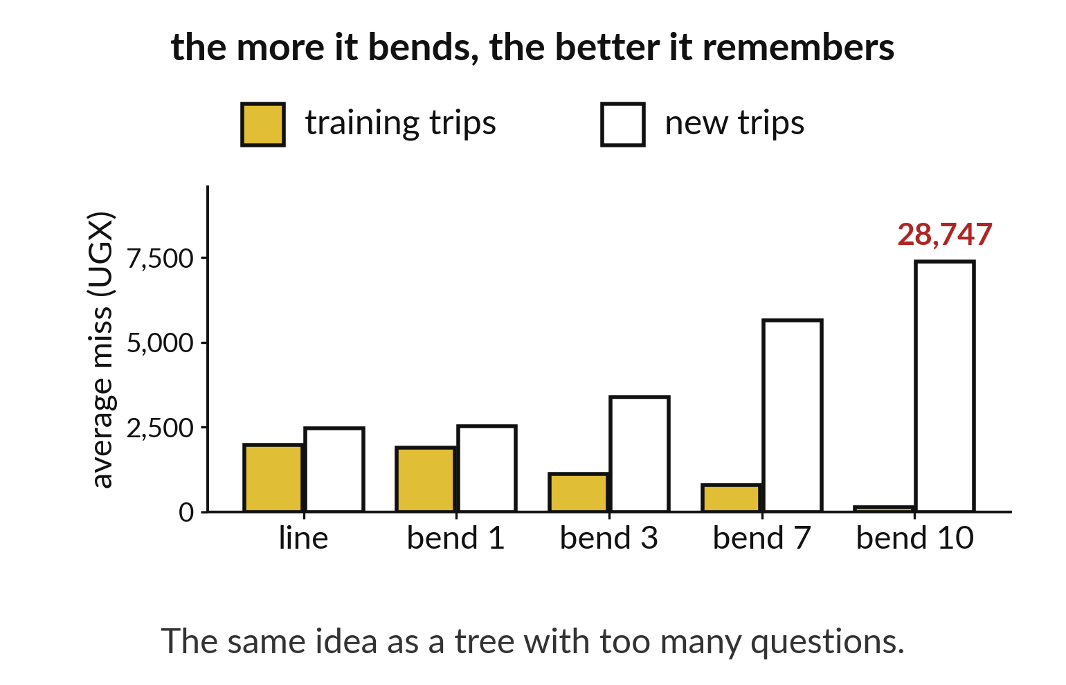
A model that bends more memorises the practice
Gold bars show the training miss.
White bars show the miss on new trips.
The gap grows as the curve bends.
Notes:
Allow the line to bend more, and the miss on training trips shrinks. The miss on new trips grows. The model is memorising the practice and failing the exam.
The same thing happens to a tree that is allowed too many questions.

Slide 14
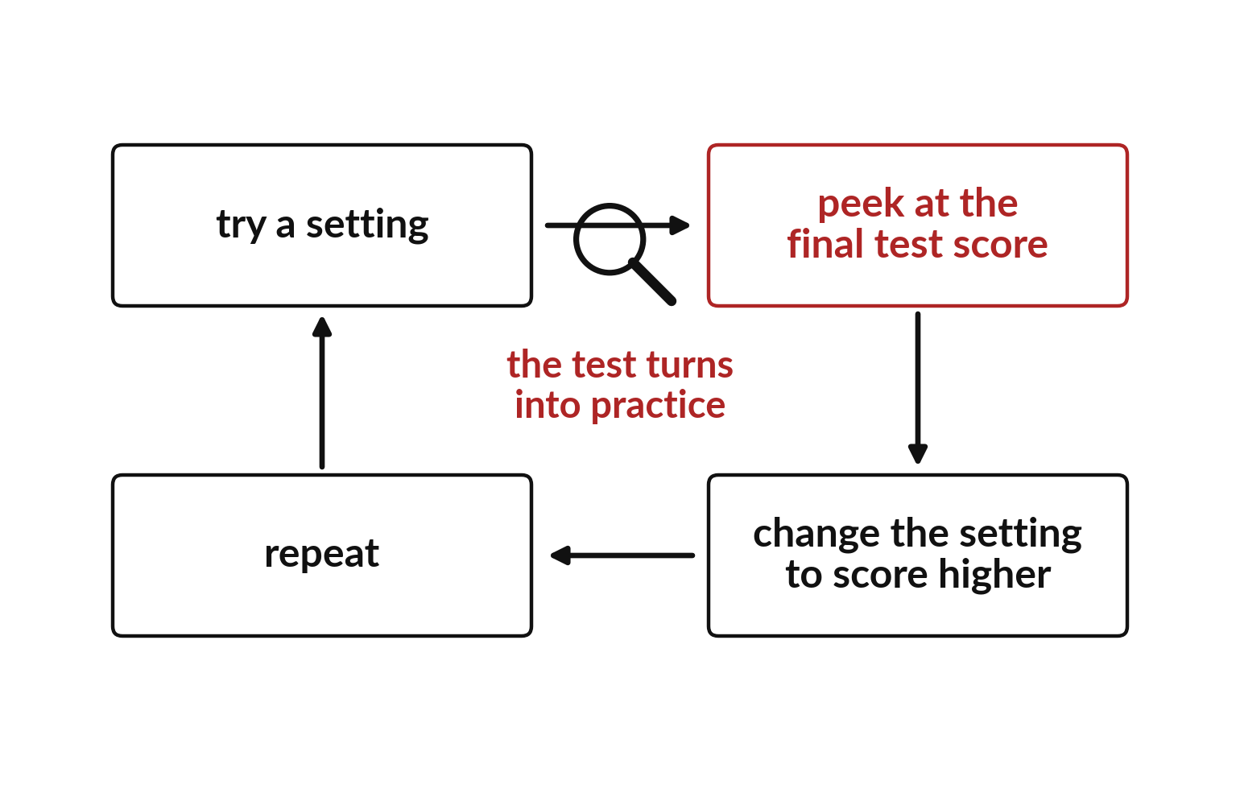
Peeking at the final test turns it into practice
Score on the final test.
Change a setting and score again.
The test now shapes your choice.
Notes:
It is tempting to check the final test, change a setting, and check again. Each peek leaks a little of the test into your decisions, and the test stops being a fair exam.
So we keep a separate validation part for choosing settings, and we open the final test once.

Slide 15
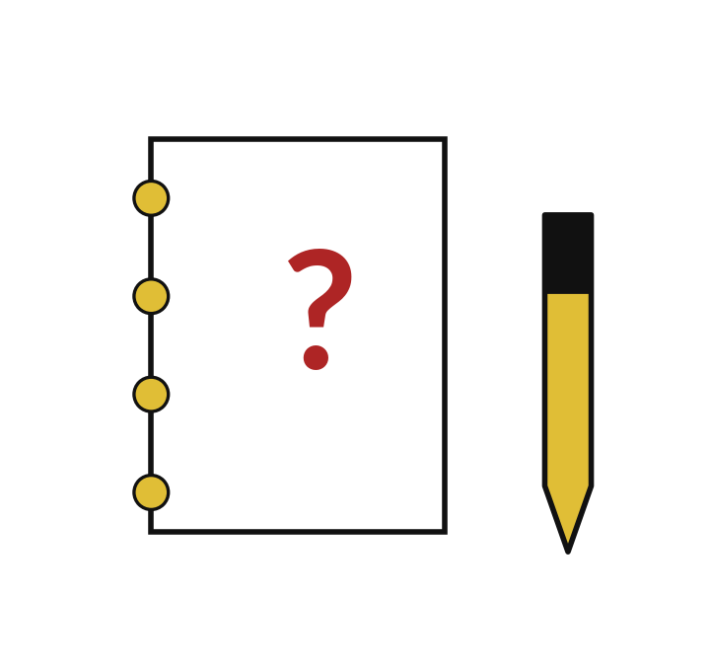
Predict: The tree that remembered
Predict which tree scores 100% on the training flowers.
Write your guess on paper before we run it.
Notes:
Train trees that may ask more and more questions, and print their training and test scores.
Now your guess. Predict which tree scores 100% on the training flowers. Put your guess on paper now, even if you are unsure.

Slide 16
Run it: The tree that remembered
Each line prints the depth, the training score and the test score.
The tree with depth None may ask as many questions as it likes and scores 1.0 on the training flowers, because it memorised them.
Its test score does not rise with it.
Notes:
Watch the output as it appears. Match each line of the output with the line of code that made it.
Each line prints the depth, the training score and the test score. The tree with depth None may ask as many questions as it likes and scores 1.0 on the training flowers, because it memorised them. Its test score does not rise with it. That gap between training and test is the sign of overfitting. score gives the accuracy.
Tell the person next to you whether your guess matched.

Slide 17
Investigate: The tree that remembered
1. Why is 100% on training flowers a warning sign?
2. Can we use the test score to pick the best depth?
Notes:
Now we look closely at the tree that remembered. I have two questions for you.
Question one. Why is 100% on training flowers a warning sign? Think about it for a moment, then tell the person next to you.
Here is how I would answer it. The tree may have memorised the flowers. Only the test score says how it does on new ones.
Question two. Can we use the test score to pick the best depth? Have a go in your head first.
What I would say is this. No. A choice made by looking at test scores uses the test as a practice exam, and the final test then proves nothing.

Slide 18
Modify: change one thing
Print the gap between the last tree's training and test scores.
Then tell your neighbour what changed and how you know.
Notes:
Your hands on the keyboard now. Print the gap between the last tree's training and test scores. Then explain to your neighbour what the change did.
The result: The gap is the training score minus the test score; it is zero or more.

Slide 19
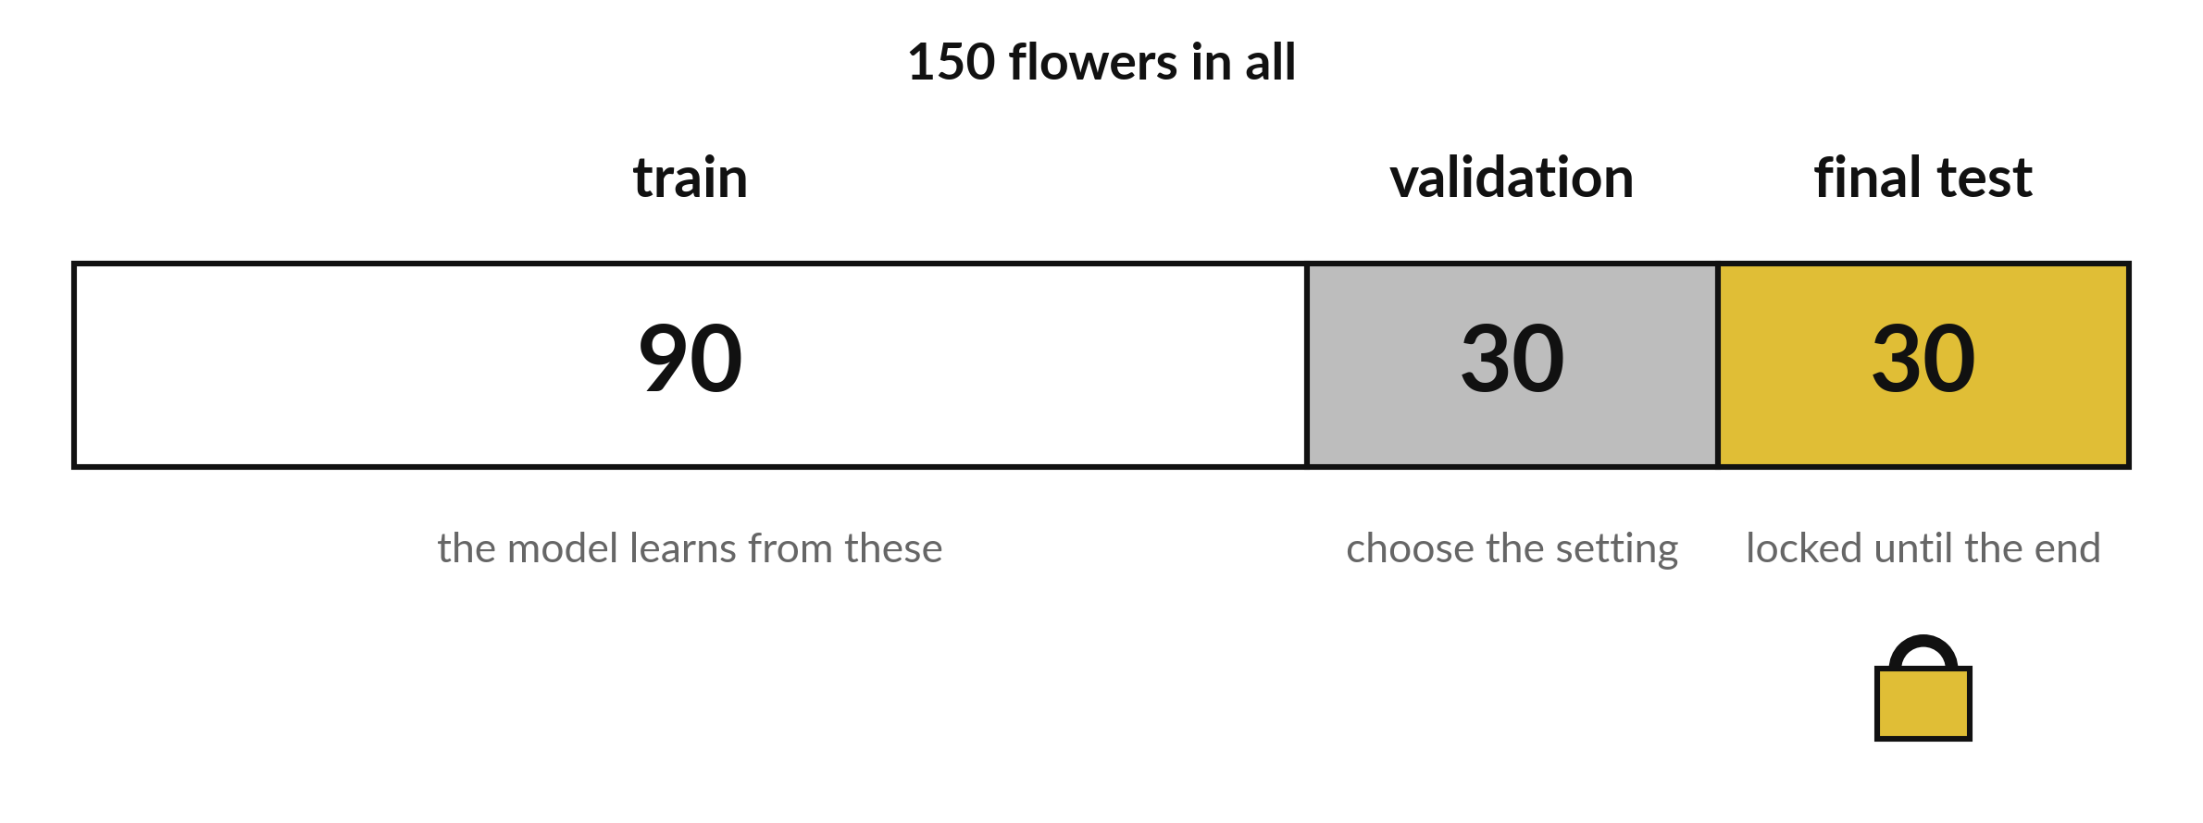
Choose on validation and open the final test last
Train on 90. Choose a setting using the 30 validation flowers. Open the 30 test flowers once.
Notes:
The flowers are split three ways. Ninety for training. Thirty for validation, where we compare settings. Thirty for the final test, which stays locked until the very end.
Next session you will do this yourself and compare two tree depths.

Slide 20

Make: your own version
Draw the 2 by 2 matrix for the toy answers and label both axes. Count the right and the wrong predictions. Explain why trying many settings against the final test answers weakens that test.
Save it as ML17. Write two sentences: what you changed and how you checked it.
Notes:
This task is yours. Run your code after every step so you can see where a problem begins. If you get stuck for a few minutes, read your error message, check the error card, and then ask me.
Save it as ML17. I will come round to each of you and ask what you changed and how you checked it.

Slide 21

Two errors you may meet today
It means: The axes were read the wrong way round: rows are actual, columns are predicted.
Fix: Label both axes before reading any cell.
The two kinds of mistake sit in the wrong cells
It means: The two lists were passed to confusion_matrix in the wrong order. It expects the actual values first and the predicted values second.
Fix: Write confusion_matrix(actual, predicted) and check that the row totals match the real class counts.
The matrix has actual and predicted swapped
Notes:
Here are two errors from this session, so you recognise them when they appear.
This is the first one. You will see: The two kinds of mistake sit in the wrong cells. It means this: the axes were read the wrong way round: rows are actual, columns are predicted. To fix it, label both axes before reading any cell.
The next one. You will see: The matrix has actual and predicted swapped. It means this: the two lists were passed to confusion_matrix in the wrong order. It expects the actual values first and the predicted values second. To fix it, write confusion_matrix(actual, predicted) and check that the row totals match the real class counts.
When you are stuck, read the last line of the message first.

Slide 22
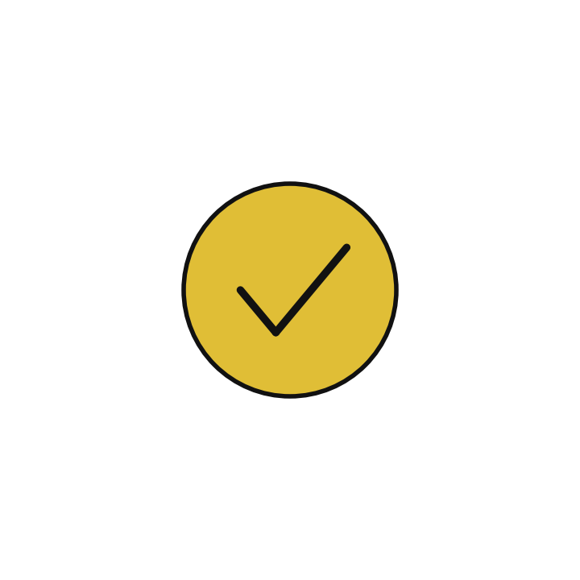
Finish this sentence in your notebook
A great training score with a weaker test score means overfitting, and a final test is only fair if no choice has used it.
Then save your notebook, close it and open it again to check it saved.
Notes:
Last step. Our question for today was: When is a very high score a warning sign?
Finish this sentence in your notebook, in your own words. A great training score with a weaker test score means overfitting, and a final test is only fair if no choice has used it.
Then save your notebook, close it and open it again to check it saved.

