Slide 1
Build the project baseline
How much does a plain guess miss by, before any model helps?
Machine Learning | Session 20 of 24 | Week 7, Your project
Holiday Data and AI Camp | The National ICT Innovation Hub, Nakawa
Notes:
Good to see you. Today is session 20 and our topic is build the project baseline.
By the end of today you will be able to split data into training, validation and locked test, fit a baseline on training only, and draw one descriptive chart.
We will answer one question: How much does a plain guess miss by, before any model helps?

Slide 2
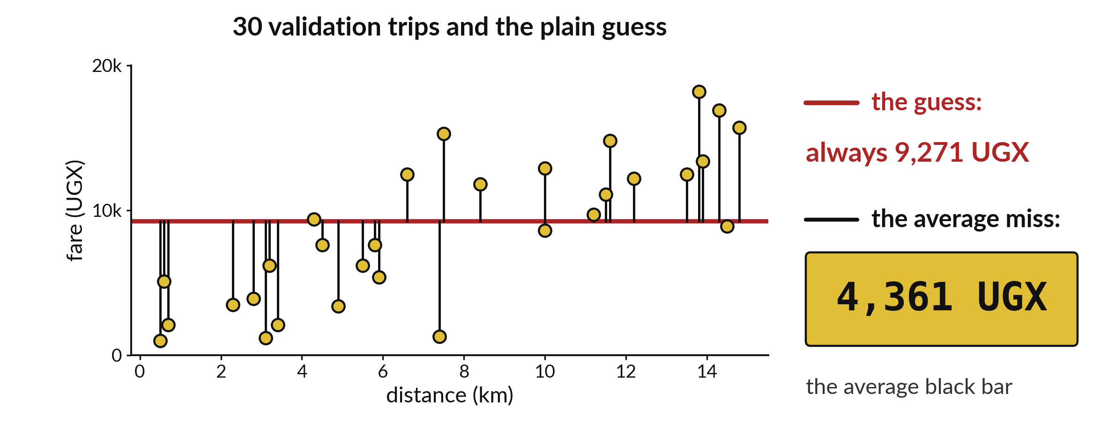
How much does a plain guess
miss by, before any model helps?
Notes:
The red flat line is the plain guess: the mean fare of the training trips, about nine thousand two hundred and seventy one shillings. Each black bar is how far one validation trip is from that line. Their average is four thousand three hundred and sixty one shillings. That is the bar every model has to beat. Today you work it out for your own project.

Slide 3
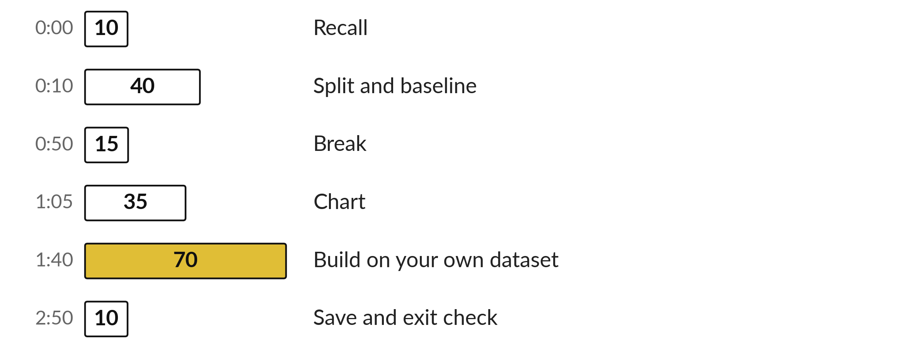
Three hours, mostly doing
Most of our time is spent doing, in small steps, with a guess before every run.
Notes:
Here is how the 3 hours go. Each bar is as long as the time we spend on that part.
First, 10 minutes. Recall. Then, 40 minutes. Split and baseline. After that, 15 minutes. Break. Next, 35 minutes. Chart. Then, 70 minutes. Build on your own dataset. Then, 10 minutes. Save and exit check.
Notice how much of the time is yours. You listen for a short while and then you do. That is on purpose, because you learn this by doing it.

Slide 4

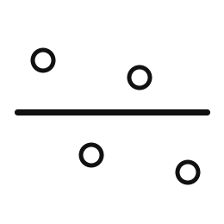
Words for today (1 of 2)
three-way split
Training, validation and final test parts.
Practice, mock and real exam.
baseline error
The average miss of the plain guess on validation.
How wrong the average guess is.
Notes:
First the words, because every one of them is used in the code later.
three-way split. Training, validation and final test parts. You have seen this before. Practice, mock and real exam.
baseline error. The average miss of the plain guess on validation. How wrong the average guess is.

Slide 5
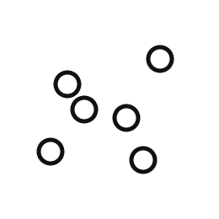
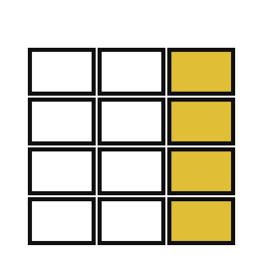
Words for today (2 of 2)
scatter plot
Each row is a dot; its place shows two values.
Dots on a map of distance and fare.
training only
Fit anything only on the training part.
Learning only from the textbook.
Notes:
Here are the rest of today's words.
scatter plot. Each row is a dot; its place shows two values. Imagine it like this. Dots on a map of distance and fare.
training only. Fit anything only on the training part. An example from everyday life. Learning only from the textbook.

Slide 6
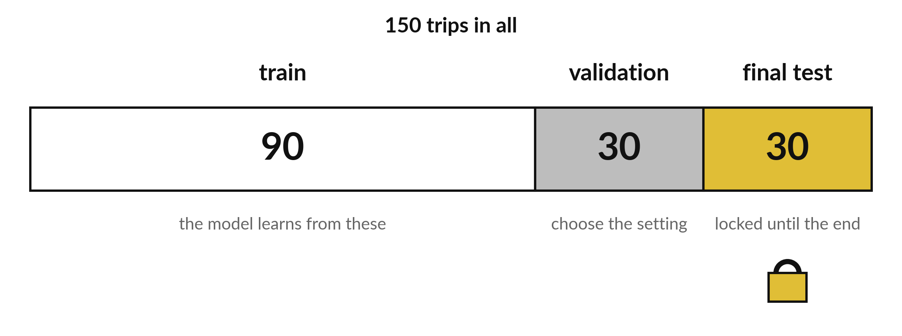
The fares split into 90, 30 and 30 trips
Same shape as the flowers split. Training teaches. Test stays locked.
Notes:
The fares file is cut the same way as the flowers. Ninety trips to learn from, thirty to choose between models, and thirty locked away for the end.
Use the same random state as before so your numbers match the ones on the screen.

Slide 7
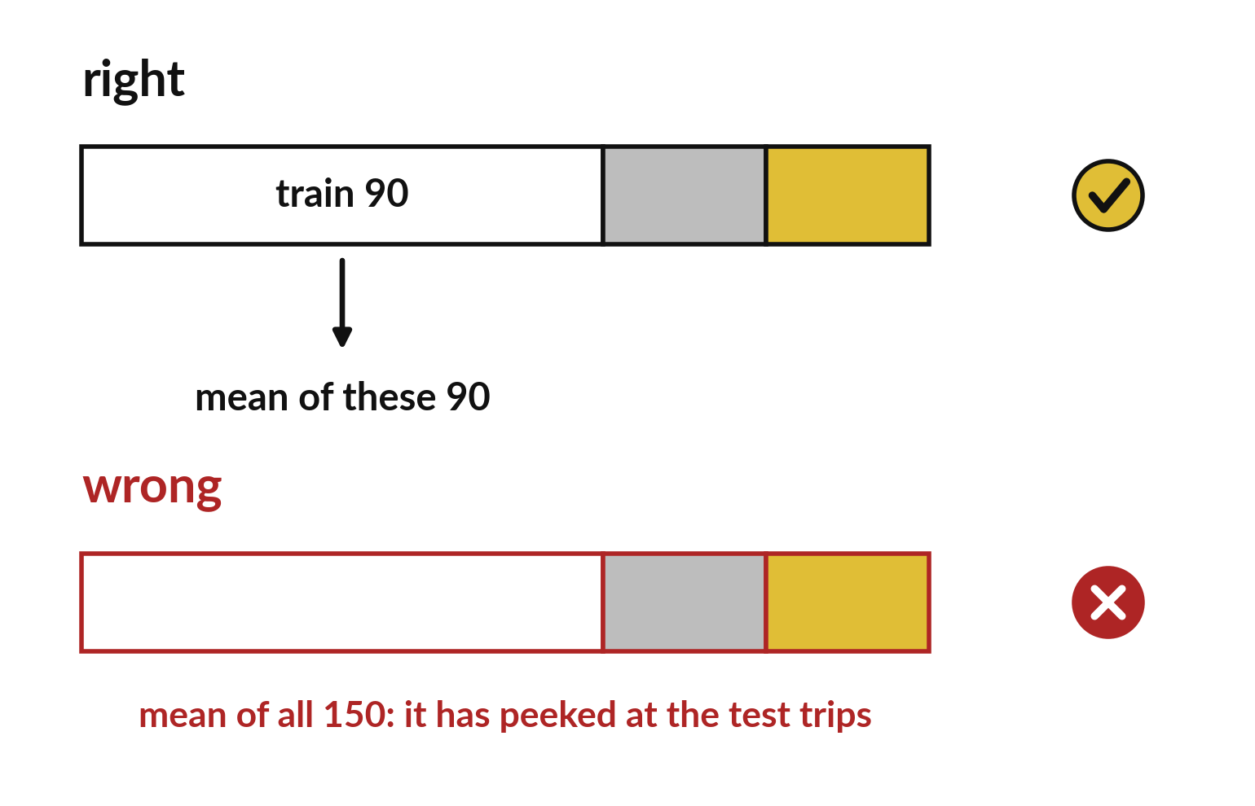
The baseline mean uses the training trips only
Take the mean of the 90 training fares.
Never include validation or test trips.
Otherwise the guess has peeked.
Notes:
The baseline is the mean fare of the training trips. If you take the mean of all hundred and fifty, the guess has already seen the test trips and its score is a little too good.
Check which table your mean comes from.

Slide 8

Predict: Split and fit the baseline (1 of 2)
import pandas as pd
from sklearn.model_selection import train_test_split
from sklearn.dummy import DummyRegressor
from sklearn.metrics import mean_absolute_error
fares = pd.read_csv("synthetic_fares.csv")
X = fares[["distance_km", "rush_hour", "raining"]]
Read the first part of the code. 6 lines. Say what each one does.
The second part comes next.
Notes:
Read this first part of the code with me before we run anything. ['Use the fares as the worked example, then repeat with your own dataset.', 'Lock 20% away, take 25% of the rest for validation, and fit the mean guess on training only.']

Slide 9
Predict: Split and fit the baseline (2 of 2)
y = fares["fare_ugx"]
X_dev, X_test, y_dev, y_test = train_test_split(
X, y, test_size=0.2, random_state=7
)
X_train, X_val, y_train, y_val = train_test_split(
X_dev, y_dev, test_size=0.25, random_state=7
)
baseline = DummyRegressor(strategy="mean").fit(X_train, y_train)
val_baseline_mae = mean_absolute_error(y_val, baseline.predict(X_val))
print(len(X_train), len(X_val), len(X_test), round(val_baseline_mae))
Predict the three sizes and whether the baseline will miss fares by more than UGX 3000 on average.
Write your guess on paper before we run it.
Notes:
Use the fares as the worked example, then repeat with your own dataset. Lock 20% away, take 25% of the rest for validation, and fit the mean guess on training only.
This is the part where you decide. Predict the three sizes and whether the baseline will miss fares by more than UGX 3000 on average. Put it on paper first. We will check it together in a moment.

Slide 10

Run it: Split and fit the baseline
The cell prints 90, 30, 30 and 4361.
The plain guess misses the validation fares by about UGX 4361 on average.
Any model you build must beat that on the same validation trips.
The baseline was fitted on the 90 training trips only.
Notes:
Let us see what happens. Match each line of the output with the line of code that made it.
The cell prints 90, 30, 30 and 4361. The plain guess misses the validation fares by about UGX 4361 on average. Any model you build must beat that on the same validation trips. The baseline was fitted on the 90 training trips only. The 30 test trips stay locked.
Which line of the output matches which line of the code? Point to each pair.

Slide 11

Investigate: Split and fit the baseline
1. Why is the baseline fitted on training only?
2. What would make the baseline number meaningless?
Notes:
Now we look closely at split and fit the baseline. I have two questions for you.
Question one. Why is the baseline fitted on training only? Talk it over with your neighbour for a minute.
What I would say is this. Fitting it on all rows would let it see the validation and test answers.
Question two. What would make the baseline number meaningless? Think about it for a moment, then tell the person next to you.
Let me answer it. Computing it on rows that were used to fit it.

Slide 12

Modify: change one thing
Print the share of the 150 trips used for training.
Then tell your neighbour what changed and how you know.
Notes:
Change one thing and watch what happens. Print the share of the 150 trips used for training. When you have run it, tell your neighbour what changed and how you know.
Here is what happens. 0.6, which is 90 out of 150.

Slide 13

Break
15 minutes away from your screen
Stand up. Drink some water. Tell someone what you guessed in the first half.
Notes:
Break time. 15 minutes away from your screens. Stand up, drink some water and tell someone what you guessed in the first half.
When we come back we start the second idea.

Slide 14
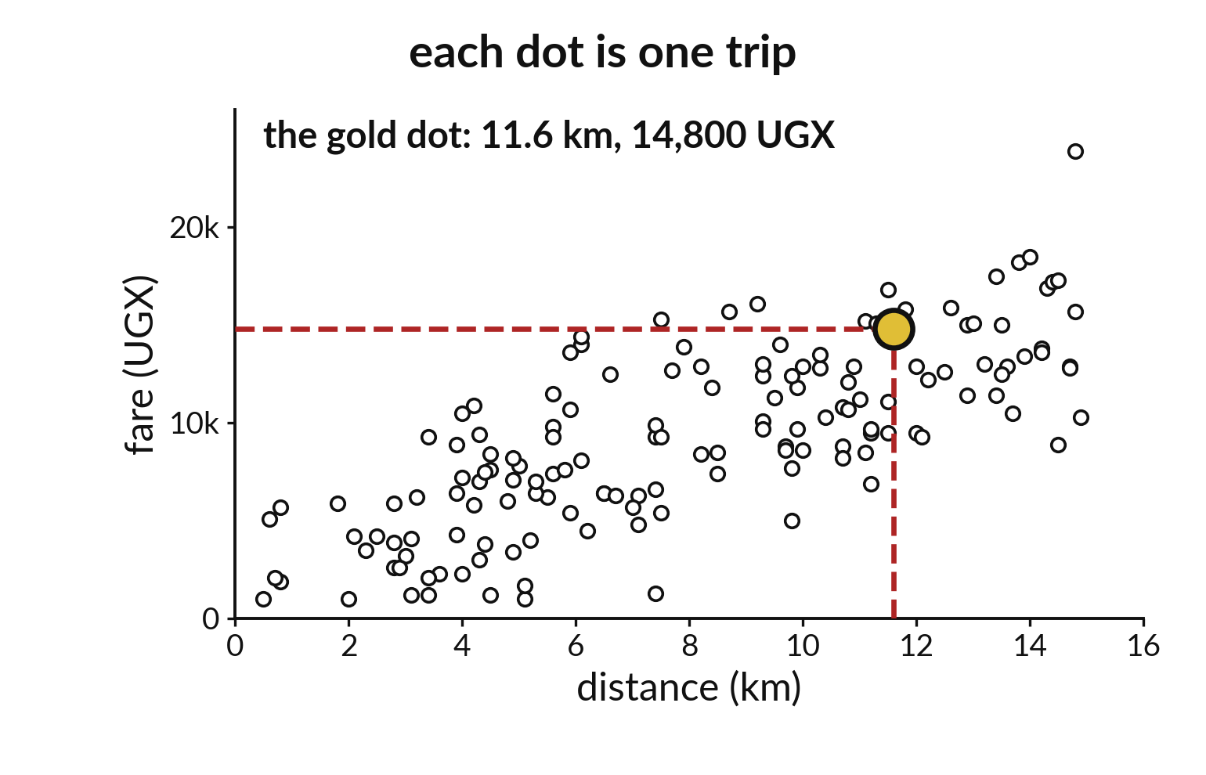
Each dot in a scatter plot is one trip
Distance runs across.
Fare runs up.
The gold dot is one trip.
Notes:
A scatter plot gives every trip a dot. The distance is how far across the dot sits. The fare is how high it sits. The gold dot is one trip of about eleven point six kilometres that cost fourteen thousand eight hundred shillings.
Find a trip of about two kilometres. What did it cost?

Slide 15
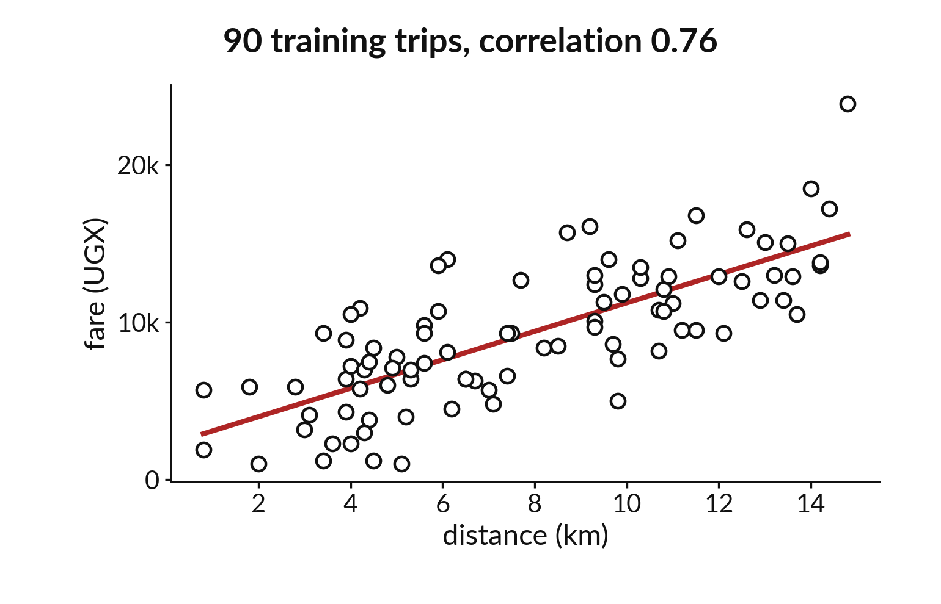
Longer trips cost more, correlation near 0.76
The dots climb to the right.
The red line follows them.
Correlation 0.76 means a strong link.
Notes:
Draw the ninety training trips and the dots climb to the right. Longer rides cost more. A straight line follows them, and the correlation is about zero point seven six.
That strong link is why distance is a promising input.

Slide 16

Predict: One descriptive chart
import seaborn as sns
import matplotlib.pyplot as plt
train = X_train.copy()
train["fare_ugx"] = y_train
sns.scatterplot(data=train, x="distance_km", y="fare_ugx")
plt.xlabel("Distance (km)")
plt.ylabel("Fare (UGX)")
plt.title("Fare against distance, training trips")
plt.show()
train_corr = train["distance_km"].corr(train["fare_ugx"])
Predict the shape of the dots: rising, falling or no pattern.
Write your guess on paper before we run it.
Notes:
Plot the training trips: distance on one axis, fare on the other. Label both with units.
Make a prediction. Predict the shape of the dots: rising, falling or no pattern. Put your guess on paper now, even if you are unsure.

Slide 17
Run it: One descriptive chart
The dots rise from left to right with a lot of scatter.
The correlation on the 90 training trips is about 0.76.
Longer trips cost more, but two trips of equal length can differ by thousands of shillings.
Notes:
Running it now. Match each line of the output with the line of code that made it.
The dots rise from left to right with a lot of scatter. The correlation on the 90 training trips is about 0.76. Longer trips cost more, but two trips of equal length can differ by thousands of shillings. That scatter is why even the best line will still miss.
Keep your guess. We use it in the next step.

Slide 18
Investigate: One descriptive chart
1. What does the scatter around the rising pattern tell you?
2. Why plot only the training trips?
Notes:
Now we look closely at one descriptive chart. I have two questions for you.
Question one. What does the scatter around the rising pattern tell you? Think about it for a moment, then tell the person next to you.
Let me answer it. Distance is not the whole story, so the model will make errors.
Question two. Why plot only the training trips? Have a go in your head first.
The answer is this. Looking at validation or test answers while choosing would leak information about them.

Slide 19
Modify: change one thing
Colour the dots by rush_hour by adding hue="rush_hour" to the plot.
Then tell your neighbour what changed and how you know.
Notes:
Make one small change. Colour the dots by rush_hour by adding hue="rush_hour" to the plot. Run it, then tell someone what you saw.
What you should find: Two colours appear, and they overlap a lot: rush hour changes the fare little.

Slide 20
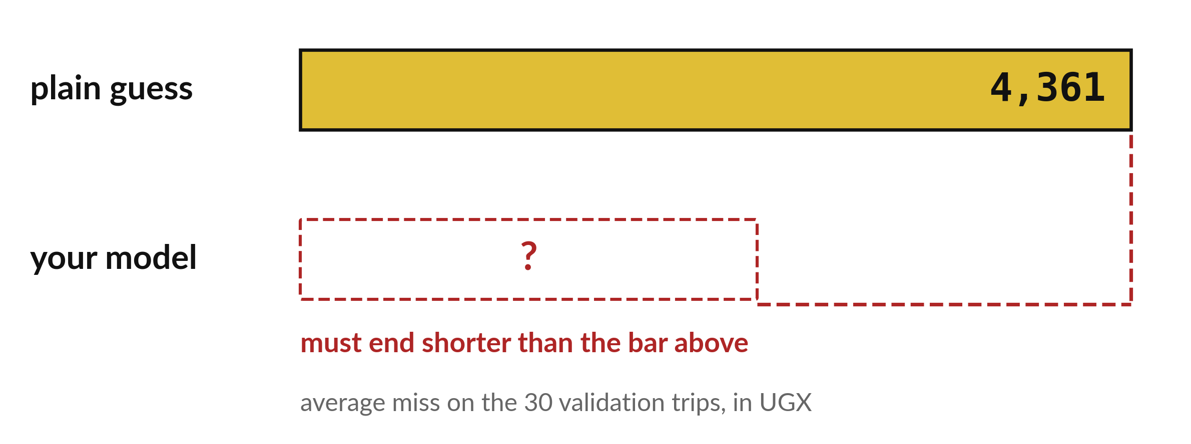
A model must score below the plain guess
Validation miss for the plain guess: 4,361 UGX.
Notes:
This is the bar. The plain guess misses by four thousand three hundred and sixty one shillings on the validation trips. Every model you try next session has to land to the left of it.
A model that cannot beat the bar is not helping, however clever it sounds.

Slide 21

Make: your own version
Complete the three-way split, the baseline and one labelled chart for your own project dataset. Save the notebook, your data dictionary and the cleaning log. If no cleaning was needed, record the checks that found nothing.
Save it as ML20. Write two sentences: what you changed and how you checked it.
Notes:
This task is yours. Run your code after every step so you can see where a problem begins. If you get stuck for a few minutes, read your error message, check the error card, and then ask me.
Save it as ML20. I will come round to each of you and ask what you changed and how you checked it.

Slide 22

Two errors you may meet today
It means: Both scores were computed from the same predictions, so the baseline is not a separate guess.
Fix: Build the baseline from the training mean alone and score the model with its own predict, both on X_val and y_val.
Baseline and model score exactly the same
It means: X and y have different lengths because one was filtered and not the other.
Fix: Create X and y from the same table at the same step.
ValueError: Found input variables with inconsistent numbers of samples
Notes:
Here are two errors from this session, so you recognise them when they appear.
This is the first one. You will see: Baseline and model score exactly the same. It means this: both scores were computed from the same predictions, so the baseline is not a separate guess. To fix it, build the baseline from the training mean alone and score the model with its own predict, both on X_val and y_val.
The next one. You will see: ValueError: Found input variables with inconsistent numbers of samples. It means this: X and y have different lengths because one was filtered and not the other. To fix it, create X and y from the same table at the same step.
When you are stuck, read the last line of the message first.

Slide 23

Finish this sentence in your notebook
The baseline error on validation is the number my model has to beat.
Then save your notebook, close it and open it again to check it saved.
Notes:
Last step. Our question for today was: How much does a plain guess miss by, before any model helps?
Finish this sentence in your notebook, in your own words. The baseline error on validation is the number my model has to beat.
Then save your notebook, close it and open it again to check it saved.

