Slide 1
Explain the project to a parent
Can a parent say what my model predicts, how I tested it and why it is limited?
Machine Learning | Session 23 of 24 | Week 8, Hand over
Holiday Data and AI Camp | The National ICT Innovation Hub, Nakawa
Notes:
Here we go. Today is session 23 and our topic is explain the project to a parent.
By the end of today you will be able to explain your project in five minutes with five slides, one demonstration, one chart and one limit, without jargon.
We will answer one question: Can a parent say what my model predicts, how I tested it and why it is limited?

Slide 2
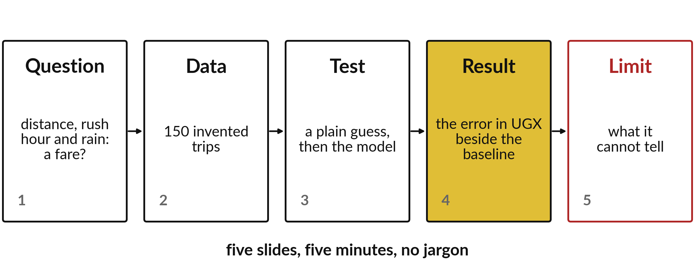
Can a parent say what my model predicts,
how I tested it and why it is limited?
Notes:
Your showcase has five slides, one for each of these ideas. The question, the data, the test, the result and the limit. Five minutes in all, with no jargon a parent would stumble over. Today you build the five slides and rehearse them with a partner.

Slide 3
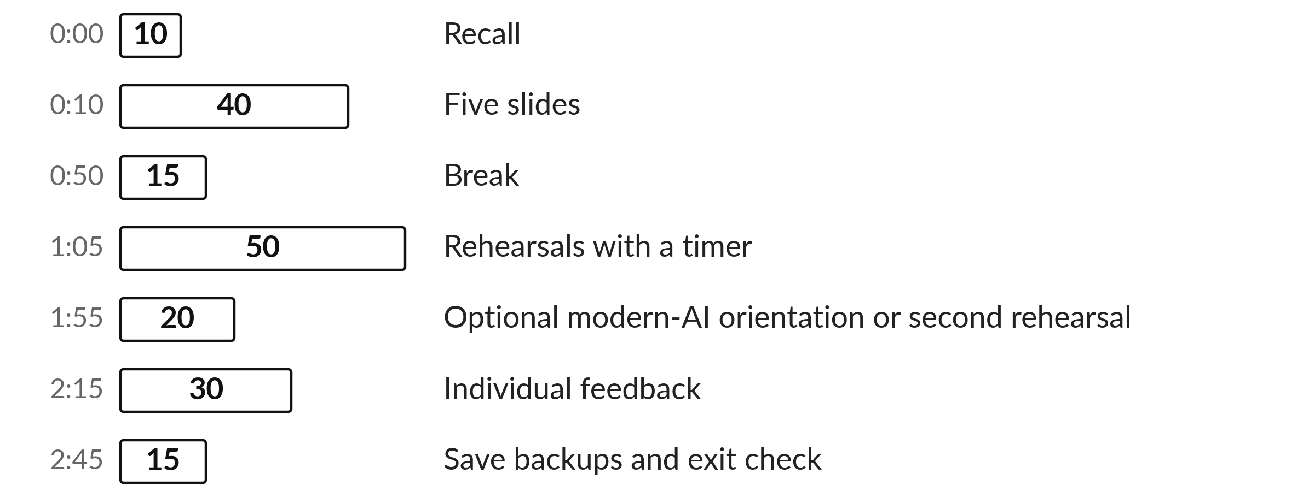
Today's plan in minutes
You build five slides, then rehearse in turn with a timer.
Notes:
Here is how the 3 hours go. Each bar is as long as the time we spend on that part.
First, 10 minutes. Recall. Then, 40 minutes. Five slides. After that, 15 minutes. Break. Next, 50 minutes. Rehearsals with a timer. Then, 20 minutes. Optional modern-AI orientation or second rehearsal. Then, 30 minutes. Individual feedback. Last, 15 minutes. Save backups and exit check.
You build five slides, then rehearse in turn with a timer. Ask me now if any part of the plan is unclear.

Slide 4



Words for today (1 of 2)
claim
A statement that needs a visible result.
I say the model predicts fares to within about UGX 3000.
demonstration
Showing your own work running or explaining its steps.
Showing the dish you cooked.
audience
The people listening and what they already know.
The parents in the room.
Notes:
First the words, because every one of them is used in the code later.
claim. A statement that needs a visible result. I say the model predicts fares to within about UGX 3000.
demonstration. Showing your own work running or explaining its steps. Think of a shop. Showing the dish you cooked.
audience. The people listening and what they already know. Imagine it like this. The parents in the room.

Slide 5


Words for today (2 of 2)
backup
A screenshot or saved file you can show if the laptop fails.
A spare key.
disclosure
Saying where help or AI was used.
Thanking those who helped.
Notes:
Here are the rest of today's words.
backup. A screenshot or saved file you can show if the laptop fails. An example from everyday life. A spare key.
disclosure. Saying where help or AI was used. Here is a way to see it. Thanking those who helped.

Slide 6
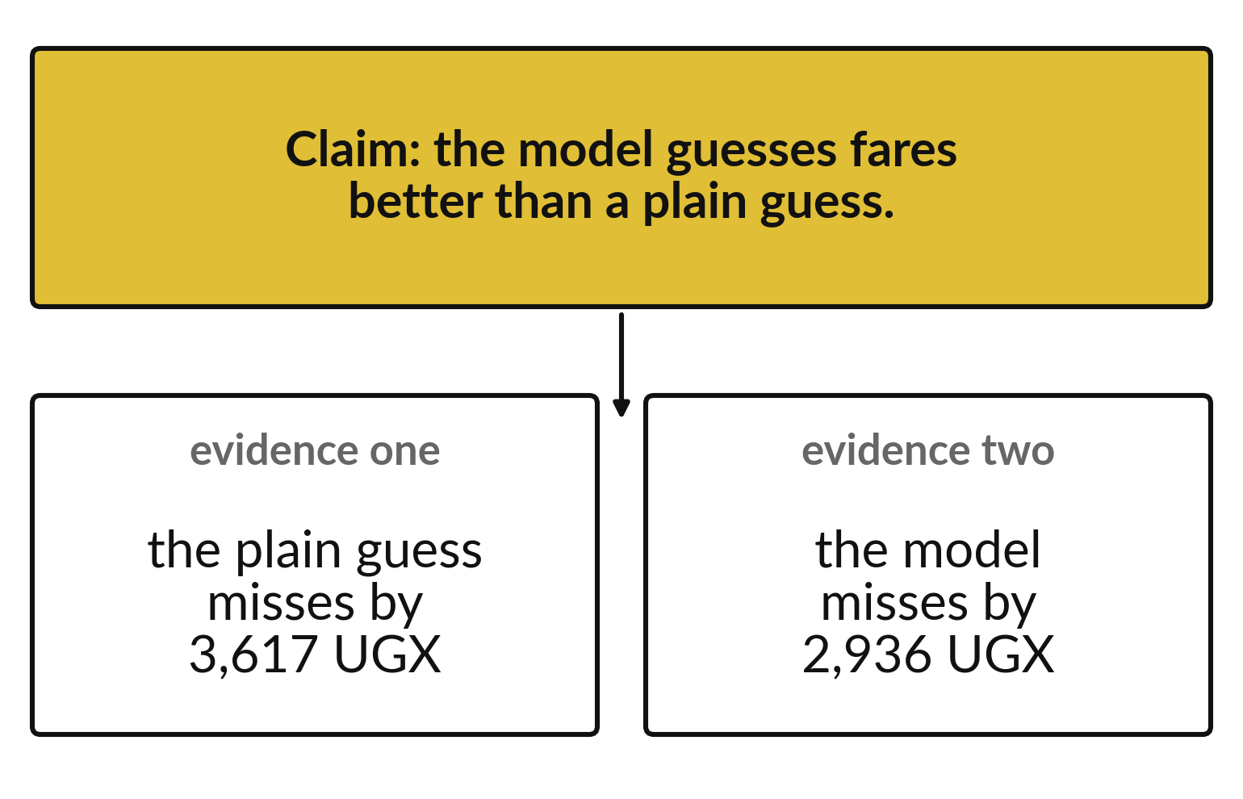
A claim stands on the numbers that support it
State the claim in one sentence.
Give the plain guess error.
Give the model error beside it.
Notes:
Start with the claim. The model guesses fares better than a plain guess. Then show the two numbers that support it: the plain guess misses by three thousand six hundred and seventeen, the model by two thousand nine hundred and thirty six.
A claim with no number is only an opinion.

Slide 7

Predict: Five slides, five minutes
Write on a card, in one sentence each, what a prediction, a feature and a target mean for your project.
Write your guess on paper before we run it.
Notes:
Build five slides: my question; what data I used; what I built; my result against the baseline; the limit and the next step. Say what a prediction, a feature and a target are in plain words.
Now your guess. Write on a card, in one sentence each, what a prediction, a feature and a target mean for your project. Jot it on paper before anyone speaks.

Slide 8

Run it: Five slides, five minutes
A listener should be able to say what was predicted, how it was tested and why the result is limited.
One chart and one worked prediction say more than a list of library names.
Show only approved, non-personal data.
Notes:
Watch the output as it appears. Match each line of the output with the line of code that made it.
A listener should be able to say what was predicted, how it was tested and why the result is limited. One chart and one worked prediction say more than a list of library names. Show only approved, non-personal data. Prepare a screenshot backup and disclose any assistance. Publishing online is optional and needs agreement.
Tell the person next to you whether your guess matched.

Slide 9

Investigate: Five slides, five minutes
1. What makes a slide too crowded?
2. What belongs on the limit slide?
Notes:
Now we look closely at five slides, five minutes. I have two questions for you.
Question one. What makes a slide too crowded? Write your answer in one line before we compare.
Here is how I would answer it. More than one idea, or code the audience cannot read from the back.
Question two. What belongs on the limit slide? Say it quietly to yourself before anyone answers.
What I would say is this. That the data is invented, the test is small, and the model is a demonstration.

Slide 10

Modify: change one thing
Time yourself giving the five slides without looking at notes.
Then tell your neighbour what changed and how you know.
Notes:
Your hands on the keyboard now. Time yourself giving the five slides without looking at notes. Run it, then tell someone what you saw.
What you should find: Five minutes is enough for one question, one demonstration and one chart. Cut anything that takes more.

Slide 11

Break
15 minutes away from your screen
Stand up. Drink some water. Tell someone what you guessed in the first half.
Notes:
Break time. 15 minutes away from your screens. Stand up, drink some water and tell someone what you guessed in the first half.
When we come back we start the second idea.

Slide 12
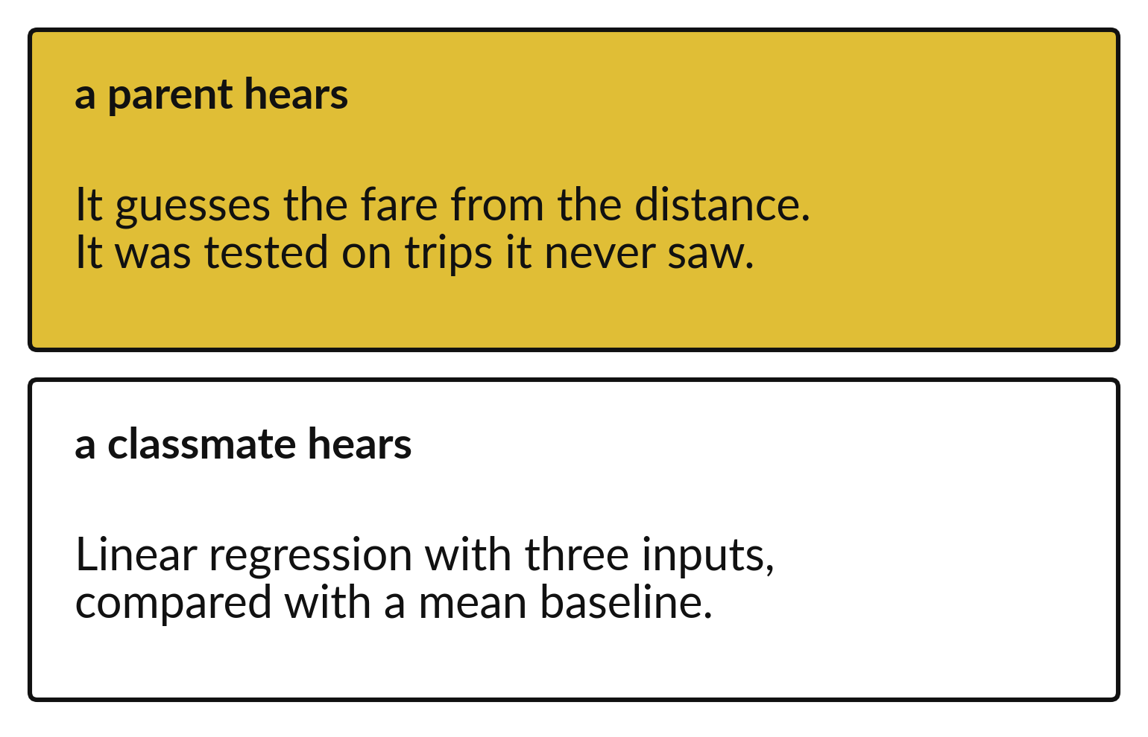
Say the finding in words your listener knows
A parent wants the idea.
A classmate wants the method.
Choose words for the person in front of you.
Notes:
The finding is the same for everyone. The words change. To a parent you say that it guesses the fare from the distance, and was tested on trips it never saw. To a classmate you can name the method.
Write your sentence for a parent first. If they would understand it, the rest is easy.

Slide 13
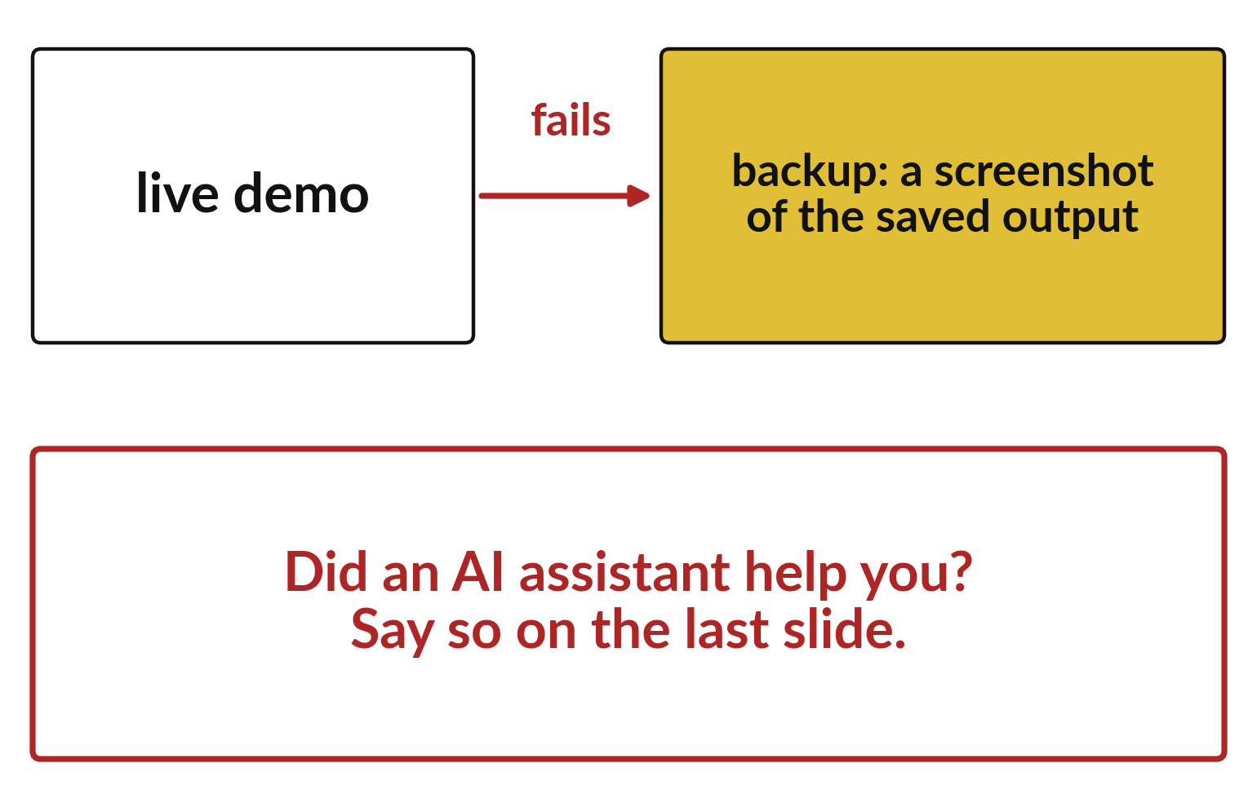
Prepare a backup demo and say if AI helped
Keep a screenshot of the saved output.
Use it if the live run fails.
Disclose any AI help on the last slide.
Notes:
Laptops fail at the worst moments. Keep a screenshot of your saved output, so you can carry on if the live run breaks. And if an AI assistant helped you, say so on the last slide.
Being open about help is part of doing honest work.

Slide 14
Predict: Rehearse and receive feedback
Predict the question a parent is most likely to ask.
Write your guess on paper before we run it.
Notes:
Give the talk to a partner and answer one question. Your partner says back what the model predicts and how you tested it.
This is the part where you decide. Predict the question a parent is most likely to ask. Guess on paper first. Surprises are useful.

Slide 15
Run it: Rehearse and receive feedback
Common parent questions: where did this number come from, what did you leave out, and what cannot this model tell us.
Answer by pointing to the chart or the table.
If the partner cannot repeat your target and baseline, replace explanation with a worked example.
Notes:
Let us see what happens. Match each line of the output with the line of code that made it.
Common parent questions: where did this number come from, what did you leave out, and what cannot this model tell us. Answer by pointing to the chart or the table. If the partner cannot repeat your target and baseline, replace explanation with a worked example.
Which line of the output matches which line of the code? Point to each pair.

Slide 16
Investigate: Rehearse and receive feedback
1. If the explanation is mostly code, what should replace it?
2. Is it fine to say I do not know?
Notes:
Now we look closely at rehearse and receive feedback. I have two questions for you.
Question one. If the explanation is mostly code, what should replace it? Say it quietly to yourself before anyone answers.
What I would say is this. The question, a labelled chart and a worked prediction.
Question two. Is it fine to say I do not know? Give it thirty seconds and then we will hear a few answers.
Let me answer it. Yes, and say what you would check next.

Slide 17
Modify: change one thing
Say your project's limit in one sentence a younger student would follow.
Then tell your neighbour what changed and how you know.
Notes:
Change one thing and watch what happens. Say your project's limit in one sentence a younger student would follow. After you run it, say in one sentence what changed and how you checked.
You should see this. For example: The fares are invented, so this shows how a model works and not what real riders pay.

Slide 18

Make: your own version
Practise defining prediction, feature and target without jargon. Save a screenshot backup of your demonstration and disclose any AI assistance.
Save it as ML23. Write two sentences: what you changed and how you checked it.
Notes:
This task is yours. Run your code after every step so you can see where a problem begins. If you get stuck for a few minutes, read your error message, check the error card, and then ask me.
Save it as ML23. I will come round to each of you and ask what you changed and how you checked it.

Slide 19

Two errors you may meet today
It means: There are more than five ideas.
Fix: Keep one idea per slide and cut the rest.
The slides run over five minutes
It means: The notebook was not restarted or the data file was moved.
Fix: Show the screenshot backup and explain the steps.
The demonstration does not run
Notes:
Here are two errors from this session, so you recognise them when they appear.
This is the first one. You will see: The slides run over five minutes. It means this: there are more than five ideas. To fix it, keep one idea per slide and cut the rest.
The next one. You will see: The demonstration does not run. It means this: the notebook was not restarted or the data file was moved. To fix it, show the screenshot backup and explain the steps.
When you are stuck, read the last line of the message first.

Slide 20

Finish this sentence in your notebook
A parent can say what my model predicts, how it was tested and why it is limited.
Then save your notebook, close it and open it again to check it saved.
Notes:
Last step. Our question for today was: Can a parent say what my model predicts, how I tested it and why it is limited?
Finish this sentence in your notebook, in your own words. A parent can say what my model predicts, how it was tested and why it is limited.
Then save your notebook, close it and open it again to check it saved.

