Slide 1
A first neural network, and why bigger is not automatically better
Does a neural network beat a small tree on 150 flowers?
Machine Learning | Optional extension after session 24
Holiday Data and AI Camp | The National ICT Innovation Hub, Nakawa
Notes:
Good to see you. Today is session 25 and our topic is A first neural network, and why bigger is not automatically better.
By the end of today you will be able to compare a small neural network with a decision tree and a baseline, and say why a bigger model is not automatically better.
We will answer one question: Does a neural network beat a small tree on 150 flowers?

Slide 2
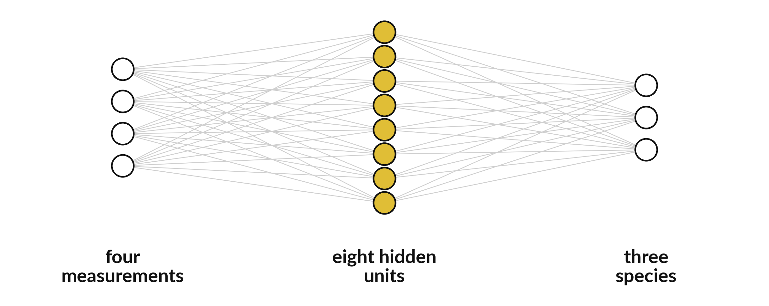
Does a neural network beat
a small tree on 150 flowers?
Notes:
This is a small neural network. Four circles on the left take the four flower measurements. Eight hidden circles in the middle combine them. Three circles on the right stand for the three species. Each line carries a weight, the same kind of number you met in the weighted sum. The question for today is whether this bigger model is worth the extra trouble on a small set of flowers.

Slide 3
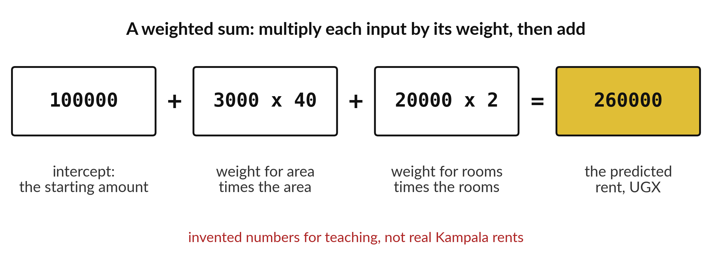
A network repeats the weighted sum many times
Each line in the network carries a weight like these.
Notes:
You already know a weighted sum from the matrix lab. Multiply each input by its weight and add the results. A neural network does this again and again, with many weights, and the weights are learned from examples.
Nothing else is hiding inside. It is the same arithmetic, repeated.

Slide 4
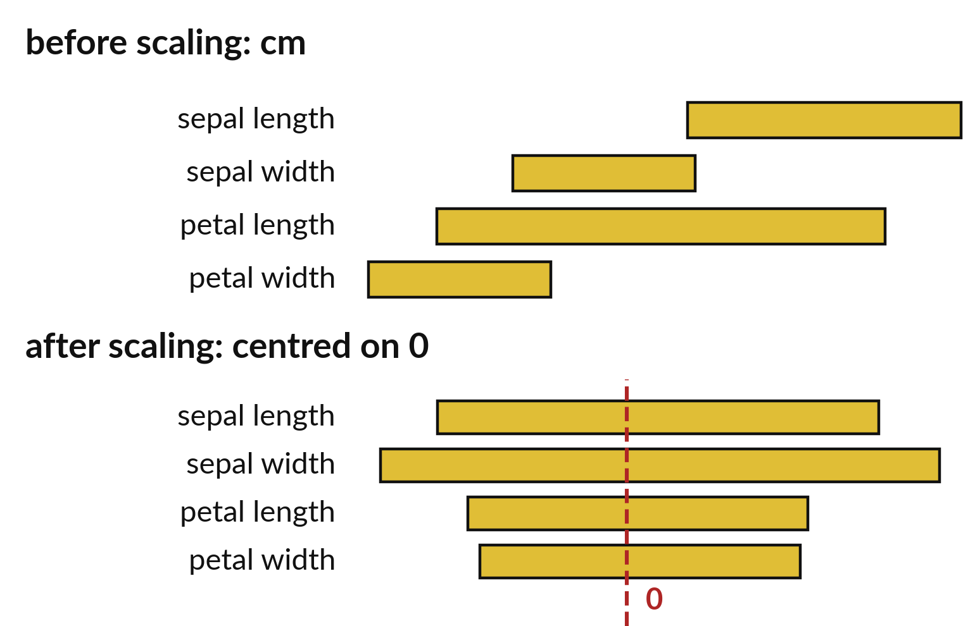
Scaling puts every measurement
on a similar footing
Petal length runs wider than petal width.
Scaling centres each column on zero.
Networks learn badly without it.
Notes:
The four flower measurements run over different ranges. Petal length covers about six centimetres, petal width only about two. A network trains poorly when numbers are on such different scales.
Scaling moves every column to centre on zero and a similar width, and the network learns much more smoothly.

Slide 5

Predict: A network, a tree and a baseline
Predict whether the network will score higher than the depth 3 tree.
Write your guess on paper before we run it.
Notes:
This optional notebook is not assessed. It uses scikit-learn's MLPClassifier, a small neural network, on the iris flowers.
This is the part where you decide. Predict whether the network will score higher than the depth 3 tree. Write it on paper. It does not have to be right.

Slide 6

Run it: A network, a tree and a baseline
On 150 flowers a neural network has no advantage over a small tree.
A bigger model is not automatically a better one, and it needs more data, more care and more checking.
Notes:
Let us see what happens. Match each line of the output with the line of code that made it.
On 150 flowers a neural network has no advantage over a small tree. A bigger model is not automatically a better one, and it needs more data, more care and more checking.
Which line of the output matches which line of the code? Point to each pair.

Slide 7

Investigate: A network, a tree and a baseline
1. Why scale the inputs first?
2. What would convince you a network is worth using?
Notes:
Now we look closely at A network, a tree and a baseline. I have two questions for you.
Question one. Why scale the inputs first? Give it thirty seconds and then we will hear a few answers.
What I would say is this. Networks learn badly from numbers on very different scales.
Question two. What would convince you a network is worth using? Talk it over with your neighbour for a minute.
Let me answer it. A clear gain on data it has not seen, after the baseline and the tree are beaten.

Slide 8

Modify: change one thing
Change hidden_layer_sizes from (8,) to (16,) and run it again.
Then tell your neighbour what changed and how you know.
Notes:
Change one thing and watch what happens. Change hidden_layer_sizes from (8,) to (16,) and run it again. Then explain to your neighbour what the change did.
The result: The score changes a little. A bigger network is not automatically better.

Slide 9

Make: your own version
Write two sentences: which model scored best and whether the difference is big enough to matter.
Save it as ML25. Write two sentences: what you changed and how you checked it.
Notes:
Now you do the real work yourself. Start with the first step. If you get stuck for a few minutes, read your error message, check the error card, and then ask me.
Save it as ML25. I will come round to each of you and ask what you changed and how you checked it.

Slide 10

Two errors you may meet today
It means: The network stopped before it finished learning.
Fix: Raise max_iter and run it again.
ConvergenceWarning
It means: The random_state is missing.
Fix: Set random_state=7 so the run repeats.
Scores change every run
Notes:
Two things are likely to go wrong today. It helps to know them before they happen.
This is the first one. You will see: ConvergenceWarning. It means this: the network stopped before it finished learning. To fix it, raise max_iter and run it again.
The next one. You will see: Scores change every run. It means this: the random_state is missing. To fix it, set random_state=7 so the run repeats.
If you meet one of these, fix it and carry on. It happens to everyone.

Slide 11

Finish this sentence in your notebook
A bigger model is not automatically a better one, and I check it against a baseline.
Then save your notebook, close it and open it again to check it saved.
Notes:
Before we finish, go back to the question we began with: Does a neural network beat a small tree on 150 flowers?
Copy this sentence into your notebook and make it yours. A bigger model is not automatically a better one, and I check it against a baseline.
Then save your notebook, close it and open it again to check it saved.

