Slide 1


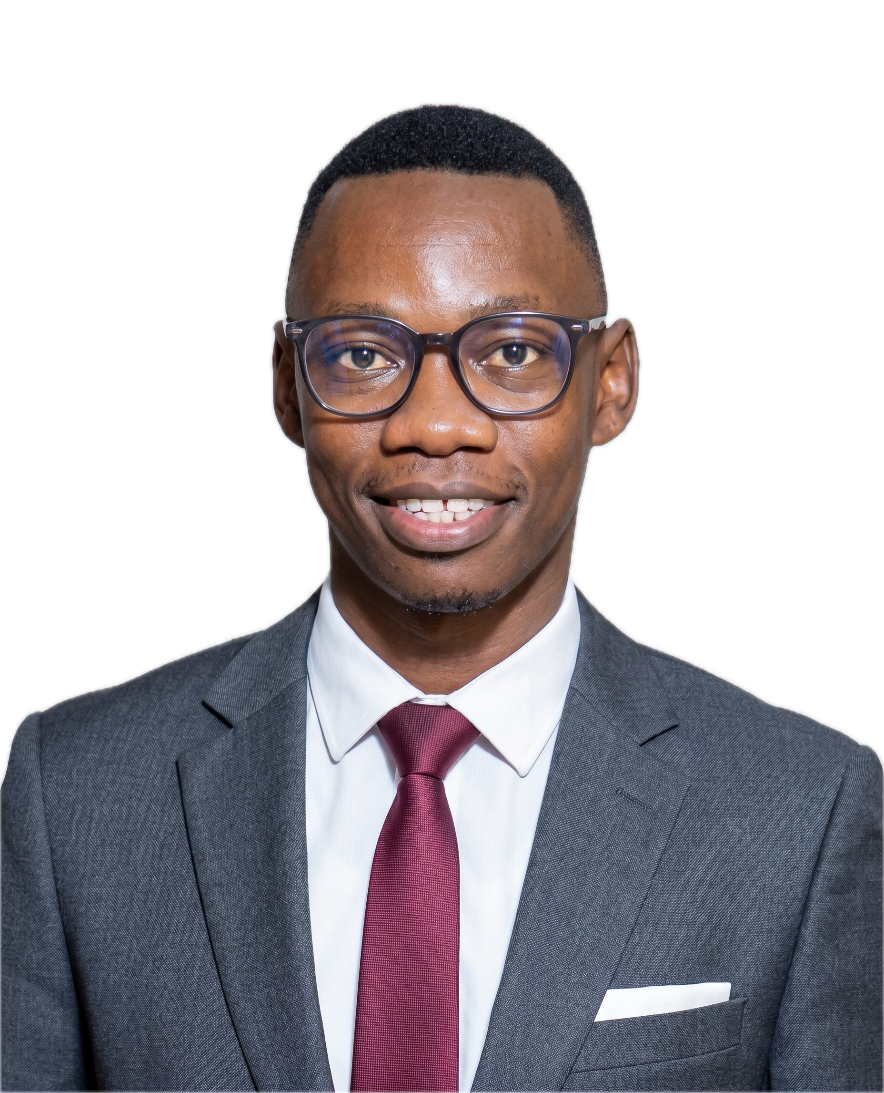
















D E C E M B E R 2 0 2 6 I N T A K E
HOLIDAY
Today’s
Learners.
Tomorrow’s
Leaders.
DATA
&
AI
CAMP
Jotham Martin Wambi
Main Tutor
Practical skills. Real projects.
Data Scientist & ML/AI Engineer
Lecturer – AI & Machine Learning,
International University of East Africa (IUEA)
Greater opportunities.
Master’s – Yamaguchi University, Japan
Skills today.
Incoming PhD Student – OMU, Japan
Greater opportunities tomorrow.
linkedin.com/in/jothammartinwambi
DATA ANALYSIS
MACHINE LEARNING
Turn real data into
useful insights
Teach computers to find patterns
& make predictions
Python
pandas
SQL
Python
pandas
scikit-learn
Python (programming basics)
Python
SQL (querying data)
Machine learning concepts
Data Cleaning & Preparation
Model training
Data Visualization (dashboards & charts)
Prediction & evaluation
Basic statistics
Real-world datasets
BUILD: A data analysis project
BUILD: A prediction model
e.g. sales, customer or social media data
e.g. house prices, classification
or recommendation
8 weeks
Max. 5
learners/group
No coding
experience needed
Only 15
places
(whole programme)
Programme fee (per learner)
Reserve your place →
UGX 800,000
UGX 1,000,000
+256 750 990 718
Small group · exactly 5 learners
Private / semi-private
1–4 learners
jothammartin.wambi@gmail.com
Scan to WhatsApp
Skills today.
Greater opportunities tomorrow.
Python
Data Analysis
Good
Data.
Better
Decisions.
Machine Learning
For S.4, S.5 & S.6 students,
and school leavers.
A Brighter Future
Notes:
# Sources and artwork handling
Portrait: the organiser's original `Jotham Martin Wambi Pic.jpeg`, included unchanged as `assets/actual-portrait.jpeg`. `assets/actual-portrait-cutout.png` uses the actual photographic subject with a foreground mask from Apple Vision. The face, clothing and pose were not regenerated or retouched. `source/mask_portrait.swift` records the masking operation. Colour decoding and transparency are part of normal raster compositing.
Design reference: organiser-supplied `Pasted 2026-09-28 at 10.39.12 AM.png`. The reconstructed classroom, desk, books, mug and brush artwork follows that reference. The background is reconstructed raster artwork, not the original editable design file. The classroom-only plate was prepared using built-in ImageGen, with the generated person removed; the original photographic cutout is a separate layer. See IMAGE_PROMPTS.md.
The original top composition, pastel course panels, dark fee/contact blocks and books-and-mug footer are retained. The middle panel is extended by 240 pixels; canvas 1024 × 1776. This creates space for the user's expanded learning lists and Build outcomes without compressing the original top and footer.
Learning copy and examples: organiser's preceding request. Pricing and contact wording follow the supplied reference. “Incoming PhD” refers to April 2027; OMU means Osaka Metropolitan University. No institutional sponsorship is implied. Exact venue and dates are not supplied. The working supplied QR opens https://wa.me/256750990718.
Internet logos/icons: Devicon (Python, pandas and scikit-learn), Font Awesome Free (supporting icons), Tabler (network), Carbon (prediction symbol in prior revision), Microsoft Fluent Emoji (chart in prior revision). Caveat font: Google Fonts. The original URLs and license notices remain in assets/internet-sources.json and the license files. Some earlier unused vector assets are retained for future edits.

