Slide 1


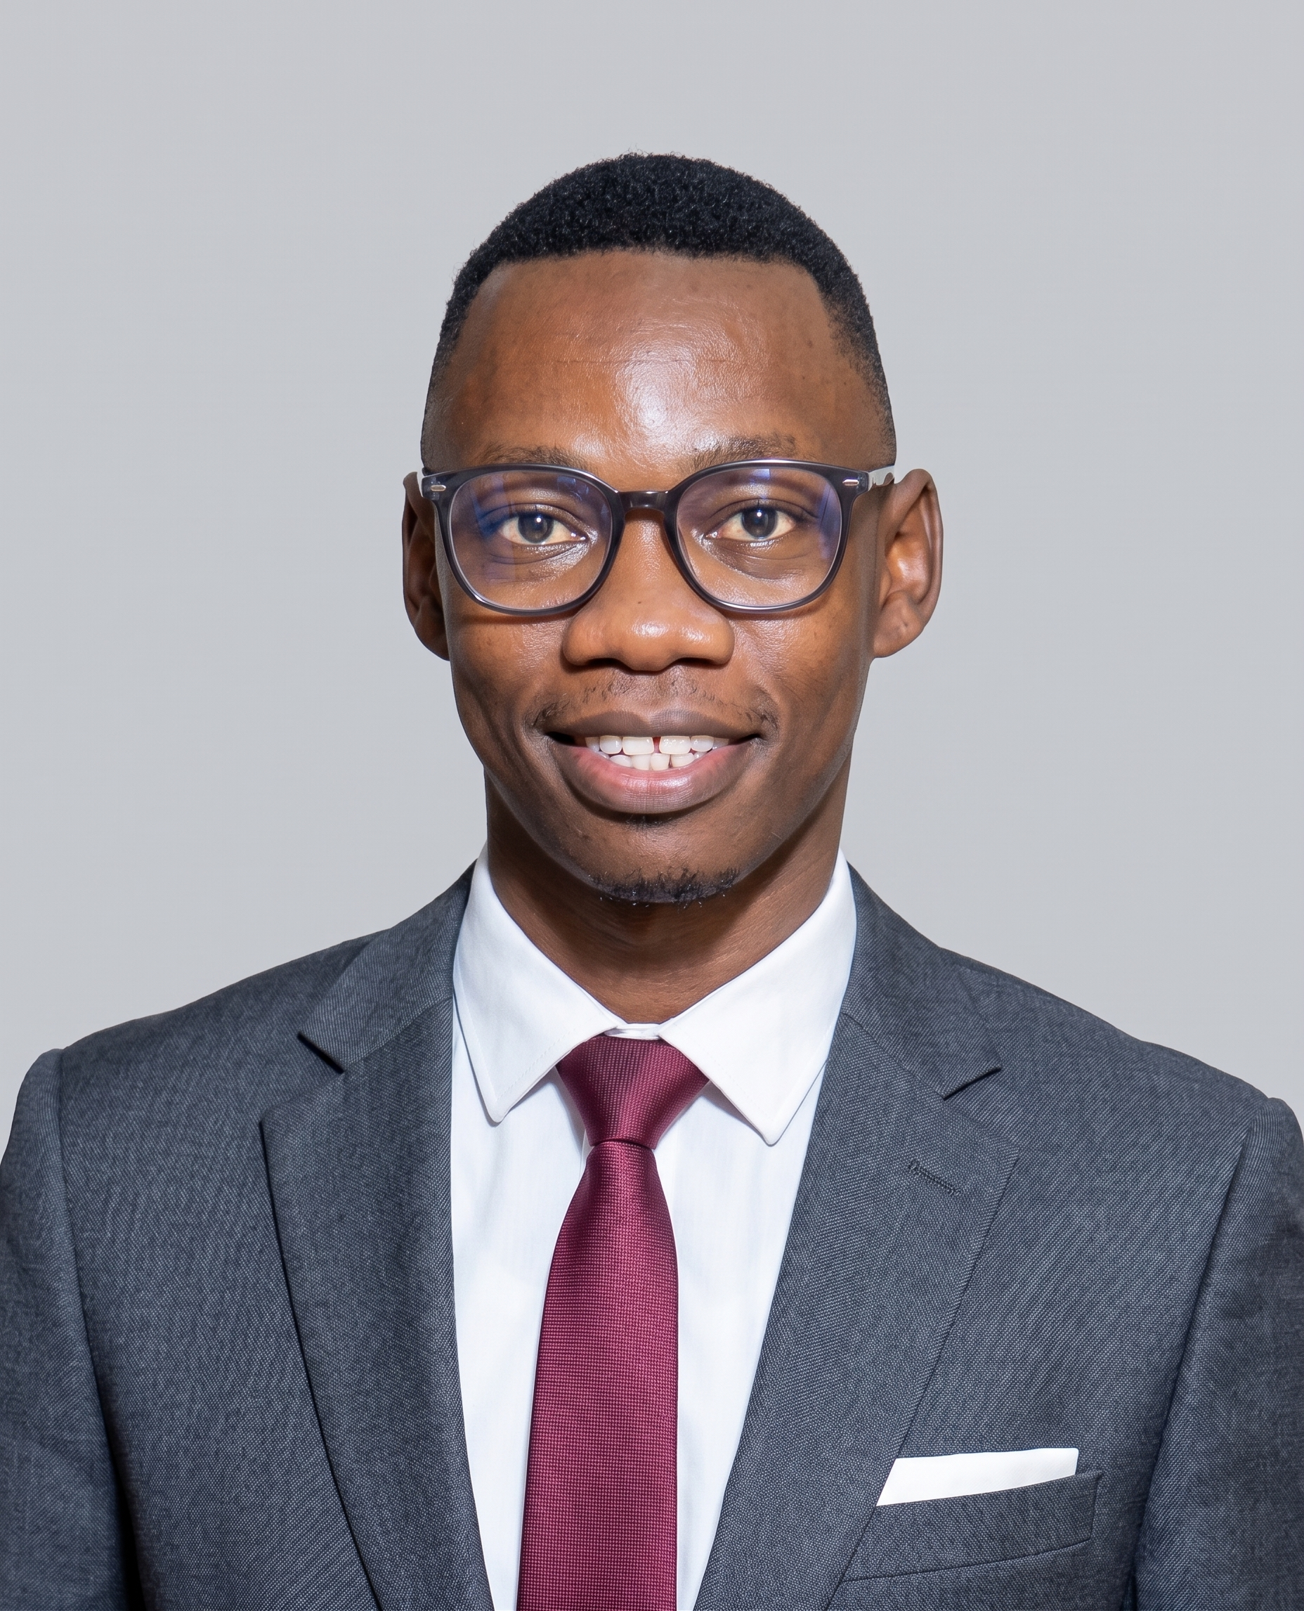





















D E C E M B E R 2 0 2 6 I N T A K E
HOLIDAY
DATA
&
AI
CAMP
Practical skills. Real projects.
Greater opportunities.
Skills today.
Jotham Martin Wambi
Greater opportunities tomorrow.
Main Tutor · Data Scientist & ML/AI Engineer
Lecturer, AI & Machine Learning, IUEA
DATA ANALYSIS
MACHINE LEARNING
Turn real data into
useful insights
Teach computers to find patterns
& make predictions
Python
pandas
SQL
Python
pandas
scikit-learn
Python (programming basics)
Python
SQL (querying data)
Machine learning concepts
Data Cleaning & Preparation
Model training
Data Visualization (dashboards & charts)
Prediction & evaluation
Basic statistics
Real-world datasets
BUILD: A data analysis project
BUILD: A prediction model
e.g. sales, customer or social media data
e.g. house prices, classification
or recommendation
By the end of the camp, learners will have:
Built a practical
portfolio project
Analysed
real datasets
Created data
visualisations
Built a
prediction model
Machine Learning track
8 weeks
Max. 5
learners/group
No coding
experience needed
Only 15
places
(whole programme)
Programme fee (per learner)
Reserve your place →
UGX 800,000
UGX 1,000,000
+256 750 990 718
Small group · exactly 5 learners
Private / semi-private
1–4 learners
jothammartin.wambi@gmail.com
Skills today.
Scan to WhatsApp
Greater opportunities tomorrow.
Python
Data Analysis
Good
Data.
Better
Decisions.
Machine Learning
For S.4, S.5 & S.6 students,
and school leavers.
A Brighter Future
Notes:
# Sources and image handling
Portrait: the original organiser-supplied Jotham Martin Wambi Pic.jpeg is embedded unchanged as assets/actual-portrait.jpeg. Display width 390, height 390 × 2292 / 1856. No crop, background mask, retouching, regeneration, horizontal/vertical distortion or text overlay is applied. Its original grey photographic background and complete shoulders remain visible.
Surrounding artwork: the classroom, desk, books and mug are the previously reconstructed background from the supplied flyer. That backdrop is separate from the portrait. The original-style colour palette, handwritten footer and course panels are retained. The flyer is taller to accommodate the added learning and outcome content without shrinking the text.
Learning topics: latest organiser-supplied text. Shared outcomes combine the duplicate practical-project and portfolio-project ideas. The prediction-model outcome is explicitly marked as Machine Learning track; track-specific Build examples remain in their respective panels.
Technology logos: Devicon. Skill ticks and shared outcome icons: Font Awesome Free circle-check, folder-open, database, chart-column and brain; https://github.com/FortAwesome/Font-Awesome/tree/6.x/svgs/solid . Icons recoloured to the flyer palette. Existing licenses and source URLs are included in assets. Other prior icons remain from Tabler, Carbon and Microsoft Fluent Emoji. Caveat font is from Google Fonts.
Pricing and contacts follow the supplied reference. QR opens https://wa.me/256750990718. Exact venue and dates are not supplied. The portrait JPEG is the only image of the organiser in the rendered flyer; no generated person or foreground mask is used.

