Slide 1
Can I trust this model? Overfitting, cross-validation and leakage
How do we know a model that predicts cooling load will still work on a building it has never seen?
CML3112 | Civil Engineering and Architecture | Week 10, class 3 of 4 | Tuesday 17 November 2026, 11:00 to 14:00
KLAi | International University of East Africa | Jotham Martin Wambi
Notes:
Welcome back. In the first two classes you built models that predict cooling load and models that answer yes or no. Today we ask the question an engineer must always ask: can I trust this?
A score that looks good is not enough. We learn how a model fools us, and how to test it so that it cannot.
The question for today is this: How do we know a model that predicts cooling load will still work on a building it has never seen? Keep it in mind. At the end of the session we come back to it and see how much more you can say.

Slide 2




Today in one view: what you will leave with
By the end of today you can
Explain underfitting, a good fit and overfitting (the bias-variance trade-off), and choose max_depth with a validation curve
Work out training error, validation error, the generalisation gap, and a cross-validation mean and standard deviation, by hand
Score a model with K-fold and GroupKFold cross-validation, and report the mean with its standard deviation
Name three kinds of data leakage and use a checklist that blocks them
Notes:
Here is what you can do by the end of today. You can explain underfitting, a good fit and overfitting, the bias-variance trade-off, and you can choose max_depth by looking at a validation curve. You can work out the training error, the validation error, the generalisation gap, and the mean and standard deviation of cross-validation scores, by hand.
You can score a model with K-fold and GroupKFold. And you can name three kinds of data leakage and keep a checklist that blocks them. Nothing is submitted today. At the end I explain how the class counts.

Slide 3
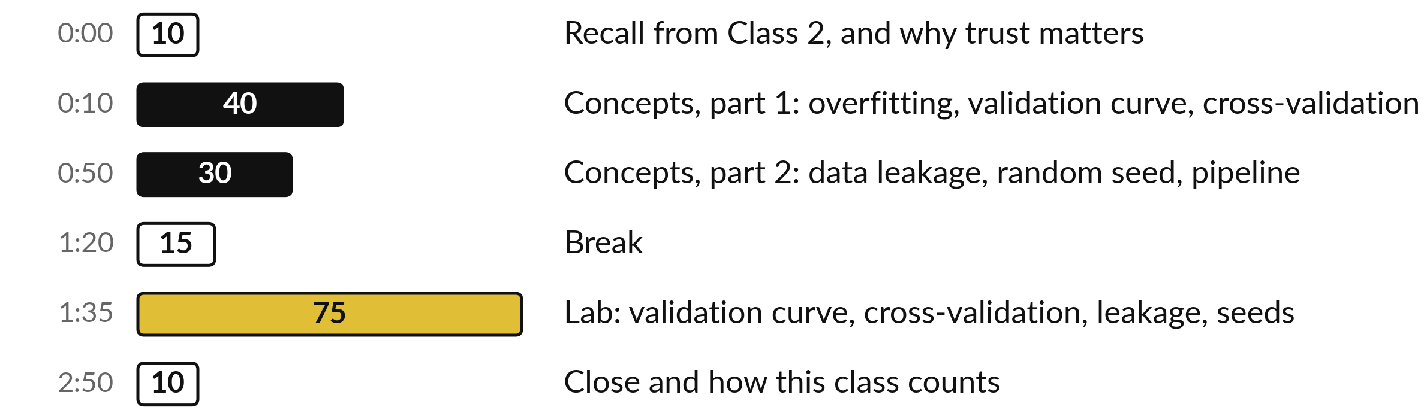
Your three hours: ideas first, then the lab
Concepts first, with no laptops. Then the lab, with the notebook open.
Notes:
We have three hours. The first seventy minutes are concepts only, with no laptop, so you can listen and ask. Then a break. Then the lab, about an hour and a quarter, where you run everything on your own data. The ideas come first and the code comes second.
Here is how the three hours run. First, ten minutes. Recall from Class 2, and why trust matters. Then, forty minutes. Concepts, part 1: overfitting, validation curve, cross-validation. After that, thirty minutes. Concepts, part 2: data leakage, random seed, pipeline. Next, fifteen minutes. Break. Then, 75 minutes. Lab: validation curve, cross-validation, leakage, seeds. Then, ten minutes. Close and how this class counts.

Slide 4

Three questions from last time
1. Why is a majority-class baseline (a model that always predicts no) a poor model, even when its accuracy is about 80 percent?
2. In a confusion matrix, what is a false negative (FN) and what is a false positive (FP)?
3. What happened to recall and false positives when we lowered the decision threshold from 0.5 to 0.3?
Answer aloud first. Then we check together.
Notes:
Three quick questions from Class 2. Answer aloud first, and then we check together. It is a warm-up to bring last time back.
Question one. Why is a majority-class baseline (a model that always predicts no) a poor model, even when its accuracy is about 80 percent? Take a moment.
A good answer is this. It finds none of the real positive cases, so its recall is 0. Accuracy hides that.
Question two. In a confusion matrix, what is a false negative (FN) and what is a false positive (FP)? Say it to yourself first.
A good answer is this. False negative: the model said no (negative) and the truth was yes (positive). False positive: the model said yes and the truth was no.
Question three. What happened to recall and false positives when we lowered the decision threshold from 0.5 to 0.3? Think about your own task as you answer.
A good answer is this. Recall rose from 0.67 to 1.00. False positives went from 0 to 1.
If an answer was missing, do not worry. Your notes from last class have it. Now to today.

Slide 5



Answers to the three questions from Class 2
Question | Short answer
Why is a majority-class baseline (a model that always predicts no) a poor model, even when its accuracy is about 80 percent? | It finds none of the real positive cases, so its recall is 0. Accuracy hides that.
In a confusion matrix, what is a false negative (FN) and what is a false positive (FP)? | False negative: the model said no (negative) and the truth was yes (positive). False positive: the model said yes and the truth was no.
What happened to recall and false positives when we lowered the decision threshold from 0.5 to 0.3? | Recall rose from 0.67 to 1.00. False positives went from 0 to 1.
Notes:
Here are the answers, so you can check yourself and use this slide to revise. A majority-class baseline, a model that always predicts no, can have a high accuracy, but it finds no real positive case, so its recall is zero. A false negative is a no when the truth was yes, and a false positive is a yes when the truth was no.
Lowering the decision threshold from 0.5 to 0.3 moved recall from 0.67 to 1.00 on the validation rows. Today we ask a different question about the same models: can we trust a score at all?

Slide 6

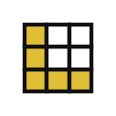



Words we use today
Word | What it means
Overfitting | The model fits the noise in the training set (it nearly memorises it) and does worse on new rows. Underfitting is the opposite: too simple to learn the pattern.
Cross-validation | Scoring a model K times. The rows are cut into K parts called folds. Each fold takes one turn as the validation fold (held-out fold).
Data leakage | Information from outside the training set reaches the model while it is trained, so the score looks better than it really is.
Bias-variance trade-off | Too simple a model misses the pattern (high bias, underfitting). Too flexible a model chases noise (high variance, overfitting).
Random seed | A fixed number (random_state in scikit-learn) that makes a random choice repeat exactly.
Notes:
Five words for today. I give the plain meaning of each, and we use every one of them before the end of the session.
Overfitting. The model fits the noise in the training set (it nearly memorises it) and does worse on new rows. Underfitting is the opposite: too simple to learn the pattern.
Cross-validation. Scoring a model K times. The rows are cut into K parts called folds. Each fold takes one turn as the validation fold (held-out fold).
Data leakage. Information from outside the training set reaches the model while it is trained, so the score looks better than it really is.
Bias-variance trade-off. Too simple a model misses the pattern (high bias, underfitting). Too flexible a model chases noise (high variance, overfitting).
Random seed. A fixed number (random_state in scikit-learn) that makes a random choice repeat exactly.

Slide 7



A model that looks good on paper
can fail on a new machine or site
A model is built from data on four buildings and then used on a fifth building.
The size of the cooling plant is chosen from the model’s prediction.
If the prediction is wrong, the building is too hot or the plant is too big.
Notes:
Start with a story from your own field. A model is built from data on four buildings and then used on a fifth building. The size of the cooling plant is chosen from the model’s prediction. If the prediction is wrong, the building is too hot or the plant is too big.
In the office the model looked excellent, so everybody trusted it. The trouble is that the office score came from rows the model had already been trained on, or from a test that was too easy. Today is about checking a model the way real life will check it.
Have you ever trusted a number from a machine or a spreadsheet and then been surprised?

Slide 8
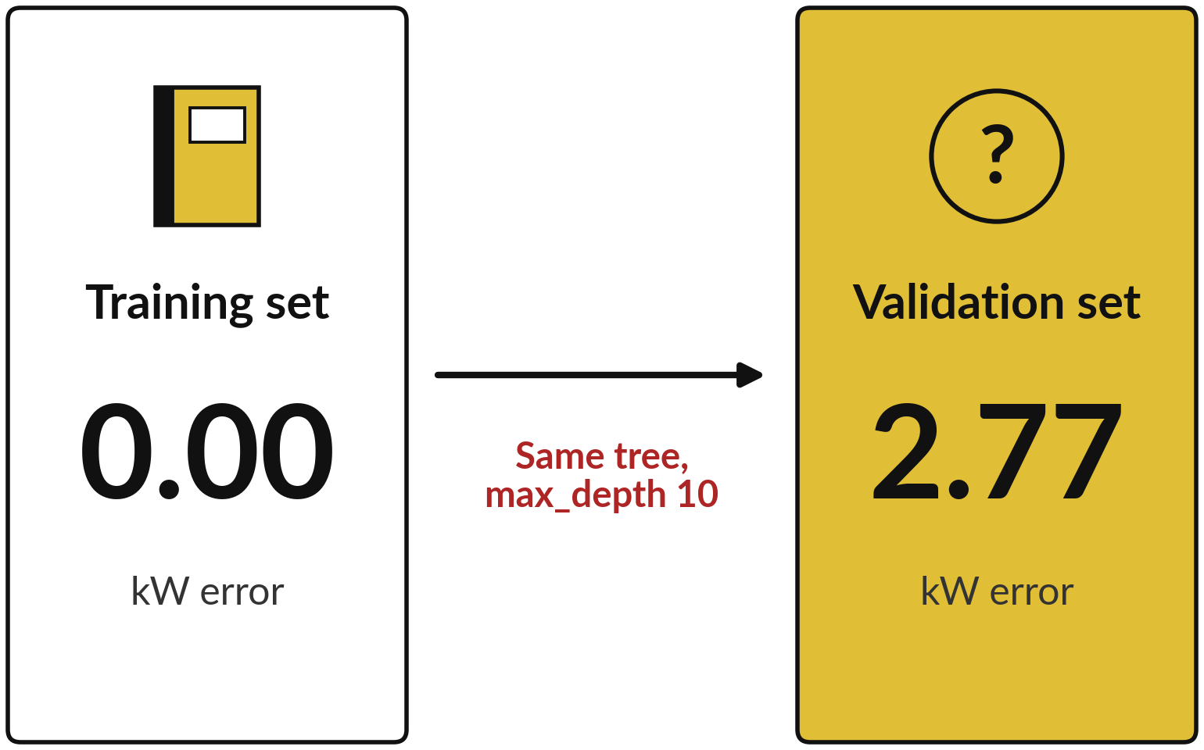
A model must do well on rows it has never seen
Generalisation means doing well on held-out data: rows the model has never seen.
The tree was trained on the training set, so its error there is almost zero.
The validation set was held out. On it the prediction error is far larger. The difference is the generalisation gap.
Notes:
Here is one tree, grown ten questions deep, scored two ways. The training set is the rows it was trained on, and there its error is 0.00 kW, which is almost perfect. The validation set was held out, and there its error is 2.77 kW. The difference between the two is called the generalisation gap.
Same model, same data, two very different stories. Doing well on held-out rows it has never seen is called generalisation, and it is the only thing we really want. A score on rows the model was trained on tells us about its memory, and a score on new rows tells us about its skill.
Which score would you show a client?

Slide 9
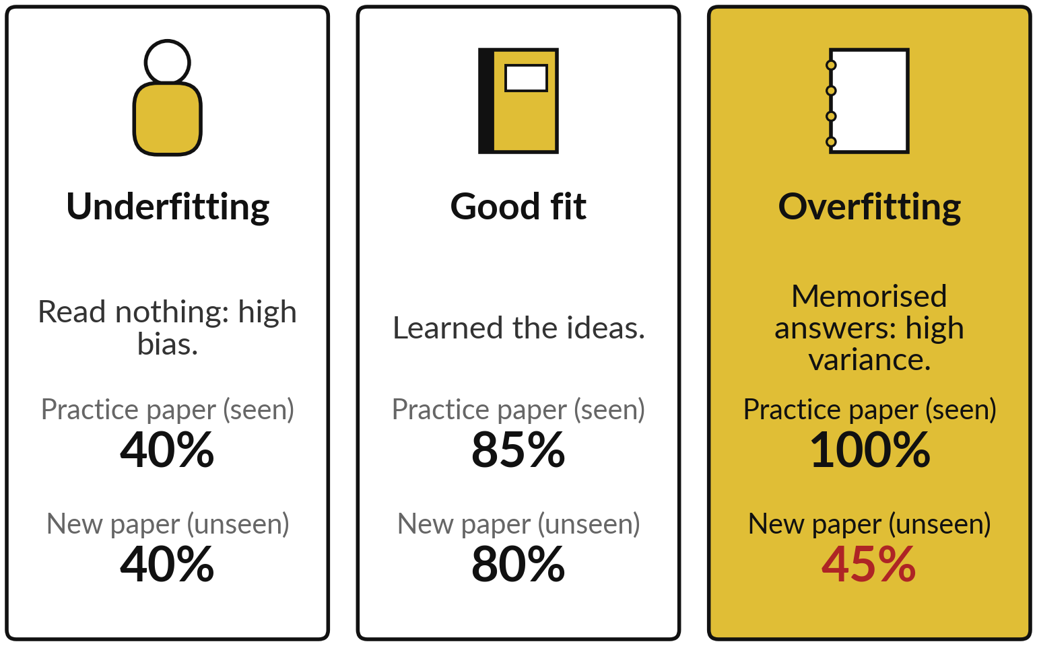
Underfitting, a good fit and
overfitting look like three students
The marks in the picture are illustrative (made up). Each student stands for one kind of model.
Practice paper = training set. New paper = held-out rows.
Bias-variance trade-off: too simple a model misses the pattern, too flexible a model chases noise.
Notes:
Think of three students. The first read nothing, so the practice paper and the new paper both go badly. That is underfitting: a model too simple to learn the pattern, which the industry calls high bias. The second understood the ideas, so the marks are good on both papers.
That is a good fit. The third memorised last year’s answers. Perfect on the practice paper and poor on the new paper. That is overfitting: the model fits the noise, which the industry calls high variance. Balancing the two is the bias-variance trade-off. The practice paper stands for the training set, the new paper for held-out rows, and the marks are made up.
Can you think of someone who passed by memory and then struggled on the job?

Slide 10
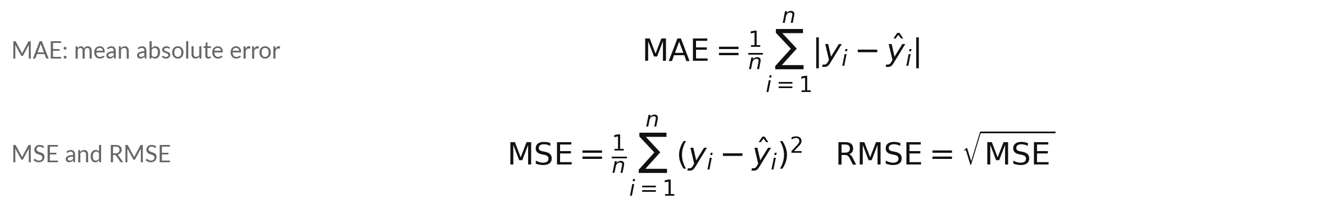
Reminder from Class 1: MAE and
RMSE measure the prediction error
Symbol | What it means | In our data
MAE | The mean size of the error. The bars drop any minus sign | Class 1 model: 0.74 kW
MSE, RMSE | MSE: mean of the squared errors. RMSE: its square root, in the target unit | Class 1 model: RMSE 0.88 kW
n, y, ŷ | n rows scored; y is the actual target of row i; ŷ (y-hat) is the prediction | 15 validation rows; cooling load in kW
Illustrative example (made up): errors of 1, 2 and 3 give MAE = 2, MSE = 4.67 and RMSE = 2.16.
Notes:
Before we use the word MAE all class, here is a reminder from Class 1. For every row, take the actual target and the prediction, and look at the size of the prediction error. The MAE is the mean of those errors, and the bars mean we drop any minus sign.
The RMSE squares each error first, averages, and then takes the square root, so one big error counts for more. Our linear regression model from Class 1 had an MAE of 0.74 kW and an RMSE of 0.88 kW on the validation rows. Today we mostly use the MAE.
Why would one very large error matter more to an engineer?

Slide 11
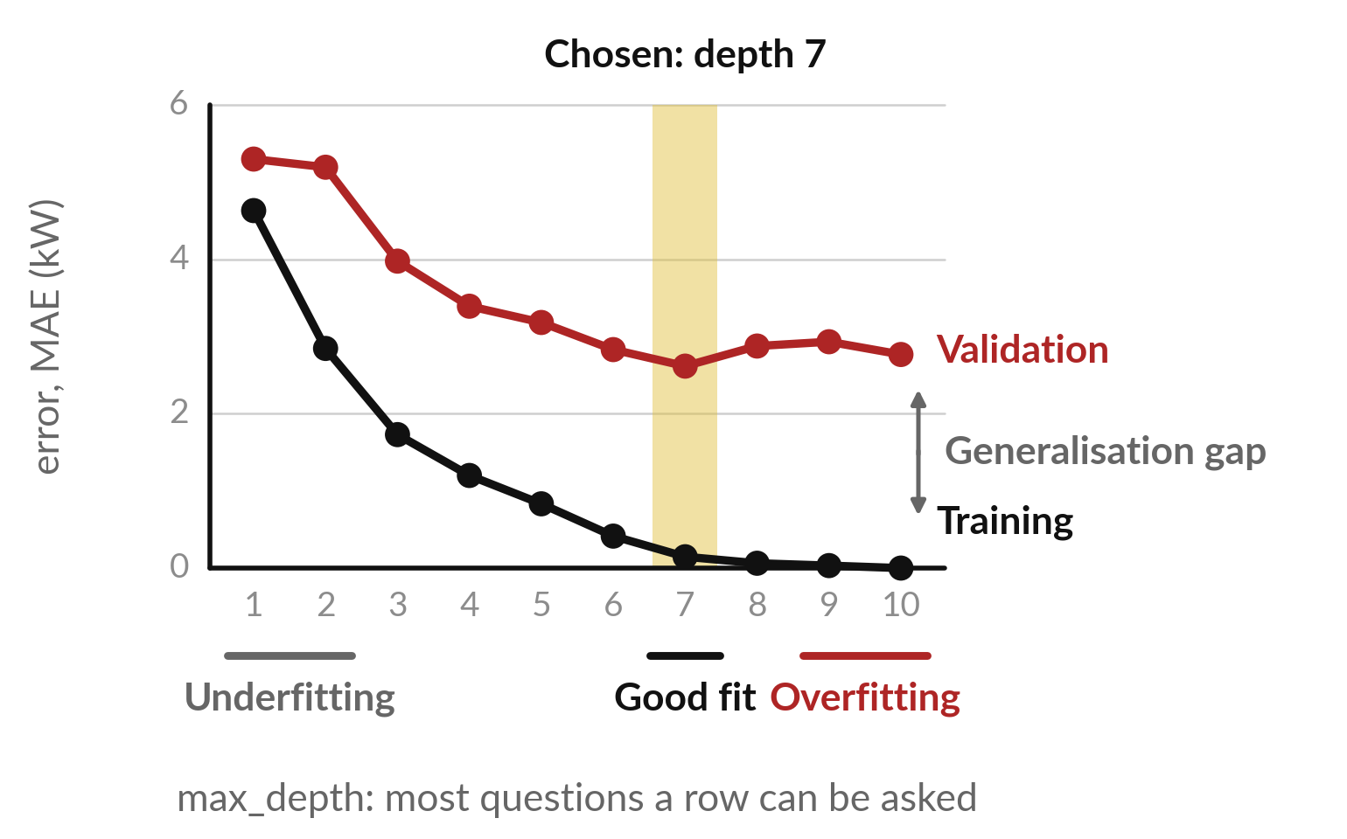
The validation curve: as max_depth grows, training
error keeps falling but validation error stops
A validation curve plots both errors against model complexity, here max_depth (most questions a row is asked).
Each dot is one tree. Black: training error, falling to 0.00. Red: validation error. Between them: the generalisation gap.
The gold band is the max_depth we choose.
Notes:
This is a validation curve from our data. It plots error against model complexity. Each point is a tree with a different max_depth, the largest number of questions a row can be asked on the way down the tree. The black line is the error on the training rows, and it falls all the way to 0.00.
The red line is the validation error. It falls at first and then stops improving, and at depth 10 it sits at 2.77. The distance between the lines is the generalisation gap. The gold band is the depth we choose, depth 7. At the end of the Class 1 lab you tried depths 1, 2 and 8.
This curve is what you were seeing. Where does the generalisation gap start to grow?

Slide 12
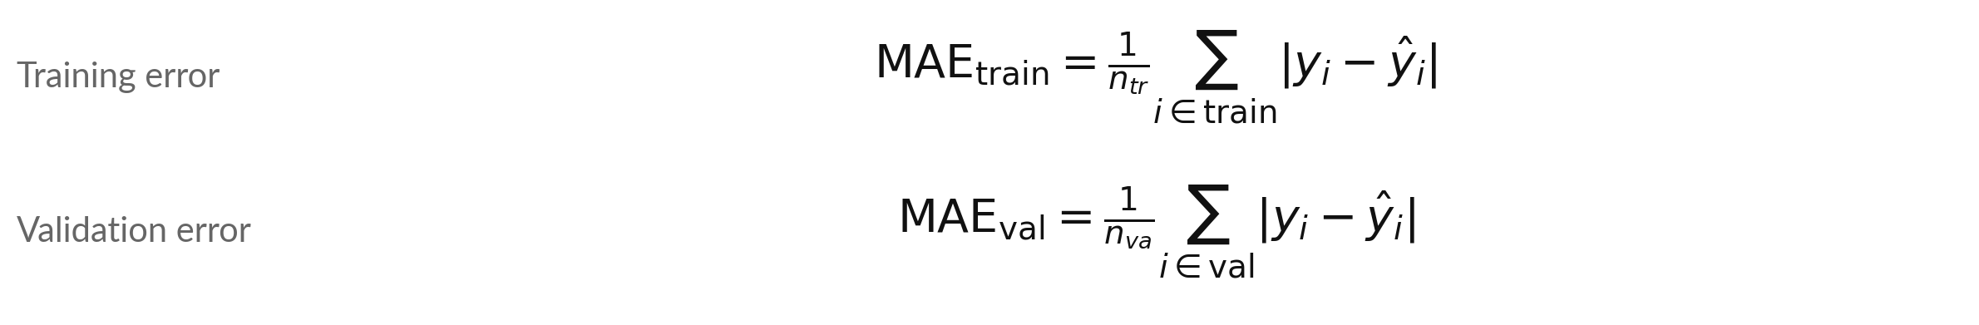
Training error, validation error and the
generalisation gap are short formulas
Symbol | What it means | In our data
MAE | Mean absolute error: the average size of the prediction error. The small label train or val says which rows | Depth 10: 0.00 and 2.77 kW
n | How many rows. The small label tr means training and va means validation | 58 and 15 rows
i | A row number. The sum adds up the rows of that group | Row 1, row 2, and so on
y, ŷ | The real target of row i, and the model’s prediction for it. The bars | | drop any minus sign | cooling load and the tree’s answer, in kW
Notes:
Class 1 gave you the MAE. Here it is again, written for two groups of rows. The training error adds up the size of the prediction error on every training row, then divides by the number of training rows. The validation error does the same on the validation rows.
The bars mean the size of the error, so a plus or a minus makes no difference. In our data at depth 10 the training error is 0.00 kW and the validation error is 2.77 kW. Which rows is the tree trained on, and which rows does it never see?

Slide 13
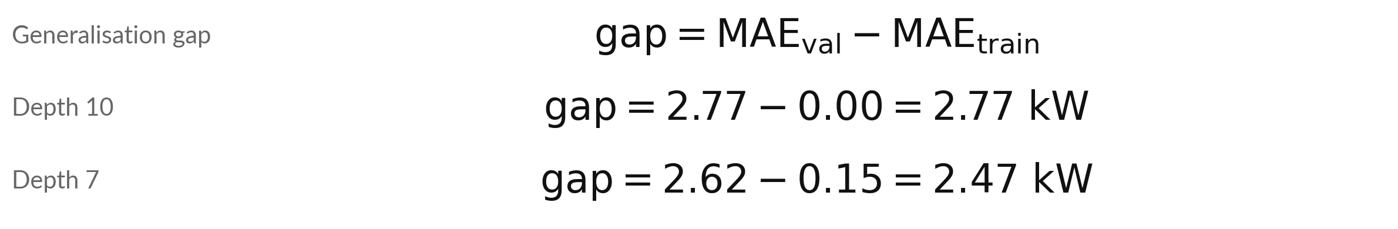
The generalisation gap is the validation
error minus the training error
Symbol | What it means | In our data
gap | Generalisation gap: how much worse the model is on new rows | Depth 10: 2.77 kW
MAE_val | Validation error, from the formula before | 2.77 kW at depth 10
MAE_train | Training error, from the formula before | 0.00 kW at depth 10
A gap near 0 means about the same error on new rows as on the training set. A big gap means overfitting.
Notes:
The generalisation gap is one subtraction: the validation error minus the training error. At depth 10 it is 2.77 minus 0.00, which is 2.77 kW. At our chosen depth, depth 7, it is 2.62 minus 0.15, which is 2.47 kW. A small gap says the model does about as well on new rows as on its training set.
A big gap says it is overfitting, fitting the noise in the training set. Next we see the gap for five depths in one table.

Slide 14
As max_depth grows, the training error keeps
falling but the validation error does not
max_depth | Leaf nodes | Training MAE | Validation MAE | Generalisation gap (validation minus training)
1 | 2 | 4.63 | 5.30 | 0.67
2 | 4 | 2.84 | 5.19 | 2.35
4 | 15 | 1.20 | 3.39 | 2.19
7 (chosen) | 46 | 0.15 | 2.62 | 2.47
10 | 58 | 0.00 | 2.77 | 2.77
MAE in kW. A leaf node is a final node at the bottom of the tree, and it holds the prediction. A deeper tree has more leaf nodes. The linear regression model from Class 1 scores 0.74 kW, better than every tree.
Notes:
Same numbers as the curve, in a table. Look at the leaf nodes, the final nodes at the bottom of the tree. Every row ends in exactly one leaf node, and the tree gives every row in it the same prediction. At depth 1 there are 2 leaf nodes.
At depth 10 there are 58, for only 58 training rows, so the tree is close to keeping one answer for each row. That is overfitting. The last column is the generalisation gap from the last slide. One more fact for later: the linear regression model from Class 1 scored 0.74 kW, better than every tree.
A deeper tree is not a better model. What does that suggest about the shape of this data?

Slide 15
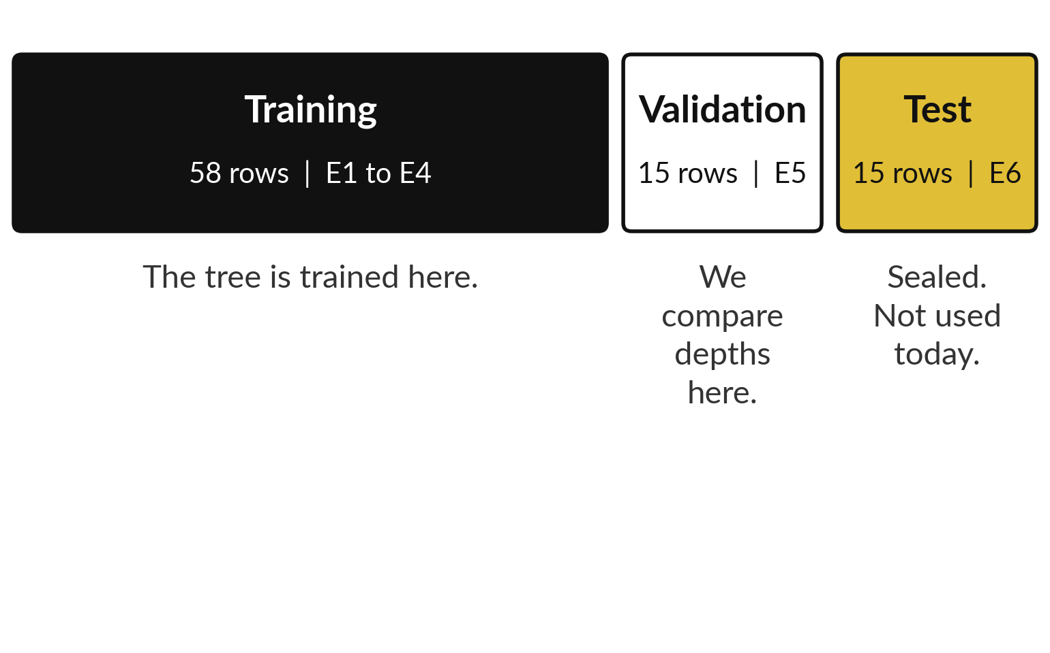
We choose max_depth on the validation
set and keep the test set sealed
Each set is made of whole equipment groups. The picture shows how many rows each set has.
There are only 15 validation rows, so a score can move by luck.
We never tune anything on the test set.
Notes:
How did we choose depth 7?
We looked at the validation set only. The picture shows the three sets of our data: the training set from groups E1 to E4, the validation set from group E5, and the test set from group E6. We never touch the test set today. And we must be honest about the validation set: it has only 15 rows, so its scores are noisy, and a change of a few percent could be luck.
So we need a rule for choosing a model that does not chase small differences. That rule comes next. Why would picking the lowest score alone be risky with so few rows?

Slide 16
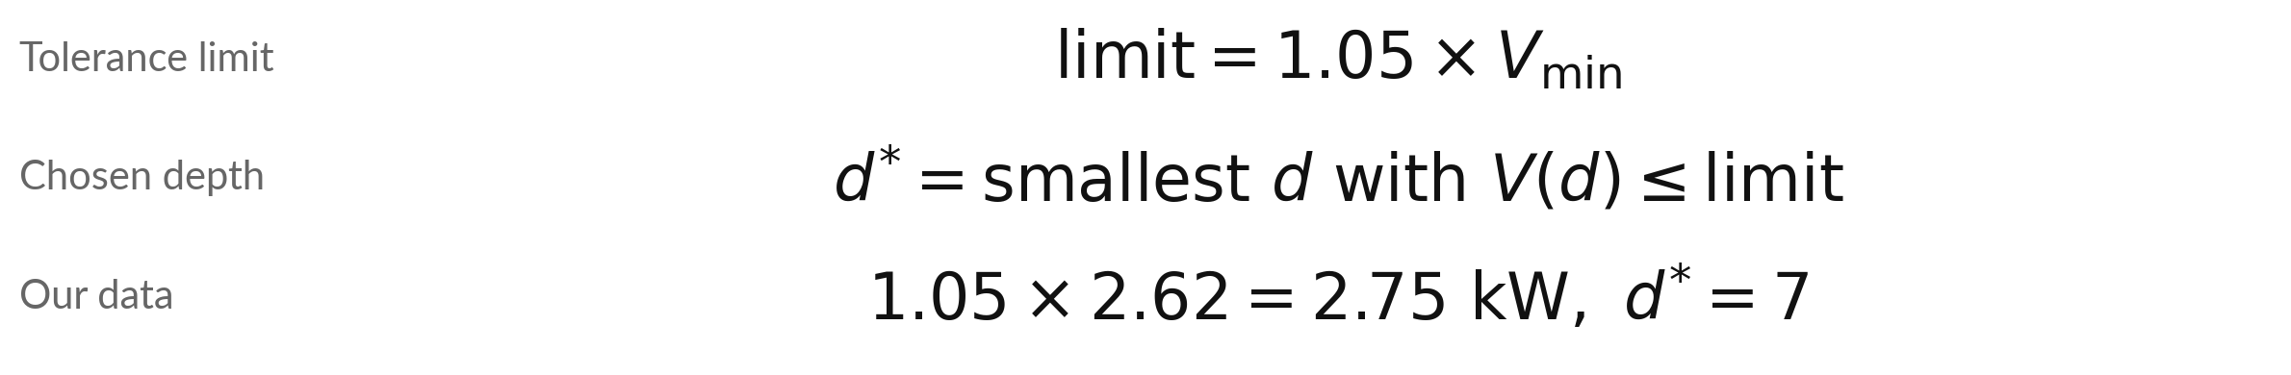
Choose the simplest model within
a tolerance of the best score
Symbol | What it means | In our data
V(d) | Validation MAE of the tree with max_depth d | 5.30 at depth 1, 2.77 at depth 10
V_min | The lowest validation MAE over depths 1 to 10 | 2.62 kW, at depth 7
limit | The tolerance limit: the lowest value plus 5 percent | 2.75 kW
d* | The chosen depth: the smallest d that passes | Depths that pass: 7
A rule of thumb (parsimony: prefer the simpler model), like the one-standard-error rule. d* = chosen max_depth.
Notes:
Here is the rule for choosing the simplest model within a tolerance of the best validation score, as arithmetic. Find the lowest validation error, V min. For us it is 2.62 kW, at depth 7. Add 5 percent by multiplying by 1.05, which gives the limit, 2.75 kW.
Any depth whose validation error is at or below the limit is within the tolerance of the best. The depths that pass are 7. We take the smallest of them, depth 7, because a simpler tree is less likely to overfit. This is a common practical rule, the idea of parsimony, similar in spirit to the one-standard-error rule.
The 5 percent is our own choice and it is not a law. What would change if the limit were 1.00?

Slide 17
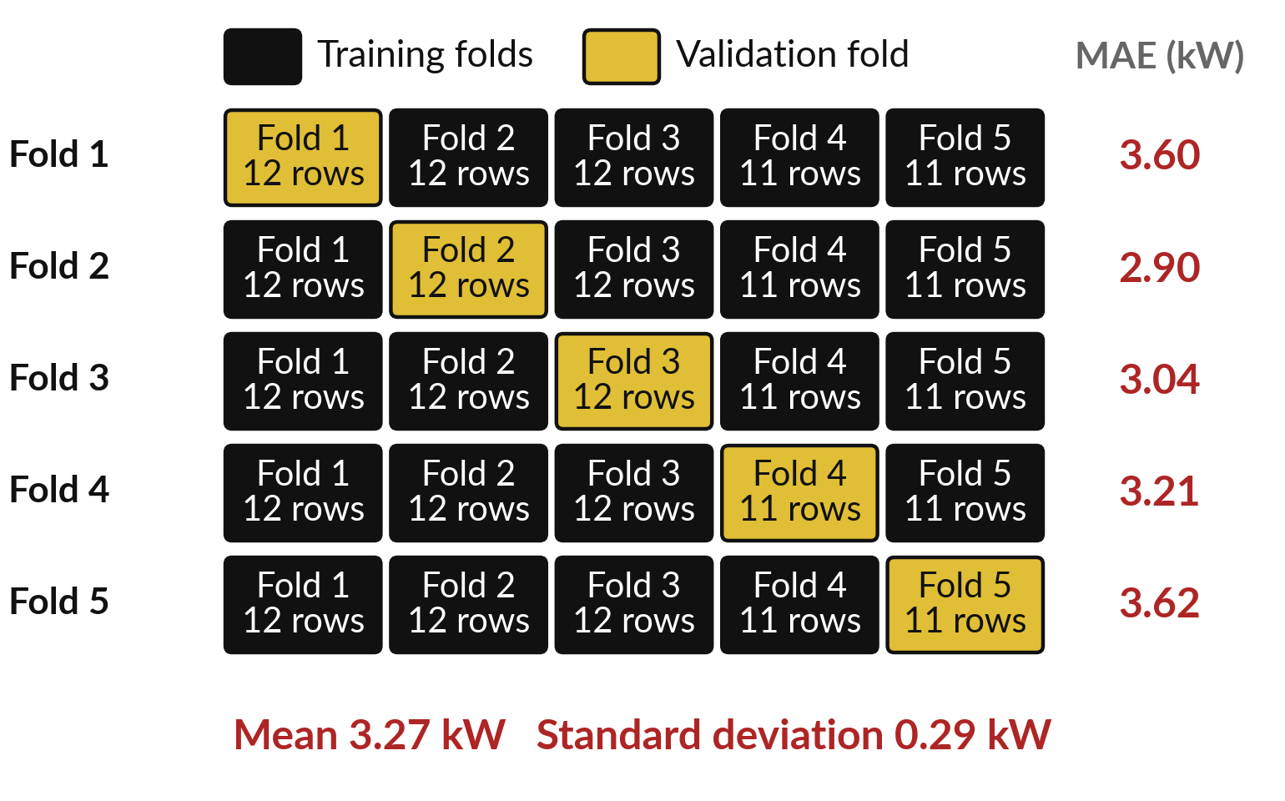
One split can be lucky, so K-fold cross-validation
lets every fold take a turn as the validation fold
K-fold cross-validation cuts the 58 training rows into K = 5 folds (parts of the rows), in the order the rows appear (no shuffle).
In each row, the tree is trained on 4 folds and scored on the gold fold: the validation fold (held-out fold).
After 5 rows each fold has been the validation fold once. The 5 scores of a max_depth 4 tree are on the right.
Notes:
A single validation split is one test on one day, and the day may be lucky or unlucky. K-fold cross-validation takes several tests. Cut the 58 training rows into five folds. In the first row of the picture, the tree is trained on folds two to five, and fold one is the validation fold, also called the held-out fold.
It is used only to score the tree. Some books call it the test fold, but it is not the sealed test set E6. In the next row a different fold is the validation fold, and so on, until every fold has had its turn. Here are the five scores for a depth-4 tree, from 2.90 to 3.62 kW. Five scores tell us more than one.

Slide 18
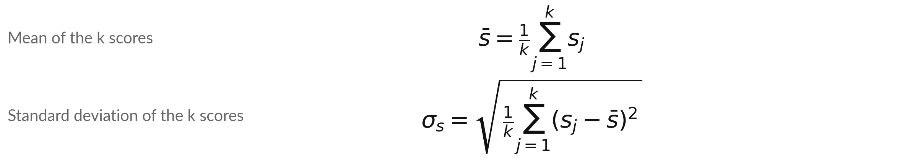
K-fold gives k scores, and we report
their mean and their standard deviation
Symbol | What it means | In our data
s | The MAE when fold j is the validation fold (j is the fold number) | 3.60, 2.90, 3.04, 3.21, 3.62 kW
k | The number of folds, so the number of scores | 5 folds
s̄ | The mean (average) of the k scores (s with a bar) | 3.27 kW
σ | The standard deviation (sigma): the typical distance of a score from the mean. We divide by k, as np.std does | 0.29 kW
Notes:
Two formulas turn the five scores into two numbers. The mean adds up the k scores and divides by k. The standard deviation asks how far each score sits from the average, squares those distances so plus and minus cannot cancel, takes their average, and then the square root.
For our five scores the mean is 3.27 kW and the standard deviation is 0.29 kW. We divide by k, the same as NumPy, so your numbers match the notebook. A small standard deviation means the folds agree. A large one means the score depends on which fold you ask. First we do it by hand with four easy numbers.

Slide 19
By hand with four illustrative scores: the
mean is 3 and the standard deviation is 0.71
Fold | Score (MAE) | Distance from the mean | Squared distance
1 | 2 | -1 | 1
2 | 3 | 0 | 0
3 | 3 | 0 | 0
4 | 4 | +1 | 1
Mean = (2 + 3 + 3 + 4) / 4 = 3. Mean of the squared distances = (1 + 0 + 0 + 1) / 4 = 0.5 (the variance). The square root of 0.5 is 0.71, the standard deviation. These four scores are illustrative (made up).
Notes:
Let us do it by hand with four illustrative, made-up fold scores: two, three, three and four. The mean is twelve divided by four, which is three. Now the standard deviation. How far is each score from the mean?
Minus one, zero, zero and plus one. Square them, so that plus and minus cannot cancel: one, zero, zero, one. Their mean is a half, which is the variance. The square root of a half is 0.71. That number is the standard deviation, the typical distance of a fold score from the mean. Check the 0.71 on your own page.

Slide 20
The same steps on our five real scores:
mean 3.27, standard deviation 0.29 kW
Fold | Score (MAE, kW) | Distance from the mean | Squared distance
1 | 3.60 | +0.32 | 0.104
2 | 2.90 | -0.38 | 0.143
3 | 3.04 | -0.23 | 0.054
4 | 3.21 | -0.06 | 0.004
5 | 3.62 | +0.35 | 0.122
Sum | 16.37 | 0.00 | 0.427
Mean = 16.37 / 5 = 3.27. Mean of squares = 0.427 / 5 = 0.085. Square root = 0.29, the standard deviation. Worked from unrounded scores, so the last digit can differ.
Notes:
Now the same steps on the five real scores from our depth-4 tree. The scores add up to 16.37, so the mean is 3.27 kW. Each score has a distance from that mean, some above and some below, and the distances add up to zero. We square them, and the squares add up to 0.427.
Divide by five to get 0.085, and the square root of that is 0.29 kW. That is the standard deviation you will see in the notebook. Compare it with the mean. Is it small or large?

Slide 21
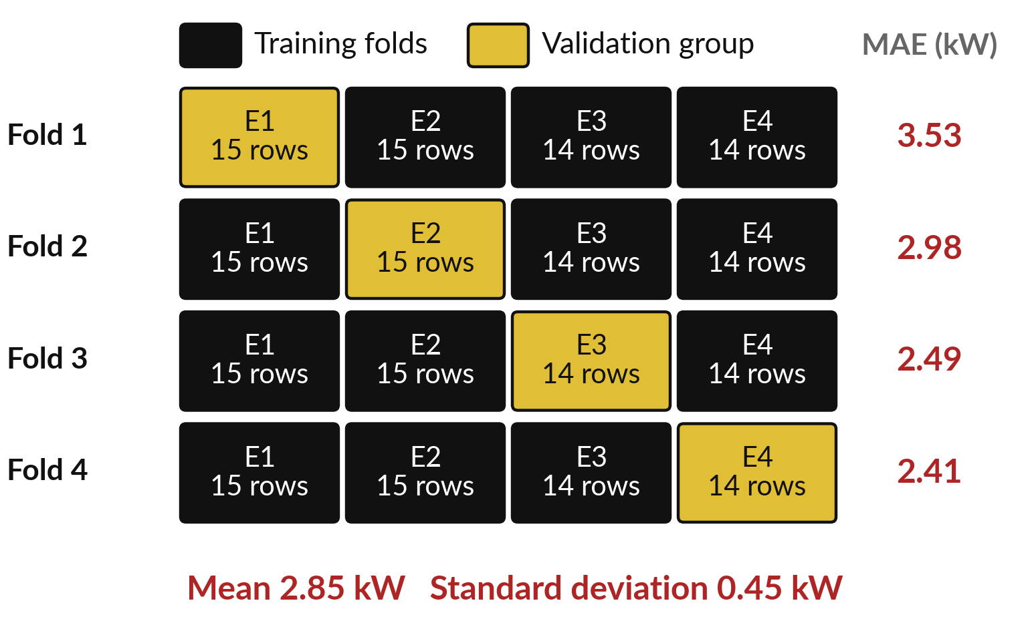
GroupKFold holds out a whole equipment group
in each fold, which is how the model is really used
GroupKFold keeps each equipment group whole. In each fold one group, E1, E2, E3 or E4, is the validation fold.
The tree is trained on the other three groups and scored on the held-out building group, like a new site.
Each fold gives one score. The mean and standard deviation are worked out as before.
Notes:
Plain K-fold mixes rows from every group, so the model has already seen the same building while it is trained. In real use a new building arrives, and nobody has seen it. GroupKFold fixes that by keeping each equipment group whole. In each fold it holds out one group, E1, E2, E3 or E4, trains on the other three, and scores the held-out group.
The four scores run from 2.41 to 3.53 kW, with a mean of 2.85. Which of the two designs looks more like the situation you will face at work?

Slide 22
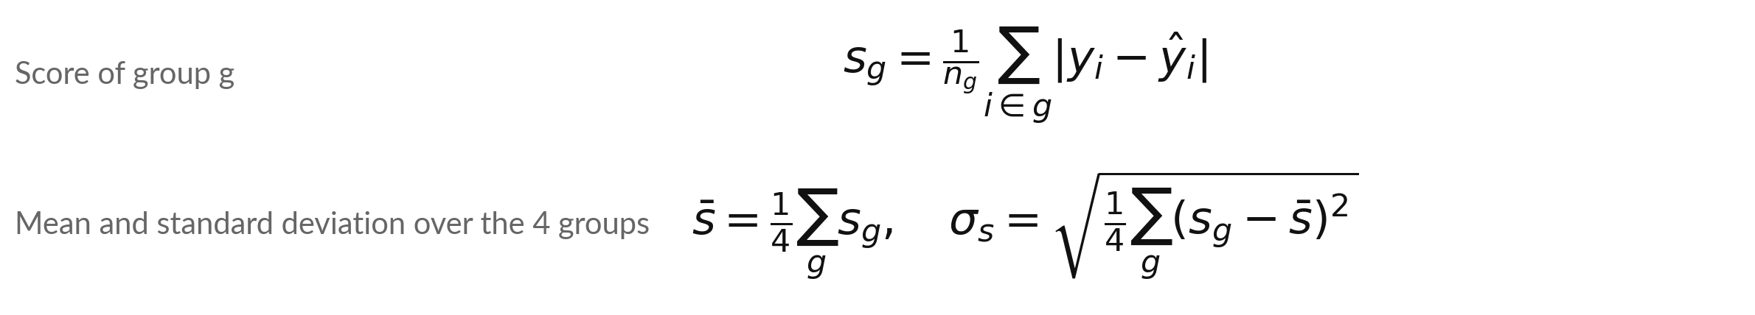
GroupKFold uses the same formulas,
with equipment groups as the folds
Symbol | What it means | In our data
g | The group held out in one fold: E1, E2, E3 or E4 | E1, then E2, E3, E4 in turn
n | Number of rows in group g (the small label g) | E1 15, E2 15, E3 14, E4 14 rows
s | MAE on group g (the small label g), using a tree that was never trained on g | E1 3.53, E2 2.98, E3 2.49, E4 2.41 kW
s̄, σ | Mean of the 4 scores, and their standard deviation | 2.85 and 0.45 kW
Notes:
GroupKFold needs no new maths. The score for a group g is the MAE on the rows of that group, using a tree trained on the other three groups that never saw g. Then we take the mean of the four scores and their standard deviation, with the same two formulas as before, with four in place of k.
Our four scores have a mean of 2.85 kW and a standard deviation of 0.45 kW. Which group was hardest to predict?

Slide 23


The same max_depth 4 tree gets three
different scores, depending on how we test it
Way of testing | Scores (MAE) | Mean | Standard deviation
Single validation split (group E5) | 3.39 | 3.39 | one score only
K-fold, k = 5 (rows in order, no shuffle) | 2.90 to 3.62 | 3.27 | 0.29
GroupKFold, k = 4 | 2.41 to 3.53 | 2.85 | 0.45
MAE in kW. Group E5 turned out harder than the average group, so its single score is higher than both averages. The standard deviation shows how far to trust each mean.
Notes:
Here is the same tree scored three ways. The single split on group E5 says 3.39. Plain K-fold says 3.27, with a standard deviation of 0.29. GroupKFold says 2.85, with a standard deviation of 0.45. Group E5 happened to be harder than the average group, so the single split gave a gloomier answer than cross-validation.
It could just as easily have been luckier. Report the mean and the standard deviation, and say how the folds were made. Which of the three would you quote to a client, and what would you add?

Slide 24
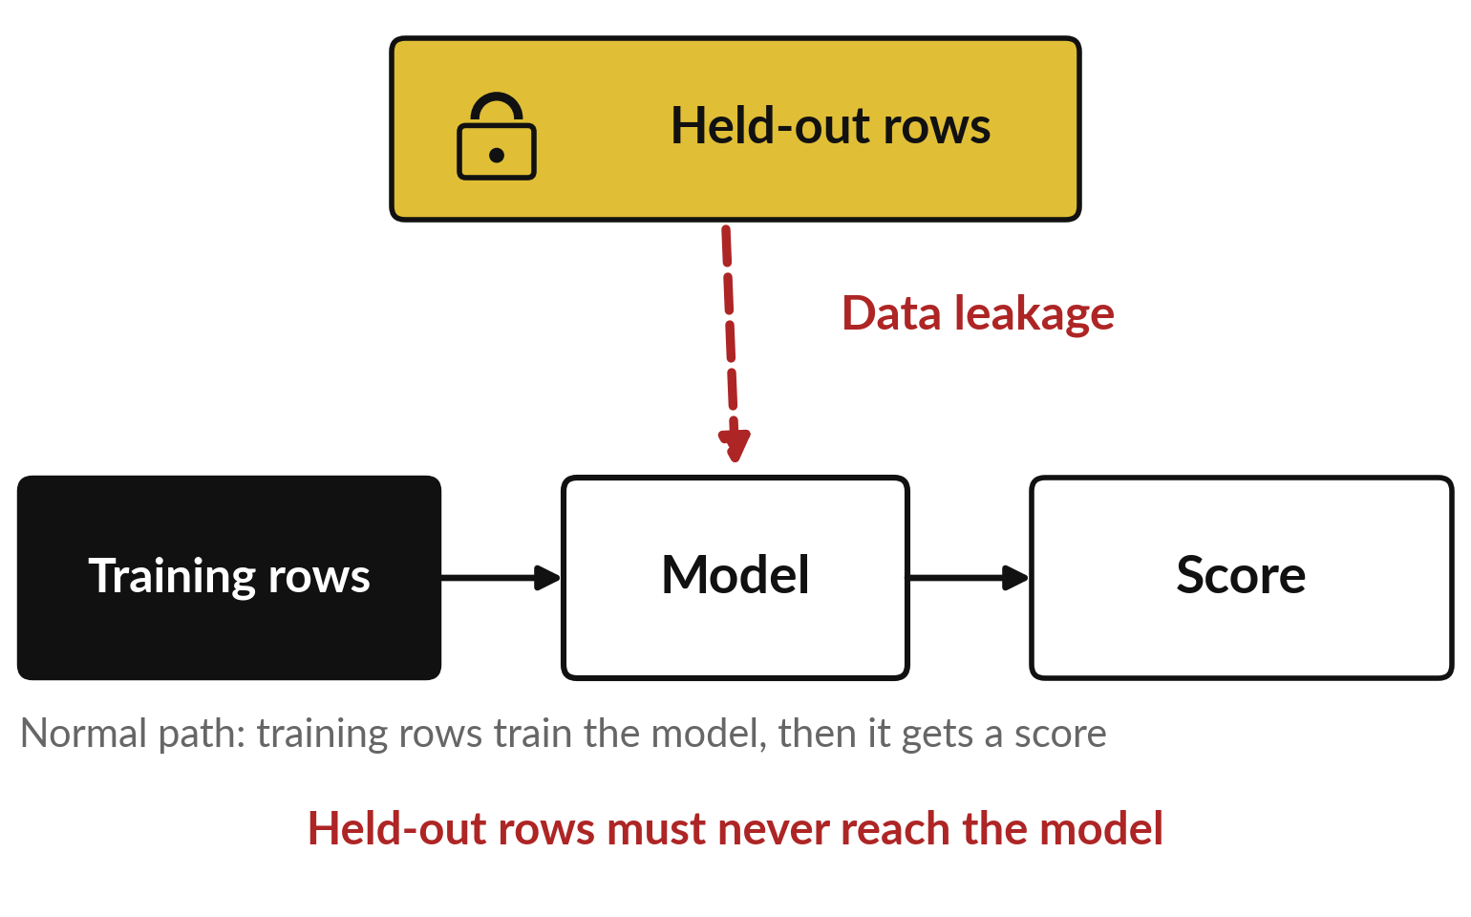
Data leakage is information from outside
the training set reaching the model
Data leakage: information from held-out data, which the model should not see, reaches the model while it is trained.
Held-out rows are the validation or test rows. The dashed red arrow is the leakage.
The score looks excellent, then the model fails on real new rows.
Notes:
Now the second big danger. Data leakage means information from outside the training set reaches the model while it is trained. The picture shows the normal path along the bottom: the training rows train the model, and then the model gets a score. The held-out rows are the validation or test rows, and they must stay out of training.
If anything from them slips in, along the red arrow, the model has seen the answers. The score then looks excellent, and the first real machine breaks the spell. The worst part is that nothing warns you. There is no error message, only a score that is too good.
Have you seen a result that looked too good to be true?

Slide 25
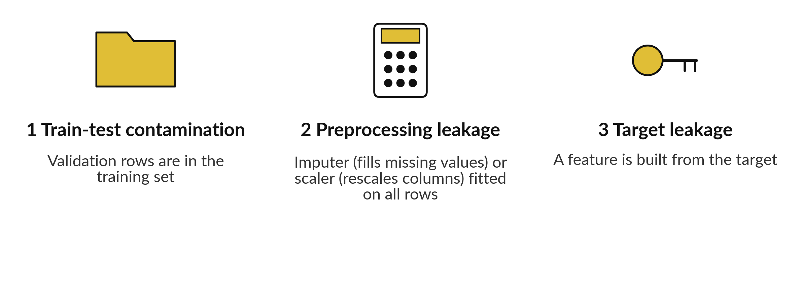
Data leakage comes in three common kinds
All three make the score look too good.
Notes:
Three kinds cover most cases. Train-test contamination: validation rows end up in the training set, for example by joining two files, or by tuning on the test rows again and again. Preprocessing leakage: an imputer, which fills missing values, or a scaler, which rescales columns to a common scale, is fitted on all rows before the split, so the training set carries information about the validation rows.
Target leakage: a feature is computed from the target, such as a column that is only filled in after the failure has happened. We show each one with real numbers.

Slide 26
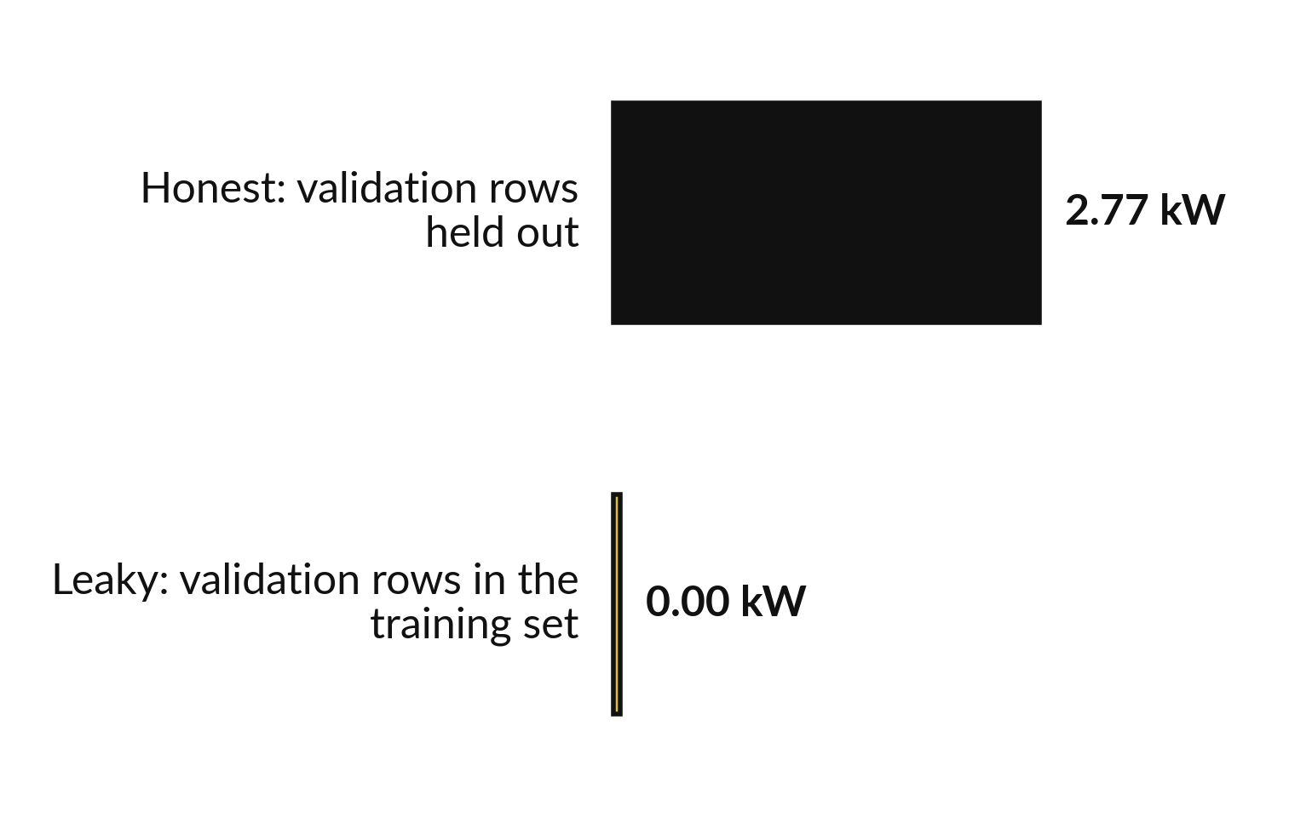
Train-test contamination: validation rows in
the training set make the score look perfect
Same max_depth 10 tree. Only the training set changed.
In the leaky run the tree was already trained on the validation rows, so it reproduces their answers (overfitting).
The honest score is the real one.
Notes:
This is the real demonstration from our data. The same tree, depth ten. In the honest version the validation rows are held out, and the validation error is 2.77 kW. In the leaky version we put the validation rows into the training set first, which is train-test contamination.
The error drops to 0.00. The tree has simply memorised those rows, so the leaky score is perfect and tells us nothing. Nobody would do this on purpose, but a join or a copy and paste can do it quietly. Which of the two scores would predict a new machine?

Slide 27
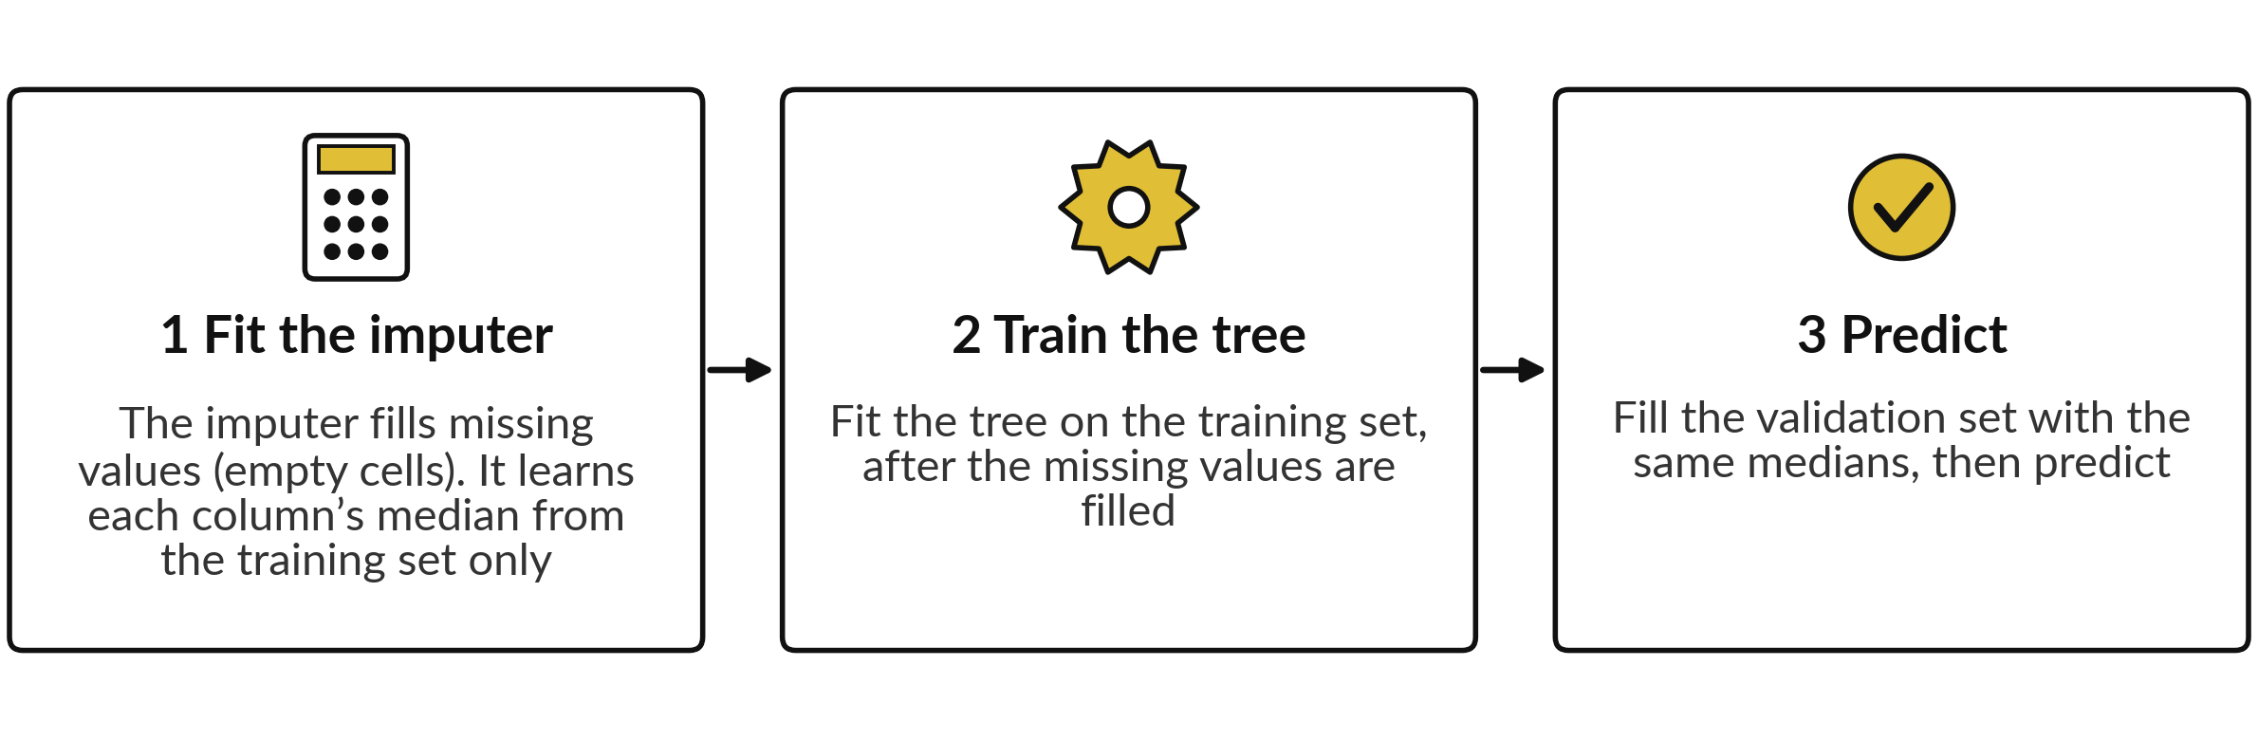
A Pipeline fits the imputer on the training set
only, which prevents preprocessing leakage
Median of ambient_c: 26.07 from the training set, 25.37 from all rows (preprocessing leakage). Only one value is missing, so the score did not change.
Notes:
Preprocessing leakage is the quiet one. If you fill missing values, or scale columns, using all the rows, the validation rows have helped to decide the fill. In our data the median ambient temperature is 26.07 from the training set and 25.37 from all rows. We tried both, and the validation error did not change, because only one value is missing.
So here the habit costs nothing. That is exactly why it is dangerous: a clean score does not prove a clean method. The fix is a Pipeline, which chains the imputer and the tree. In every fold it fits the imputer on the training folds only, then fills the validation fold with those same numbers.

Slide 28
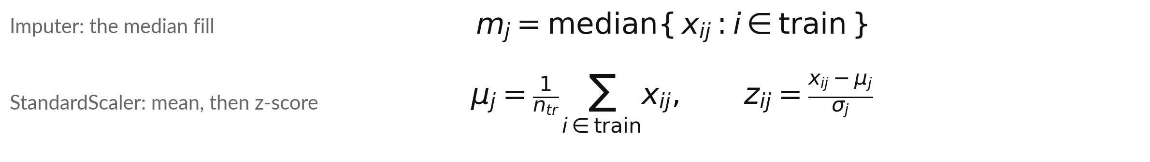
The pipeline rule: fit on the training
set only, then apply the same numbers
Symbol | What it means | In our data
i, j, x, n | i is the row, j the column, x the value in row i and column j, n the number of training rows. In preprocessing leakage, i includes validation rows | j = 1 load_pct, j = 2 ambient_c; n = 58
m | Median of column j over the training rows | ambient_c: 26.07. From all rows: 25.37, leakage
μ, σ | Mean and standard deviation of column j over the training rows | load_pct: 59.89 and 22.73
z | The z-score (scaled value) of row i in column j | Row 1: (59.15 - 59.89) / 22.73 = -0.03
Notes:
Here is the pipeline rule as a formula. The median for column j is taken over the training rows only. The mean and the standard deviation for column j are also taken over the training rows only. Then the same three numbers are applied to every row, including the validation rows.
The leakage is simple to state: if the row number i also runs over the validation rows, the imputer or scaler has seen them. Take row one of our training data. Its load is 59.15. Subtract the mean 59.89, divide by the standard deviation 22.73, and the z-score is -0.03.
Class 2 used this scaler, and the pipeline does it for you inside every fold.

Slide 29
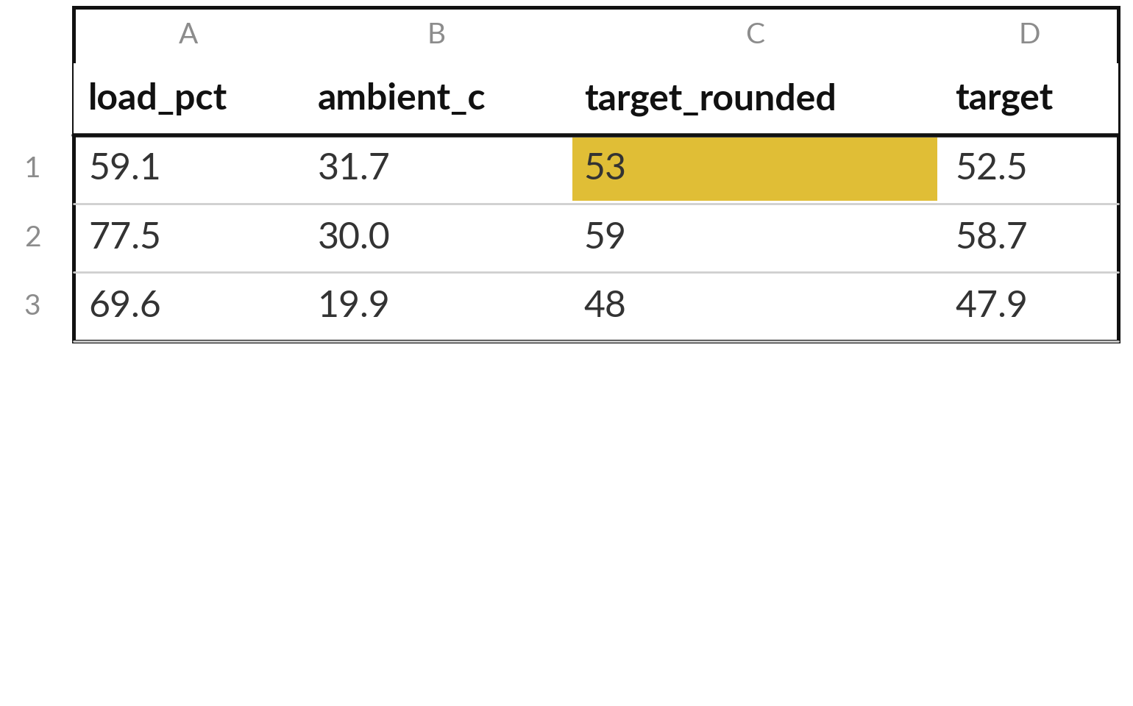
Target leakage: a feature built from the target
gives a great score that cannot be repeated
With that feature a max_depth 4 tree scores 0.54 kW. With honest features it scores 3.39 kW.
target_rounded is the target rounded to a whole number. At prediction time the target is unknown.
A feature recorded after the event is also target leakage.
Notes:
This is target leakage. Suppose someone adds a feature that is the target rounded to a whole number. A depth-4 tree with that feature scores 0.54 kW on the validation rows, against 3.39 without it. It looks like a miracle. But when a new reading arrives, the target is exactly what we do not know yet, so the feature cannot be filled in.
Real examples are a repair code written after the failure, or a daily total computed from the very value we predict. Ask of every feature: will I have this at the moment I need the prediction?

Slide 30



Keep this checklist: five questions
before you trust a score
Was the score measured on held-out data (rows the model never saw)?
Were the imputer and the scaler fitted on the training set only (no preprocessing leakage)?
Does any feature come from the target, or only exist after the event (target leakage)?
Is the test set (group E6) still sealed?
Is the score a cross-validation mean, shown with its standard deviation?
Notes:
Here is the checklist I want you to keep, and I will ask for it again next class. One: was the score measured on held-out data, rows the model never saw?
Two: were the imputer and the scaler fitted on the training set only?
Three: does any feature come from the target, or only exist after the event?
Four: is the test set, group E6, still sealed?
Five: is the score a cross-validation mean, shown with its standard deviation?
If you can answer yes to all five, you may trust the number a little. If you cannot, find out why before you show it to anyone. Take a photo of this slide now.

Slide 31
The same code can give different numbers, so we fix
the random seed (random_state) and write it down
random_state (the random seed) | max_depth 10 tree: validation MAE | Shuffled 5-fold: mean MAE
1 | about 2.9 | about 3.2
17 | about 2.8 | about 2.9
99 | about 3.0 | about 2.9
MAE in kW. The data and the code are the same in every row. Only the seed changed. A random seed makes a random choice repeat exactly. Your last digit can differ.
Notes:
Random choices sit inside many tools. A tree breaks ties at random, and shuffled folds mix the rows at random. A random seed, which scikit-learn calls random_state, is a number that makes those choices repeat exactly. Look at the table. With the same data and the same code, the depth-10 tree scores about 2.9, 2.8 or 3.0 kW, depending on the seed.
So a number without its random seed is only half a result. We use random_state equal to seventeen everywhere, and the difference between seeds also tells us how much of a score is luck. Why does a colleague need your seed?

Slide 32
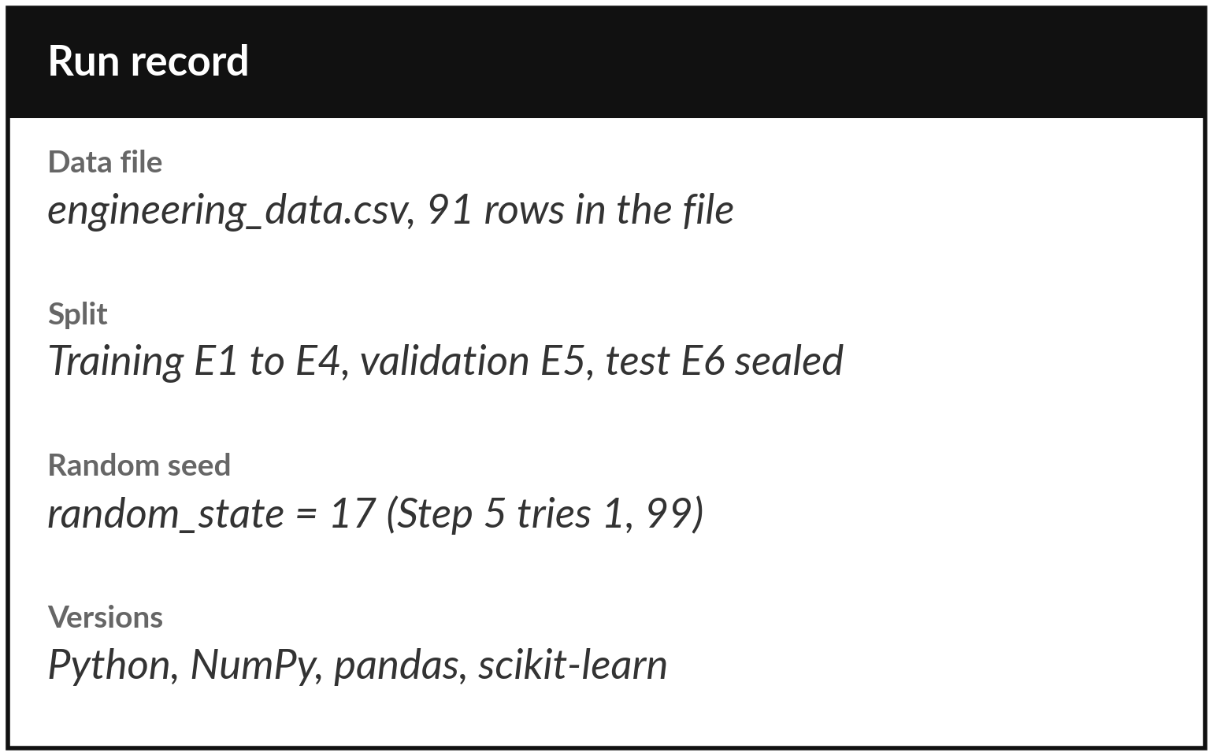
Write down what you ran, so anyone can repeat it
Anyone with this record should get your numbers. After cleaning in Class 1, 88 rows remain: 58, 15, 15.
The notebook prints the record for you.
Paste it under every result you report.
Notes:
Reproducibility means that someone else, or you in six months, can run the same code and get the same numbers. For that you need a short record. Which data file, and how many rows. After cleaning in Class 1, the usable rows are fewer than the rows in the file, and the record says so.
How the rows were split. The random seed. And the versions of Python, NumPy, pandas and scikit-learn, because a new version can change a result slightly. The notebook prints this record in the last step. Paste it under every result you report. It takes ten seconds. It is the difference between a result and a claim.

Slide 33
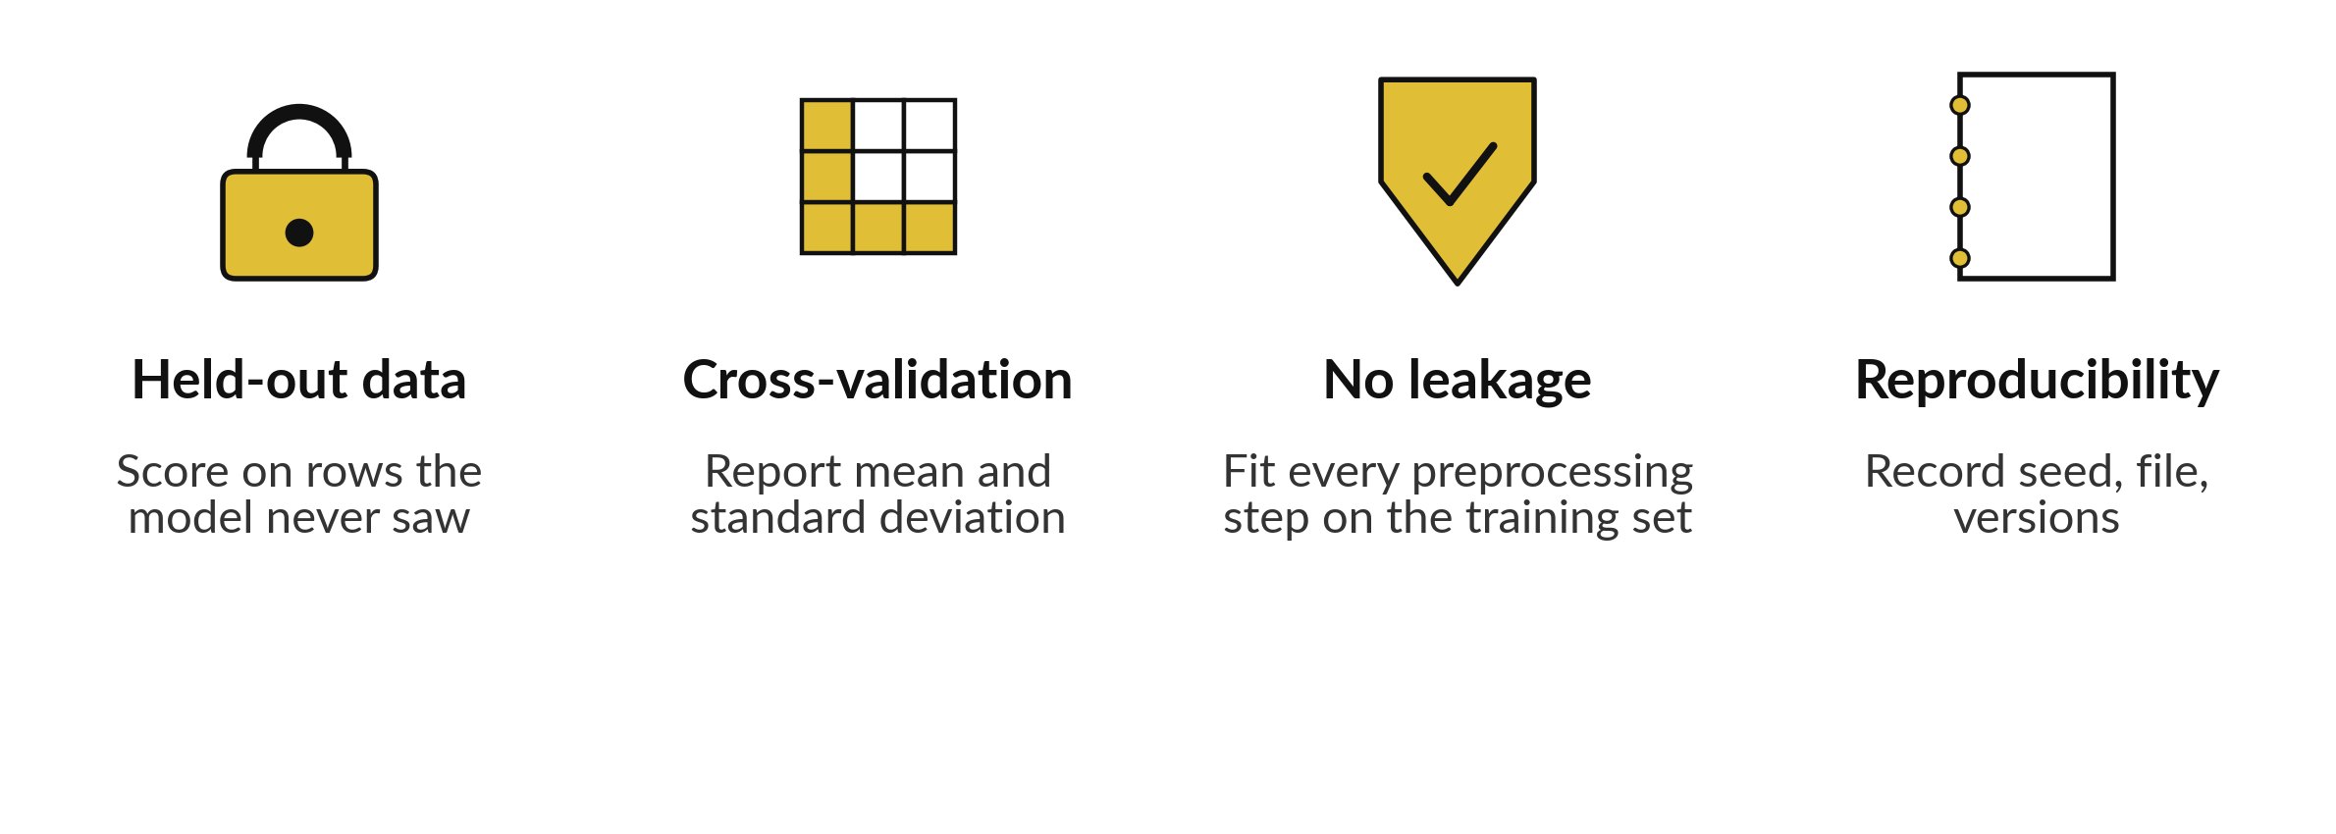
Trust comes from four habits
Next class: features and choosing a model. These habits are the rulebook.
Notes:
Let us gather it up in four habits. Score on rows the model never saw. Use cross-validation, so you report a mean with a standard deviation, and GroupKFold when the model will meet new machines. Fit every preprocessing step, the imputer and the scaler, on the training set only.
And keep a record for reproducibility: the random seed, the data file and the versions. With these four habits, a score becomes something you can defend. Before the break, say aloud which habit you are most likely to forget.

Slide 34
Read the workflow before you write it
In plain words
pipeline = make_pipeline(imputer, tree_model)
group_kfold = GroupKFold(n_splits=4)
cv_scores = cross_val_score(
pipeline, X_train, y_train,
groups=groups, cv=group_kfold,
scoring="neg_mean_absolute_error")
print(-cv_scores.mean(), cv_scores.std())
make_pipeline chains the imputer and the tree into one model (a Pipeline).
GroupKFold(n_splits=4) makes 4 folds. Each fold holds out one equipment group as the validation fold.
cross_val_score runs the whole pipeline on every fold and returns one score per fold.
The scoring name gives the MAE with a minus sign, so we print -cv_scores.mean().
cv_scores.std() is the standard deviation of the scores.
Notes:
Before the break, here is the workflow in six lines. First the Pipeline: the imputer and the tree, chained into one model, so the imputer is fitted inside every fold. Then GroupKFold with four splits, so each fold holds out one equipment group, and we pass the group labels with groups.
Then cross_val_score, which runs that pipeline on every fold and returns one score per fold. The scoring name has the word neg in it, because scikit-learn likes bigger to be better, so errors come back negative. We put a minus in front to get the MAE back. Finally we print the mean and the standard deviation.
You can read this aloud now. In the lab you run it.

Slide 35
Part 2: the lab
Close the slides. Open the notebook. Same steps, your own data.
Notes:
That is the end of the concepts. Everything you need is on the slides you have just seen, and every term is explained again inside the notebook. Please open the notebook now, and keep the slides closed except for the check slides at the end of the deck.
I will walk around. Raise your hand if a cell gives an error. Remember to run the cells in order from the top.

Slide 36
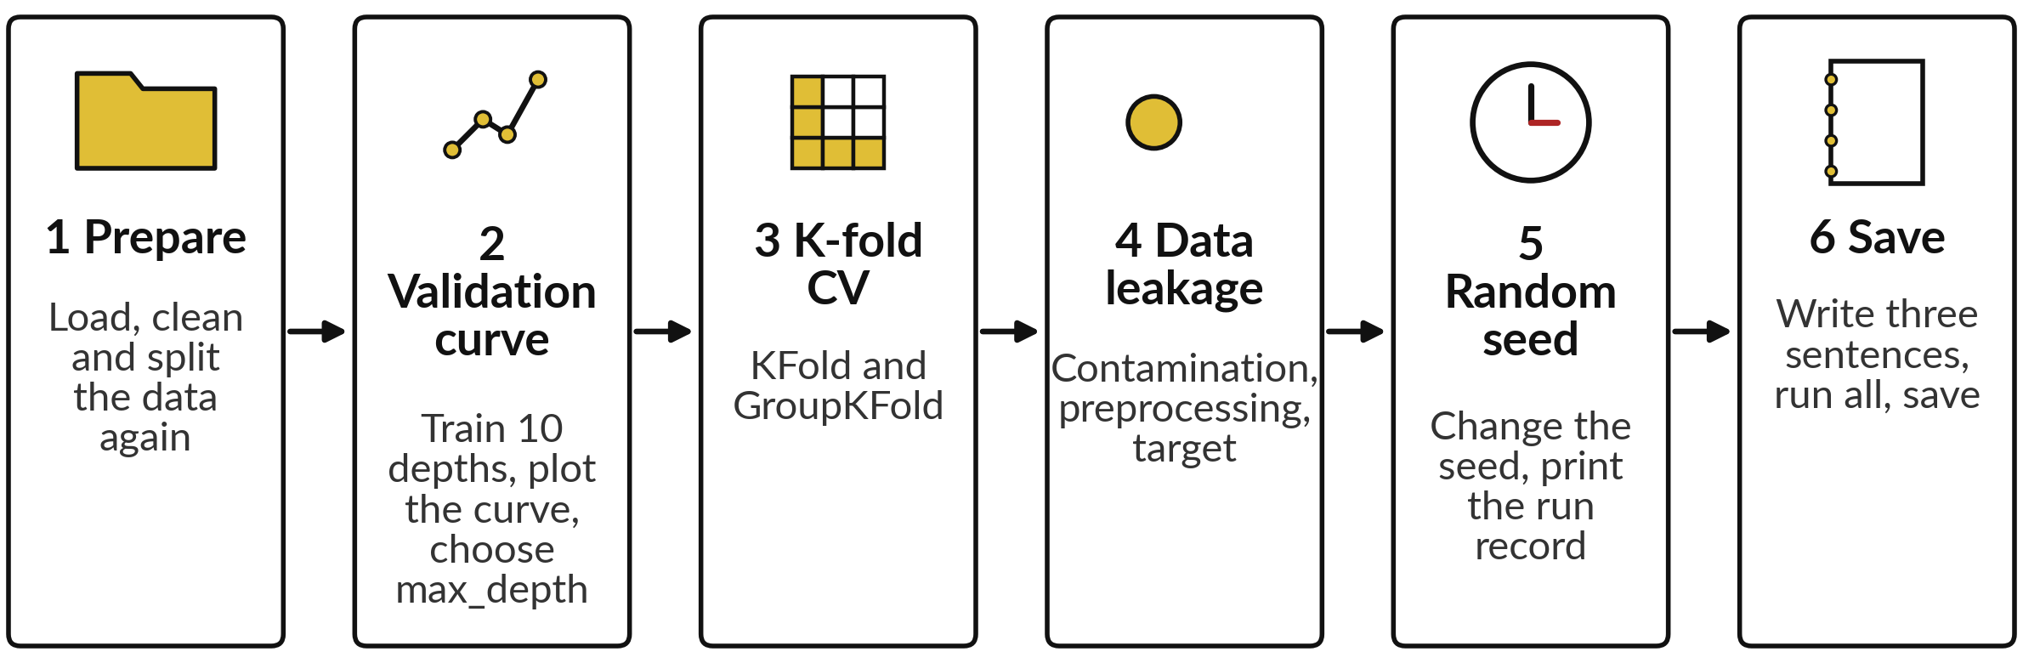
The lab has six steps, and the
first five end with a check
In each step, predict first, run second, then read what the output tells you.
Notes:
Here are the six steps. One, prepare the data again, briefly. Two, train trees of depth one to ten, plot the validation curve and choose max_depth using the validation set only. Three, run K-fold and GroupKFold cross-validation and print the mean and the standard deviation. Four, reproduce the three kinds of leakage: contamination, a fill value from all rows, and a feature built from the target.
Five, change the random seed and watch a number move, then print the run record. In each step, predict first, then run, then read. Six is your short conclusion and a save.

Slide 37






Check your numbers against
these before you move on
What you print | You should see
Rows: training, validation, test | 58, 15, 15
Validation MAE at max_depth 1 and at 10 | 5.30 and 2.77 kW
Chosen max_depth | 7
K-fold, k = 5: mean and standard deviation | 3.27 and 0.29
GroupKFold, k = 4: mean and standard deviation | 2.85 and 0.45
max_depth 10: honest and leaky validation MAE | 2.77 and 0.00
max_depth 10 tree, random_state 1 and 99 | about 2.9 and about 3.0
MAE in kW. If your number differs, stop and ask. Find the step that went wrong. The two seed numbers are about values: a difference in the second decimal is fine.
Notes:
Use this table as your checkpoint. If your numbers match, carry on. If they do not, call me over, because every later step builds on the earlier ones. The most common reasons are a cell run out of order, a missing random_state, or a depth typed wrongly. A leaky score of zero point zero zero is correct, because that is the whole point of the demonstration.
Do not edit a number to make it match. Find the cause.

Slide 38




Four problems you will meet,
what they mean and what to do
What you see | What it means | What to do
NameError: X_train | Step 1 was not run | Run all cells from the top, in order
An error that mentions groups | GroupKFold needs the group labels (a groups argument) | Pass groups=groups
All scores are negative | scikit-learn gives errors a minus sign (neg_ scoring: bigger is better) | Put a minus in front: -scores
Numbers differ a little from the slide | The random seed (random_state) is missing or different | Use random_state=17 in every tree, except in Step 5 where the seeds 1 and 99 are tested on purpose
Notes:
Four problems come up most often. A name error on X_train means Step 1 was not run, so run all cells from the top. An error that mentions groups means GroupKFold needs the group labels, so pass groups equals groups. Negative scores are not a bug. scikit-learn gives errors a minus sign so that bigger is better, so put a minus in front.
And if your numbers differ a little from the slide, check that random_state equals seventeen in every tree, except in Step 5, where we try other seeds on purpose. Read the last line of any error first.

Slide 39


How this class counts towards your coursework
Nothing is submitted today.
Block 2 is Classes 3 and 4. Its assignment has three parts: A9 (validation and trust, from today's lab), A10 (features) and A11 (model recommendation), both from Class 4. Block 2 is practice: it does not count toward your final mark, but it is collected and you get feedback.
The Block 2 assignment closes on Tuesday 1 December, 11:00 (Kampala time).
The Block 2 quiz opens in the last 20 minutes of Class 4, stays open for 24 hours, and covers Classes 3 and 4.
Notes:
A word on how this counts. The block work is practice: it does not count toward your final mark (only A1 to A5 and Q1 to Q5 do), but it is collected and you get feedback. Nothing is submitted today. Block 2 is this class and the next one. Its assignment has three parts: A9 on validation and trust, which repeats the steps of today's lab, and A10 and A11 on features and on recommending a model, which come from Class 4.
All three close on Tuesday 1 December, 11:00, Kampala time. The Block 2 quiz opens in the last twenty minutes of Class 4, stays open for twenty-four hours, and covers both classes. Keep your saved notebook, because next class we extend it.

Slide 40
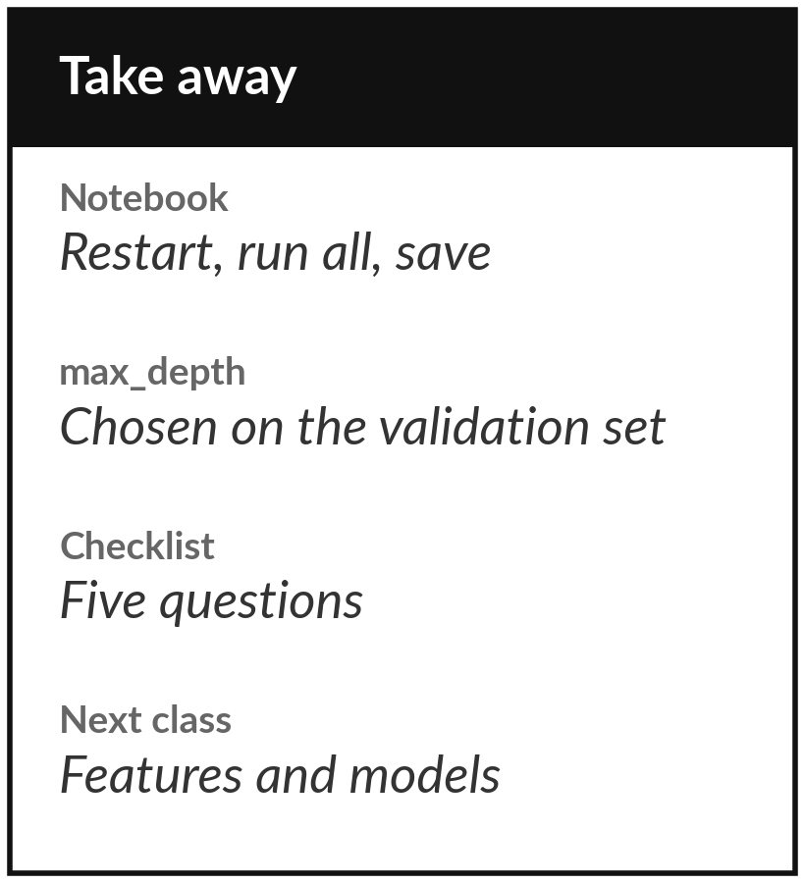
Save the notebook and keep the checklist
What you keep from today
Your saved lab notebook, the chosen max_depth, and the five-question checklist for trusting a score.
Our question today
How do we know a model that predicts cooling load will still work on a building it has never seen?
Next class
Class 4: features and choosing a model, plus the project brief.
Notes:
Before you go, restart the notebook, run all cells from the top and save it. Keep the max_depth you chose and the checklist, because you will use both again. Next class we look at which columns the model should use and how to choose between models, and I explain how the project sitting works.
If anything today was unclear, write the question down and bring it.
We began with this question: How do we know a model that predicts cooling load will still work on a building it has never seen? Before you go, say in one sentence what you can now say about it.

